Slide 1
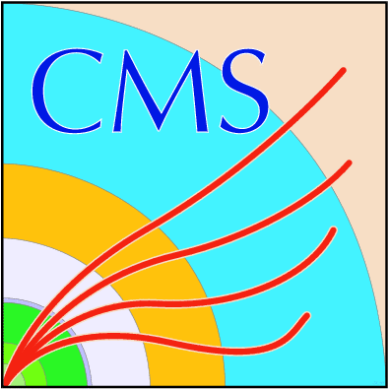
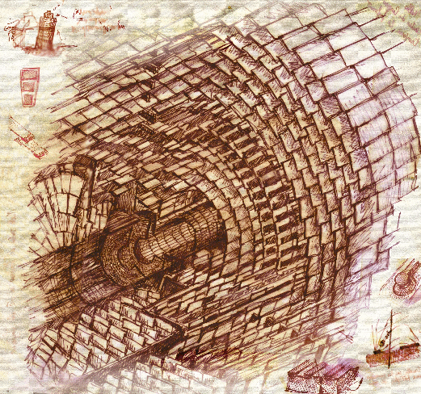
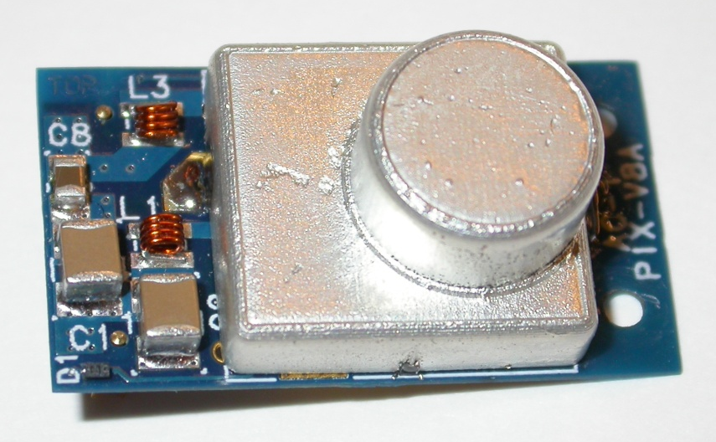

A DC-DC Conversion Powering Scheme
for the CMS Phase-1 Pixel Upgrade
Lutz Feld, Martin Fleck, Marcel Friedrichs, Richard Hensch,
Waclaw Karpinski, Katja Klein, Jan Sammet, Michael Wlochal
1. Physikalisches Institut B, RWTH Aachen University
Topical Workshop on Electronics for Particle Physics
Oxford, September 20th, 2012

Slide 2
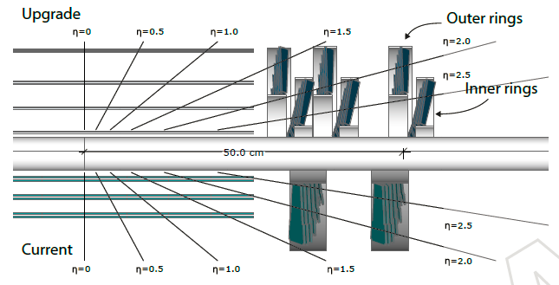
The Phase-1 Pixel Upgrade
During LHC Phase 1 the luminosity will be doubled, up to ~ 2⋅10³⁴ cm⁻²s⁻¹
→ Exchange of CMS pixel detector in shutdown 2016/2017
  Optimized readout chip (ROC)
  Less material, e.g. through CO₂ cooling
  Factor of 1.9 more channels → factor 1.9 higher power consumption
Existing services must be re-used
→ Power losses in cable channels increase by factor ~ 4 → heat load too high
→ will move to a DC-DC conversion powering scheme
Phase-1 layout
Present layout

Slide 3
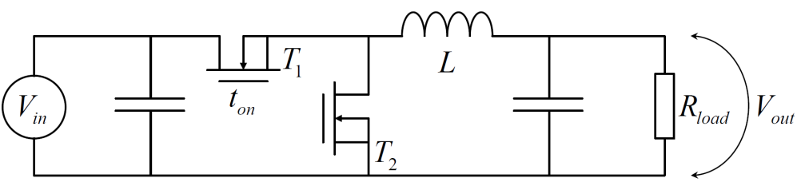
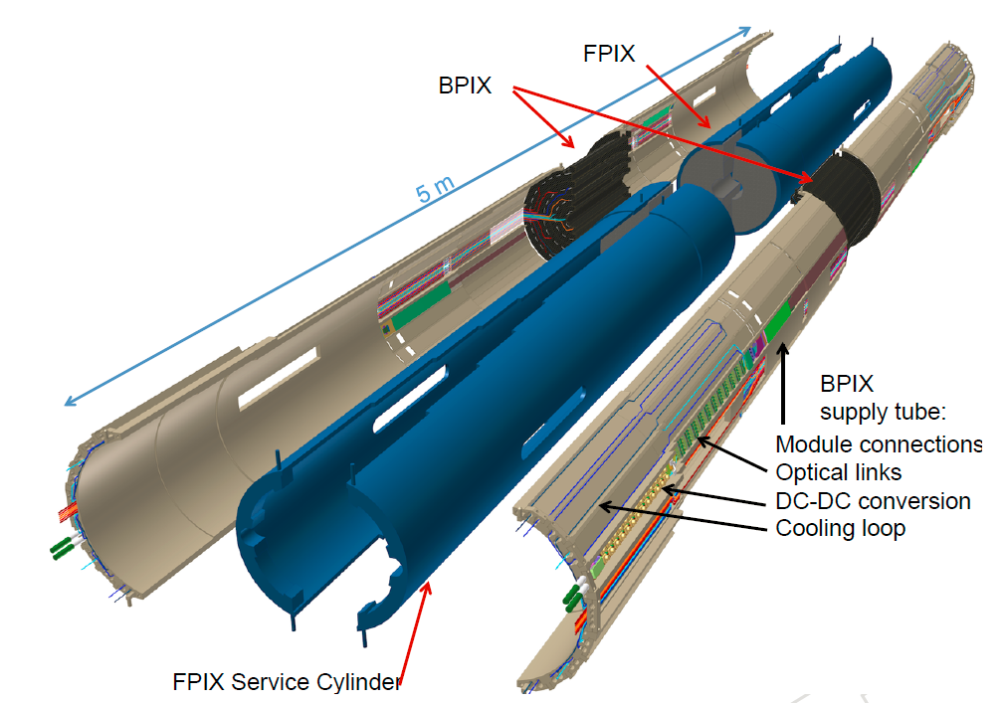
DC-DC Powering for the Pixel Upgrade
DC-DC buck converters
  Vin = 10V
  Vout = 2.4 or 3.0V
  (analog and digital pixel module circuitry)
Conversion ratio of 3-4
→ power losses reduced by factor ~ 10
Located on supply tube & service cylinder
Cooled from CO₂ pipes
In total 1184 DC-DC converters
2.2m distance to front-end
→ material and EMI less
critical than in other
applications
Vin = 10V
Vout = 2.4 / 3.0V

Slide 4
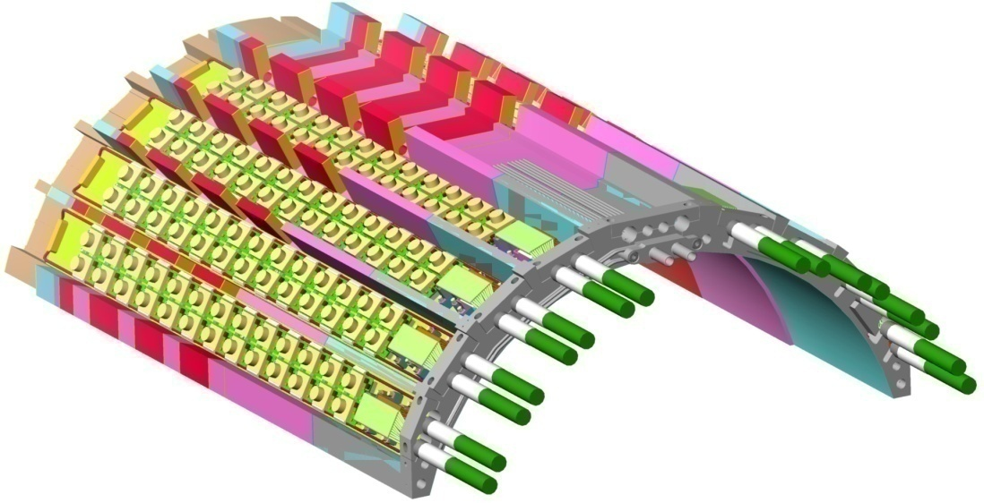
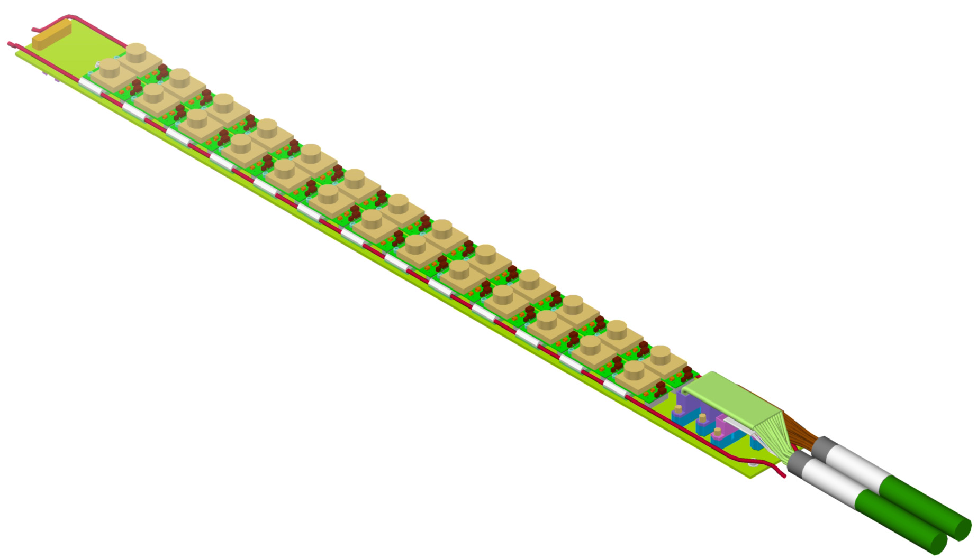
DC-DC Powering for the Pixel Upgrade
”analogue
converters”
layer 1
”digital
converters”
layer 4
served by cable 1
layer 2
layer 3
served by cable 2
13 converter pairs per bus board
6 - 7 pairs powered from one power supply
Each converter pair serves 1 - 4 pixel modules
Iout < 3A per converter
cable 1
cable 2

Slide 5
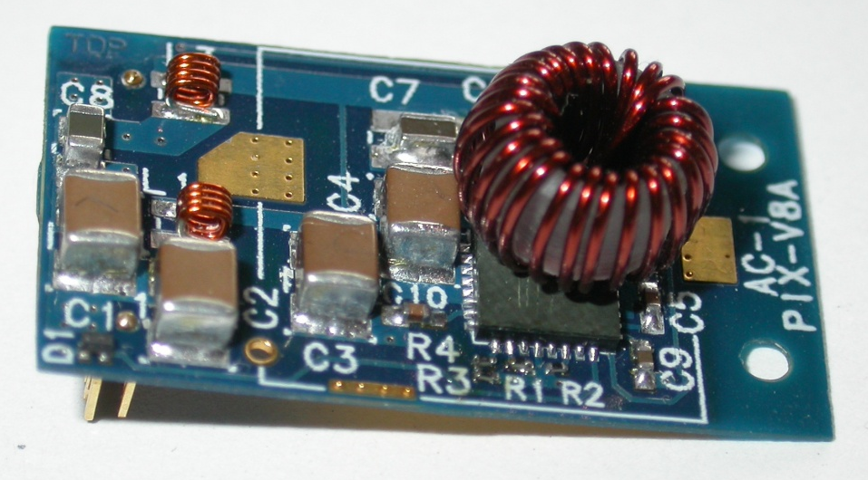
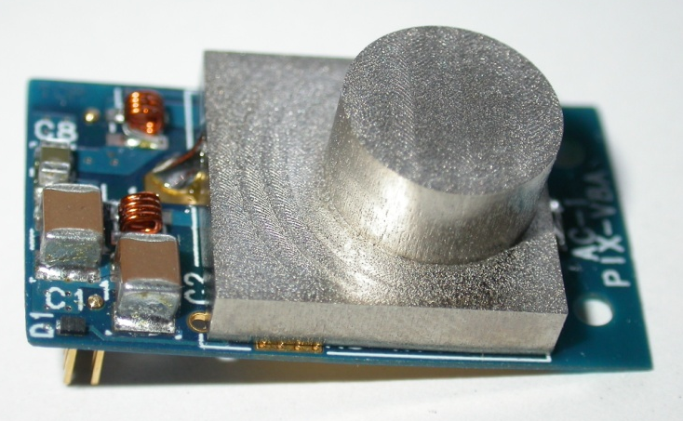
AC_PIX_V8 DC-DC Converters
Custom rad.-tolerant tolerant buck converters, optimized for our application
V_{out} = 3.0V or 2.4V
Switching frequency f_{s} = 1.5MHz
2-layer PCB
Toroidal plastic core inductor L = 450nH
Pi-filters at in- and output
ASIC: AMIS4 by CERN-PH-ESE (St. Michelis, F. Faccio)
Latest available prototype in radiation-tolerant
AMIS I3T80 0.35µm CMOS (ON Semiconductor)
[2012 JINST 7 C01072]
AC_PIX_V8 A: 2.8cm x 1.6cm; ~ 2.0g
Why is a shield required?
to shield the magnetic emissions
as cooling contact for the coil
to segregate “noisy“ parts from output filters
→ 60 DC-DC converters have been built
Aluminium shield

Slide 6
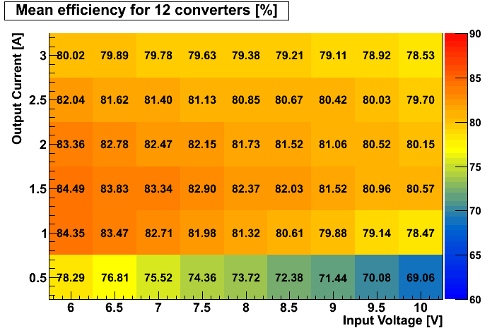
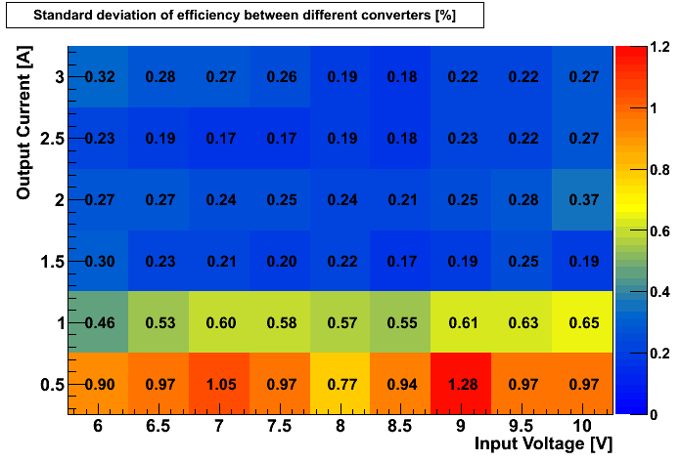
Power Efficiency
Mean efficiency (12 converters)
V_{out}= 2.5V
Standard deviation (12 converters)
V_{out}= 2.5V
Mean efficiency and standard deviation based on 12 converters
Very good efficiency – 80% or higher, except for very low output currents
Very uniform – SD below or around 0.5%, except for very low output currents (1%)

Slide 7
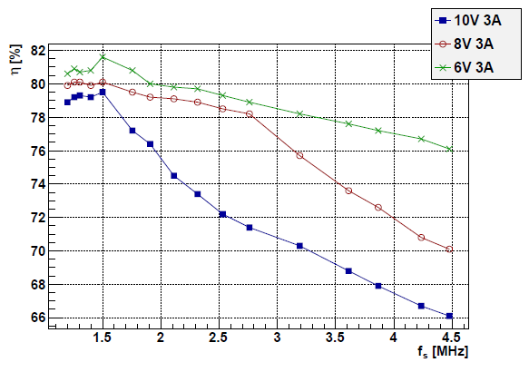


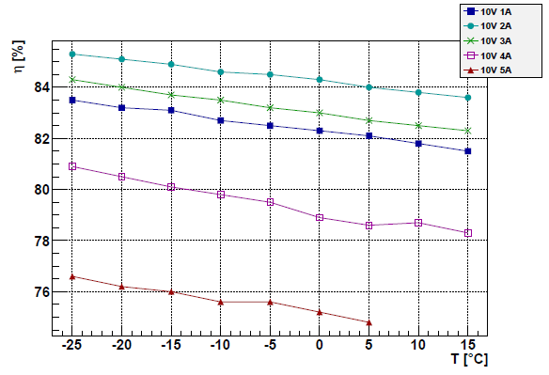
Efficiency vs. f_{s} and Temperature
Vout = 2.5V
Switching frequency adjusted with
external potentiometer
Efficiency is maximal for f_{s} ≈ 1.5MHz
  Higher conduction losses for lower f_{s}
  Higher switching and driving losses for
  higher f_{s}
Vout = 3.3V
Previous measurements with cooling at +20°C
Efficiency rises with decreasing temperature
(lower Ohmic losses)
About 0.05% (abs.) increase per K
Increase when moving to pixel operating
temperatures of -20°C: < 2% (abs.)

Slide 8
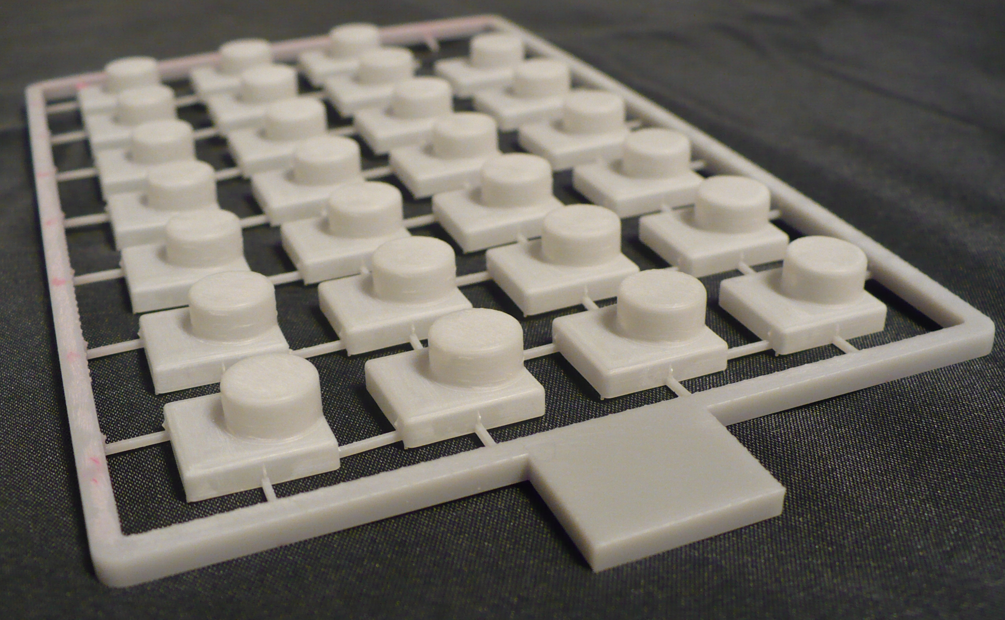
Shielding
Space constraints → tricky shape!
0.3mm plastic galvanically coated with 30µm Cu + electro-less 1µm Sn
Two methods are considered for the body:
  Rapid prototyping: fast and flexible → good for prototyping (and mass production?)
    Thin layers are difficult (0.3mm still not quite achieved)
    Radiation hardness to be investigated
    Price ~ 10 Euro per piece (quote for 3000 pieces)
  Injection moulding: mould is expensive → mass production, when shape is fixed
    Price ~ 5 Euro per piece (quote for 3000 pieces)
Protoypes made with
rapid prototyping

Slide 9
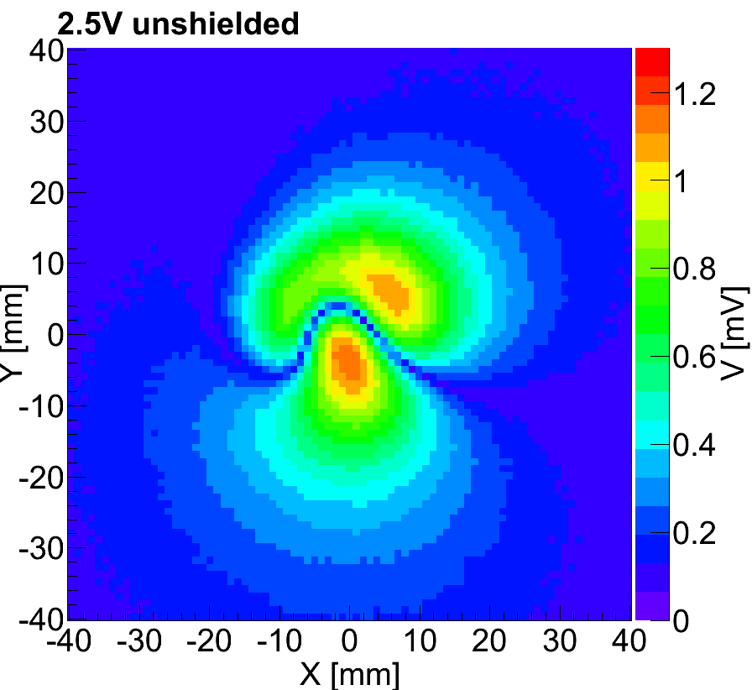
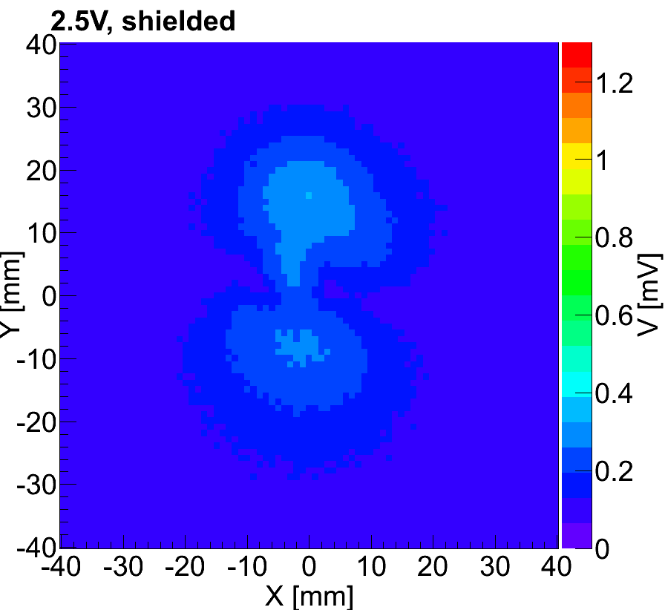
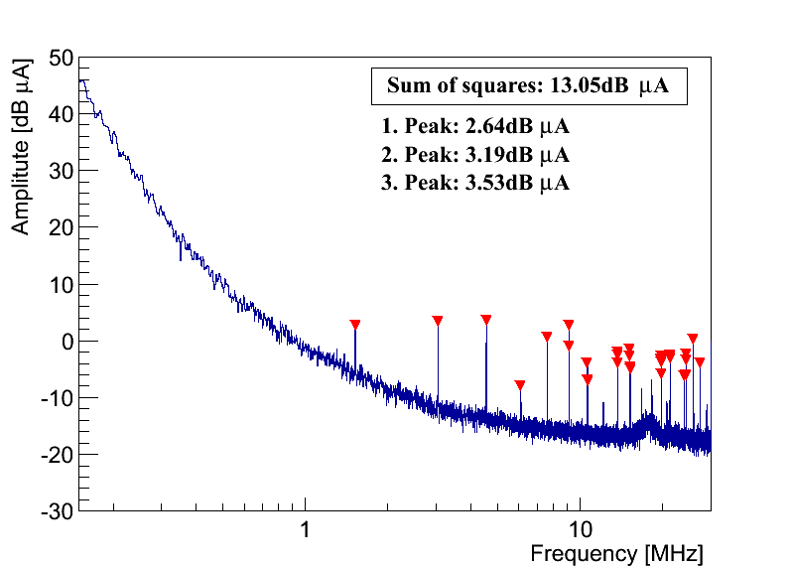
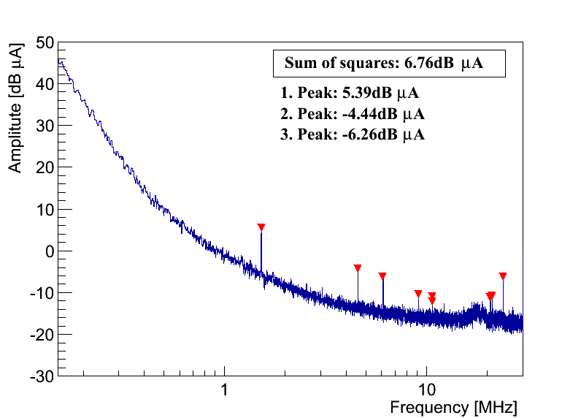
Shielding
Strong reduction of magnetic emissions and Common Mode output noise:
No shield
With shield
B-field, measured
with pick-up probe
above coil/shield
No shield
With shield
Common Mode
output noise spectrum,
measured with
spectrum analyzer

Slide 10
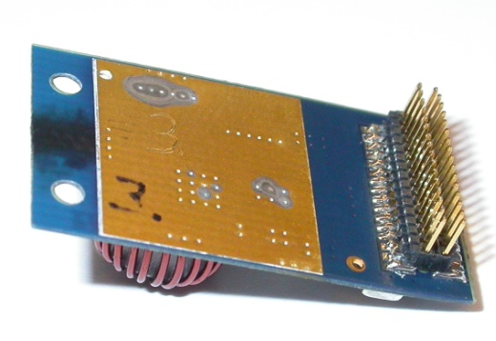
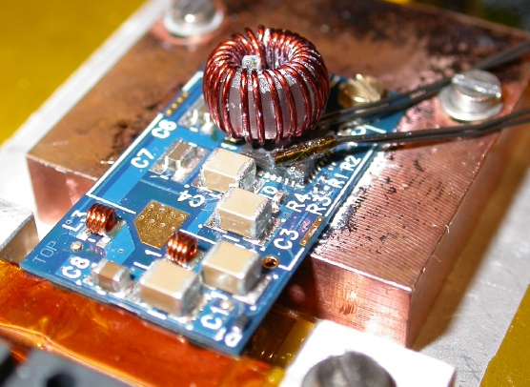
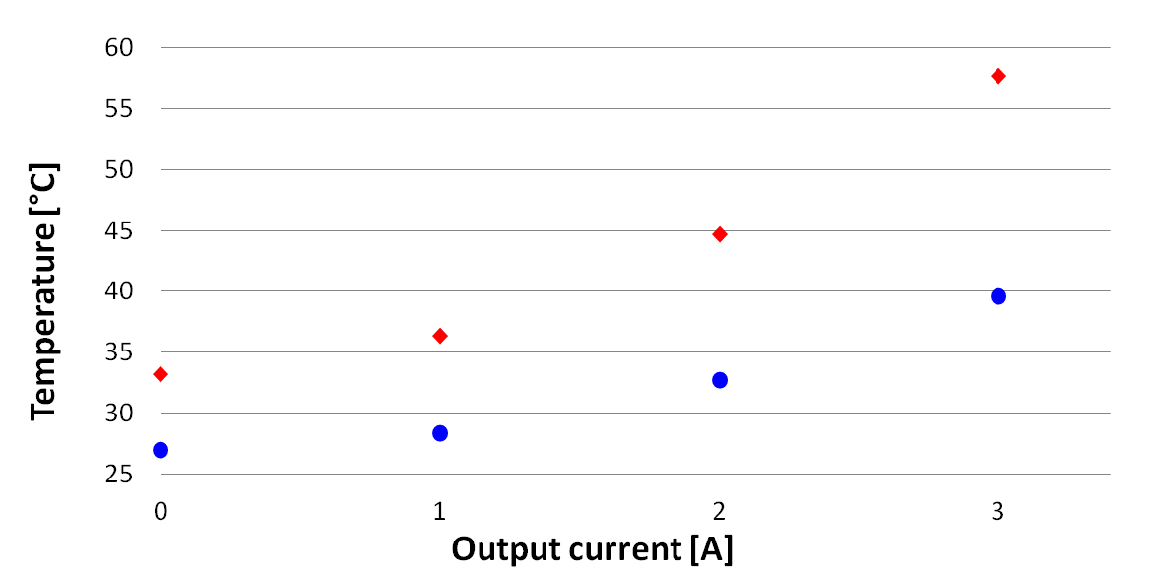
Thermal Studies on Single Converters
Inefficiency of 20% → converters need to be cooled
Hot spots: chip and coil
  Chip cooled from back-side
  Shield acts as cooling contact for coil
Measurements with thermistors on chip and inside coil (difficult)
Shield reduces temperature of inductor by up to ~ 20K
Coil temperature
- without shield
- with shield

Slide 11
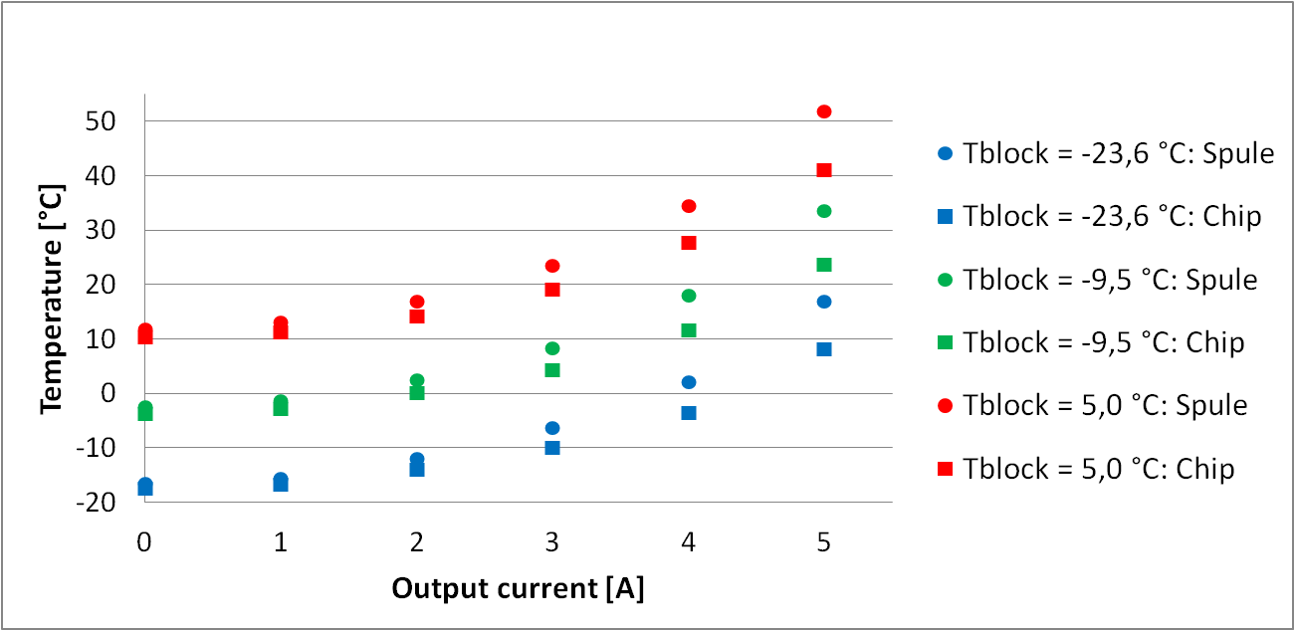
Thermal Studies on Single Converters
No thermal problem, even for Iout = 4A
Cooling block
temperature:
• Coil temperature
○ Chip temperate
+5°C
-10°C
-24°C

Slide 12
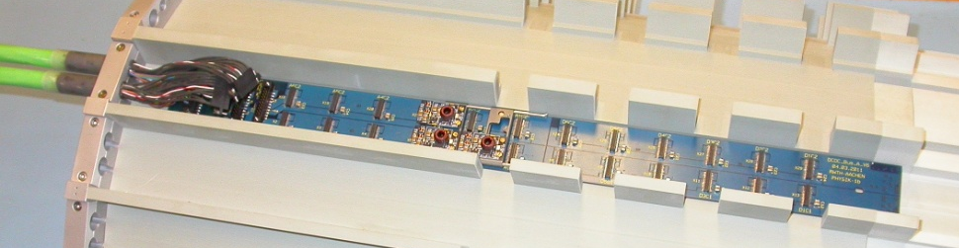
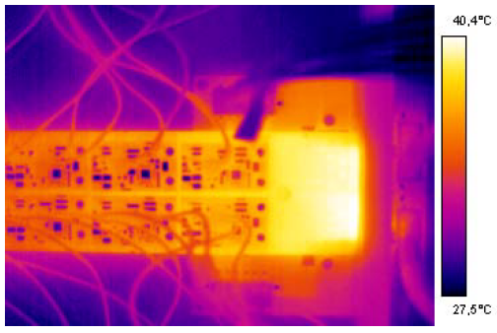
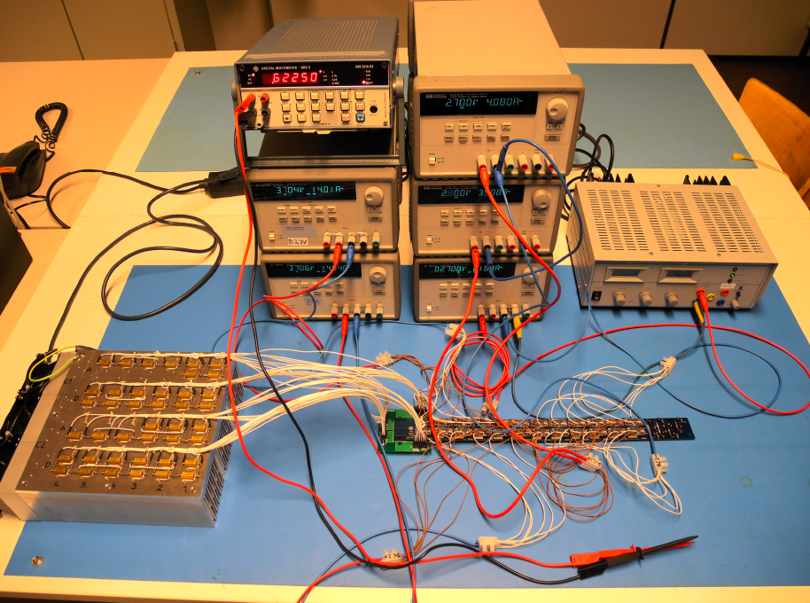
The DC-DC Bus Board
Input and output voltages, control signals
and bias voltages
8 Cu layers a 70µm
Protoype for 24 converters studied
Voltage drops to be well understood (no remote sensing!)
  Reasonable agreement with calculation
  No degradation after 120 thermal cycles between -10°C and
  +40°C under load
488mm x 40mm x 1.6mm
+40.4°C
Calculation Measured before TC Measured after TC

Slide 13
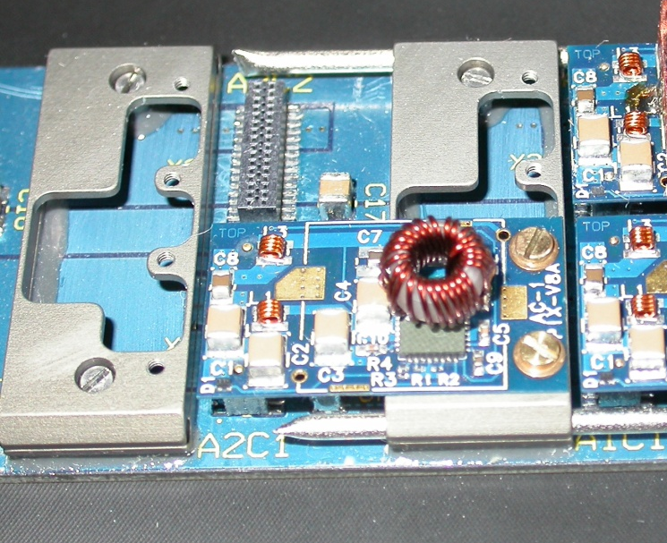
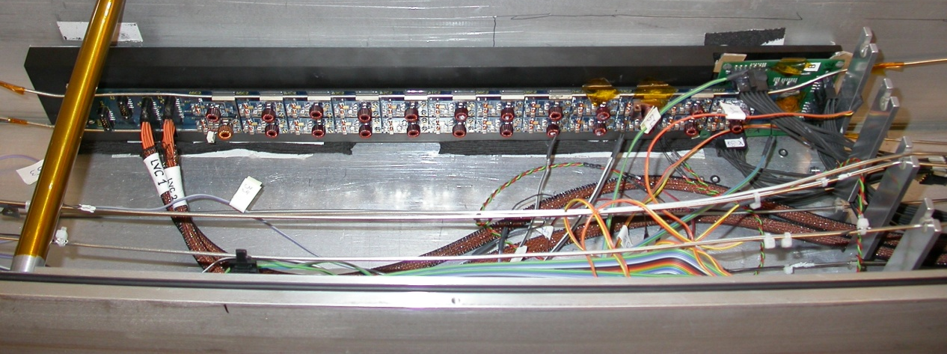
CO₂ Cold Test with Bus Board
Aluminium cooling bridges
Two-phase CO₂ cooling system
Tests performed with fully equipped bus board and
lab CO₂ cooling system, operated at -20°C
Pipes are thin: 1.7/2.0 mm in lab; 1.8/2.2mm in CMS
A programmable load can be applied to each converter
Protoype bus board with 24 DC-DC converters
Thermistors on coils,
pipes, cooling bridges
Evacuated box

Slide 14
CO₂ Cold Test with Bus Board
20K
15K
ΔT between pipe and cooling bridge about 15K → optimization needed
ΔT betw. coil/chip of shielded converter & cooling bridge about 20K → as expected

Slide 15
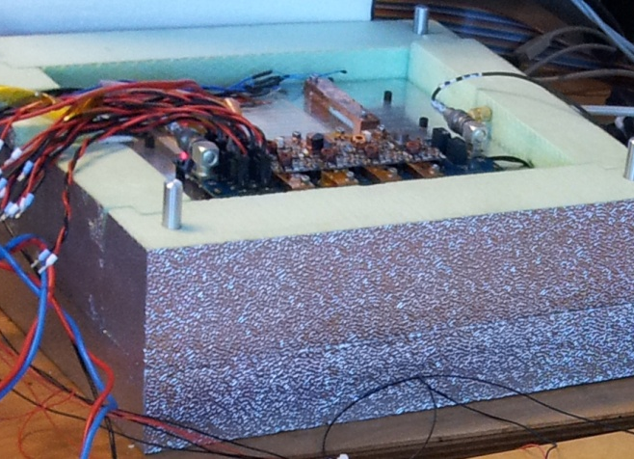
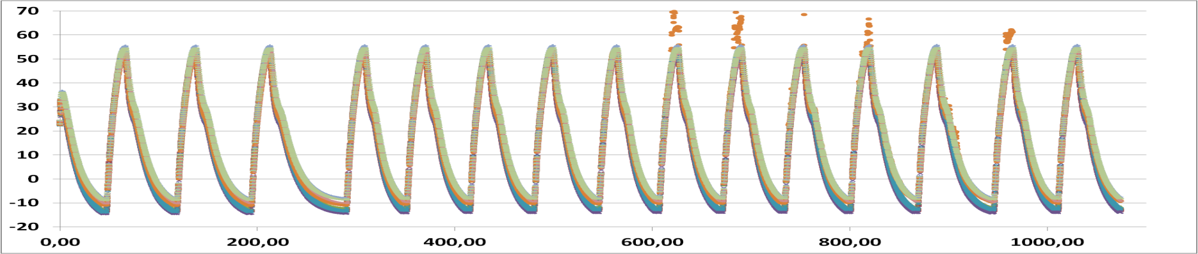
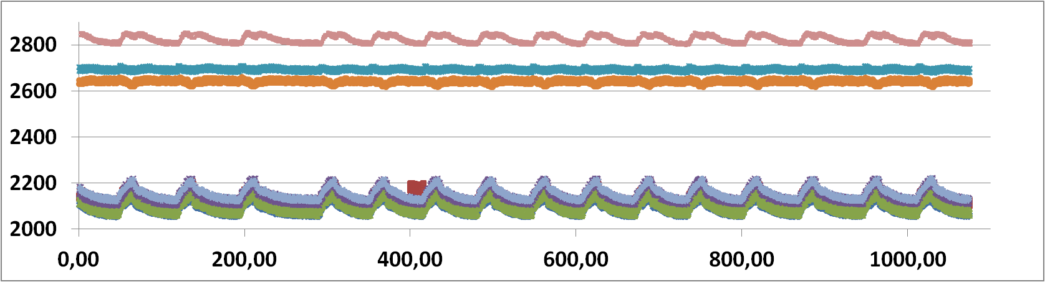
Thermal Cycling
Different temperatures in CMS: CO₂ cold/warm; power on/off
   check if convs. work between -30°C and +35°C block temp.
   impose thermal stress (accelerated aging)
Cold box for 16 DC-DC converters
8 converters exposed to 15 cycles → still working fine
T of shield of 8 converters
Temperature [°C]
Output voltage of 8 converters
Vout [V]
Vout variation probably
due to T-dependence
of bandgap reference
time [min]
17h

Slide 16
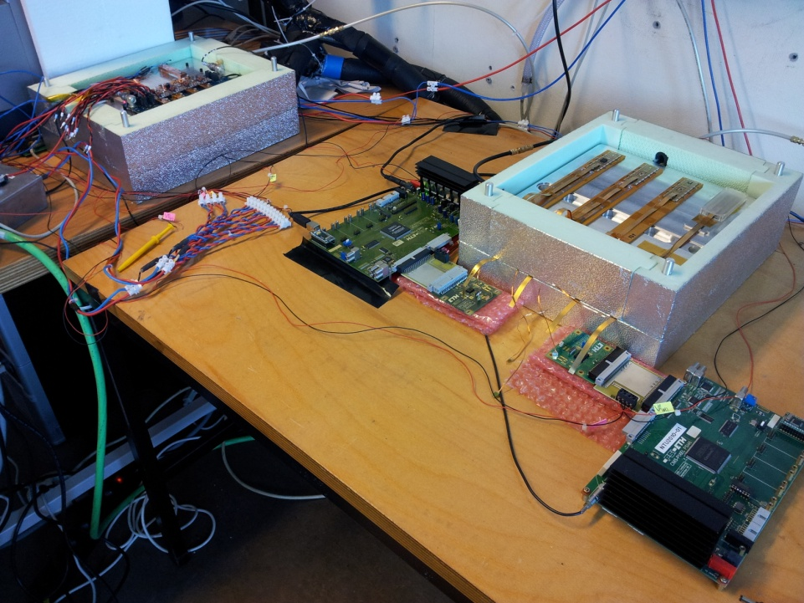
System Tests with Pixel Modules
Check for possible degradation of module performance due to DC-DC converters
2 (present-type) pixel modules powered from 1 converter pair
In total 8 pairs of DC-DC converters on bus board prototype
Dig. current
depends
on readout
activity!
Dynamic digital load
Modules
I (t)
Pixel module
Pixel module
Const. analogue
load
DC-DC converters
Module
adapter
Module
adapter
0.17 Ω
Connector
board
Connector
board
0.35 Ω
CAEN Pixel PS
V_{D}
V_{D}
readout
readout
V_{D}
V_{D}
SY1527
+ Branch Controller
EASY
4000
PSM
A4603
Long power cables (40m)
V_{A}
V_{A}
8 DC-DC
converters
on common bus board
HV (150V)
V_{A}
V_{A}

Slide 17
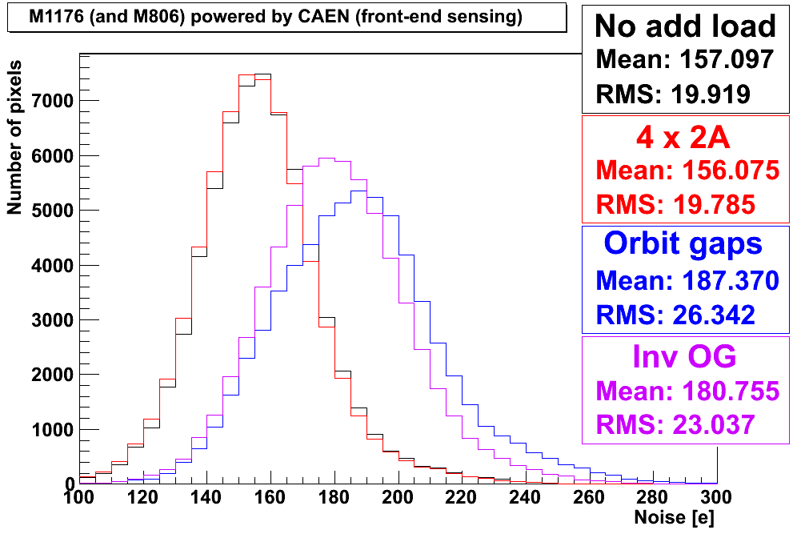
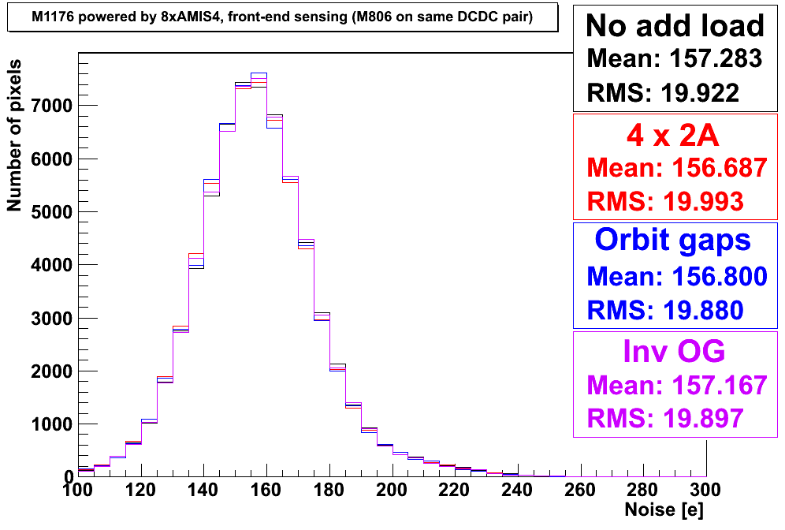
System Tests with Pixel Modules
Noise of each pixel is extracted as width of its “S-curve“
Comparison betw. conventional powering with CAEN PS and DC-DC powering
  No difference observed for constant load
  For dynamic load changes, noise with conv. powering increases by 19 and 15%
  DC-DC converters increase robustness, due to local regulation and filtering
Conventional powering (CAEN)
DC-DC conversion powering
Load from pixel modules only
Constant nominal load on all converters
Load changes as expected from LHC orbit gaps
→ drop from 2A to 0A for 3µs every 89µs
Inverted orbit gaps (few filled bunches in LHC)

Slide 18
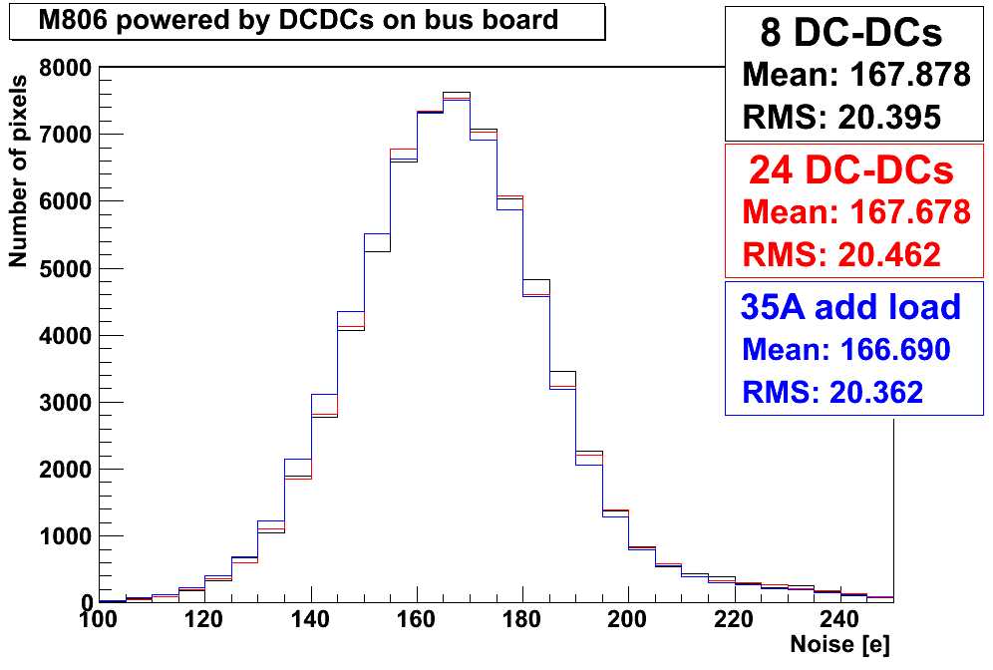
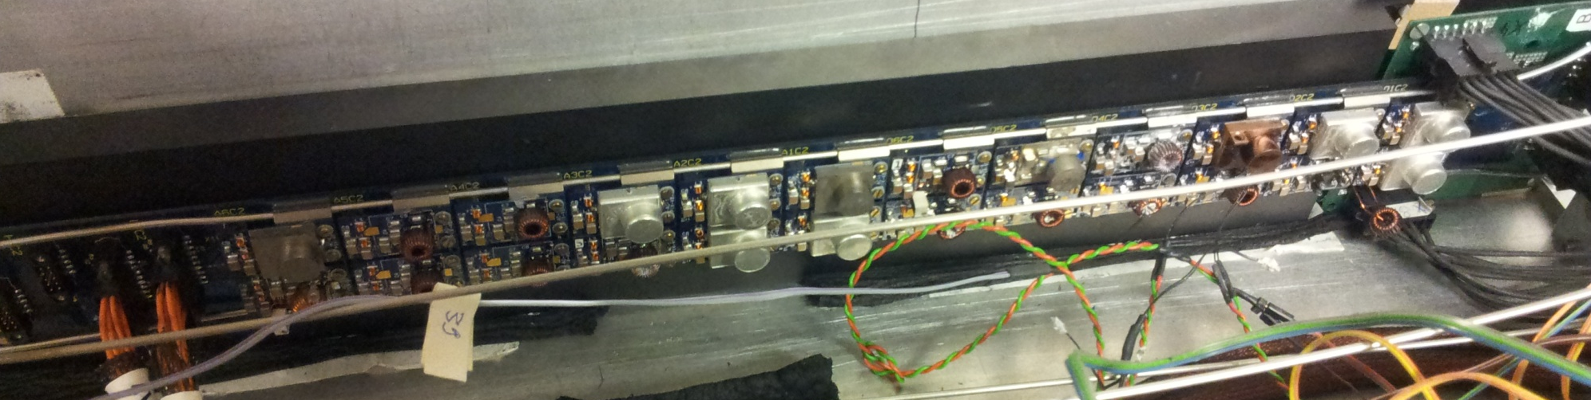
System Tests with Pixel Modules
24 DC-DC converters on bus board
Two pixel modules powered from one converter pair
3A load on all analog converters → 35A
→ No increase of pixel noise wrt 8 DC-DC converters
Vdig
Vana

Slide 19
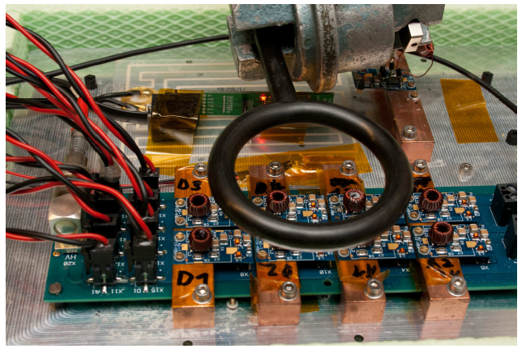
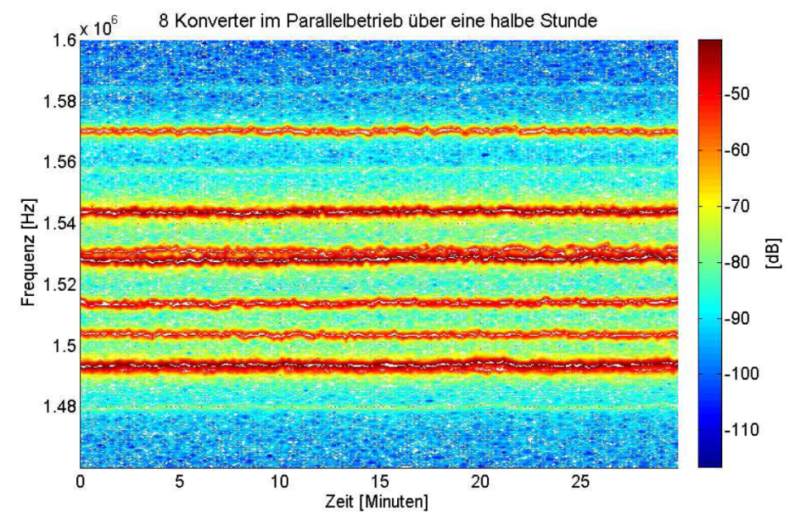
Synchronisation of DC-DC Converters
Depending on their coupling, oscillators can lock in frequency and phase
  Described by the Kuramoto model
  Many examples in nature: e.g. mechanically coupled metronoms
Coupling of DC-DC converters on common power line might increase input noise
Idea: try to see/induce coupling, and try to change f_{s} through disturbations
  f_{s} measured with pick-up probe and spectrum analyzer
  relative phase measured with oscilloscope
f_{s} of 8 (yes!) converters vs. time
Frequency [Hz]
Intensity [dB]
Time [min]

Slide 20
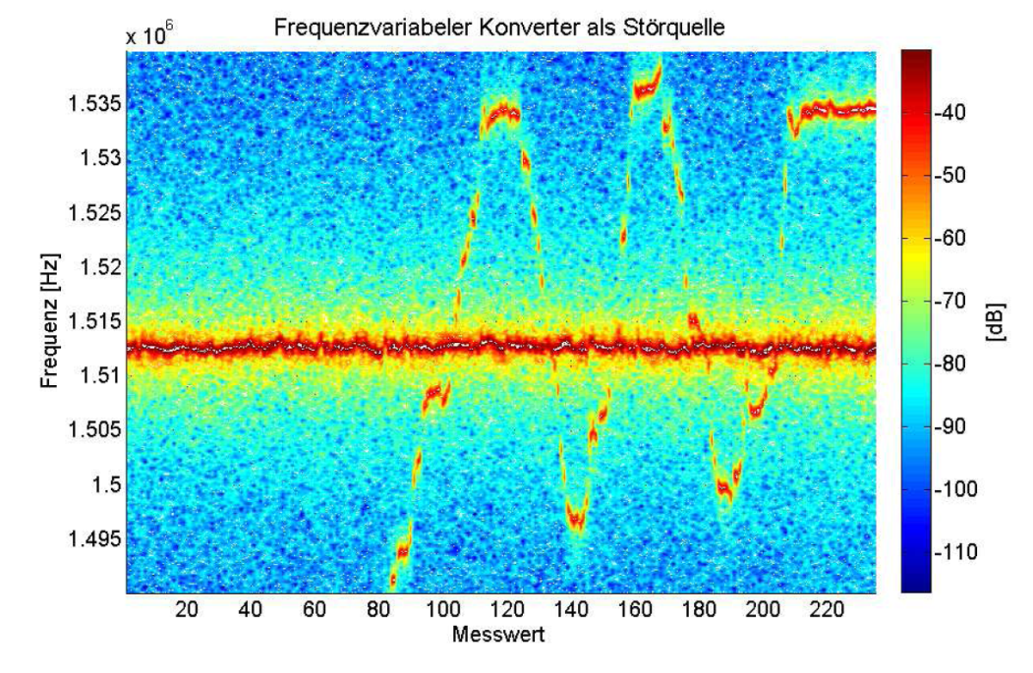
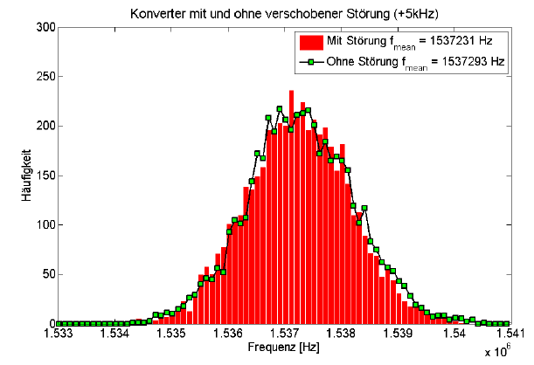
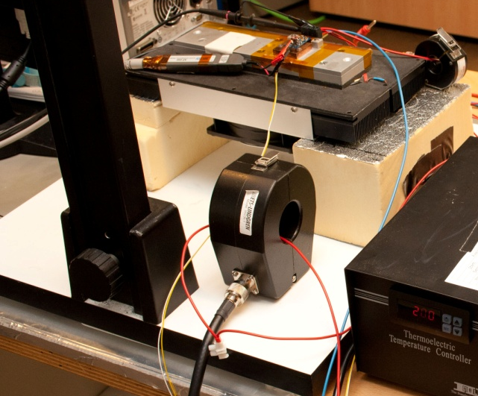
Synchronisation of DC-DC Converters
Two converters operated
  f_{s} of one converter adjustable with poti
  Check effect on the other converter
no f_{s} shift or phase locking observed
Intensity [dB]
Frequency [Hz]
External disturbation
  conductive: on input cable (740mV_{pp})
  radiative: with external coil (~10mW)
→ no significant changes in the frequency
distribution of converter observed
Measurement number
Without disturbance
With disturbance at f = fs – 5kHz
# of entries
Switching frequency [Hz]

Slide 21
Conclusions & Outlook
DC-DC conversion will be used in the CMS Phase-1 pixel upgrade
DC-DC buck converters based on AMIS4 ASIC extensively tested
  Efficieny uniform and high - around 80%
  System tests with pixel modules show no degradation
First system tests with a fully equipped bus board were successfull
Started to investigate industrialization options and to prepare QA set-ups
Move to AMIS5 ASIC in Autumn
Mass production in 2013/2014

Slide 22
Back-up Slides

Slide 23
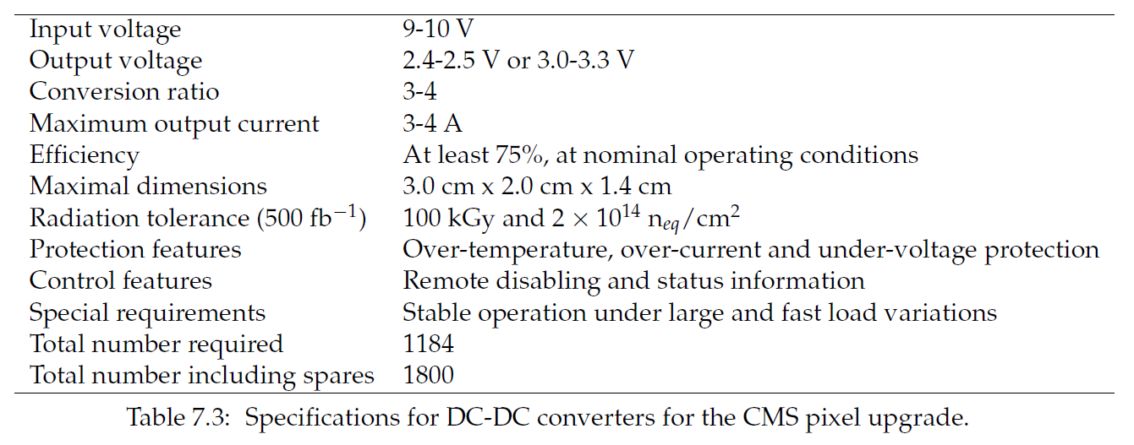
Specification of DC-DC Converters

Slide 24
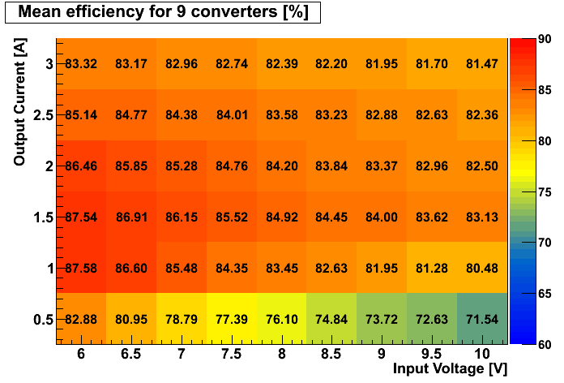
Power Efficiency
V_{out}= 2.5V
V_{out}= 3.3V
Mean efficiency is shown based on 12 and 9 converters, respectively
Very good efficiency – 80% or higher, except for very low output currents

Slide 25
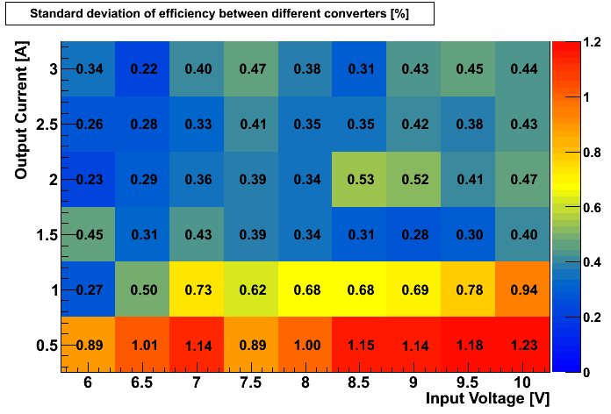
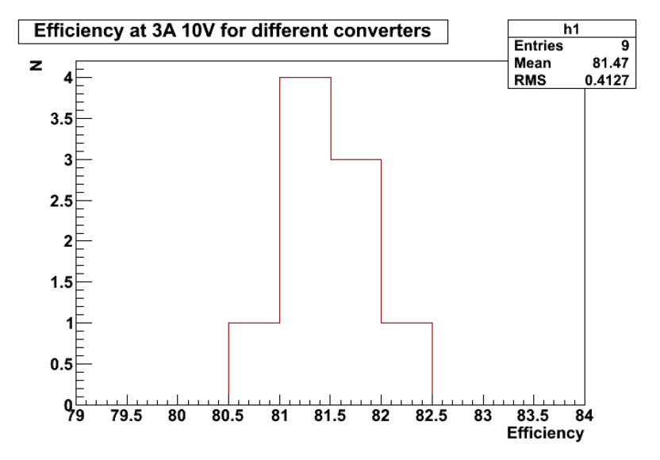
Uniformity of Power Efficiency
V_{out}= 2.5V
V_{out}= 3.3V
Standard deviation is shown based on
12 and 9 converters, respectively
Very uniform – with SD below or around 0.5%,
except for very low output currents (1%)

Slide 26
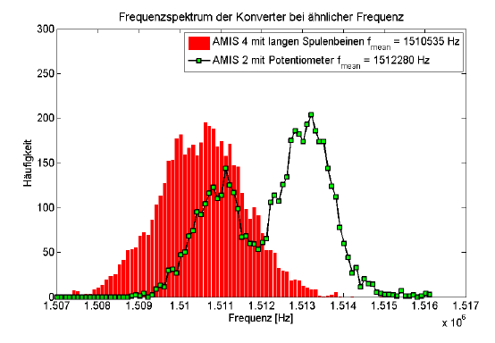
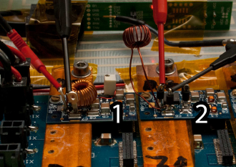
Coupling of DC-DC Converters
Two converters operated: “C1“ and “C2“
  C1: f_{s} adjustable with potentiometer
  Check effect on C2 = DUT
no f_{s} shift or phase locking observed
However, under special, unrealistic
circumstances converters do couple
  C1 with poti, C2 with long inductor leads
  f_{s} of C1 slightly detuned → jumps to f_{s} of C2
  Phase-locking observed as well
Intensity [dB]
Frequency [Hz]
Measurement number
C1 (with poti)
C2 (with long inductor leads)
# of entries
Frequency [Hz]

Slide 27
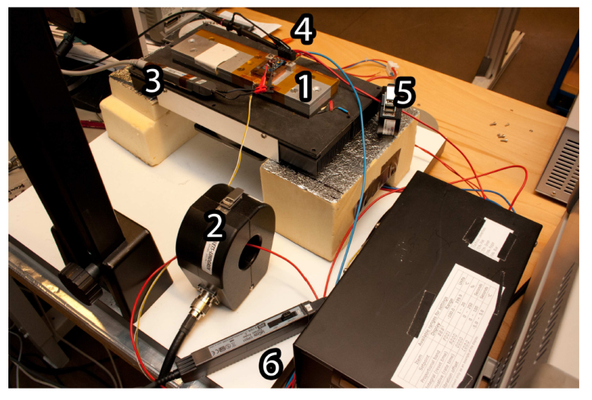
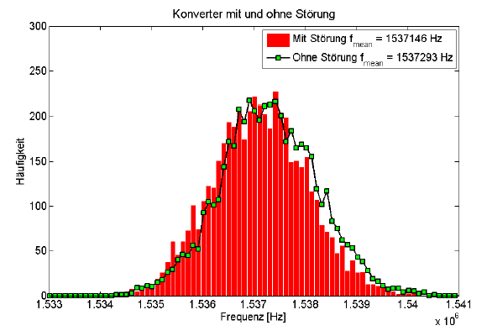
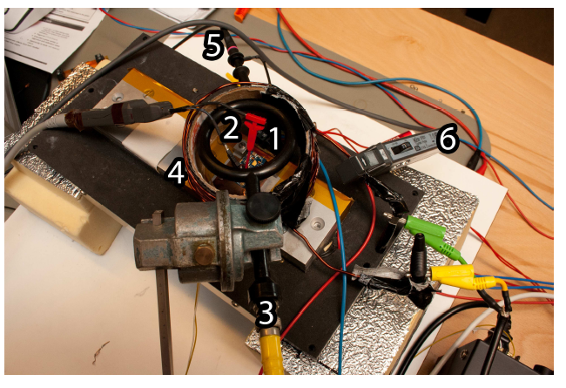

Coupling of DC-DC Converters
Interference induced on input cable (740mV_{pp}) and with external coil (~10mW)
→ no significant changes in the frequency distribution (5000 measurements) of DUT
With disturbance
Without disturbance
# of entries
Frequency [Hz]
With disturbance
Without disturbance
# of entries
Frequency [Hz]

