Slide 1
thanks to: TE/EPC/CC, Y. Thurel, A. Masi, M. Brugger, G. Spiezia et al…

Slide 2
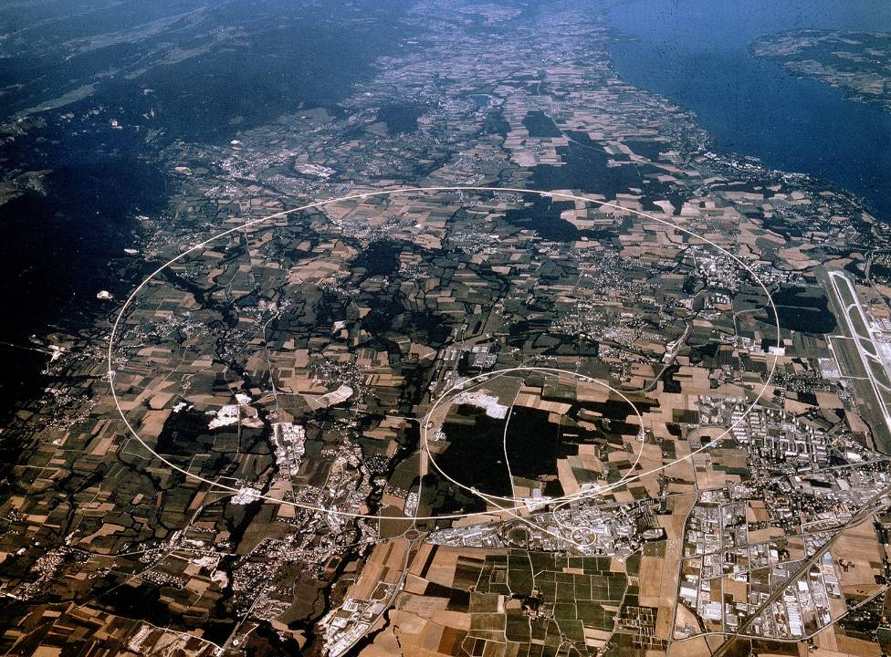
CERN
CERN Accelerator Complex
Lake Geneva
Large Hadron Collider
(LHC)
Geneva
Airport
CERN LAB 2 (France)
Super Proton Synchrotron
(SPS)
Proton Synchrotron
(PS)
27km long
150m underground
CERN LAB 1 (Switzerland)

Slide 3
CERN
CERN Accelerator Complex
Beam Dumping Systems
Large Hadron Collider
(LHC)
Beam-2 Transfer Line
(TI8)
Super Proton Synchrotron
(SPS)
Beam-1 Transfer Line (TI2)
100us for one turn,
CERN, the LHC and Machine Protection

Slide 4
CERN
CERN Accelerator Complex
CMS
LHC-b
ALICE
ATLAS

Slide 5
CERN
CERN Accelerator Complex
CMS
LHC-b
ALICE
ATLAS

Slide 6
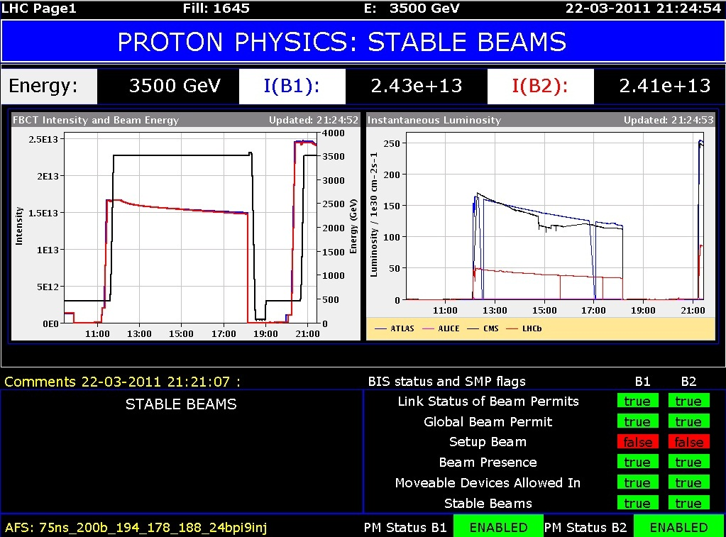
CERN
CERN Accelerator Complex
CMS
LHC-b
ALICE
ATLAS

Slide 7
Introduction
Power Converters = Power Supplies
Critical for operation of CERN’s machines
Direct impact on beam quality
Direct impact on machine availability
Year
Peak Energy
[TeV]
Peak Intensity
[p]
Peak Luminosity
[cm⁻² s⁻¹]
2010
3.5
4 x 10¹³
2.0 x 10³²
2011
3.5
2.0 x 10¹⁴
3.6 x 10³³
2012
4
2.2 x 10¹⁴
7.7 x 10³³
LS₁₋₂
≈6.5
≈3 x 10¹⁴
≈1 x 10³⁴
[1,2,3]

Slide 8
Introduction
Power Converters = Power Supplies
Critical for operation of CERN’s machines
Direct impact on beam quality
Direct impact on machine availability
Year
Peak Energy
[TeV]
Peak Intensity
[p]
Peak Luminosity
[cm⁻² s⁻¹]
2010
3.5
4 x 10¹³
2.0 x 10³²
2011
3.5
2.0 x 10¹⁴
3.6 x 10³³
2012
4
2.2 x 10¹⁴
7.7 x 10³³
LS₁₋₂
≈6.5
≈3 x 10¹⁴
≈1 x 10³⁴
[1,2,3]
LS1 = Long Shutdown #1 – from 2013 to 2014 – upgrade magnet interconnects
LS2 = Long Shutdown #2 …

Slide 9
Introduction
Power Converters = Power Supplies
Critical for operation of CERN’s machines
Direct impact on beam quality
Direct impact on machine availability
Year
Peak Energy
[TeV]
Peak Intensity
[p]
Peak Luminosity
[cm⁻² s⁻¹]
2010
3.5
4 x 10¹³
2.0 x 10³²
2011
3.5
2.0 x 10¹⁴
3.6 x 10³³
2012
4
2.2 x 10¹⁴
7.7 x 10³³
LS₁₋₂
≈6.5
≈3 x 10¹⁴
≈1 x 10³⁴
Increasing energy and intensity = increasing levels of radiation in machine environment
[1,2,3]
existing converter controls would have low availability when
higher energies and intensities are reached in the LS₁₋₂ era
Function Generator Controller
F
G
C
Function Generator Controller
F
G
C
lite
a design optimised for high availability in radiation = the next 25 years of LHC

Slide 10
Power Converters & Controls

Slide 11
Magnet Powering Circuit

Slide 12
Magnet Powering Circuit

Slide 13
Magnet Powering Circuit

Slide 14
Power Converter

Slide 15
Power Converter
Closed Loop Current Regulation
Converter State Control (ON/OFF/RESET)
Machine Protection Interlocks
Diagnostics

Slide 16
Power Converter Types
[4,5]

Slide 17
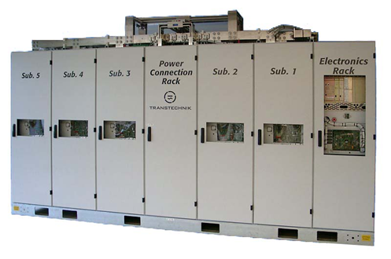
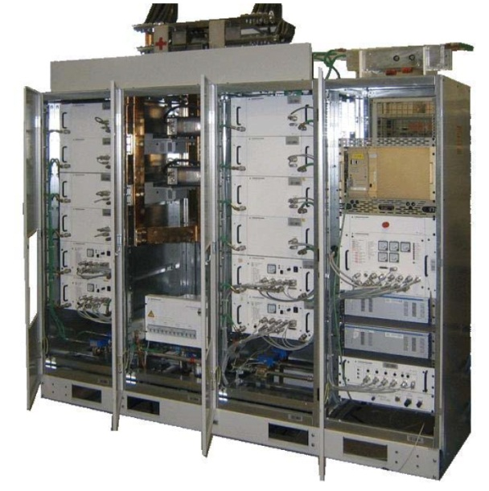
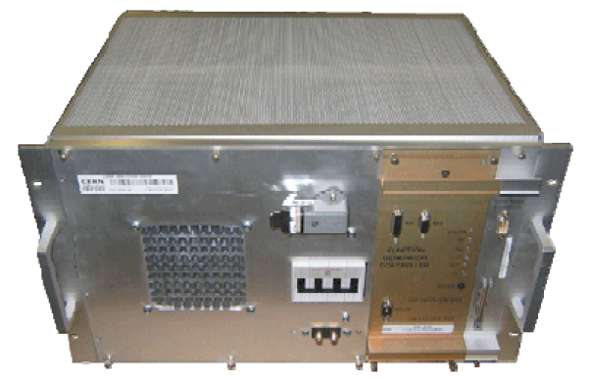
Power Converter Types
G
C
Function Generator Controller
F
[4,5]

Slide 18
Radiation Effects

Slide 19
in a nutshell
1. Displacement Damage (DD)
2. Total Ionising Dose (TID)
3. Single Event Effects (SEE)
cumulative
prompt

Slide 20
in a nutshell
1. Displacement Damage (DD)
2. Total Ionising Dose (TID)
3. Single Event Effects (SEE)
defects accumulate and gradually destroy the silicon lattice

Slide 21
in a nutshell
1. Displacement Damage (DD)
2. Total Ionising Dose (TID)
3. Single Event Effects (SEE)
SIO₂
SIO₂

Slide 22
in a nutshell
1. Displacement Damage (DD)
2. Total Ionising Dose (TID)
3. Single Event Effects (SEE)
SIO₂
SIO₂

Slide 23
in a nutshell
1. Displacement Damage (DD)
2. Total Ionising Dose (TID)
3. Single Event Effects (SEE)
SIO₂
SIO₂
accumulate and gradually degrade the transistor function

Slide 24
in a nutshell
1. Displacement Damage (DD)
2. Total Ionising Dose (TID)
3. Single Event Effects (SEE)
SIO₂
SIO₂
electrons collected by junctions creating
parasitic current
SE Transient (SET)
SE Upset (SEU)
SE Functional Interrupt (SEFI)

Slide 25
in a nutshell
1. Displacement Damage (DD)
2. Total Ionising Dose (TID)
3. Single Event Effects (SEE)
N
P
P
N
N
P
CMOS parasitic bi-polar transistors…
Switch on = short drain to source…
SE Latch-up (SEL)

Slide 26
in a nutshell
1. Displacement Damage (DD)
2. Total Ionising Dose (TID)
3. Single Event Effects (SEE)
cumulative
cumulative
prompt
Non-Ionising Energy Loss
Grays
Cross-section
SE Upset (SEU)
SE Transient (SET)
SE Functional Interrrupt (SEFI)
lifetime!
SE Latchup (SEL)
random in time failure!
mitigation is possible…

Slide 27
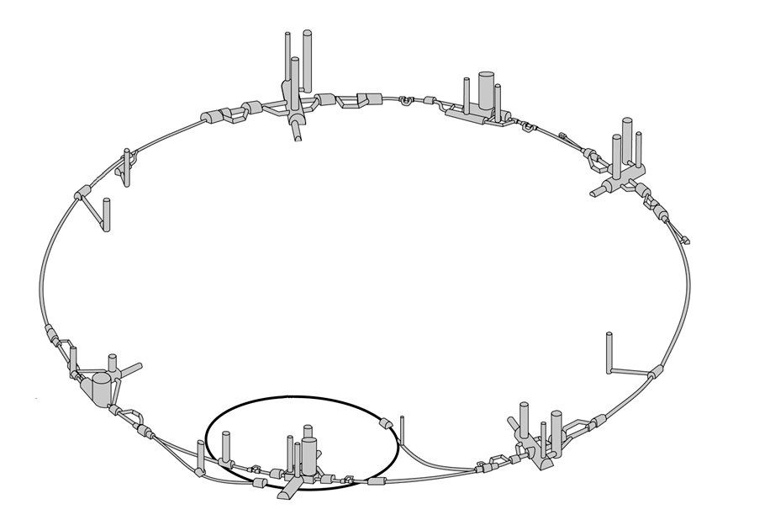
Power converters are installed in one of five areas with machine radiation risks:
Surface Buildings
none
Perpendicular galleries
none - low
Parallel galleries
low
Alcoves
medium - high
LHC Tunnel
high
[6]

Slide 28
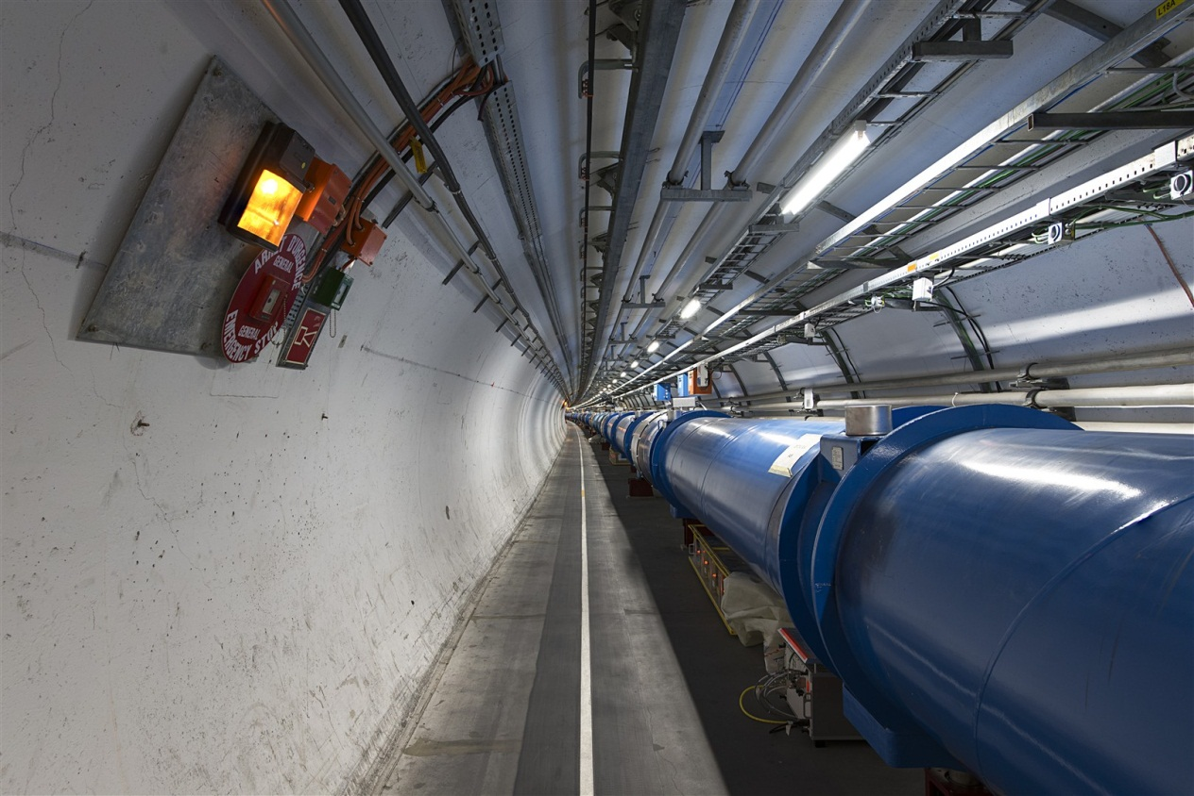
Power converters are installed in one of five areas with machine radiation risks:
Power Converter

Slide 29
Power Converter Types
FCG2
≈1000 FGClite needed…
[4,5]

Slide 30
FGClite

Slide 31
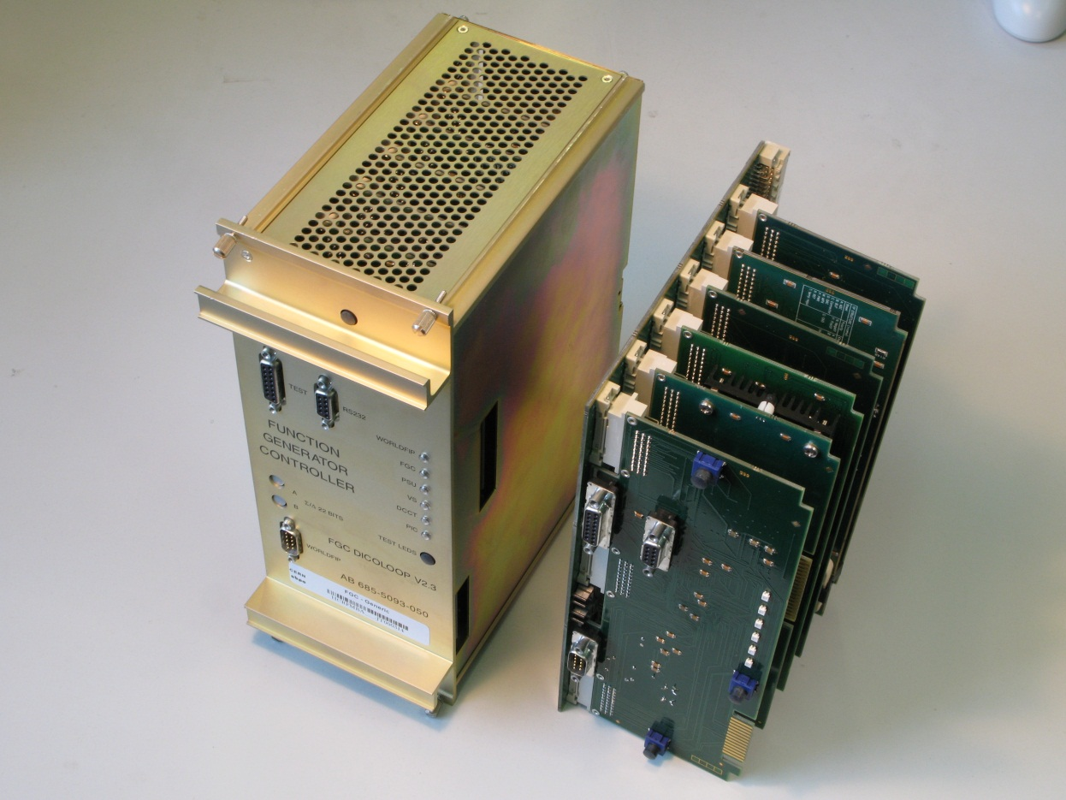
FGC2

Slide 32
Function

Slide 33
Software versus Programmable Logic
µP
DSP

Slide 34
Interesting Points
power converter electrical interface = same
Voltage Source, Interlocks, DCCT will all be the same interface
power converter operational functions = same
The LHC is still going to be the LHC after LS1…
FGC2 hardware documentation limited… 10 years… technical motivations in the mind of previous experts
FGClite hardware requirements document = reverse engineering FGC2 before starting… Ouch!
PCAD 2002
Altium Designer
FGC2
FGClite
Xilinx Schematic Entry
VHDL
use several FPGAs, figure the rest out later… Is this becoming a standard design practice?
Programmable Logic needs special attention in mission critical systems

Slide 35
Design Flow

Slide 36
Design Flow for Radiation Tolerance

Slide 37
Design Flow for Radiation Tolerance
Class 0 (C₀)
components known to be resistant, or easily replaced, conceptual design not influenced by these components.
Resistors, capacitors, diodes, transistors…
Class 1 (C₁)
components potentially susceptible to radiation, in less-critical parts of the system. Substitution of parts or mitigation of issues is possible with a re-design.
Regulators, memory, level translators…
Class 2 (C₂)
components potentially susceptible to radiation, in more-critical parts of the system. The conceptual design is compromised if these components do not perform well. Substitution of parts or mitigation of issues would be difficult.
ADC, FPGA, fieldbus driver

Slide 38
Design Flow for Radiation Tolerance

Slide 39
Design Flow for Radiation Tolerance

Slide 40
Design Flow for Radiation Tolerance

Slide 41
Design Flow for Radiation Tolerance
[7]

Slide 42
Lifetime & Reliability

Slide 43
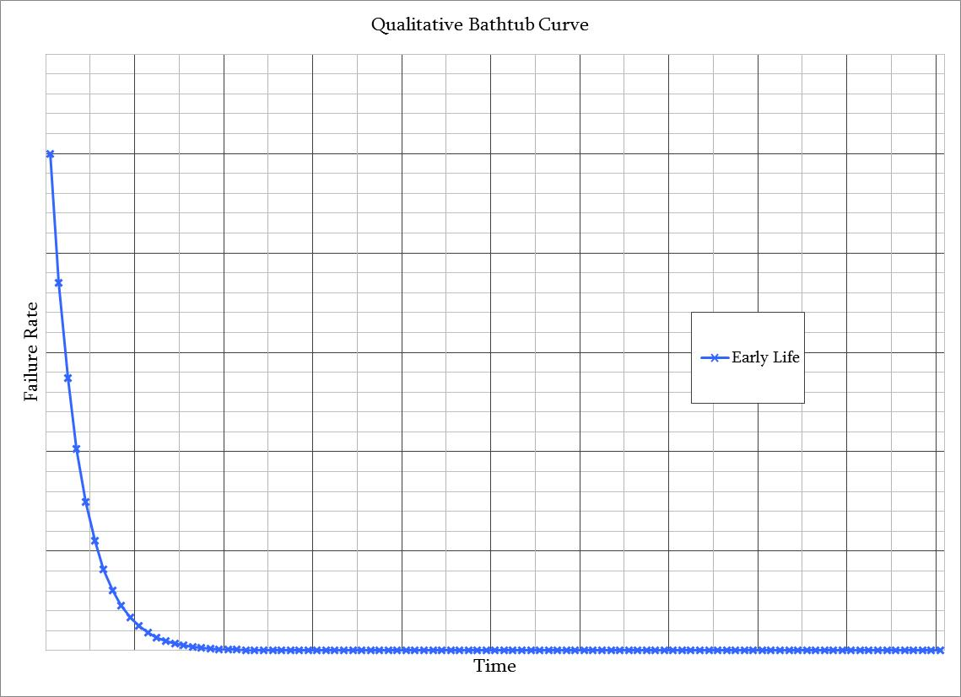
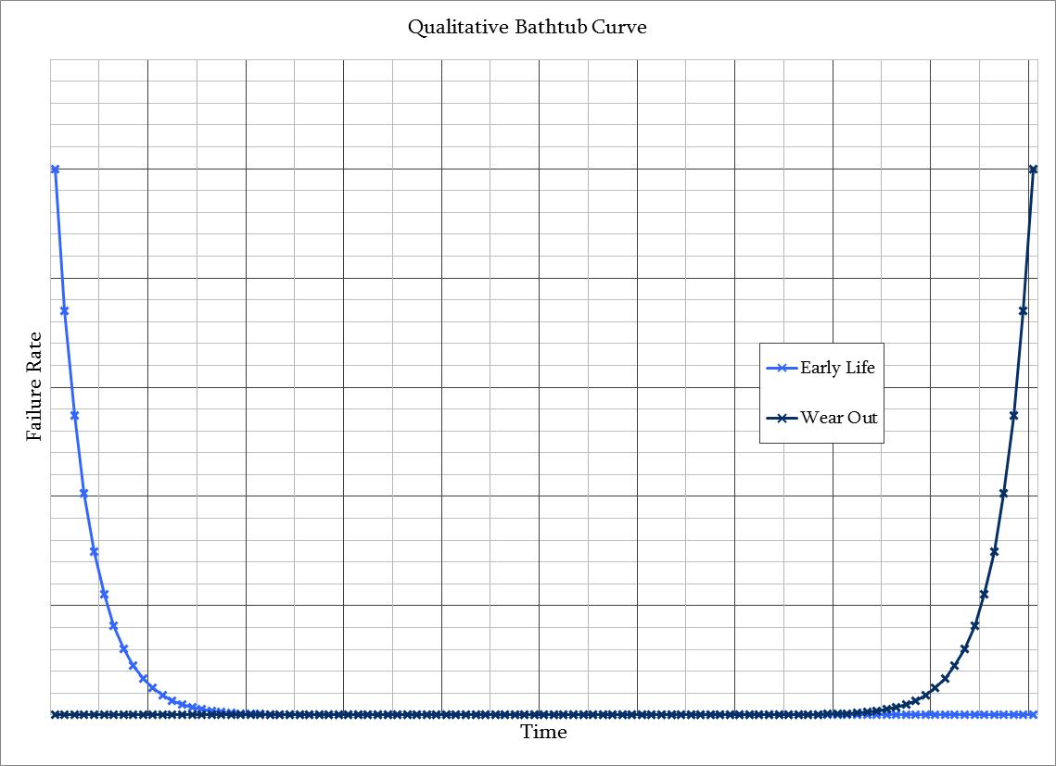
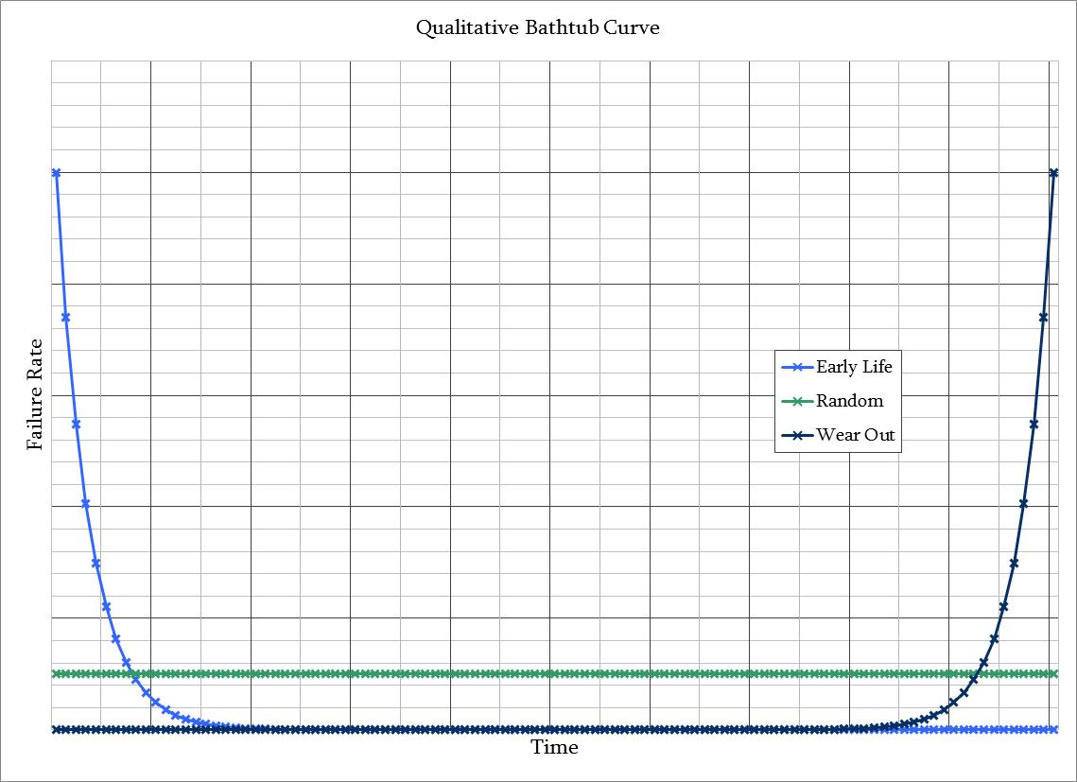
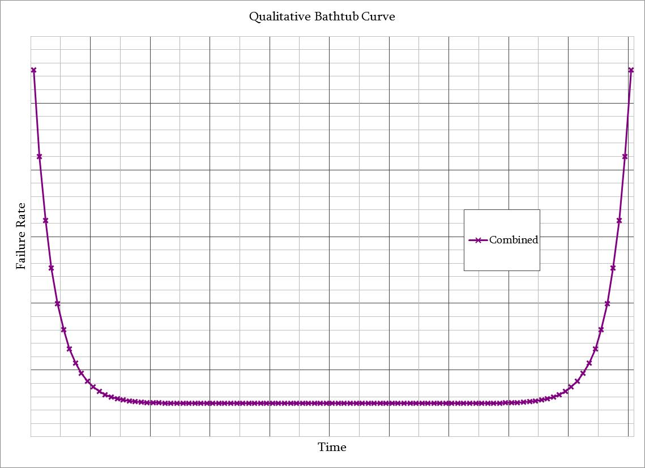
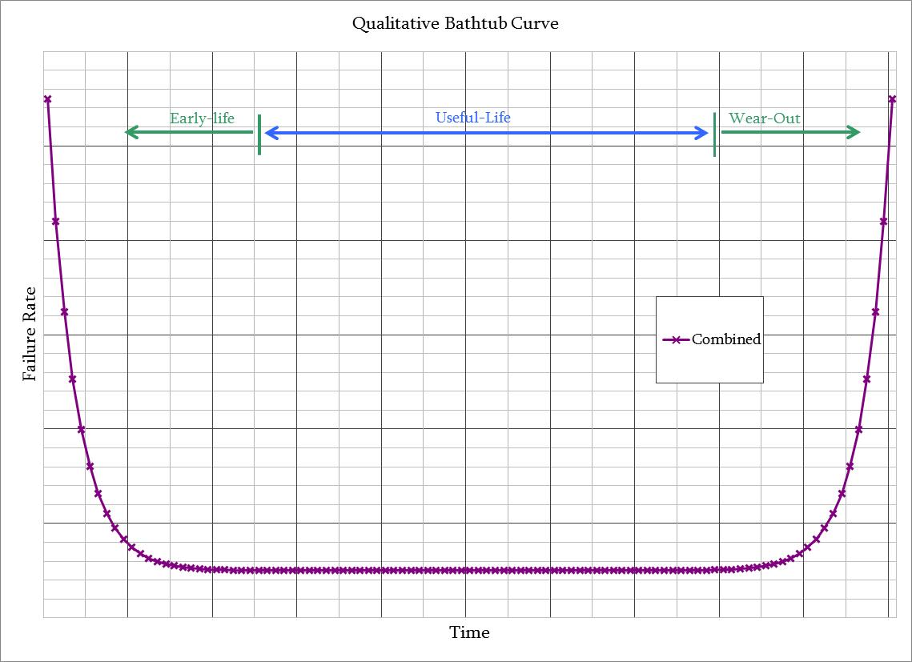

Slide 44
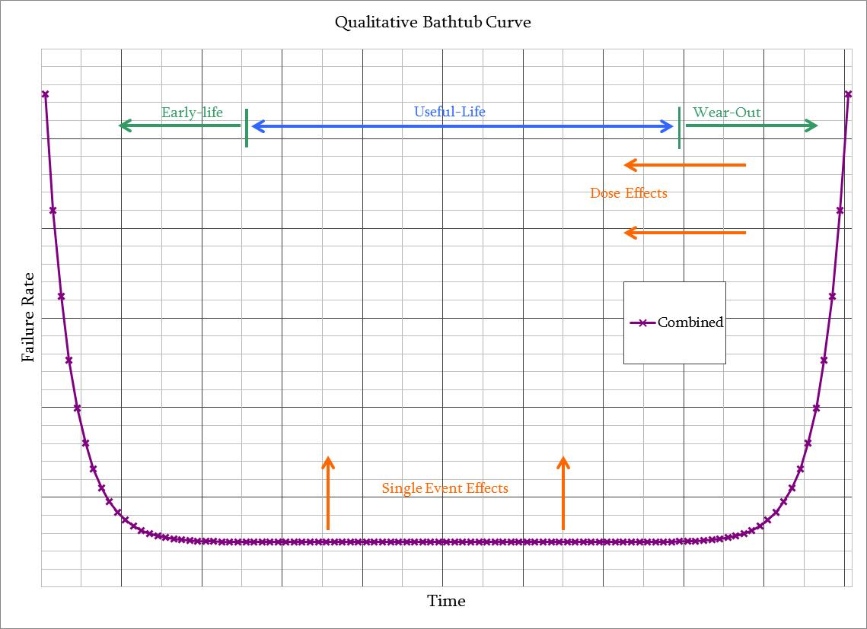

Slide 45
Stress screening
Run in
Burn in
Maintenance
Plan
Programmable Logic?
considered by Reliability Analysis

Slide 46
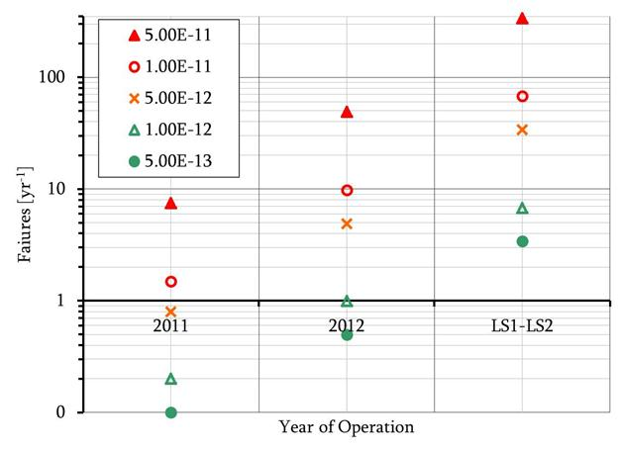
FGClite Reliability Requirements
acceptable failure rate < 40 per year…
cross-section <1 x 10⁻¹²
SEE radiation
Mean Time Between Failures > 200000 hours
(1000 units x 8800 hours per year) / 40
> 300000 hours
electrical
cross-section
[7]

Slide 47
FGClite Reliability Requirements
acceptable failure rate < 40 per year…
cross-section <1 x 10⁻¹²
SEE radiation
Mean Time Between Failures > 200000 hours
> 300000 hours
electrical
>200 Grays
DD / TID radiation
equipment lifetime > 25 years…
design for 25 years
electrical

Slide 48
In Closing…

Slide 51
Visions of the Future
to design a system for use in radiation…
mitigate the risks in every other way first
move equipment… shield equipment …is the equipment’s function really needed?
more simple function = better
it does the minimum needed… it does it very well... risks assessed for additional features…
follow a strict development plan
basic design has to be rock solid before adding complications for radiation
Trust… but verify
specify function... formalise if needed… test against function… follow the V-model…
“Fly like you test, test like you fly”
[8]
make tests as realistic as possible = test-bench function, test environment
risk is never zero
As Low As Reasonable Possible (ALARP)

Slide 52
Visions of the Future
to design a system for use in radiation…
in machine protection
mitigate the risks in every other way first
move equipment… shield equipment …is the equipment’s function really needed?
more simple function = better
it does the minimum needed… it does it very well... risks assessed for additional features…
follow a strict development plan
basic design has to be rock solid before adding complications for radiation
Trust… but verify
specify function... formalise if needed… test against function… follow the V-model…
“Fly like you test, test like you fly”
[8]
make tests as realistic as possible = test-bench function, test environment
risk is never zero
As Low As Reasonable Possible (ALARP)

Slide 53
fin – thank you!

Slide 54
References
[1]
From the Chamonix Performance Workshop 2011
http://indico.cern.ch/conferenceOtherViews.py?view=standard&confId=103957
[2]
Extracted from http://lhc-statistics.web.cern.ch/LHC-Statistics/index.php
[3]
Extrapolated from W. Herr’s talk:
“Luminosity Performance Reach After LS1”
[4]
Derived from
http://cdsweb.cern.ch/record/1123729/files/LHC-PROJECT-REPORT-1133.pdf?version=1
[5]
Photographs courtesy Y. Thurel et al, from:
“LHC Power Converters the Proposed Approach”
[6]
Diagram background is from http://cdsweb.cern.ch/record/842349/
[7]
Figures and flow derived from work by Y. Thurel and S. Uznanski
[8]
Several sources – not an original statement from CERN.
E.G. http://ntrs.nasa.gov/archive/nasa/casi.ntrs.nasa.gov/20080019635_2008018965.pdf

