Slide 1
Using reconfigurable FPGAs in radioactive environments: challenges and possible solutions
Massimo Violante
Politecnico di Torino
Dip. Automatica e Informatica
Torino, Italy

Slide 2
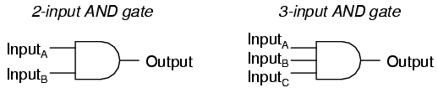
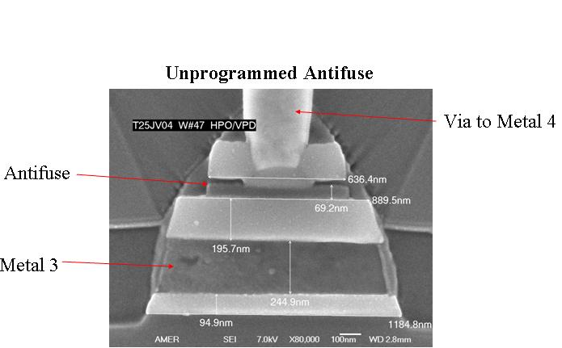
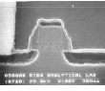
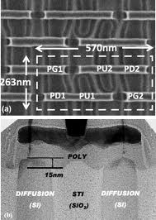
FPGA structure/technology
Logic Blocks & Interconnections
Configuration Elements
Antifuse
Flash
SRAM
Before programming

Slide 3
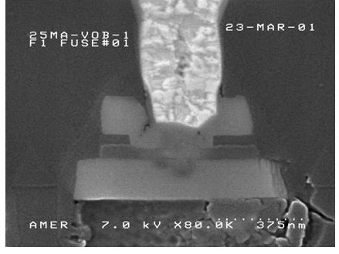
FPGA structure/technology
Logic Blocks & Interconnections
Configuration Elements
Antifuse
Flash
SRAM
After programming

Slide 4
Why FPGAs?
Antifuse FPGAs are used heavily as they allow shorter time to market, and lower costs for small volumes than ASICs
No versatility (one-time programmable)
SRAM-/Flash-based FPGAs are reprogrammable
The benefits of versatility:
  Reconfigurable computing
  Feature improvements over the years
  Bug fixing (!)
Source: Microsemi

Slide 5
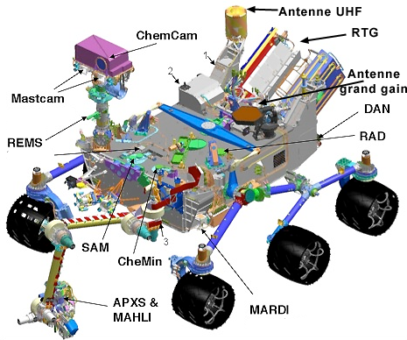
Bug fixing
Buggy Chip

Slide 6
Reconfigurable FPGAs vs radiation
As a matter of fact, most of the reconfigurable FPGAs are soft w.r.t. radiation
To use them in radioactive environments it is compulsory to:
  Understand effects from the designers perspective
  Understand if/why mitigation techniques may fail
  Define validation flows

Slide 7
Outline
Radiation effects in SRAM-/Flash-based FPGAs
Design mitigation issues
Design validation
Conclusions

Slide 8
Outline
Radiation effects in SRAM-/Flash-based FPGAs
Design mitigation issues
Design validation
Conclusions

Slide 9
Effects relevant for FPGAs
Single Event Effects (SEE)
Total Ionizing Dose
(TID)
Soft Errors
Hard Errors
Single Event Transient (SET)
Functional Interrupt (SEFI)
Single Event Upset (SEU)
Single Event Latchup (SEL)
Displacement Damage
(DD)
Gate Rupture (SEGR)
Single Event Burnout (SEB)
Addressed in this talk

Slide 10
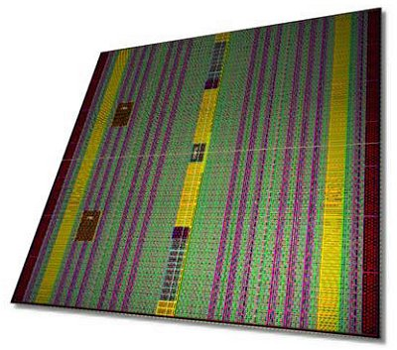
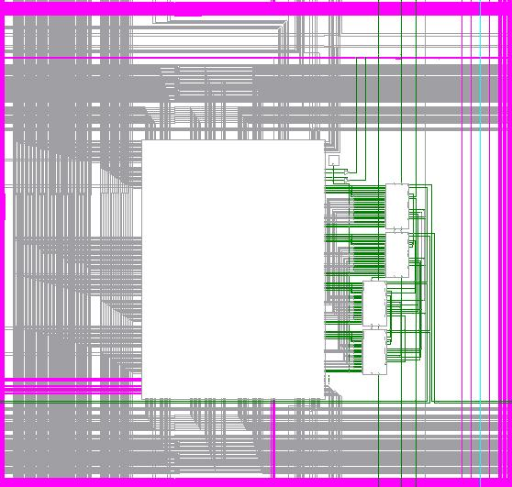
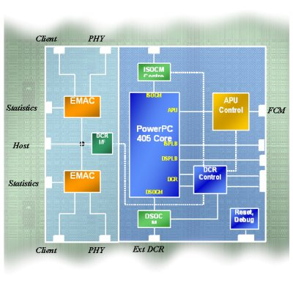
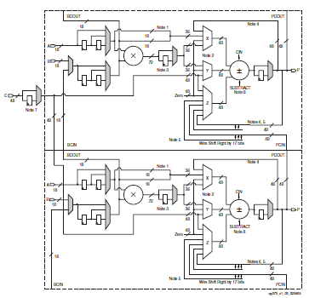
SRAM-based FPGA Architecture
Xilinx Virtex-4QV
CLB
Lookup Table (LUT)
A B C D
BRAM
0
1
PowerPC
1
1
1
1
1
Boolean Function
F(A,B,C,D)
‘0’
1
0
1
PowerPC
0
0
DSP
1
0
1
0
Notes:
The configuration memory is spread throughout the device in a large array.
Each logic block contains its own configuration cells locally.
A data frame is a one bit vertical slice through the array.
The configuration logic identifies each frame with a unique address “minor” as
well as a unique address for the column that it lies in.
Configuration data is loaded serially or in byte-parallel into the interface where
it is assembled into a frame in a shift register.
The entire frame is loaded into memory all at once.

Slide 11
SEU in SRAM-based FPGAs: CLB slice
I₁
I₂
I₃
I₄
CLB slice
0
0
LUT
0
1
Transient Effect (corrected at next ffp load)
0
1
1
1
0
0
0
1
0
1
1
1
LUT
routing
Persistent effect (corrected by reconfig)
Configuration memory bits
Notes:
When we take a look in the FPGA architecture, there are two basic elements to implement the logic in a FPGA, the lookup table that is responsible to implement the logic functions as truth tables and the flip-flops. They are all located in the CLB slices. These basic elements are connected through a programmable routing that are multiplexers or pass transistors controlled by static memory cells.
When a SEU occurs in one of these memory cells: the configuration memory bits (LUTs and routing) or in the CLB flip-flop, the stored value is flipped, this creates a fault with a permanent effect in the case of LUT or routing, or a fault with a transient effect in the case of the CLB flip-flop.

Slide 12
SRAM-based FPGA
General Routing Matrix (GRM)
Xilinx Virtex-4QV
Direct lines
Long lines
CLB
CLB
CLB
CLB
CLB
CLB
CLB
Hex lines
CLB
CLB
Hex connections
CLB
CLB
CLB
CLB
CLB
CLB
CLB
CLB
CLB
Direct connections
Fast connect
Double lines
CLB
CLB
CLB

Slide 13
SEU in SRAM-based FPGAs:
Routing configuration cells
Xilinx Virtex-4QV
Direct connections:
Hex connections:
0
1
open
open
short
short
1
0
0
1
1
1
short
open
Persistent effect (corrected by reconfig)

Slide 14
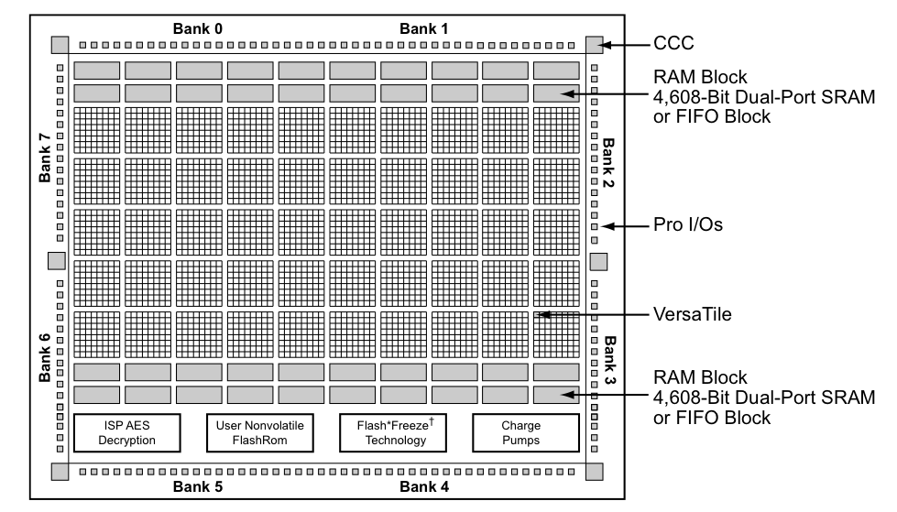
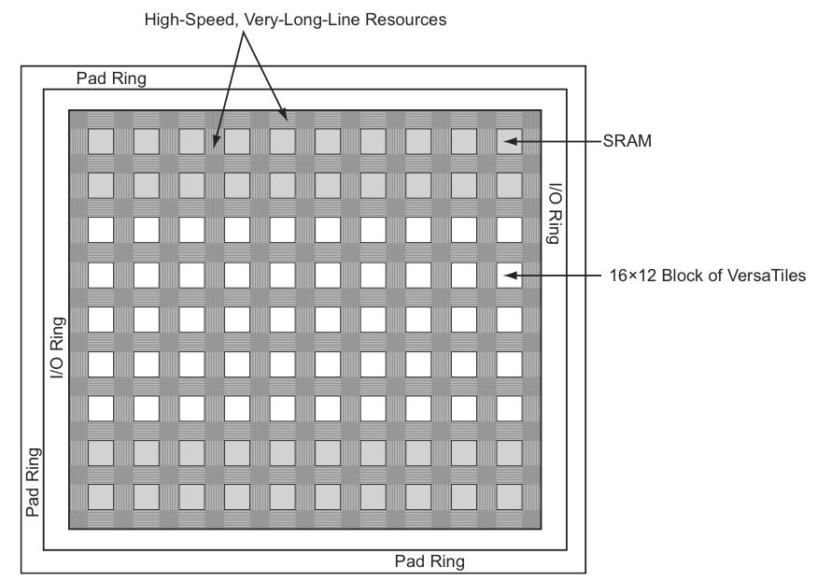
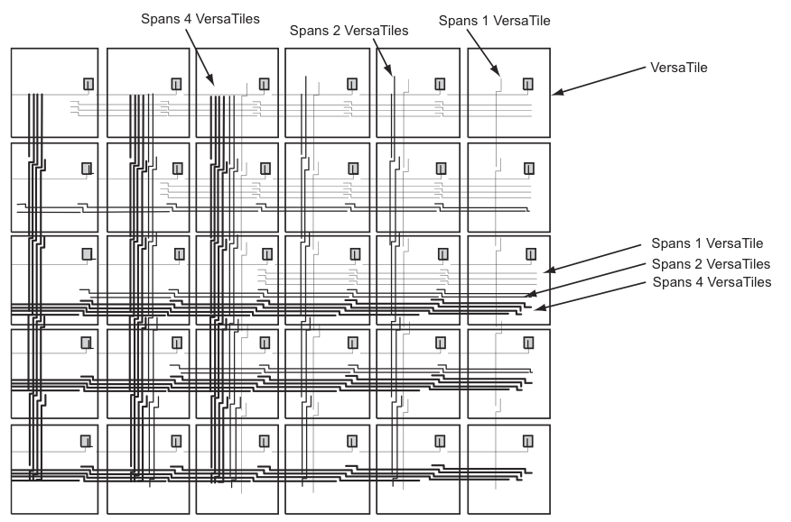
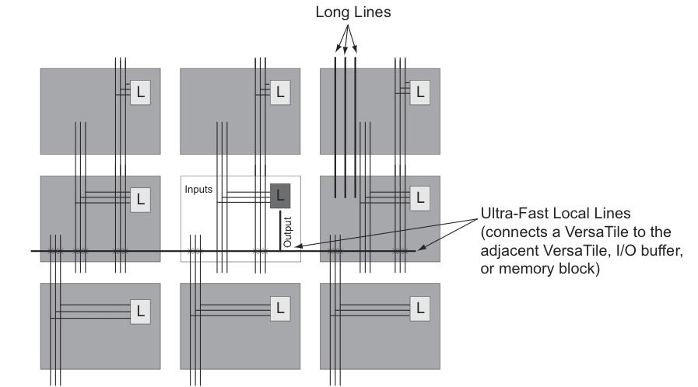
Flash-based FPGA
Microsemi ProAsic3

Slide 15
SEE sensitivity
Configurable Logic Block called VersaTile
VersaTile
Effect 1:
SET in the logic
logic

Slide 16
SEE sensitivity
Configurable Logic Block called VersaTile
VersaTile
X
Effect 2:
SEU in the ffp
ffp

Slide 17
SEE sensitivity
Floating Gate (FG) switch
Effect 3:
SET in the logic path
SET in the routing path

Slide 18
What to remember so far
SRAM-based FPGAs are soft against radiation
  User logic (SET)
  User memory (SEU, MBU)
  Control logic (SEU, SEFI)
  Configuration memory (SEU, MBU)
Flash-based FPGAs are soft against radiation
  User logic (SET)
  User memory (SEU, MBU)
  Control logic (SEU, SEFI)

Slide 19
Outline
Radiation effects in SRAM-/Flash-based FPGAs
Design mitigation issues
Design validation
Conclusions

Slide 20
Problems and solutions
The problems
  SEU
  SET
  SEL
  SEFI
  TID
The solutions
  Device-level solutions
    Make the device design rad tolerant
  Design-level solutions
    Make your design rad tolerant
Which is the best solution?

Slide 21
Which is the best solution?
From the designer perspective the answer is easy: device-level solutions
  Problem solved at the root
  No need to put extra-effort to design for SEE mitigation and validate the resulting design
However, few devices are ready (?) today
  Atmel AT280 (SRAM-based, old concept, poor back-end tools)
  Xilinx Virtex-5QV (SRAM-based, ITAR restricted, expensive)
  No Flash-based device available

Slide 22
A pragmatic compromise
Select among commercial devices those that are immune to TID and SEL
Design your application for SEE mitigation using
  Appropriate system architecture for SEE removal
  Appropriate circuit architecture for SEE masking

Slide 23
System Architecture
Payload FPGA
Payload FPGA on-chip configuration is refreshed periodically
SRAM-based FPGAs
  To remove SEE in c.m.
FLASH-based FPGAs
  To anneal TID effects
Period depends on the radiation environment
System
Controller
Config
Bus
Configuration
Memory Backup

Slide 24
Architecture for SEE masking
D1.1
D1.2
Your design

Slide 25
Architecture for SEE masking
TMR Domain
Voter Partition
V1
D1.1
V2
D1.2
V3
V1
D2.1
V2
D2.2
V3
V1
D3.1
V2
D3.2
V3
Your design
In SRAM-based FPGAs this is logic+FF
In Flash-based FPGAs it is only FF

Slide 26
Architecture for SEE masking
All masking techniques are based on the single-fault assumption (1 SEE = 1 fault in the design)
But
SEE in the configuration memory may produce multiple faults

Slide 27
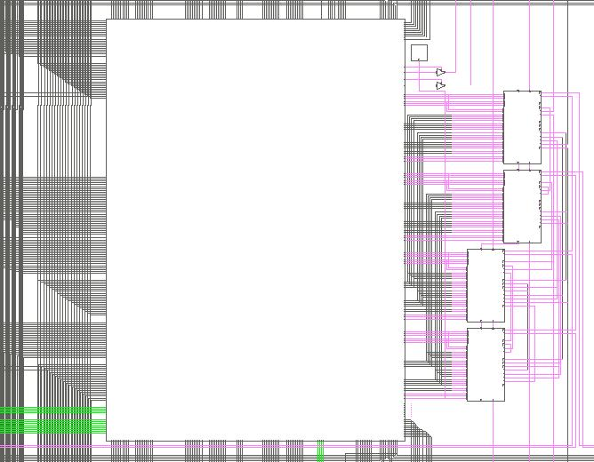
An example: original circuit
The original netlist
The bitstream
0 | 1 | 0 | 0 | 0 | 0
1 | 0 | 0 | 0 | 0 | 0
1 | 1 | 0 | 0 | 0 | 0
0 | 0 | 0 | 0 | 1 | 0
0 | 1 | 0 | 1 | 0 | 0
0 | 0 | 0 | 0 | 0 | 0

Slide 28
An example: single effect
The corrupted netlist
The bitstream
1→0
An open circuit is created
0 | 1 | 0 | 0 | 0 | 0
* | 0 | 0 | 0 | 0 | 0
1 | 1 | 0 | 0 | 0 | 0
0 | 0 | 0 | 0 | 1 | 0
0 | 1 | 0 | 1 | 0 | 0
0 | 0 | 0 | 0 | 0 | 0

Slide 29
An example: multiple effects
The corrupted netlist
The bitstream
0→1
A short circuit is created
0 | 1 | 0 | 0 | 0 | 0
1 | 0 | * | 0 | 0 | 0
1 | 1 | 0 | 0 | 0 | 0
0 | 0 | 0 | 0 | 1 | 0
0 | 1 | 0 | 1 | 0 | 0
0 | 0 | 0 | 0 | 0 | 0

Slide 30
Why TMR may fail?
Original netlist
SEE-corrupted netlist
Domain 1
Domain 1
Domain 2
Domain 2
The SEE modifies the same signal in two domains → SEE is producing multiple effects not masked by voters

Slide 31
An example
Design: TMR design (in theory any SEE should be mitigated)
Fault injection in config. mem. (about 20 Mbits)
Resource | Failure
LUT | 71
Global routing | 3,503
CLB Local routing | 53
CLB configuration | 1
Total | 3,628

Slide 32
What to remember so far
SRAM-/Flash-based FPGAs may be OK for radioactive environments provided that
  Proper device is selected (TID, SEL)
  Design mitigation is used
SEE mitigation is needed → huge costs
  3x FFs, 3x IO, >4x user logic, >20% on clock frequency
Mitigation may fail due to multiple effects of SEE in configuration memory → validation needed

Slide 33
Outline
Radiation effects in SRAM-/Flash-based FPGAs
Design mitigation issues
Design validation
Conclusions

Slide 34
Validation approaches
Qualitative validation via design inspection before place & route
Quantitative validation after place & route
  Simulation-based validation
  Emulation-based validation
Main issue in quantitative validation: amount of faults to be simulated
  20 Mbits in config. mem., 1 M functional input vectors @ 100 MHz → about 2.3 days to perform exhaustive fault injection

Slide 35
Activities @ PdT
Design-oriented configuration memory analysis
# of SEU
# of SEU
# of input vectors
Static analysis
# of input vectors

Slide 36
Config. mem. analysis
Reverse engineer the configuration memory of FPGA of choice
Configuration bitstream
0 | 1 | 0 | 0 | 0 | 0
1 | 0 | 0 | 0 | 0 | 0
1 | 1 | 0 | 0 | 0 | 0
0 | 0 | 0 | 0 | 1 | 0
0 | 1 | 0 | 1 | 0 | 0
0 | 0 | 0 | 0 | 0 | 0
FPGAs resources
Configuration memory bits layout

Slide 37
Config. mem. analysis
Read the place & routed design and build the netlist/bitstream association
For each bit of the bitstream:
  Flip the bit and update accordingly the netlist
  Is the original netlist corrupted (does the error arrive to outputs or memory element)?
    Yes → the bit is sensitive
    No → the bit is not sensitive
Analysis is done looking at the error propagation path, and it does not consider workload

Slide 38
Operational modes
Discovery mode: it analyzes the bitstream while neglecting mitigation schemes
  Lists sensitive bits
TMR mode: it analyzes the bitstream while automatically recognizing (X)TMR mitigation scheme
  Lists bits that violate (X)TMR scheme (domain crossing events)
  List bits that produce warnings (may lead to domain crossing events in case of accumulation)

Slide 39
Domain crossing events
TMR Domain
Voter Partition
V1
D1.1
V2
D1.2
V3
V1
D2.1
V2
D2.2
V3
V1
D3.1
V2
D3.2
V3

Slide 40
Domain crossing events
V1
D1.1
V2
D1.2
V3
V1
D2.1
V2
D2.2
V3
V1
D3.1
V2
D3.2
V3
One Single Event Upset (SEU) in the configuration memory provokes two circuit modifications in two TMR domains in the same TMR partition → The fault propagates beyond the voter boundary

Slide 41
Warnings
V1
D1.1
V2
D1.2
V3
V1
D2.1
V2
D2.2
V3
V1
D3.1
V2
D3.2
V3
One SEE in the configuration memory provokes two circuit modifications in two voter partitions → The fault stops at the voter boundary

Slide 42
TMR-mode algorithm
The algorithm recognizes automatically TMR domains, voters, and voter partitions
Forward error propagation:
  Find all the paths from the fault site to the circuit outputs, or memory elements
  Is the fault propagating to only one of the voter inputs?
    Yes → the bit is not sensitive
    No → the fault propagates to at least two inputs of a voter in the same partition → the bit is sensitive
V
V

Slide 43
The report
Detailed report is produced for Xilinx devices
Resource: PIP Block Adr 0 Maj Add 6 Min Add 14 Bit 156
Involved PIP : Y1 -- S2BEG2
FAR: 0x000c1c00 Bit: 156
Net = data_bus_IBUF_TR

Slide 44
Example
X-TMR LEON3 processor on Xilinx xc2v6000
  20 Mbits in config. mem., 1 M functional input vectors @ 100 MHz
2,603,950 are SEE-sensitive for the design (computed in about 2 hours vs 2.3 days)
3,628 SEUs lead to actual application failure for the considered workload (fault injection completes in about 7 hours)

Slide 45

Complete design flow
Input design
STAR
Workload
XST synthesis
List of sensitive bits
FLIPPER
TMR tool
VPLACE
Fault coverage
Output design
Robust placement
PAR
RoRA/PAR
bitstream
Robust bitstream

Slide 46
Outline
Radiation effects in SRAM-based FPGAs
Design mitigation issues
Design validation
Conclusions

Slide 47
Conclusions
SRAM-/Flash-based FPGAs are very attractive for bringing reconfiguration in radioactive environments
Bullet-proof (i.e., rad-hard) devices are not ready
Solutions are available based on rad-tolerant devices (no TID/no SEL), however
  It is the designer responsibility to implement mitigation
  It is the designer responsibility to validate the mitigation
  Zero failure may not be possible thus estimating residual error rate is mandatory

Slide 48
Acknowledgment
Monica Alderighi
Niccolò Battezzati
Fabio Casini
Fernanda Lima Kastensmidt
David Merodio Codinachs
Luca Sterpone
Atmel, France
Boeing Satellite Systems, USA
EADS-IW, France
European Space Agency, The Netherland
Thales Alenia Space, Italy

