Slide 1
Ultra-Low-Power Radiation Hardened ADC for Particle Detector Readout Applications
Esko O. Mikkola,¹ Visu Swaminathan,² Balasubramarian Sivakumar² and Hugh J. Barnaby²
¹Ridgetop Group, Inc. Tucson, Arizona, USA
²Arizona State University, Tempe, Arizona, USA
Presented at: TWEPP, Oxford, UK, September 20, 2012

Slide 2
Outline
Program Overview
Motivation for the Work
Special Analog Design Techniques
Results
Schedule and Future Work
Summary

Slide 3
Program overview
Ridgetop Group has been awarded a U.S. Department of Energy (DOE) Small Business Innovative Research (SBIR) Phase II contract (2 years) to design and fabricate a 12-bit, 40MS/s, 20mW radiation hardened pipeline ADC for High Energy Physics detector readout applications. The output clock rate of the ADC is matched to the decoder/serializer designed by SMU for the ATLAS LAr upgrades.
Phase I feasibility study (9 months) has been finished and the Phase II period has just started.
This presentation discusses the design concepts and progress.

Slide 4
Motivation for the Work
The upgrades of the LHC have a need for 12-14bit, 40MS/s, low-power ADC that is hardened against single-event effects and 3.5Mrad of Total Ionizing Dose (TID).
TID problems have practically disappeared from 130nm and smaller-geometry CMOS processes (if thin-oxide FETs are used).
Designing analog and mixed-signal circuits within the low breakdown voltage constraints of FETs from 130nm and smaller processes is difficult.
We have successfully combined several recently developed circuit techniques to obtain a 12-bit pipeline ADC that uses a 1.2V power supply.

Slide 5
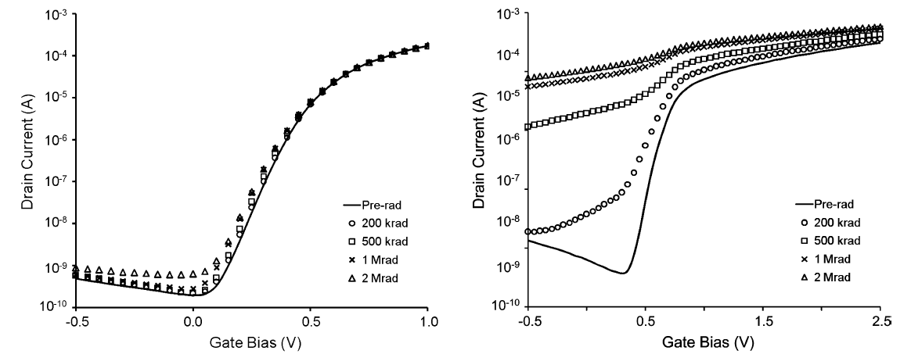
TID hardness of CMOS processes
It s commonplace for ADC designers to use the high-voltage I/O transistors available in the small-geometry CMOS processes for more headroom in their amplifier designs. These thick-oxide transistors are not hard against TID.
TID response of RVT 90 nm (W = 540 nm, L = 120 nm) n-channel MOSFET. [1]
Radiation response of a 90 nm high voltage I/O transistor (W = 520 nm, L = 240 nm). [1]
[1] Michael McLain, Hugh J. Barnaby, et al. “Enhanced TID Susceptibility in Sub-100 nm Bulk CMOS I/O Transistors and Circuits” IEEE TRANSACTIONS ON NUCLEAR SCIENCE, VOL. 54, NO. 6, DECEMBER 2007.

Slide 6
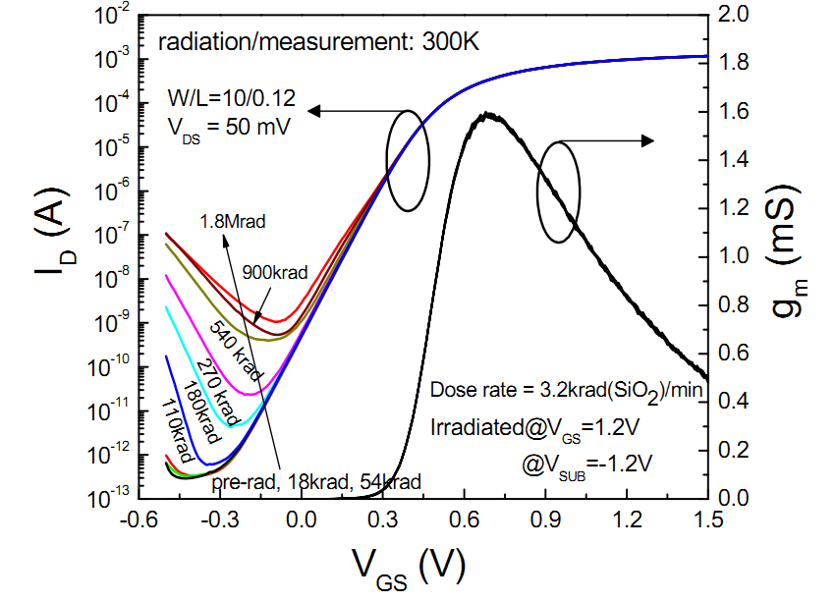
TID hardness of CMOS processes
Our design uses only the thin-oxide FETS in the IBM 8RF 130 nm process. The TID tests results of IBM 130nm NMOS are shown below.

Slide 7
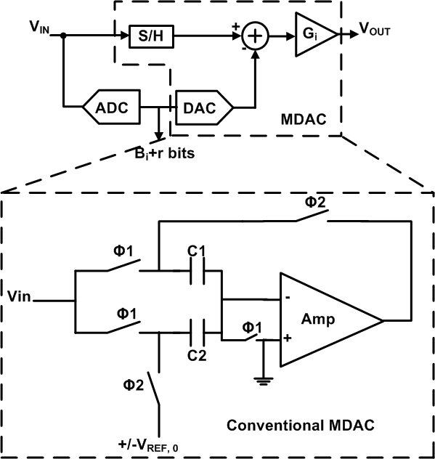
Conventional MDAC Stage in a Pipeline ADC
Sub-ADC can tolerate large comparator offsets with RSD algorithm.
Linearity and accuracy requirement are imposed on the DAC and a gain stage.
MDAC is the Critical Block!!

Slide 8
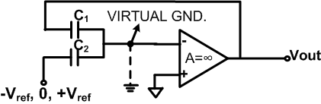
Why do we need high Op-amp gain?
Basic operation of op-amp is to maintain virtual ground at the inverting terminal.
But with finite gain, it will NOT be ‘0’ but given by -V_{out}/A.
Thus op-amp gain needs to be high. In sub 130nm CMOS technologies this is difficult to achieve and requires complex, high power amplifier designs.
Solution:
The first special design technique we applied, Correlated Level Shifting (CLS), makes gain of the op-amp proportional to A² (gain squared).

Slide 9
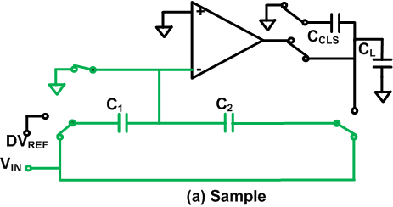
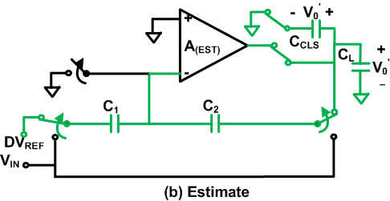
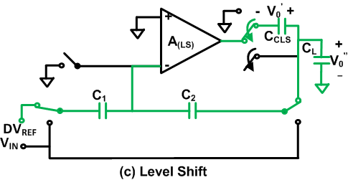
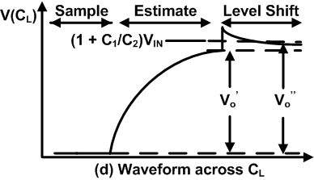
Technique #1: Correlated Level Shifting (CLS)
[Ref] : B.R.Gregoire and U.Moon, “An over-60 dB true rail-to-rail performance using correlated level shifting and an opamp with only 30 dB loop gain,” IEEE J. Solid-State Circuits, vol. 43, no. 12, pp. 2620–2630, Dec. 2008.

Slide 10
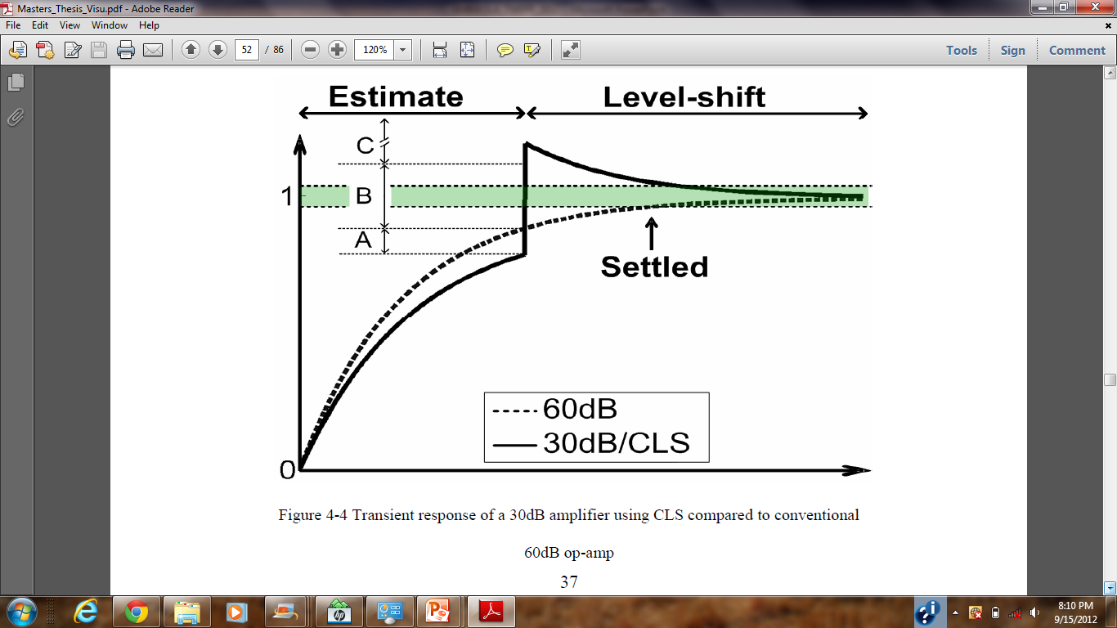
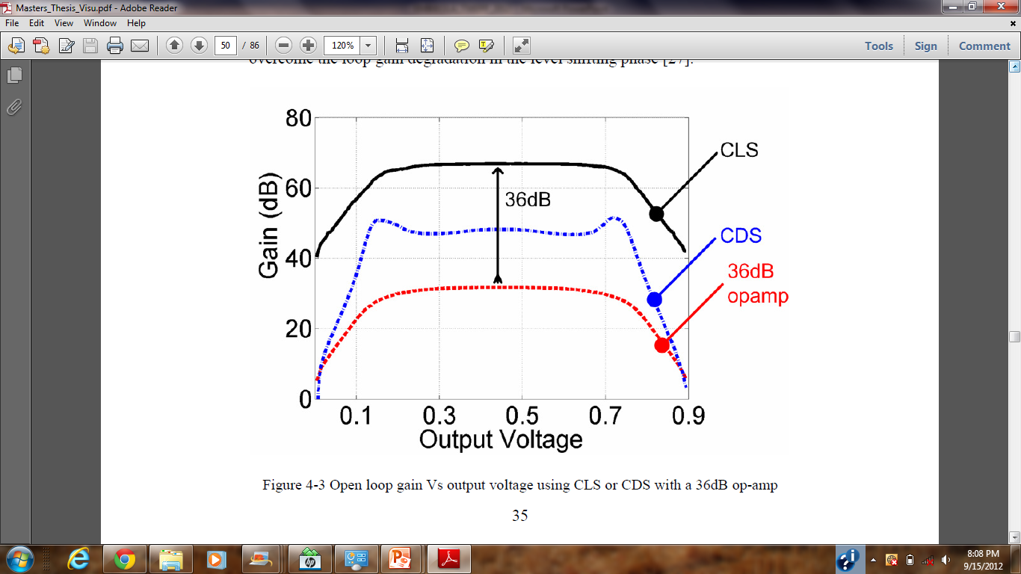
Technique #1: Correlated Level Shifting (CLS)
Correlated Level Shifting effectively squares the gain and allows using simple, robust, low gain, low power amplifier topologies at low power supply levels for high resolution gain stages.

Slide 11
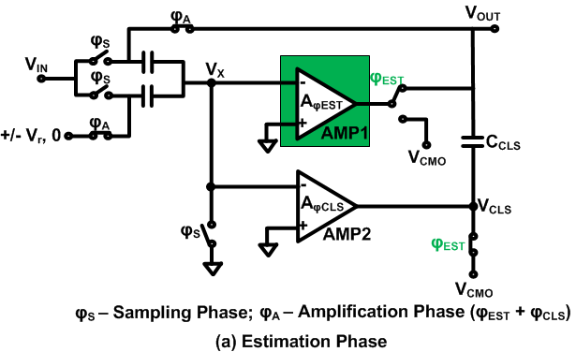
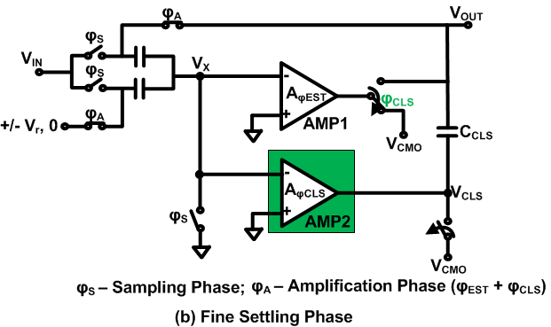
Technique #2: Split-CLS Architecture
Basic CLS is still not optimized for power since the same amplifier is used for estimation and fine settling (i.e. level shifting). Estimation needs high voltage swing and high slew rate, but low gain and bandwidth, whereas fine settling needs only low voltage swing and low slew rate, but high gain and bandwidth. In the Split-CLS technique the one “universal” amplifier is replaced with two specialized ones and lots of power is saved.
[Ref] B. Hershberg, et.al, “Design of a split-CLS pipelined ADC with full signal swing using an accurate but fractional signal swing opamp”, IEEE J. Solid-State Circuits, vol. 45, no. 12, pp. 2623–2633, Dec. 2010.

Slide 12
Further Power Optimization
Split-CLS needs two specialized low-power amplifiers for each stage.
Though, it is power efficient when compared to conventional MDAC, it can be improved further.
Solution:
Estimation amplifier is idle during sampling phase and fine settling phase.
Similarly, fine settling amplifier is used only during fine settling (level shifting) phase.
These amplifiers can be shared across the stages and utilized efficiently. The third technique we have used is op-amp sharing.

Slide 13
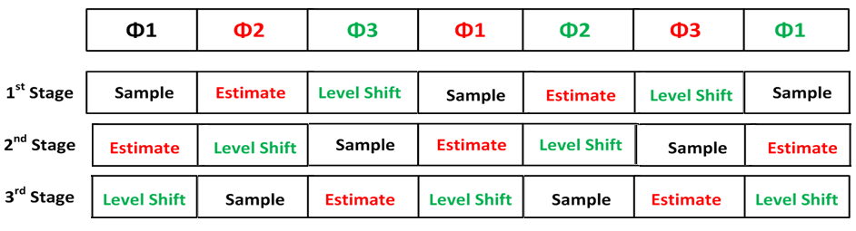
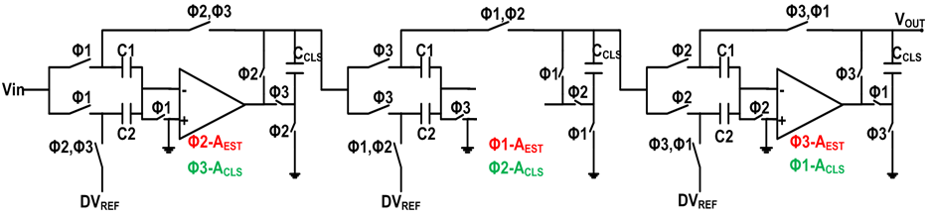
Technique #3: Op-amp Sharing
0 25 50 75 100 125 150 Time [ns]
Clocks
(a) Phases of three stages
@60ns
AMP2
NO
AMP
AMP1
1st Stage
2nd Stage
3rd Stage
Three stages of MDACs need only two op-amps (connections shown at the time instant of 60ns)

Slide 14
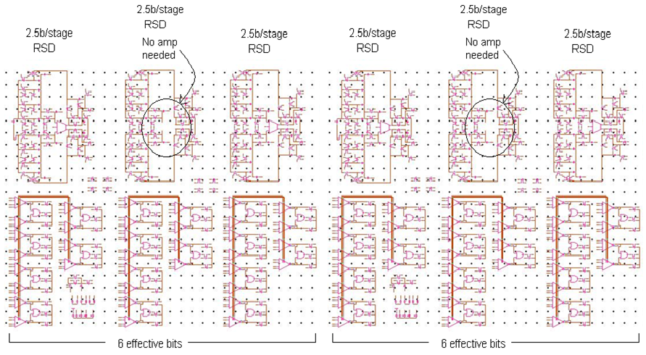
Whole Transistor-level Simulation Schematic
“High-spec” stages
“Low-spec” stages

Slide 15
Performance Comparison
Total power calculation:
Amplifier power: 7mW
Comparator power 1.8mW
Clock generation and distribution: 2mW
Output logic: 1mW
Parallel to LVDS: 2mW
Output pad drivers: 3mW
Total: 14.8 mW
ADC | AD9042 | Split-CLS [Ref] | This Work
Technology | 5V bipolar | 180nm | 130nm
Supply Voltage | 5V | 1.8V | 1.2V
Input Voltage Range | 2V | 1.4V | 1V
Sampling Frequency | 41MHz | 20MHz | 25MHz*
ENOB | 10.9 | 11.1b | 11.3b
Latency | Not specified | Not specified | 120ns**
Analog Power | Not specified | 15mW | 7mW
Total Power | 595mW | Not specified | 15mW
TID | >1MRad(Si) | Not specified | >1.8MRad(Si)
Results Based on | Actual tests | Actual tests | Simulations
*Will be increased to 40MHz
**Will be decreased to 75ns
[Ref] B. Hershberg, et.al, “Design of a split-CLS pipelined ADC with full signal swing using an accurate but fractional signal swing opamp”, IEEE J. Solid-State Circuits, vol. 45, no. 12, pp. 2623–2633, Dec. 2010.

Slide 16
Simulated Performance
ENOB at 25MS/s sampling frequency. At 40MS/s the ENOB is currently below 10-bits => we are making improvements to the design.

Slide 17
RHBD and radiation effect simulations
TID: The thin-oxide transistors in the 130nm CMOS process are hard to multimegarads of TID.
Single event effects:
We have simulated (TCAD + Cadence Spectre) the ADC stages with single event strike models and transients/upsets longer than 3 clock cycles did not appear (except in the BGR).
We did not include any memory or background calibration loops in order to avoid permanent errors.
The used Band Gap Reference (BGR) had up to 250ns transients in these simulations. We are looking into how to make it harder against SETs.
We are debating whether we need to use RHBD (TMR, DICE) for the output logic blocks.
130nm CMOS should be immune to latchup when biased at 1.2V.

Slide 18
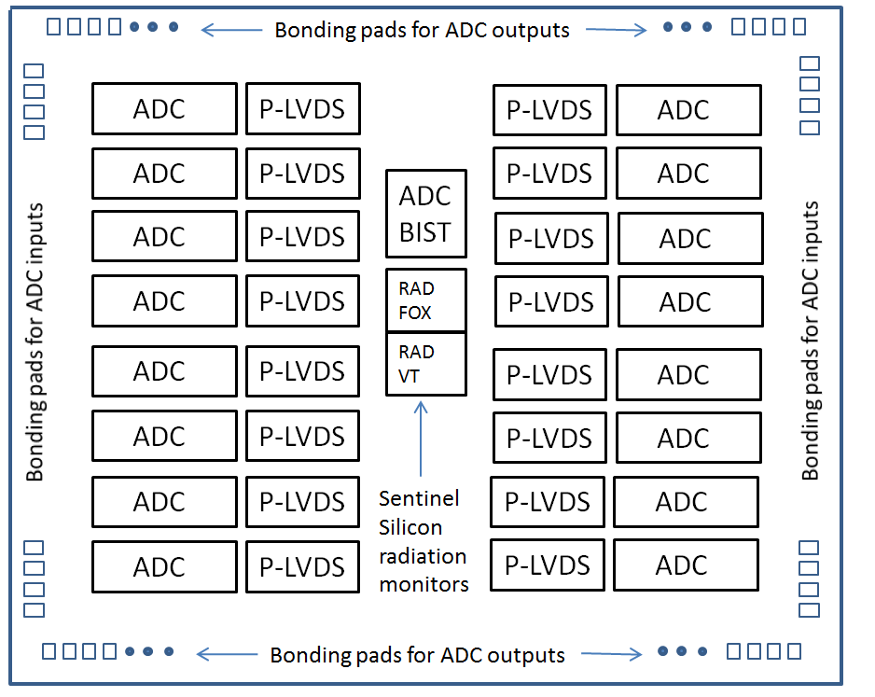
Chip Floorplan
The final chip will have 16 ADCs with parallel-to-LVDS converters and BIST circuits.

Slide 19

Ridgetop’s BIST IP
Rad-VT and Rad-FOX are degradation monitors for TID-induced V_{T} shifts and leakage currents.
ADC-BIST is a IP block that monitors degradation and shifts in ADC parameters.
ProChek is a test system that is used to characterize a fabrication process for high-reliability, rad-hard designs.

Slide 20
Schedule and Future Work
Task | Schedule
Increase sampling rate to 40 MS/s | September – December 2012
Optimize, layout and fabricate Test Chip #1 (one ADC channel) | January – April 2013
Test functionality of the ADC on Test Chip #1 | September – October 2013
Test radiation hardness of the ADC on Test Chip #1 | October – November 2013
Design, layout and fabricate Test Chip #2 (16 ADC channels) | May 2013 – January 2014
Test Functionality of the ADCs on Test Chip #2 | May - June 2014
Test Radiation hardness of the ADCs on Test Chip #2 | June – July 2014

Slide 21
Summary
12-bit, 40MS/s, 15mW radiation hardened pipeline ADC has been designed and simulated with transistor level models in the IBM 8RF process. The design uses 1.2V power supply and it is hard to more than 1.8Mrad(Si) of TID.
This ADC has been designed by Ridgetop Group Inc. in a U.S. DOE 9 month phase I SBIR program.
Phase II (2 years) has just started during which two test chips with complete ADCs will be designed, fabricated and tested.
We would like to give special thanks to the U.S. Department of Energy for funding and Dr. Andy Liu from SMU for consultation.

