Slide 1
Current CLIC Energy Stages

Slide 2
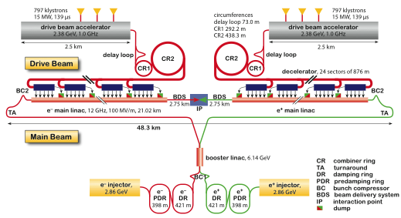
Layout at 3 TeV
Drive Beam Generation Complex
Main Beam Generation Complex

Slide 3
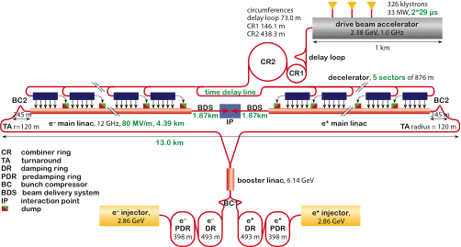
Layout for 500 GeV
Only one DB complex
Shorter main linac
Shorter drive beam pulse
Drive Beam Generation Complex
797 klystrons
15 MW, 2x29µs=58µs
2.5 km
Drive beam
Main beam
Main Beam Generation Complex

Slide 4
Potential CLIC Parameters Based on 3TeV
B. Dalena, D.S.

Slide 5
Potential CLIC Parameters Based on 500GeV

Slide 6
Potential CLIC Staged Parameters
First stage ML structures are re-used

Slide 7
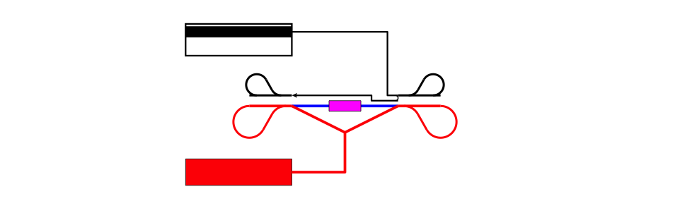
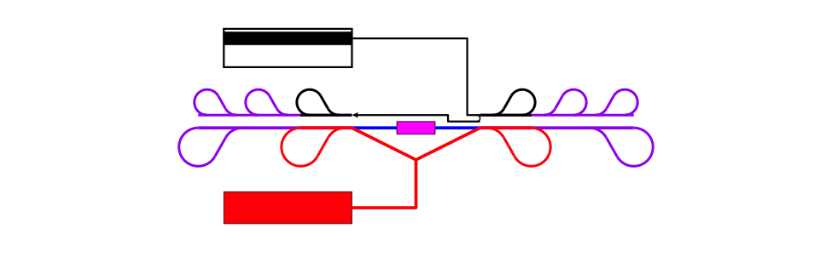
Concept First Stage
Concept! Not to scale

Slide 8

Concept Second Stage

Slide 9
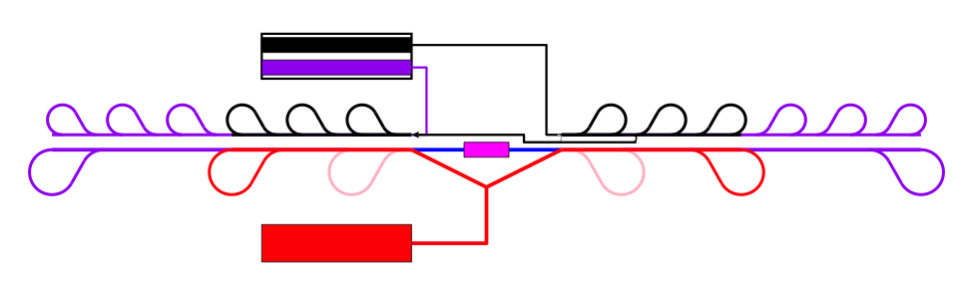
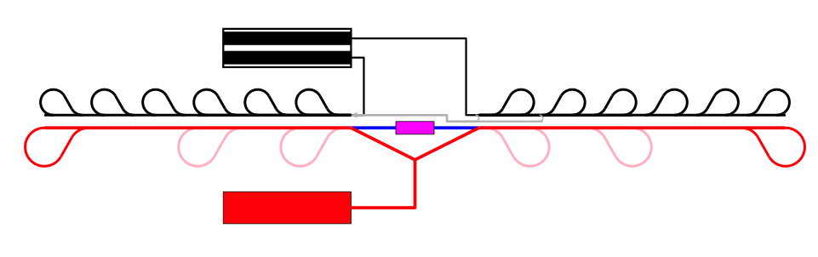
Concept Third Stage

Slide 10
Alternative CLIC Staged Parameters
First stage ML structures are not re-used

Slide 11
Workplan for First Stage
Decide on strategy for first stage
  Energies and luminosities required (physics)
  Accelerating structure
  PETS/decelerator, gradient
  Sub-staging strategy
Develop solution
  Lattice design
  Long transfer line lattice and integration into tunnel, if needed
  Performance studies, background, etc.

Slide 12
Sub-Stages: 1^{rst} Stage of CLIC
Could consist of two (three) installation sub-stages
Build tunnel long enough for top (or 500GeV), install only enough structures for Higgs and run
Then add structures for top and run
If needed add structures for 500Gev and run
Or build full stage
run only at full energy, i.e. top threshold or 500GeV
or run also at lower energies

Slide 13



Sub-stages
Baseline 500GeV
First sub-stage, option 1
First sub-stage, option 2

Slide 14



Low Energy Running
Baseline 500GeV
Reduced gradient
Early extraction, option 1
Early extraction, option 2

Slide 15
Natural First Stages
Some issue with energy granularity
Current 500GeV structures require 16% more power than 3TeV structures
just live with it
reduce gradient and main beam current by 8%
reduce the number of PETS per decelerator and drive beam energy by 16% (check decelerator stability)
No of decelerators | potential | 80/1.07 MV/m | Fewer structures
3 | 316 | 294 | 275
4 | 415 | 386 | 361
5 | 515 | 478 | 446
Note: a small problem with the fill factor needs to be overcome

Slide 16
Natural First Stages
Some issue with energy granularity
Current 500GeV structures require 16% more power than 3TeV structures
just live with it
reduce gradient and main beam current by 6.5%
reduce the number of PETS per decelerator and drive beam energy by 13% (check decelerator stability)
No of decelerators | baseline | 80/1.065 MV/m | Fewer structures
3 | 307 | 290 | 275
4 | 404 | 380 | 361
5 | 500 | 471 | 446
Note: using current 500GeV lattice design

Slide 17
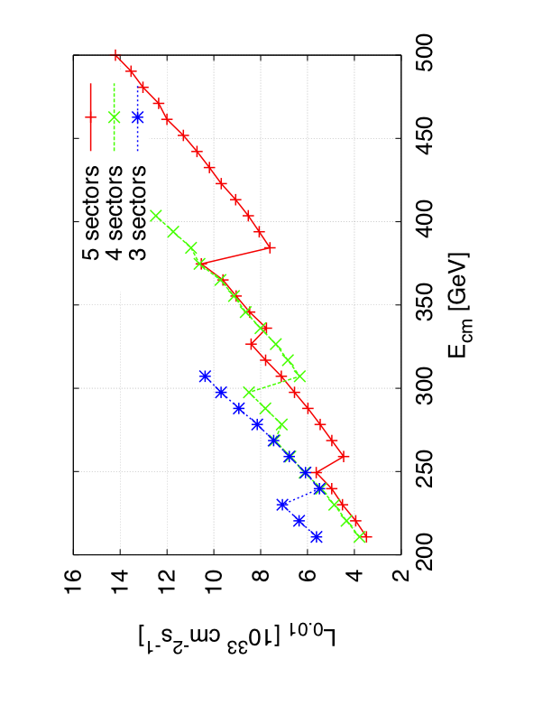
Luminosity at Lower Energies
Baseline design
Energy changed by gradient scaling
Cases with less used sectors and scaling
Little gain at 250 and 350 GeV

Slide 18
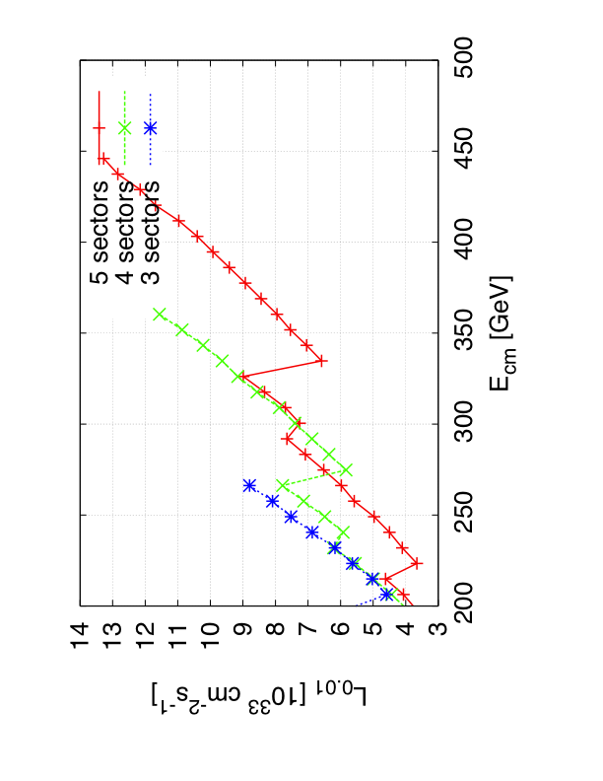
Luminosity at Lower Energies II
Reduced structure number design
Energy changed by gradient scaling
Cases with less used sectors and scaling
Some gain at 250 and 350 GeV

Slide 19
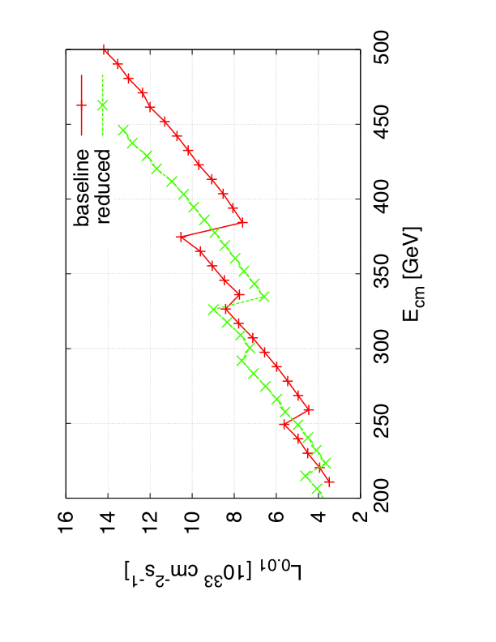
Luminosity at Lower Energies
Baseline vs. reduced structure number design
Energy changed by gradient scaling
Baseline is slightly better at 250 and 350 GeV

Slide 20
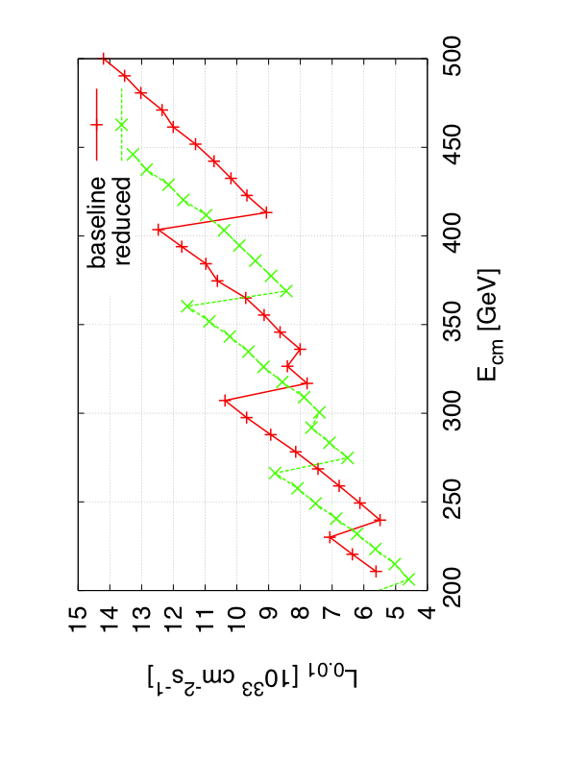
Luminosity at Lower Energies
Baseline vs. reduced structure number design
Energy changed by early extraction and gradient scaling
Reduced number of structures is somewhat better at 250 and 350 GeV

Slide 21
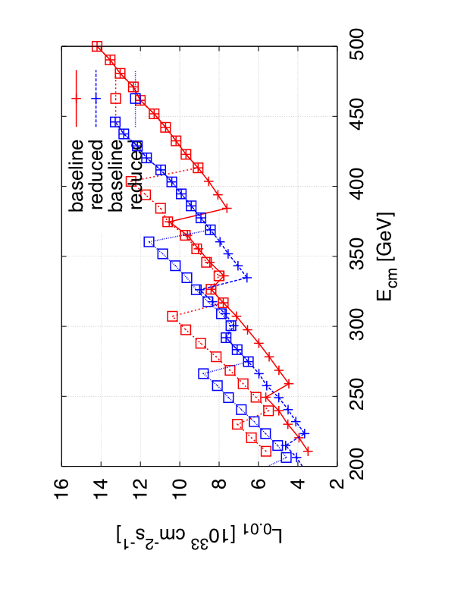
Luminosity at Lower Energies
Baseline vs. reduced structure number design
Energy changed by gradient scaling and early extraction
Little gain at 250 and 350 GeV

Slide 22
E_{cm} | Baseline scaling | Baseline extraction | Reduced scaling | Reduced extraction
250 GeV | 6.2 / 5.6 | 7.5 / 6.1 | 5.6 / 4.9 | 9.6 / 7.5
350 GeV | 10.7 / 8.5 | 11.8 / 8.6 | 10.0 / 7.5 | 15.9 / 10.8

Slide 23
Workplan for Second Stage
Need to understand if we can have physics input
  Can only use knowledge derived from LHC and first stage experiments
  Will then try to find a technical solution
Otherwise need to use a technically justified second stage
  E.g. go up to the maximum energy with one drive beam accelerator, i.e. about 50% of the final energy (current choice)
  Or define step to have good luminosity at any energy between first and full second stage energy
    But would need some figure of merit/operational requirements for this
  Will need to develop scheme to run at different energies
    Have one for the final stage, but needs to be reviewed for second stage

Slide 24
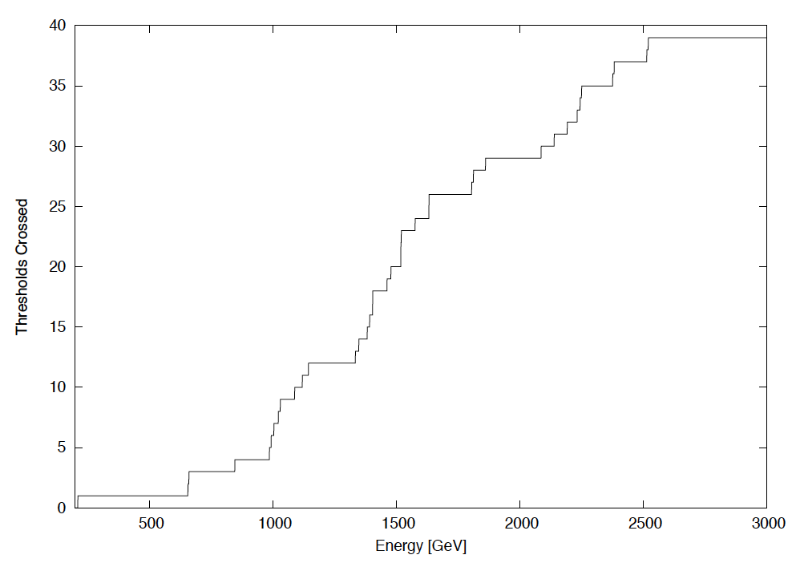
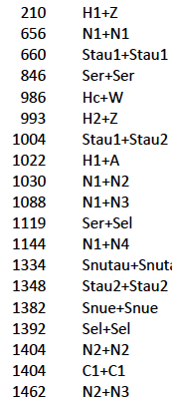
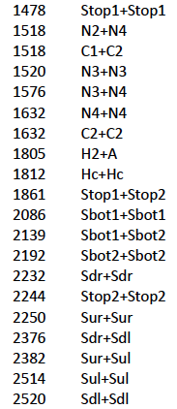
Thresholds Crossed as a function of Energy (GeV)

