Slide 1
ISOLDE Powering and ELENA
David Nisbet

Slide 2
Intro
Introduction - powering the ISOLDE complex
DC Systems v pulsed systems
Powering Bends, Quads and Steerers
Controls and diagnostics
Estimate of ELENA requirements
Conclusions

Slide 3
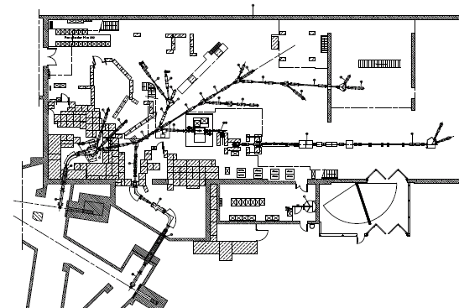
Introduction - powering the ISOLDE complex
Machine layout

Slide 4
Introduction - powering the ISOLDE complex
The ISOLDE complex, with many beam lines, is a diverse user of beams, beam treatment and experiments
Currently the entire complex uses >500 systems under the management of TE-EPC
  Grouped into >50 different types
  Range from [10V to 60kV] and [500uA to 1kA]
The many beam treatments in the complex leads to a large diversity of equipment (see Fredrik Wenander presentation)
  Also due to the historical ‘growth’ of the complex through CERN and non-CERN developments

Slide 5
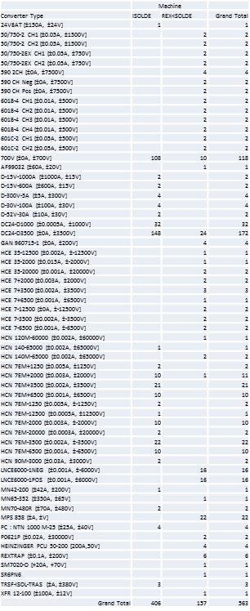
Introduction - powering the ISOLDE complex
The power converter types at ISOLDE

Slide 6
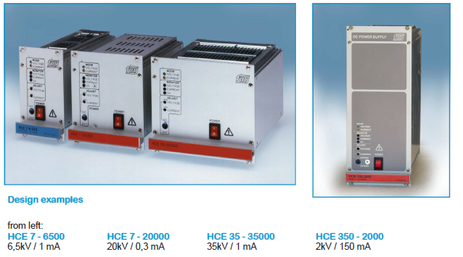
DC electrostatic powering
Recommendation
  Minimise the flavours found in the accelerator
  Cheaper; easier to operate and maintain;
As the systems are DC
  Very low power is required
  Systems are physically small -> up to 30 per rack

Slide 7
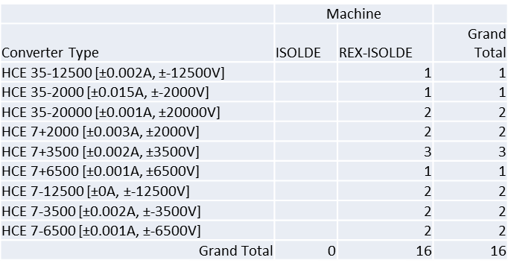
DC electrostatic powering
The power converter types used for ISOLDE transfer lines and recommended for use on future projects
If the proposals don’t fit with the accelerator needs
  Straight forward to extend up to 35kV and 35W
  Try to standardise!
http://www.fug-elektronik.de/webdir/PDF/e/e_datasheet_HCE.pdf

Slide 8
Pulsed electrostatic powering
Additional constraints on the choice of power converter
  Power source needs to sink and source current quickly
  Peak current and power is much higher
  The voltage rise and fall time is a critical parameter
  Not available ‘off the shelf’ from commercial suppliers
EPC currently have very few pulsed systems in the ISOLDE complex
Kickers are required for ejection from ring and into experimental areas
These are generally the responsibility of the TE-ABT group
  Check if the ABT group already have appropriate technology
ELENA will probably need pulsed quads to compensate dipole effects
  Typical solution would switch rapidly between 2 DC sources using semiconductor switches; other solutions can be envisaged.
  Synergy with kicker technology? Otherwise some development required.

Slide 9
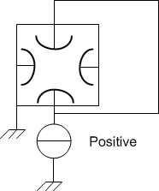
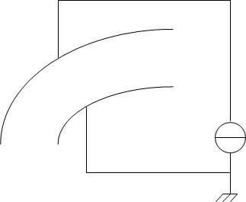
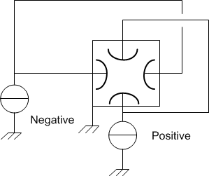
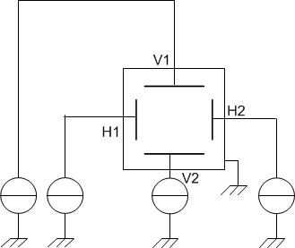
Powering bends, quads and steerers
Preferred configurations if permitted by optics:
1x unipolar
1x unipolar
4x unipolar
Bending configuration
1x negative
1x positive
Quad configurations
Steerer configuration

Slide 10
Controls and diagnostics
For DC systems, we currently use PLCs in the ISOLDE complex
  Provides a slow control and acquisition solution for general monitoring
  Acquisition of output voltage and power system state is generally sufficient
  Specification of setpoint and measurement performance? 10⁻⁴ resolution and 10⁻⁴ absolute ?
Acquisition of Pulsed Systems
  In addition to the slow (PLC) control, triggers and fast acquisition are required
  Standard solutions available from the CO group would typically be used
  Check also synergies with the TE-ABT group

Slide 11
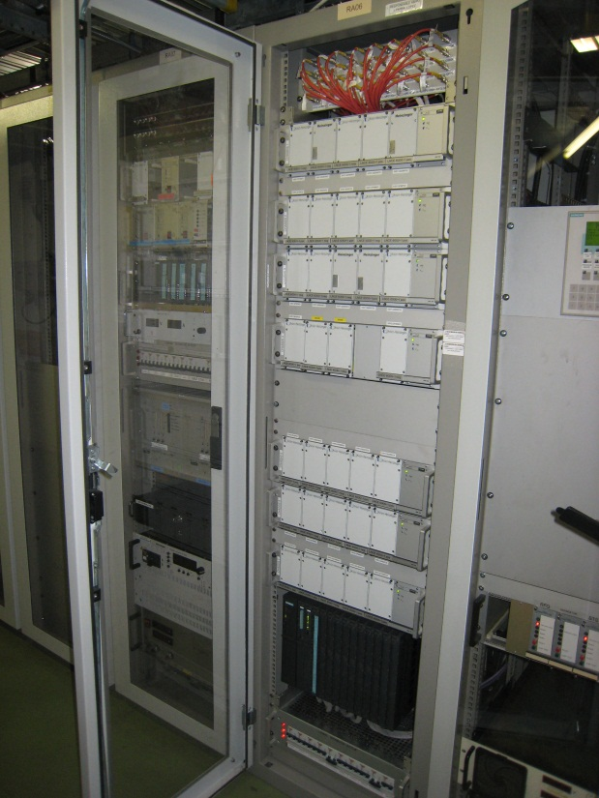
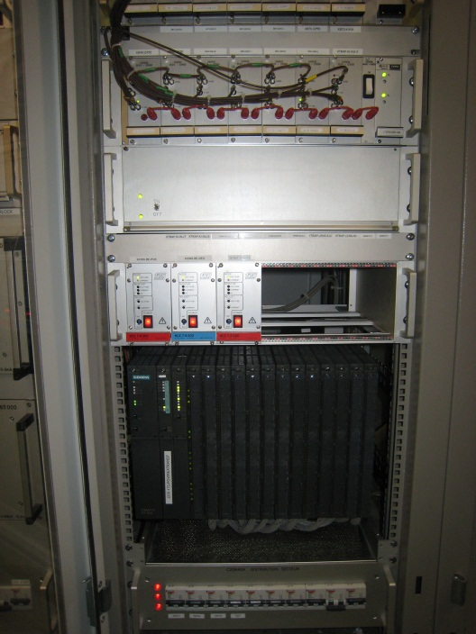
An ELENA TL shopping list for power
Function | Machine Qty | PC Qty | 19” Racks
Quads | ~20 | ~20 – 40 | ~2
Bends | ~6 | ~6 | ~0.25
Steerers | ~20 | ~80 | ~3
Pulsed | ~5 | ~10 | ~1
Approx budget: 500 kCHF

Slide 12
Conclusions
Simple approach is best for the many small DC power sources required
  Only a few types need to be considered compared to ISOLDE complex
  Straightforward to extend to 35kV for modest cost
Pulsed approach needs much more care
  Load capacitance, switching times, diagnostics
  Possibly the TE-ABT group have a solution ready to go?
Consideration should be given to diagnostics requirements
  Acquisition rate and acquisition performance (eg 10⁻⁴ absolute measurement performance required?)

