Slide 1
2012 Injector Schedule
K. Hanke / OP Days 2012

Slide 2
OP day

Slide 4
early start-up, late stop
4 technical stops / MD blocks
number of floating MDs
ion run in the middle of the year
FT experiments and LHC are trying to get most out of it before LS1

Slide 5
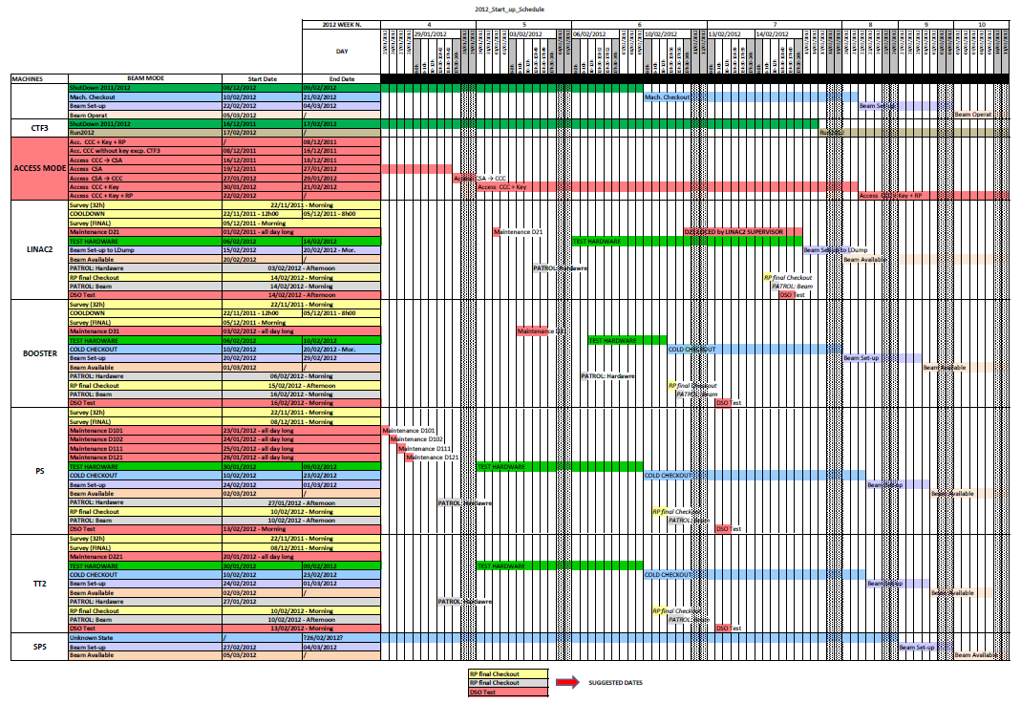
Detailed Start-up Schedule for the Injector Complex (F. Chapuis)
FOM 44 (2011) https://espace.cern.ch/be-dep/FOM/Minutes%202011/11-29-2011.pdf

Slide 6
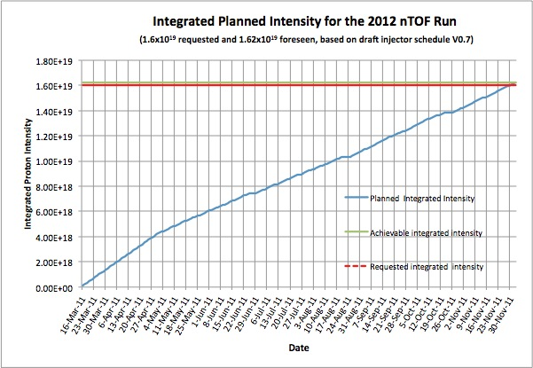
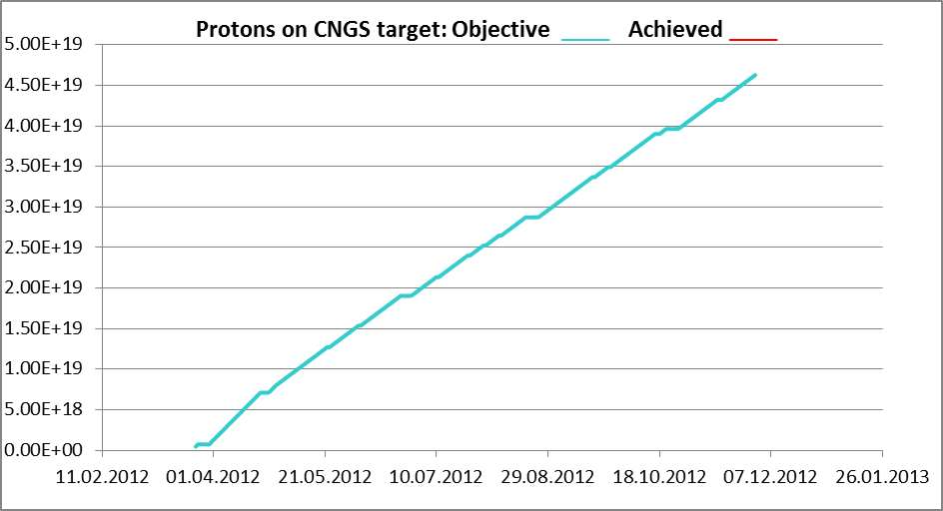
2012 Challenges
ISOLDE
key dates:
protons to ISOLDE 26/3
ISOLDE physics 2/4
end of protons 3/12
many REX runs scheduled before LS1
20 experiments, 250 shifts
priority: 8 experiments, 164 shifts
preparation for HIE-ISOLDE
D. Voulot
R. Steerenberg
Estimation for protons on CNGS for 2012. The run with bunched beam is not taken into account.
K. Cornelis

Slide 7
Hope to see you soon at the first FOM 14/2 (after Chamonix)

