Slide 2
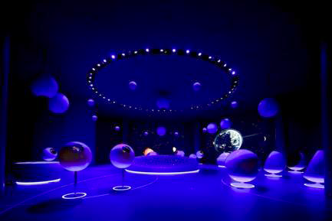
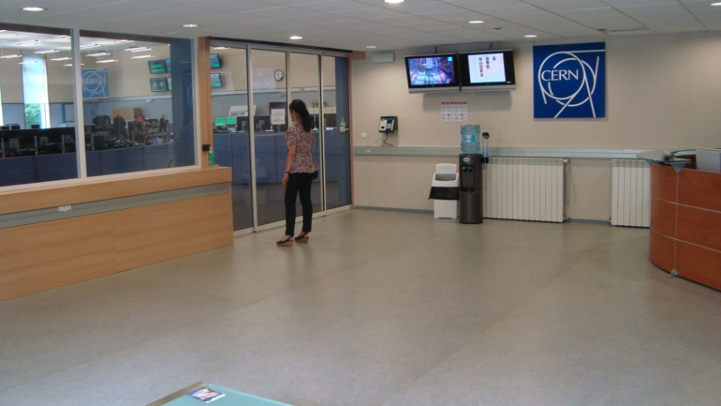
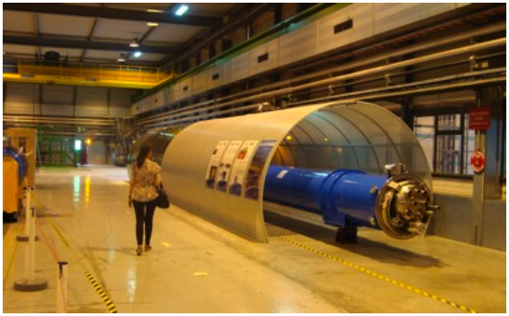
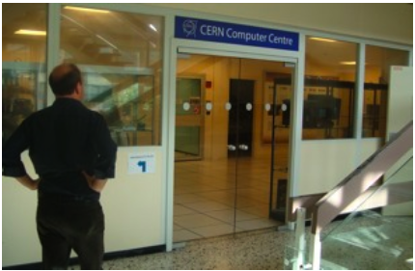
Cern visit points
The Universe of Particles exhibition is an excellent starting point for a visit, but the primary motivation for visitors to CERN is to see science in action, the reality of CERN’s cutting-edge research.
CERN wishes to apply a similar approach to three of its most popular visit sites:
The CERN control centre (CCC), the superconducting magnet test facility (SM18), and the computer centre (CC) where all data is recorded and distributed world-wide for processing.

Slide 3
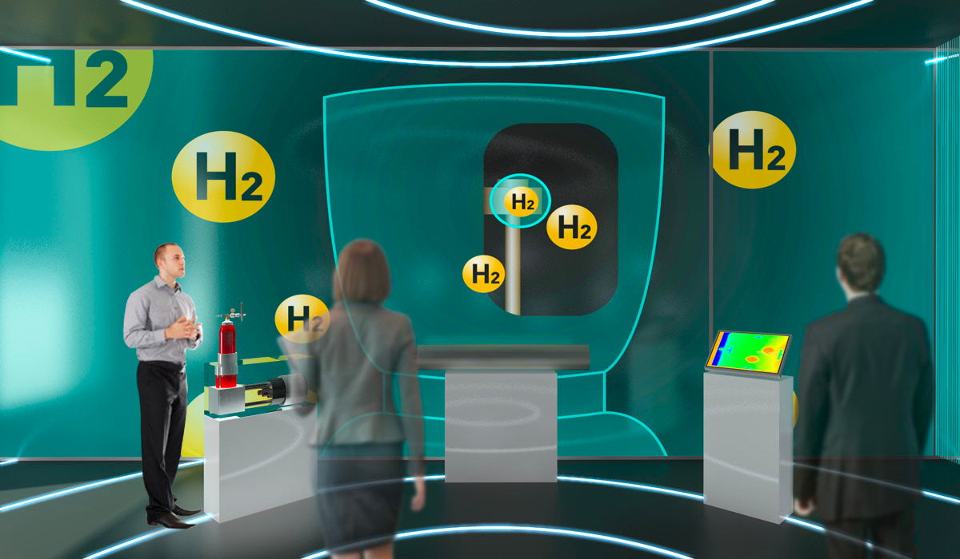
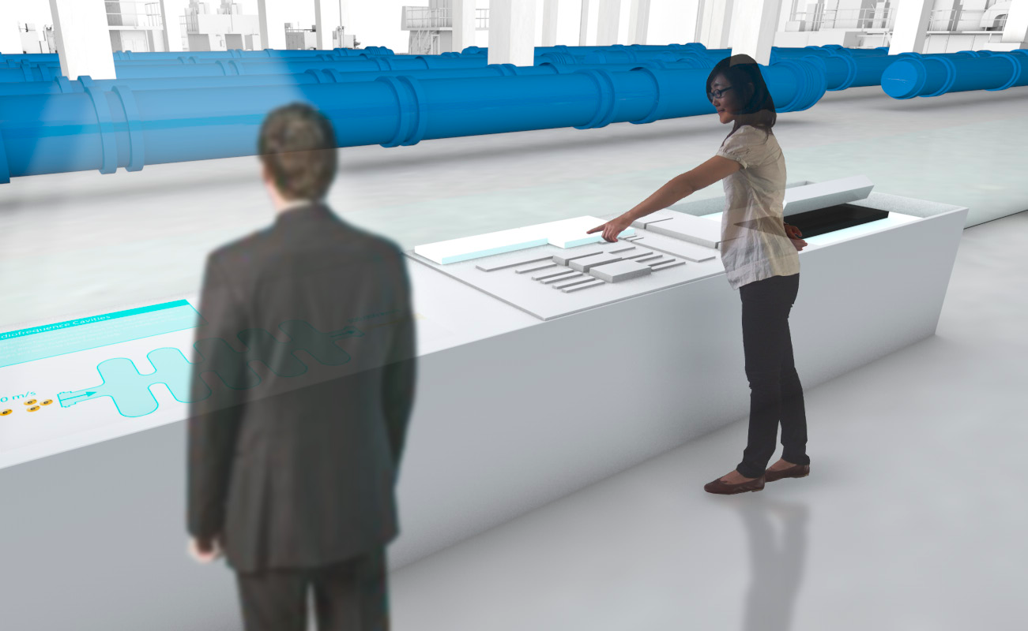
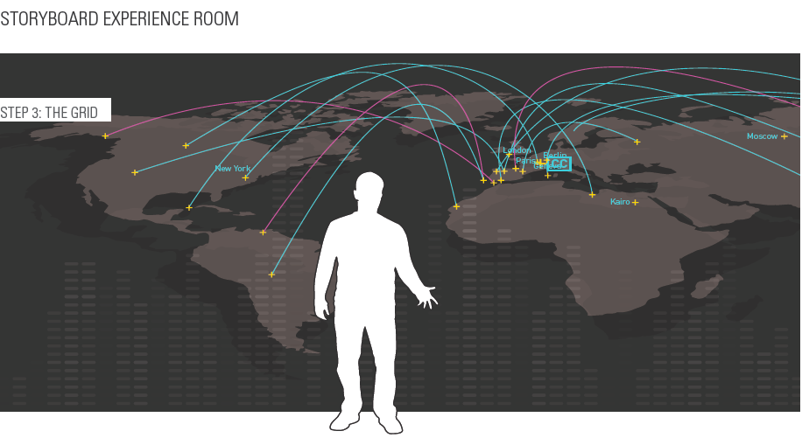
Cern visit points
CERN is seeking an innovative exhibition design.
The design team should combine creative excellence with cost consciousness.
Visit sites are working laboratories and this places constraints on visitor flow.
Visit flow shall not disrupt the normal work of the site, nor place visitors in a situation of
danger (proximity to high voltage, overhead cranes etc.)
New content shall include interactive technology and also the display of real objects to reveal hidden parts of the equipment on show.
Audiovisual material shall be used to bring the technical explanations to life.
Visit experience shall reinforce the idea that CERN is a centre of excellence
CCC
SM18
CC

Slide 4
Project schedule
Project study launched 2010
Market Survey July 2011
Invitation to tender September 2011
Evaluation of tender reply October 2011
• Assignment: December 2011
• Delivery of primary content: January - March 2012
• Schematic Design: February - March 2012
• Delivery secondary content: March -May 2012
• Detailed Design: April - June 2012
• Base Built Works: June - August 2012
• Sign off Detailed Design: June - July 2012
• Final Content Delivery: June - August 2012
• Production Mock ups: July - August 2012
• Production off site: August - October 2012
• Installation on site: Sept.-November 2012
• Hand over / Tests: December 2012

Slide 5
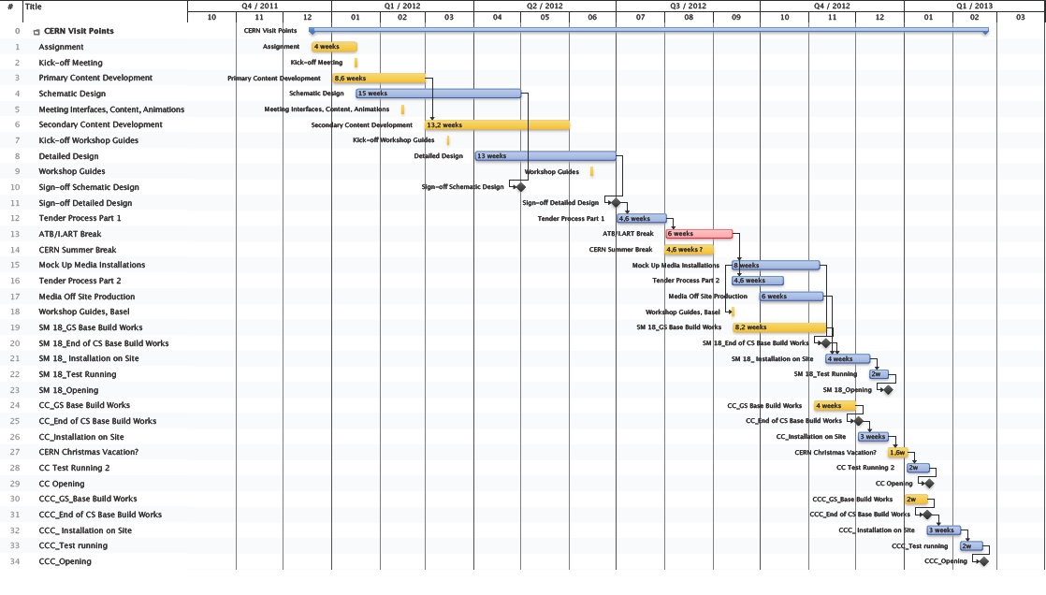
Schedule CERN Visit Points

Slide 6
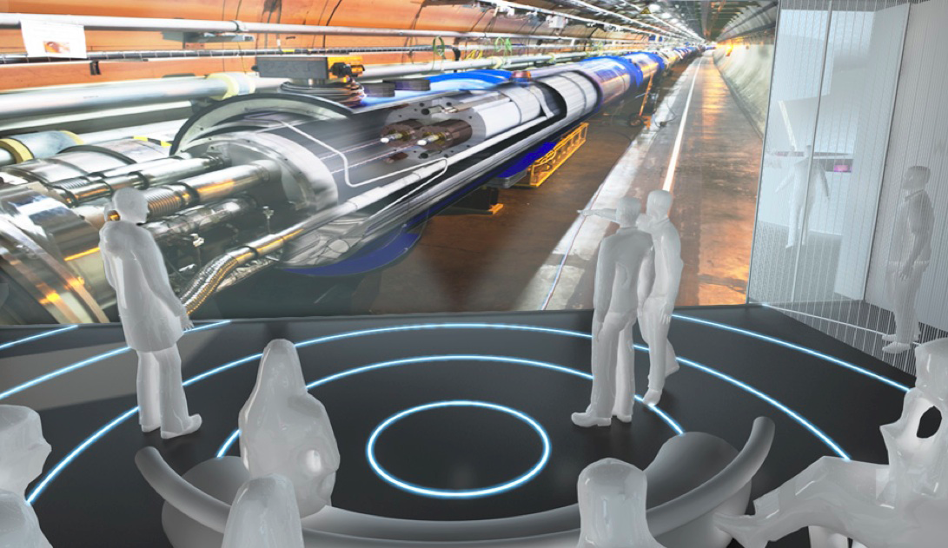
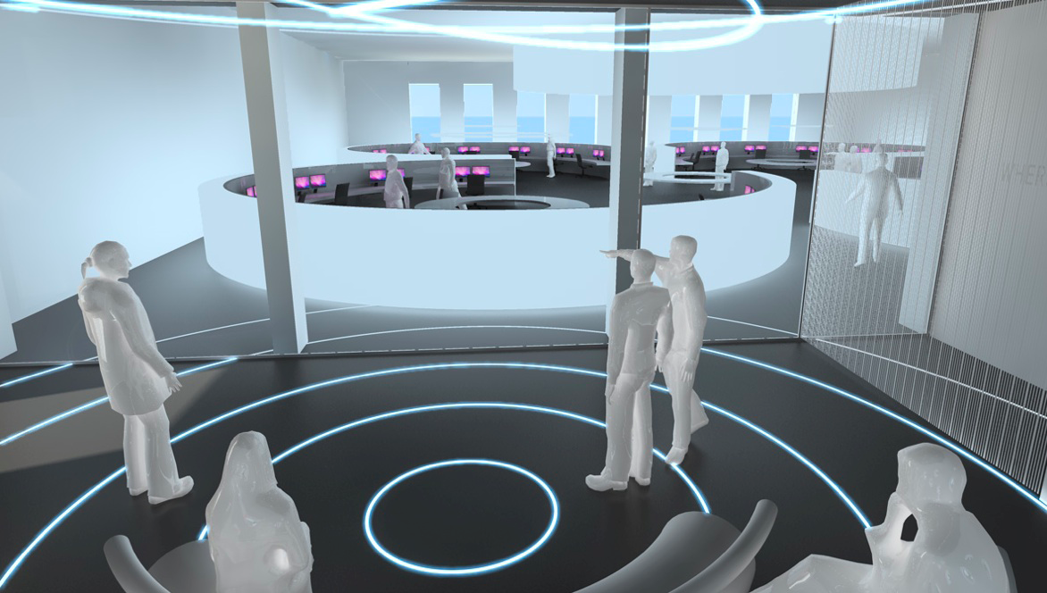
Projection wall
The main new features in the modified CCC entrance would be:
A ʻprojection wallʼ made of ʻintelligent glassʼ, that would replace the wall between the entrance room and the CCC, except for the existing sliding door entrance of the CCC.
The ʻintelligent glassʼ can be switched between two states: either opaque (during projection) or transparent (to show the CCC). Its surface is multi-touch sensitive allowing to move/enlarge/shrink objects, start/stop animations or videos, etc.

Slide 7
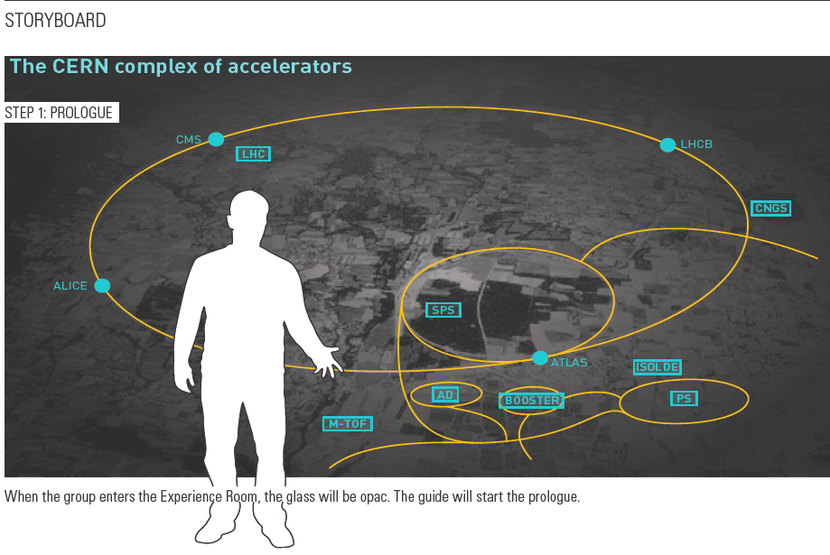
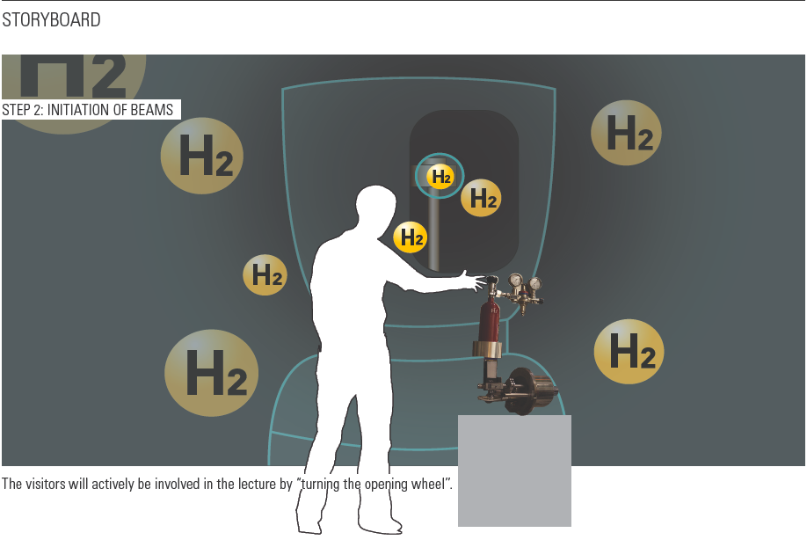
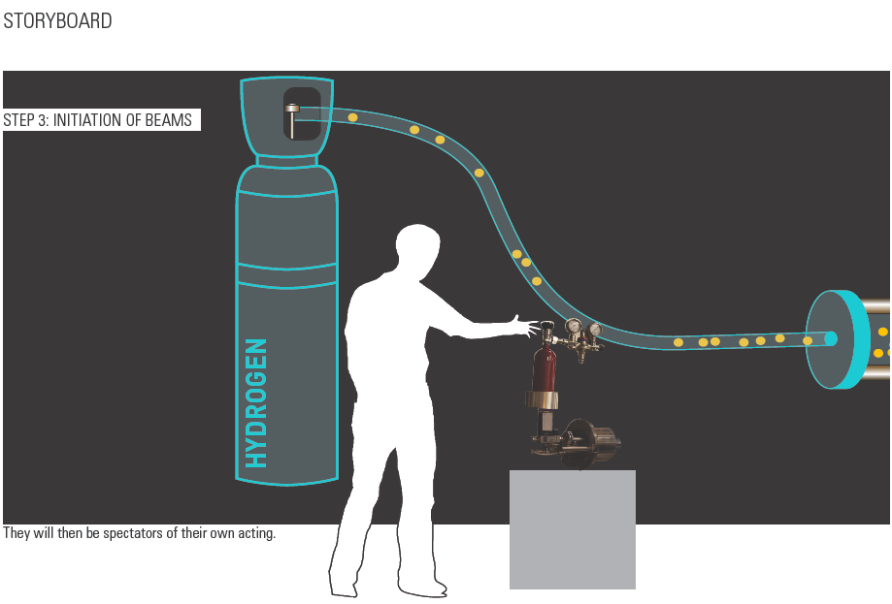
CCC visit point

Slide 8
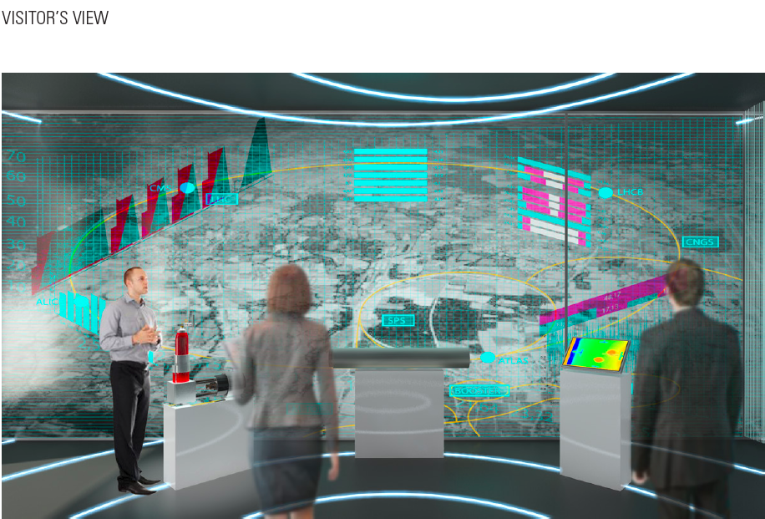
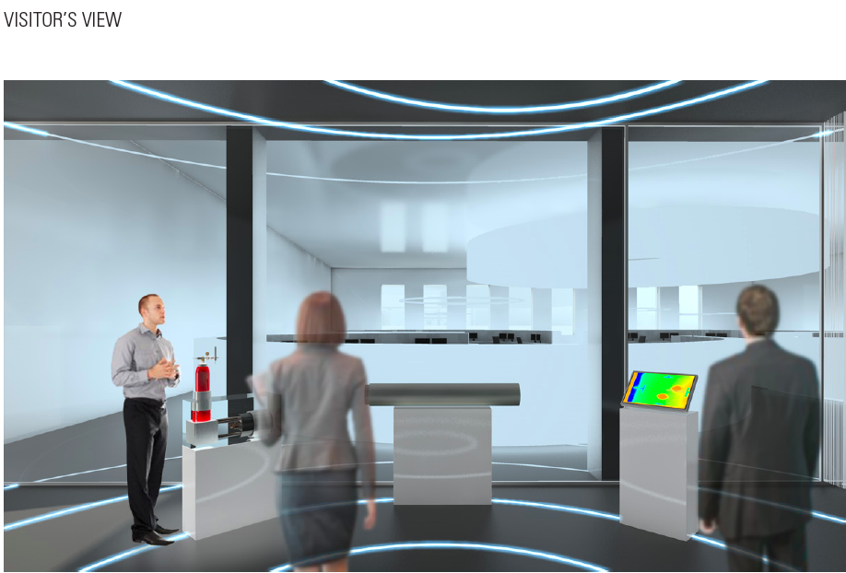
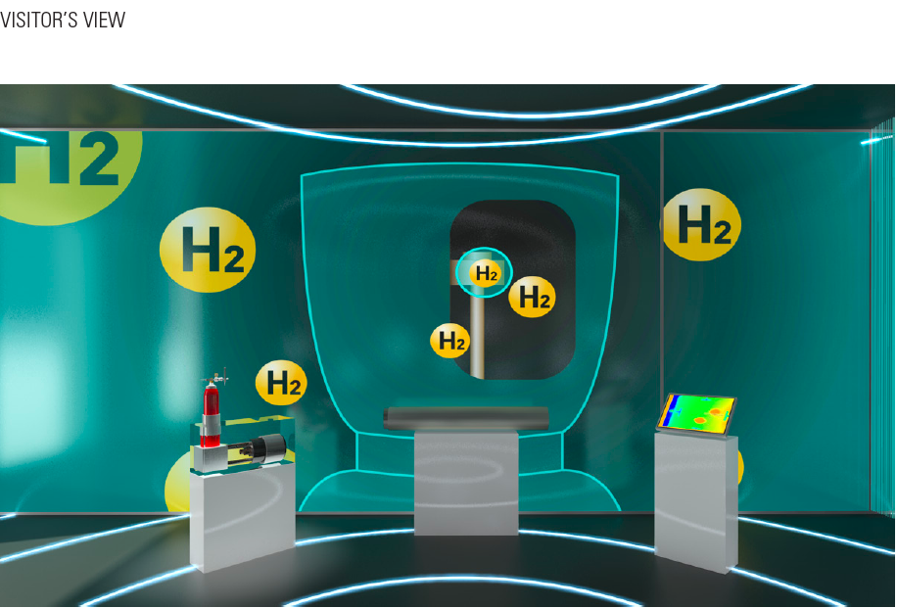
CCC visit point
A projection wall made of intelligent glass

Slide 9
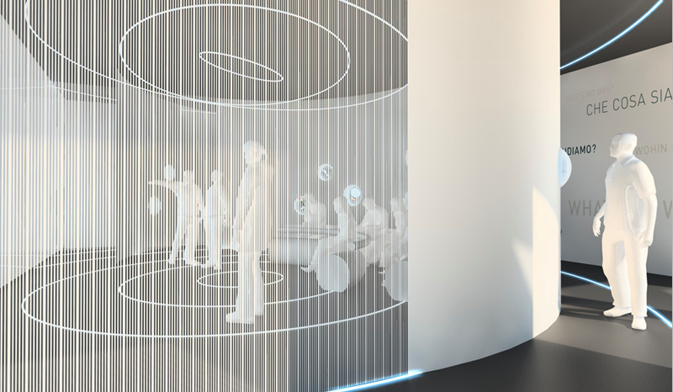
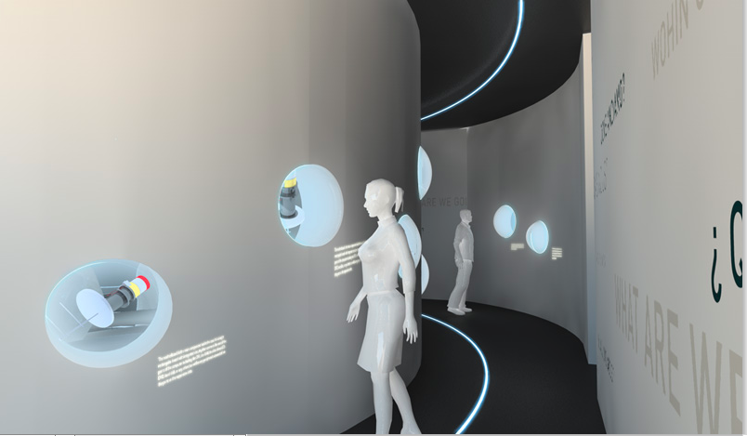
Architectural concept
An access corridor to reach the CCC during visits, plus sliding doors (or curtains) to separate and to darken the presentation room during visits.

Slide 10
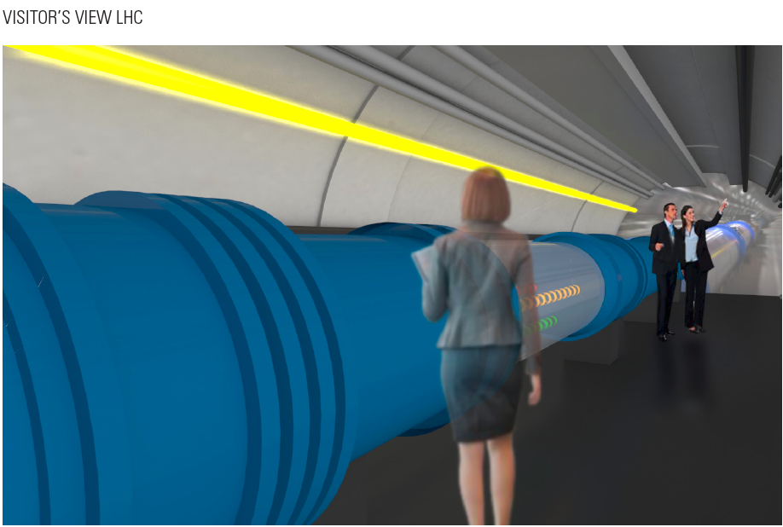
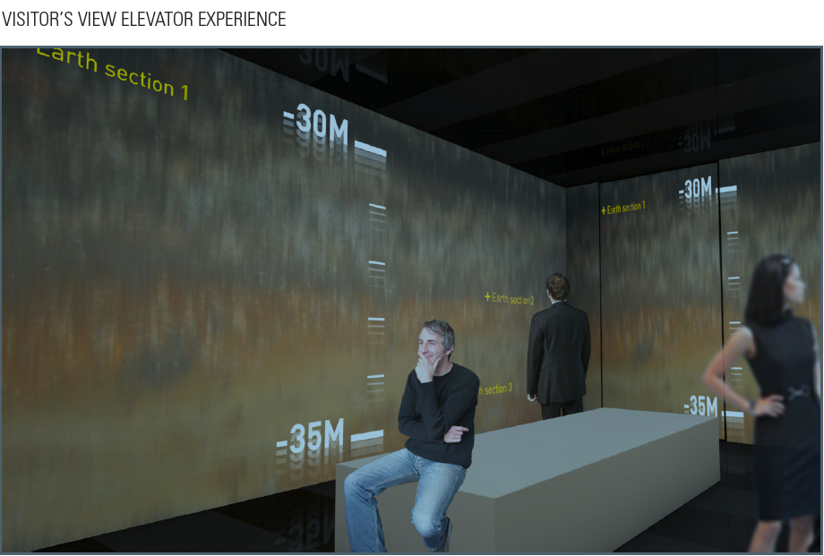
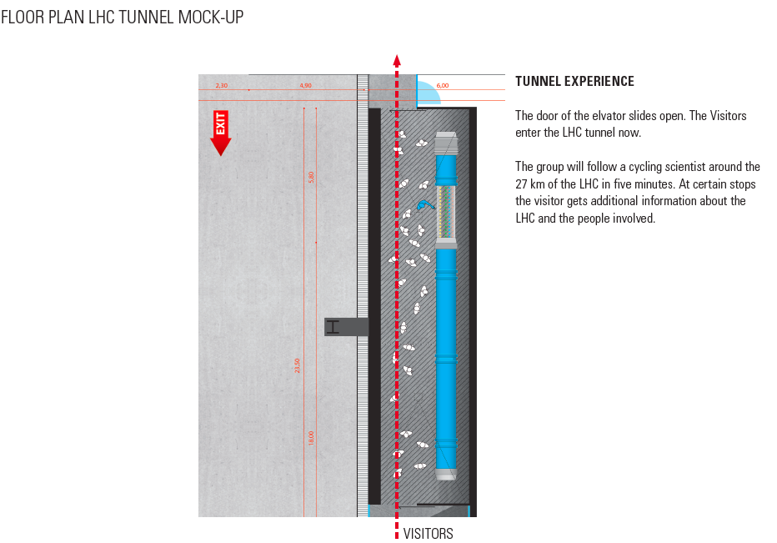
SM 18 visit point

Slide 11
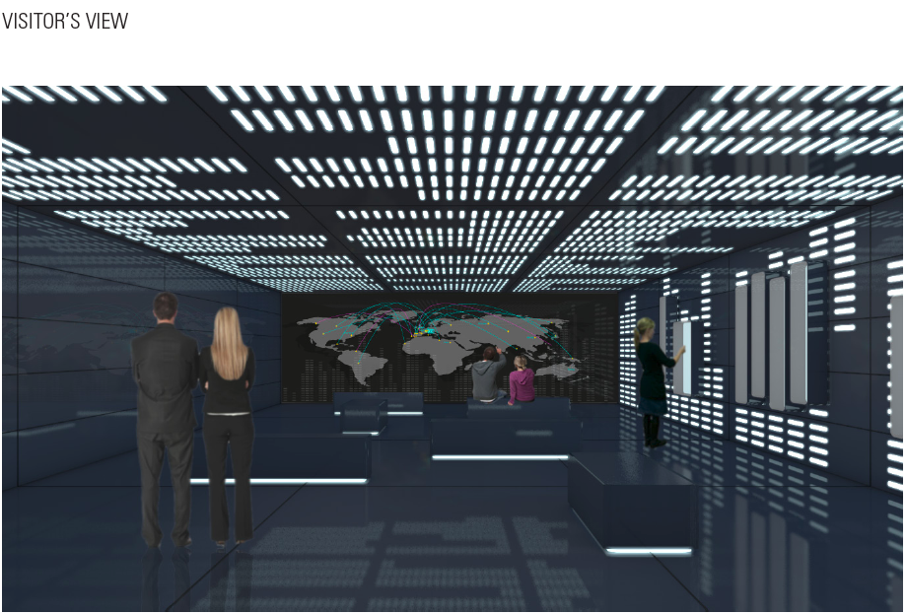
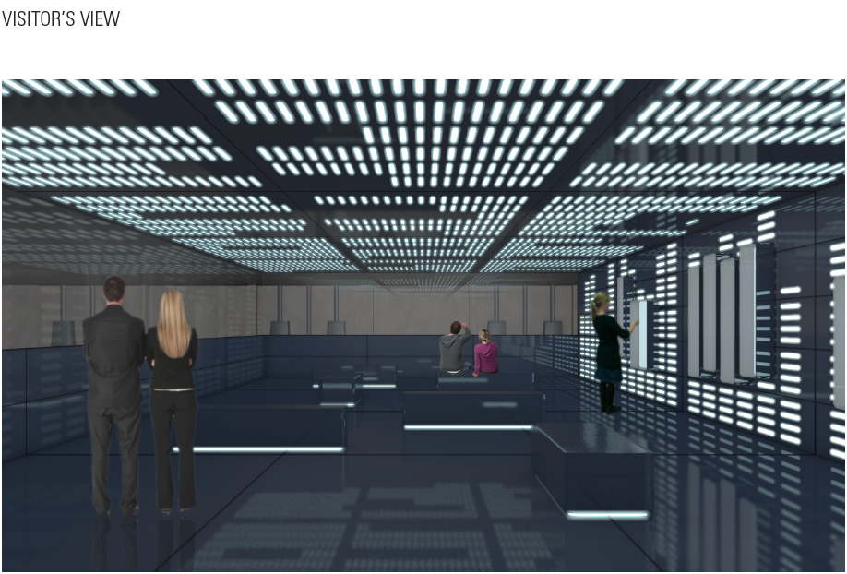
CC visit point

Slide 12
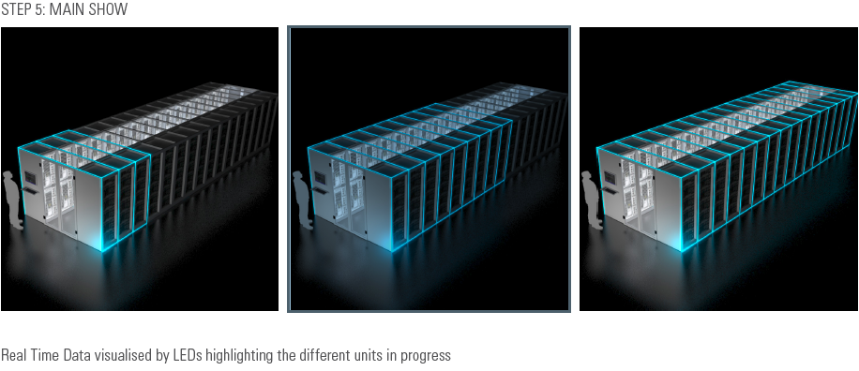
CC visit point

Slide 13
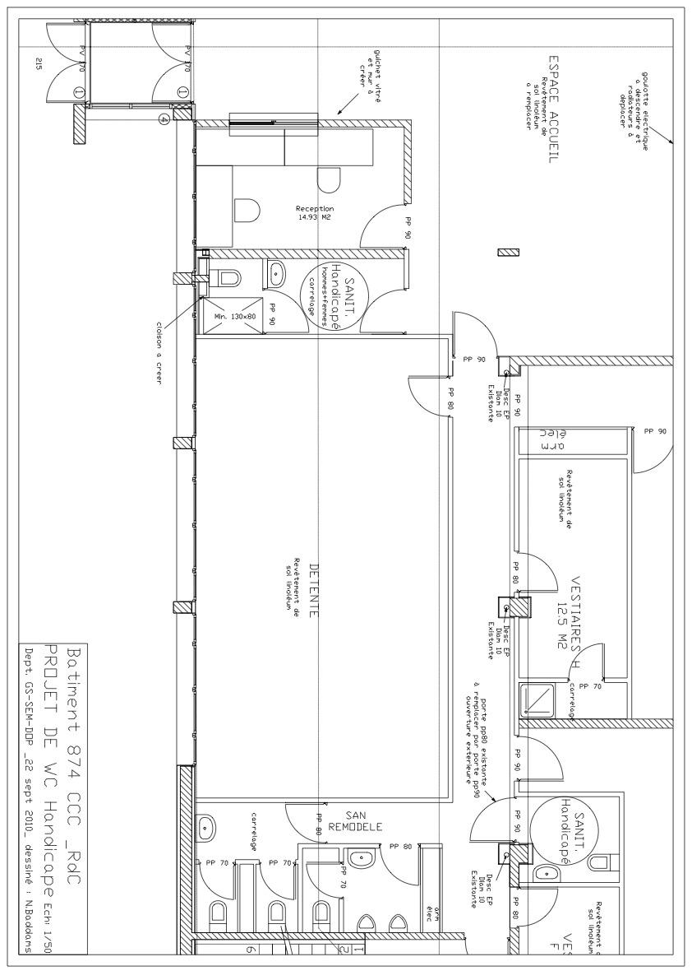
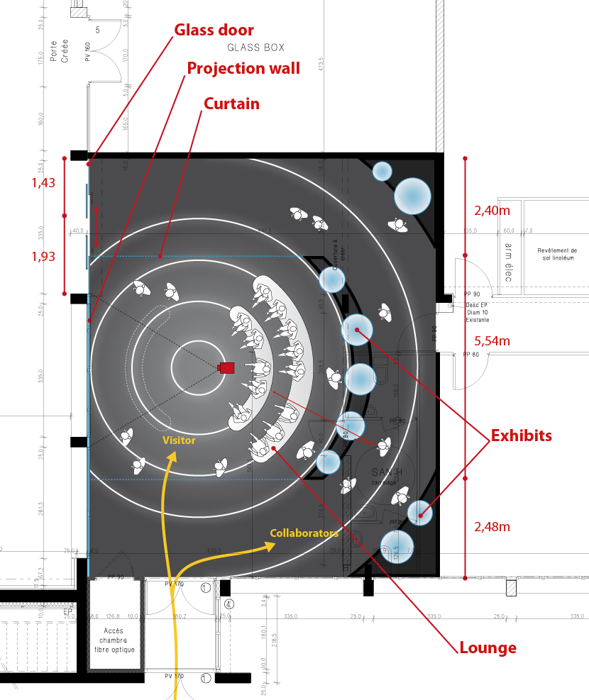
Civil engineering
Modification needed
The present toilet in the entrance will be dismantled. (GS/M.Poehler)
The secretary place will be moved into the CCC. (OP)
○ Handicap toilet will be moved into the corridor on the left side. (GS/M.Poehler)
The main entrance door will be modified. GS/M.Poehler)
Visitor
Centre
H
S
kitchen
wc
H WC
E

Slide 14
Civil engineering
H
Entrance

Slide 15
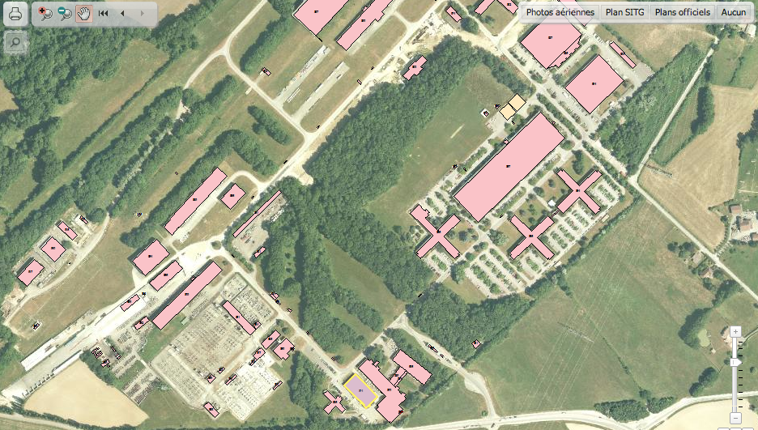
Bus parking
p
CCC
Possible solutions without additional civil engineer. Guided Visit’s will arrive either with private Bus or Cern Bus, both could reach a parking area nearby and be called IN when the visit is finished.

Slide 16
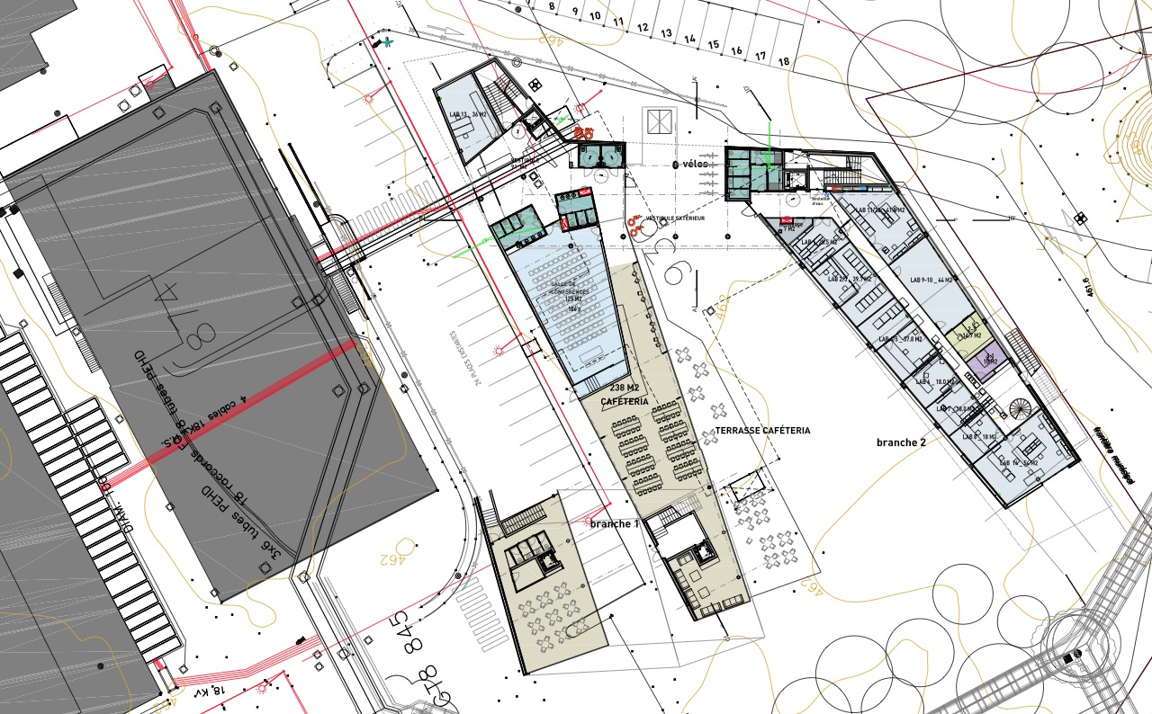
BE is in the Building Business!
Bldg 774
Replacing the Pavillon

Slide 17
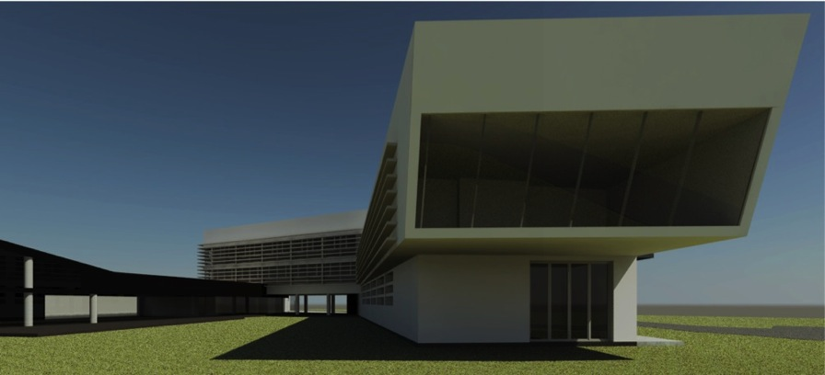
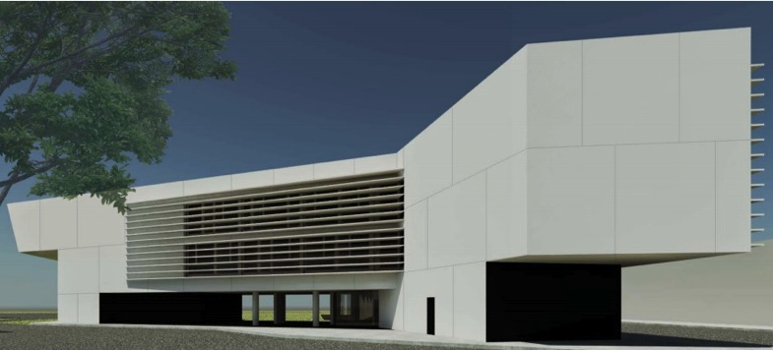
Building 774
Will contain:
Cafeteria
Visitors Facilities
Auditorium
All of BE-CO
Parking ‘round the back’
‘Green’ technologies
Present Status:
Directorate has given the green light for the market survey
FC adjudication in June 2012
Construction starts July 2012!
Completed Nov. 2013
Complimentary to the CCC visitors project

Slide 18
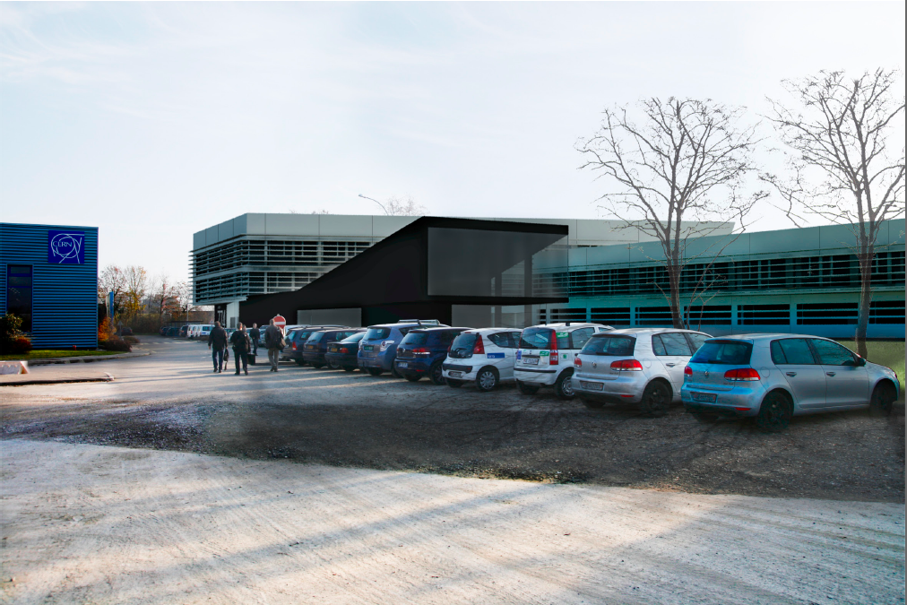
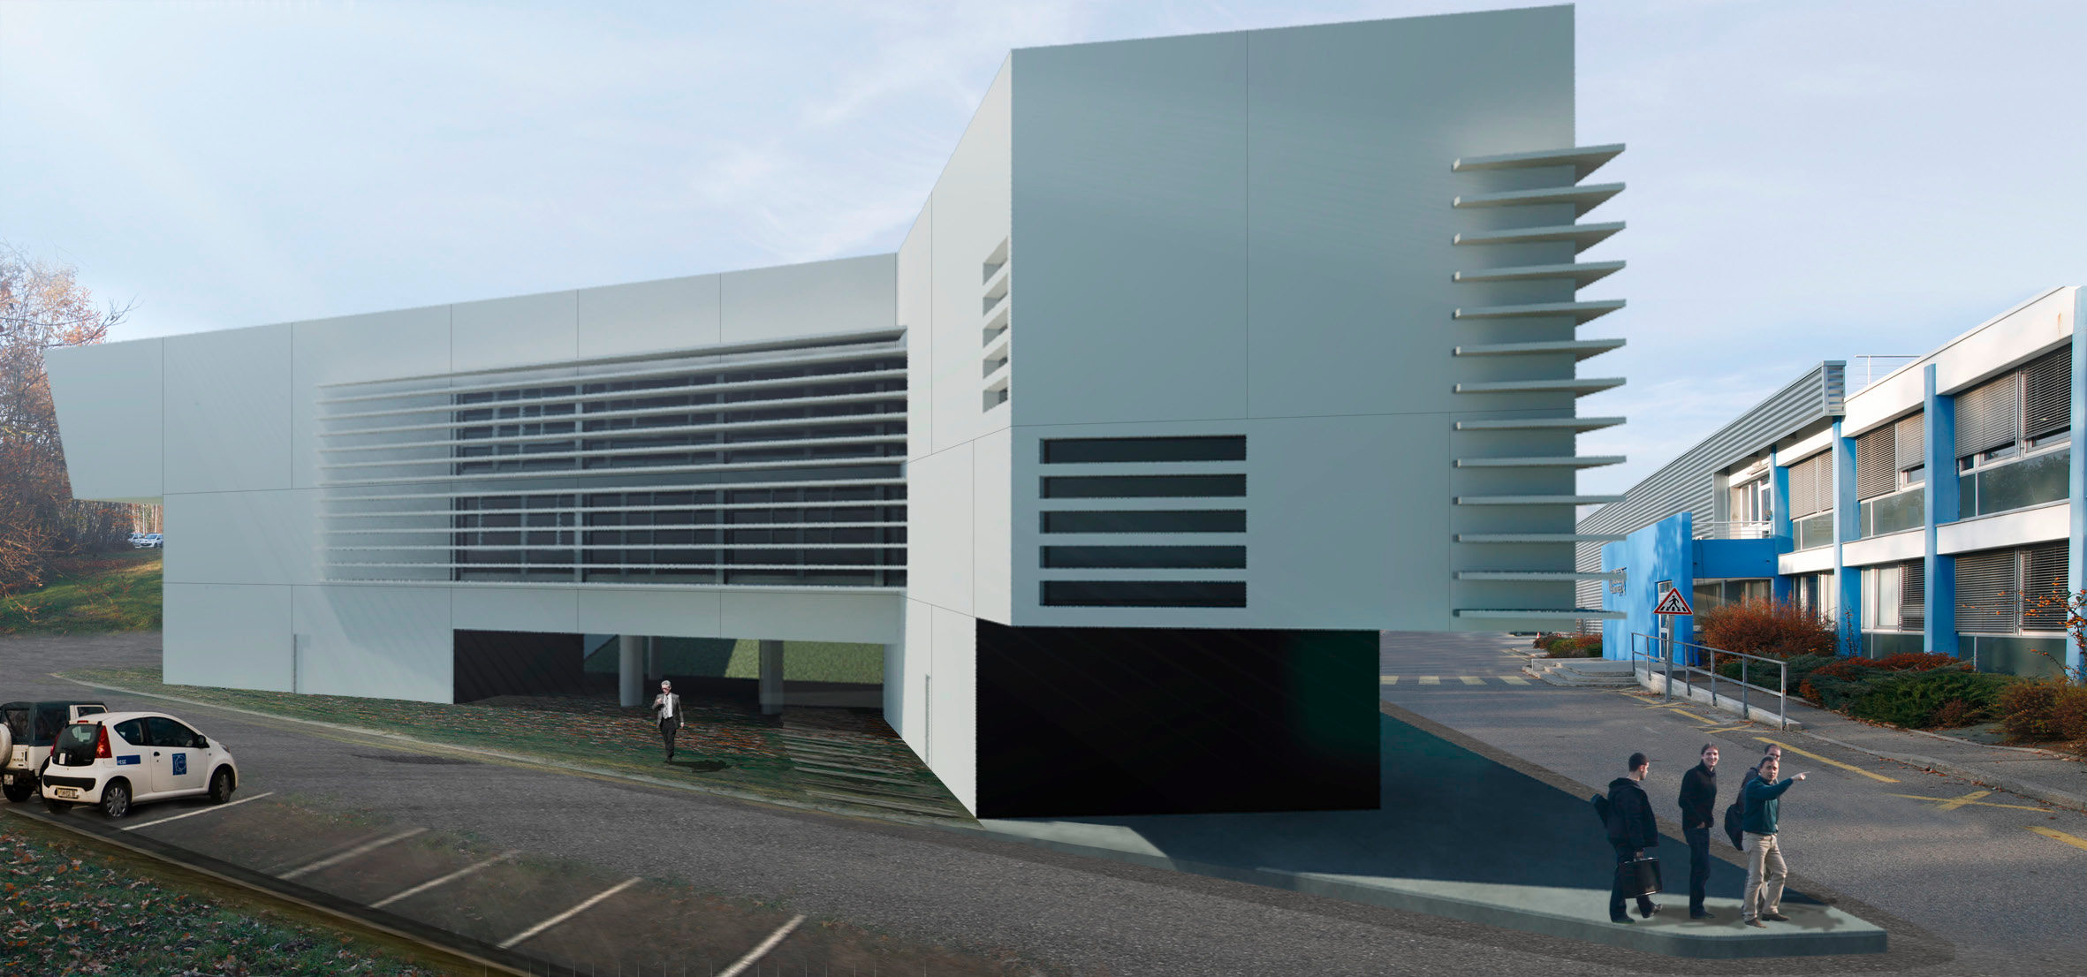
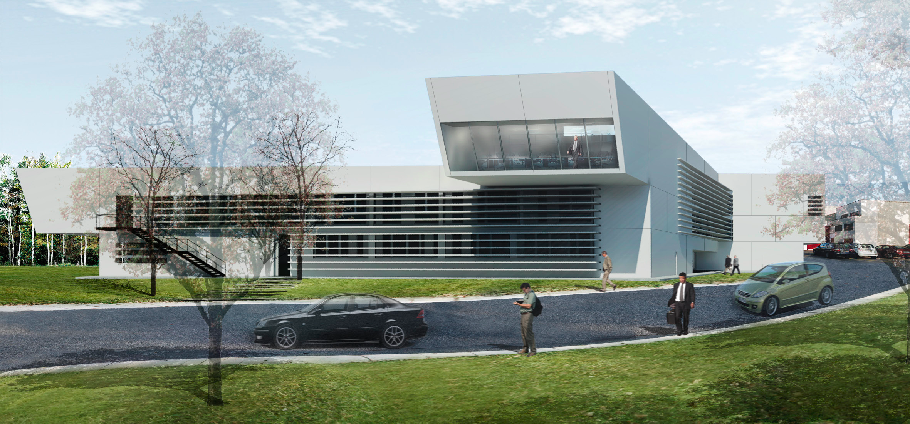
Building 774
Thank you

Slide 19
Thank you

Slide 20
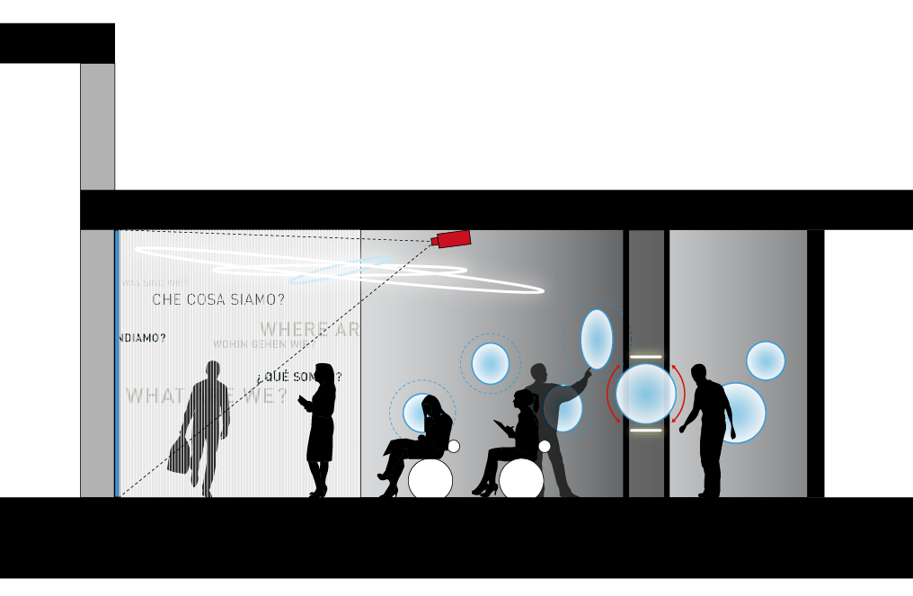
Functional concept
A cross section view to illustrate the main passages into the CCC outside visits time,
and the alternative passage when visit’s occurs.

Slide 21
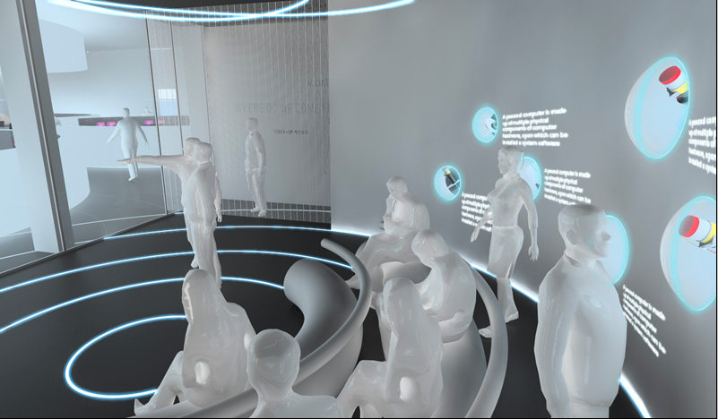
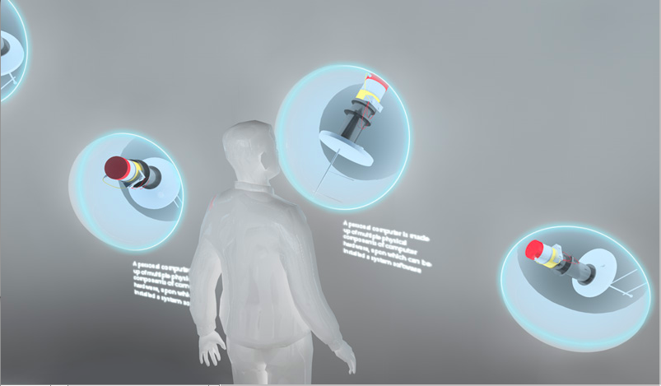
Accelerator hardware tool
Exhibition spheres integrated into separation wall - they contain real objects that are connected to the CCC (e.g. beam diagnostics, extraction elements, etc). For each of these objects, a short animation exists that guides can show when they talk about it.

Slide 22
Hardware description

Slide 23
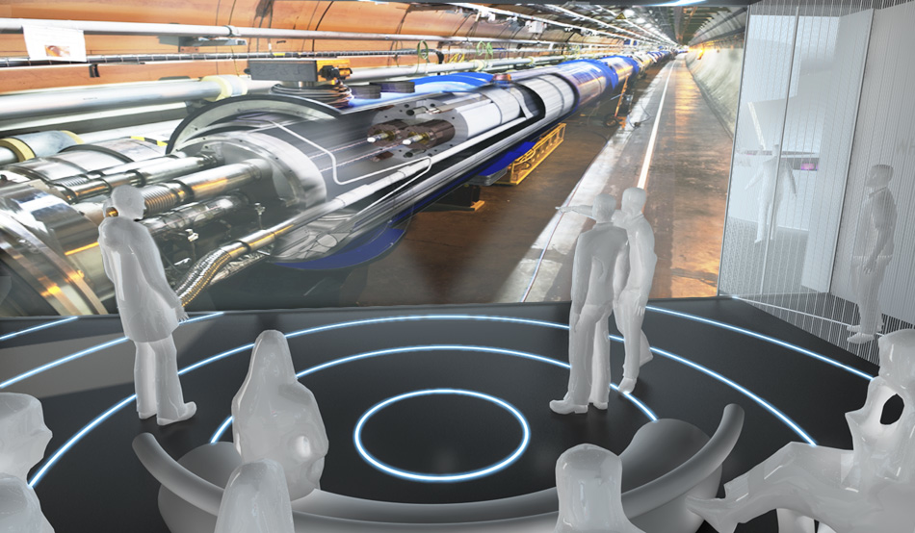
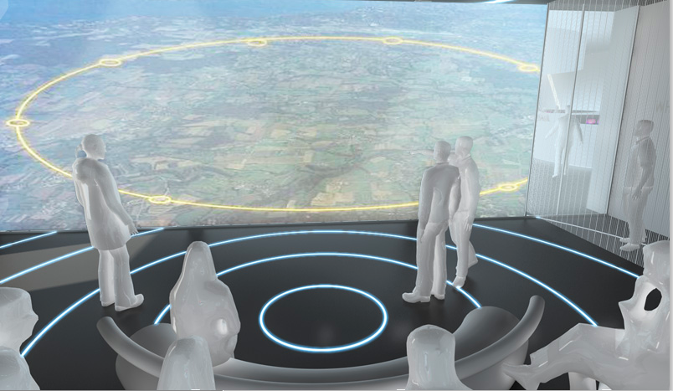

Slide 24
Entrance and passage to services

Slide 25
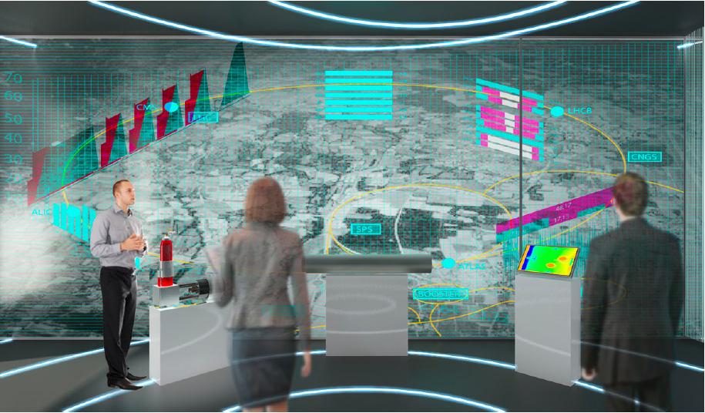
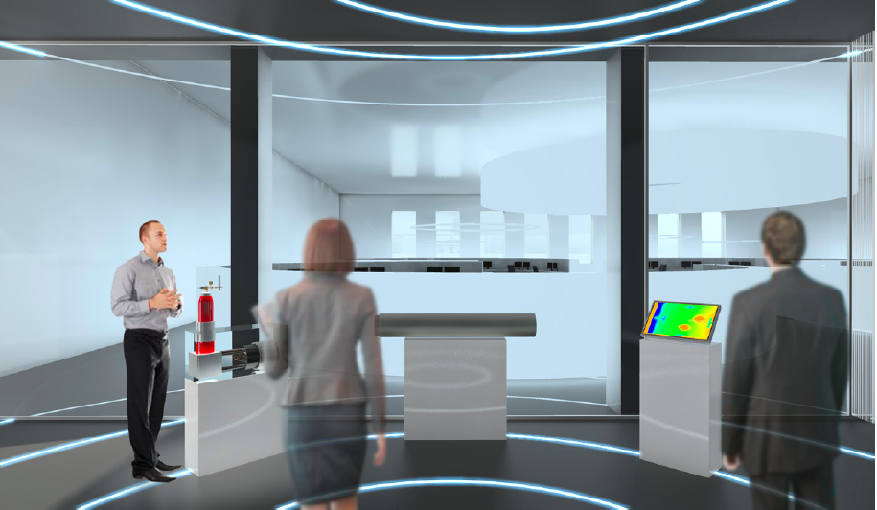
Cern visit points CCC
The Universe of Particles exhibition is an excellent starting point for a visit, but the primary motivation for visitors to CERN is to see science in action.
CERN wishes to apply a similar approach to the CERN control centre (CCC), the superconducting magnet test facility (SM18), and the computer centre (CC).
Visit experience shall reinforce the idea that CERN is a centre of excellence.
A projection wall made of intelligent glass
Empty area not adapted to visitors

Slide 26
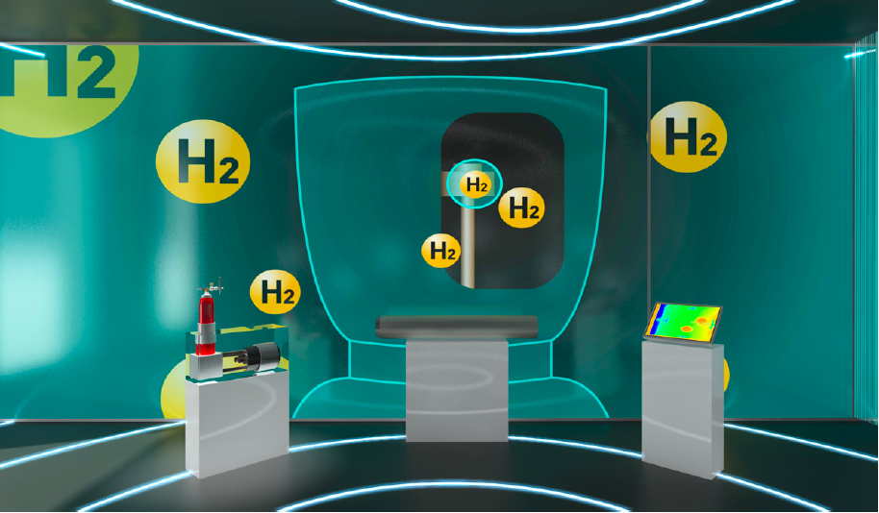

Slide 29
CCC visit point

Slide 30
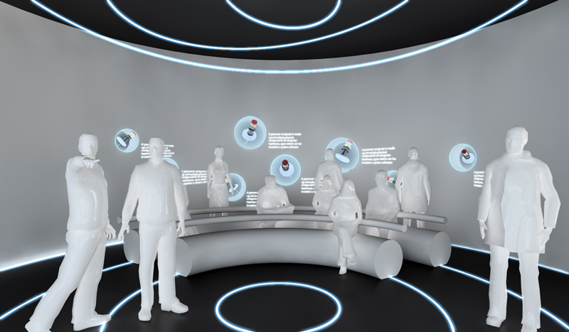
Possible ergonomics
Seating area for 15-20 people. Seating the visitors would avoid the well-known ʻby-standerʼeffect: in a group of e.g. 25 people, the most interested 3-4 people cluster around the guide and block the sight/sound for the others, who wander off and miss most of the explanations.

Slide 31
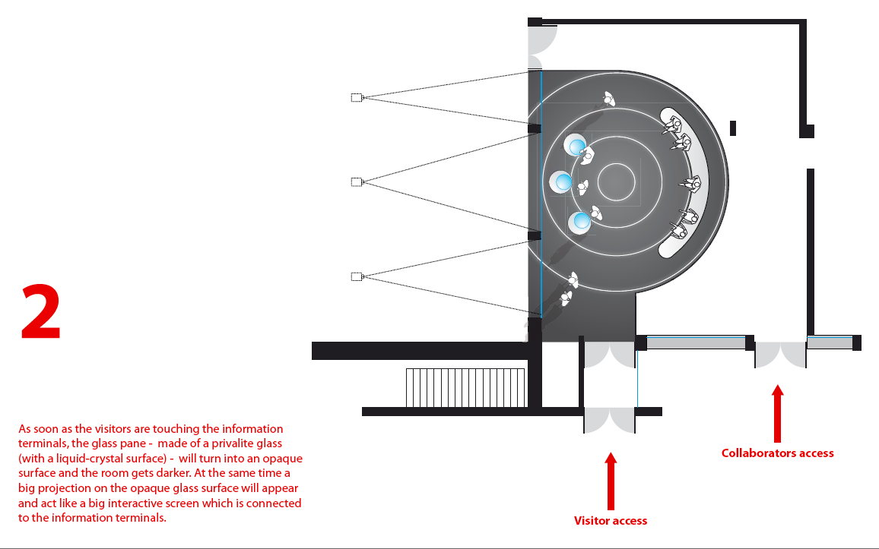
CCC visitor centre

Slide 32
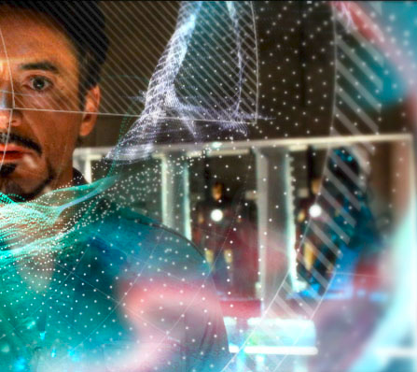
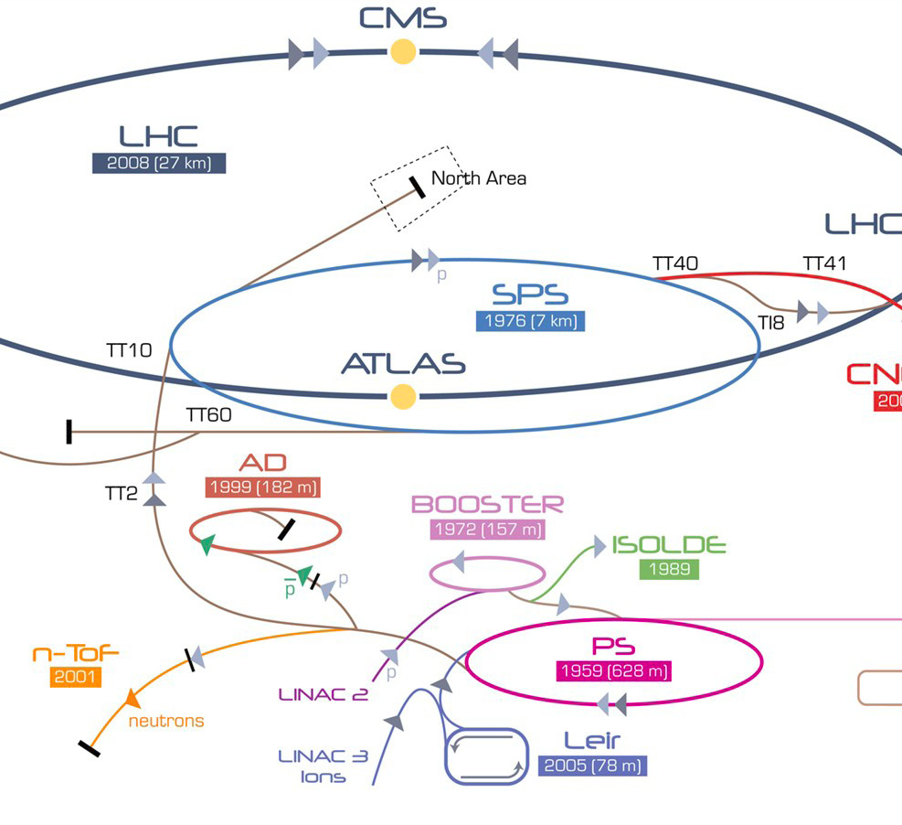

Key guideline
BRINGING REALITY TO THE FORE
INTEGRATION OF OBJECTS
HIGH TECH
TAILORED TO GUIDES
REDUNDANCY
INTERACTIVE PRESENTATIONS
ILLUSTRATIONS / GRAPHICS
LIFE TIME

Slide 33
wc

