Slide 1

LINAC4 commissioning plans etc.
Alessandra Lombardi
on behalf of the LINAC4 team

Slide 2
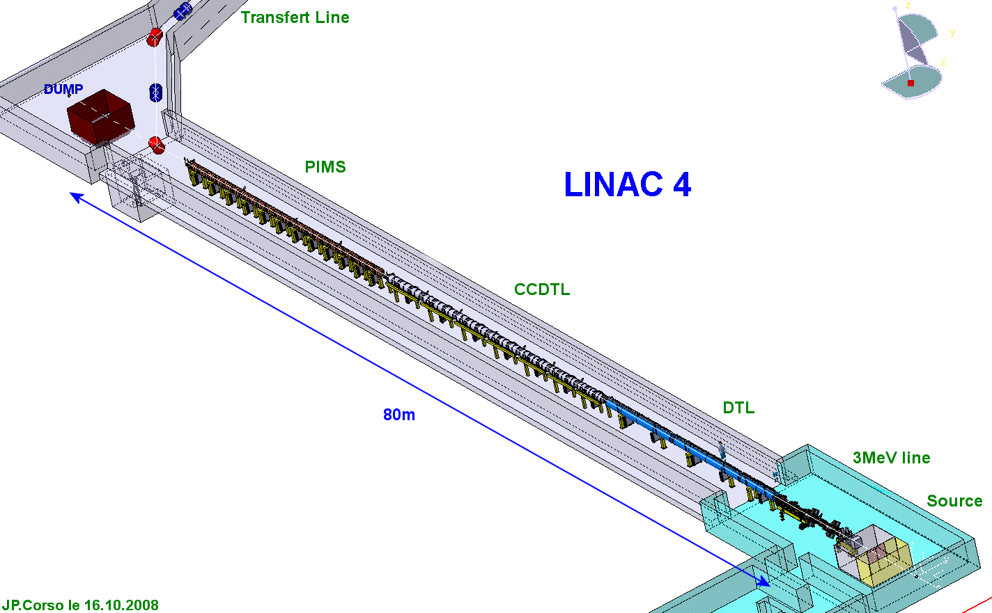
Preinjector
3 MeV
Source(s)
2 solenoids
RFQ
11 EMQ
3 Cavities
2 Chopper units
dump
352 MHz
Π-mode Structure
160 MeV
12 Modules
8 Klystrons
12 EMQ
12 steerers
23 m
Cell-Coupled Drift Tube Linac
100 MeV
7 Modules
7 Klystrons
7 EMQ
7 steerers
14 PMQ
25 m
Drift Tube Linac
50 MeV
3 Tanks
3 Klystrons
1 EMQ
2 steerers
114 PMQ
19 m

Slide 3

Layout of LINAC4
45keV
45keV
3MeV
3MeV
50MeV
102MeV
160MeV
H-
LEBT
RFQ
MEBT
DTL
CCDTL
PIMS
Low Energy beam transport
2 solenoid
1.8 m
Radio Frequency Quad.
352.2MHz
3 m
MEBT
11 EMQ
3 Cavities
2 Chopper units.
352.2MHz
3.9 m
Drift Tube Linac
3 Tanks
114 PMQ
1 EMQ
352.2MHz
19 m
Cell-Coupled Drift Tube Linac
7 Modules
7 EMQ
14 PMQ
352.2MHz
25 m
Π-mode Structure
12 Modules
12 EMQ
352.2MHz
22.9 m
Up to 3 MeV “charge insensitive”
In the MEBT line we have to respect the chopping dynamics
We need to match to a permanent focusing channel in the DTL and CCDTL

Slide 4
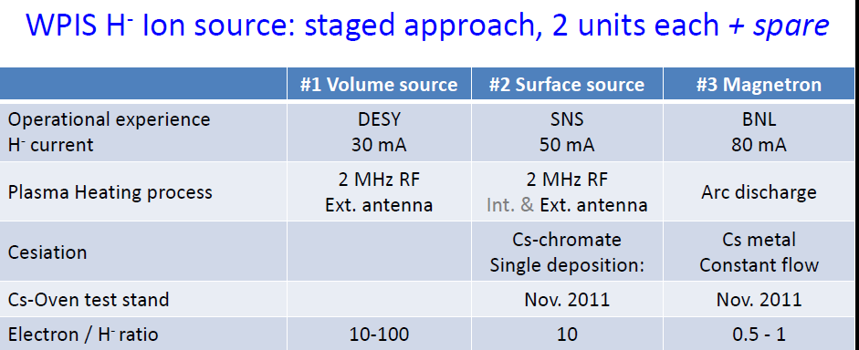
“The source(s)”
45 keV beam available | aug 2012 | mid 2013 | after 2015

Slide 5
Preinjector
3 MeV
Source(s)
2 solenoids
RFQ
11 EMQ
3 Cavities
2 Chopper units
dump
352 MHz
Π-mode Structure
160 MeV
12 Modules
8 Klystrons
12 EMQ
12 steerers
23 m
Cell-Coupled Drift Tube Linac
100 MeV
7 Modules
7 Klystrons
7 EMQ
7 steerers
14 PMQ
25 m
Drift Tube Linac
50 MeV
3 Tanks
3 Klystrons
1 EMQ
2 steerers
114 PMQ
19 m

Slide 6
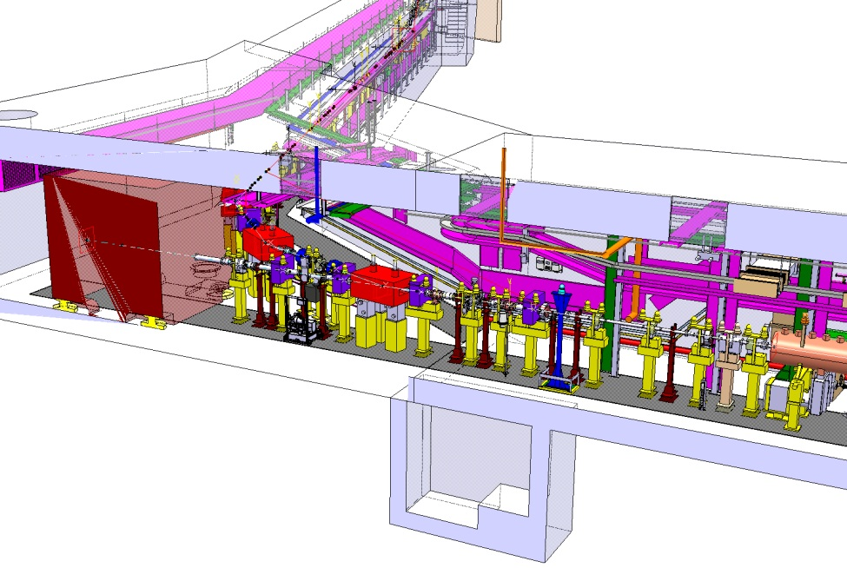
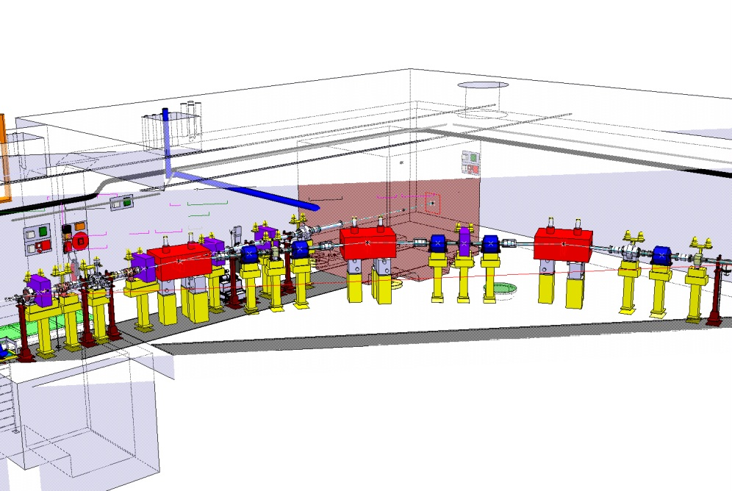
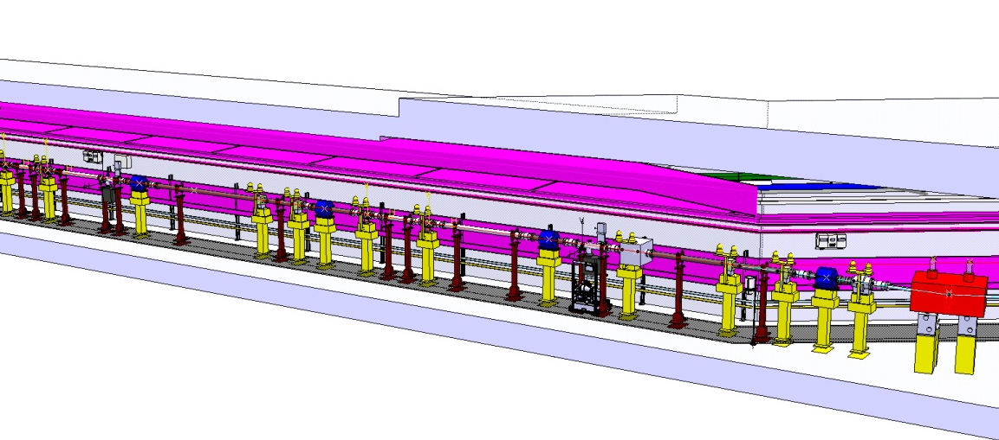
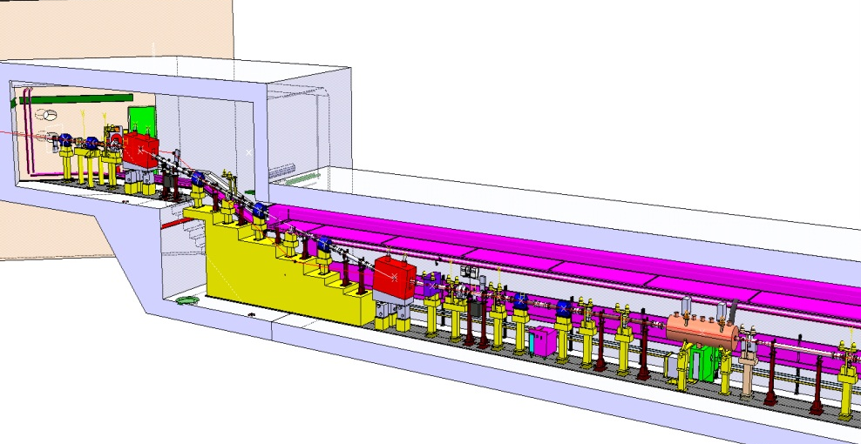
Transfer Line
70deg towards LINAC2 or to DUMP
Up 2.5 m step to level with PSB

Slide 7
Nominal Beam at PSB
Intensity | 40 mA
Transverse | Ε= 0.3-0.4 pi mm mrad norm rms Alpha= 0 Beta x = 5,2.5,10 m Beta y = 4,2,8 m Dispersion = 0 or 1.2 m
Longitudinal | ±100 keV rms energy spread (100-800 KeV possible) 160 MeV ± 1.2 MeV (dynamically over 20 µsec)
Chopped | 1 µsec for the distributor rise time 1 MHz frequency of the PSB as low as just letting few µbunches (50 nsec)

Slide 8
What needs to be set
 |  | EFFECT ON
Focusing | LEBT solenoids (2) | Intensity and Transverse Emittance
 | MEBT quadrupoles (11) | Chopping efficiency
 | DTL CCDTL PIMS quads (22) | Intensity
 | Transfer Line quadrupoles (15+18) | Intensity , Matching and Dispersion
Steering | Steerers hor and vert (36) | Intensity
RF | Phase and Amplitudes (22) | Energy, energy spread

Slide 9
Stages
 | Energy | Key issue |  | Completed in the tunnel by
LINAC4 stand alone | 3MeV | RFQ transmission Chopping |  | May 2013
 | 12 MeV | Matching to DTL |  | Sep 2013
 | 30-50 MeV | Transporting in PMQ channel |  | Dec 2013
 | 100 MeV | Setting the RF phases |  | Mar 2014
 | 160 MeV - DUMP | Reliability |  | End 2014
Connection to PSB | 160 MeV –LBE LBS |  |  | T0+8months

Slide 10
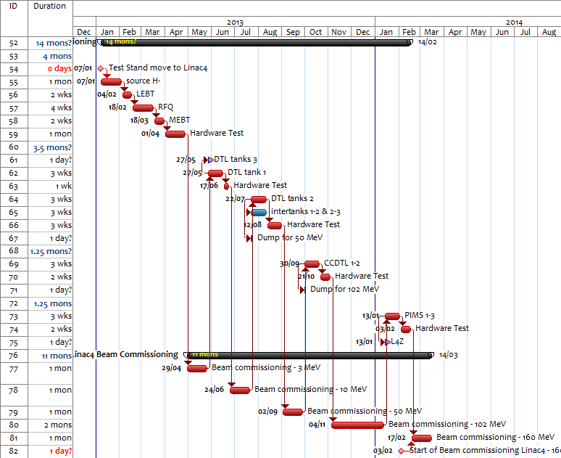
Feb-14
NO CHANGE

Slide 11
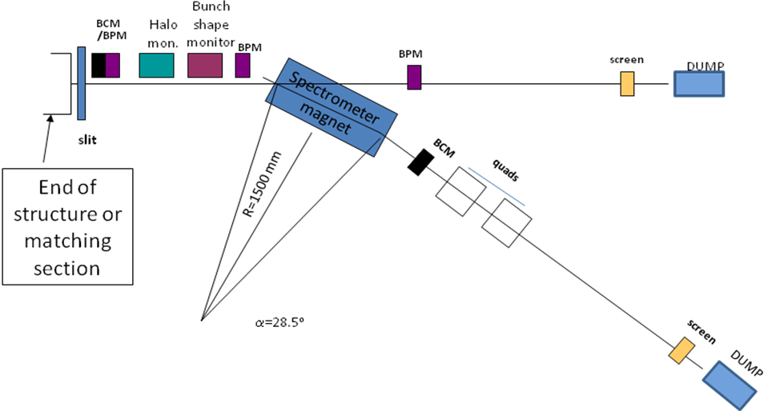
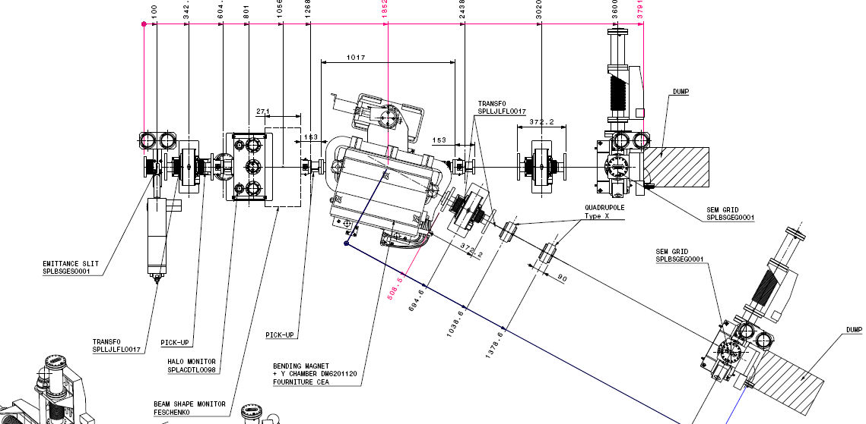
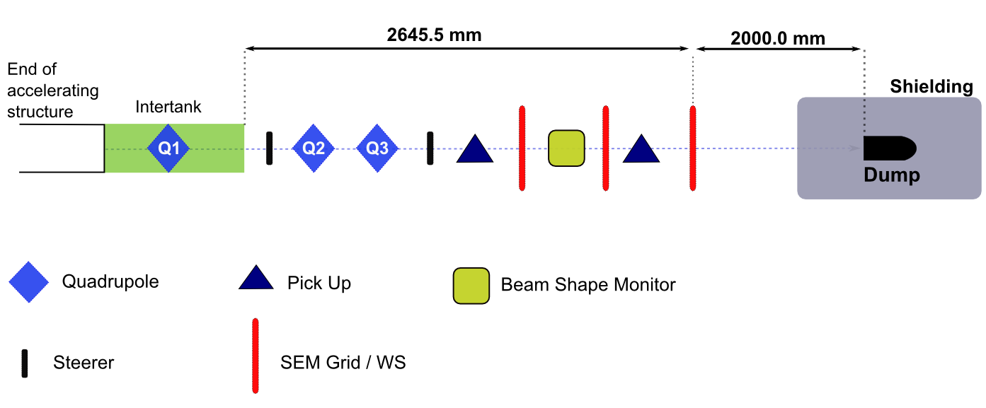
Movable Temporary Benches
Low energy bench (up to 12 MeV)
Spectrometer (0.2 %) Slit and Grid Emittance ToF (calibration) Bunch Shape Monitor Halo Monitor (chopping eff.)
Medium energy bench (up to 100 MeV)
ToF (0.1 %) Emittance via Profiles Bunch Shape Monitor

Slide 12
Permanent Measurement Line
4 profile monitors (emittance)
Bunch shape monitor (phase spread)

Slide 13
At 160 MeV on the DUMP
Fine tuning of the whole LINAC
Operational beam parameters at the end of the LINAC to be used as an input to rematch the line and prepare a fast commissioning of the lines.
Reliability run

Slide 14
Refurbished LBE LBS
Emittance via Q-scan
Energy spread and energy swing
Draft !

Slide 15
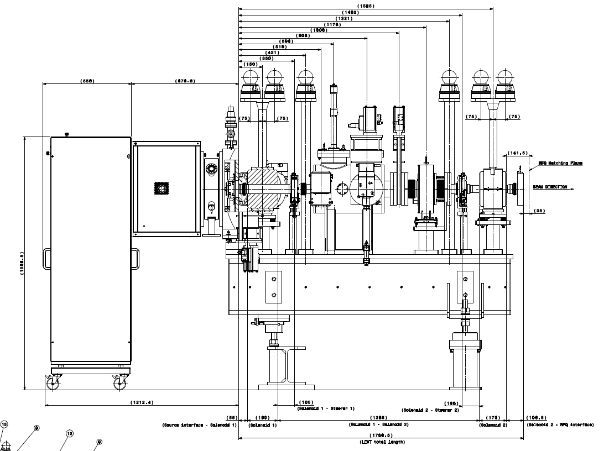
What have done so far
+83mm Drift
Emittance Meter
Solenoid
Steerer
Iris
Faraday Cup
Pre Chopper
SEM-Grid
BCT
Slit

Slide 16
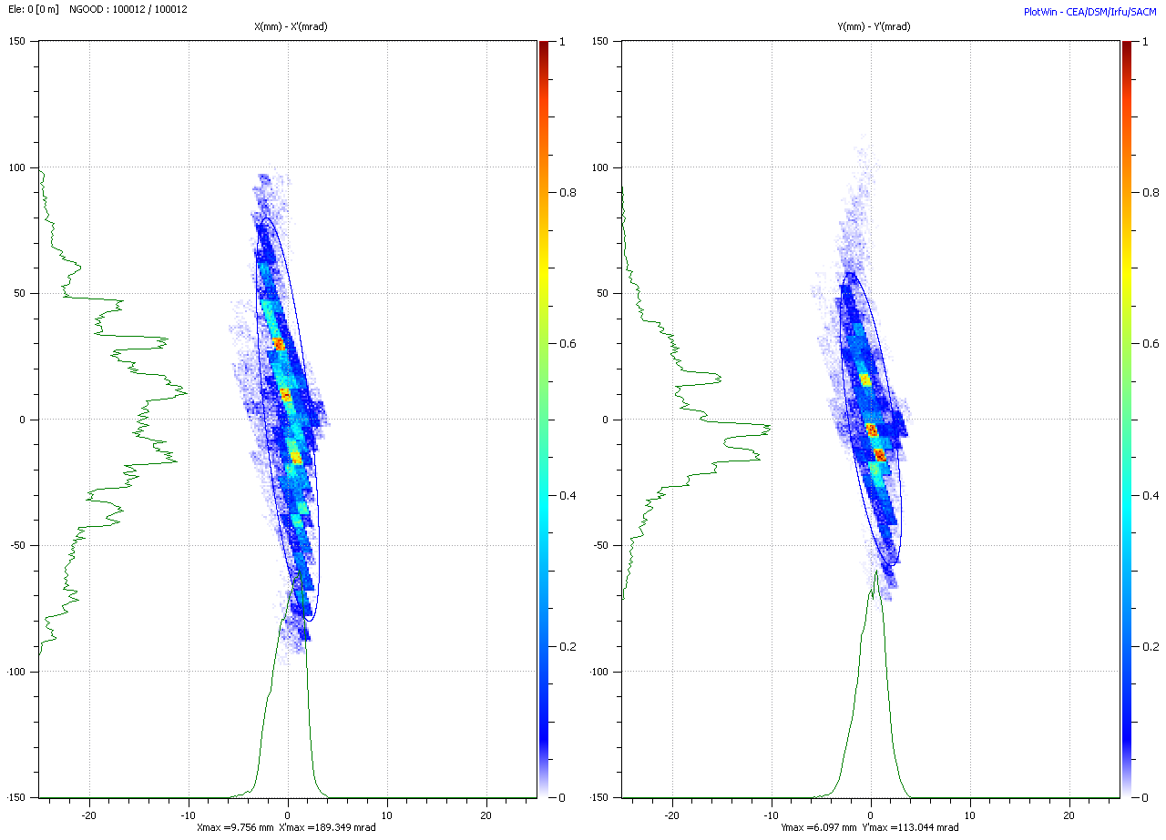
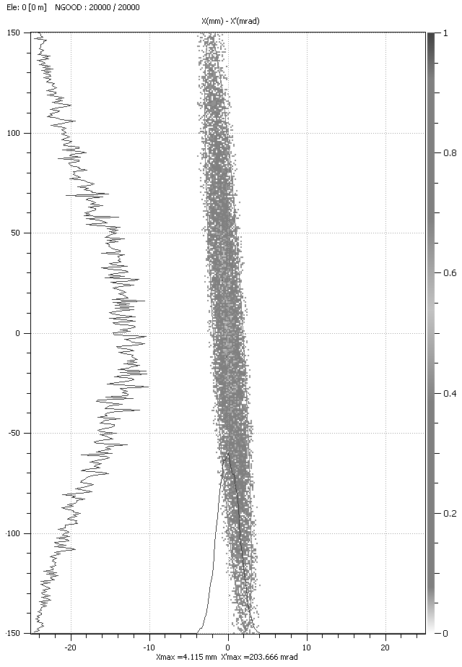
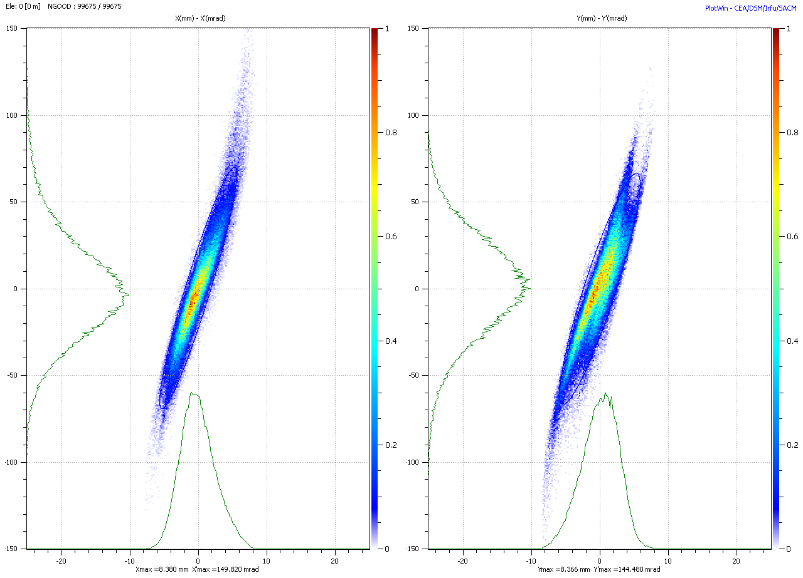
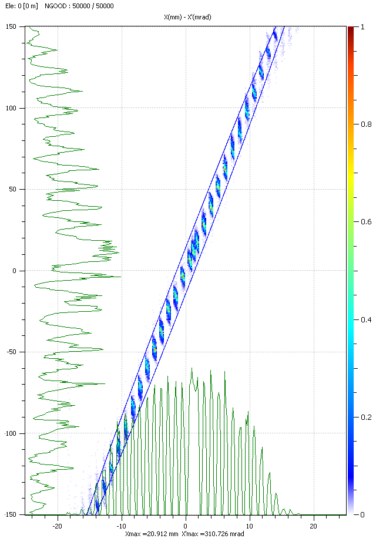
What have done so far
RFQ acceptance vs. Measured emittance | Measured after source vs. Measured at the RFQ input plane and backtracked to the source

Slide 17
What if…we need 50MeV p
Need DTL + CCDTL module 4 + all the quadrupoles – not before end 2014
Switch the source to P mode and complete installation new transfer line
Reposition BHZ20
E = 0.28 pi rms norm
DW=100 keV (1rms)
40 mA
50MeV
400 μsec

Slide 18

Support from OP
Software – for diagnostics applications – coordinated by Giulia Bellodi
Participation to commissioning of the LINAC ( 3 teams with 1 LINAC expert, 1 RF expert , 1 operator) , work on the basis of 2 shifts/day for 6 months during 2013/2014.
18 man.month of experienced operators (=6 months * 3 operators) in 2013/14 available for Linac4 commissioning. To be aligned with commissioning schedule.
Who is going to operate LINAC4 and from where?

Slide 19
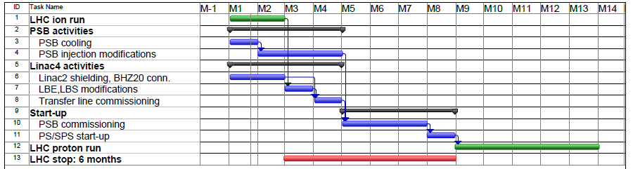
Connection to PSB
Need 8 months / LHC stop of 6 months
Ready from 2015 (Linac4 must be already commissioned)

Slide 20
Summary
Plan for commissioning LINAC4 in 5 stages with two temporary measurement benches. We believe that we have sufficient diagnostics to set all the linac parameters (about 130) . Energy spread can be measured properly only at 12 MeV and in the LBS.
The present schedule foresees end of commissioning + reliability run at the end of 2014
From 2015 LINAC4 can be connected to the PBS
Need a shutdown of 8 months for the connection

