Slide 1
LHC QPS UPDATE
OP Participation in QPS work

Slide 2
Contents:
QHDS switch exchange
F3/F4 swap
Plans for 2012

Slide 3
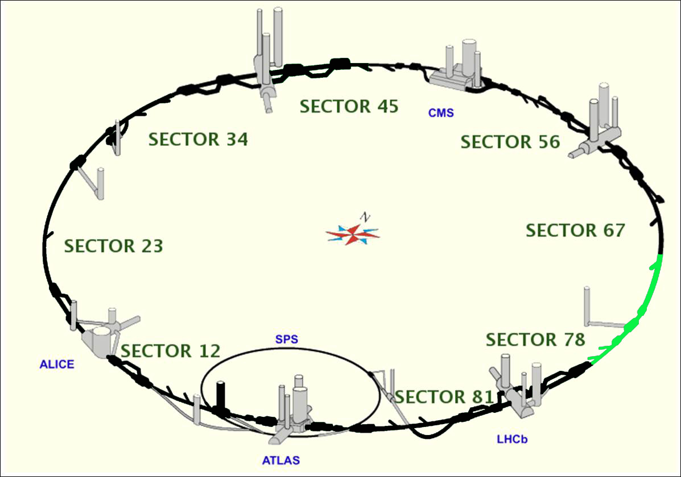
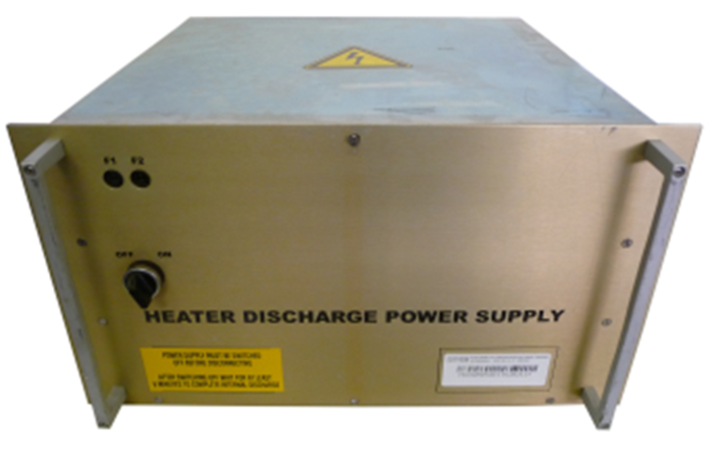
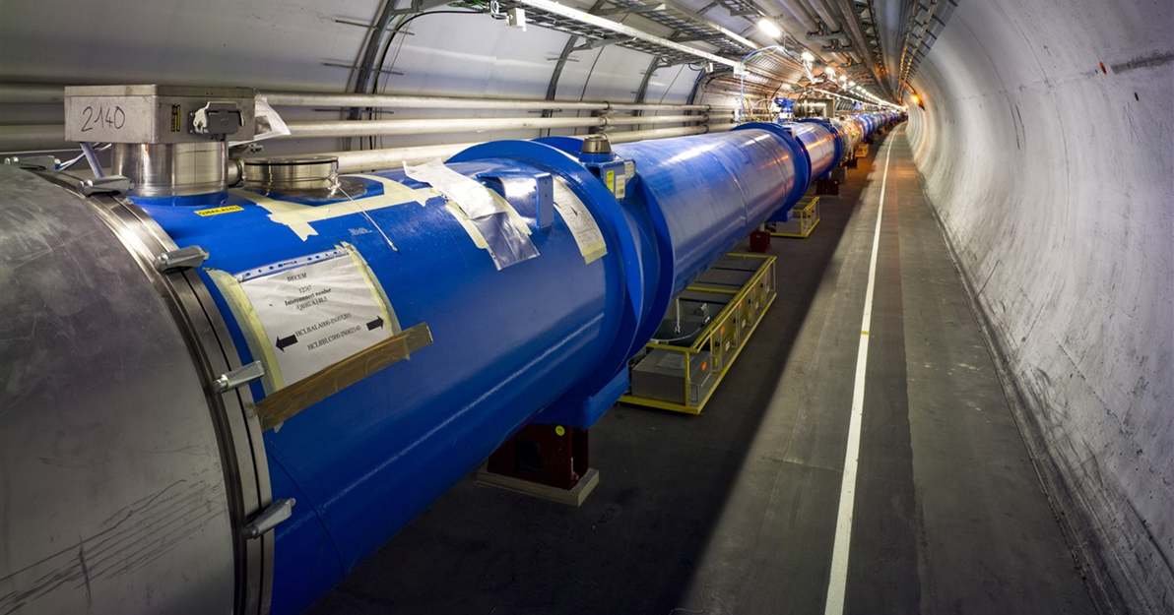
QHDS switch exchange:
What was the work again?:
  Continue switch replacement program of QPS heater power supply switches …
  6076 switches in total to exchange
  1400 already done (1-01-2011)
Status as of 01/01/11

Slide 4
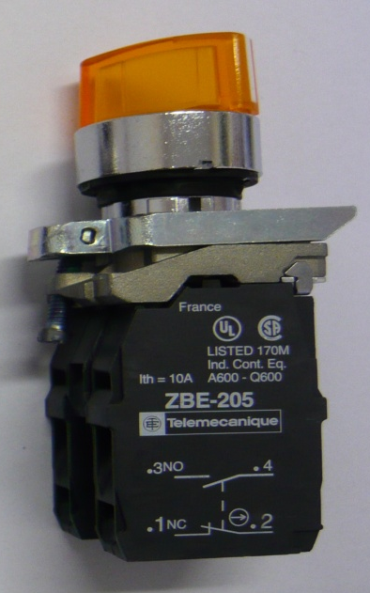
QHDS switch exchange:

Slide 5
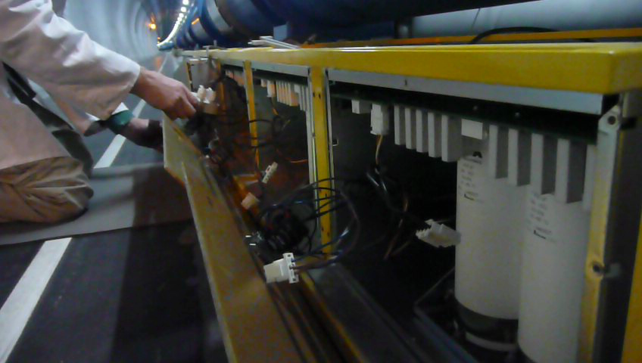
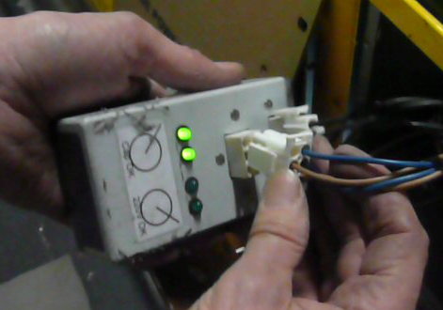
The OP task:
Quality control
Individual system test

Slide 6
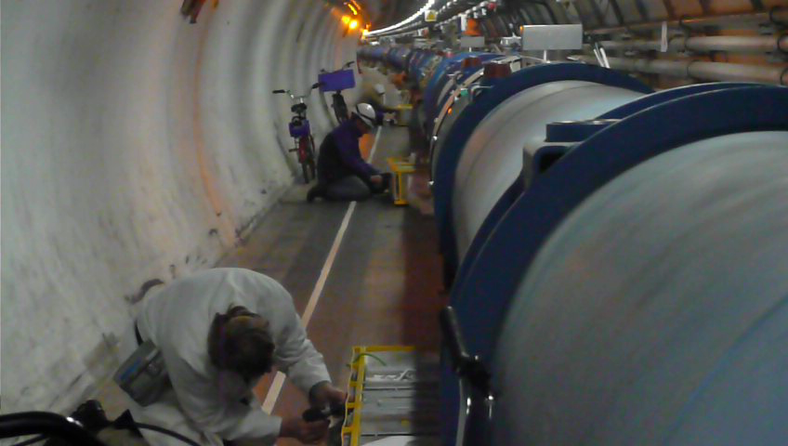
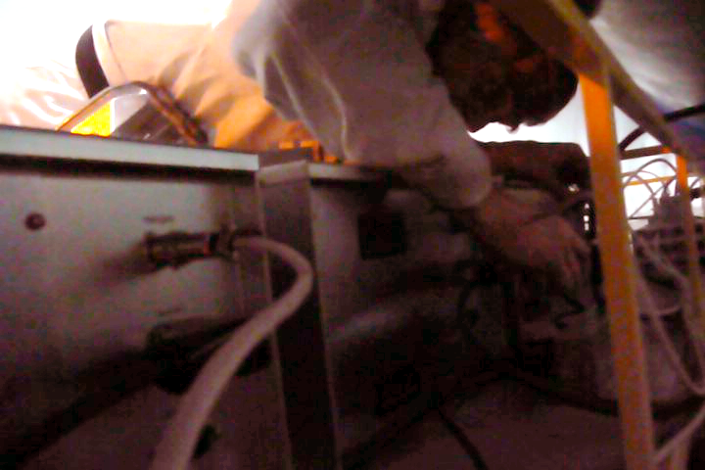
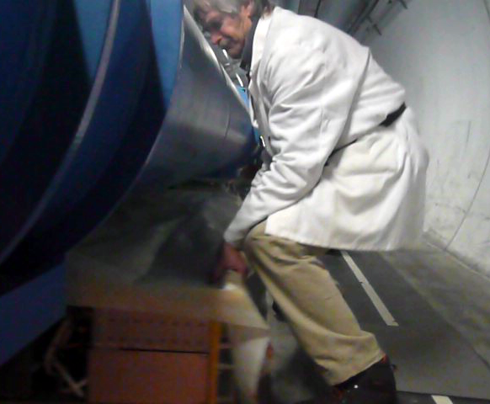
The OP task:
Closing up the crate
Harsh conditions

Slide 7
The Challenge
Replace 3000+ switches during Christmas stop
  Time slot: 35 working days
  target: 40 switches per day per person
The Team:
  Volunteers from OP (=> 3rd Job activity)
  27 team members (from all 4 islands)
  1 OP volunteer per day
Notes:
2 permanent workers from external company
Last week reinforcement from three polish guys

Slide 8
The OP-QPS team in 2011/2012
TI: 5 pers.
Ronan Ledru, Richard Luidzen, Jesper Nielsen, Julien Pache, Chris Wetton
PS/PSB: 7 pers.
  Abdelouahid Akroh, David Allen, Denis Cotte, Marc Delrieux, Herve Genoud,
  Miguel lozano, Frank Peters
SPS: 6 pers.
  Serge Massot , Jeremi Fleuret, Oscar Andujar, Rene Hazelaar, Kevin Cunnington,
  Eric Veyrunes
LHC: 10 pers.
  Guy Crockford, George Henry Hemelsoet, Alick Macpherson, Gabriel Mueller,
  Lene Norderhaug, Dario Romano, Nick Ryckx, Roberto Sanchez Lopez,
  Ronaldus Suykerbuyk, Mario TerraPinheiro
Coordination: Ron, Herve and Alick

Slide 9
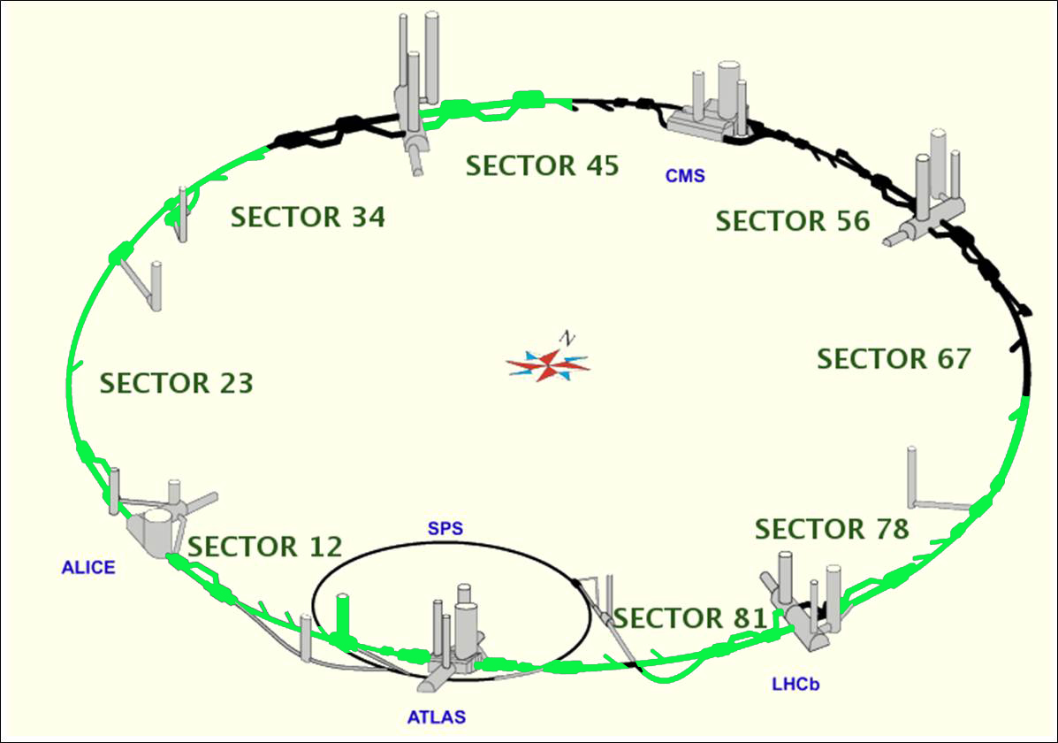
Switch replacement Status:
ON SCHEDULE
Status as of 25/01/12

Slide 10
F3/F4 swap
What is it all about:
Several beam dumps because of loss of mains power on the QPS system.
Cause: circuit breaker trips due to current peaks in mains current of QPS system.
Test results in: EDMS 1149398
Notes:
2 permanent workers from external company
Last week reinforcement from three polish guys

Slide 11
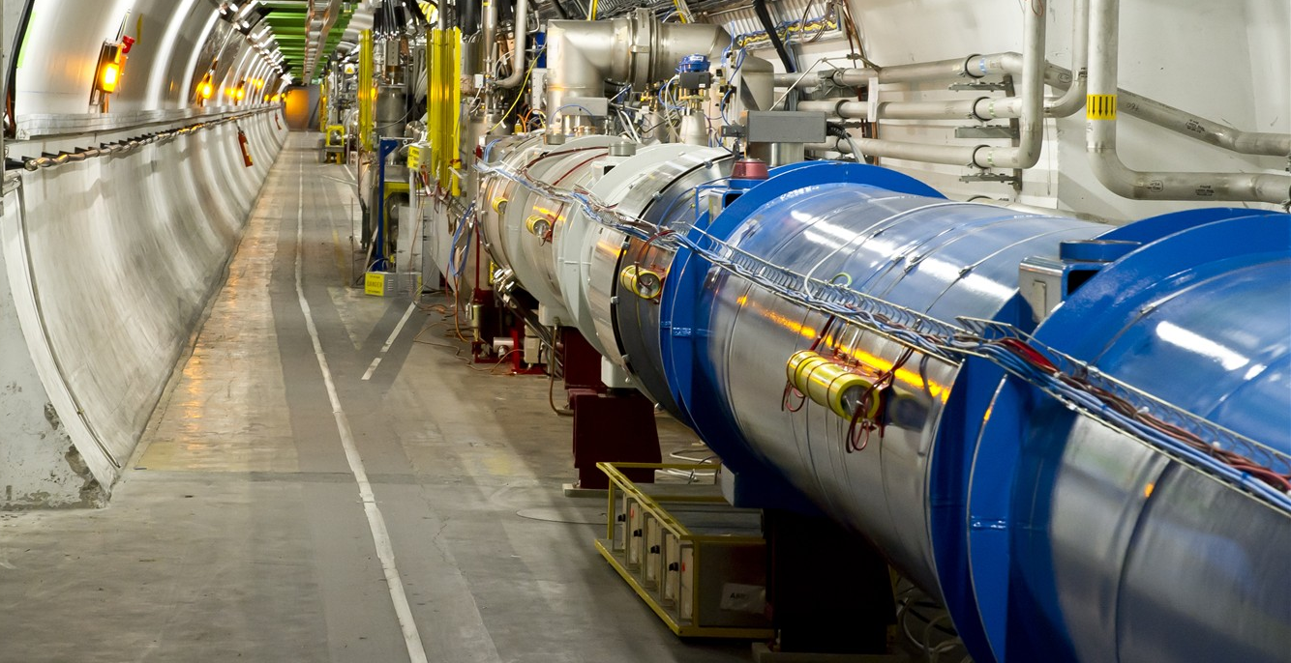
F3/F4 swap
What is it all about:

Slide 12
F3/F4 swap
Coffret F3
Coffret F4
6 Amps
Super fast circuit breaker
ABB
S502-C6
MG
C60N-C10
10 Amps
Fast circuit breaker
High Peak Current
Low Peak Current
Chaufferette 1
DQHDS
Chaufferette 3
DQHDS
Chaufferette 2
DQHDS
Chaufferette 4
DQHDS
Alim. à découpage
SYKO
Alim. Lineaire
Powerpac
Alim. Lineaire
Powerpac
Crate iQPS
Crate New QPS
Notes:
2 permanent workers from external company
Last week reinforcement from three polish guys

Slide 13
F3/F4 swap
Coffret F3
Coffret F4
ABB
S502-C6
MG
C60N-C10
Chaufferette 1
DQHDS
Chaufferette 3
DQHDS
Chaufferette 2
DQHDS
Chaufferette 4
DQHDS
Alim. à découpage
SYKO
Alim. Lineaire
Powerpac
Alim. Lineaire
Powerpac
Crate iQPS
Crate New QPS
Notes:
2 permanent workers from external company
Last week reinforcement from three polish guys

Slide 14
F3/F4 swap
What is it all about:
Coffret F3
Coffret F4
ABB
S502-C6
MG
C60N-C10
Chaufferette 1
DQHDS
Chaufferette 3
DQHDS
Chaufferette 2
DQHDS
Chaufferette 4
DQHDS
Alim. à découpage
SYKO
Alim. Lineaire
Powerpac
Alim. Lineaire
Powerpac
Crate iQPS
Crate New QPS
Notes:
2 permanent workers from external company
Last week reinforcement from three polish guys

Slide 15
Plans
Switch replacement:
  OP team stops on 1st Feb
  All switches to be replaced by 21st Feb
New work packages ...
  F3/F4
    Work package to be defined
    QPS will probably request OP involvement
  Extraction Breakers

Slide 16
Conclusions
Strong OP commitment: 27 Volunteers
OP-QPS work packages completed on schedule
High standard of quality control
  On average we found 2 faults per day
Nothing resist the OP Force!!

Slide 17
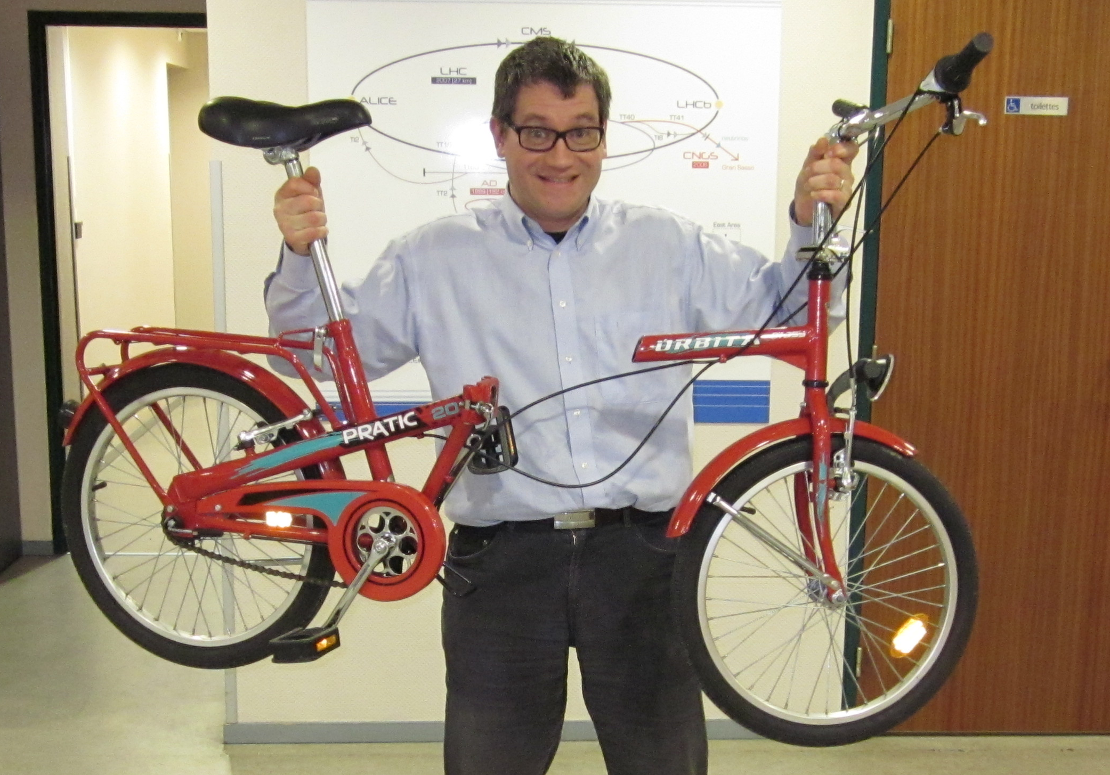
Not even bicycles!

