Slide 1
Common production, incl. common issues like event overlay
Akiya Miyamoto
2 February 2012
KEK
Linear Collider Software Meeting @ CERN

Slide 2
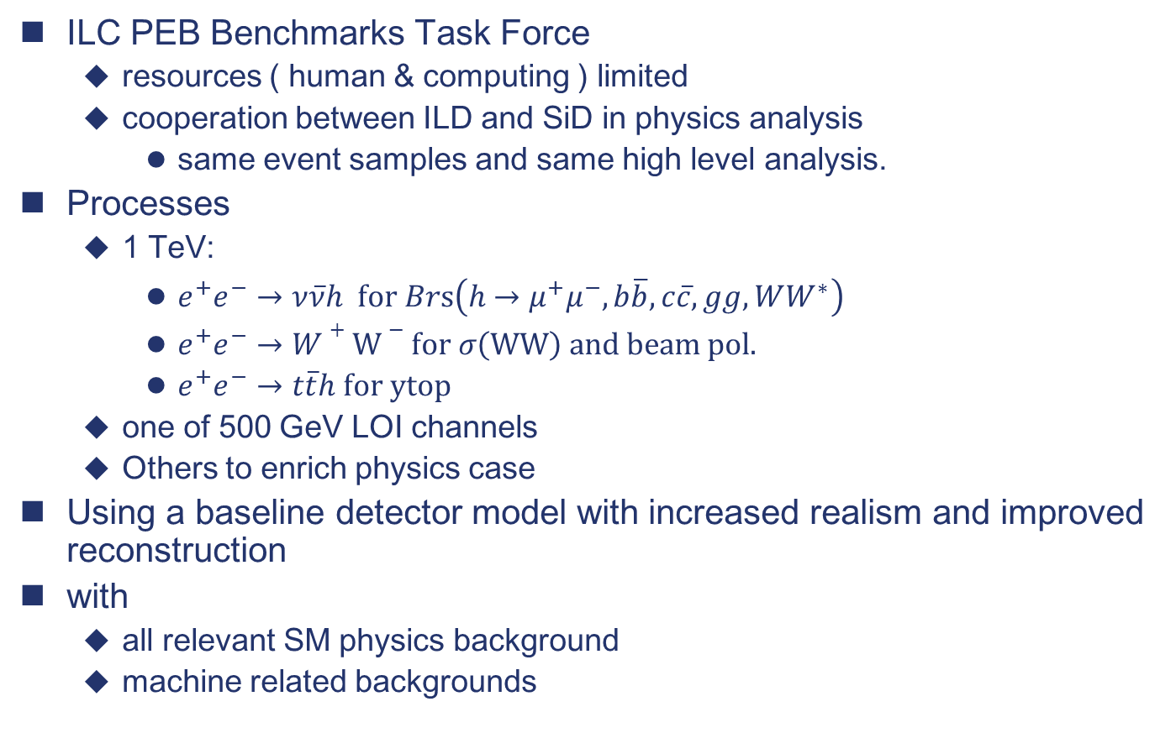
DBD benchmarking requirements
ILC PEB Benchmarks Task Force
  resources ( human & computing ) limited
  cooperation between ILD and SiD in physics analysis
    same event samples and same high level analysis.
Processes
  1 TeV:
    $e^{+}e^{−}→ν\overline{ν}h \text{for} Br\text{s}\left(h→μ^{+}μ^{−}, b\overline{b}, c\overline{c}, gg, WW^{∗}\right)$
    $e^{+}e^{−}→W+W−for σ\left(WW\right) and beam pol.$
    $e^{+}e^{−}→t\overline{t}h for ytop$
  one of 500 GeV LOI channels
  Others to enrich physics case
Using a baseline detector model with increased realism and improved reconstruction
with
  all relevant SM physics background
  machine related backgrounds

Slide 3
Generator samples
ILC generator event samples
  ILC 1 TeV beam parameter has just fixed and common generator samples are about to generate
  Work sharing ( for 1 TeV samples ) agreed
    ννH :
    4f ( WW, ZZ, singleW, singleZ, … )
    2f ( μμ, ττ, ee with kinematic cuts )
    6f
    tth, 8f ( ttZ, ttbb) by Physsim
    γγ/eγ/γe→ff, hadrons, mini-jets
    pairs
  Statistic: 1ab⁻¹ or 10k as a first step. Could be increased if need more.
  Based on SVN version of whizard code and inputs
  Meta files are prepared on a web.
  Common samples are placed in /grid/ilc/prod/ilc/mc-dbd : To be used for simulation inputs
Note: in the case of CLIC
  The standard binary is provided by Stephan. Generator events are generated as a first step of GRID production.

Slide 4
Simulation
Geant4
  Geant4.5 will be used
  Physics List:
    CALICE recommends QGSP_BERT_HP.
    set G4NEUTRONHP_NEGLECT_DOPPLER to reduce CPU time
    Another candidates
      PhysicsShielding
      FTFP_BERT
      ➔ Study by CALICE is needed

Slide 5
Machine backgrounds
γγ→hadrons
  At least, one bunch of backgrounds will be overlaid
    Bunch separation : 366ns. Expect O(1) bkg events per bunch Xing
  Issue: IP Z smearing with σ_{Z}=225μm. Separately for signal event and background event. Can the event reconstruction (LCFIVertex) work properly ?
e⁺e⁻ pairs
  a few x 10k pairs per bunch crossing at 1 TeV
  SiD : overlay one bunch of pairs with a p_{t} cut at generator level.
  ILD : not considered now. SiD method may be applicable.

Slide 6
Common DST
Main topics of the session tomorrow
LCIO: common IO and data model is the bases for common DST. But exact information and qualities in objects are not identical between ILD and SiD
Required common-ness depend on the purpose of common DST. For the common high level physics analysis, equalities on
  4 vectors, vertex info. …
  Particle IDs
  …
would be desirable. Need to agree very soon before starting production
New features of DST for DBD
  ILD case:
    LOI: 2,4,6 jet clustering with LCFIVertexing
    DBD plan: Vertexing in DST, but jet clustering and vertex tagging ( incl. NN training ) should be made in user analysis

Slide 7
GRID production
Events
  More than O(10M) SM events for 1ab⁻¹ 1TeV with no cuts
  10 min/events x 10M events x 2000 CPUs ➔ 35 days per detector
  User specific productions would be required. Ex. ZHH at 500 GeV
For efficient production,
  Generator level cuts are crucial.
    consistency between ILD and SiD
    Inputs from analysis groups
      study stdhep files and samples by pilot production
      proposed us exact number of events to simulate for each files.
GRID tools
  SiD: ILCDIRAC
  ILD: Tools at DESY&KEK + ILCDIRAC ?
Production
  ILC VO. Focus on sites with large resources
    DESY, CERN, IN2P3, KEK (from April), FNAL, …
  Resource sharing
    mechanism ?
    Schedule ?
      Small test production has already started
      Full production. When ? Original ILD plan : 5 months from March

