Slide 1
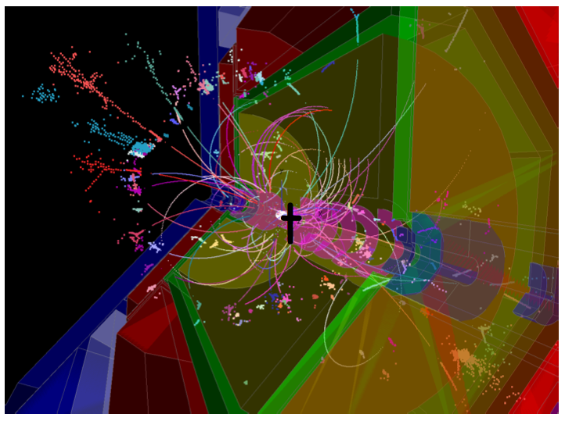
Goals and Aims for Software Development for ILD
Steve Aplin
Linear Collider Software Meeting
2nd Febuary 2012

Slide 2
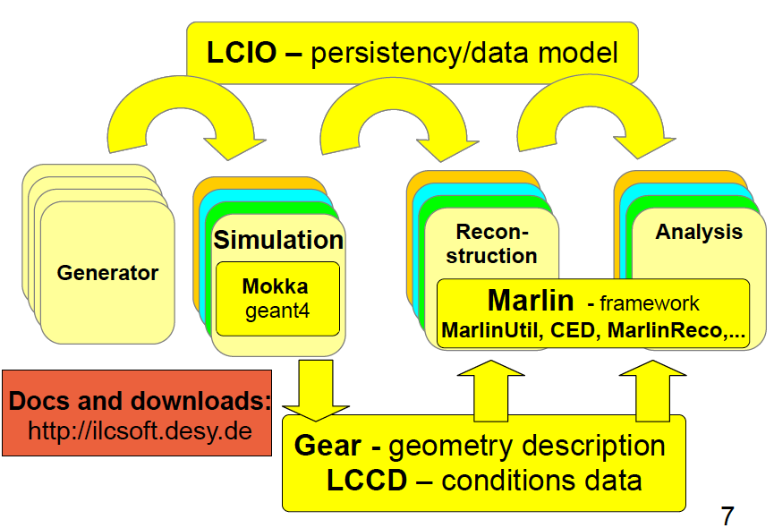
Current Situation

Slide 3
Current Situation
Increased Realism = Increase in Real Work

Slide 4
Moving Forwards
  DBD has already brought Multiple ILD Detector Variants, this creates a fair amount of work to maintain consistency and relative parity.
  With the context of ILD, R+D programs often show a desire to demonstrate the validation of hardware proposals in the Full Sim and Reconstruction, beyond the scope of Physics Analyses.
  When talking about the evolution of iLCSoft it is important to remember that at least 3 Test Beam groups use components of iLCSoft and require continuity.

Slide 5
Resource Utilisation
  CPU utilisation …
  Grid Resources are moving increasingly to Multi-Core. This needs to be considered, as it can be a real pain having to change existing procedures or face losing access to resources …
  Processing of Background often places quite some burden on smart file handling, which in the Grid environment only makes things more complicated.

Slide 6
Into the “Unknown”
  Currently it is difficult to see beyond the DBD at the moment, but there are certainly issues that can be identified now which need addressing.
  Geometry with the Mokka/Marlin framework is a major issue.
  The performance of the Track Reconstruction in the face of background remains to be verified, although this will be revealed as we prepare the DBD.
  It should be remembered that both of these issues form part of the work being addressed with AIDA.

Slide 7
Into the “Unknown”
  Currently it is difficult to see beyond the DBD at the moment, but there are certainly issues that can be identified now which need addressing.
  Geometry with the Mokka/Marlin framework is a major issue.
  The performance of the Track Reconstruction in the face of background remains to be verified, although this will be revealed as we prepare the DBD.
  It should be remembered that both of these issues form part of the work being addressed with AIDA.
Consolidation and Evolution, rather than Revolution

