Slide 1
slic updates
  If requested, store and save calorimeter hit positions within cells to enable more refined hit calculations.
  Will be used to study RPC charge-sharing code.
  Can write out each individual calorimeter hit in sensitive layers, but creates large output files, would like to integrate into slic.
  Also working to define efficient time history for cal hits.

Slide 2
org.lcsim Calorimetry
RPC response will be improved to account for charge sharing across readout pads, electronic noise and inefficiency.
  Algorithms will be implemented in reconstruction software, may be migrated to simulation software if deemed appropriate.
GEM and Micromegas responses will also be modelled.
Scintillator response will still be supported, input from CALICE on uniformity, etc. will be used.

Slide 3
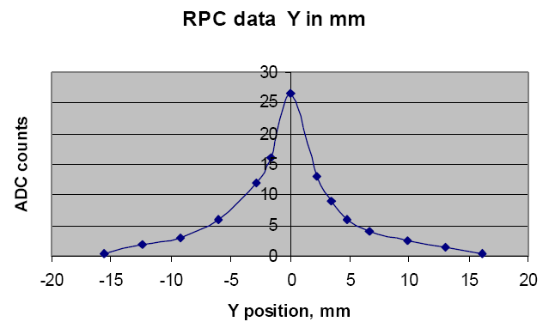
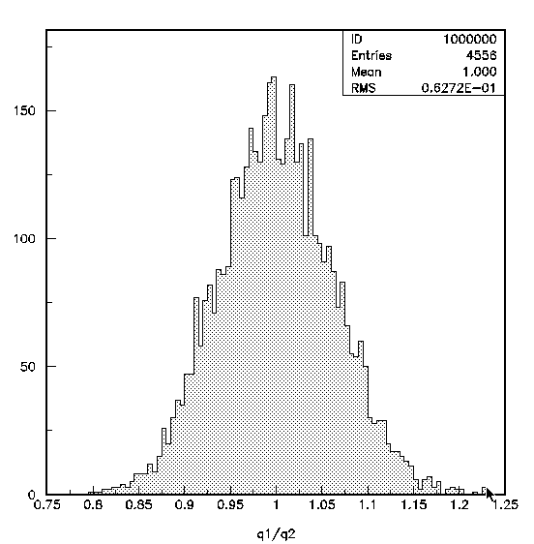
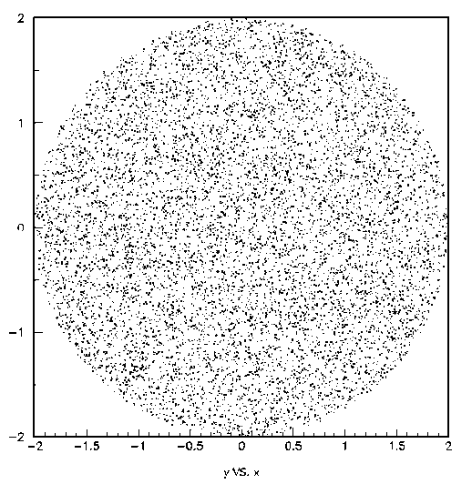
Charge distribution on pads (I)
Measured charge distribution as
function of y in the pick-up plane
D.Underwood et al.
Before re-writing
After re-writing
Throw 10,000 points in
x,y plane, calculate charge Q(r),
sum up charge on 1 x 1 cm² pads
Using look-up table, much faster
Better accuracy
Distribute charge on 3x3 pads
Ignore charge outside 3x3
This part of the new algorithm
still need to be verified by old
program
Lei Xia

Slide 4
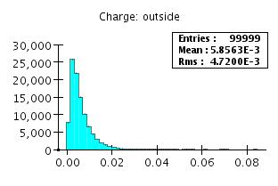
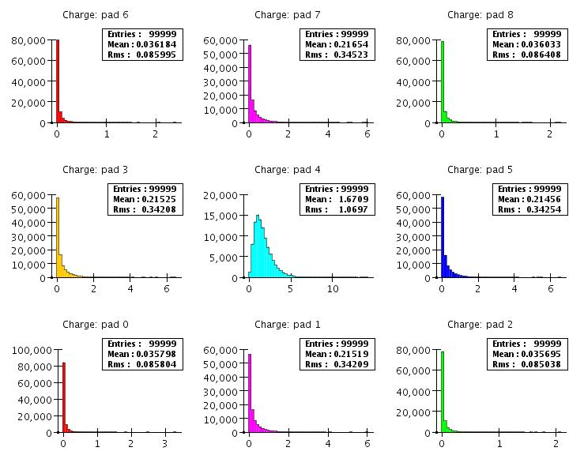
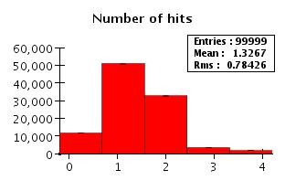
Charge distribution on pads (II)
Total charge [pC] outside
3x3 pads: < 1%
Charge distribution [pC] on 3x3 pads
(6.3kV, E_{dep} randomly generated on central pad)
N(hit) distribution (thr = 0.6pC)
Efficiency ~ 89%
Multiplicity ~ 1.33
Lei Xia

