Slide 1
ATLAS Data Preservation and Access
Roger Jones

Slide 2
ATLAS Data Access Policies
Important to distinguish data preservation and openness of access
Opening data access
  Preparatory discussions within the collaboration
  Has clear implications for authorship/membership rules
    Needs CB-level discussion
    Past experience says these topics provoke long discussion in the CB!
  Hoped to agree a policy along the lines of the Data Policy Harmonization Group straw man

Slide 3
ATLAS Data Preservation
Data Preservation
  There are DP policies implied in the Computing TDRs
    conserve all raw data during the lifetime of the experiment
    All formats & code used for paper analyses to be archived
    Tier 0/1s responsible for the physical preservation
  Some tacit belief that older sets may be ‘retired’
    Retired data no longer to be on disk or under active analysis
    This may need to be revised e.g. if external access is then granted
    Obvious resource implications
  First priority to to preserve data for active use by the collaboration

Slide 4
ATLAS DP Practical Steps
Making sure raw data can be reprocessed long-term (Level 4)
  Identifying key datasets for ‘unique data’ preservation
  Setting up regular reprocessing and validation
Ensuring the capability to run old trigger selections offline
AODfixing may be useful
  This means level 4 operations can be applied to level 3 AOD format
Level 1 data
  Extensive use of Inspire/HEPdata for level 1

Slide 5
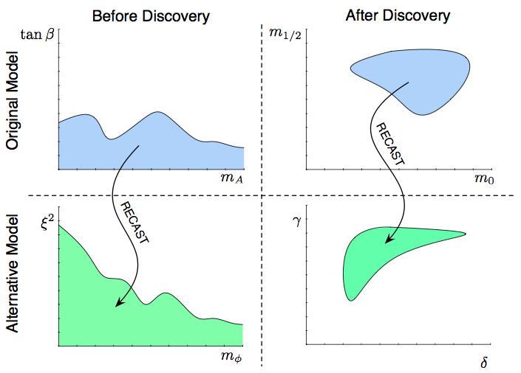
Practical steps - RECAST
arXiv:1010.2506
Framework developed to extend impact of existing analyses
Candidate for within-experiment and long-term analysis archival, encapsulating the full trigger & event selection, data, backgrounds, systematics
Allow an existing analysis to be reinterpreted under an alternate model hypothesis
  Complete information from original analysis, including the tacit information, contained in the data
  Not optimized for the new model, but more reliable than a naïve reanalysis?
Recast seen as a very promising solution for preserving analyses and useful, cost effective preservation of information – addresses levels ~1-~3

Slide 6
ATLAS DMP Organization
Data Preservation now included as part of the upgrade activity planning
  May increase the funding options
  Data Management Planning will be required by some funders for upgrade grants
  Looking at the cost/benefit of various strategies
  Resource tensioning with other upgrade activities

