Slide 1
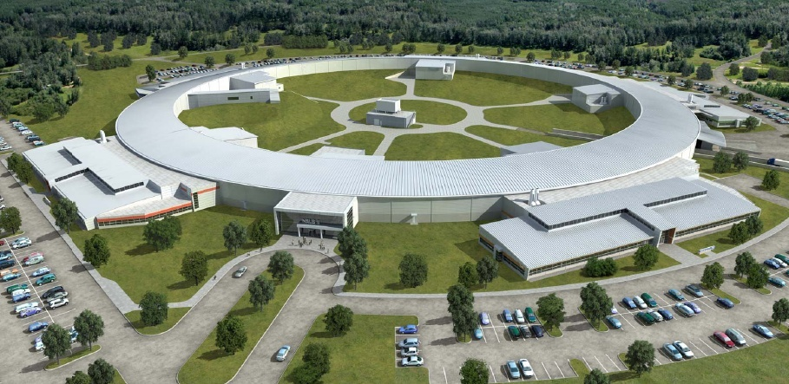
NSLS-II RF Systems
Jim Rose on behalf of the NSLS-II RF group
CWRF2012
May 7-11, 2012

Slide 2
Outline
Introduction to NSLS-II
RF Systems at the NSLS-II
  Linac
  Booster cavity and Transmitter
  SR Transmitter
  SR 500 MHz Cryomodule
  LLRF
  LHe Cryogenic System
Schedule
Future expansion
Conclusions

Slide 3
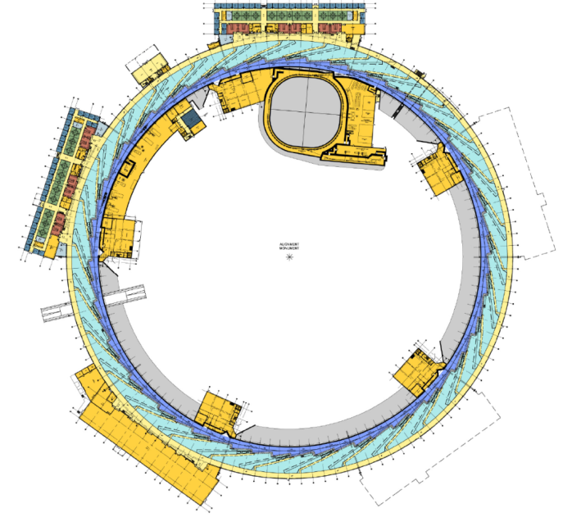
NSLS-II RF Systems
Storage Ring: Two ~9m RF straights each with two 500 MHz SRF cavities and one 1500 MHz passive bunch lengthening cavity
Only one RF straight in initial operations
3 GeV booster with one 7-cell cavity powered by 80 kW IOT amplifier
RF building housing two 300 kW klystron amplifiers
Also houses 850 W LHe refrigerator
Future expansion for another 2 RF systems
200 MeV linac with four 5.2 m TW structures powered by two 42 MW klystrons with SS modulators and third “hot spare”

Slide 4
NSLS-II Technical Requirements & Specifications
Energy 3.0 GeV Circumference 792 m Number of Periods 30 DBA Length Long Straights 6.6 & 9.3m Emittance (h,v) <1nm, 0.008nm Momentum Compaction .00037 Dipole Bend Radius 25m Energy Loss per Turn <2MeV | Energy Spread 0.094% RF Frequency 499.68 MHz Harmonic Number 1320 RF Bucket Height >2.5% RMS Bunch Length 15ps-30ps Average Current 500ma Current per Bunch 0.5ma Charge per Bunch 1.2nC Touschek Lifetime >3hrs
The RF systems uses a single 9.3 m RF straight that contains two 500 MHz Cornell-type superconducting RF cryo-modules and a passive 1500 MHz third harmonic cavity for bunch lengthening
A second 9.3m straight is reserved for future RF systems

Slide 5
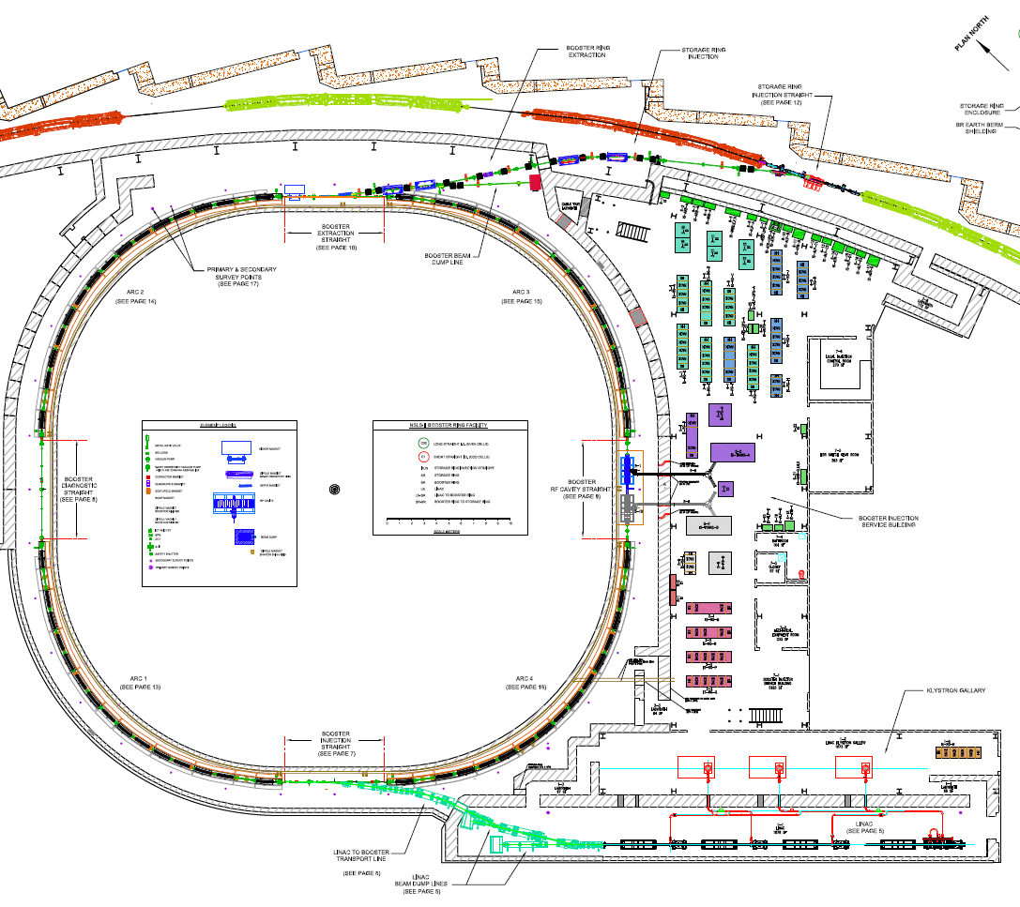
Injector Layout
Booster Parameters
Cicumference: 154m
Harmonic # 264
Rep rate 1 (2) Hz)
Energy 0.2 to 3.0 GeV
RF Voltage 0.2-1.2MV
1 to 150 bunches
7 Cell “PETRA” type cavity
80 kW IOT
Transmitter
Linac
200 MeV
15 nC in 150-300 ns
0.5% dE/E rms

Slide 6
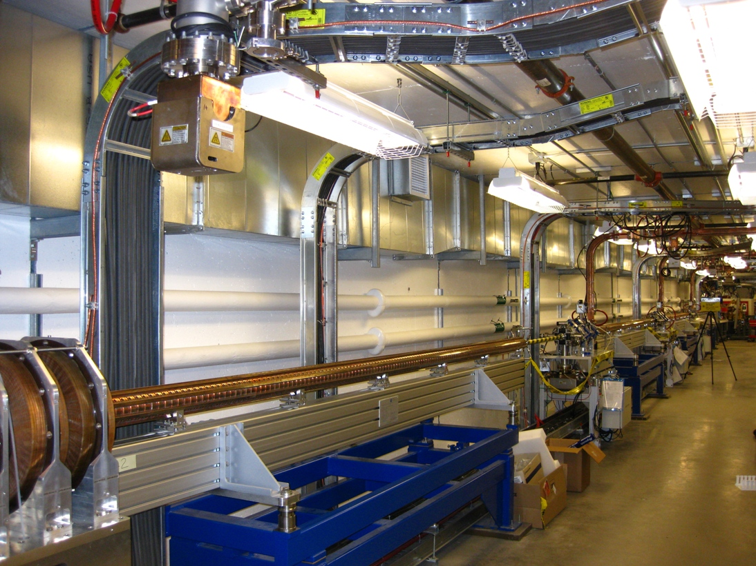
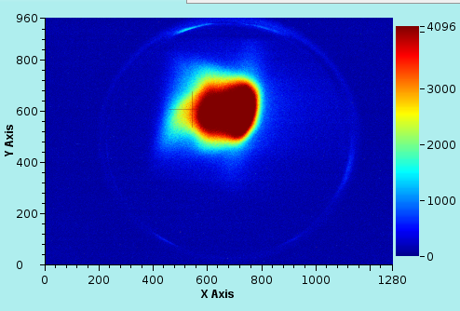
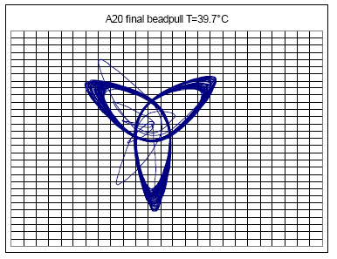
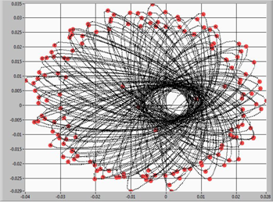
Linac: Commissioning in progress
200 MeV attained
15 nC in 150 ns bunch train beam-loading compensation reduced dE/E from >5% to 0.35% rms
Full width of screen ~ 4%
Courtesy of Christian Piel, RI
Screen shot courtesy of F. Gao
Feed-forward system programs RF drive to compensate for beam loading of TW structures achieves
repeatable results over a wide range of beam currents. N. Towne PhysRev “Beam Loading…”

Slide 7
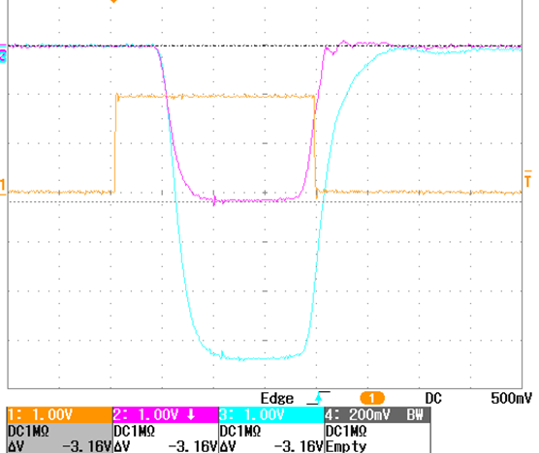
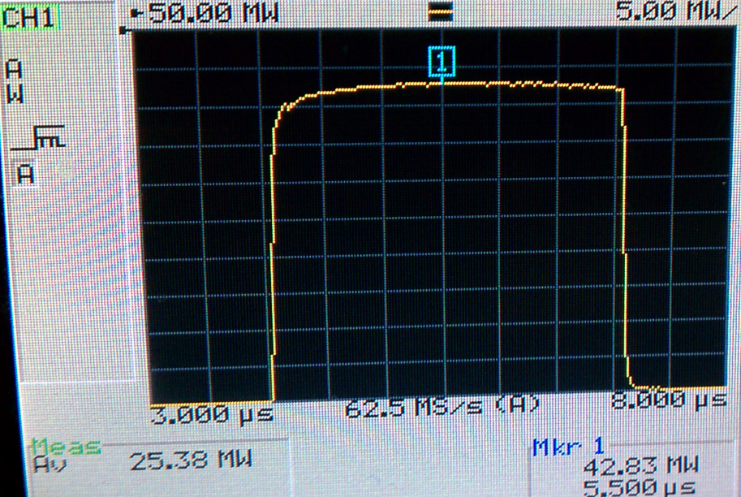
Linac: Scandinova Modulators
Site acceptance tests
Trigger
Klystron current ~320Amp
RF Pulse flatness exceeds that achieved by PFN type modulators
“out of the box”, no tuning required on site.
No issues during commissioning
RF output power 42 MW
Klystron voltage ~ 300kV

Slide 8
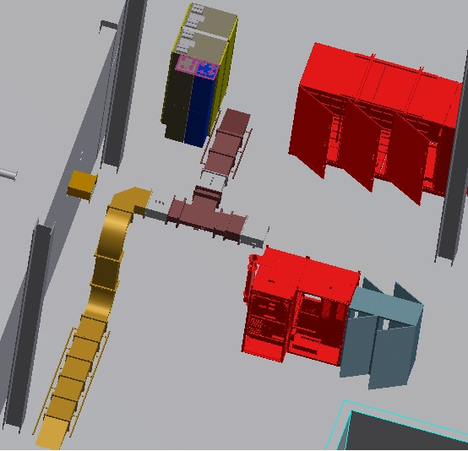
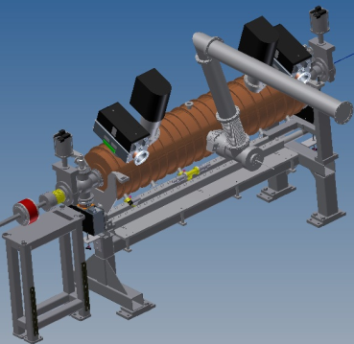
Booster RF system
Booster cavity assembly complete valve to valve and under vacuum
Transmitter fabrication complete and mechanical installation into injector building is complete
RF cavity controller, master oscillator distribution racks
HVPS
Load
90 kW IOT transmitter
circulator
Test Load

Slide 9
Beam Loading parameters
Cavity
detuning
-8.3kHz
500MHz
f_{rev}
f_{s} ~ 4kHz
f_{rev}
-384kHz
+384kHz
 | Baseline | Fully Built Out
R/Q | 44.5 | 44.5
Q₀ | 7.5*10⁸ | 7.5*10⁸
Revolution Frequency | 384 kHz | 384 kHz
Total V | 3.3 M | 4.9 MV
Synchrotron Frequency | 3 kHz | 4 kHz
Number of cavities | 2 | 4
Q_{L}* | 1.2*10⁵ | 6.7*10⁴
Bandwidth (FWHM) | 4 kHz | 7.4 kHz
Frequency detuning | -6.4 kHz | -8.3 kHz
* Q_{L} ~ 86k for minimum reflected power over all phases (preliminary)

Slide 10
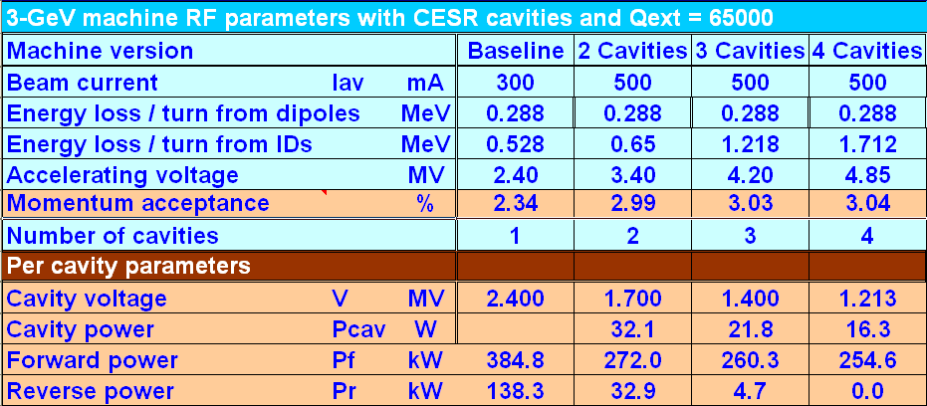
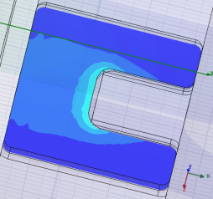
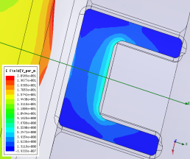
CESR cavity coupling optimized across all NSLS-II operating scenarios
Q_{ext} ~ 65000 is optimal for full build-out, meets baseline, interim conditions
Cornell
NSLS-II

Slide 11
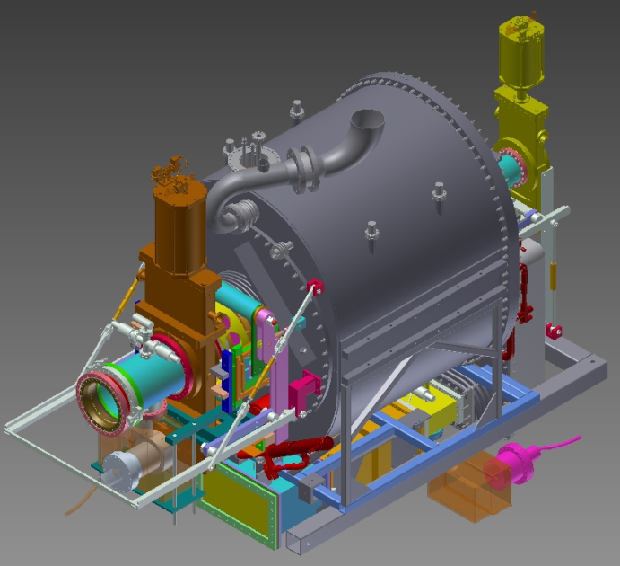
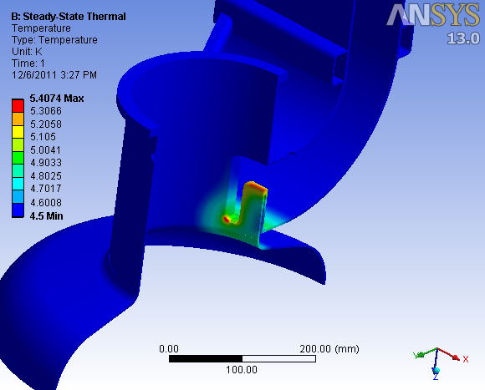
Storage Ring 500 MHz Cryomodules
Final Design Review to be held on 8 February 2012
Will review design, assembly and test plans, instrumentation and P&ID
Approval to proceed already given for
  Production of helium vessel
  LN2 shield
  Magnetic shield
  Insulating vacuum shell
  Gate valves and vacuum pumps
  and controllers
Coupler thermo-mechanical analysis complete- this was the last outstanding design task.
M. Yeddulla,
V. Ravindranath
Courtesy B. Gash

Slide 12
Storage Ring 500 MHz Cryomodules
AES contract awarded April 2011.
Scope includes cryomodules, cavity interconnect spool piece, beamline tapers, vacuum and instrumentation
  The niobium was to have been BNL supplied material and was ordered in February for delivery in May; the first material was received in August and failed incoming inspection and the order was canceled. The contract was amended to have AES provide the Nb and the order was placed in October. It was delivered in March and the 13mm and 35 mm material does not meet the tensile strength specifications causing some concern due to the large emphasis the DOE places on the design to meet the ASME pressure vessel codes
The first cryomodule is scheduled for delivery in February of 2013.
Tooling for pressing of half cells, beam tube flutes, and beam tubes is complete

Slide 13

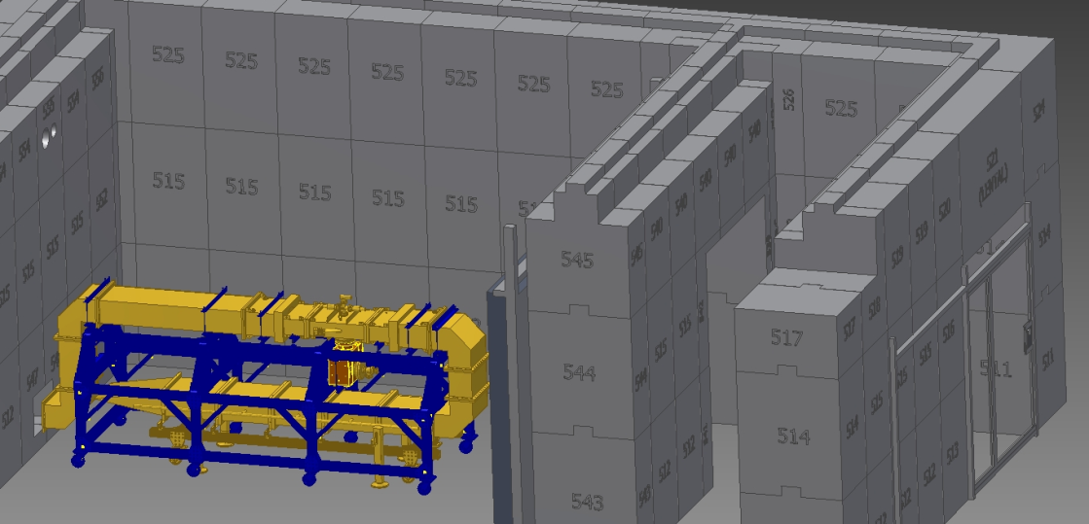
500 MHz Cryomodule: Progress
RF window test stand design complete
RF window tests with 300 kW klystron amplifier at BNL in the RF blockhouse

Slide 14
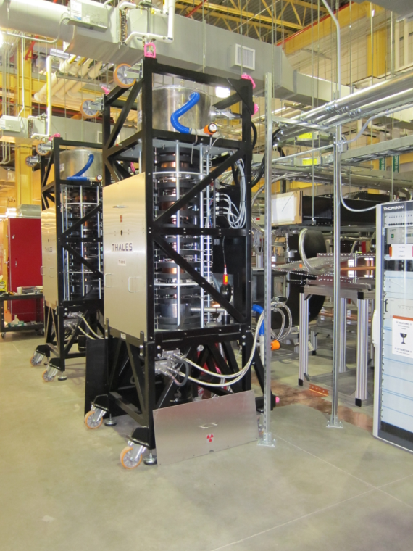
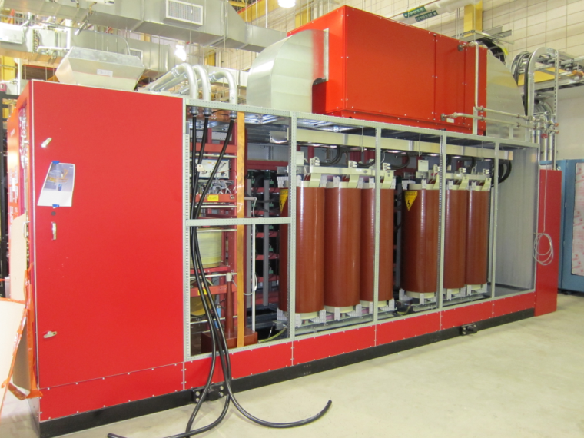
Storage Ring Transmitter
Turn key 540 kVA klystron solid state switching power supply with mod-anode, filament supplies, interlocks and controls
300 kW klystron amplifier
Installation of both transmitters is complete. Integrated testing is in progress. High power tests of klystron 1 to 280kW, system 2 limited by failing crowbar test

Slide 15
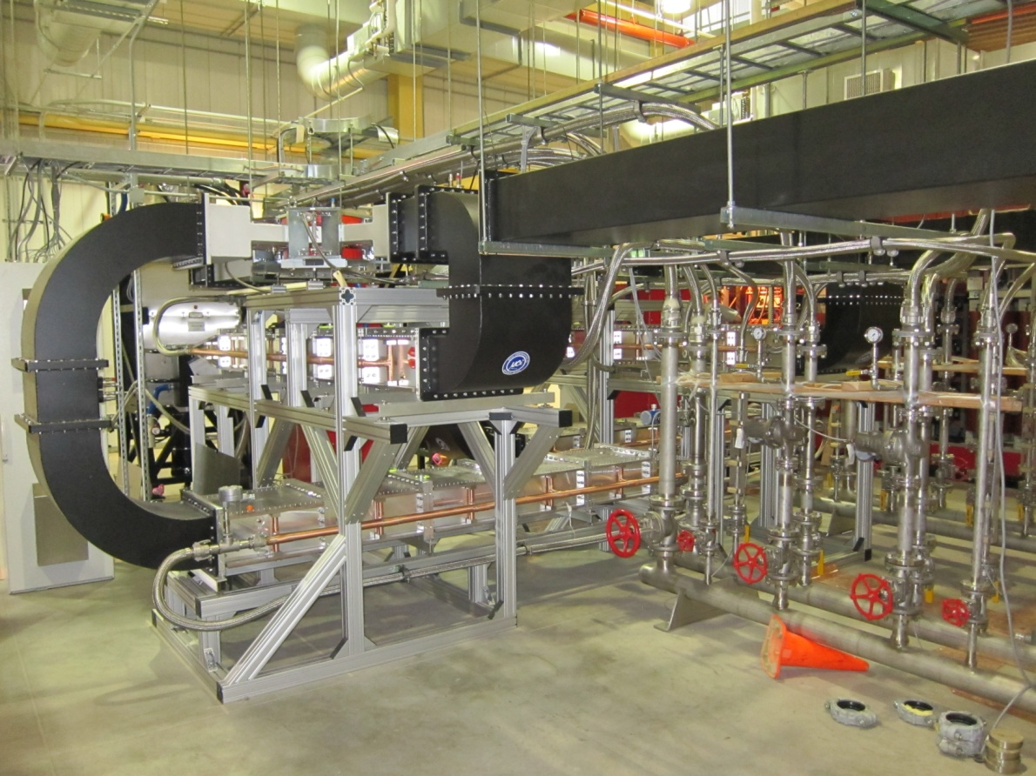
SR Transmitter: Transmission line network complete
Circulator
Test load
Circulator load
Water Manifold

Slide 16
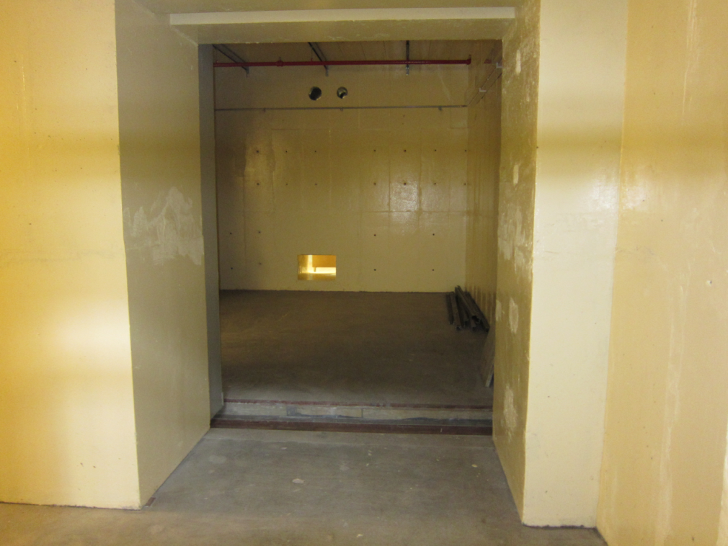
RF Blockhouse for cavity testing
500 MHz Waveguide run finished to the blockhouse
Waiting for PPS system and cable tray/AC power
Required for testing of the booster cavity in late March, dewar test of the harmonic cavity in April
Test of the harmonic cavity is necessary to confirm cryomodule performance before completing cryo interface, tuner and HOM loads

Slide 17
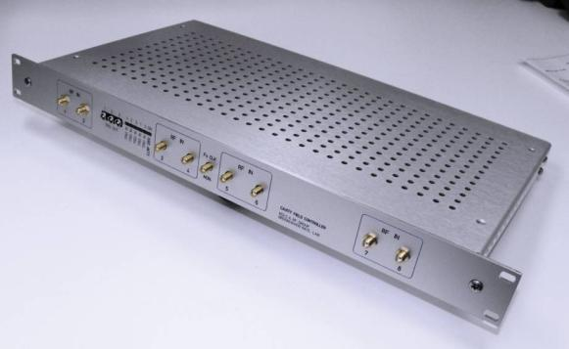
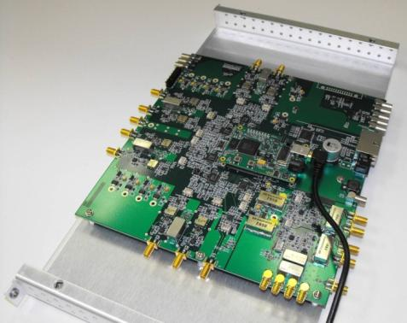
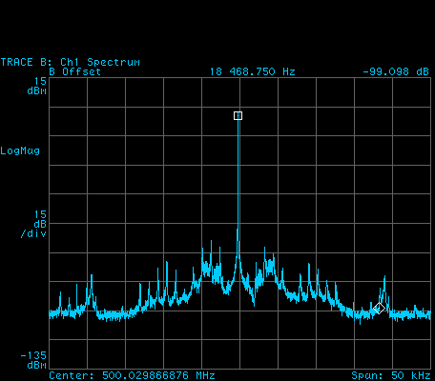
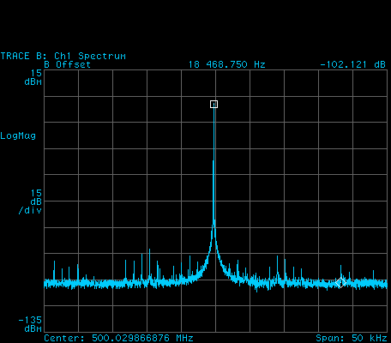
Cavity Controller: Last workshop reported on successful test at CLS…
Digital Field Controller
50 MHz IF
Tested at CLS on hardware nearly identical to NSLS-II: 300 kW klystron and CESR-B SRF cavity
Meets NSLS-II field spec. of 0.15 degree and 0.05%
H. Ma
CLS Analog
A=0.073%rms
φ=0.12° rms
NSLS-II
A=0.026%rms
φ=0.02°rms
CLS tests courtesy M. de Jong

Slide 18
Digital Controller Functionality
Down/up conversion from/to 500 MHz
I/Q-based IF signal processing over the 50 – 56 MHZ frequency range
Open-loop operation
  Amplitude and phase set points with readback
  Feed Forward Table with CW, Pulsed, Pulse on CW, Triangular and Ramp functions
Closed-loop operation
  Programmable amplitude and phase set points referenced to a separate rf reference signal
  Programmable proportional and integral gain with readbacks
  Loop Phase Rotation at turn on measures open loop phase Fwd vs. Cavity and sets to180
  Fast ramp down of the closed-loop set points that is triggered by a hardwired interlock fault input (RFinhiBit).
  External fiducial for synchronization with other rf systems and machine events
  RF limiter in IF output: real time limiter linear in amplitude and phase
  Circular buffer triggered by internal or external events captures fast RF and beam signals
  Eight channel 1024 sample data acquisition in logic “Scope Function”
  Ability to ramp the closed-loop set points using a programmed ramp table (booster)
  Future plans include 6-channel vector Network Analyzer functions (S21, S31, S41, S51…)

Slide 19
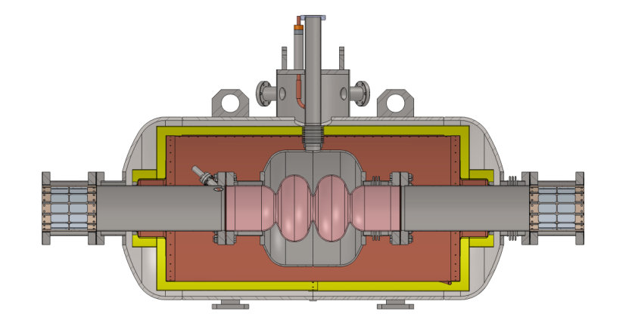
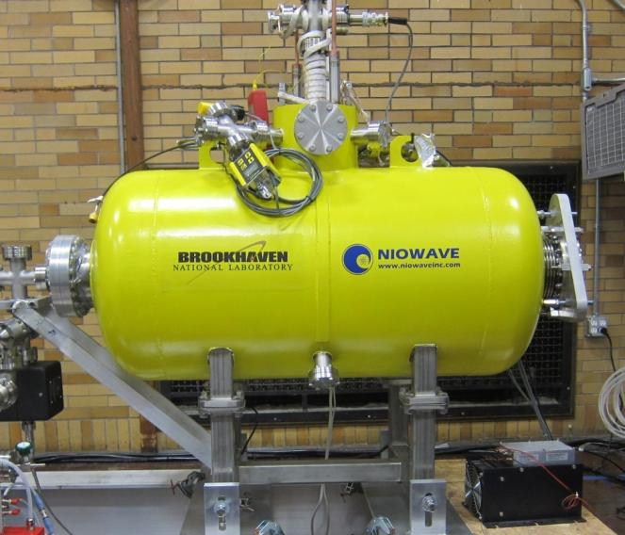
Landau Cavity: cryomodule complete last April
First horizontal cold test complete completely validates 0-π mode tuning over 1 MHz bandwidth. Low Q loaded (6e7 vs. 2e8) explained by trapped TE mode when tested without dampers.
Need to design and fabricate ferrite dampers, tuner mechanism

Slide 20
3rd Harmonic cavity
Work still to be done on 3rd HC:
Modification of cryogenic LHe, LN2 and cold GHe interconnects to mate with our standard cryo-interface, add instrumentation
Fabrication assembly and test of motorized tuner
Fabrication of HOM loads
Assembly in clean room
Prior to the start of the above final design tasks we plan to perform cold tests in house in our RF blockhouse with dewar supplied LHe, LN2 to confirm the theory of TE10 mode losses contributing to the lower than expected Q -external
In addition to reducing the program risk, the training and experience gained is essential for the NSLS-II RF group

Slide 21
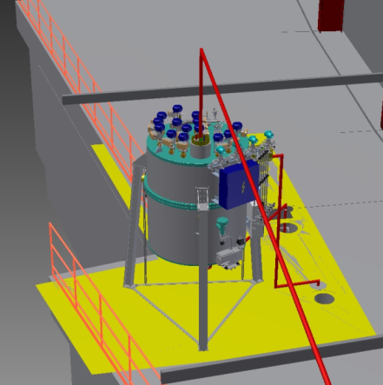
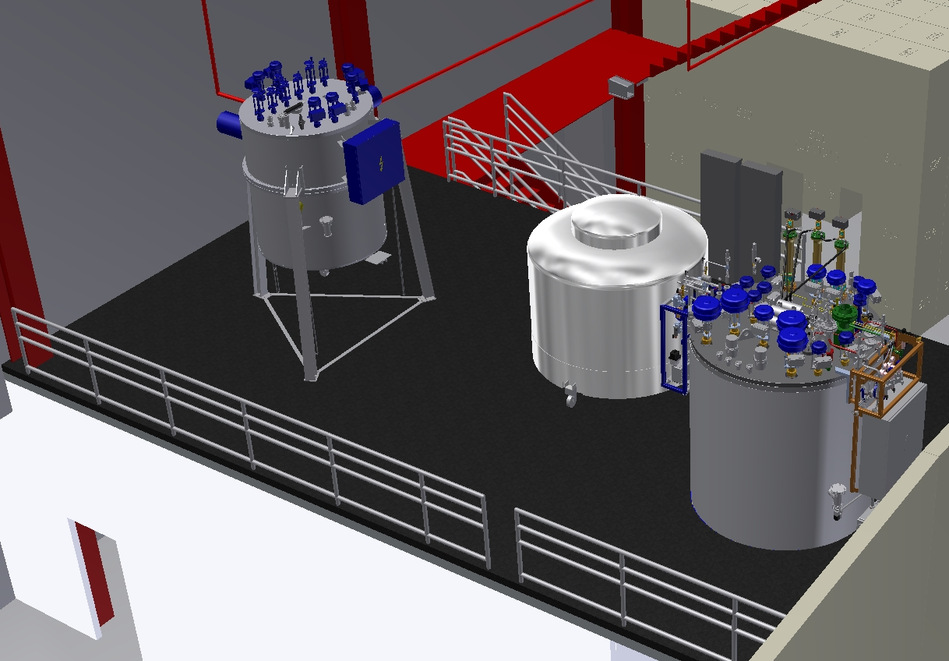
RF Cryogenic System: 850 W Helium refrigerator and LN2 Dedicated to RF
Valve Box
Manifold Valve Box
Dewar
Cold Box
Cold box test scheduled for the end of June. Kaeser main (2) and recovery compressor orders placed. Vacuum Jacketed transfer line design in progress.
RF group is resposnsible for Cryo in construction, and will be responsible for valve box control only in operation

Slide 22
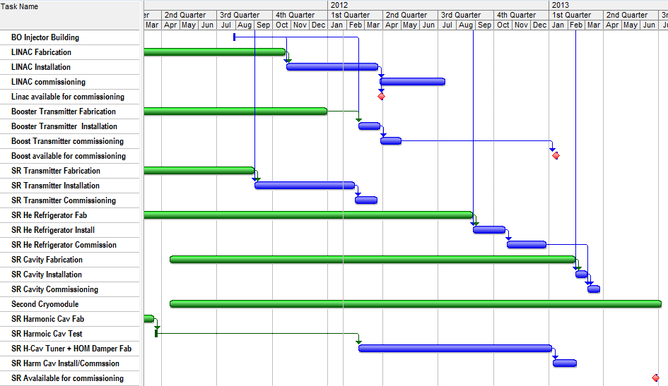
RF Global Schedule

Slide 23
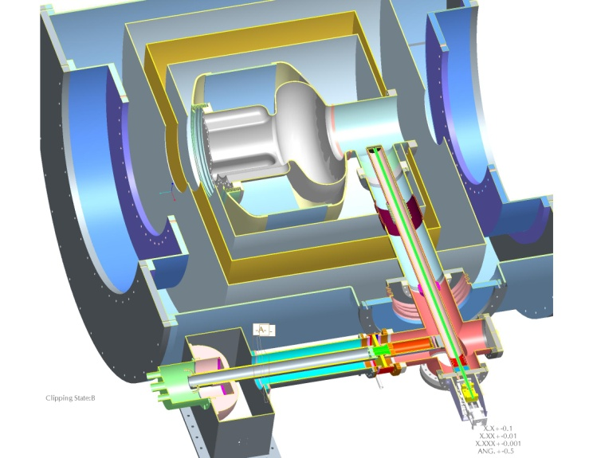
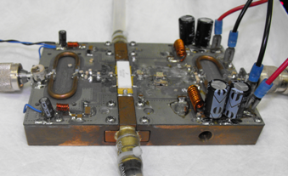
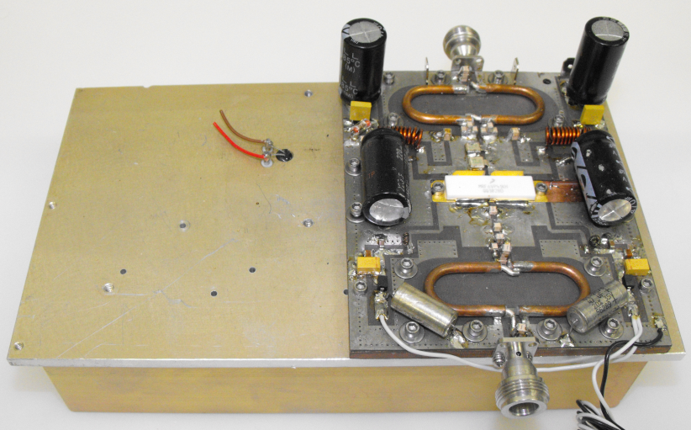
Upgrade Plans
NSLS-II is installing only half of the required RF power in the baseline project.
We have small scale programs to develop cryo-modules, couplers and RF power sources that can provide greater than 400 kW per station for the remaining two RF systems
Transistor evaluation boards courtesy of Freescale and NXP
Cryomodule and coupler concepts courtesy of AES

Slide 24
Summary
The NSLS-II construction has passed the halfway mark
The project has had to balance innovation against schedule and cost risk. In the end we have risks (from green to red) in the following systems:
  SS modulators for the linac klystrons
  IOT amplifier with SS switching HVPS powering 7-cell copper cavity in the booster
  Klystron amplifier with SS HVPS powering SRF cavities with modified coupler for storage ring
  Innovative two coupled cell passive SRF cavity for bunch length control
  All digital (50 MHz IF) cavity controller with high functionality
The project must decide in the next several years the approach to take for the second half of the NSLS-II installation
We appreciate the opportunity this workshop gives us to interact with the worlds experts to help us down this path

Slide 25
Acknowledgements
This work was performed by and under the guidance of
J. Cupolo, R. D’Alsace, P. Davila, D. Durfee, R. Fliller, B. Gash, F. Gao, A. Goel, B. Holub,Y. Kawashima, H. Ma, A. Marone, K. McDonald, P. Mortazavi, J. Oliva, S. Ozaki, J. Papu, K. Pedersen, E.Quimby, G.Ramirez, J. Rose, T. Shaftan, R. Sikora, C. Sorrentino, N.Towne and F.Willeke as well as the support of the entire NSLS-II team.
We would also like to thank the SCRF groups at Cornell, KEK, CLS, TPS and DLS for their continuing help and encouragement, in particular Hasan Padamsee, Sergie Belomestnykh, Valery Shemelin, Takaaki Furuya, Mark de Jong, Chaoen Wang and Morten Jensen
We would like to acknowledge the excellent work by our major vendors: Advanced Energy Systems, Linde, L3, Niowave, Research Instruments, Thales and Thomson

