Slide 1
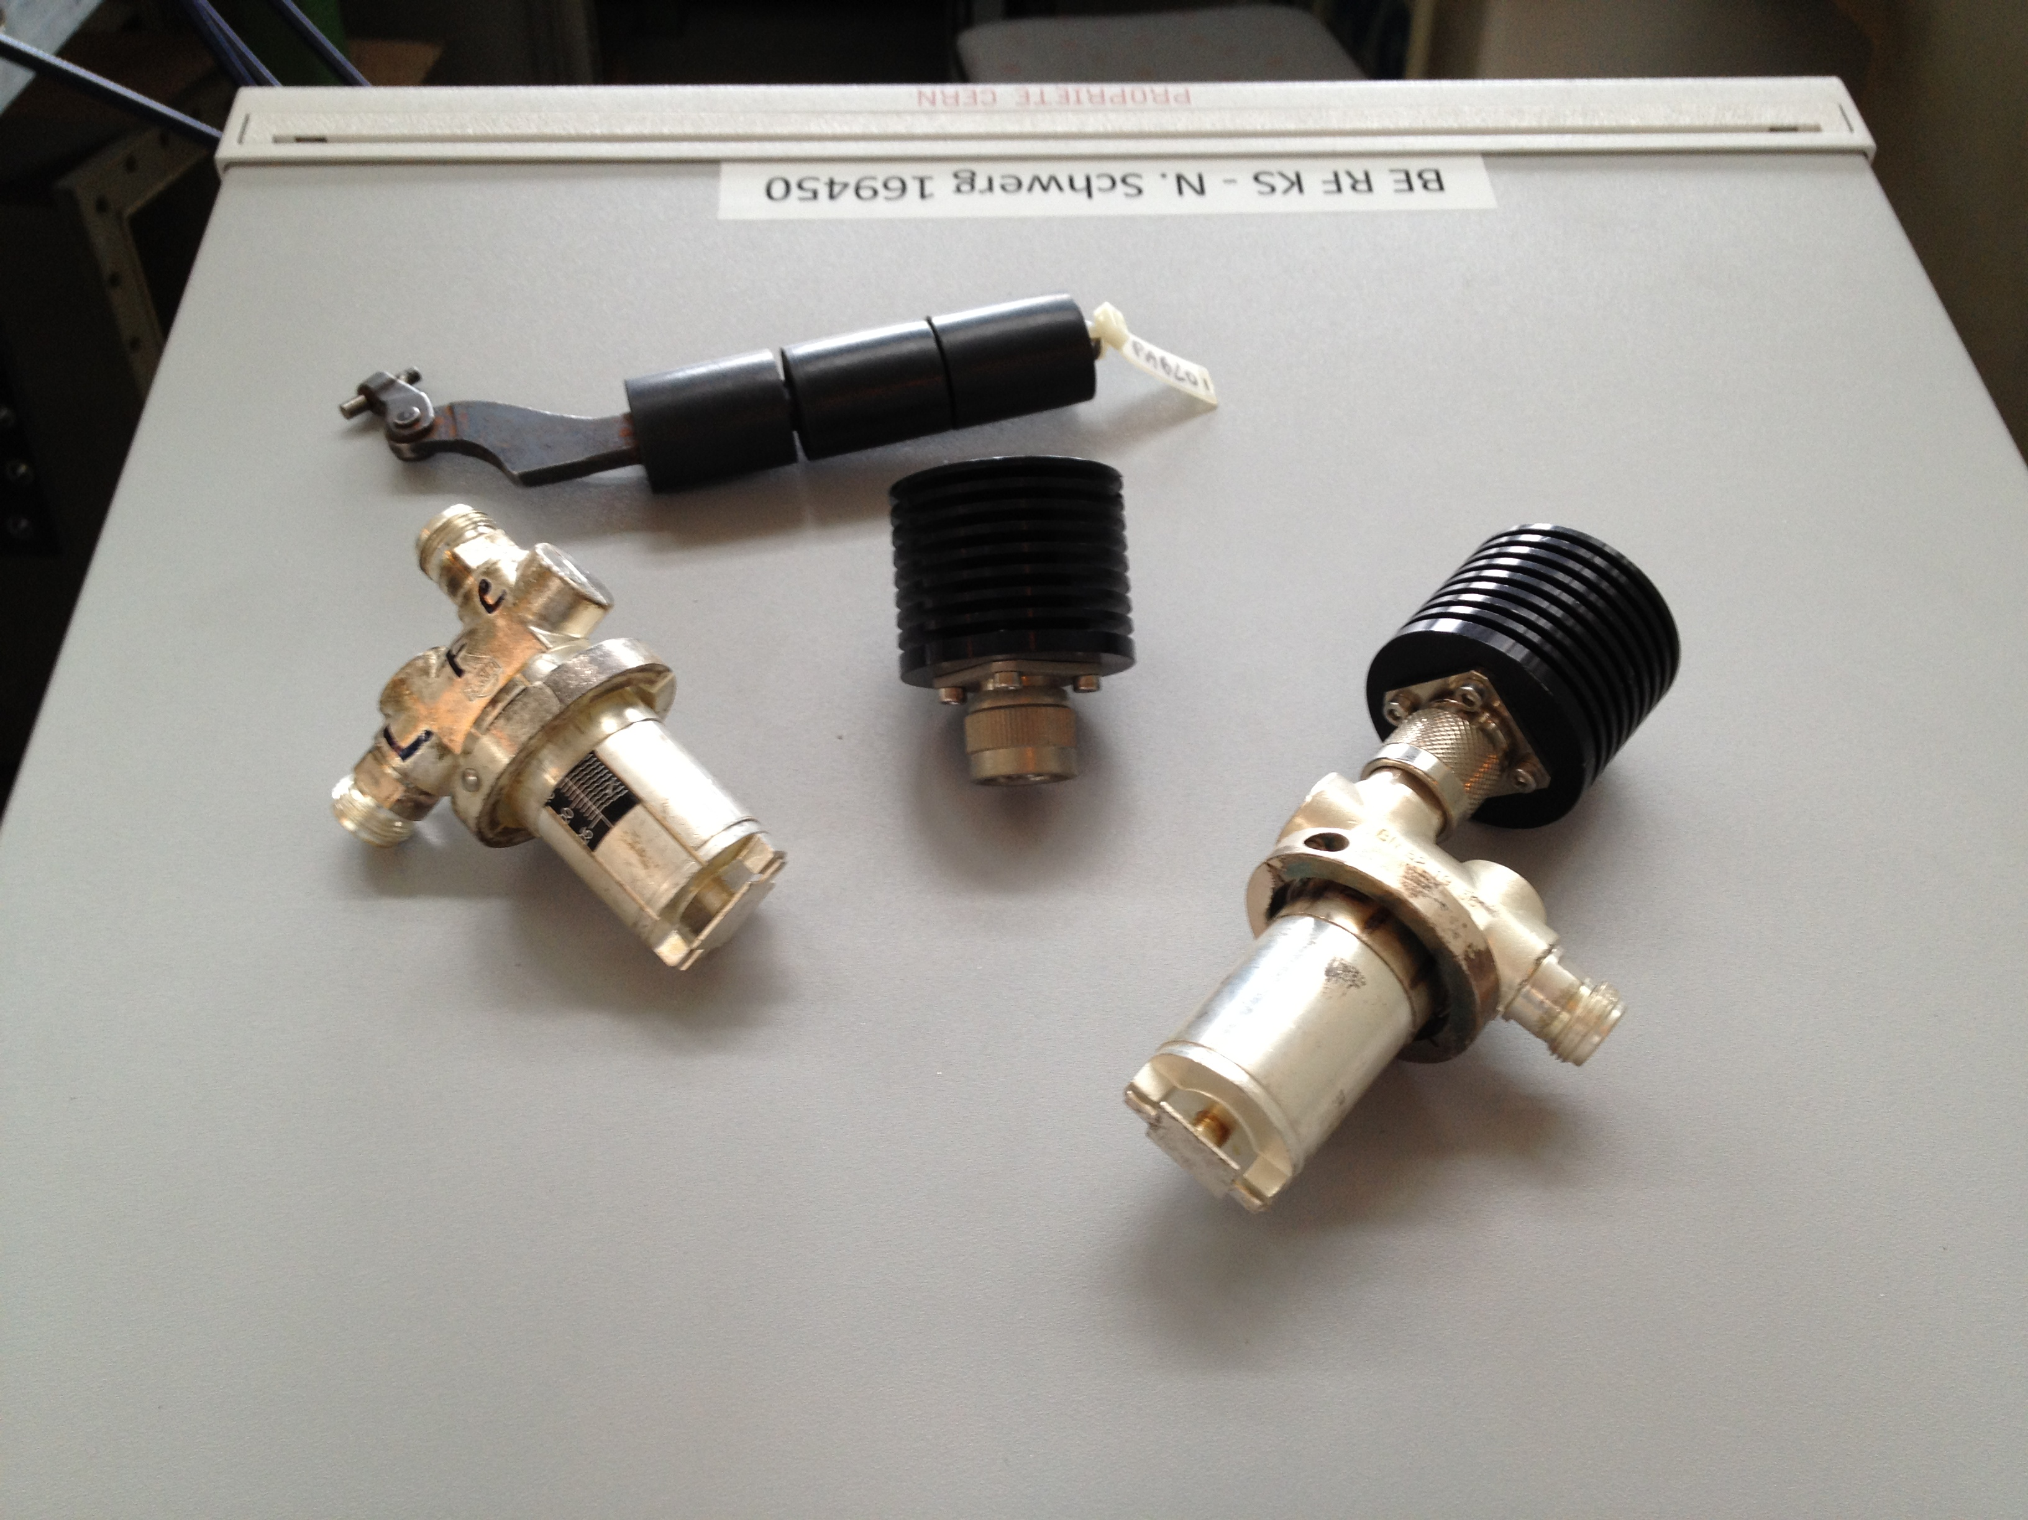
Seventh CW and High Average
Power RF Workshop 2012
Waveguide Directional Couplers
Standing Wave Issue
Nikolai Schwerg - CERN BE RF KCA

Slide 2
Waveguide TE₁₀-Mode
A
B
A
B
C
C
E-Field
H-Field

Slide 3
Directional Coupler
E-Field
H-Field

Slide 4
Electric Field Coupling
E-Field
Current

Slide 5
Electric Field Coupling
I/2
I/2
d
|E|
E-Field
Current

Slide 6
Magnetic Field Coupling
U/2
U/2
Voltage
H-Field

Slide 7
Coupling & Directivity
U₁ = I/2 Z_{L}
U₂ = I/2 Z_{L}
+ U/2
- U/2
= U
= 0
⬅ U(d, α) = Z_{L} I(d)
❷
❶
I/2
U/2
U/2
I/2

Slide 8
Coupling & Directivity
U₁ = I/2 Z_{L}
U₂ = I/2 Z_{L}
+ U/2
- U/2
= 0
= U
❷
⬅ U(d, α) =-Z_{L} I(d)
❶
I/2
U/2
U/2
I/2

Slide 9
Calibration Procedure
Coupling:
Directivity:
d
|E|
Coupling:
Directivity:
-59
-80
-60
-90
-61
-100
337
377 MHz
337
377 MHz

Slide 10
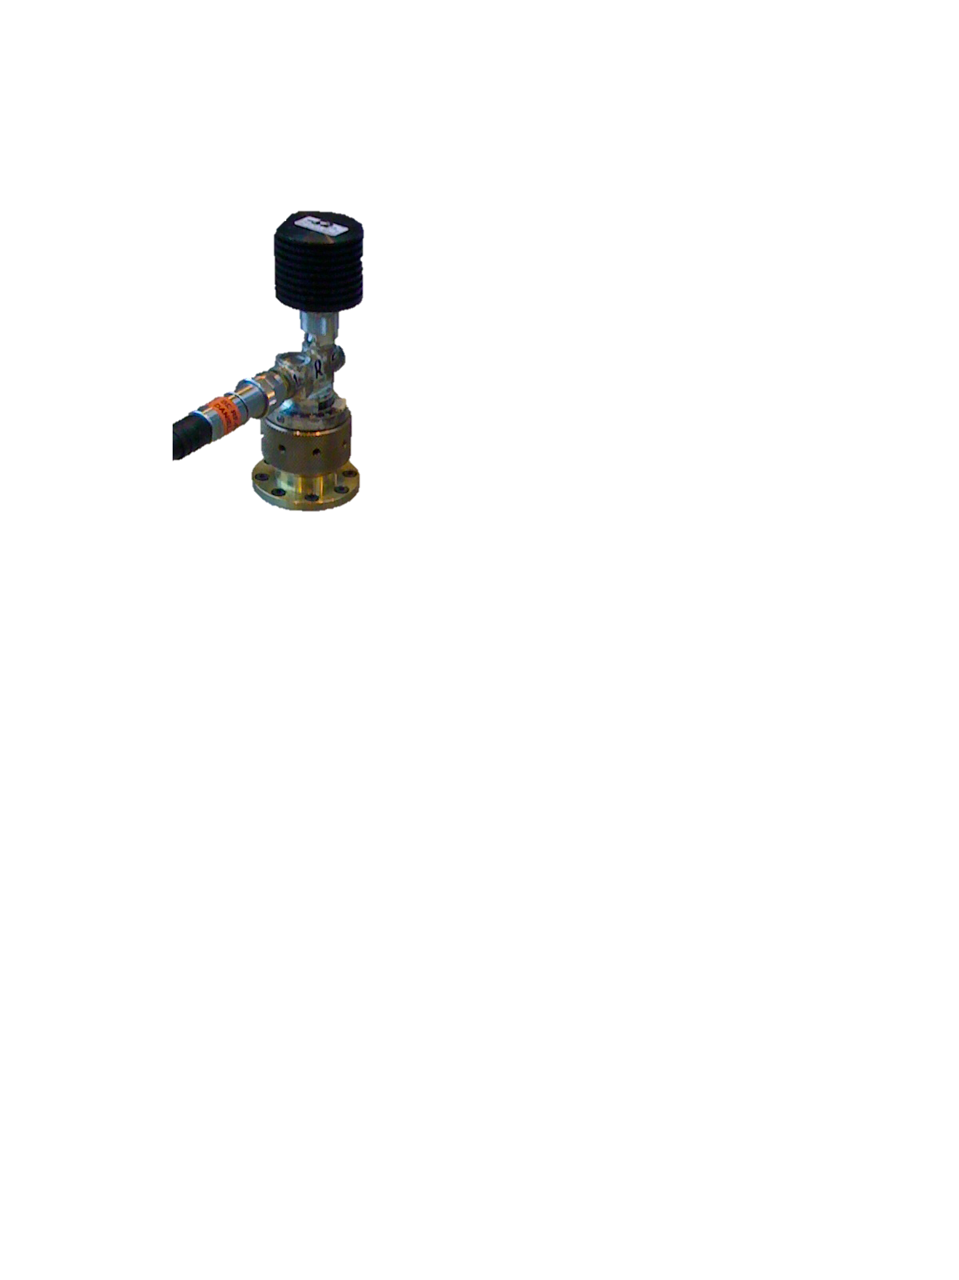
Calibration Procedure
90 dB Isolation close to VNA noise floor
Aim for directivity first
Maintaining good directivity when
  Re-connecting loads
  Re-attaching couplers
  Swapping couplers

Slide 11
Directivity Issue
15 dB Variation!

Slide 12
Isolation Signal
Reflection of transition
causes miscalibration!
S-Parameter
Coupling
Reflection
Voltages
Miscalibration
Standing
wave
Isolation
ideal

Slide 13
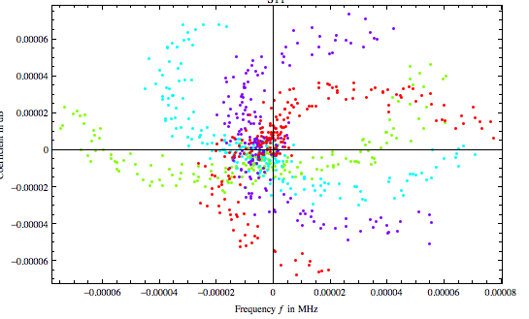
Extracting “Real” Isolation
Im
Re
Isolation
(in complex plane)

Slide 14
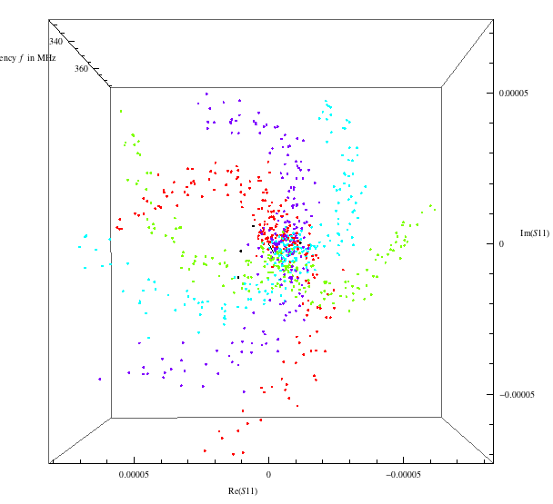
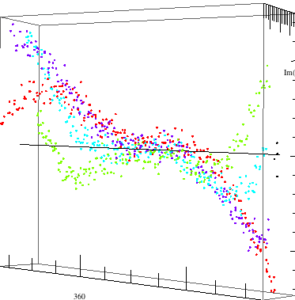
Extracting “Real” Isolation

Slide 15
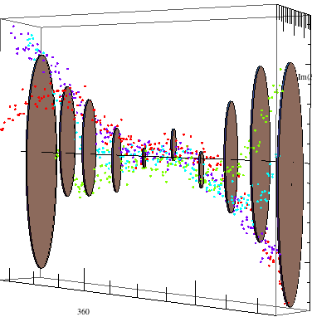
Extracting “Real” Directivity
Reconstruction
Measurement
Points

Slide 16
Extracting “Real” Isolation
Isolation and “variable” Fraction

Slide 17
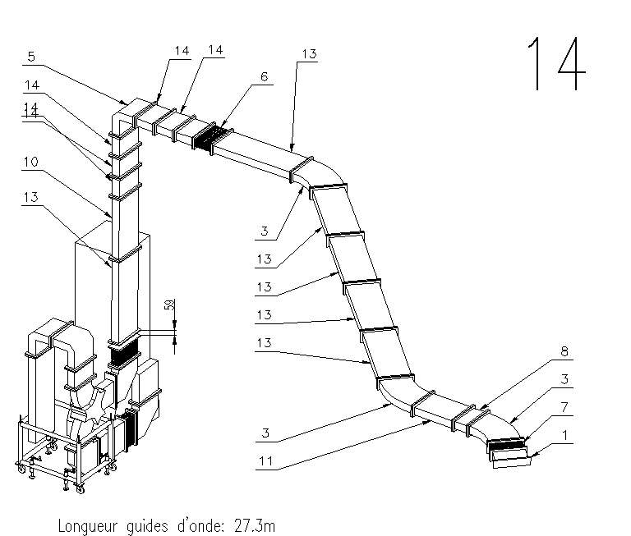
Application
Waveguide
Directional Coupler
FWD*
RFL
from Circulator
Cavity
FWD
RFL*

Slide 18
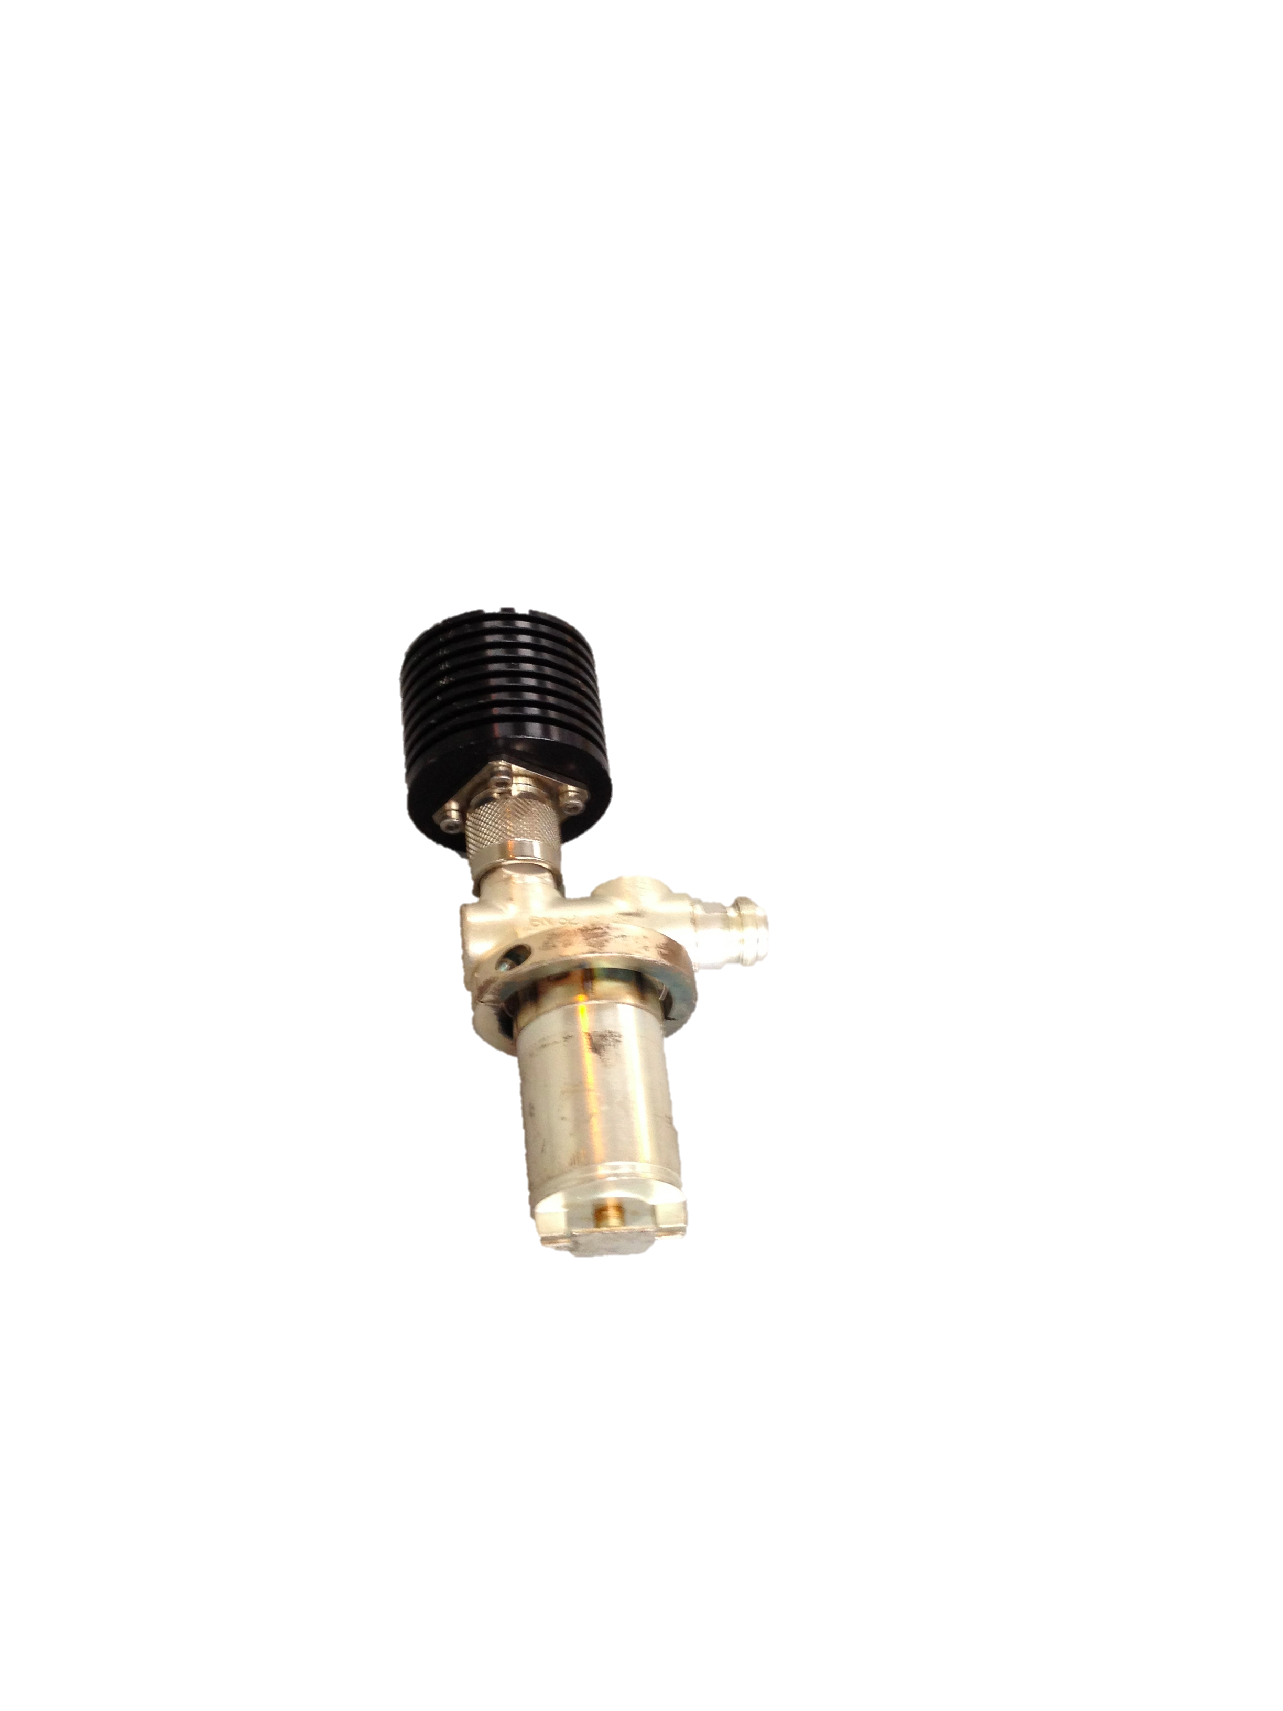
Summary
Loop couplers are more “resistant” than we thought
Inevitable standing waves strongly affect directivity
With increased effort standing waves can be compensated for

Slide 19
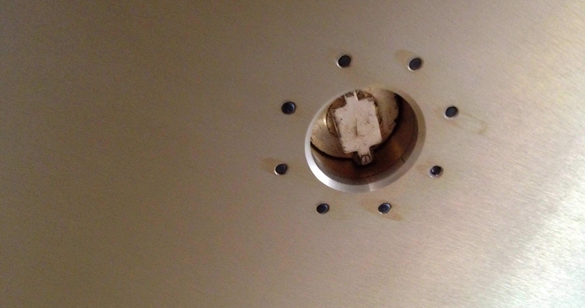
Thank you for your attention!

