Slide 1
Anticipated Performance

Slide 2
Basic assumptions
Beam parameters are given at injection in LHC: beam loss and blow-up inside the LHC are not accounted for.
All necessary improvements are implemented in the injectors (Linac4, PSB to PS transfer at 2 GeV, coupled bunch instabilities suppressed, e-cloud suppressed, hardware upgraded…)
Estimated beam degradation in the accelerator chain (based on observations in 2010):
  PS: 5 % beam loss, 5 % transverse blow-up
  SPS: 10 % beam loss, 5 % transverse blow-up.
RF gymnastics being kept, imperfections are unchanged:
  +-10 % fluctuation of all bunch parameters within a given PS bunch train.
  Traces of ghost/satellite bunches.

Slide 3
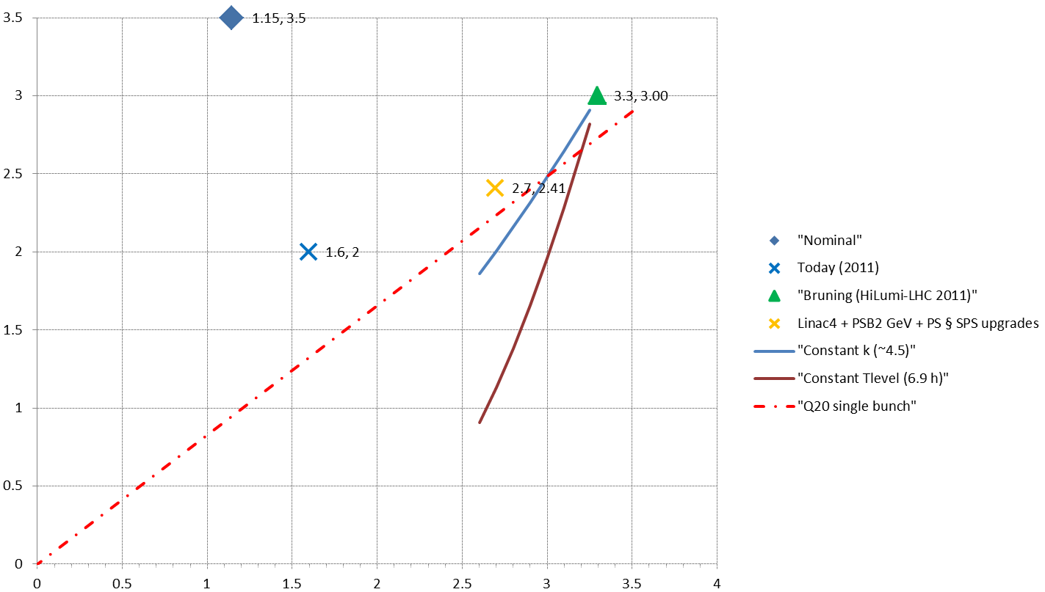
Beam parameters at LHC injection [50 ns]
HL-LHC requirement at 7 TeV
Nominal performance
Anticipated performanceafter LIU
Today (2011)
H/V transverse emittances [mm.mrad]
Constant transverse density
(Space charge)
SPS single bunch limit
Bunch intensity within constant longitudinal emittance [x10¹¹ p/b]

Slide 4
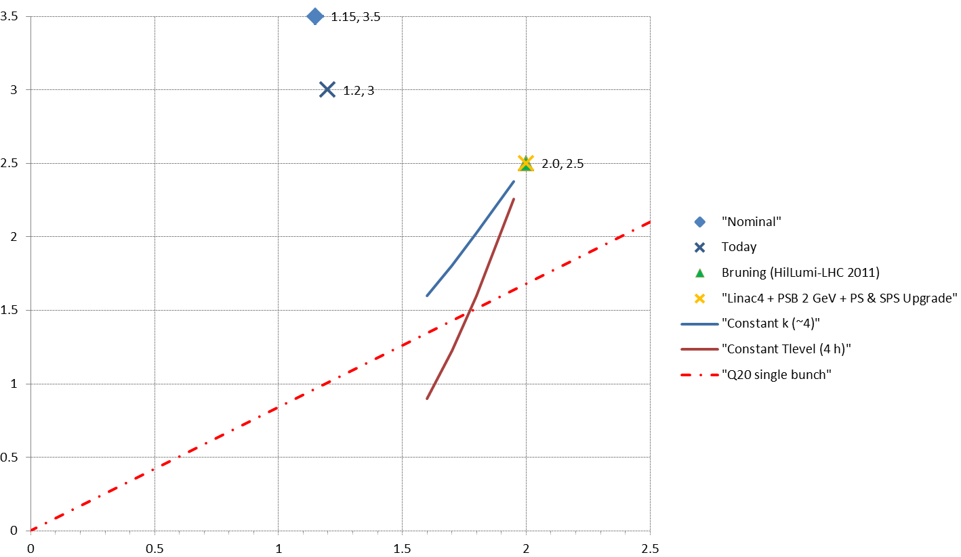
Beam parameters at LHC injection [25 ns]
Anticipated performanceafter LIU
Nominal performance
HL-LHC requirement at 7 TeV
Today (2011)
H/V transverse emittances [mm.mrad]
Constant transverse density
(Space charge)
SPS single bunch limit
Bunch intensity within constant longitudinal emittance [x10¹¹ p/b]

