Slide 1
Data Access - NFS
Ricardo Rocha
( on behalf of the DPM team )

Slide 2
Why pNFS?
Industry standard (IBM, NetApp, EMC, …)
No vendor lock-in
Free clients (with free caching)
Strong security (GSSAPI)
Parallel data access
Easier maintenance
…
But you know all this by now…

Slide 3
Overview
OPEN
1
LAYOUTGET
2
GETDEVICEINFO
METADATA SERVER
3
CLOSE
7
CLIENT
OPEN
4
READ/WRITE
DATA SERVER
5
CLOSE
6

Slide 4
Client Availability
pNFS support in linux kernel from >= 2.6.38
  Your Fedora / Debian has it… seriously
nfs-utils >= 1.2.3
But the ones we currently support do not
  RHEL5: 2.6.18
  Debian 6/Squeeze: 2.6.32
RHEL 6.2 will have a pNFS aware kernel
We provide packages for RHEL5 / RHEL6
  Enabled pNFS in the elrepo mainline kernel
  nfs-utils and AFS module we package ourselves

Slide 5
Implementation Status
Fully functional
Deployed at a few sites as a beta
  ASGC, UK GridPP, …
New beta release every month
  Announced at the DPM users forum
This will evolve into a production state soon
  Read only, write after

Slide 6
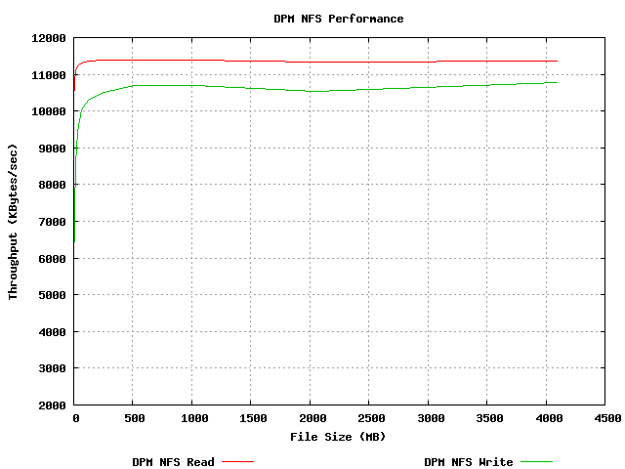
Performance: IOZONE
Server
Xeon 4 Cores 2.27GHz
12 GB RAM
1 Gbit/s links
Client
Dual core
2 GB RAM
100 Mbit/s link

Slide 7
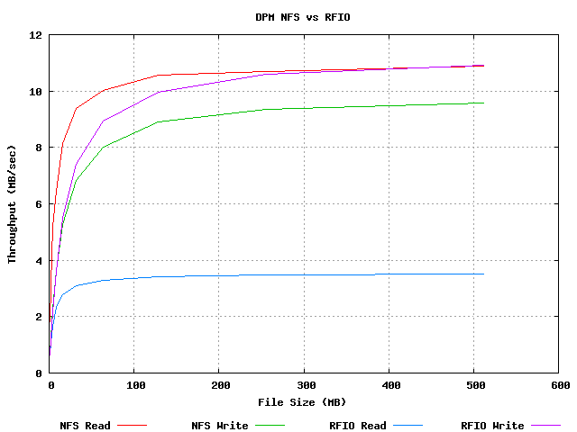
Performance: NFS vs RFIO
Server
Xeon 4 Cores 2.27GHz
12 GB RAM
1 Gbit/s links
Client
Dual core
2 GB RAM
100 Mbit/s link

Slide 8
Ongoing work
Our implementation is based on Ganesha
  A userspace NFS daemon
  http://sourceforge.net/apps/trac/nfs-ganesha/
Recently it has gained a lot of momentum
  Contributions from IBM (several developers), Panasas (idem), LinuxBox
But it also means significant refactoring is ongoing
  Especially in the pNFS API, where we had put most effort

Slide 9
Why don’t I have it already?
NFS 4.1 / pNFS is a complex specification
  And we only use a subset of the functionality
Client is evolving at the same time
Our implementation relied on our own implementation of pNFS in Ganesha
  But in the meantime IBM has thrown their army of developers on it…
  A new internal API, to each we’re adapting

Slide 10
And will that be it?
X509 support is still not clear
  Work ongoing at a GSSAPI plugin
  Much like it was done for OpenSSH (GSISSH)
Looks possible… but it’s not there yet

Slide 11
Conclusion
NFS 4.1 / pNFS gives us what we need
  Both in functionality and performance
But it has some drawbacks
  Complexity (some of which we do not need)
  Ongoing development (both client and servers)
  It makes me jealows of HTTP
Still… it’s our best shot at a standard based remote POSIX access
  And we are very close to production

