Slide 1
Testing Infrastructure
Wahid Bhimji
Sam Skipsey
Intro: what to test
Existing testing frameworks
A proposal

Slide 2
Introduction: What to test?
DPM core release as well as any new features.
Should be :
Automatic
Use production environments
Use real workloads
Allow for stress testing

Slide 3
Features to test
WebDav
  As local access protocol
  For WAN transfers
NFS v4.1
Xrootd – including redirection
Everything else in Beta
  E.g. DPM Nagios and testsuites themselves
The “basics” – i.e. what currently works /used

Slide 4
Some already available tools / tests/ frameworks
Hammercloud
  Used now for both stress testing site and blacklisting
  Range of realistic user workflows + stats such as cpu eff and ev rate
  Generally requires experiment software
ATLAS HC IO tests : (more info later)
  Uses HC framework to submit arbitrary tests and collect more stats
HCInABox :
  My own tar ball of similar tests – not supported in any way
Perfsuite / nagios tests
  Contains low level test of all required operations
  Also has a version of a root read test put in by Martin

Slide 5
Structure
ATLAS HC IO Tests
Currently
A standard Atlas dataset (DPD/AOD/ESD) “preloaded” to sites
Use both ROOT from ATLAS release and HEAD
Hammercloud
New dataset
SVN
Test code script
Set release
Datasets,…
Regularly
submitting
single tests
ROOT source (via curl)
Sites
Oracle Db
Uploads stats
Data mining tools
Command line, Web interface, Root scripts

Slide 6
Atlas HC IO Tests
ROOT based reading of DPD (or AOD):
  Somewhat like an ATLAS DPD analysis
  Provides metrics from ROOT (no. of reads/ speed)
  Happy to add detailed DPM metrics (e.g. parsing text file that comes from client when RFIO_TRACE set)
Download latest ROOT version and use
  Write a new file and then read it back
Athena (Atlas framework) D3PD making
“Realistic analysis” test
  Example physics code from a “workbook”

Slide 7
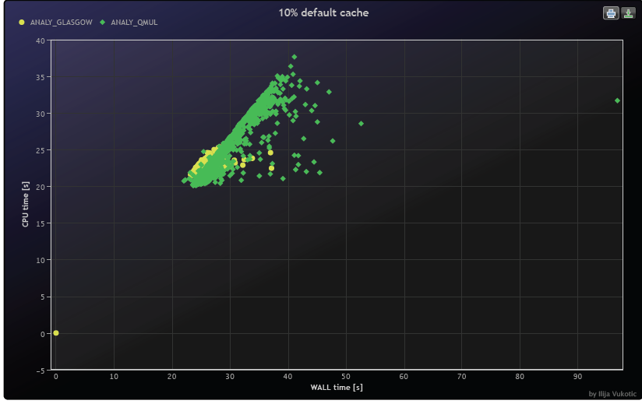
A few plots
http://ivukotic.web.cern.ch/ivukotic/HC/index.asp

Slide 8
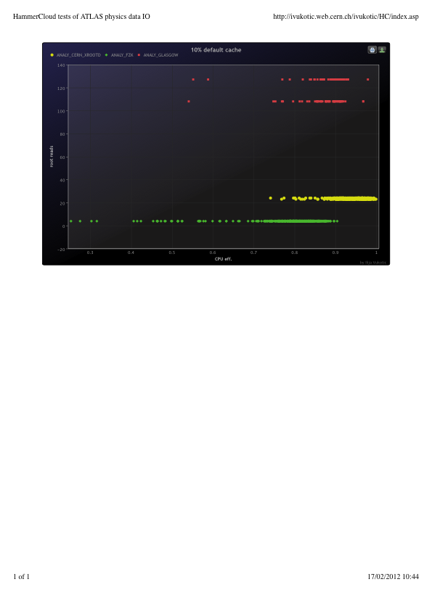
“ROOT reads”

Slide 9
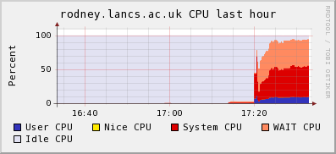
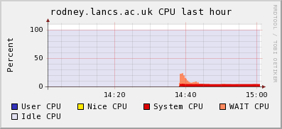
HCInABox example
Same test as (1)
Here run locally on a test disk server (from Dell).
Can artificially create load seen in production
  E.g. submit to batch 100 simultaneous jobs direct rfio reads against 1 filesystem
128k Rfio buffersize
512k Rfio buffersize
  Test also in DPM Perfsuite

Slide 10
Just to mention: different purposes
A lot of the above created for different purposes to that needed here. E.g. for
Site tuning
Experiment applications and data models
Vendor supplied storage
Middleware, protocol comparisons
  But still can be useful….

Slide 11
A proposal: Volunteer sites
Install a test DPM headnode and disk server:
  Auto-update from a test repo
Runs DPM nagios / perfsuite tests
Regular job running using the HC IO system:
  Test runs on production cluster /read from test dpm
  Easy (ish) for atlas sites/ not sure about others
  Some config. work: test “site” in atlas or hacks in job script
Can be augmented by special stress tests submitted locally or via hammercloud

Slide 12
DPM Knowledge Base
Wahid Bhimji

Slide 13
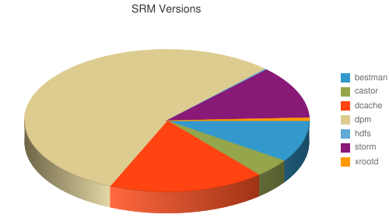
A large community to tap into….
SRM endpoints from BDII
SRC:
http://www2.ph.ed.ac.uk/~wbhimji/SRMMonitoring/
SRM type | number
Bestman | 43
Castor | 19
dCache | 80
DPM | 250
hdfs | 1
xrootd | 3
StoRM | 54

Slide 14
Various existing lists; wikis; blogs
DPM Trac
dpm-users-forum
Dpm-contrib: currently only contains toolkit (see talk by Sam earlier)
GridPP:
  Storage list; blog; wiki and weekly meeting
  Individual site blogs: e.g. Scotgrid and Northgrid
Recently DPM webinars

Slide 15

Some proposals…
Aggregating blog articles ; observations ; wikis:
  I’m not the best person to do this (!)
Host code snippets, poorly tested tools etc.
Contributions from community into core DPM
  Developers visiting CERN or working at “home”
More of these workshops (!) at other locations (?)

