Slide 1
Managing DPM with Puppet
Ricardo Rocha
( on behalf of the DPM team )

Slide 2
Puppet in DPM
Why?
  Looked for a strong configuration management solution
    For our internal testbed(s), but reusable at DPM sites
  Strong momentum, community and commercial support
    twitter, sun / oracle, rackspace, …
  (very) Extensive documentation
How?
  Set of specific modules + generic ones
  Available via puppet forge or github
  An alternative… not a replacement for YAIM
  Current support level is « best effort »
https://svnweb.cern.ch/trac/lcgdm/wiki/Dpm/Admin/Puppet

Slide 3
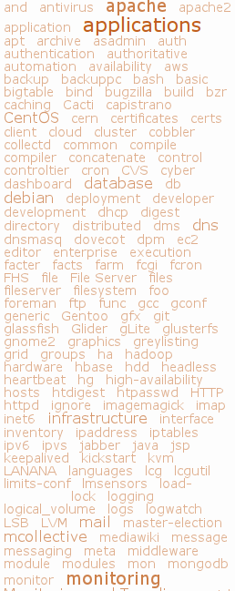
Reusable Modules
All DPM required areas are covered
As generic and reusable as possible
  Go ahead and try them for your service
  https://forge.puppetlabs.com/users/rocha
CERN
DPM
LCGUTIL
VOMS
DMS
GLITE
MYSQL
…

Slide 4
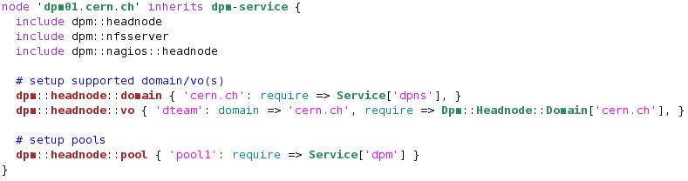
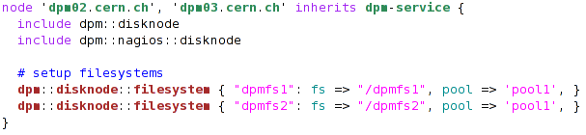

Cluster Configuration
HEAD NODE
DISK NODES
CLIENT NODES

Slide 5
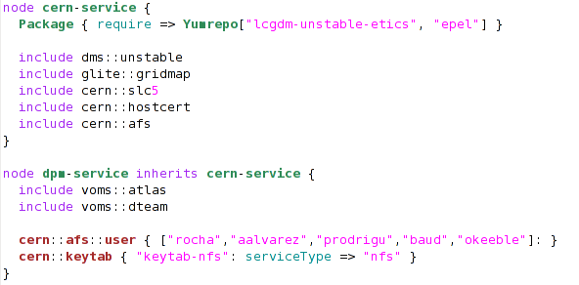
Cluster Configuration
HEAD NODE
GENERIC NODE
DISK NODES
CLIENT NODES

Slide 6
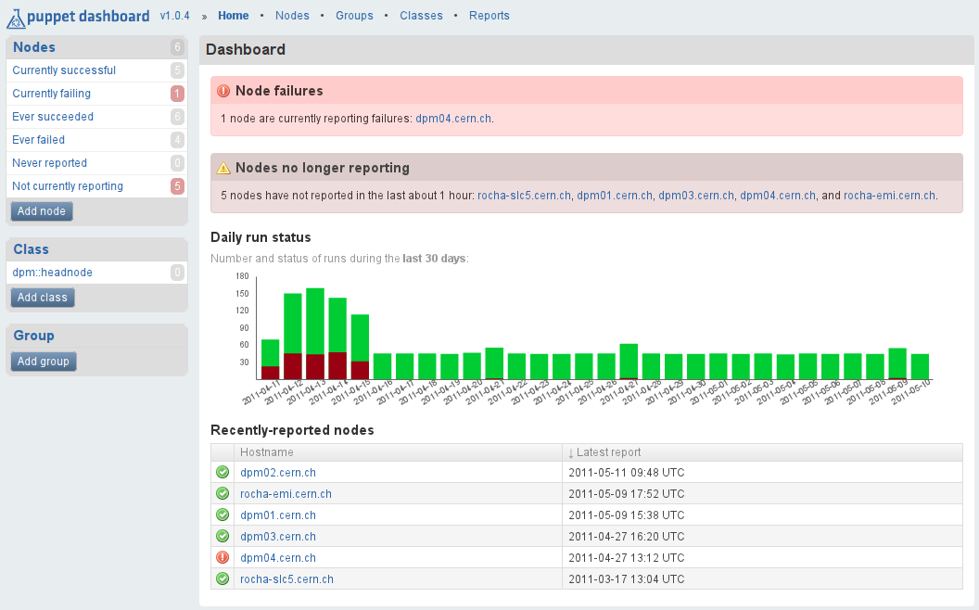
Puppet Dashboard

Slide 7
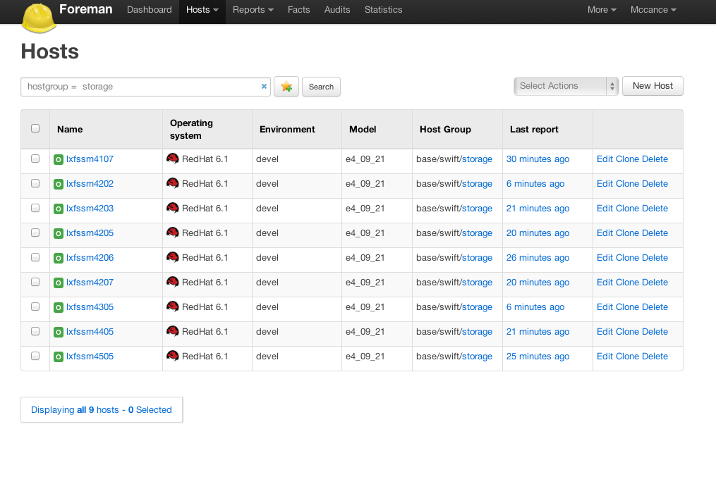
Better: Foreman
We don’t use it yet
  But CERN ‘Agile’ does

Slide 8
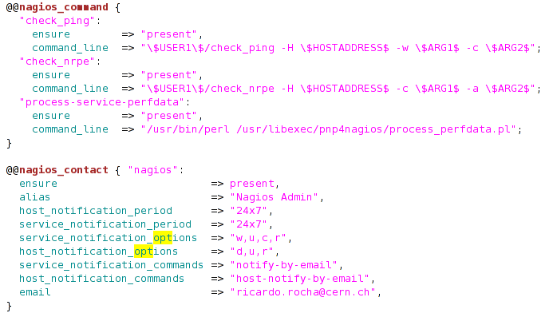
Puppet & Nagios Integration
The « cherry on top »
Puppet has built-in resource types for nagios

Slide 9
Conclusion
Puppet is widely used for configuration management
  Including WLCG sites (PIC, CERN coming, …)
Puppet in DPM stays as an option, not the default
  We will not impose a configuration system of course
Community interest?
  If more sites are interested, we can start one
Benefits are already out there
  We gave CERN ‘Agile’ a set of modules (voms, gridmap, …)
  We got others back…

Slide 10
Links
https://svnweb.cern.ch/trac/lcgdm/wiki/Dpm/Admin/Puppet
http://puppetlabs.com/
CERN Agile Infrastructure: Configuration Management

