Slide 1
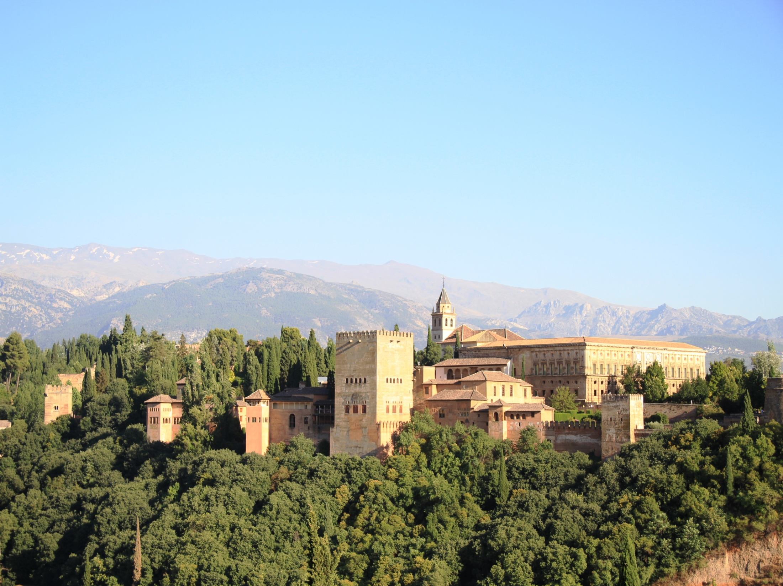
Introduction to Accelerator Physics
Granada
October 28 to November 9 2012

Slide 2
Generalities
Welcome!
All lectures in Aula Magna
Coffee, tea and poster session outside Aula Magna
Lunch back at the hotel
Secretariat about 50m away from Aula Magna
Computers available in Biblioteca for web, email
Study rooms available (Sala de Estudio 1 and 2)
Handouts provided each morning outside Aula Magna
Please, please, please give us feedback on the lectures
WiFi in the university
  Network: cviugr
  username: iap@invitados.ugr.es
  password: CERN++UGR

Slide 3
WiFi in the university
Network: cviugr
username: iap@invitados.ugr.es
password: CERN++UGR

Slide 4
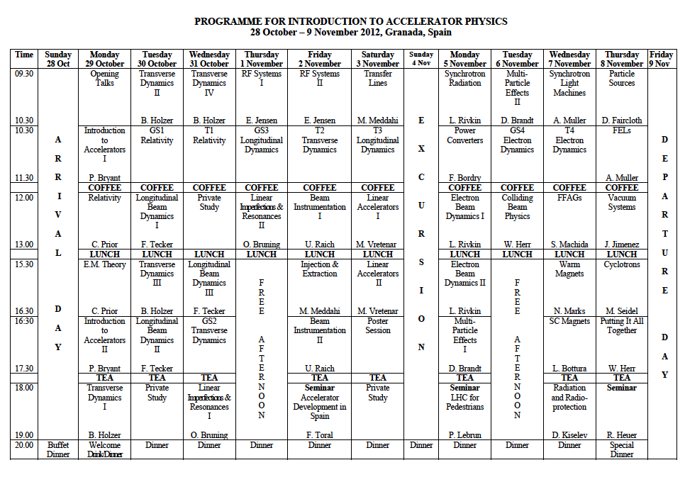

Slide 6
Tutorials
Exercises set by the 4 lecturers mentioned
  Guided Study session for each, in Aula Magna
  Tutorial for each in 4 roughly equal groups
      TG1 Aula Seminario (second floor) Surnames A to F
      TG2 Aula 24 (second floor) Surnames G to K
      TG3 Aula 25 (second floor) Surnames L to P
      TG4 Aula Magna Surnames Q to Z
Tutorial | TG4 | TG3 | TG2 | TG1
T1 Relativity | Aula Magna C. Prior | Aula 25 P. Bryant | Aula 24 W. Herr | Aula Seminario B. Holzer
T2 Trans. Dynamics | Aula Magna B. Holzer | Aula 25 W. Herr | Aula 24 O. Bruning | Aula Seminario P. Bryant
T3 Long. Dynamics | Aula Magna F. Tecker | Aula Magna F. Tecker | Aula 24 E. Jensen | Aula Seminario W. Herr
T4 Elect. Dynamics | Aula Magna M. Siedel | Aula 25 W. Herr | Aula 24 A. Wolski | Aula Seminario D. Brandt

Slide 8
Excursion
Sunday November 4, all day
  Departs 09.00 sharp (bus from 08.30)
  Visit the Nerja caves from 11.00
  Lunch on the coast from 13.30
  Return journey departs 17.30
  Dinner at the hotel as usual
We have reserved for everyone !
  We need to know if you will come or not
  Please tell Barbara YES or NO by Tuesday evening

Slide 9
Free afternoons
They are exactly that
If you want to go to the Alhambra, pre-book
If you decide not to take dinner at the hotel (after a free afternoon or otherwise) please let Barbara know the day before so that we can inform the hotel

Slide 10
Photo at 13.00
Place?
Seminar by the CERN DG
Start at 19.00
Parque de las Ciencias (30 minute walk)
Dinner at Panoramic 360 (near to above)
Short presentation on oPAC
Oliver Bruning

Slide 11
Seminar by CERN DG and special dinner
Seminar at 19.00 to allow 30mins to walk there
  Parque de les Ciencias
  http://www.parqueciencias.com/parqueciencias/
Special dinner nearby afterwards
  Restaurante 360
  http://www.panoramic360.es/
Maps ?

