Slide 1
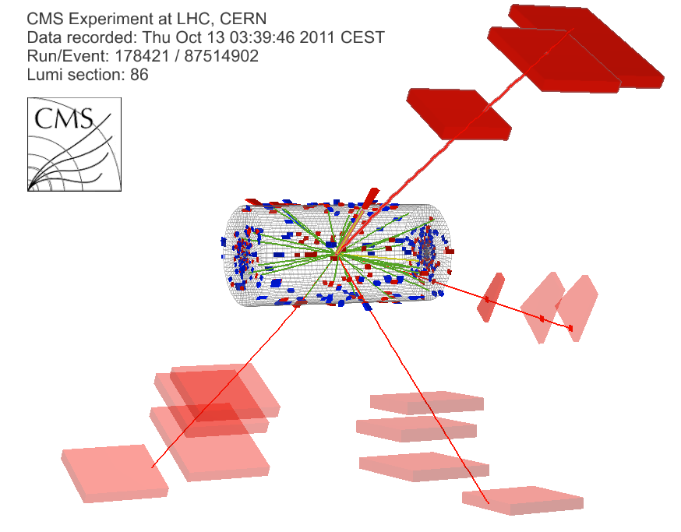
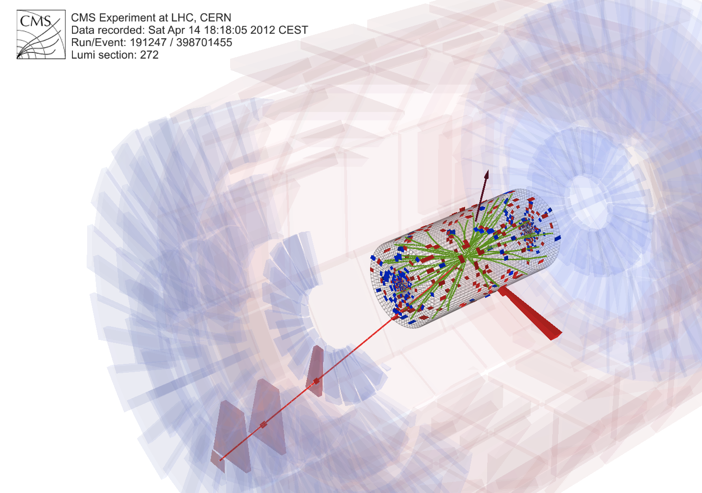
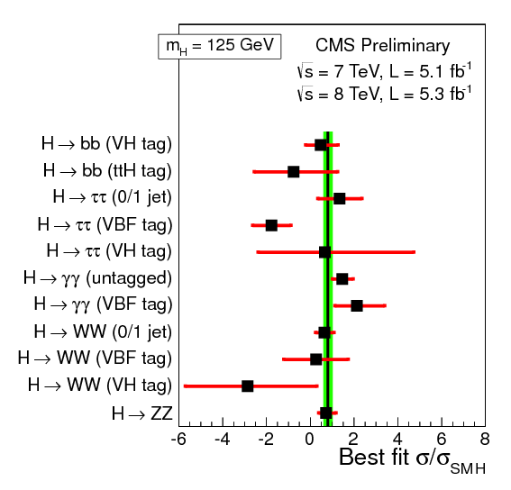
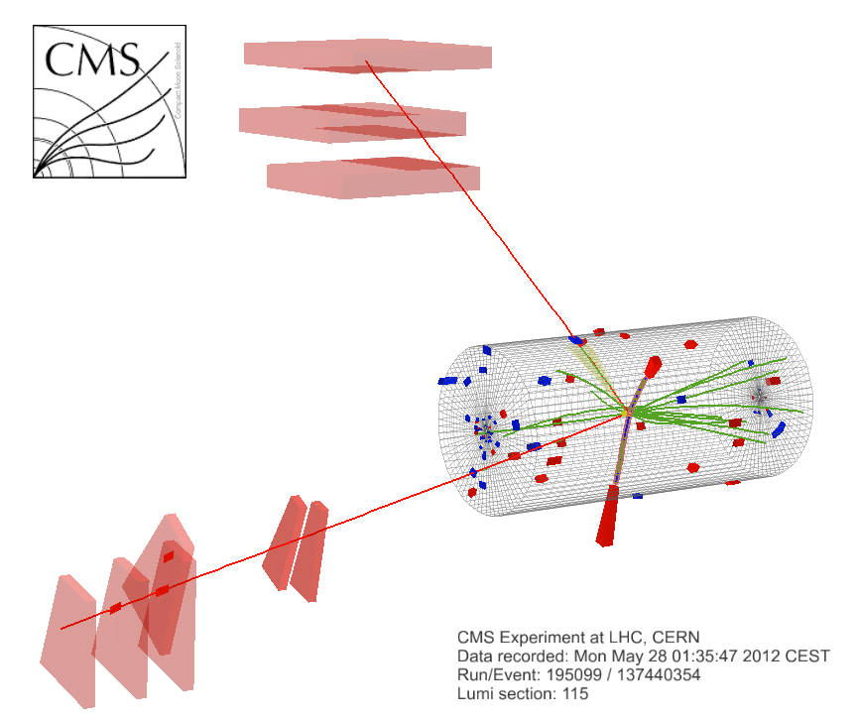
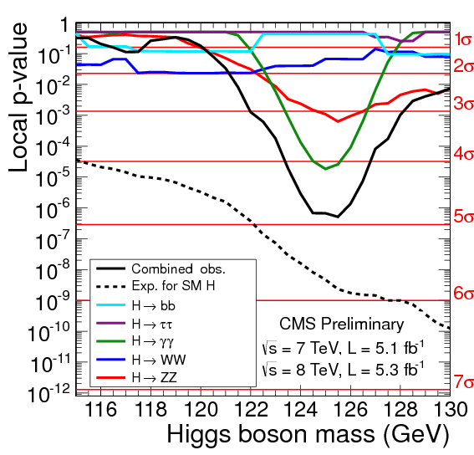
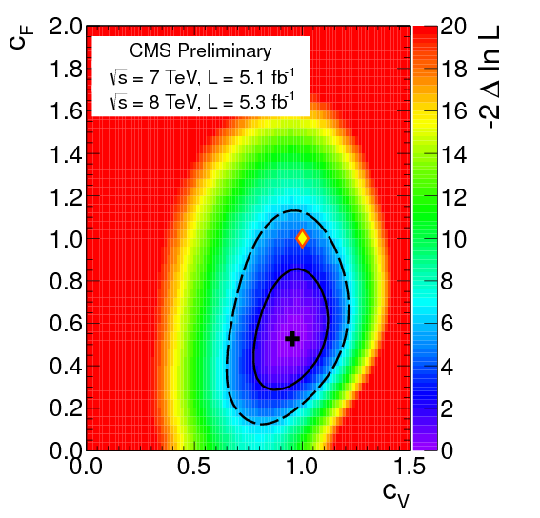
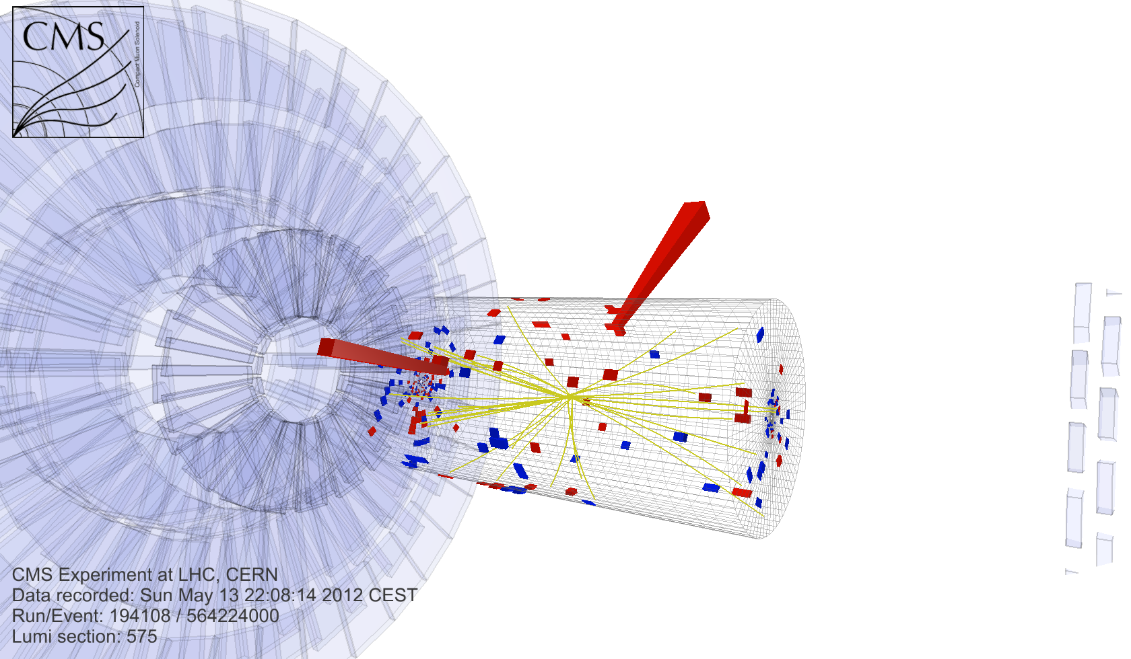
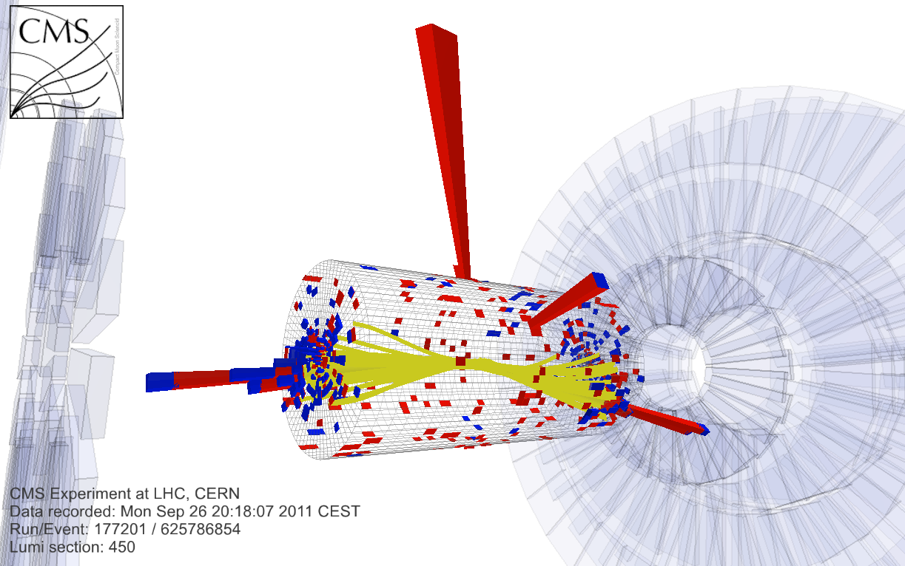
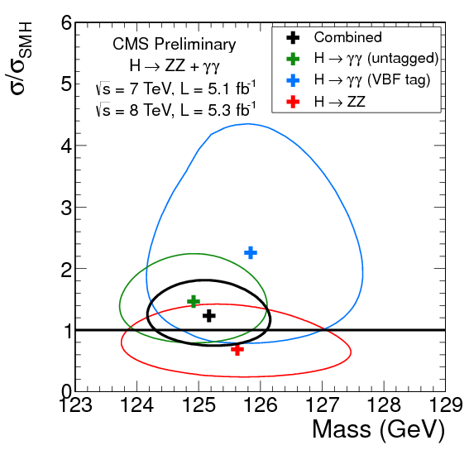
SM Higgs searches: CMS
Giovanni Petrucciani (UCSD)
on the behalf of the CMS Collaboration

Slide 2
Outline
CMS 2012 data
Search channels
Combined results
Conclusions and outlook
Focusing on what’s new in 2012, and what can be of relevance for the future. Impossible to cover everything

Slide 3
CMS 2012 data

Slide 4
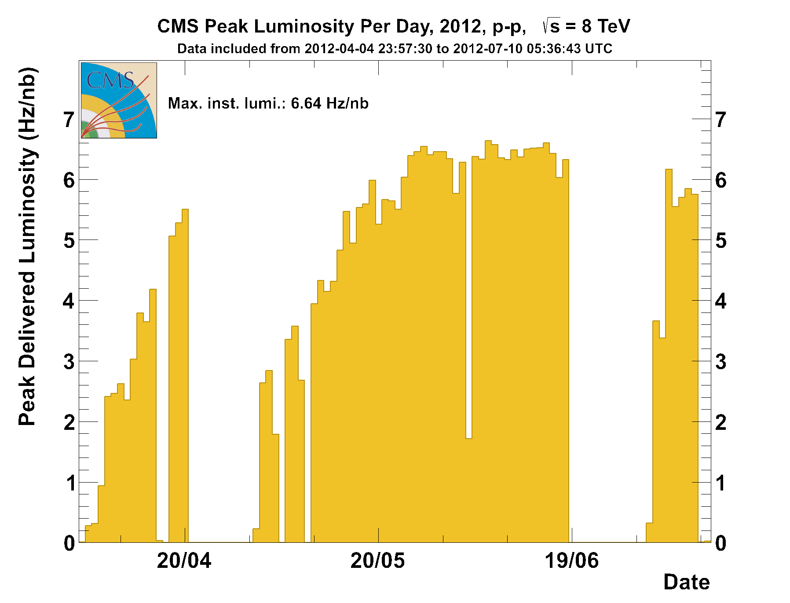
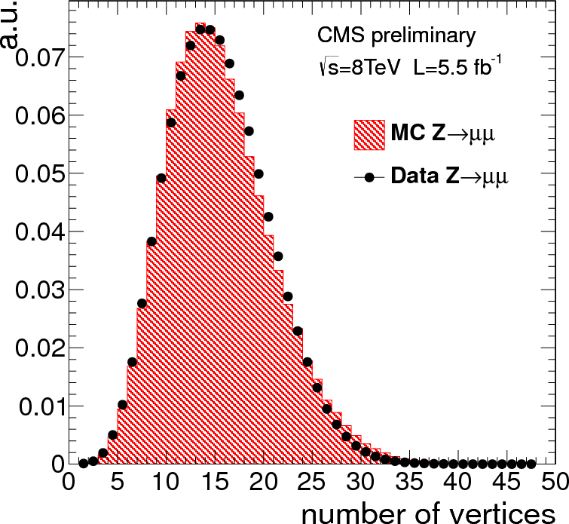
2012: the luminosity challenge
Instantaneous luminosity up to ~7·10³³
20-30 pile-up interactions per bunch crossing

Slide 5
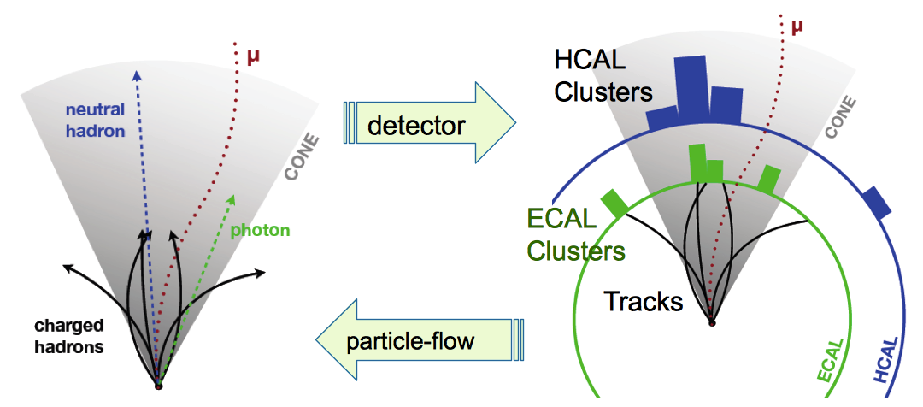
CMS Particle Flow reconstruction
Rely on high granularity of CMS detector to identify and reconstruct each individual particle in the event.
Allows tagging of charged particles from pile-up: minimize impact of PU on jet reconstruction, and lepton or photon isolation.

Slide 6
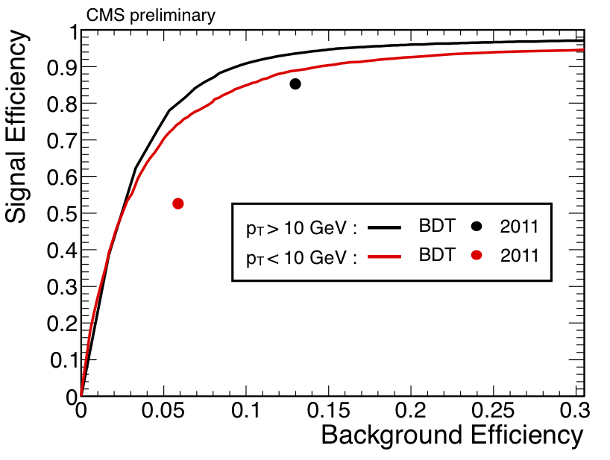
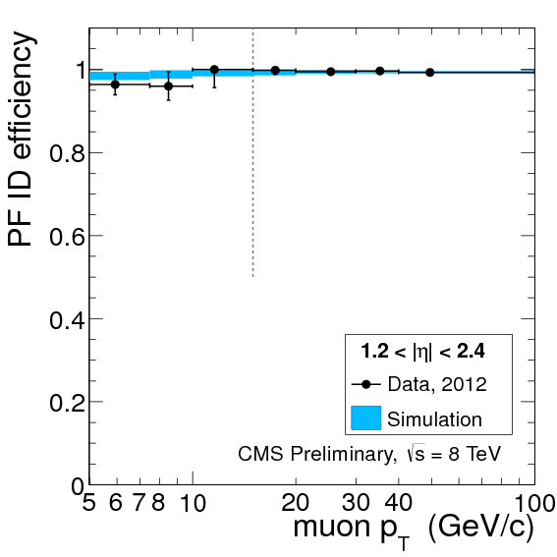
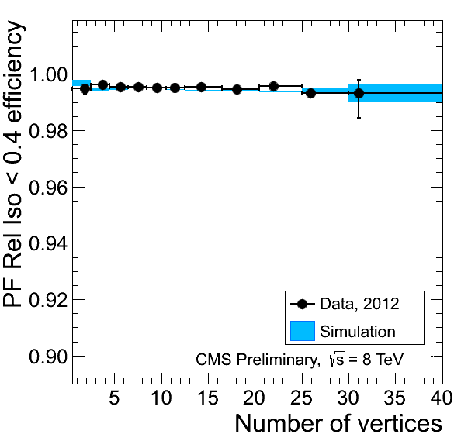
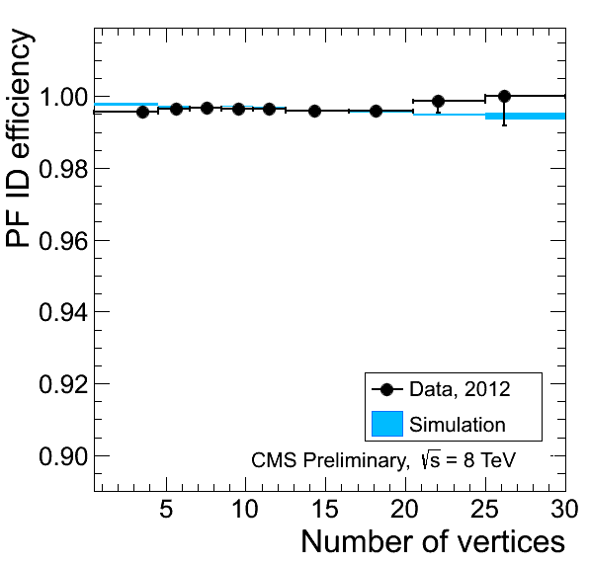
Improving lepton selection
New algorithms:
higher efficiency for same background
Particle-flow based Muon identification
New MVA-based electron identification
stable performance in high pile-up environment
(important for higher lumi runs in the future!)
Particle-flow based Muon isolation
Particle-flow based Muon identification

Slide 7
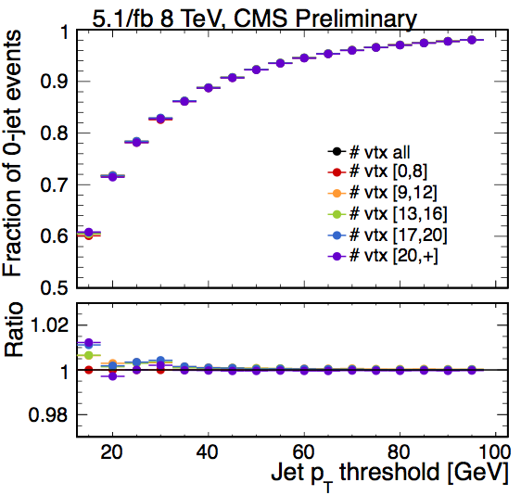
Pile-up jet tagging
Rejection of jets from PU also outside the tracker coverage, relying on jet shape variables.
Important in VBF searches.
Typical jet
Pileup jet
Validation on data: jet counting in
Z → μμ events vs vertex multeplicity.
Stable to <1% for jet p_{T} > 20 GeV

Slide 8
CMS search channels
Outline
H → γγ
H → ZZ
H → WW
H → bb
H → ττ

Slide 9
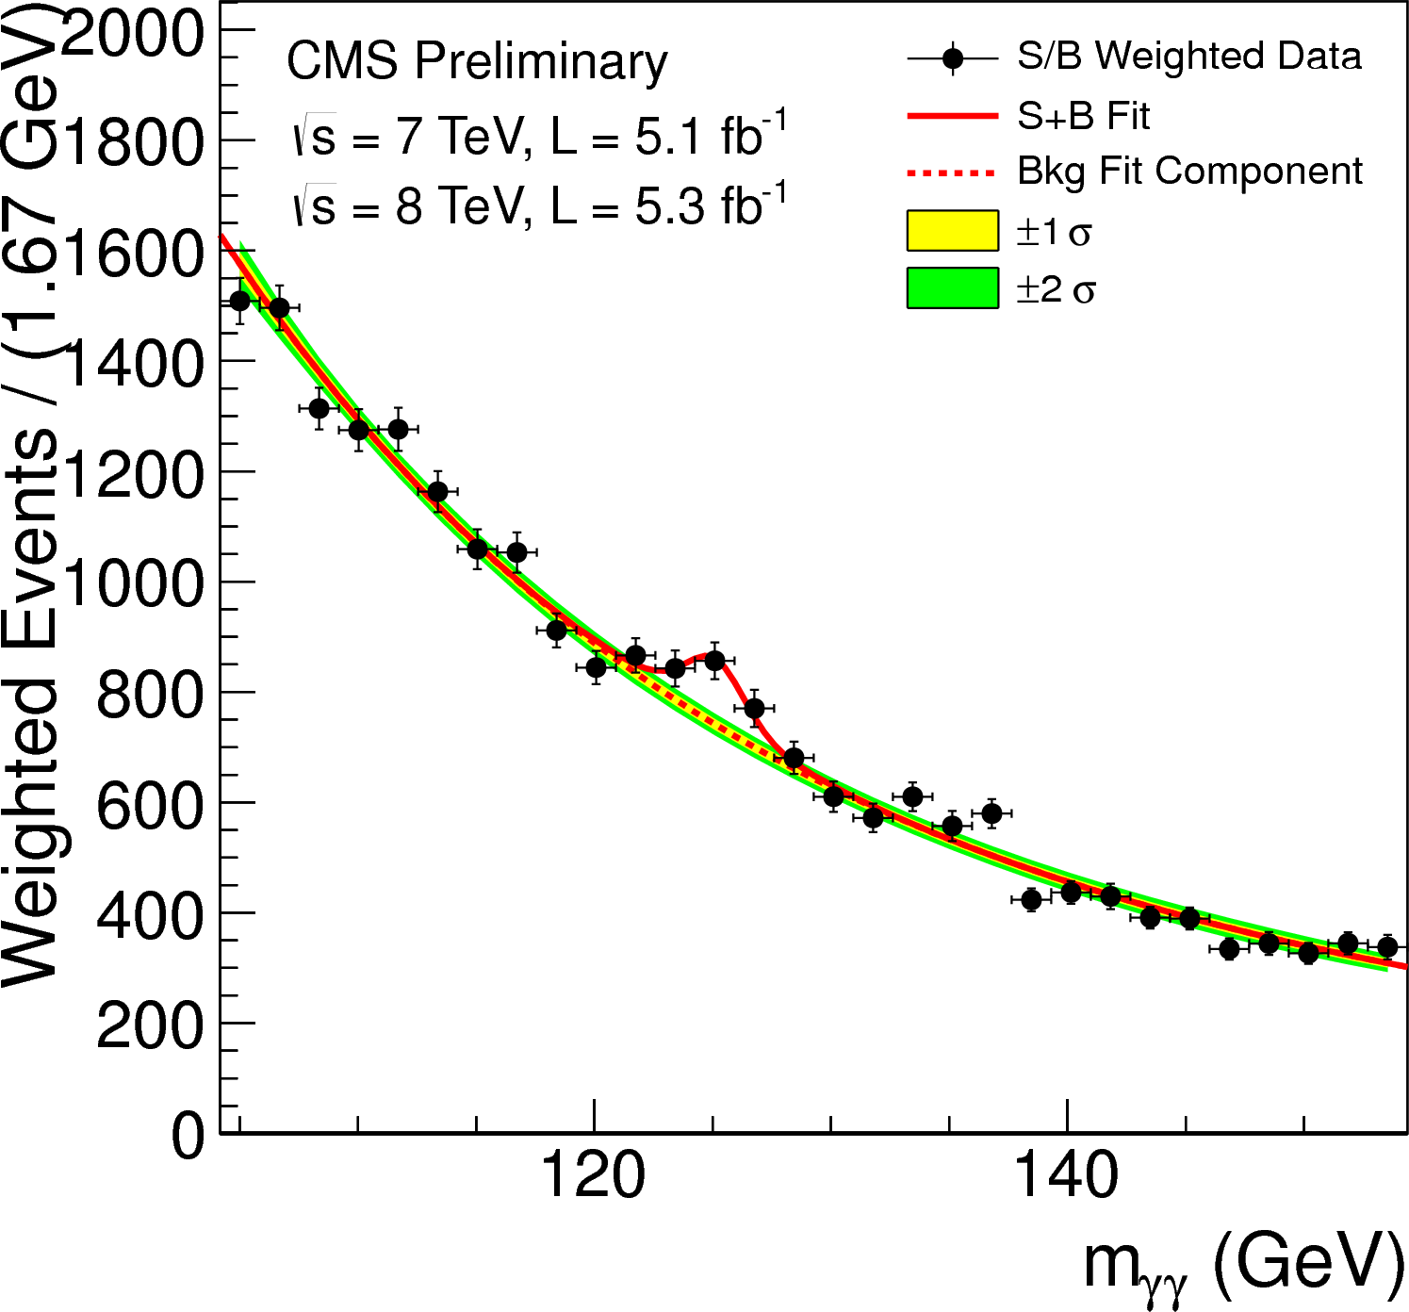
Search channels: H → γγ
Search for a narrow peak in the diphoton mass spectrum.
Analysis optimized categorizing events according to purity
and mass resolution.
Specific di-jet tag categories targeting VBF production mode.

Slide 10
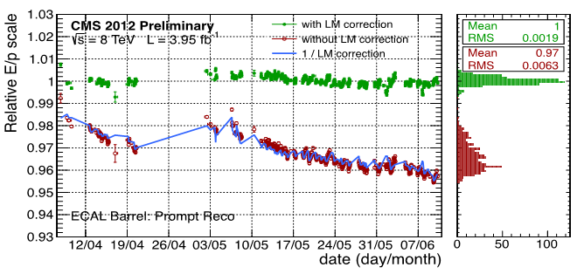
H → γγ: what’s new in 2012
2011 data reprocessed with new energy calibrations in ECAL to further improve the mass resolution.
2012 prompt reco. data: calibration stable vs time thanks to live light monitoring corrections.

Slide 11
H → γγ: what’s new in 2012
2011 data reprocessed with new energy calibrations in ECAL to further improve the mass resolution.
2012 prompt reco. data: calibration stable vs time thanks to live light monitoring corrections.
Re-optimized photon selection using isolation based on Particle Flow reconstruction
Split di-jet tag events in two categories with different purity (15% better sensitivity)

Slide 12
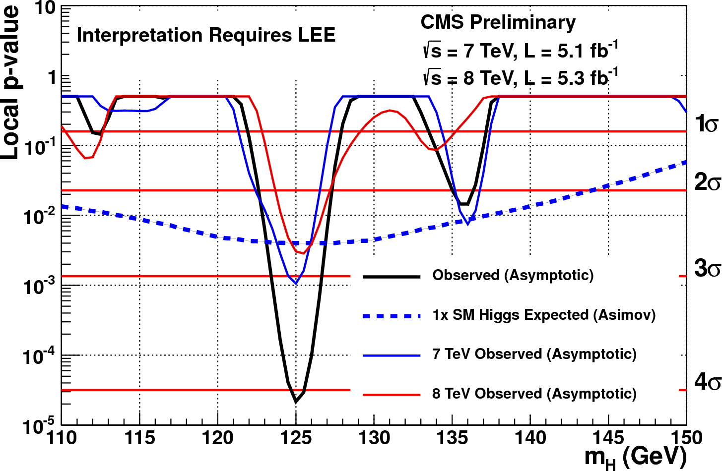
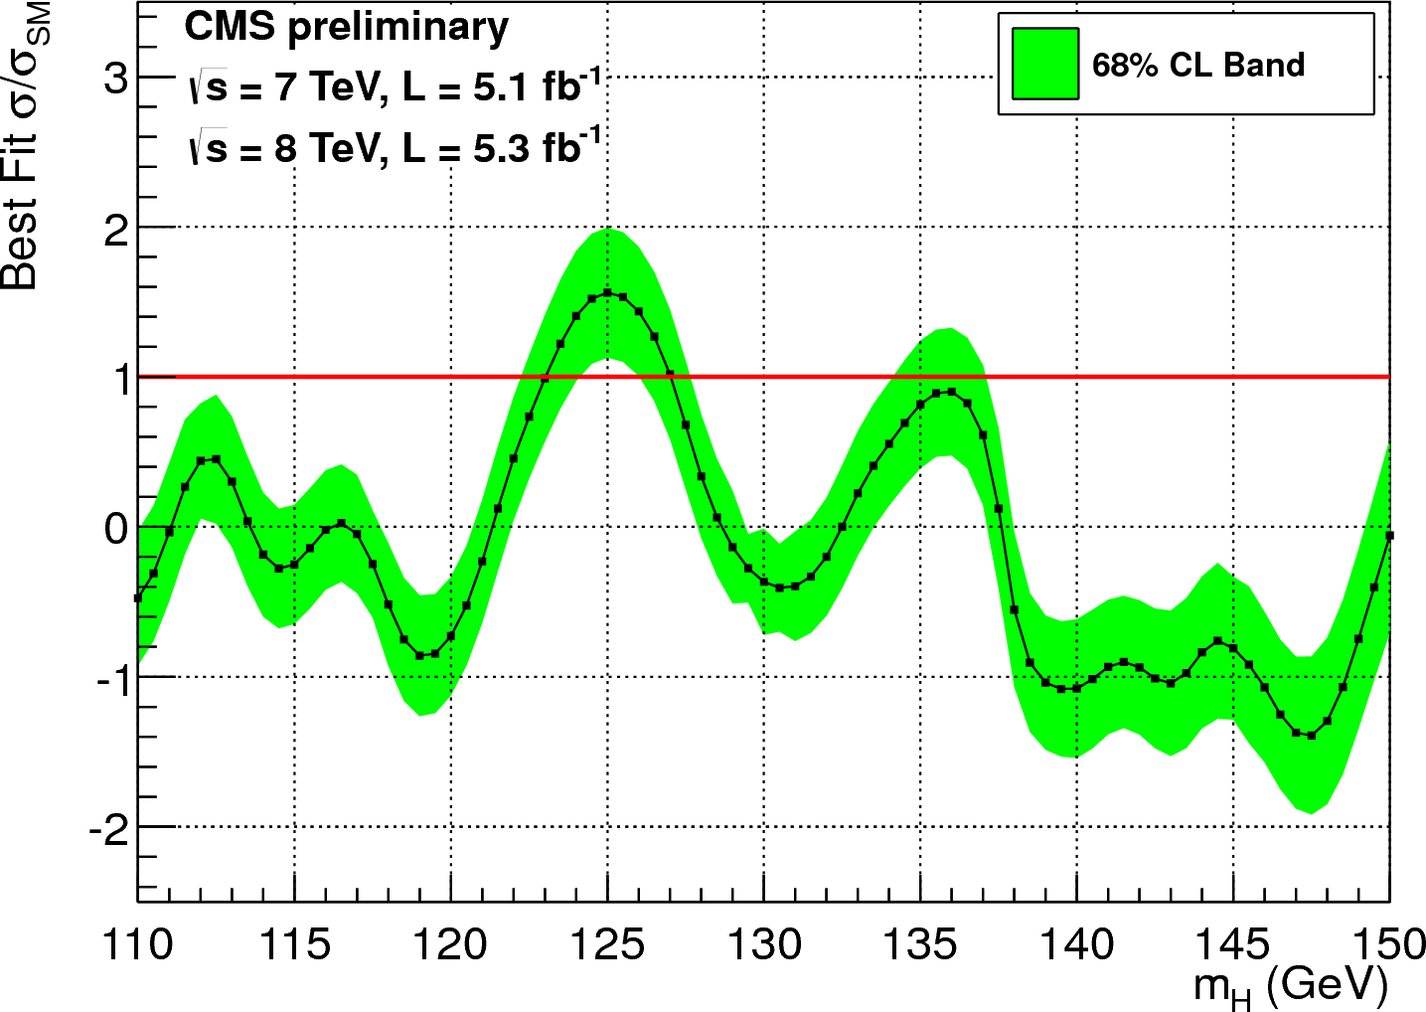
H → γγ results
Excess of events observed for diphoton masses around 125 GeV, consistently in 7 and 8 TeV data
Local significance 4.1σ. Signal strength 1.6 ± 0.4 × σ_{SMH}

Slide 13
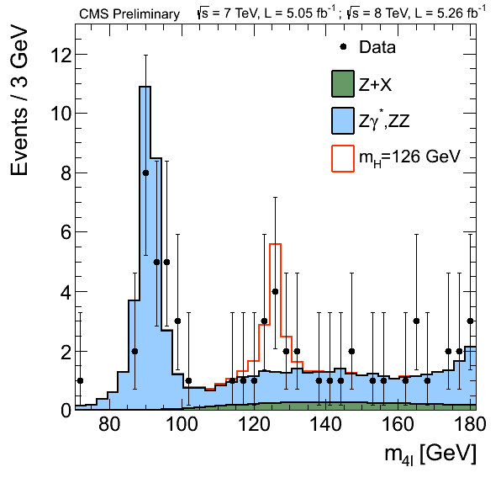
Search channels: H → ZZ → 4l
Improvements in 2012:
New lepton selection
Recovery of photons from final state radiation
Exploit angular information to discriminate signal from irreducible ZZ background
~20% gain in sensitivity with respect to the 2011 analysis
Optimization done without looking at the data in the signal region.

Slide 14
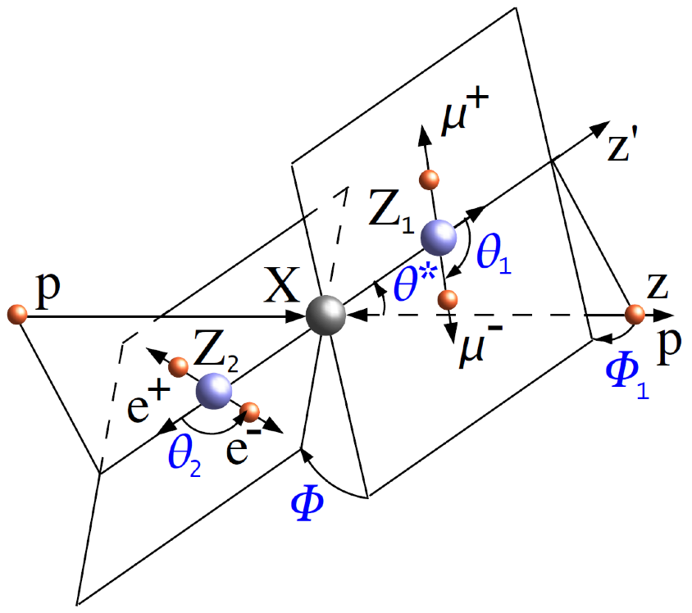
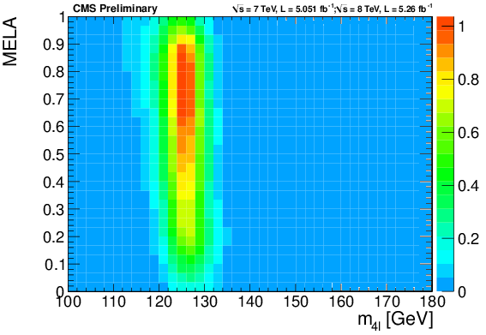
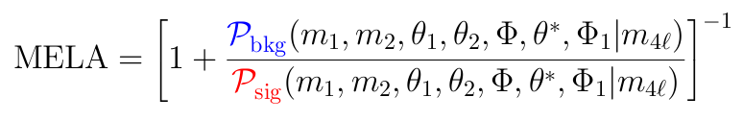
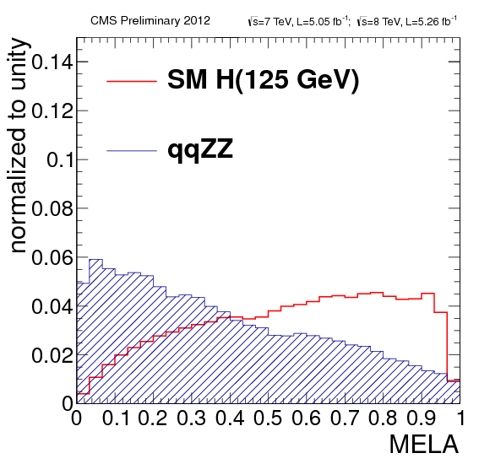
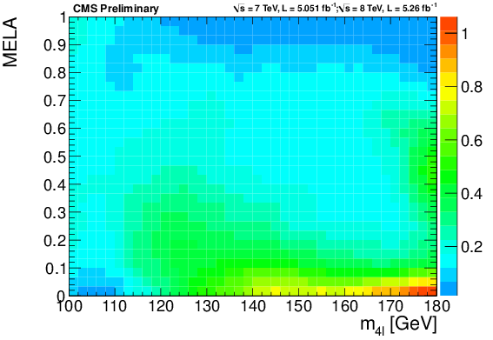
Matrix Element Likelihood Analysis
2D analysis using m_{4l} and MELA
signal
background
PRD81,075022(2010),arXiv:1001.5300

Slide 15
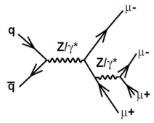
H → ZZ → 4l results
Localized excess of events observed around 126 GeV
ZZ candidates with per-event mass uncertainties

Slide 16
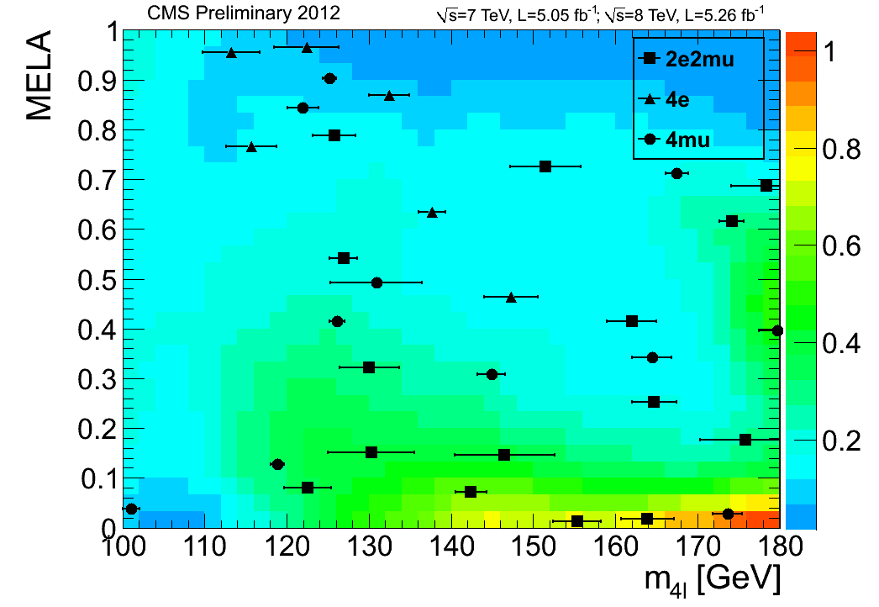
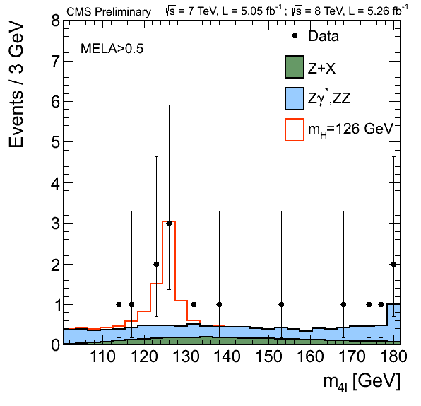
H → ZZ → 4l results
Localized excess of events observed around 126 GeV and at signal-like values of the angular discriminator

Slide 17
H → ZZ → 4l results
Localized excess of events observed around 126 GeV and at signal-like values of the angular discriminator
Local significance 3.2σ (expected from SM H: 3.8σ)

Slide 18
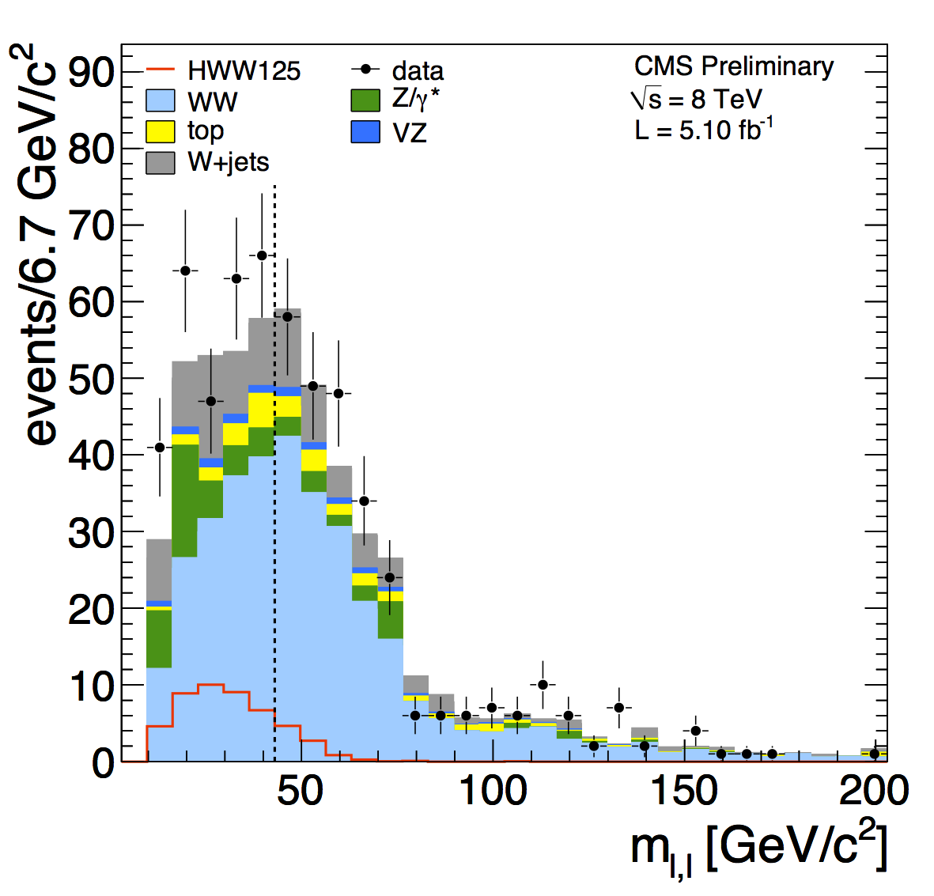
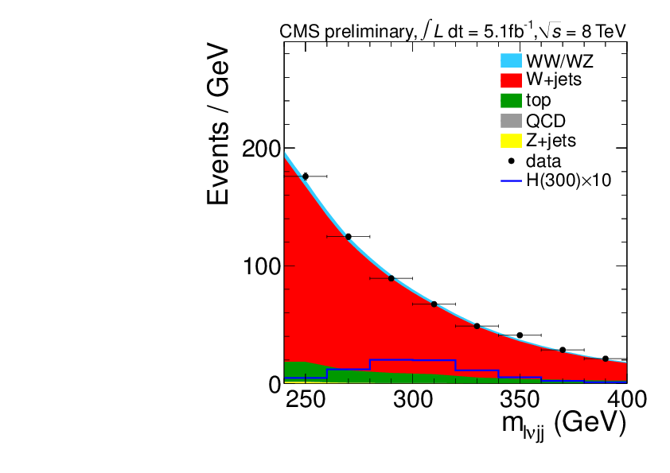
H → WW
Dileptonic channel:
  2011 analysis unchanged.
  2012 analysis with improvements in objects and methods to deal with the increase in pile-up.
  Cut-based analysis for ICHEP.
Semi-leptonic channel, new after Moriond’12, for Higgs boson masses above 170 GeV.

Slide 19
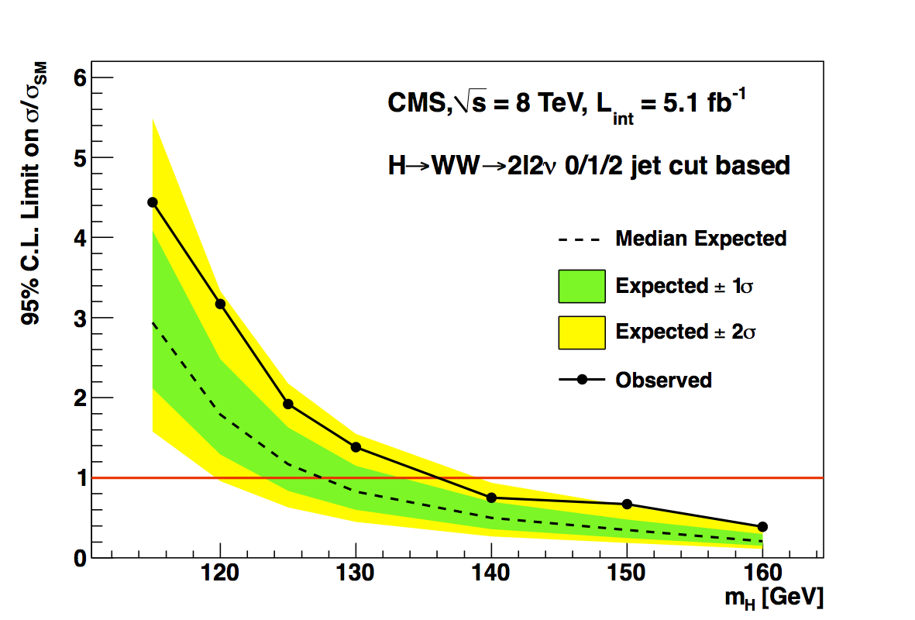
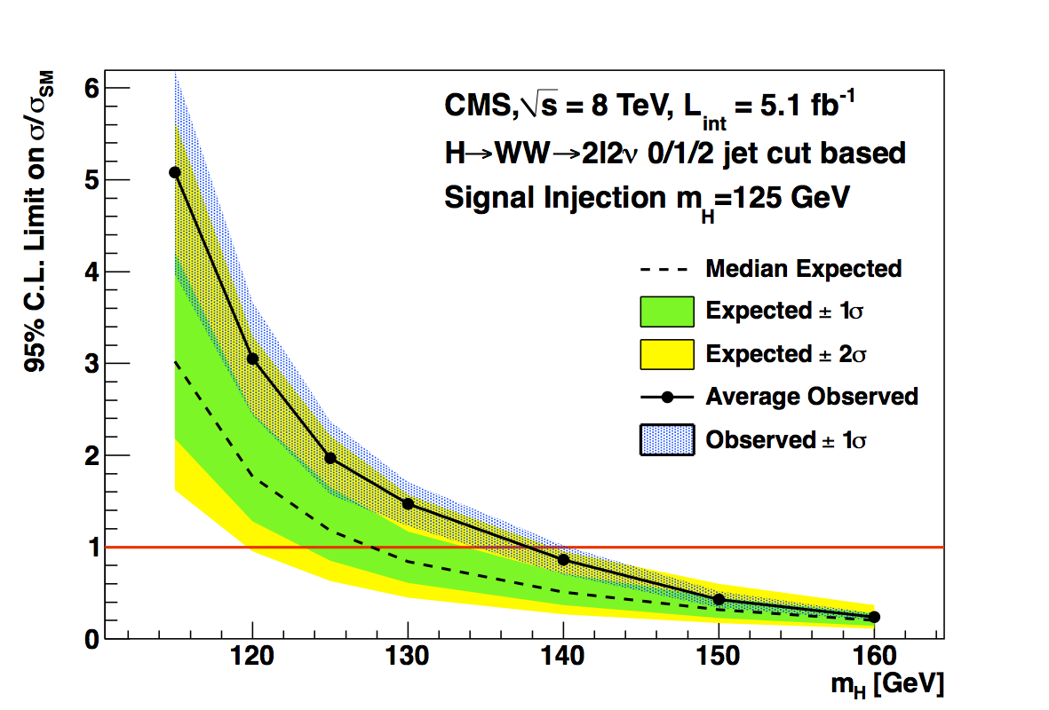
H → WW: results at low mass
Broad excess of about 1.5σ observed in the low mass range. Compatible with the expectations from a SM Higgs signal at 125 GeV, given the low mass resolution.
8 TeV observed data
8 TeV signal+background MC

Slide 20
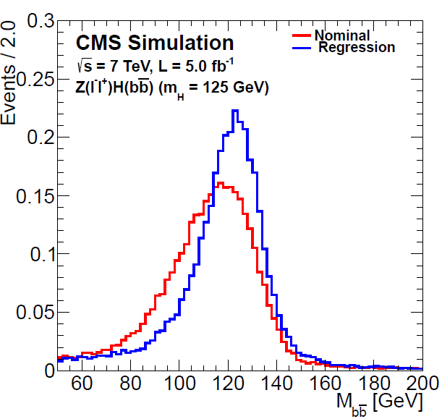
W/Z + H, H → bb
Many improvements:
Jet energy reconstruction using BDT regression
(15-20% improvement)
Extensively validated in data using Z(ll) + bb, ttbar and single top events

Slide 21
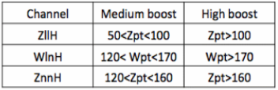
W/Z + H, H → bb
Many improvements:
Jet energy reconstruction using BDT regression
(15-20% improvement)
Categorize events in medium and high boost

Slide 22
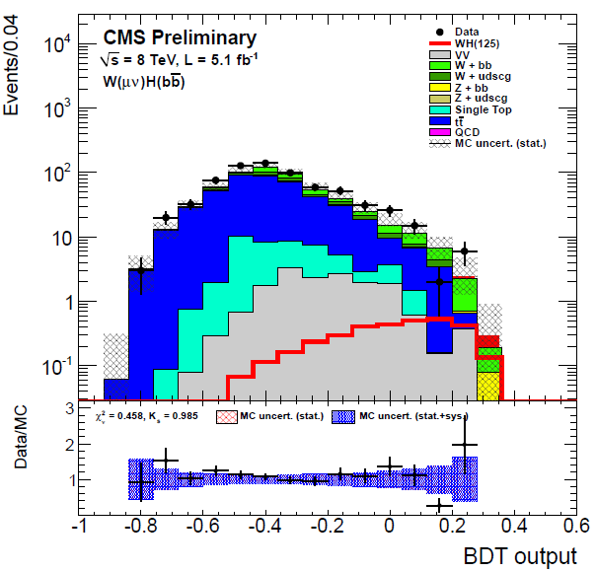
W/Z + H, H → bb
Many improvements:
Jet energy reconstruction using BDT regression
(15-20% improvement)
Categorize events in medium and high boost
Use full shape of final
MVA discriminator
Gain in sensitivity ~50% already on 2011 dataset!

Slide 23
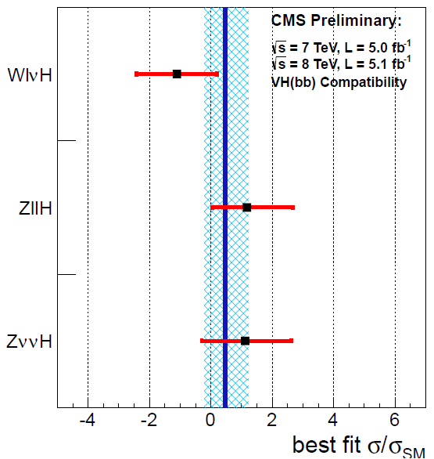
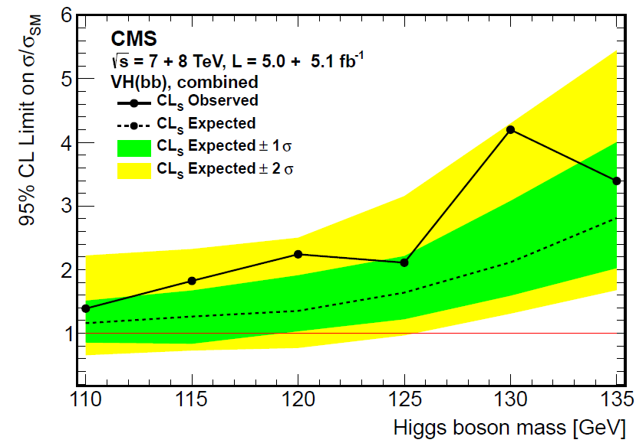
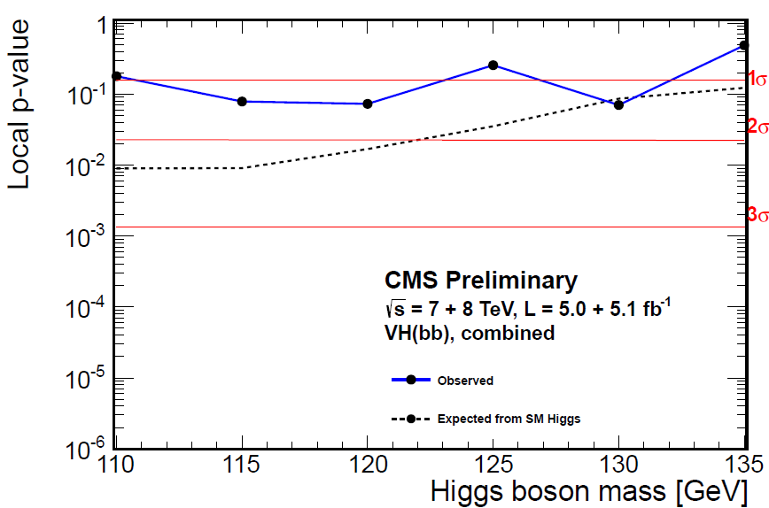
W/Z + H, H → bb: results
Some excess compared to background predictions (significance ~1σ)
Compatible both with a 1×σ_{SMH} signal and with just background.

Slide 24
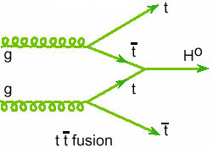
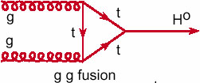
ttH, H → bb (new!)
Important to probe of the coupling:
same couplings as the dominant part of σ(gg → H) production cross section but at tree level
(no loopholes for BSM particles to contribute...)

Slide 25
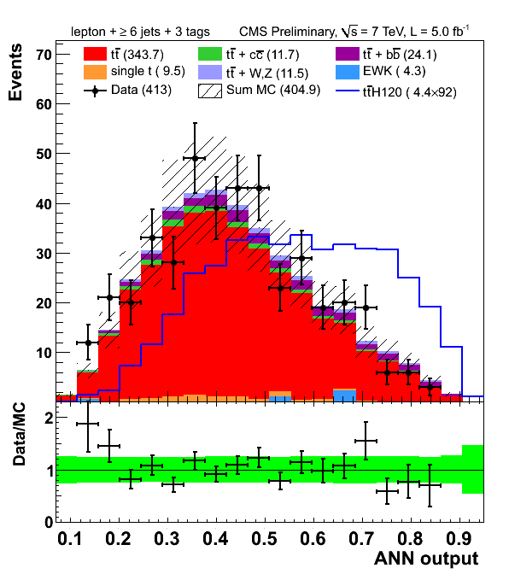
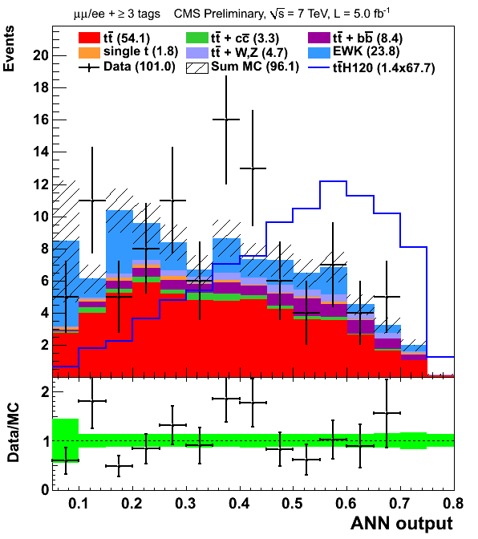
ttH, H → bb (new!)
lep+jets with 6 jets, 3 b-tags
Strategy:
Separate events by top decay mode (di-lep., lep+jets), and by number of jets and b-tags
MVA shape analysis in each event category
Categories with low S/B used to constrain the background in higher S/B ones.
di-leptonic with 3 b-tags

Slide 26
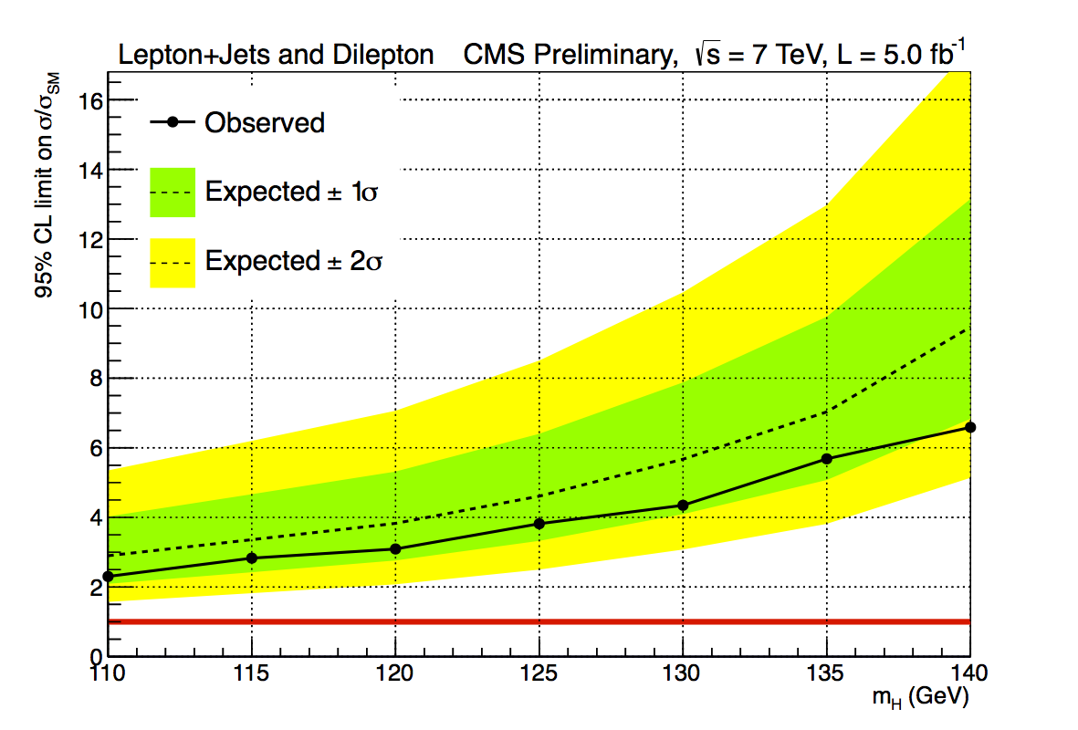
ttH, H → bb: results
Only 2011 data analyzed at the moment.
No evidence of excess, but not yet sensitive to a 1×σ_{SMH} signal anyway.
ttH cross section grows
very quickly with √s.
(x1.5 from 7 to 8 TeV,
x5 from 8 to 14 TeV!)
If scaling as √(σ×L) could
have Δσ/σ_{SMH} ~1 already
with L ~20 fb⁻¹ at 8 TeV.

Slide 27
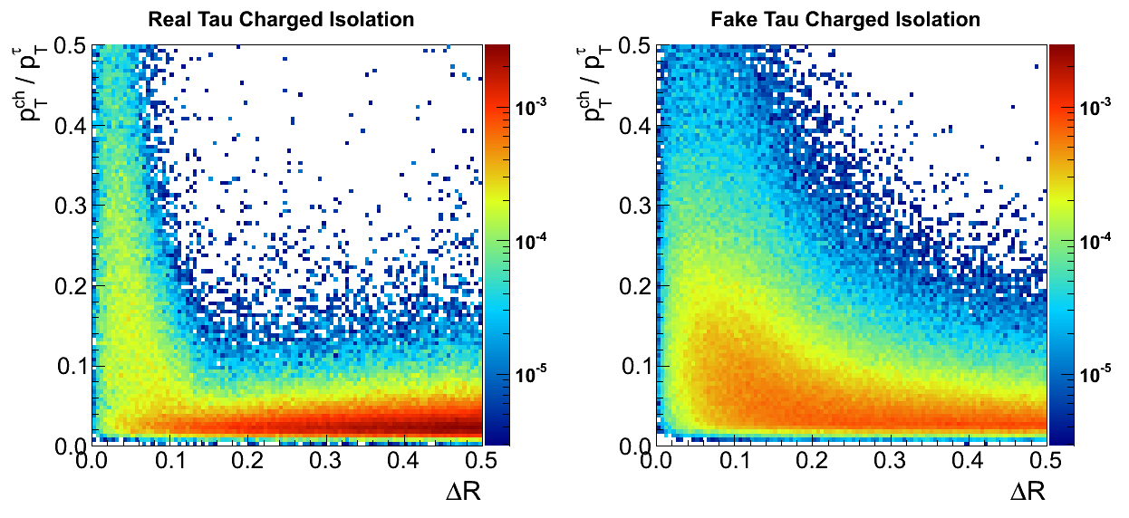
H → ττ
Analysis re-optimized:
Improved lepton and τ_{had} identification criteria
MVA-based tau isolation algorithm

Slide 28
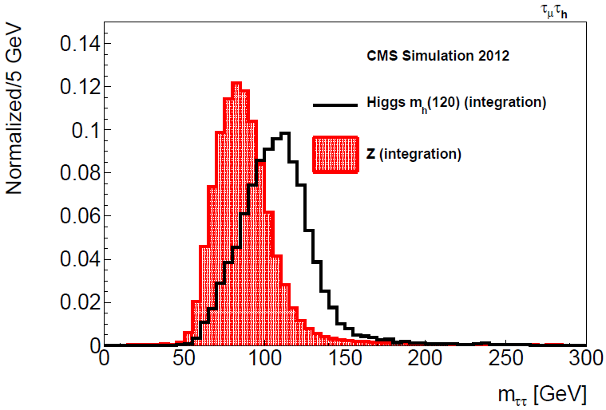
H → ττ
Analysis re-optimized:
Improved lepton and τ_{had} identification criteria
New mass reconstruction (20% better resolution)

Slide 29
H → ττ
Analysis re-optimized:
Improved lepton and τ_{had} identification criteria
New mass reconstruction (20% better resolution)
New event categorization: lower jet p_{T} thresholds, rely also on p_{T} of the tau.

Slide 30
H → ττ
Analysis re-optimized:
Improved lepton and τ_{had} identification criteria
New mass reconstruction (20% better resolution)
New event categorization: lower jet p_{T} thresholds, rely also on p_{T} of the tau.
MVA selection for VBF tag

Slide 31
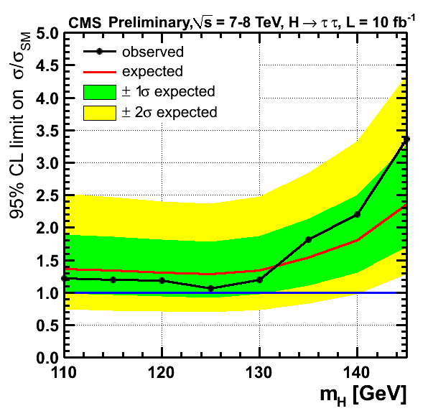
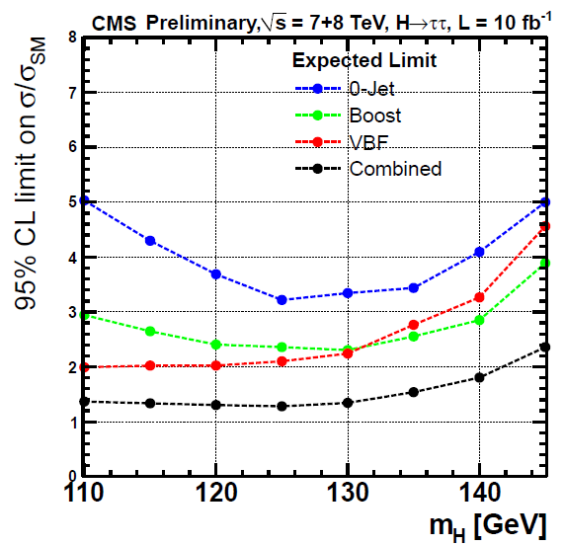
H → ττ: results
Sensitivity of new analysis very close to 1×σ_{SMH}
No excess seen. Just bad luck or non-SM Higgs?

Slide 32
Combined Results

Slide 33
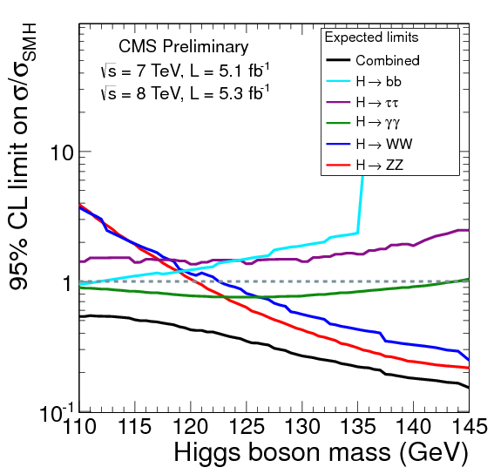
Combined results
Decay | Prod. Topology | Luminosity
H→bb | WH, ZH | 5+5 fb⁻¹ at 7+8 TeV
H→bb | ttH | 5 at fb⁻¹ at 7 TeV
H→ ττ | Inclusive + VBF | 5+5 fb⁻¹ at 7+8 TeV
H→ ττ | WH, ZH | 5 at fb⁻¹ at 7 TeV
H → γγ | Inclusive + VBF | 5+5 fb⁻¹ at 7+8 TeV
H → WW | 0/1 jet + VBF | 5+5 fb⁻¹ at 7+8 TeV
H → WW | WH, ZH | 5 at fb⁻¹ at 7 TeV
H → ZZ | Inclusive | 5+5 fb⁻¹ at 7+8 TeV
Most analyses using 5+5 fb⁻¹, many improved w.r.t. 2011
Biggest combination done so far at CMS: 95 individual final states contributing at 125 GeV mass hypothesis!

Slide 34

Combined results
Decay | Prod. Topology | Luminosity
H→bb | WH, ZH | 5+5 fb⁻¹ at 7+8 TeV
H→bb | ttH | 5 at fb⁻¹ at 7 TeV
H→ ττ | Inclusive + VBF | 5+5 fb⁻¹ at 7+8 TeV
H→ ττ | WH, ZH | 5 at fb⁻¹ at 7 TeV
H → γγ | Inclusive + VBF | 5+5 fb⁻¹ at 7+8 TeV
H → WW | 0/1 jet + VBF | 5+5 fb⁻¹ at 7+8 TeV
H → WW | WH, ZH | 5 at fb⁻¹ at 7 TeV
H → ZZ | Inclusive | 5+5 fb⁻¹ at 7+8 TeV
Most analyses using 5+5 fb⁻¹, many improved w.r.t. 2011
Biggest combination done so far at CMS: 95 individual final states contributing at 125 GeV mass hypothesis!

Slide 35


Combined results: ZZ+γγ
In high mass resolution channels, observe an excess with local significance of 5.0σ (expected from SM H: 4.7σ)
ZZ vs γγ decay mode
7 TeV data vs 8 TeV data

Slide 36
Combined results: all channels
Local significance of excess: 4.9 σ
Expected for SM Higgs signal: 5.9σ
Global significance > 4σ
We interpret this excess as the observation of a new boson with mass around 125 GeV.

Slide 37

Combined results: all channels
Best fit signal strength at mass 125 GeV:
(0.80 ± 0.22) × σ_{SMH}
Compatible with the expectations from a SM Higgs boson signal!

Slide 38
Mass of the observed particle
Likelihood scan for mass and signal strength in three high mass resolution channels:
  ZZ 4l
  γγ untagged
  γγ with di-jet tag
Results are compatible within the uncertainties

Slide 39

Mass measurement
Perform a fit of the mass with freely floating signal strength for the three final states, to minimize model dependence.
M = 125.3 ± 0.6 GeV

Slide 40

Mass measurement
Systematical uncertainty on the mass driven by energy scale uncertainty in γγ: now conservative estimate ~0.5%, will improve in the future.
M = 125.3 ± 0.4 (stat.)
± 0.5 (syst.)
= 125.3 ± 0.6 GeV

Slide 41
Is it a SM Higgs boson?
Observed signal stength in the analzyed decay modes and production topologies compatible with a SM Higgs
However, with the present data sample
only few modes have sensitivity to a signal
of SM strength.

Slide 42


Is it a SM Higgs boson?
Slightly better sensitivity when combining channels by decay mode or production topology.
Compatible with SM Higgs within uncertainties

Slide 43

Is it a SM Higgs boson?
Test of custodial symmetry: compare the signal strength observed in WW and ZZ modes.
Fit the the ZZ and WW (0/1 jet) data assuming:
  σ×BR_{H→ZZ} = μ_{ZZ} × [ σ×BR_{H→ZZ} ] _{SM Higgs}
  σ×BR_{H→WW} = R_{W/Z} × μ_{ZZ} × [ σ×BR_{H→WW} ]_{SM Higgs}
Result compatible with SM
within the large uncertainties
  R_{W/Z} = 0.9
+1.1
−0.6

Slide 44

Is it a SM Higgs boson?
Test compatibility w.r.t SM predictions by introducing two parameters (c_{V}, c_{F}) modifying the expected signal yields in each mode through simple LO expressions

Slide 45
Is it a SM Higgs boson?
Test compatibility w.r.t SM predictions by introducing two parameters (c_{V}, c_{F}) modifying the expected signal yields in each mode through simple LO expressions
c_{F}
c_{V}

Slide 46
Is it a SM Higgs boson?
Test compatibility w.r.t SM predictions by introducing two parameters (c_{V}, c_{F}) modifying the expected signal yields in each mode through simple LO expressions
c_{F}
c_{V}

Slide 47
Is it a SM Higgs boson?
Test compatibility w.r.t SM predictions by introducing two parameters (c_{V}, c_{F}) modifying the expected signal yields in each mode through simple LO expressions
c_{F}
c_{V}

Slide 48

Is it a SM Higgs boson?
CMS data compatible
with SM prediction
at 95% C.L.
Best fit c_{F} driven to low values by VBF γγ excess and ττ deficit.
More data needed
to draw any definite conclusion.
LHC Cross Section WG also converging on an improved models for these kinds of fits.
solid contour: 68% CL
dashed contour: 95% CL

Slide 49

Anything elsewhere?
Stringent exclusion limits for any heavy Higgs-like boson decaying into WW and ZZ bosons:
e.g. σ ~ 0.3× σ_{SMH} is
excluded in most of the 140-500 GeV range.

Slide 50
What next?
Measurement of spin and parity using angular distributions in ZZ, WW, γγ.
Search for deviations from the SM in the couplings by progressively introducing new degrees of freedom in the fit to the data,
in collaboration with LHC Higgs XS WG.
Improve the mass measurement.

Slide 51


Projections for J^{PC} measurements
H → ZZ → 4l
H → WW → 2l2ν
CMS Simulation L = 30 fb⁻¹ , √s = 8 TeV
JHU Generator level L = 10 fb⁻¹ , √s = 8 TeV
Expect ~3σ separation between spin 0, 2 with 10 fb⁻¹ but assuming no systematics and WW as only background
Expect ~3σ separation between scalar and pseudoscalar in 2012
http://indico.cern.ch/contributionDisplay.py?contribId=473&sessionId=53&confId=181298

Slide 52
The road goes ever on…
Expect another ~30 fb⁻¹ at 8 TeV from this run.
→ a factor 3 in integrated luminosity
Then ~300 fb⁻¹ at ~14 TeV?
→ another factor 30 in σ×L (even more for ttH)
Then ~3000 fb⁻¹ at ~33 TeV ?
→ yet another factor 30 in σ×L !
If σ×BR uncertainties on individual modes scale as √(σ×L), expect 100% → 50% → 10% → 2% !!
Expect to challenge theory accuracy in a few years.

Slide 53

The road goes ever on…
Naïve rescaling of uncertainties on σ×BR with √(σ×L),
NOT AN OFFICIAL CMS PROJECTION
Decay | Prod. | 60fb⁻¹ @ 8 TeV | 300fb⁻¹ @ 14 TeV
H→bb | VH | 30% | 10%
H→bb | ttH | 60% | 10%
H→ ττ | ggH | 40% | 10%
H→ ττ | qqH | 40% | 10%
H → γγ | ggH | 20% | 6%
H → γγ | qqH | 40% | 10%
H → WW | ggH | 16% | 5%
H → WW | qqH | 60% | 16%
H → ZZ | ggH | 16% | 5%
60 @ 8
300 @ 14
68% CL contours, assuming 100% signal purity and no correlations

Slide 54
Conclusion
In the searches for a SM Higgs boson at CMS,
a new state with mass 125.3±0.6 GeV has been observed, dominantly in the γγ and 4l modes.
Within the limited precision of the current data, the observation is compatible with the predictions for a SM Higgs boson signal, despite the larger excess in γγ and the deficit in ττ, bb modes.
More data is needed to draw any conclusions on this second point.

Slide 55
For further information:
CMS Higgs results twikipage
https://twiki.cern.ch/twiki/bin/view/CMSPublic/PhysicsResultsHIG
4th July seminar at CERN:
https://cms-docdb.cern.ch/cgi-bin/PublicDocDB/ShowDocument?docid=6125
CMS talks on Higgs searches at ICHEP 2012:
https://indico.cern.ch/conferenceProgram.py?confId=181298
(too many to list them all individually)
CMS Paper in preparation.

Slide 57

Electron energy scale: golden barrel

Slide 58

Electron energy scale: all barrel

Slide 59

Electron energy scale: all endcaps

Slide 60

Electrons from J/Psi

Slide 61

Reconstruction and selection efficiency

Slide 62

ZZ 4l: p-values 1D and 2D

Slide 63


ZZ 4l: reducible background
Closure test of estimate from anti-selected events, for the wrong
flavour and charge control sample
Data/sim comparison for the Z+l±l± control region with same sign leptons (for 4e events)

Slide 64

ZZ 4l: FSR recovery algorithm
Expected Performance for M_{H}=126 GeV
  6% of events affected
  Average purity of 80%
  2% added in analysis
Applied on each Z for photons near the leptons
μ,e
μ,e
γ
ΔR(l, γ)_{min}<0.5
Particle Flow ID
E_{T}> 2 GeV
|η|<2.4
Isolation
Z
Associates photon with Z if:
  M(ll+γ)< 100 GeV
  |M(ll+γ)-Μ_{Z}|<|M(ll)-M_{Z}|
Removes associated photons from lepton isolation calculation
64
Notes:
-FSR recovery affects 6% of the events
-80% of those events correspond to real FSR photons
-20% of those events are fakes
-The purity of 80% is enough as it can be seen from the shape
of the recovered plot. The upper tail is small and the peak
is symmetric which implies that the impurity does not affect
performance
-Maybe it can be stated in later slides that two of the events
in the interesting region have identified FSR

Slide 65
ZZ4l : 4mu + FSR event
γ(Z₁) E_{T} : 8 GeV
μ⁻(Z₁) p_{T} : 28 GeV
7 TeV DATA
4μ+γ Mass : 126.1 GeV
μ⁺(Z₂) p_{T} : 6 GeV
μ⁻(Z₂) p_{T} : 14 GeV
μ⁺(Z₁) p_{T} : 67 GeV

Slide 66
ZZ4l : Two-lepton invariant mass plots
a.u.
Grey – is simulation (expectation) for Higgs (126 GeV)
66

Slide 67

ZZ4l: ev-by-ev. comparison with 2011

Slide 68

γγ best fit by category
Excess above 1 not really just because of di-jet tag mode
category 0 = highest S/B category 3 = lowest S/B

Slide 69

γγ vertexing efficiency
Fraction of events where the selected vertex is within 1cm from the correct one

Slide 70

γγ MVA categories: background

Slide 71

γγ MVA categories vs diphoton kind

Slide 72


γγ energy resolution from Z->ee
Effect of the regression on the Z->ee peak
E_{5x5}
E_{SC}
Regr.
Both EB |η|<1
highR9

Slide 73


γγ p-value by category

Slide 74

γγ expected yields by category

Slide 75

H → WW

Slide 76

VH → bb: b-jet energy “regression”
Specialized b jet energy regression
  based on CDF http://arxiv.org/pdf/1107.3026.pdf
    => improve dijet invariant mass (and MET)
Use a specialized BDT
  trained with inputs that help differentiate b quark jets from light-flavor jets.
    i.e. properties of a secondary vertex, track information, charged constituents, variables
    related to the energy of the jet etc.
Attempts to recover the true b-jet energy.
  Variables used
    pT, η, ptRaw, ET, mT, ptLeadTrack, chf (Vertex) vtxPt, vtx3dL, vtx3deL (ZllH) MET, dPhi(Jet,MET)
  Validate in MC and control region in data
Upshot
  15-20% improved mass resolution
  m_{bb} distribution becomes more consistent with true generated mass spectrum.

Slide 77


VH → bb: signal injection at 125 GeV
signal+background MC
observed data

Slide 78
VH → bb: signal injection at 125 GeV
signal+background MC
observed data

Slide 79

H→ττ VBF MVA
Multivariate discriminator
  8 input variables
  Replaces traditional cut-based VBF selection using m_{jj} and Δη_{jj}
  Working point optimized for best sensitivity
    15-20% improvement over previous cut-based selection
MVA output validated on Z→μμ data
MVA input variables
m(jj)
Δη(jj)
Δφ(jj)
Δφ(ττ,jj)
p_{T}(jj)
p_{T}(ττ) (including MET)
Visible p_{T}(ττ)
Δη(ττ,jet)

Slide 80
Sensitivities in the five modes
Channel | m_{H} resolution | Exp. limit on σ/σ_{SM} | Expected significance | Observed significance
H -> γγ | 1-2% | 0.8 | 2.8 σ | 4.0 σ
H -> ZZ -> 4l | 1-2% | 0.6 | 3.8 σ | 3.2 σ
H -> bb | 10% | 1.5 | 1.9 σ | 0.2 σ
H -> ττ | 20% | 1.4 | 1.5 σ | -0.0 σ
H-> WW | 20% | 0.8 | 2.5 σ | 1.5 σ
All values are for a Higgs boson mass hypothesis of 125.5 GeV

Slide 81


Look Elsewhere (if you want)
In a narrow mass range, LEE can be assessed by tossing pseudo-observations and using the asymptotic extrapolations:
  [115—130] GeV: 4.9 σ → 4.5 σ
  [110—145] GeV: 4.9 σ → 4.4 σ
In the full mass range, LEE can be assessed from the number of up/down oscillations around σ/σ_{SM}=0 and using the asymptotic extrapolations:
  [110—600] GeV: 4.9 σ → 4.0 σ
LEE-corrected significance remains high in any conceivable mass range
81

Slide 82

ZZ+γγ+WW

Slide 83


7 vs 8 TeV p-values

Slide 84

Low-resolution vs high-resolution

Slide 85

Best fit 7 vs 8 TeV per mode
Notes:
non-trivial correlated uncertainties between 7 & 8 TeV
At other points, scatter between results is larger
VBF ττ “alignment” driven by downwards fluctuation in the same bin for e+τ_{h} in the two periods

