Slide 1
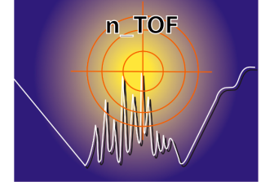


Proposal for n_TOF Experimental Area 2 (EAR-2)
CERN-INTC-2012-029
E.Chiaveri on behalf of the n_TOF Collaboration

Slide 2
ITEMS
Why EAR-2
Scientific Motivation
Facility Performance
Dosimetry and Radiation Damage
Radiation Protection Analysis
Civil Engineering & Beam Line Study
Budget, Staff & Tentative planning
Summary

Slide 3
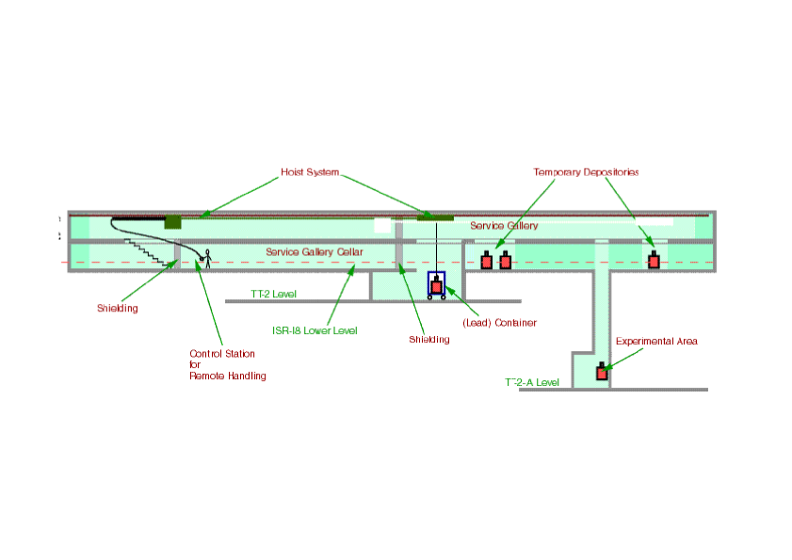
Study for n_TOF 2nd experimental area
New experimental area at 19 m (EAR-2)
Future EAR-2: flight path ~19 m at 90° with respect to the proton beam
n_TOF target
Experimental area at 185 m

Slide 4
Why AREA-2?
The main advantages of EAR-2 are:
Neutrons fluxes on average increased by a factor 25
Very small mass samples (< 1 mg)
Very small cross-sections
Much shorter time scales measurement

Slide 5
Scientific Case for EAR-2
Astrophysical Research
Nuclear Technology Application
Basic Nuclear Research
Examples of EAR-2 Proposals

Slide 6
EAR-2: Nuclear Astrophysics
very small samples
important candidates :
⁷⁹Se, ⁹⁰Sr, ⁹³Zr, ¹⁰⁷Pd, ¹³⁵Cs, ¹⁴⁷Pm, ¹⁶³Ho,¹⁷¹Tm, ¹⁸²Hf, ²⁰⁴Tl
very small cross sections
important candidates :
⁸⁶Kr, ⁸⁸Sr, ¹³⁸Ba, ¹⁴⁰Ce, ²⁰⁸Pb; isotopes of C, O, Ne, Mg
short measuring times
important candidates :
⁶⁴Zn, ⁷⁰Ge, ⁷⁶Ge, ^{80,82}Kr, ^{86,87}Sr, ^{95,96}Mo, ¹⁰⁴Pd, ^{164,166}Er, ¹⁹⁸Hg

Slide 7
EAR-2 Nuclear Technology Application
Higher neutron flux
Very small samples
Important Candidates:
Fission Cross Section :²³⁸Pu (87.7 y)/²⁴¹Pu (14.1 y) ²⁴⁴Cm(18.1 y) ^{242m}Am(141y) ²⁴³Cm (29.1y)
Capture Cross Section : ²⁴²Am (141 y)/ ²⁴³Cm (29.1 y) ²³¹Pa(32400 y)

Slide 8
Basic Nuclear Research
Higher neutron flux
Shorter time scale
Open the door to dedicated proposals devoted to the investigation of nuclear level and Photon Strength Functions (PSF)

Slide 9
LIST OF EXAMPLES OF EAR-2 PROPOSALS
Astrophysical research
Measurement of the ²⁵Mg(n,α)²²Ne cross section
Neutron capture measurement of the s-process branching point ⁷⁹Se
Destruction of the cosmic γ-ray emitter ²⁶Al by neutron induced reactions
Measurement of ⁷Be(n,p)⁷Li and ⁷Be(n,a)⁴He cross sections, for the cosmological Li problem.

Slide 10
LIST OF EXAMPLES OF EAR-2 PROPOSALS
Nuclear Technology Application
Cross sections and prompt γ-ray emission of fissile Pu isotopes
The role of ²³⁸Pu and ²⁴⁴Cm in the management of nuclear waste: simultaneous measurements of their capture and fission cross sections
Measurements of (n,xn) reaction cross sections for heavy target nuclei
Fission cross section of the ²³⁰Th(n,f) reaction
First measurement of the capture (and fission) cross sections of the fissile ²⁴⁵Cm
Cross section and angular distribution of fragments from neutron-induced fission of ²³²U

Slide 11
Neutron Fluence
Maximum Gain: 27 (keV Region)
Reference for EAR1 : FLUKA Simulations with fission collimator (d = 8 cm)

Slide 12
Neutron Fluence Comparison to EAR1
Energy Interval | EAR1 |  | EAR2 |  | Gain
 | [ n / cm² / pulse ] | Error [%] | [ n / cm² / pulse ] | Error [%]
0.02 – 10 eV | 1.07e5 | 0.2 | 1.64e6 | 2.0 | 15.4
0.01 – 1 keV | 3.98e4 | 0.3 | 1.07e6 | 1.4 | 26.8
1 – 100 keV | 5.02e4 | 0.2 | 1.36e6 | 1.3 | 27.0
0.1 – 10 MeV | 1.76e5 | 0.1 | 3.00e6 | 0.9 | 17.1
10 – 200 MeV | 4.15e4 | 0.3 | 4.78e5 | 2.0 | 11.5
Total Range (0.02 eV – 200 MeV) | 4.14e5 | 0.08 | 7.54e6 | 0.6 | 18.2
Reference for EAR1 : FLUKA Simulations with fission collimator (d = 8 cm)

Slide 13
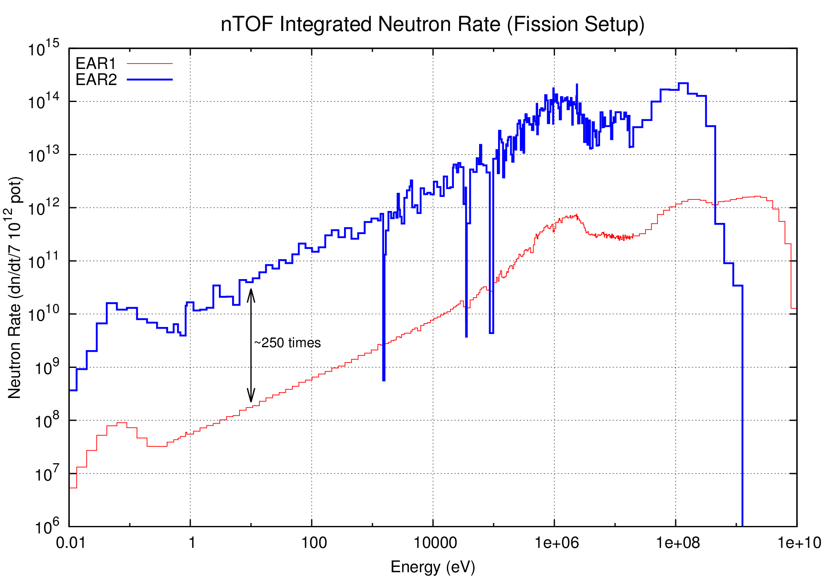
Neutron rate
25x higher fluence in EAR-2 wrt EAR-1
10x times less alphas/gamma during neutron arrival
→250x times higher neutron rate

Slide 14
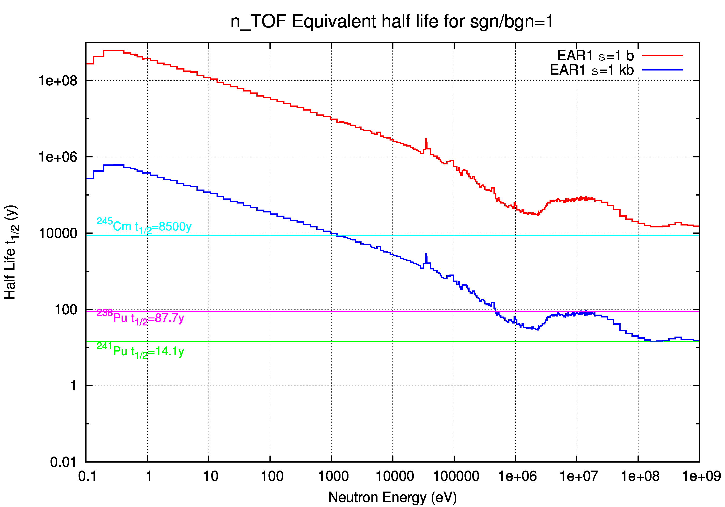

Slide 15
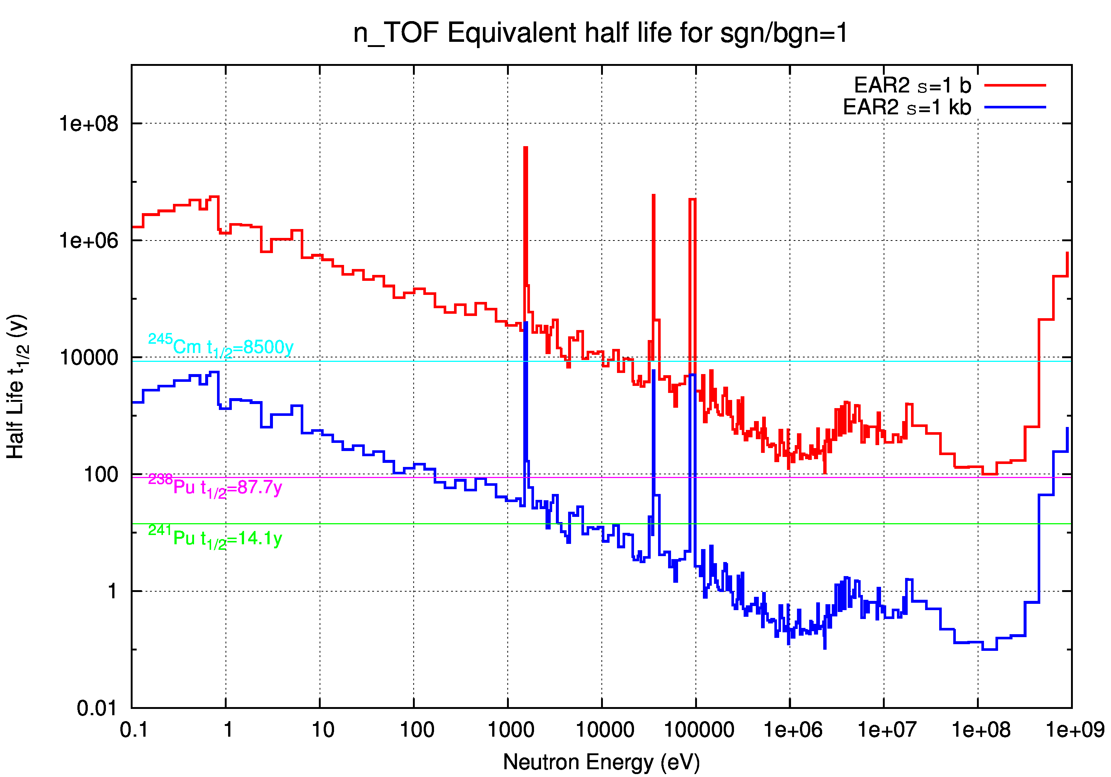

Slide 16
Dosimetry and Radiation Damage Studies
Characterization and calibrations of passive and active dosimeters as well as of detectors.
Test in its stray radiation field the radiation resistance of electronic and structural components as well as of cables
Perform irradiation of various material and electronic devices for dosimetric studies, detector development, radiation damage on electronics

Slide 17
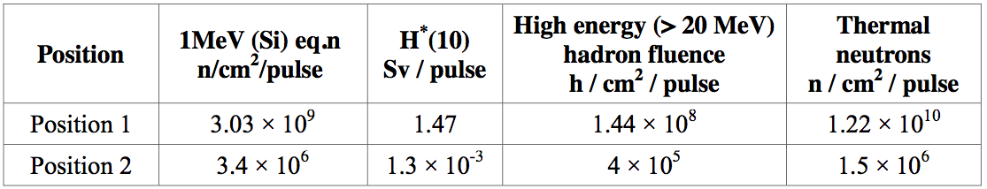
Dosimetry and Radiation Damage Studies
1 MeV (Si) equivalent neutron fluence rate. This quantity is a measure for displacement damage in (electronic) silicon-based devices. It can be correlated to its long term damage
Ambient dose equivalent (H*(10)) rate. This quantity is of relevance for passive and active dosimeters and radiation monitors

Slide 18
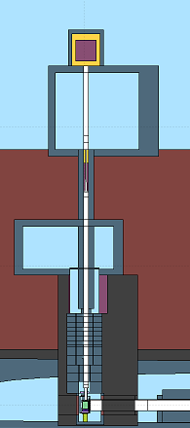
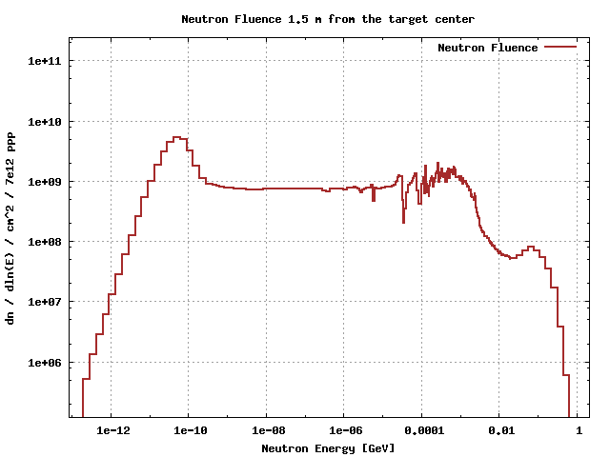
Neutron Fluence for Irradiation
Neutron Tube has 32 cm diameter
at 1.5 m from the target center
Total: 6.22e10¹⁵ n / cm^2 / 7e12 ppp

Slide 19
Radioprotection Analysis
There are two radiation protection aspects:
Radiation levels in accessible areas induced by the neutron flux between the target and the experimental area
Use of radioactive samples in the form of unsealed sources

Slide 20
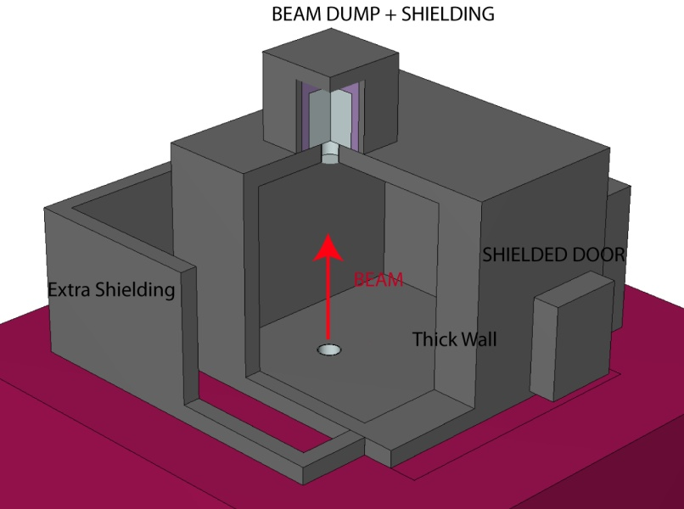
Radioprotection Analysis
Three dimension view of the experimental area as it is implemented in FLUKA for shielding calculations.

Slide 21
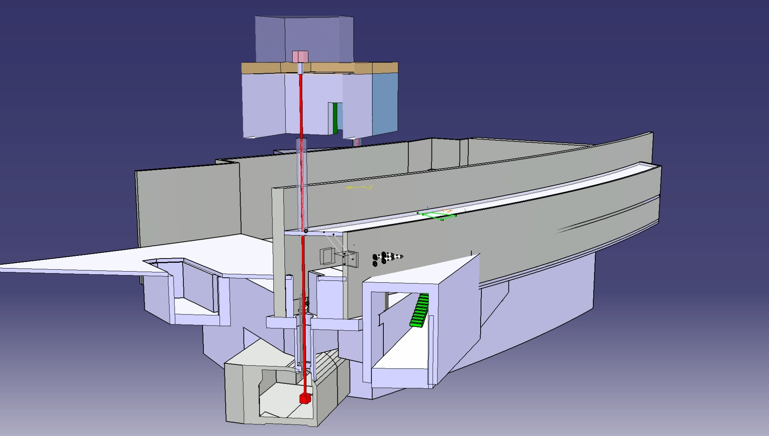
Overview of the n_TOF spallation target area
EAR2 (@20 m from pit, above ground)
To be built
ISR
Technical gallery (@10 m from pit)
Existing hole
n_TOF target pit

Slide 22
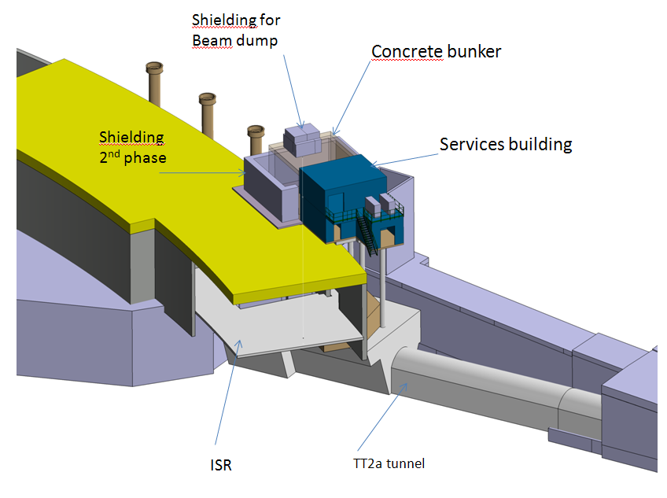
n_TOF EAR-2 surface and underground installations
Additional shielding for an upgrade of the facility for testing electronics components or material tests, which will be done without collimator, can be implemented in a second building stage by adding a base plate around the building and by positioning concrete shielding blocks as a wall around the facility

Slide 23
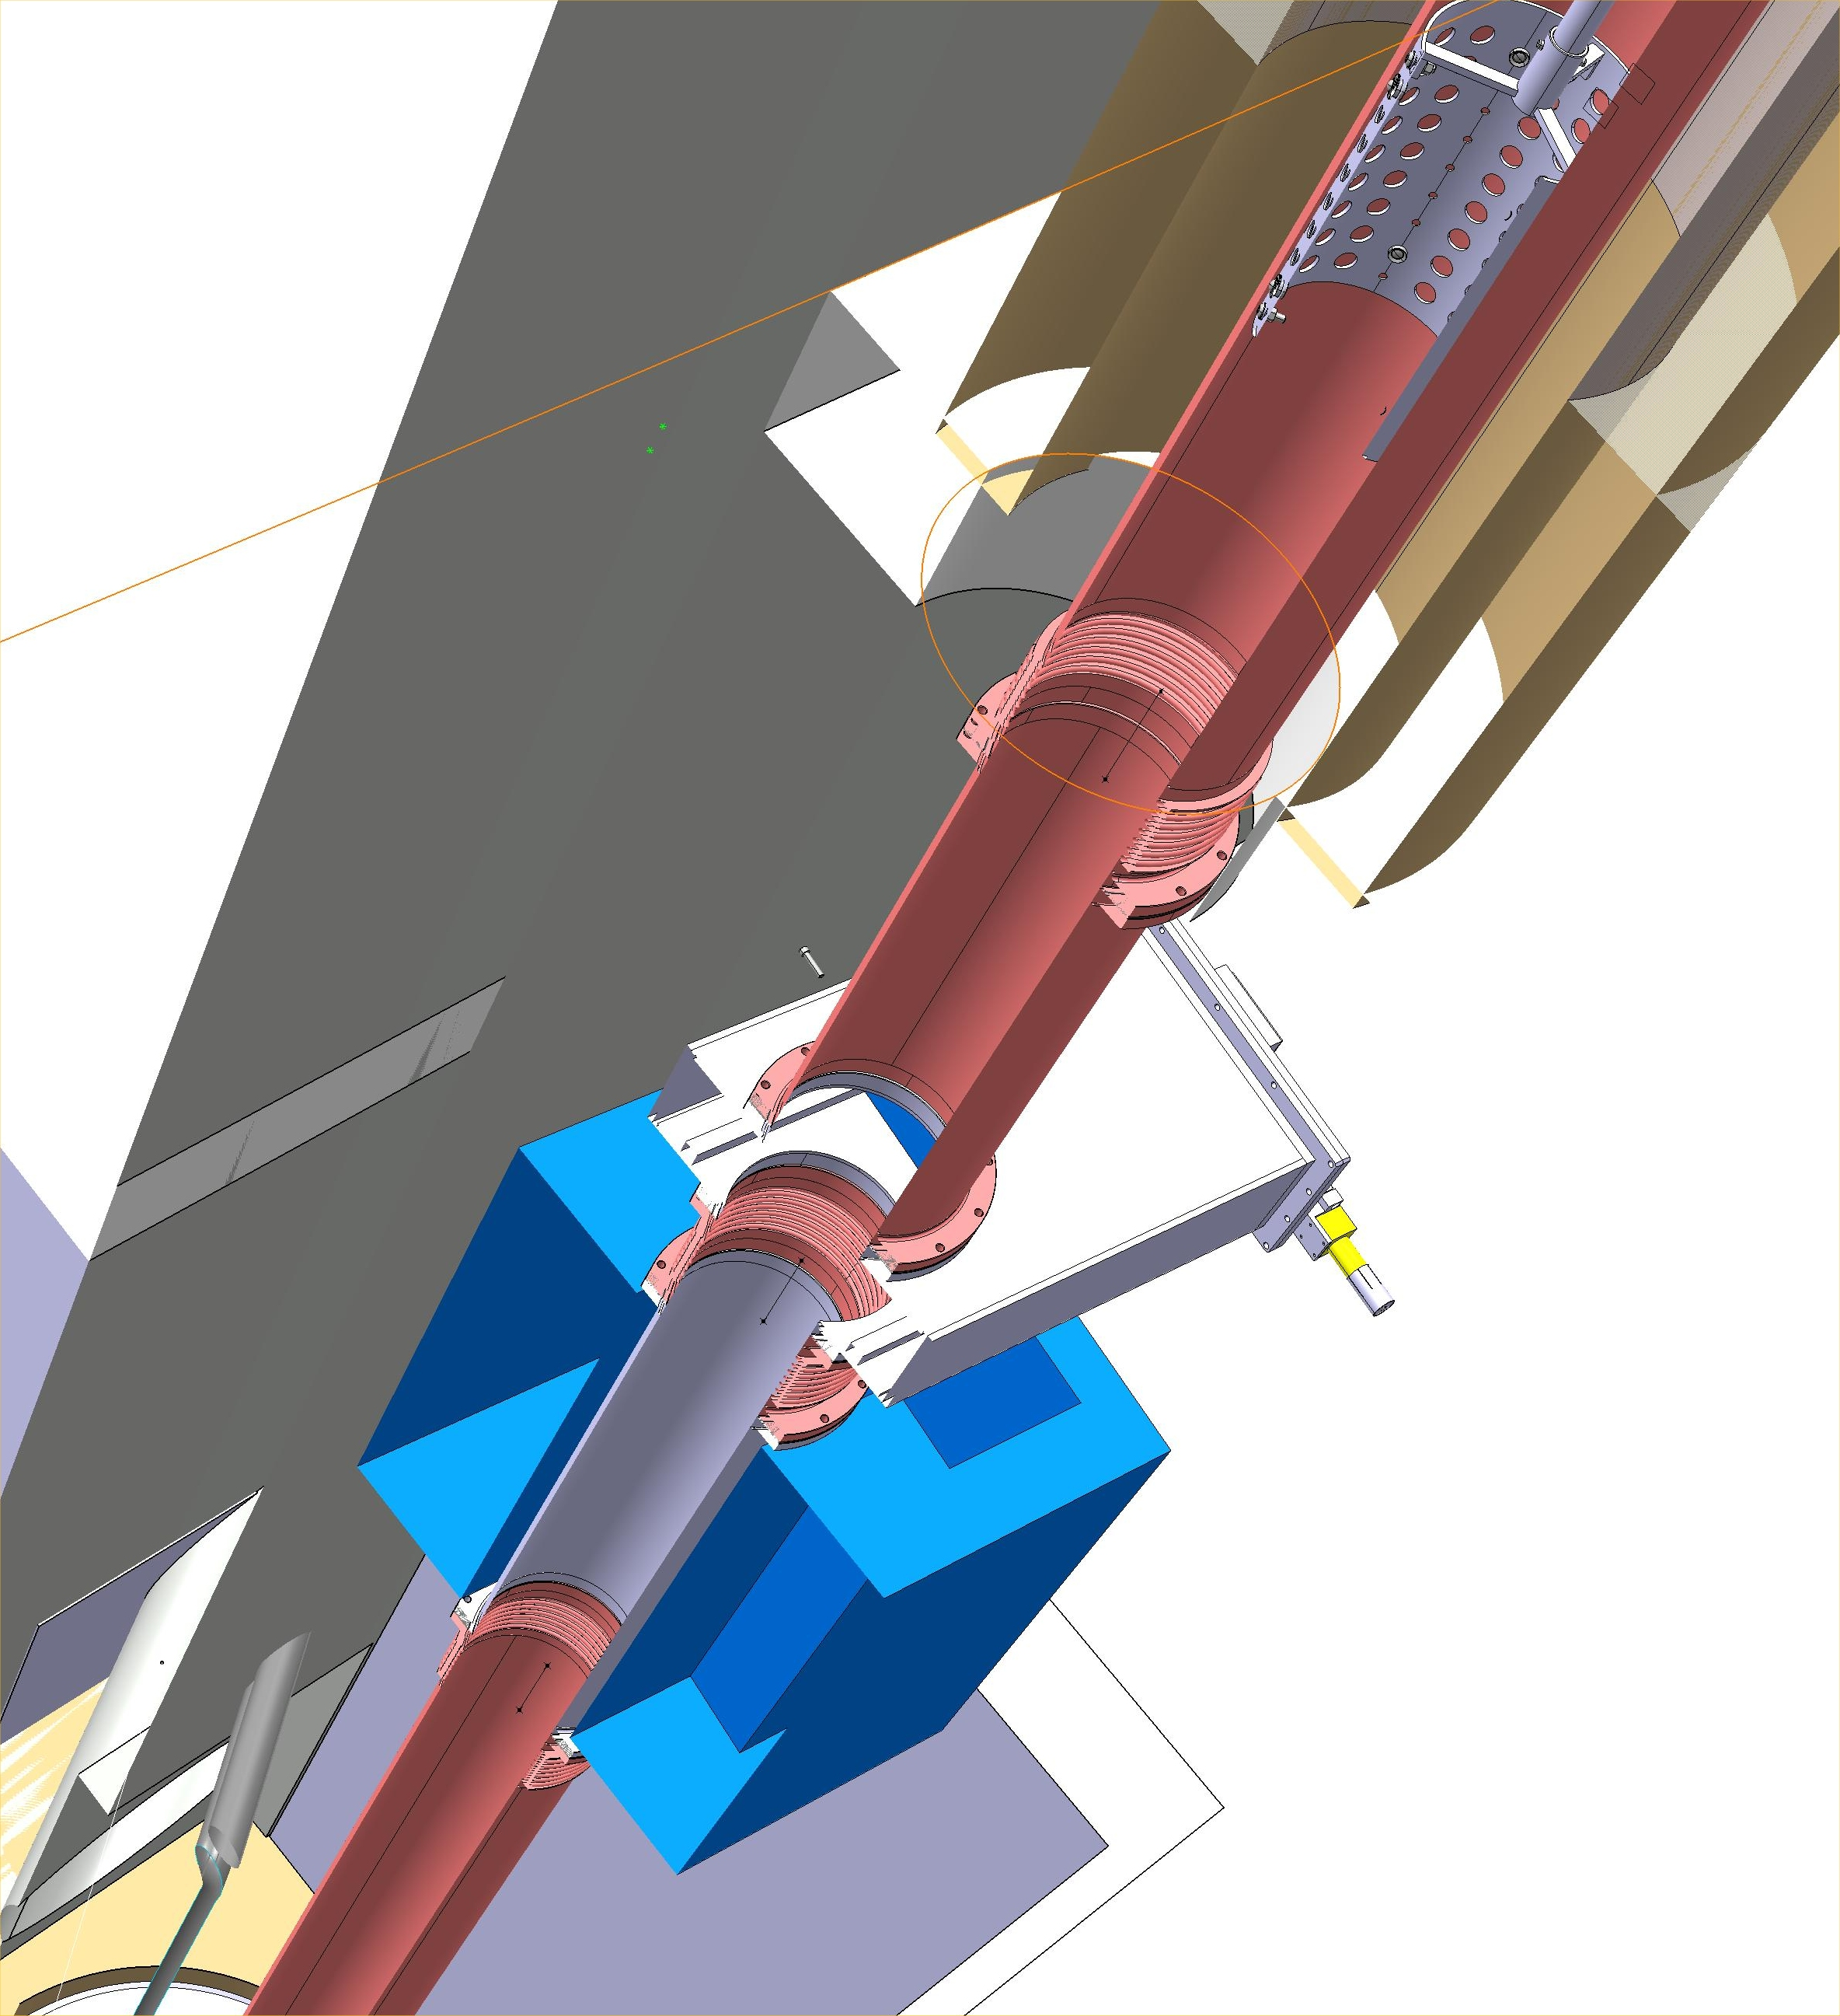
Beam line with Permanent magnet
Permanent magnet

Slide 24
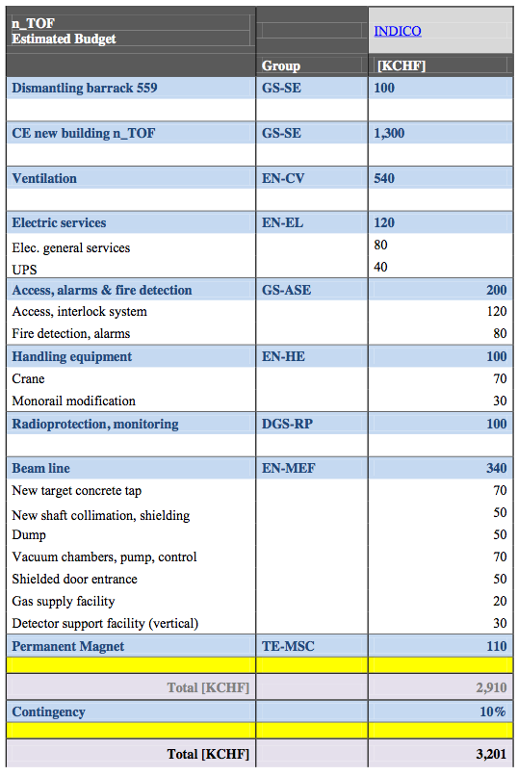
Cost EAR-2

Slide 25
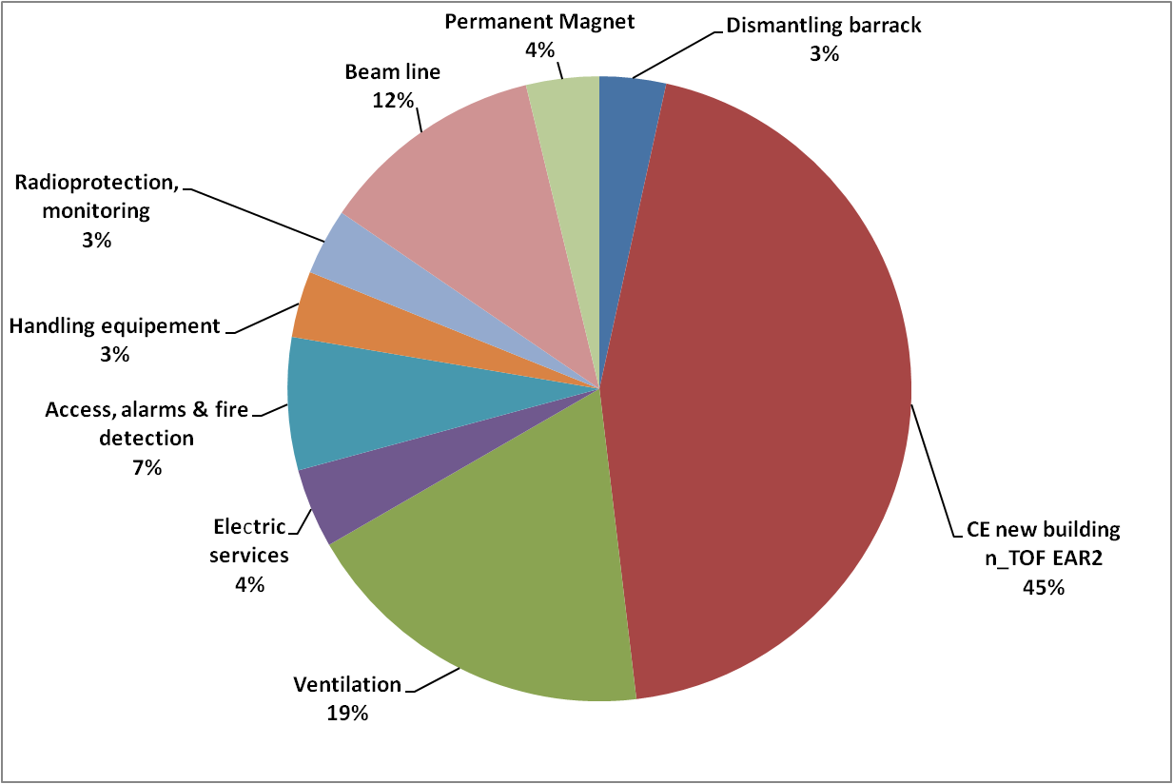
Cost Ear-2

Slide 26
Staff EAR-2

Slide 27
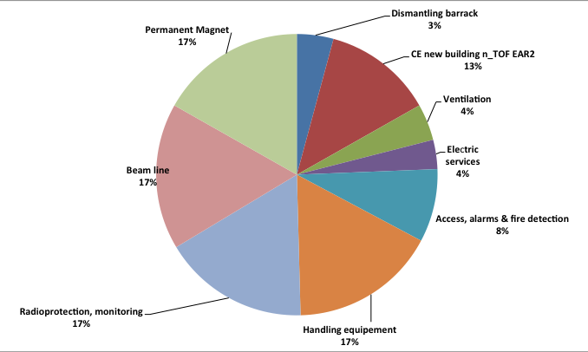
Staff EAR-2

Slide 28
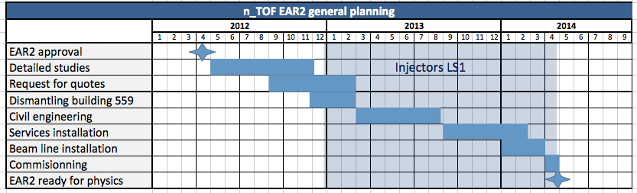
Planning EAR-2

Slide 29
EAR-2 Proposal-Conclusion
The n_TOF Collaboration Board in the meeting of Lisbon strongly supports the Proposal for EAR-2

Slide 30
Summary
The n_TOF facility is already unique in the world in terms of the instantaneous neutron flux and low background
The addition of the EAR-2 with its enhanced capabilities will increase the physics reach of the installation
EAR-2 will open new opportunities in the measurement of neutron-induced reactions with unprecedented accuracy for various important fields of physics:
nuclear technology, nuclear astrophysics and stellar evolution, basic research, medical applications, dosimetry and radiation damage

