Slide 1
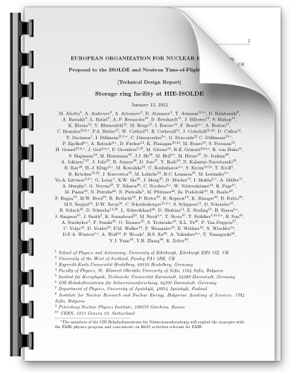
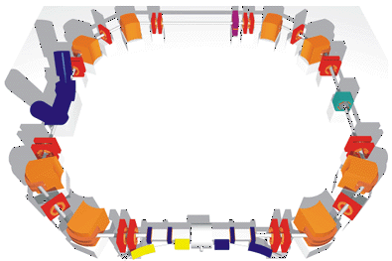
Motivation
TSR and ISOLDE
Physics
Planning
Storage ring facility at HIE-ISOLDE:
Technical Design Report
Klaus Blaum (MPI-Kernphysik, Heidelberg)
Riccardo Raabe (IKS, KU Leuven)
Phil Woods (Univ. of Edinburgh)
and the TSR@HIE-ISOLDE Collaboration

Slide 2
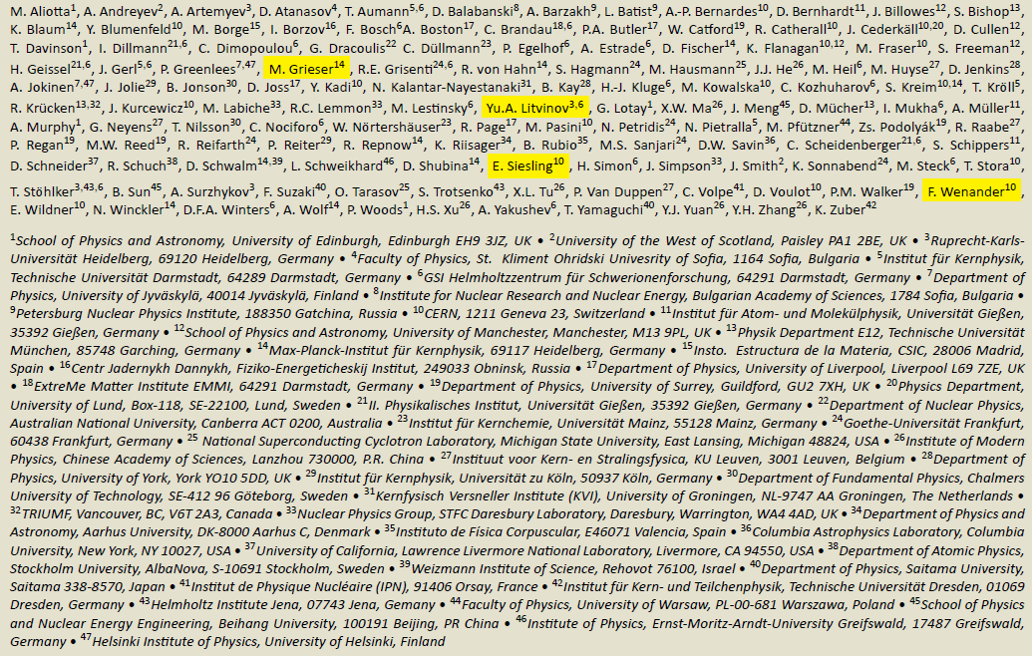
Motivation
TSR and ISOLDE
Physics
Planning
Collaboration: 129 scientists from 47 institutions in 19 countries

Slide 3
A storage ring at an ISOL facility
Motivation
TSR and ISOLDE
Physics
Planning
Advantages
With respect to in-flight
storage rings
  High intensity
  Cooler beams
With respect to “direct” beams
  Less background
  (target, beam dump)
  Improved resolution
  CW beam
Physics programme
Astrophysics
Capture, transfer reactions
⁷Be half life
Atomic physics
Effects on half lives
Di- electronic recombination
Nuclear physics
Reaction studies
Isomeric states
Halo states
Laser spectroscopy
Neutrino physics

Slide 4
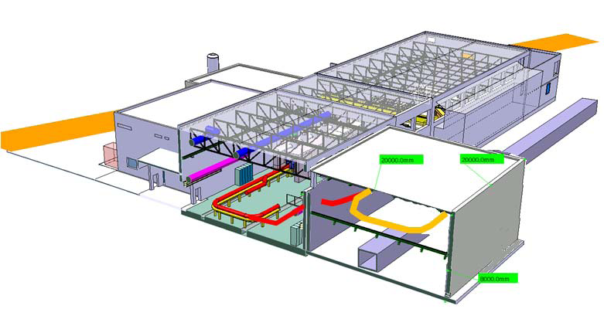
Coupling to HIE-ISOLDE: configuration
Motivation
TSR and ISOLDE
Physics
Planning
Possible TSR installation
above the CERN cable-tunnel
Tilted beamline coming up
from the machine

Slide 5
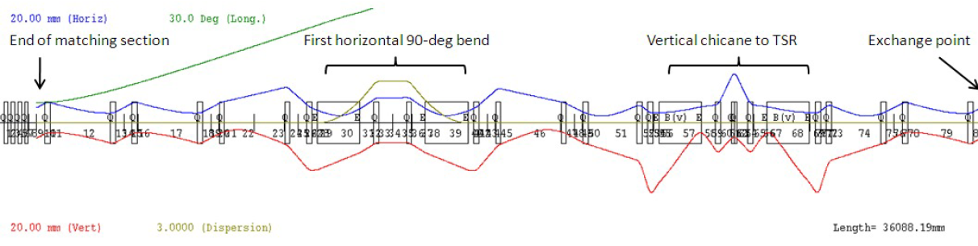
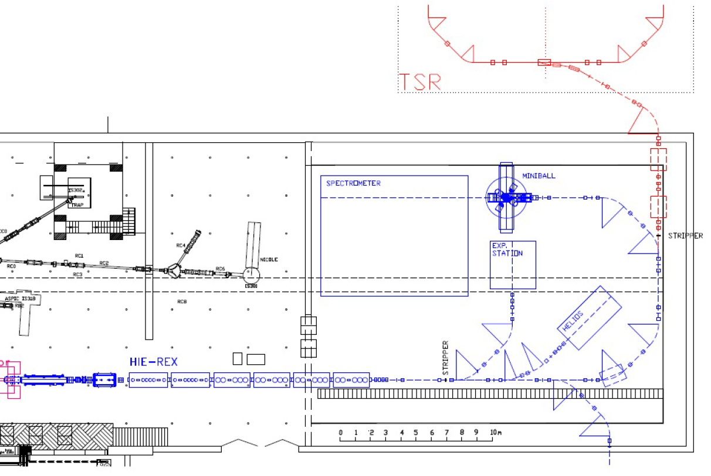
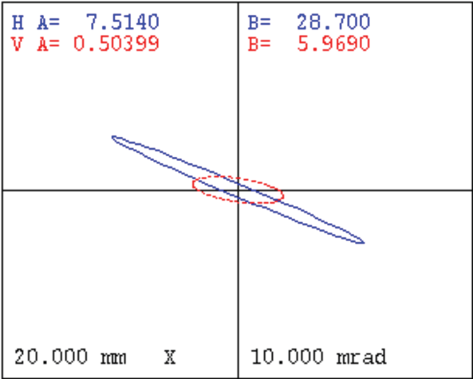
Coupling to HIE-ISOLDE: configuration
Motivation
TSR and ISOLDE
Physics
Planning
Transfer line

Slide 6
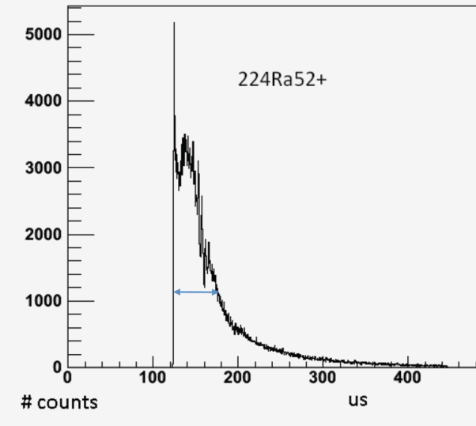
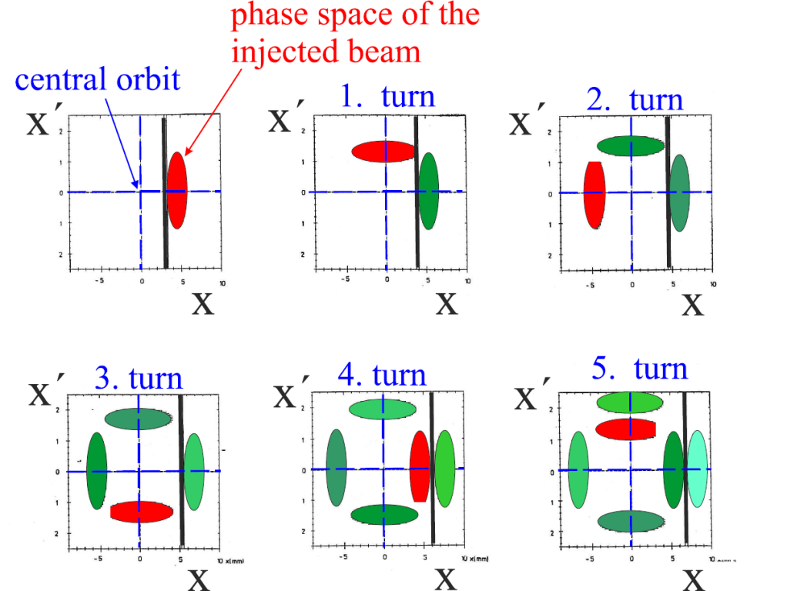
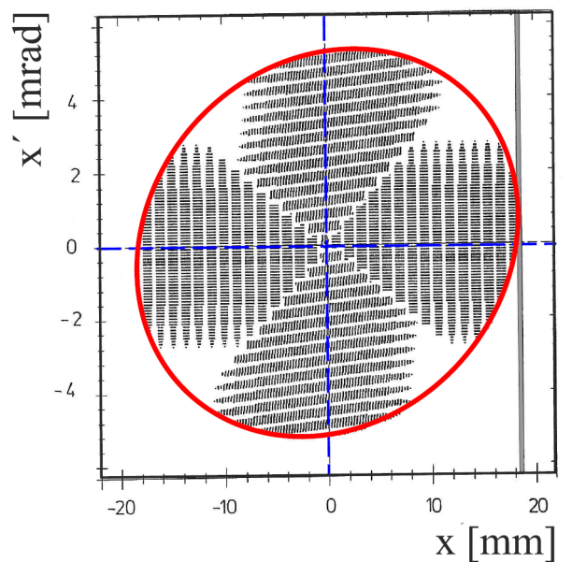
Coupling to HIE-ISOLDE: injection
Motivation
TSR and ISOLDE
Physics
Planning
EBIS time profile fits injection in TSR
Multi-turn injection:
multiplication factor =
  H acceptance TSR
  beam emittance

Slide 7
Coupling to HIE-ISOLDE: injection
Motivation
TSR and ISOLDE
Physics
Planning
EBIS time profile fits injection in TSR
Multi-turn injection:
multiplication factor =
(of the instantaneous current!)
compress
< ≈35 µs
  H acceptance TSR
  beam emittance
Beam emittance
MPIK 1.5 mm mrad
HIE-ISOLDE 3.5 mm mrad

Slide 8
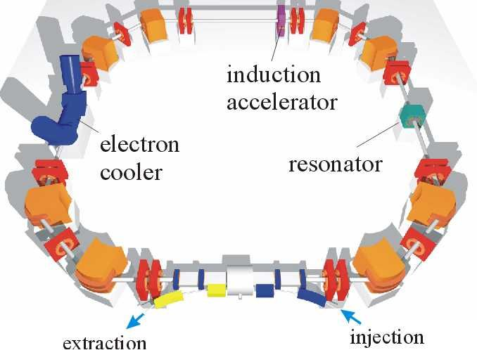
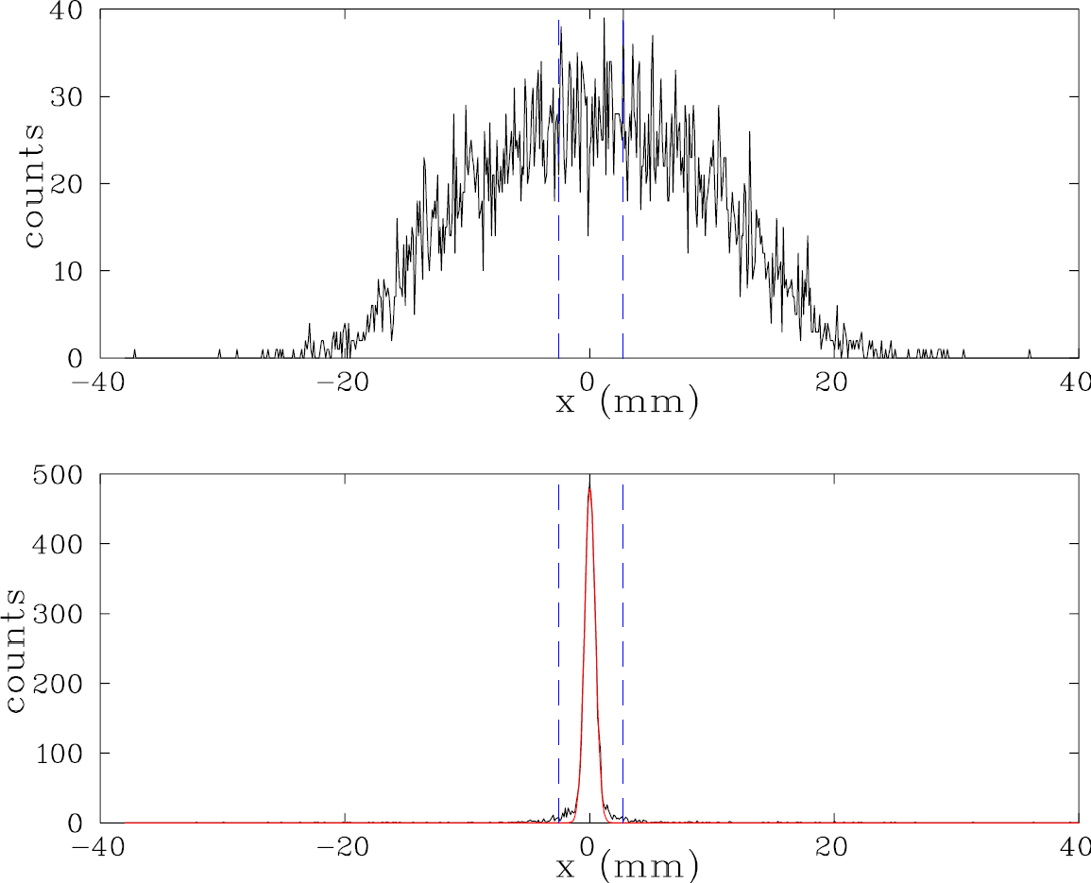
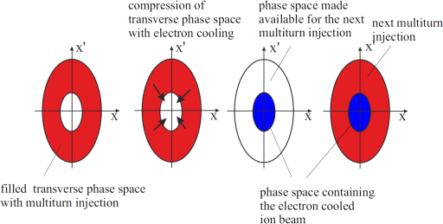
Coupling to HIE-ISOLDE: injection
Motivation
TSR and ISOLDE
Physics
Planning
EBIS time profile fits injection in TSR
Multi-turn injection:
multiplication factor =
Electron cooling
  Large gains only limited by lifetime
  H acceptance TSR
  beam emittance

Slide 9
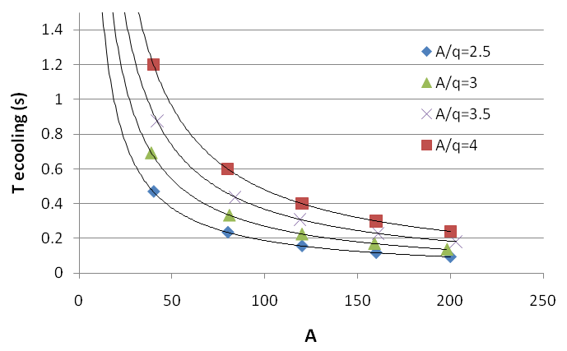
Coupling to HIE-ISOLDE: injection
Motivation
TSR and ISOLDE
Physics
Planning
EBIS time profile fits injection in TSR
Multi-turn injection:
multiplication factor =
Electron cooling
  Large gains only limited by lifetime
  Cooling times ≈ 1 s
  in any case injection max 5 Hz
  H acceptance TSR
  beam emittance
T_{c} = k A/q²

Slide 10
Coupling to HIE-ISOLDE: injection
Motivation
TSR and ISOLDE
Physics
Planning
EBIS time profile fits injection in TSR
Multi-turn injection:
multiplication factor =
Electron cooling
  Large gains only limited by lifetime
  Cooling times ≈ 1 s
  in any case injection max 5 Hz
  H acceptance TSR
  beam emittance
T_{c} = k A/q²
store ions in REXTRAP

Slide 11
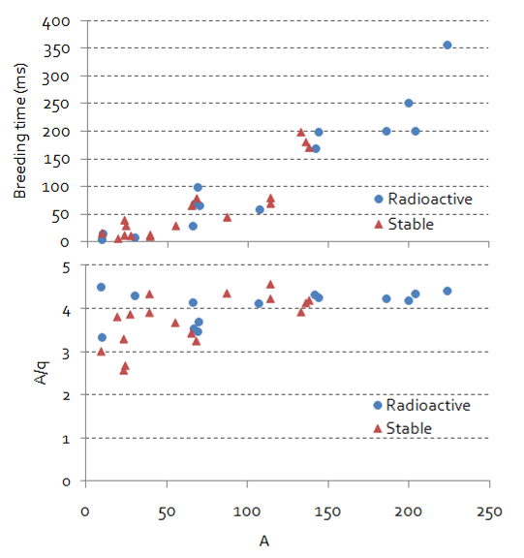
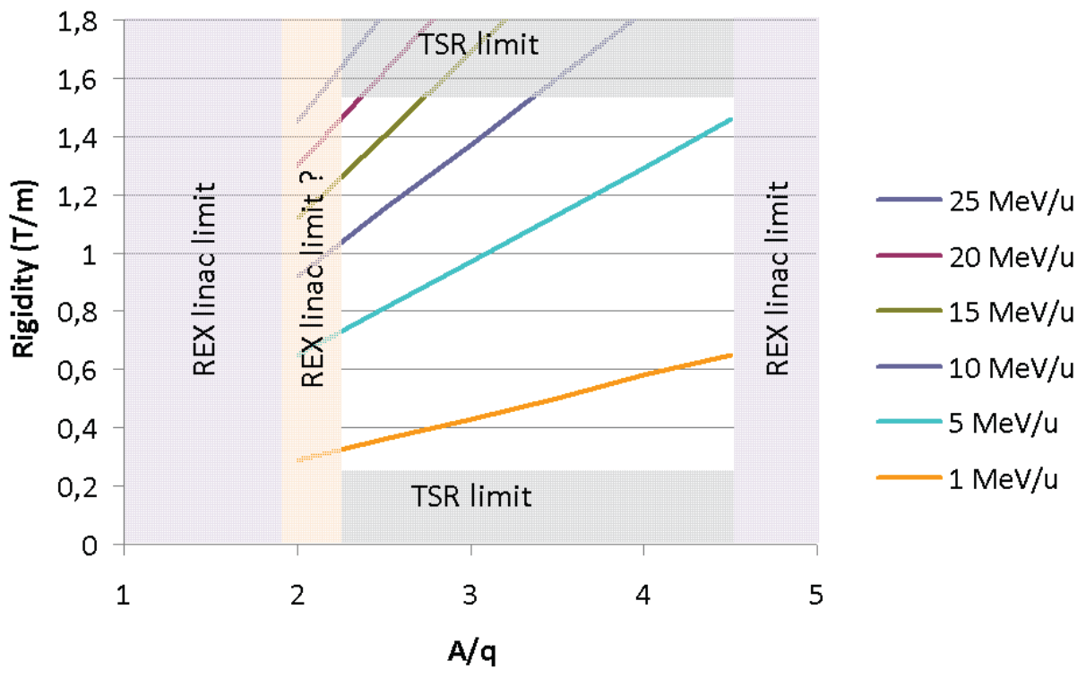
Coupling to HIE-ISOLDE: injection
Motivation
TSR and ISOLDE
Physics
Planning
EBIS time profile fits injection in TSR
Multi-turn injection:
multiplication factor =
Electron cooling
  Large gains only limited by lifetime
  Cooling times ≈ 1 s
  in any case injection max 5 Hz
Charge state
  Rigidity TSR
  Storage lifetimes
  Cooling times
  Experiments
  H acceptance TSR
  beam emittance

Slide 12
Coupling to HIE-ISOLDE: injection
Motivation
TSR and ISOLDE
Physics
Planning
EBIS time profile fits injection in TSR
Multi-turn injection:
multiplication factor =
Electron cooling
  Large gains only limited by lifetime
  Cooling times ≈ 1 s
  in any case injection max 5 Hz
Charge state
  Rigidity TSR
  Storage lifetimes
  Cooling times
  Experiments
  H acceptance TSR
  beam emittance
(stripper foil)
[charge breeder upgrade]

Slide 13
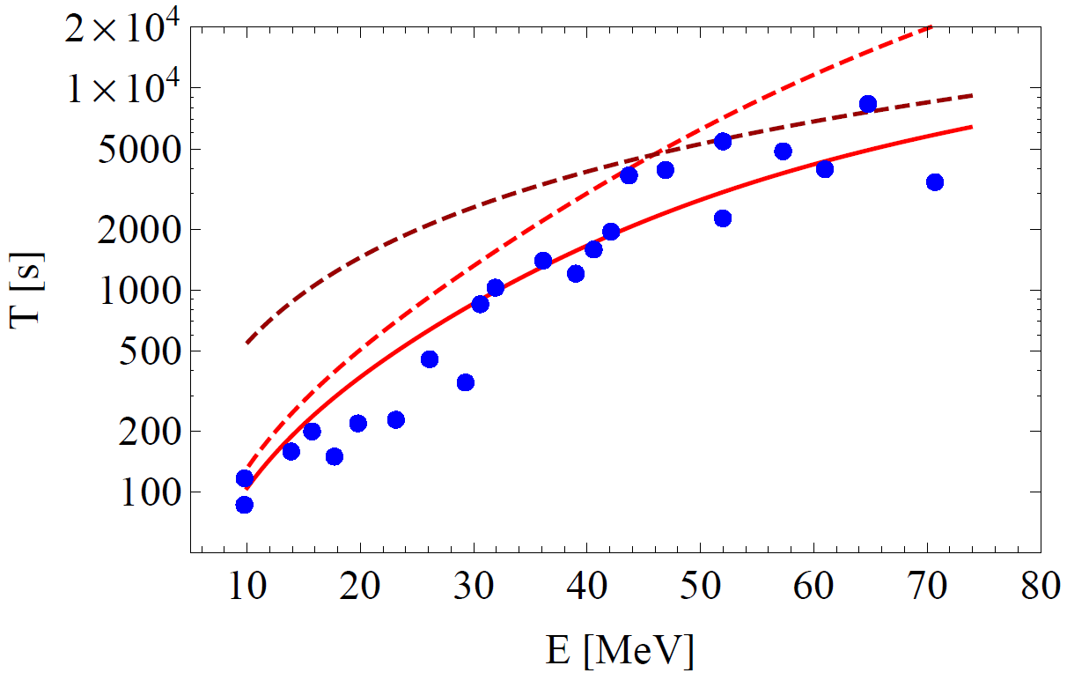
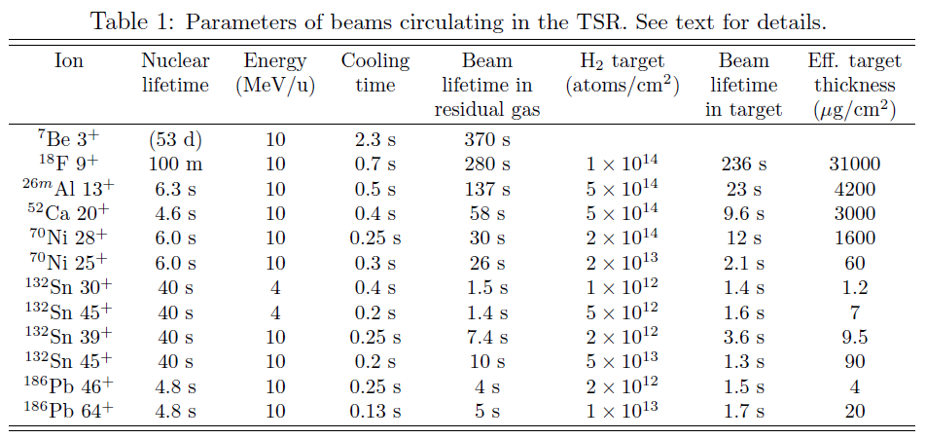
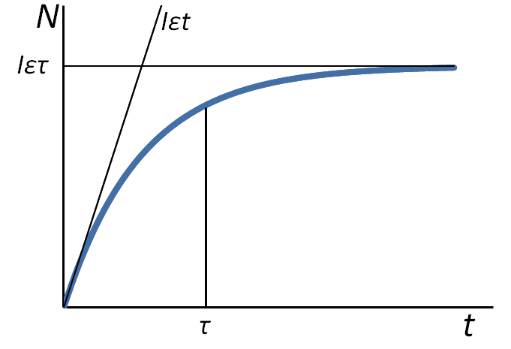
In the ring: survival times, beam handling
Motivation
TSR and ISOLDE
Physics
Planning
Survival times
  Coulomb scattering,
  electron capture and stripping
  Residual gas, electrons in the cooler and gas target
Experiment reproduced by theory
electron capture
multiple scattering
total
¹²C⁶⁺

Slide 14
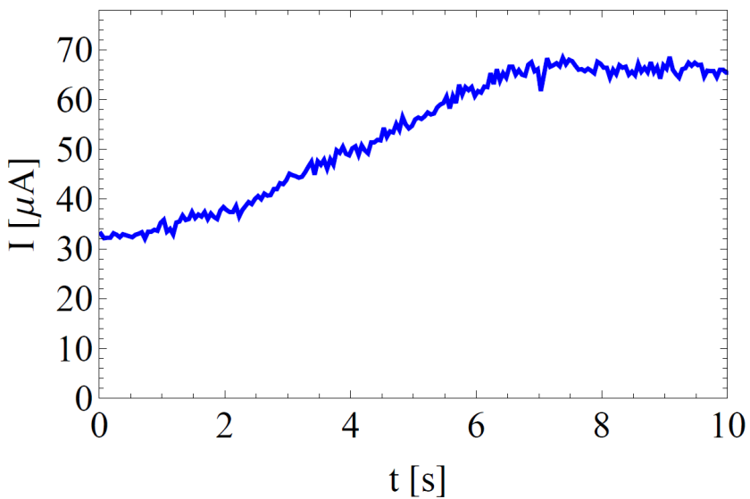
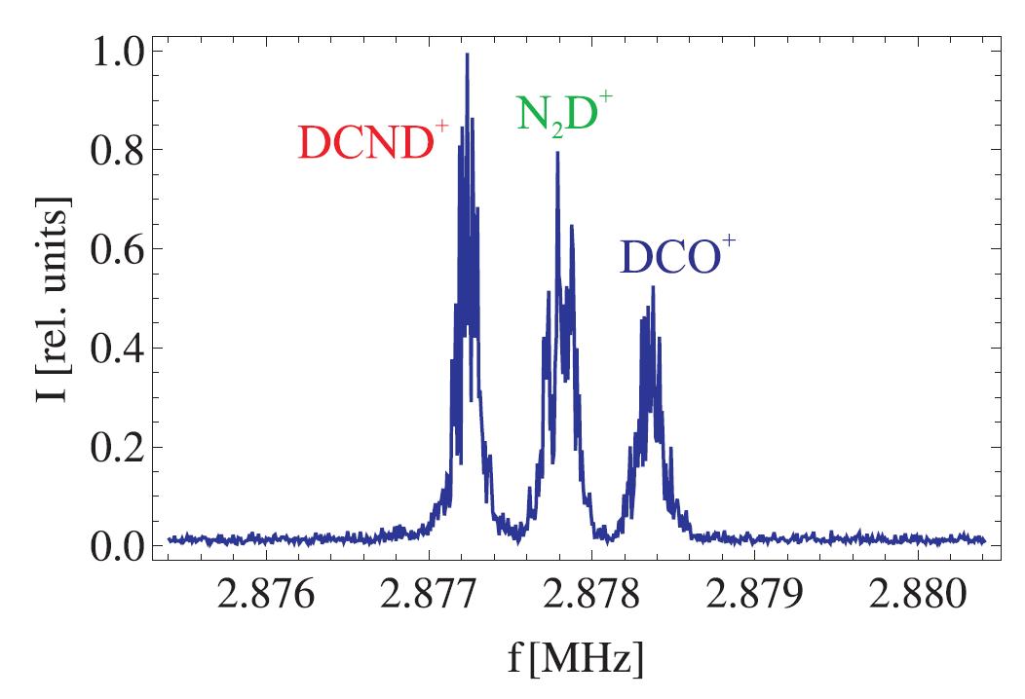
In the ring: survival times, beam handling
Motivation
TSR and ISOLDE
Physics
Planning
Survival times
  Coulomb scattering,
  electron capture and stripping
  Residual gas, electrons in the cooler
  and gas target
Experiment reproduced by theory
Acceleration and deceleration
longitudinal bunching
Mass-selective acceleration
separation M/ΔM ≈ 3000
(few hundreds ms)
¹²C⁶⁺

Slide 15
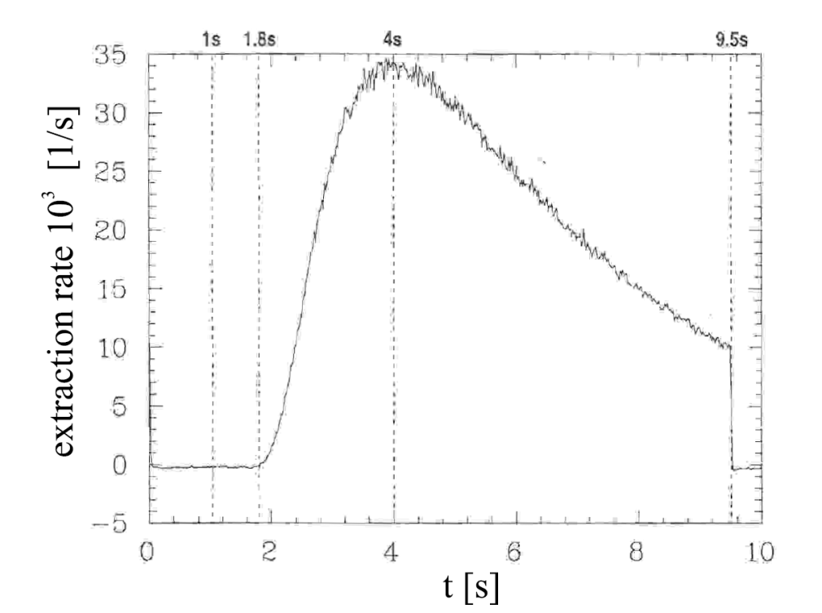
Back to ISOLDE: extraction
Motivation
TSR and ISOLDE
Physics
Planning
Extraction times
between 0.1 s and 30 s
Efficiency (cooled beam) ≈90%
Properties similar to those
of the cooled beam
Use in external experiments
(HELIOS…)

Slide 16
Beam usage
Motivation
TSR and ISOLDE
Physics
Planning
≈1 s
injection
no cooling
I_{TSR} = I_{HIE-ISOLDE} × f_{rev} / f_{inj}
cooling
I_{TSR} = I_{HIE-ISOLDE} × f_{rev} × τ
injection
stacking
Exploitation
Measurement
Acceleration/deceleration
Mass separation
Extraction

Slide 17
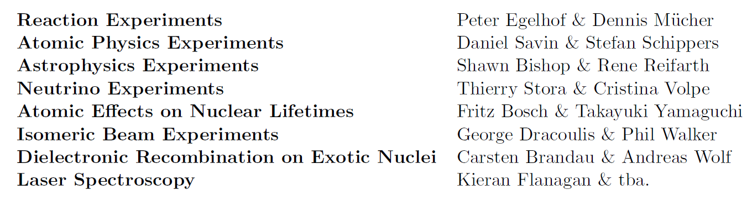
Physics programme
Motivation
TSR and ISOLDE
Physics
Planning
Conveners

Slide 18
Physics programme
Motivation
TSR and ISOLDE
Physics
Planning
Conveners

Slide 19
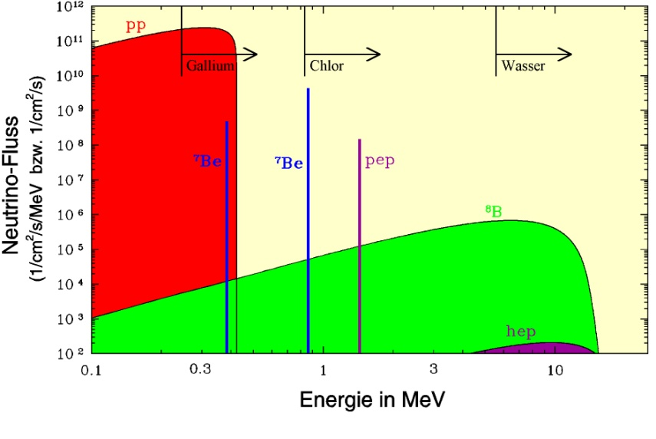
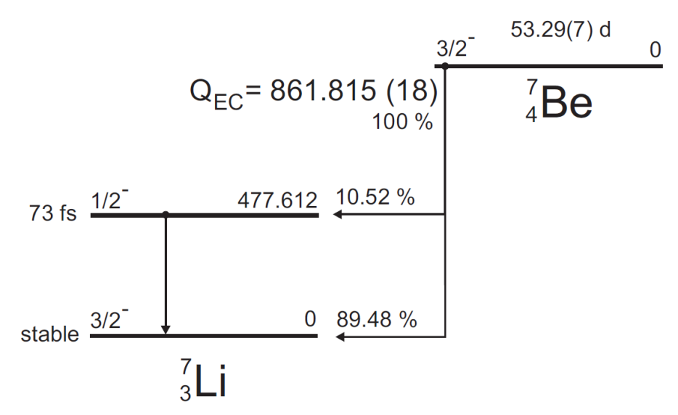
Half life of H-like ⁷Be
Motivation
TSR and ISOLDE
Physics
Planning
Half life of ⁷Be in the Sun?
Produced ν_{e} rates
τ_{7Be} ≈ 300 s
τ_{7Li} ≈ 9000 s
cooling 2.3 s
injection
≈10⁸ ions
stacking
decay

Slide 20
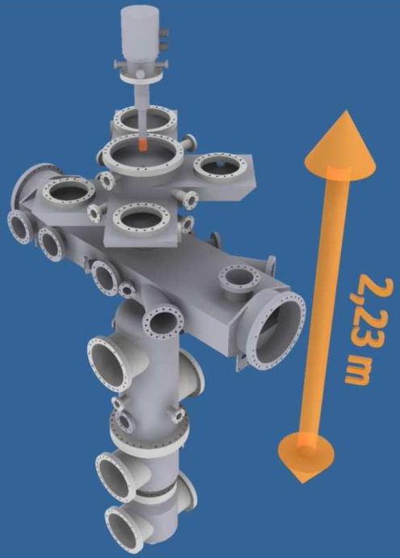
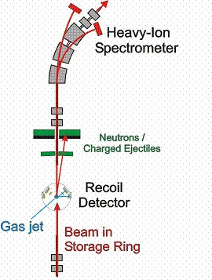
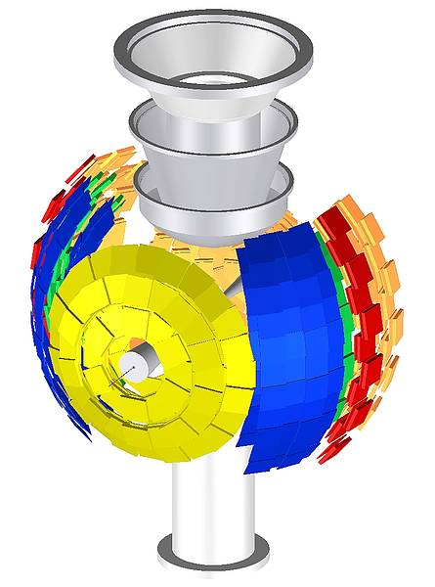
Reaction measurements
Motivation
TSR and ISOLDE
Physics
Planning
cooling ≈0.5 s
injection
≈10⁵ ions
measurement ≈1-2 s
EXL collaboration

Slide 21
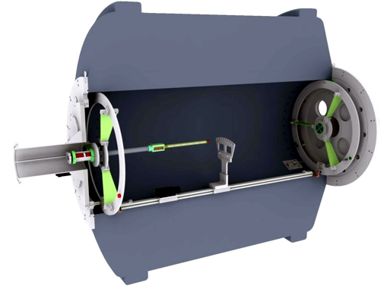
Extracted beams
Motivation
TSR and ISOLDE
Physics
Planning
cooling ≈0.5 s
injection
≈10⁵ ions
stacking ≈τ
extraction ≈5 s
Cooled beams
in HELIOS-type spectrometer

Slide 22
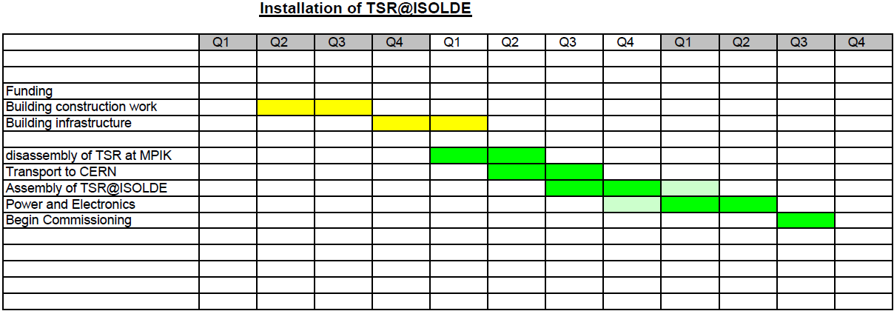
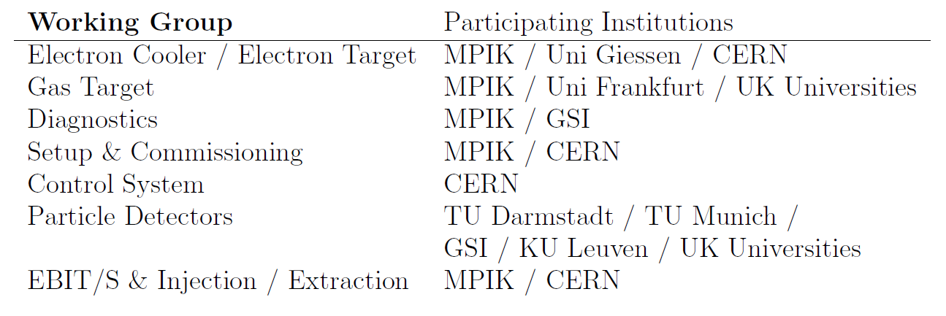
Planning
Motivation
TSR and ISOLDE
Physics
Planning
Estimates made for disassembly,
transportation, reassembly
Building (≈ 3 MCHF)
to be requested from CERN
Hardware: working groups
the Collaboration seeks funding
Running costs and manpower
provided by the Collaboration

Slide 23
Programme – Astrophysics

Slide 24
Programme – Atomic physics

Slide 25
Programme – Nuclear physics

