Slide 1
Remeasurement of ³²Ar to Test the IMME
INTC-P-332
Solving the IMME Puzzle in the A=32, T=2 Isospin Quintet
Susanne Kreim
February 1st, 2012
Physics Aims
Technical Novelties
Shift Request

Slide 2
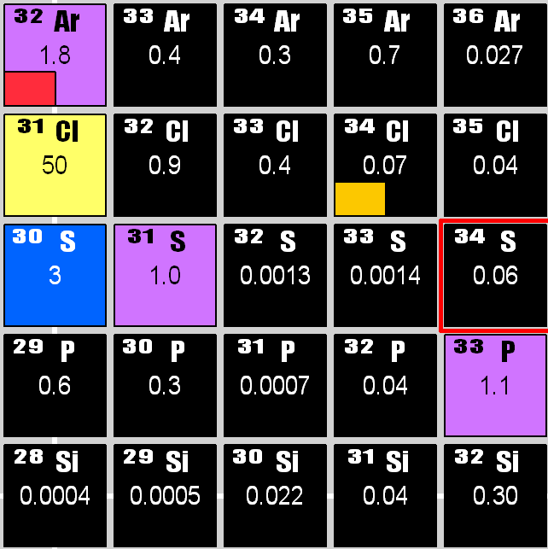
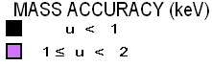
Isobaric Multiplet Mass Equation
Mirror nuclei form isospin multiplets all over the nuclear chart
The masses of isobaric analog states should lie along a parabola
Lots of evidence that at A=32 the IMME fails
  A. A. Kwiatkowski et al., Phys. Rev. C 80, 051302(R) (2009)
  C. Wrede et al., Phys. Rev. C 81, 055503 (2010)
  A. Kankainen et al., Phys Rev. C 82, 052501(R) (2010)
Breakdown of IMME points to unaccounted physics
  Theoretical: higher-order Coulomb effects, isospin mixing
  nucleon-nucelon interaction or many-body forces
  Empirical: Fit higher order of IMME
G. Audi and M. Wang, private communication (2011)

Slide 3
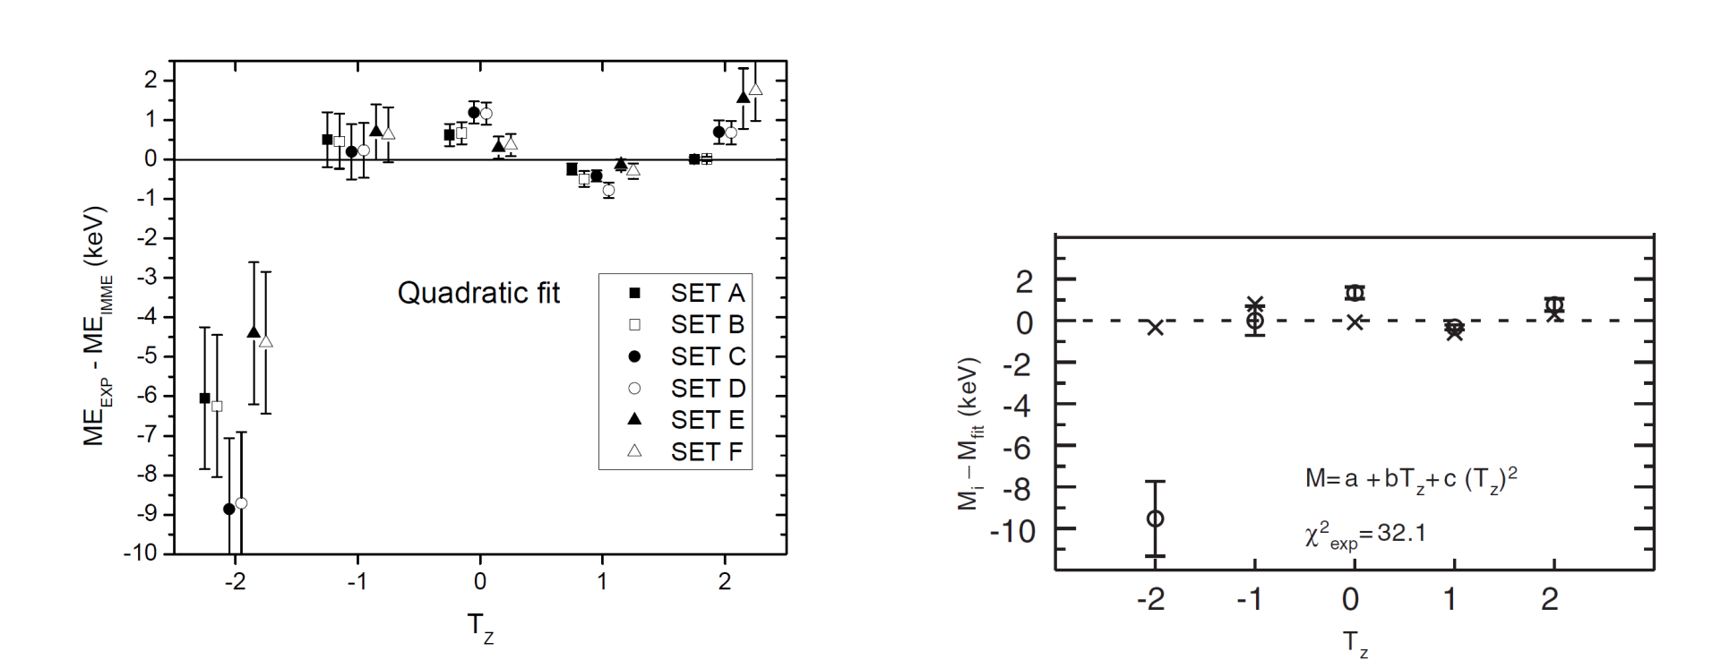
The A=32, T=2 Quintet
Mass values from different sources combined to different sets
  Penning-trap mass spectrometry
  Deduced from two-neutron separation energies
  Deduced from (n,γ) or (³He,t) reactions
Shell-model calculations to determine energy levels have greates discrepancy at T=-2
A. Kankainen et al., Phys. Rev. C 82, 052501(R) (2010)
A. Signoracci et al., Phys. Rev. C 84, 031301(R) (2011)

Slide 4
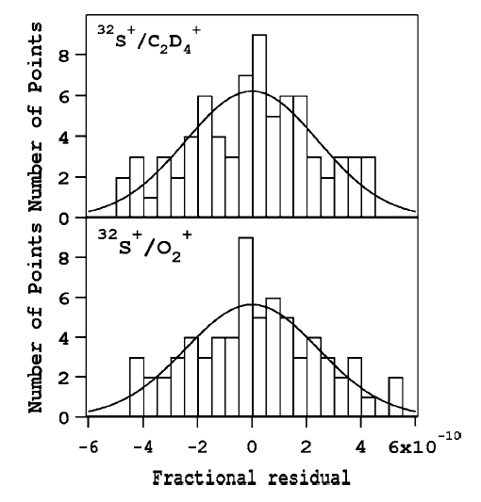
Other Masses at A=32
Investigate experimental reasons for deviation
Mass measurements of ³²Cl, ³²P, and ³²Si at the Penning-trap mass spectrometer JYFLTRAP
  A. Kankainen et al., JYFL Accelerator Laboratory Research Proposal (2011)
Wherever excitation energies of isobaric
analog states are needed, resolving power
of Penning traps can separate the states
  Common uncertainty of ground and excited state
³²S ground state (reference) measured by
non-destructive Penning-trap spectrometry
  Electronic detection via SQUIDs
  Cannot be used for exotic nuclei
W. Shi et al., Phys. Rev. A 72, 022510 (2005)

Slide 5
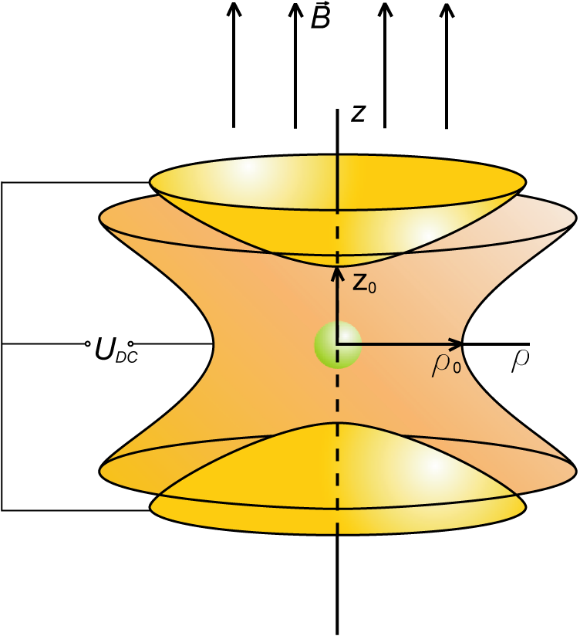
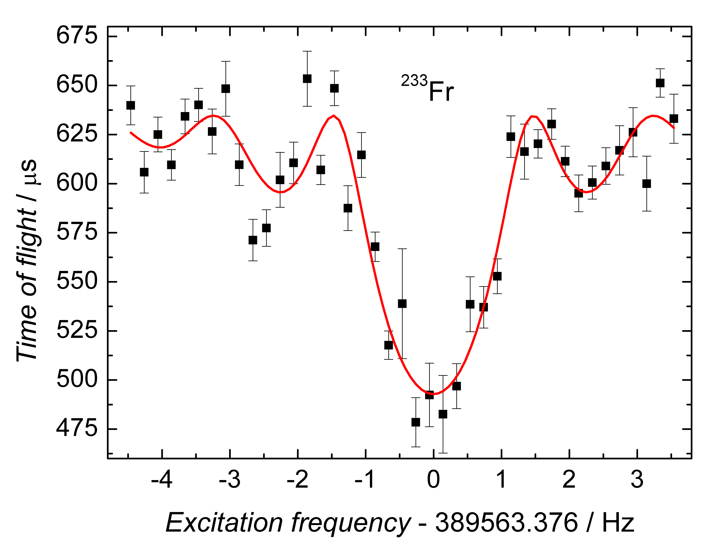
Storage and Detection
Trapping of particle via motion
in electro-magnetic field
Measurement via time-of-flight detection technique
L. S. Brown et al., Rev. Mod. Phys. 56, 233 (1986)
M. König et al., Int. J. Mass Spectrom. 142, 95 (1995)

Slide 6
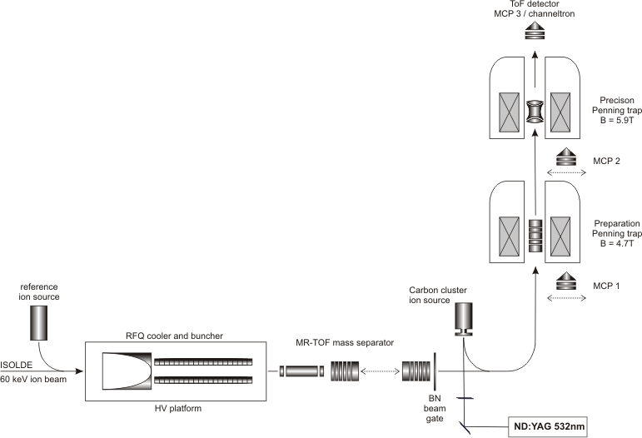
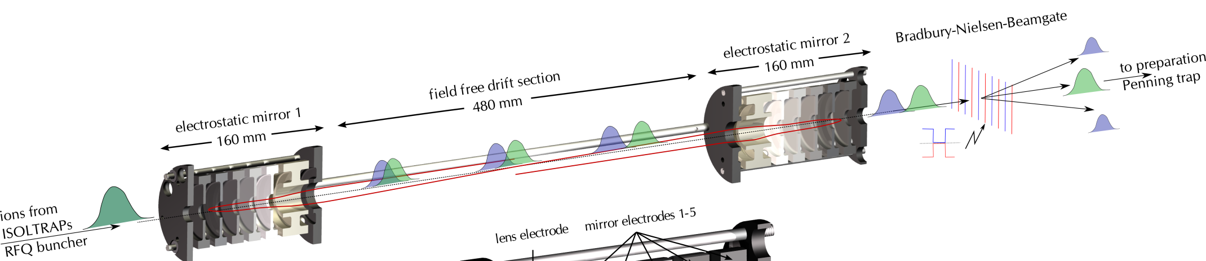
Fast Separation at ISOLTRAP
Isobar separation ~1/5 t_{1/2}
Stacking mode to accumulate statistics
  Commissioning tests planned within INTC-P-317
2 m
C-clusters!
R. N. Wolf et al., Hyp. Int. 199, 115 (2011)
M. Mukherjee et al., Eur. Phys. J A 35, 1 (2008)

Slide 7
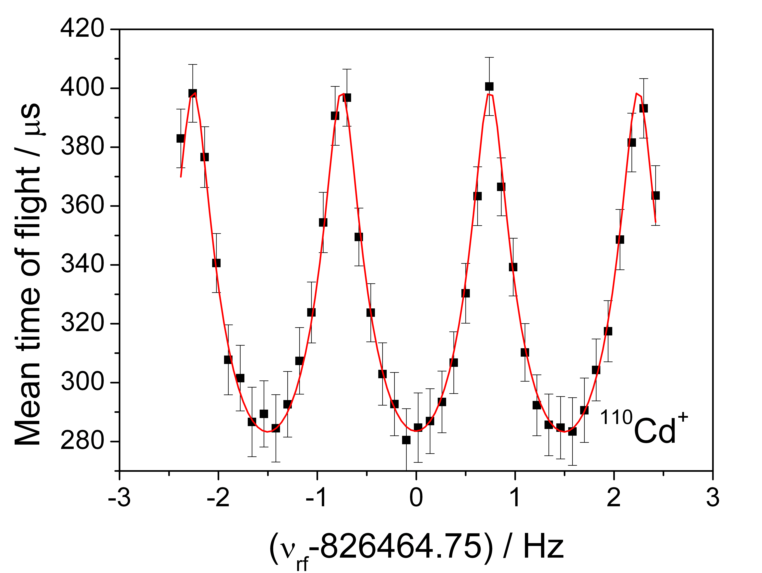
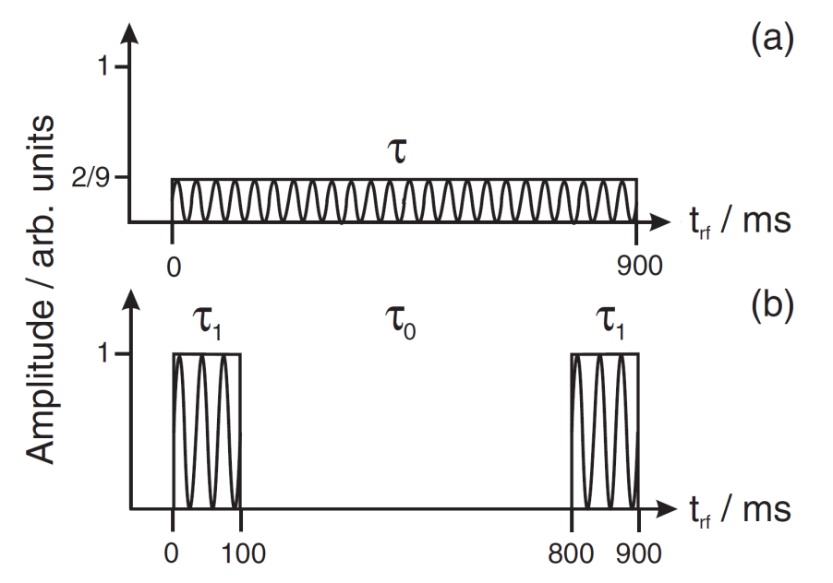
Ramsey Excitation Scheme
Ramsey excitation can be used for a gain in precision of more than a factor of 3 or vice versa the same precision with 1/10 of the statistics.
S. George et al., Phys. Rev. Lett. 98, 162501 (2007).
M. Kretzschmar, Int. J. Mass Spectrom. 264, 122 (2007).
S. George et al., Int. J. Mass Spectrom. 264, 110 (2007).
M. Suhonen et al., J. Inst, P06003 (2007).
T. Eronen et al., Phys. Rev. Lett. 100, 132502 (2008).
N.D. Scielzo et al., Phys. Rev. C 80, 025501 (2009).

Slide 8
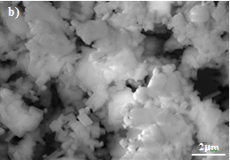
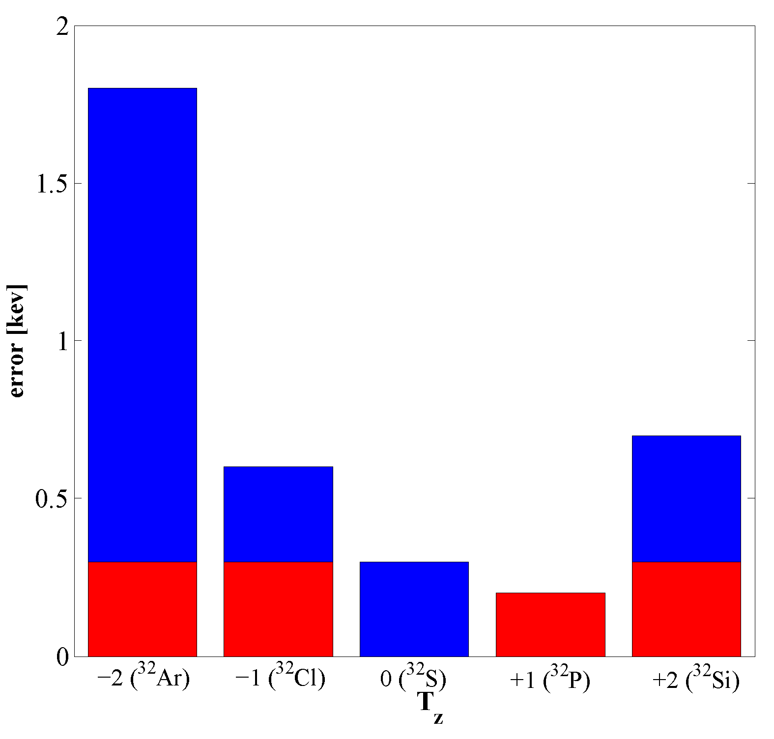
Beam Time Requests
Novel CaO target, factor 8 increase in yield
Use HRS plus slits for m/Δm ≈ 4000
Ratio of ³²Ar to ¹⁶O₂ ≈ 1:500
  Demonstrated ≈ 5·10³ for ⁸²Zn (same t_{1/2})
Nanostructured material 35-40nm
High open porosities (~47%)
J. P. Ramos, Master thesis (2012)
Yield stable over time
  No re-tuning during measurement
Target unit could be combined (WITCH)
ISOLTRAP „high-precision mode“
→ 8 plus 1 shifts

Slide 9




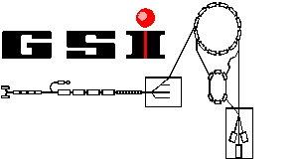






The ISOLTRAP Collaboration
... in cooperation with JYFLTRAP:
Thank you!

