Slide 1



Civil Engineering activities
@ R2E Project
18/01/2012
J. Osborne / J. Crespo

Slide 2
Index
2011/2012 Technical Stop
  Point 5: Core drilling & cutting activities
LS1
  Point 5: Core drilling activities + safe room
  Point 7: TZ Wall demolition
2
J. Osborne / J. Crespo

Slide 3
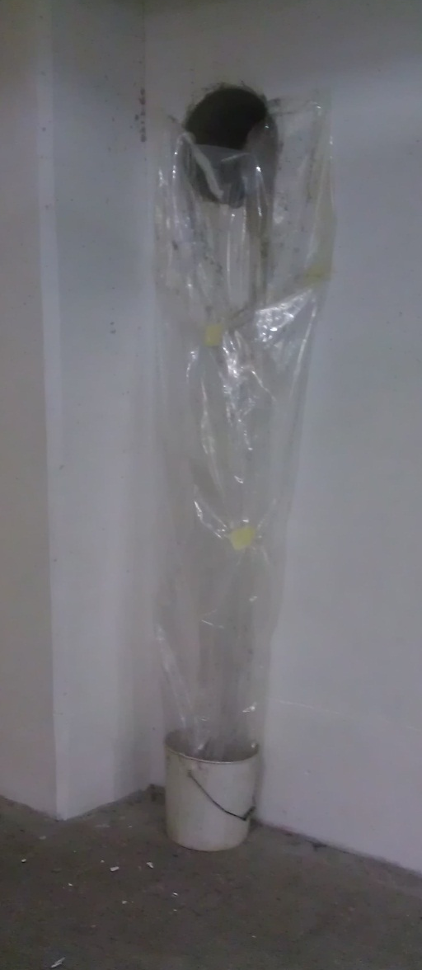
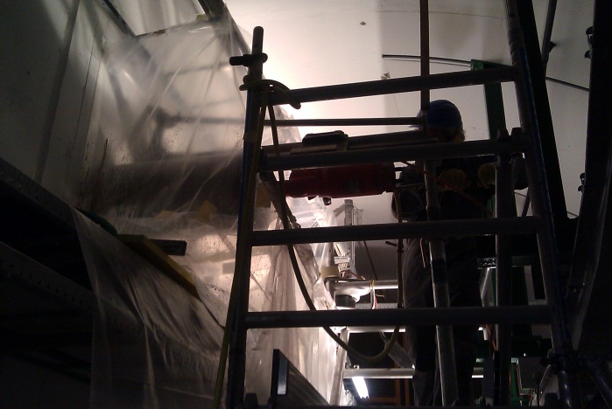
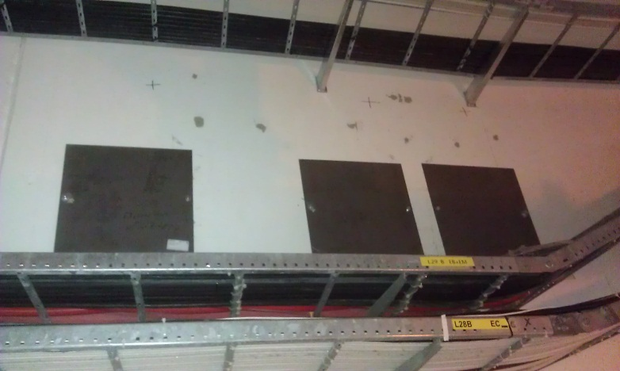
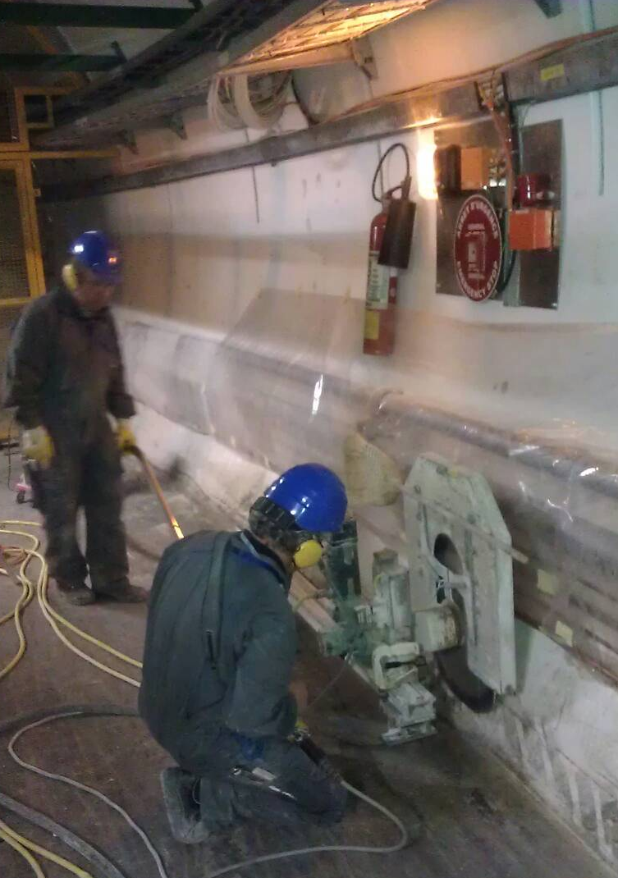
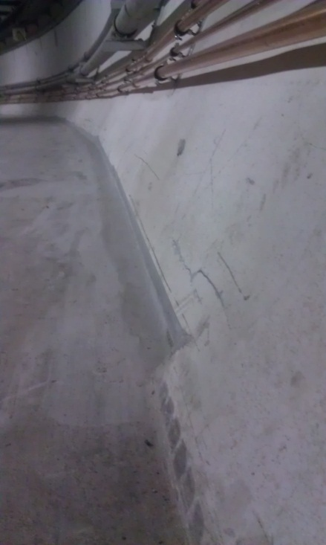
2011/2012 Technical Stop
6 ducts Ø350mm
J. Osborne / J. Crespo

Slide 4
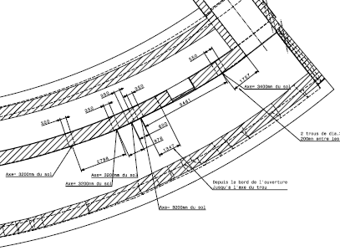
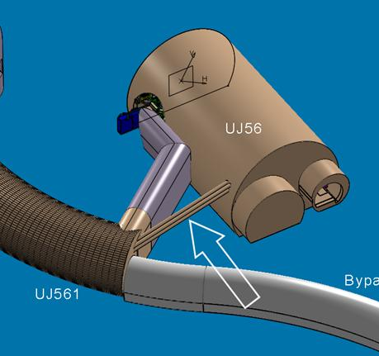
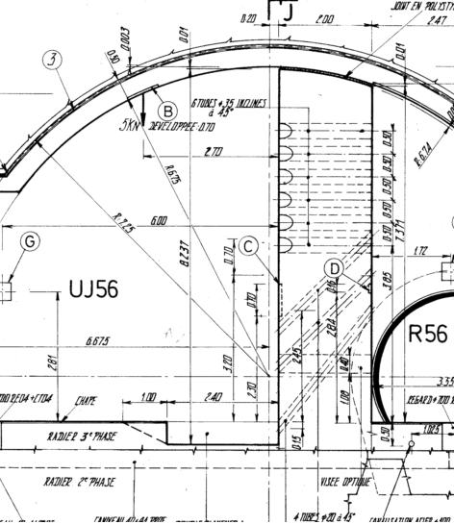
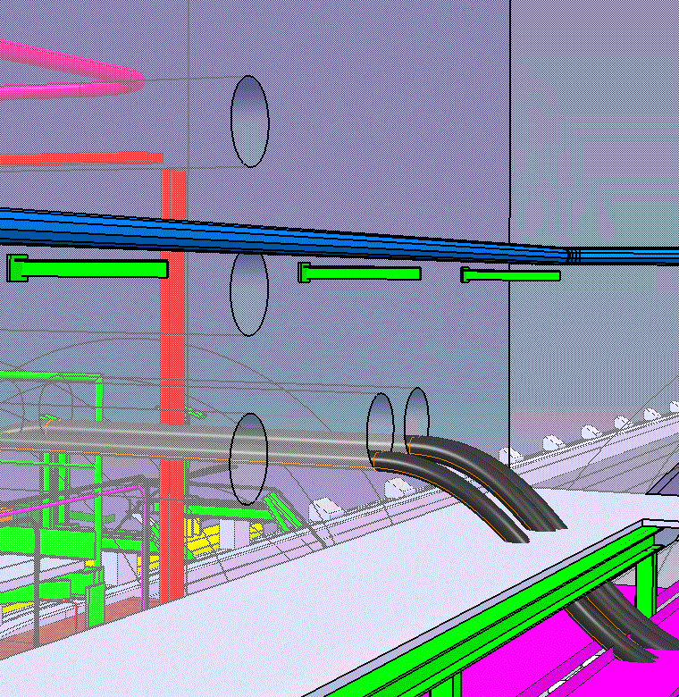
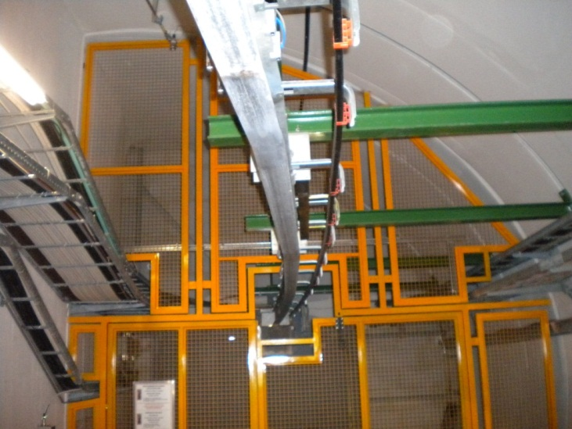
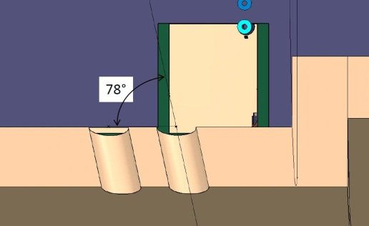
LS1 - P5
Drilling activities
2 ducts Ø350mm (UL557 - UL558)
4 ducts Ø400mm (UJ56 - UL558)
5 ducts Ø350mm (UJ56)
4
J. Osborne / J. Crespo

Slide 5
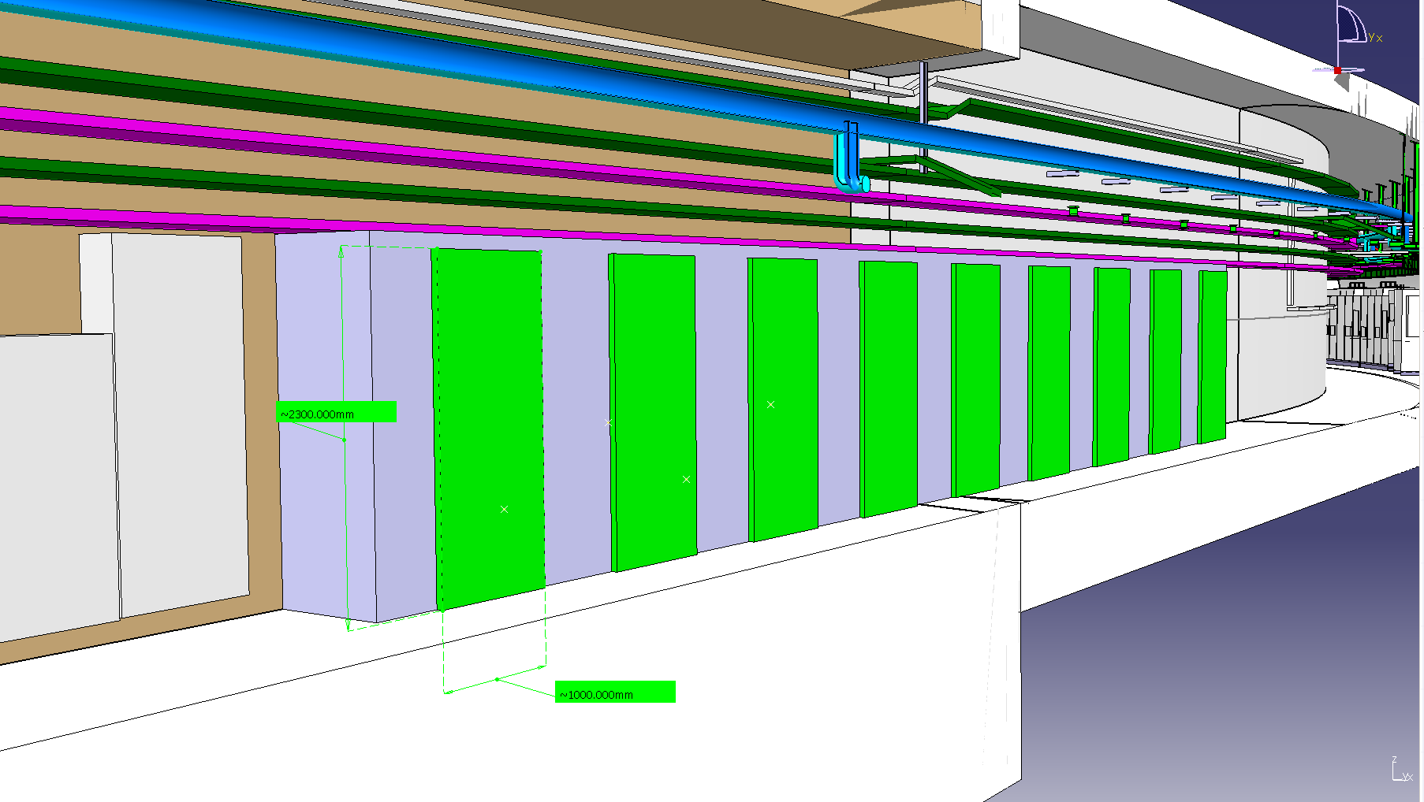
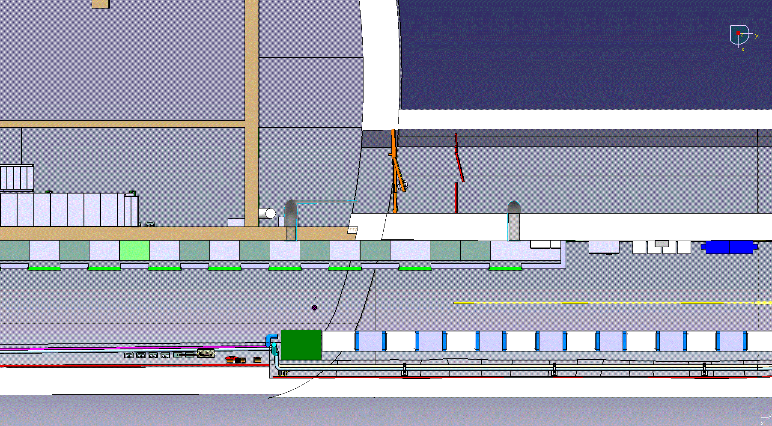
LS1 - P5
Safe room
J. Osborne / J. Crespo

Slide 6
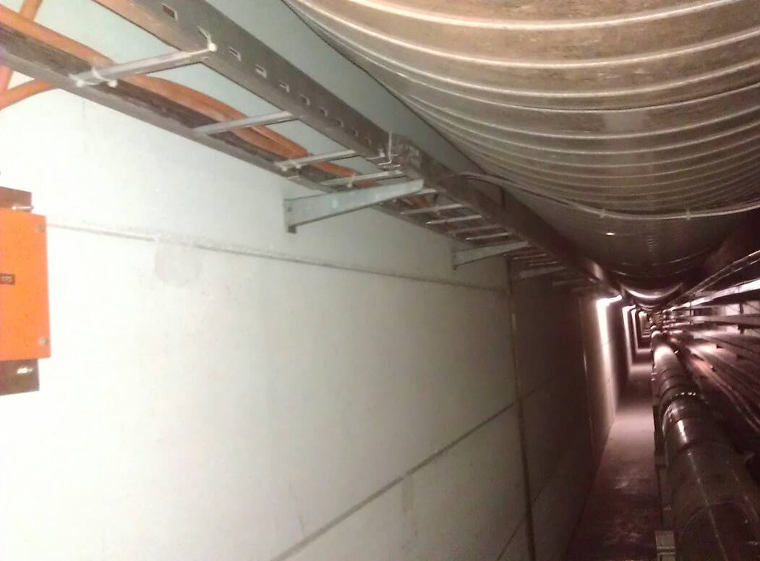
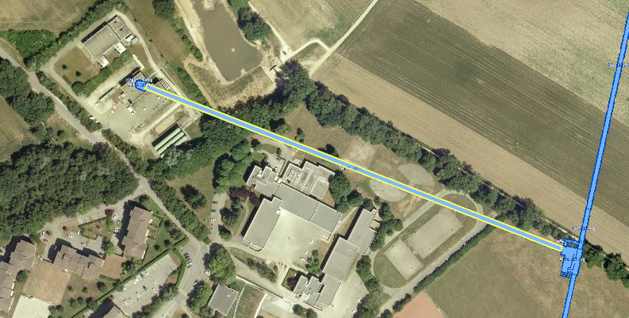
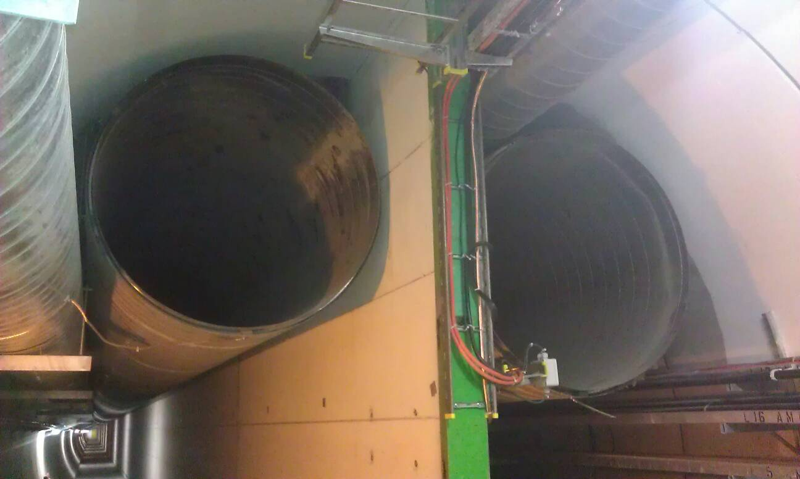
LS1 – P7
TZ76 Wall demolition
Ventilation ducts to be dismantled
Wall to be demolished
J. Osborne / J. Crespo

Slide 7
Thank you very much for your attention
Civil Engineering @ R2E
18/01/2012
J. Osborne / J. Crespo

