Slide 1


YongPyong 2012 Winter Conference on Particle Physics
February 20~23, 2012
Geant4 R & D for
Medical and Accelerator physics
Kihyeon Cho
High Energy Physics Team, KISTI

Slide 2
Contents
Introduction
  Experiment-Theory-Simulation
Geant4 Project
KISTI-Fermilab Collaboration
Simulation on secondary beam
Summary

Slide 3
Introduction

Slide 4

High Energy Physics @ KISTI
To probe the Standard Model and search for New Physics
e-Science
paradigm
Simu-lation
Experi-ment
Theory
Theory-Exp.
  FKPPL
  B physics
Theory-Simulation
  PGS
  LQCD
  Geant4
e-HEP env.
- Remote Cont.
- DP, DH
- EVO
CDF
Belle/Belle II
K.Cho and H.W.Kim, JKPS (2009)
Notes:
Wednesday, Landau shows similar diagram. According to Tony Hey, the 21st century is for data centric science called e-Science to unify theory, experiment and computing. We apply this concept to collider physics.
The goal is to probe SM and search for new physics. We focus on charm, bottom, top and Higgs.

Slide 5
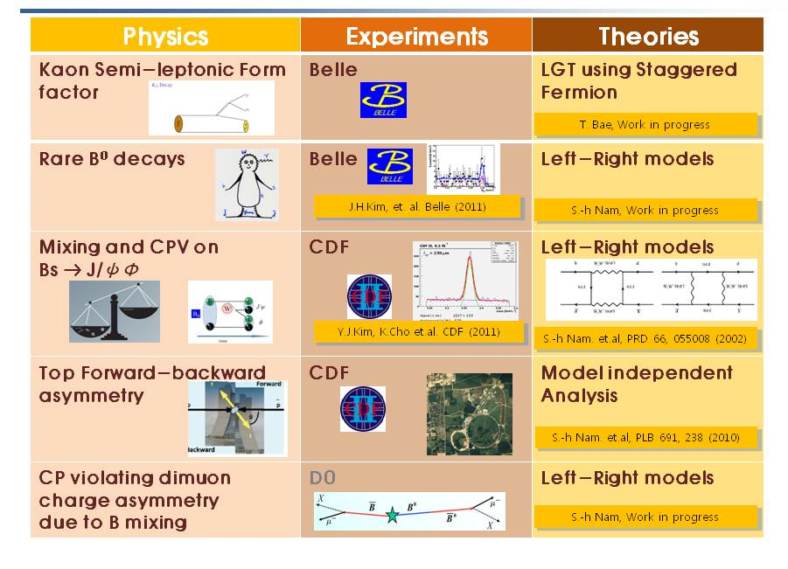
1. Theory-Experiment
⇒ Feed-back between experiments (Belle & CDF) and theories inside KISTI
4

Slide 6
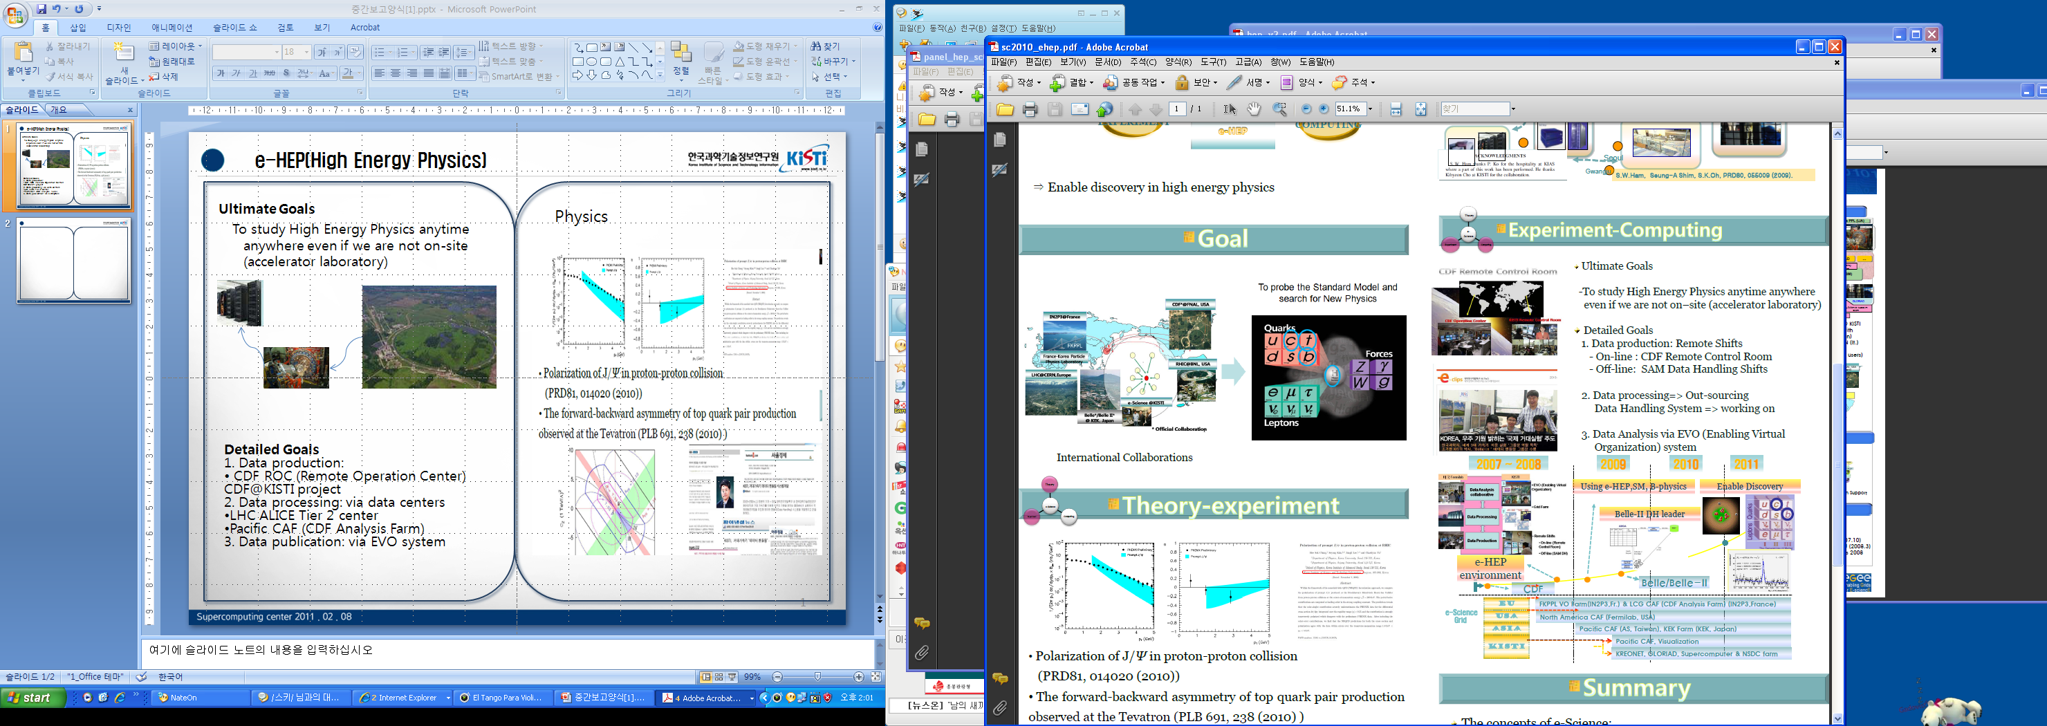
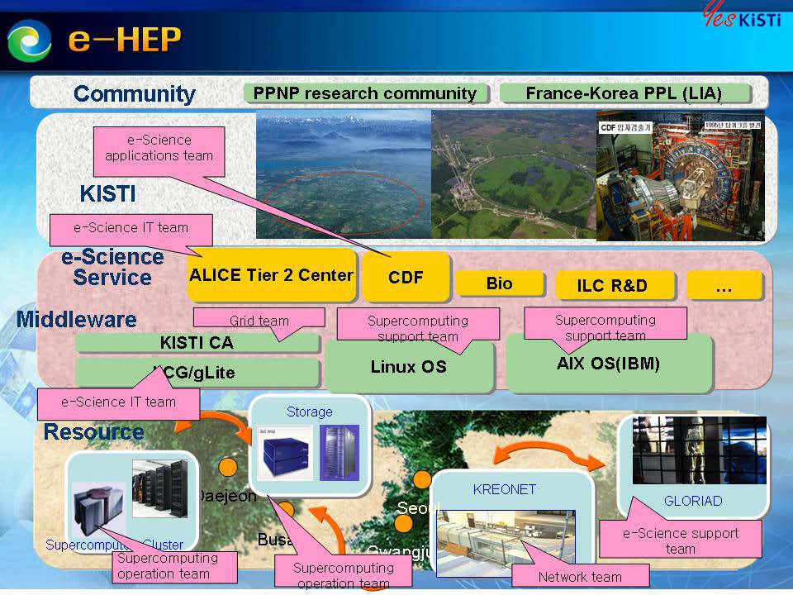
2. Experiment-Computing Simulation
e-HEP environment
  To study high energy physics anytime anywhere even if we are not on-site (accelerator laboratory)
1. Data production
• CDF Remote Control Room
@KISTI
2. Data processing
• Pacific CAF(CDF Analysis Farm) ⇒ North America CAF @KISTI
3. Data Analysis Collaboration
• EVO servers @KISTI
4. Belle II Data Handling System • Working Group Chair (K. Cho)

Slide 7
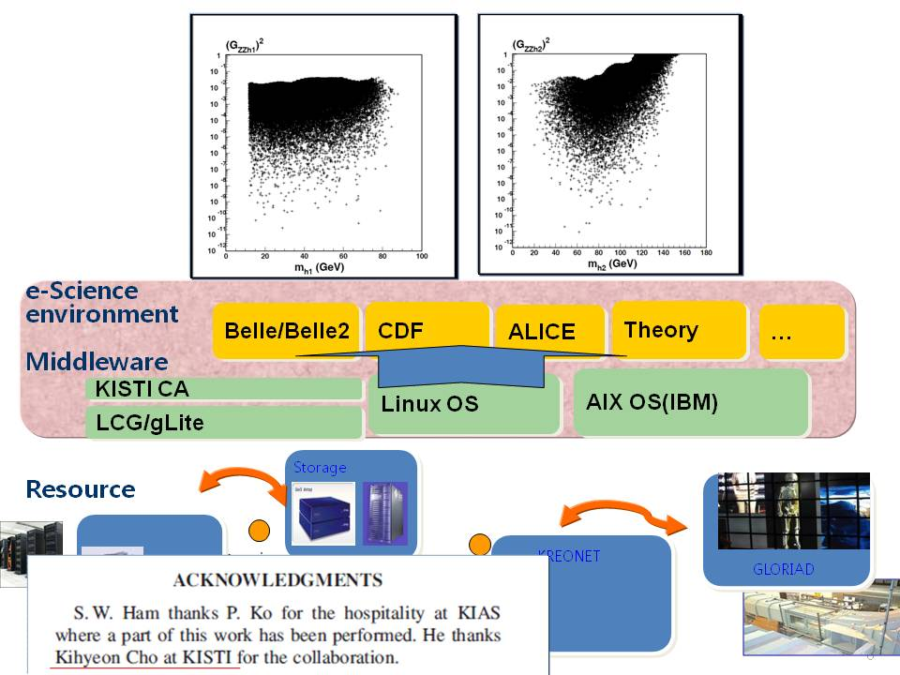
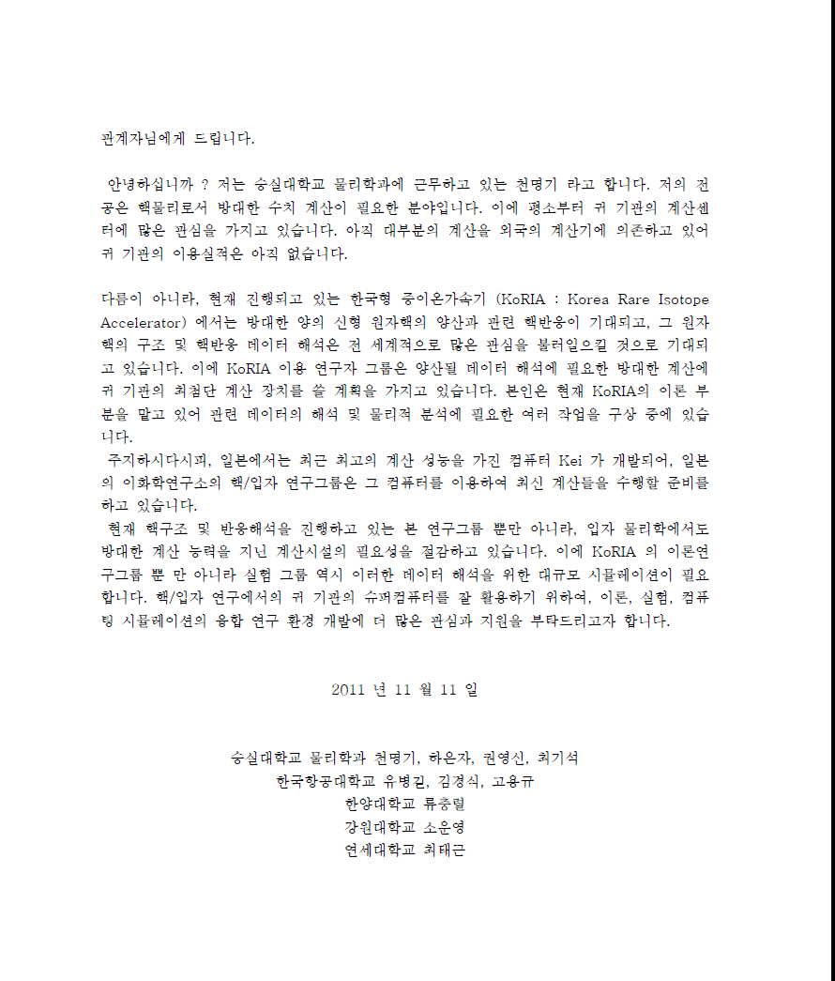
3. Theory-Simulation
Theory model – Simulations
  PGS
  LQCD
  Geant4 => Today’s talk
  Astro-Nuclear Simulation by a KoRIA user group
Ex) A study of Higgs model
using cyberinfrastructur\ @KISTI

Slide 8
Geant4 Project for
Medical and Accelerator physics

Slide 9
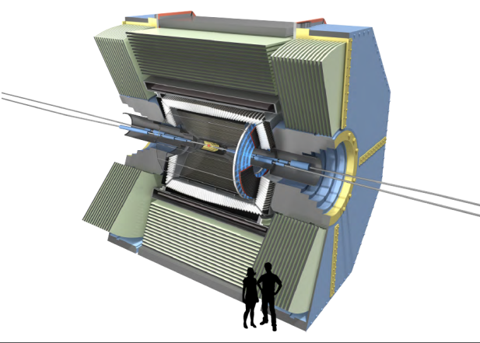
Project Outline
Title: Development of Geant4 for medical physics and High Energy physics
PI: Kihyeon Cho & Soonwook Hwang
Sponsor: Creative project by KISTI
Budget: Around half million dollar
Period: Jan. 1, 2012~ Dec. 31, 2012
Goal:
  Geant4 multi-processing R&D
  Porting on Suprecomputing
  Profiling and Large-scale test, evaluation and improvement
  Simulation for HEP and Medical physics using Geant4
  Etc.

Slide 10
HEP Collaboration (outside of KISTI)
Contact person: Kihyeon Cho
Man Power @ Fermilab
  Framework Team
  – Jim Kowalsoki (Enabling group leader), Marc Paterno
  Geant4 re-engineering
  – Pillip Canal, Soon Jun
  CERN/SFT raison and planning
  – Daniel Elvira (Detector Simulation group leader)
  …….
Man Power @ CMU
  Dongwook Jang
Man Power @ Yonsei U
  Kyungho Kim
  Youngjoon Kwon

Slide 11
Medical Physics Collaboration (outside of KISTI)
Contact person: Soonwook Hwang
Man Power @UCSF, USA
  Jungwook Shin (UCSF)
  Bruce (UCSF)
Man Power @ NCC, Korea
  Se Byeong Lee
  Jaeik Shin
  ….

Slide 12
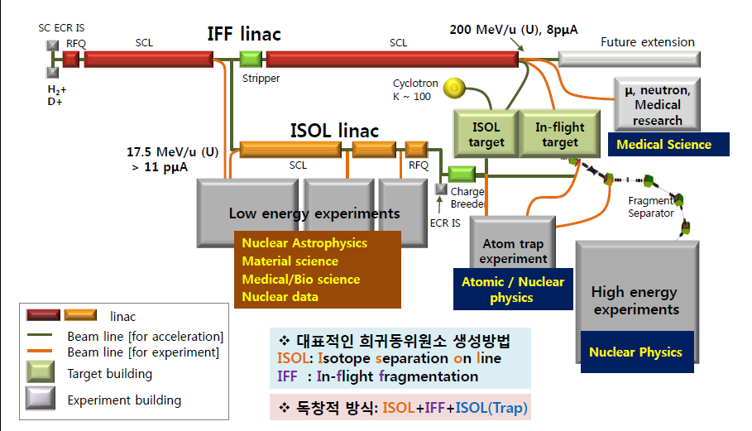
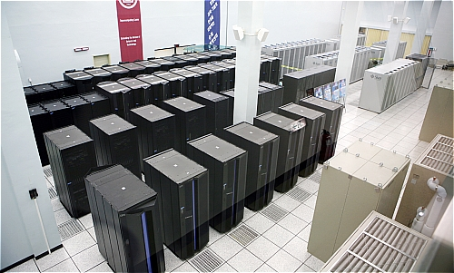
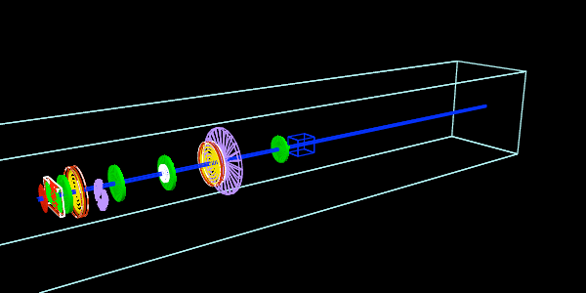
Contents
Geant4 R&D
  Supercomputing porting
  Geant4 parallel processing
  Geant4 optimization R & D
Geant4 applications for HEP
  Accelerator and astro-nuclear physics
  Detector R&D
Geant4 applications for Medical Physics
  Geant4 application for proton accelerator
  Medical physics using Geant4
  Geant4 community building

Slide 13
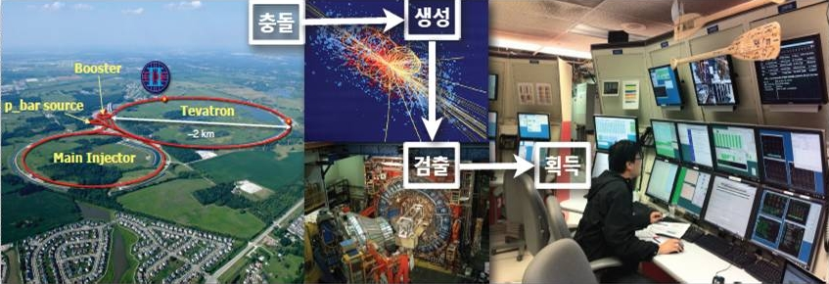
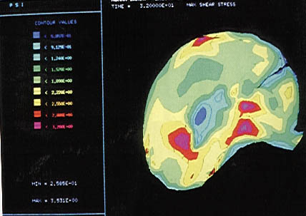
High Energy Physics vs. Medical Physics
 | High Energy Physics | Medical Physics
Input data | N/A | 50MB (ex, CT data)
Farm | Grid Farm/ Supercomputer | Supercomputer
Porting | Grid Farm | Supercomputer
Application Package | HEP Application | TOPAS, GATE
Community | HEP Application (Accelerator and Detector) | Proton Accelerator Center
International Collaboration | Fermilab, USA | UCSF/SLAC/MGH, USA
Contents of international Collaboration | Detector simulation package using Multi-thread/parallel computing | Proton Accelerator using Geant4 application

Slide 14
Global Community
(FKPPL)
International
Collaboration
HEP
Medical Physics
Appli-cation
HEP
- Accelerator R&D
- Detector, …
Medical Physics
Proton Accelerator, ..
Fermilab
- Next generation
simulation package development
UC SanFrancisco
/SLAC
/ Massachusetts General Hospital
Proton Accelerator GEANT4 Application
TOPAS
R&D
Geant4 Collaboration
code development
Geant4 R&D
Infra-structure
Grid Farm
Supercomputer
CERN
IN2P3
KEK

Slide 15
Work on Progress
Geant4 R&D
  Supercomputing Porting
    SUN Cluster Porting - Geant4-ST, MPI(ParGeant4), Geant4-MT
    Single-thread performance measurement and analysis
    Profiling and optimization
  Parallel Computing Using multi processing (core)
  -> Fermilab
    Understanding and Improvement of Single thread
    Geant4 profiling protocol code
    Studies of vectorization or parallelism of Geant4
HEP application
  Theory - MadGraph etc.
  Accelerator and Detector, etc.
Medical Application
  Medical physics Group -> NCC

Slide 16
KISTI-Fermilab Collaboration

Slide 17
KISTI-Fermilab Collaboration
 | KISTI | Fermilab
Application | Accelerator and Detector R&D | Next generation detector simulation package
R&D | Geant4 R&D | Geant4 Multi-core or parallel computing optimization
Infrastructure | Supercomputing porting | Performance profiling (Stand-alone cluster)
PI: Soon Yung Jun
Member:
  Daniel Elvira, the group leader of detector simulation
  James Kowalkowski, the group leader of computing enabling technologies
  Philippe Canal
  Krzysztof Genser

Slide 18
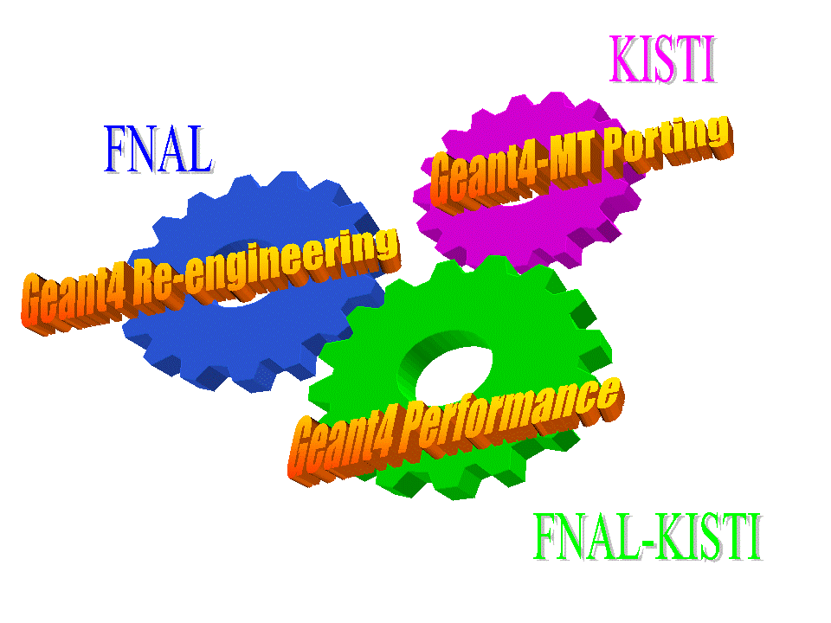
KISTI-Fermilab Collaboration
Geant4 Benchmarking and Profiling Tools
System Diagrams for Geant4 Re-engineering Effort

Slide 19
KISTI-Fermilab Collaboration
Task A: Benchmarking and Profiling Geant4 Performance
  A.1 improve performance tools and analysis for single threaded applications
  A.2 test multi-thread profiling tools
  A.3 performance runs on KISTI supercomputers
Task B – Initiating Geant4 R&D for Multi-Core and Many-Core Era
  B.1 Develop strategies for Geant4 re-engineering
  B.2 Develop prototypes
  B.3 document design changes for the Geant4 tracking process

Slide 20
Simulation on Secondary beams

Slide 21
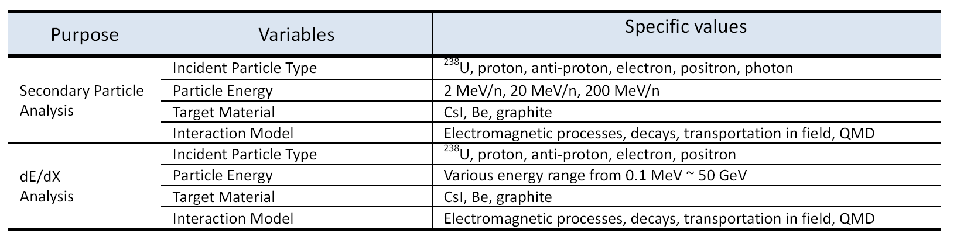
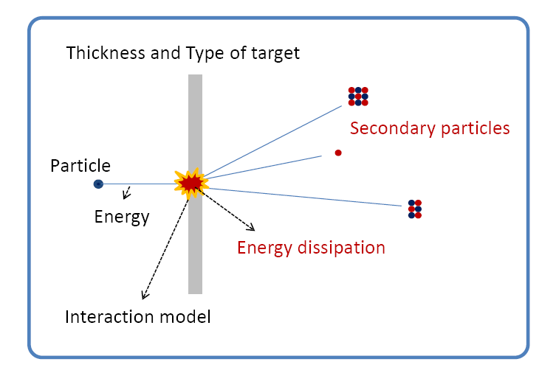
Simulation on secondary beam
Object
  Geant4 Simulation for secondary beams and dE/dx
Method
  To analyze secondary beam depending on incident beam energy, target material, interaction model, …
Output
  Secondary particles
  Energy dissipation…

Slide 22
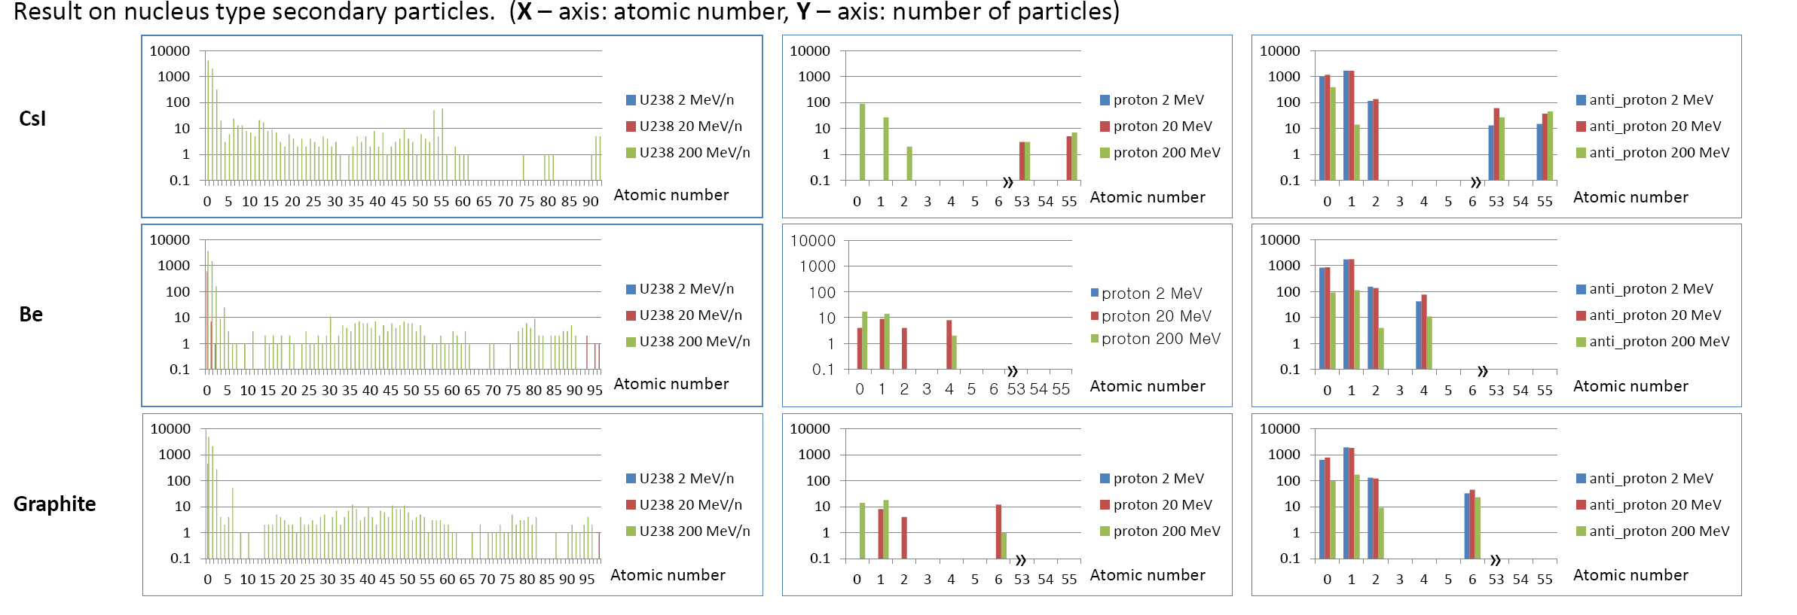
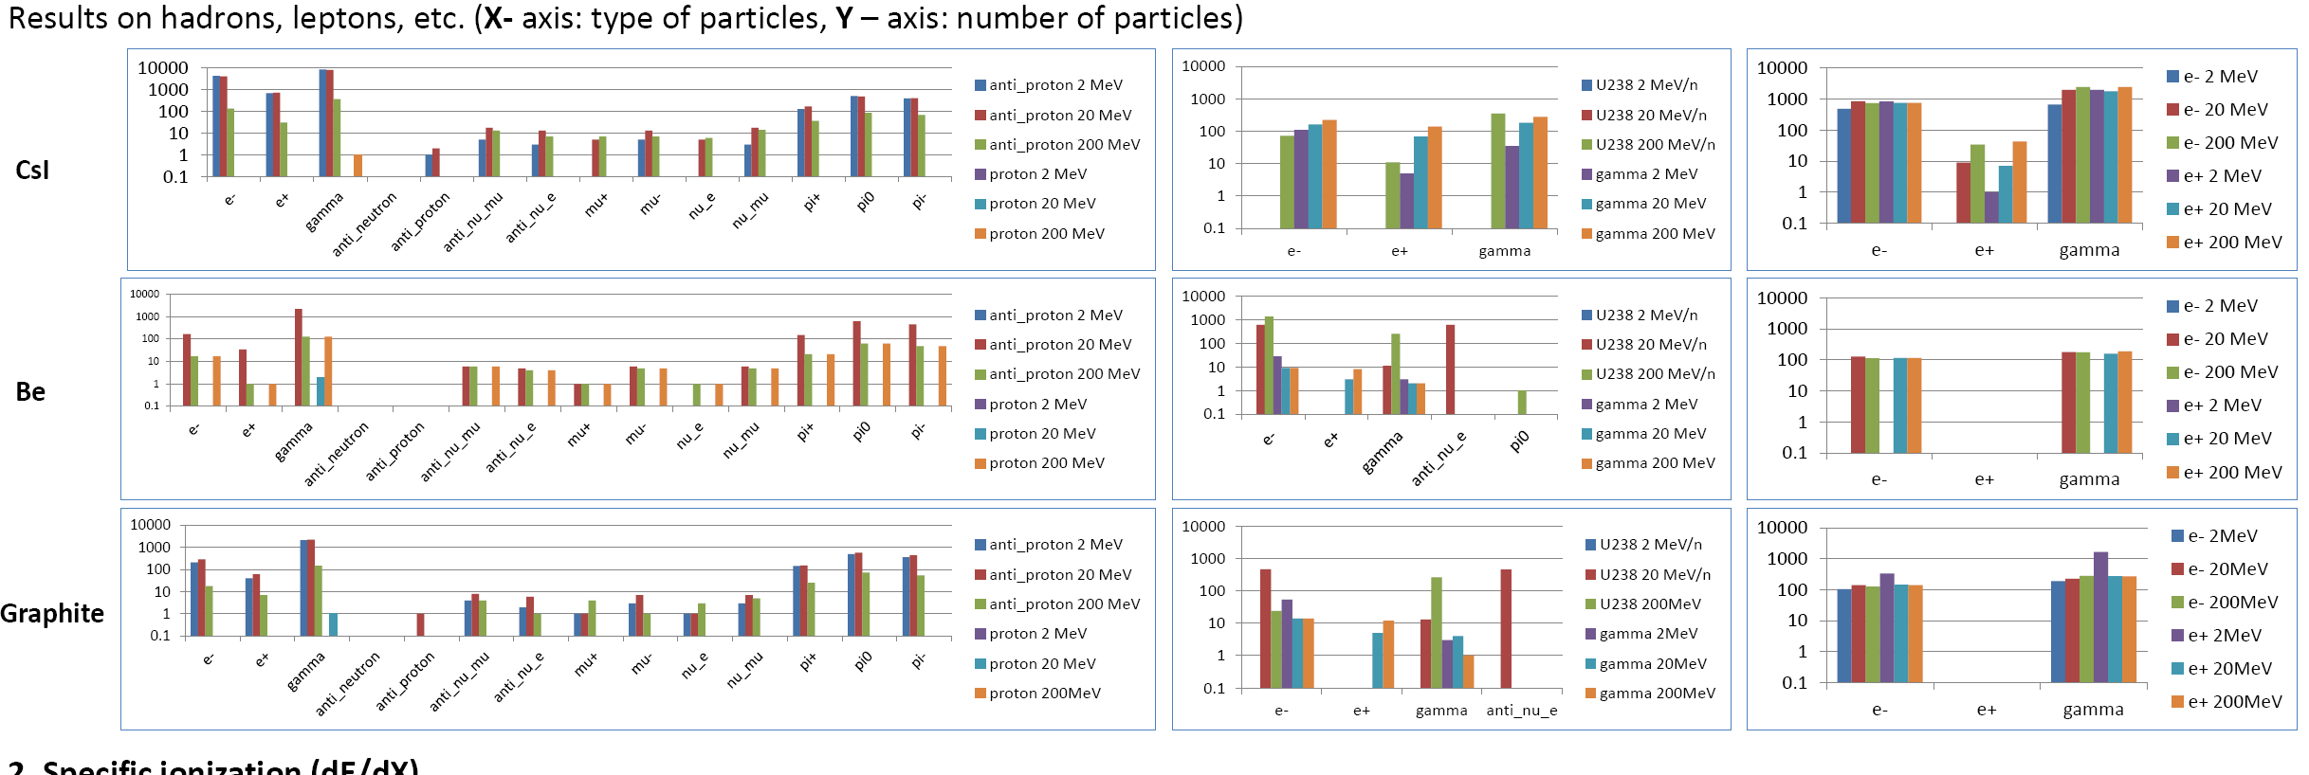
Preliminary results

Slide 23
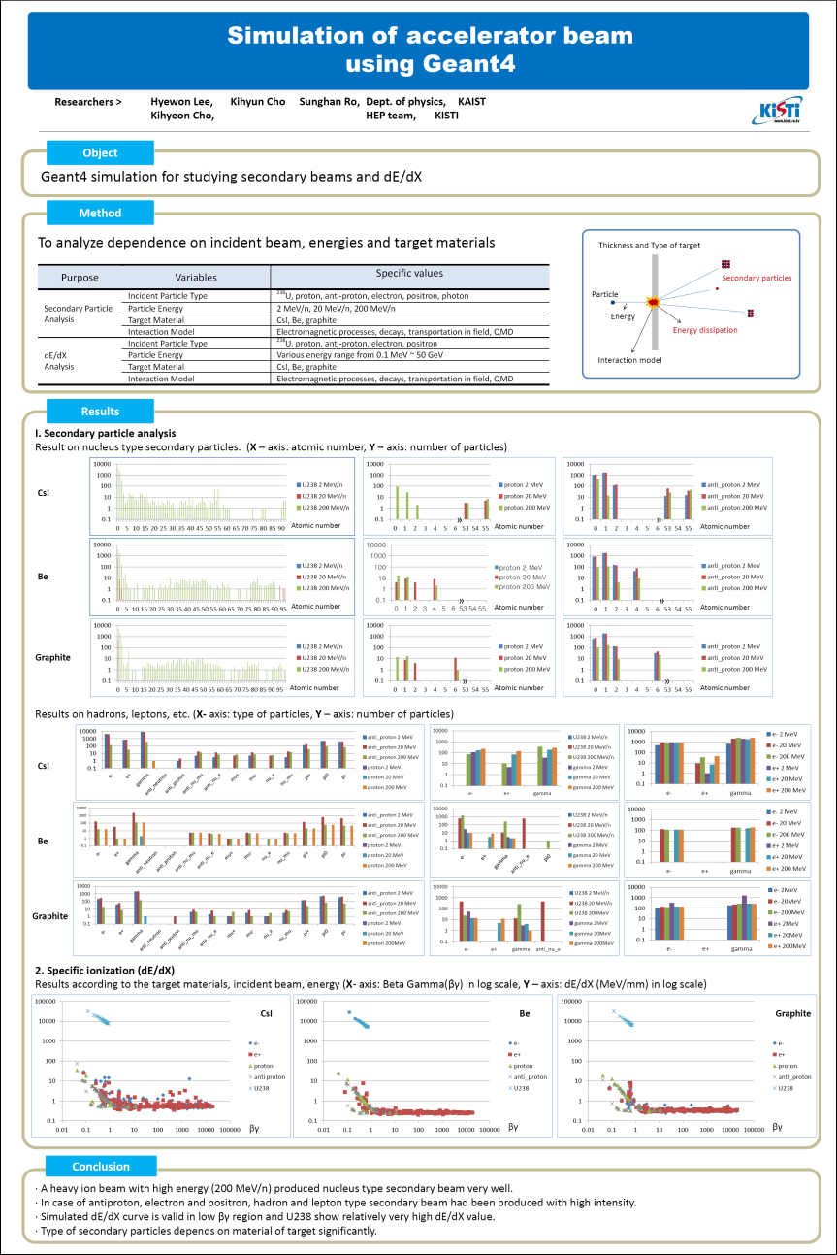
Preliminary results
A heavy ion beam with high energy (200 MeV/n) produced nucleus type secondary beam very well.
Type of secondary particle depends on material target significantly.
Work on progress

Slide 24
Summary
As one of e-Science paradigm of experiment-Theory-Simulation, Geant4(Theory-Experiment) project has been launched this year in Korea.
Geant4 project is for High Energy Physics and Medical Physics.
Since several accelerator are building in Korea, Geant4 @ supercom will help for accelerators and detectors R&D.
* Geant4 Home page
  https://hep.kisti.re.kr/geant4

Slide 25

Thanks
cho@kisti.re.kr
HEP@KISTI

