Slide 1

Rare Isotope Science Project
Sun Kee Kim

Slide 2


Slide 3



Vision & Objective of IBS
Vision
To be one of the world’s leading 10 research institutes in basic science
Objective
To become a hub of the world’s basic science research which will lead the advancement of scientific knowledge
To train the future leaders of basic science by providing the best possible research environment for young scientists
Research Themes
Early Stage
Initially Directors are selected without any limit on research themes
⇒ Timetable for the implementation of research fields agreed
on the appointment of Directors
Established Stage
Research themes are taken into account in the selection of Directors.
1

Slide 4

4. Organizational Structure
IBS Organization
IBS consists of 50 research centers, supporting organizations, and affiliated research institutes.
- The research centers will be separately located at headquarters (15), campuses* (25),
and extramural research centers (10).
※ When criteria for excellence are not met, the number of research centers
for each location may change.
* Campuses: KAIST Alliance (10), GIST (5), DGIST‧UNIST‧POSTECH Alliance (10)
Individual Research Center
Function
Basic unit of IBS conducting research in the same place
- Extramural research centers belong to universities or other research institutes.
The composition of staff varies depending on research theme and
research plan (around 50 staff, USD 9 million for annual budget).
- Each center includes a Director, around 5 group leaders, and support staff.
Staff
Management
Director is guaranteed autonomy and independence in operating a research center.
5

Slide 5


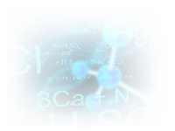
5. Selection & Management of Research Centers
Selection of Directors
Requirements
Scientists fully committed to managing research centers and conducting research over the long term
Scientists with world renowned research achievements or the potential to do so
Scientists capable of carrying out and managing large-scale research projects
Criteria of Selection
Excellence of candidates will be a top priority while creativity and superiority of research plan will also be considered.
Selection and Evaluation Committee (SEC)
It evaluates the selection of Directors and their output on a 3 year basis.
President appoints 15 scholars in various research fields from both at home and abroad.
7

Slide 6







Organization
4. Organizational Structure
Board of Directors
Auditor
President
Scientific Advisory Board
Accelerator Institute
(Affiliated Institution)
Secretariats
Office of
Policy Planning
Rare Isotope Science Project
Office of
Research Services
Research Center
(Headquarters)
Research Center
(Campus)
Research Center
(Extramural)
Office of Administrative Services
The number of staff: 3,000 (2017, including visiting scientists and students)
Annual Budget: USD 610 million (2017, including operational cost for the Accelerator Institute)
4

Slide 7





6. Buildings
Buildings
Temporary headquarters is currently in the Daeduk District with offices for research and administration.
IBS will construct its own headquarter buildings and 3 campuses (including amenities for overseas scientists).
Master plan of construction will be established by May, 2012 and the construction is scheduled to be completed by the end of 2015.
Each campus uses spaces of the universities which host IBS campuses.
11

Slide 8
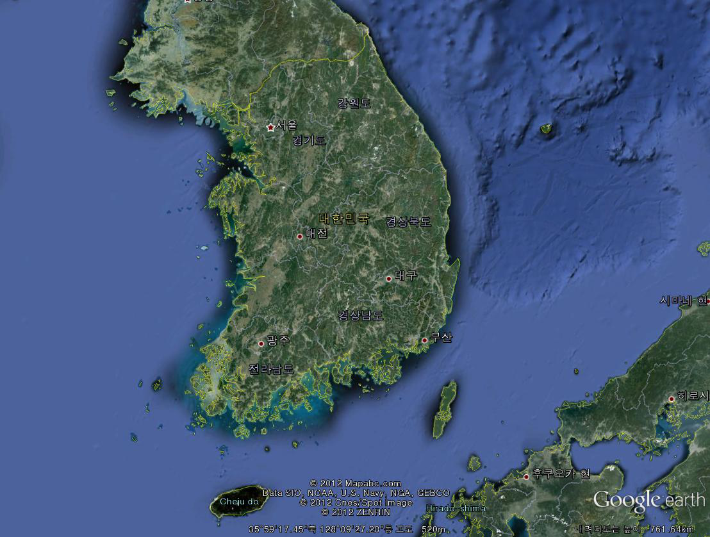
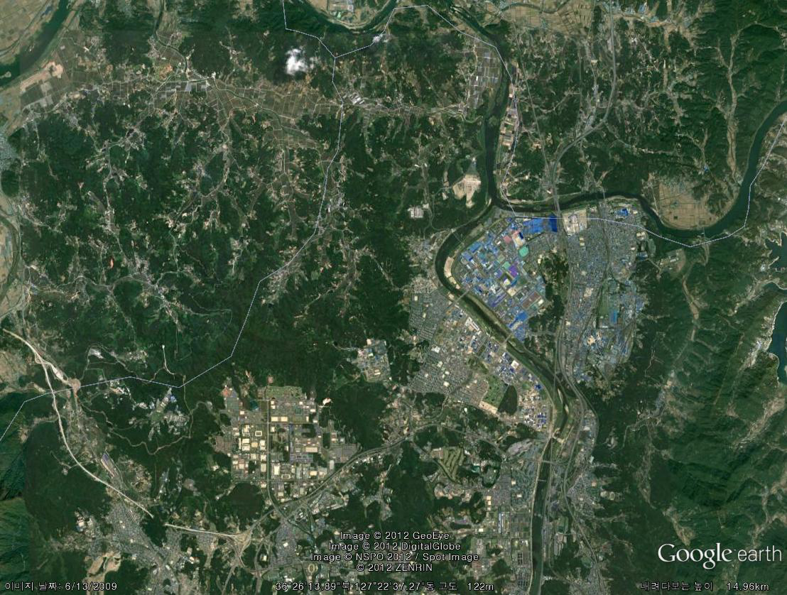
Where we are ?

Slide 9
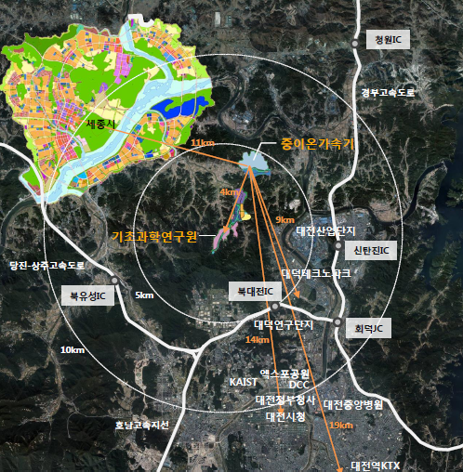
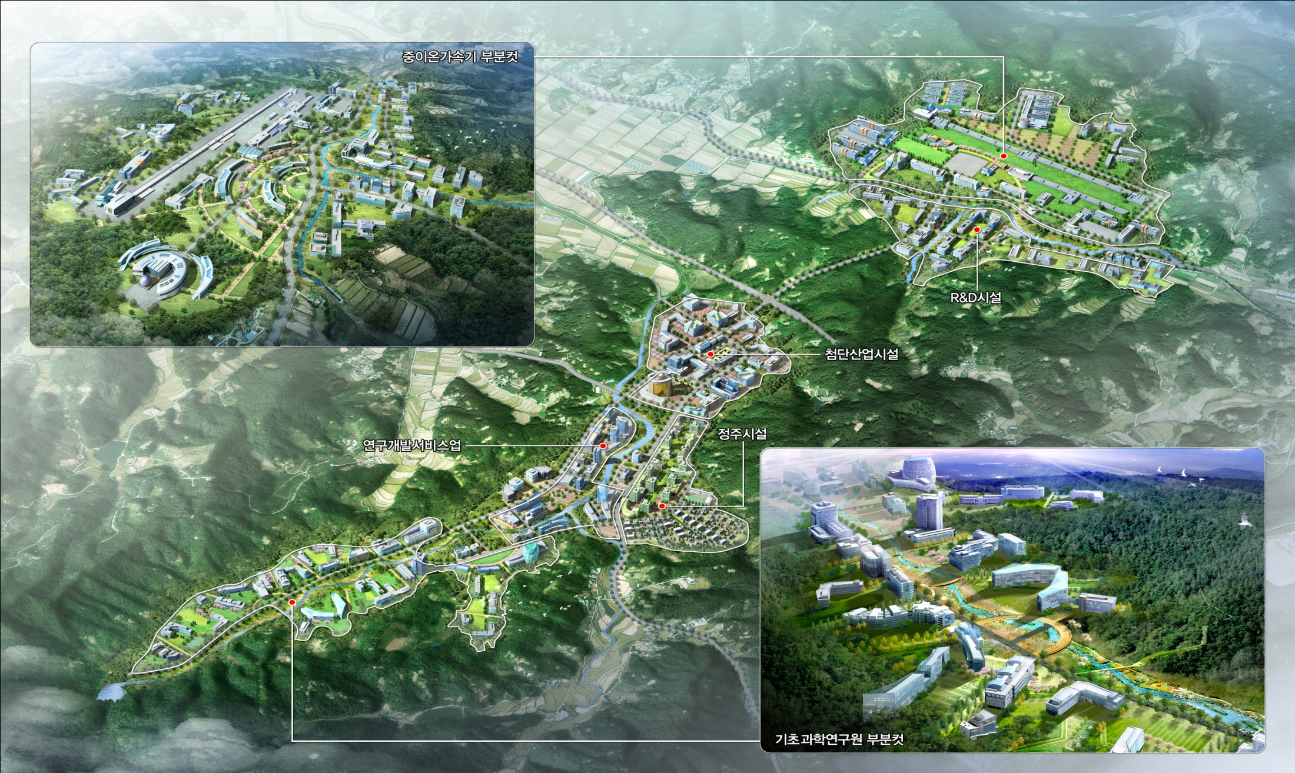
Science Business Belt

Slide 10
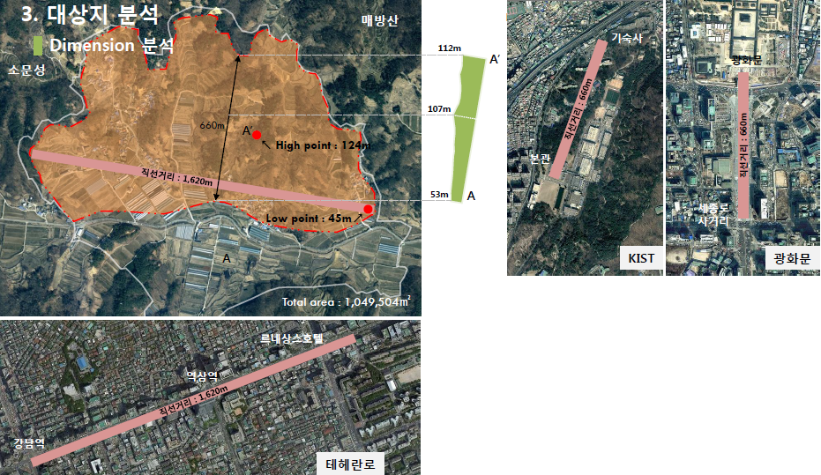

Slide 11
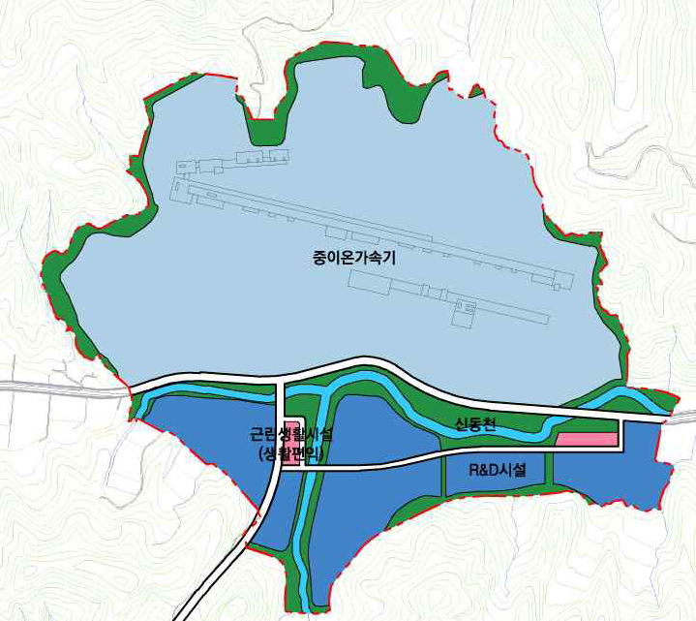
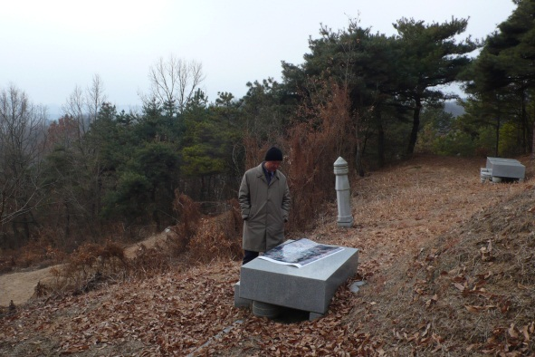
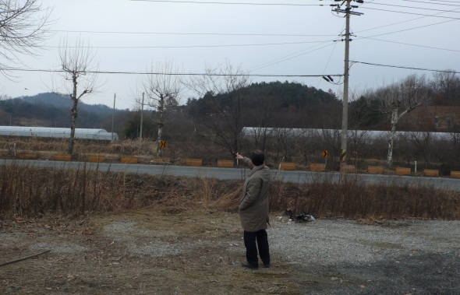
0
10
20
30
40
50
60
70
80
90
100m
ECR
LEBT
RFQ
SCL 1
SCL 1
SCL 1
Stripping station
SCL 2
SCL 2

Slide 12
Research Topics with Rare Isotopes
Nuclear Physics
Exotic nuclei near the neutron drip line
Superheavy Elements (SHE)
Equation-of-state (EoS) of nuclear matter
Origin of Elements
Stellar Evolution
Nuclear Astrophysics
Origin of nuclei
Paths of nucleosynthesis
Neutron stars and supernovae
Nuclear data with fast neutrons
Basic nuclear reaction data for future nuclear energy
Nuclear waste transmutation
Atomic/Particle physics
Atomic trap
Fundamental symmetries
Material science
Production & Characterization of new materials
β-NMR / μSR
Medical and Bio sciences
Advanced therapy technology
Mutation of DNA
New isotopes for medical imaging
Application of Rare Isotopes

Slide 13

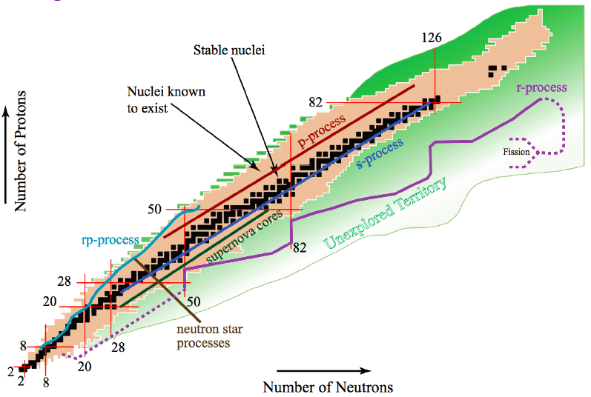

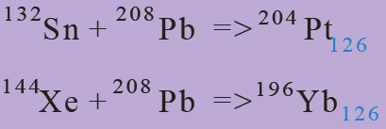


Slide 14
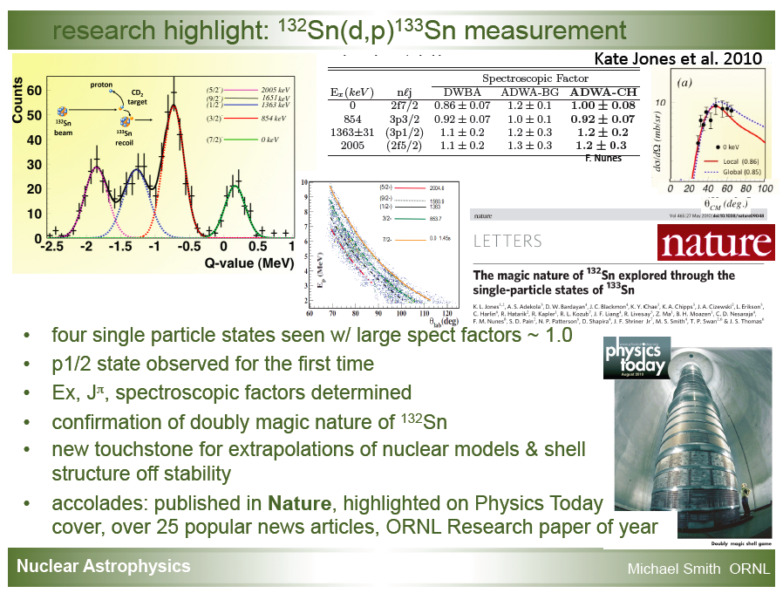

Slide 15
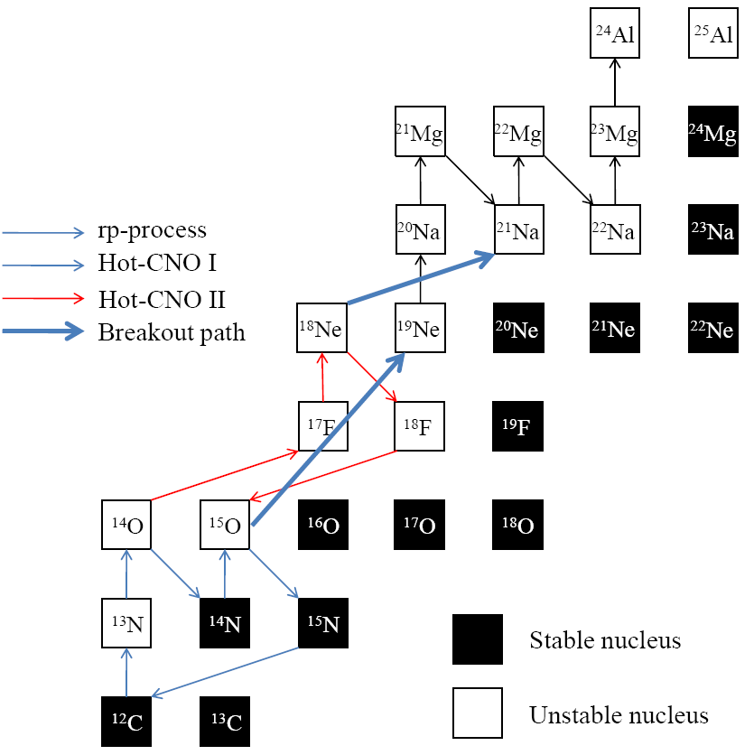
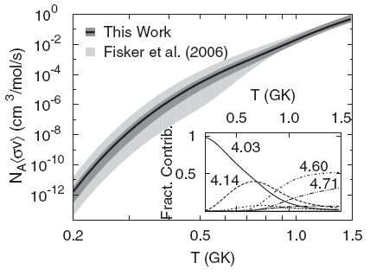
¹⁵O(α,γ)¹⁹Ne
Breakout reaction from hot-CNO to rp-process in stellar explosion such as in binary system (novae and X-ray bursts)
Reaction rate of ¹⁵O(α,γ)¹⁹Ne
by indirect methods
uncertain!!
PRL 98, 242503 (2007)
No direct measurement has been made before!!
Challenges
for direct measurement we need
beam intensity > 10¹¹ pps,
target density > 10¹⁸ atoms/cm²,
recoil detection efficiency > 40%
→ then ~1counts/hr
Notes:
15O(a,g)19Ne 핵반응은 신성 또는 엑스레이버스트와 같은 천체 환경에서 Hot-CNO 순환과정으로부터 폭발적인 수소연소 반응인 rp-process으로의 breakout 핵반응으로 알려져 있습니다.
질량수 100정도까지의 양성자 과잉핵종의 대부분을 생성하는 rp process가 어떠한 천체 환경하에서 일어나는 가를 이해하기 위해서는
15O(a,g)19Ne 핵반응과 같은 breakout 반응에 대한 핵반응율을 측정하는 것이 매우 중요합니다.
15O(a,g)19Ne 핵반응율을 직접 측정하기 위해서는 다음과 같은 challenge가 있습니다.
우선 높은 세기의 15O 방사성 핵종빔이 필요합니다. 아직 이 정도 세기의 15O RI 빔을 생성할 수 있는 시설은 세계에 없습니다.
또한 충분한 두께의 표적, 높은 효율의 되튐 질량분리기 등 도전해야할 과제가 많은 만큼
KoRIA에서의 연구 주제로써 충분한 가치가 있다고 판단됩니다.

Slide 16
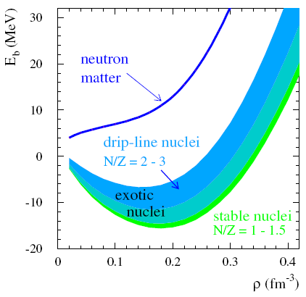
Nuclear Equation of State
B.-A. Li, L.-W. Chen
& C.M. Ko
Physics Report,
464, 113 (2008)
18
E (MeV)
Symmetric
nuclear matter
(ρ_{n}=ρ_{p})
CDR, FAIR (2001)
Isospin
asymmetry
0
ρ
Nucleon
density
δ
F. de Jong & H. Lenske, RPC 57, 3099 (1998)
F. Hofman, C.M. Keil & H. Lenske, PRC 64, 034314 (2001)
ρ (fm⁻³)

Slide 17
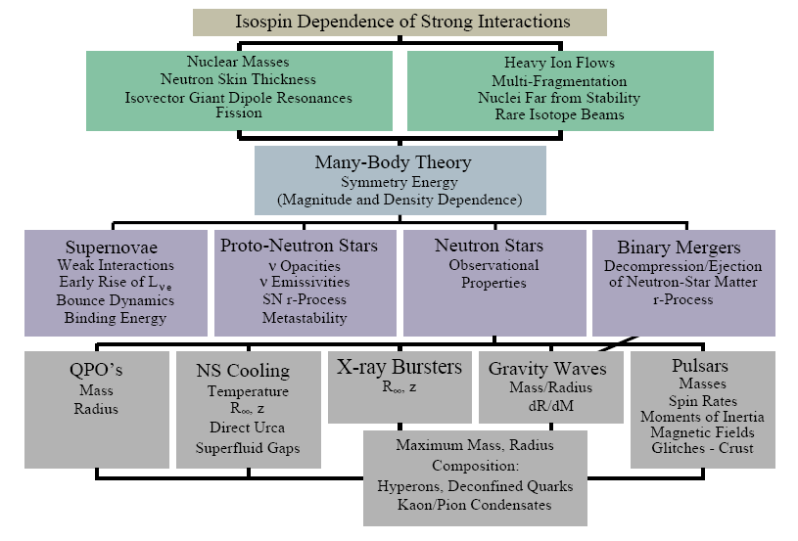
Importance of Symmetry Energy
RIB can provide crucial input.
Effective field theory, QCD
π⁻/π⁺
K⁺/K⁰
n/p
³H/³He
γ
isodiffusion
isotransport
+ isocorrelation
isofractionation
isoscaling
A.W. Steiner, M. Prakash, J.M. Lattimer and P.J. Ellis, Physics Report 411, 325 (2005)
Red boxes: added by B.-A. Li

Slide 18

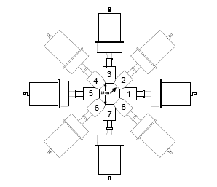
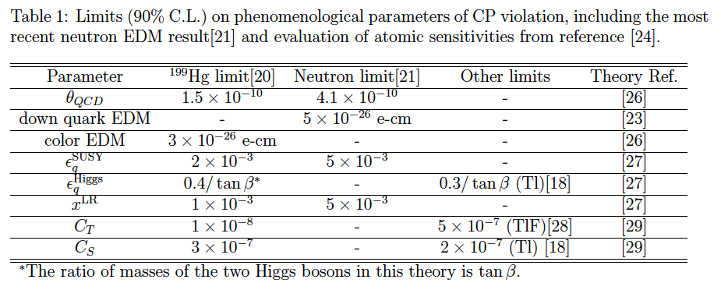
Radon-EDM Experiment
TRIUMF E929 Spokesperson
T. Chupp (Univ of Michigan)
C. Svensson (Guelph)
Produce rare ion radon beam
Collect in cell with co-magnetometer
Measure free precession
(γ anisotropy or β asymmetry)
²²³Rn (23 min) EDM projected sensitivity
Facility | ²²³Rn Yield | S_{d} (100 d)
ISAC | 10⁷ – 10⁸ s⁻¹ | 10⁻²⁶ - 10⁻²⁷ e-cm
Project X | 10¹¹ s⁻¹ | 10⁻²⁸ e-cm
~ 10⁻³⁰ e-cm
for ¹⁹⁹Hg

Slide 19
Rare Isotope Factory
19
High intensity RI beams by ISOL & IFF
  70kW ISOL from direct fission of ²³⁸U induced by 70MeV, 1mA p
  400kW IFF by 200MeV/u, 8pμA ²³⁸U
High energy, high intensity & high quality neutron-rich RI beams
  ¹³²Sn with up to ~250MeV/u, up to 9x10⁸ pps
More exotic RI beams by ISOL+IFF+ISOL(trap)
Simultaneous operation modes for the maximum use of the facility
ISOL(Isotope Separator On-Line)
p → thick target (eg. Uranium Carbide)
fission fragments → rare isotopes
IF(In-Flight Fragmentation)
Heavy ion beam → thin target
projectile fragmentation
→ high energy RI beam or
→ stopping and reacceleration

Slide 20
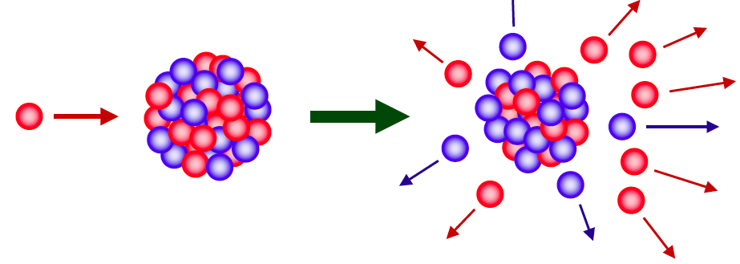
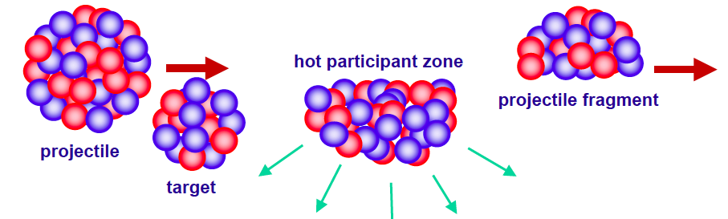
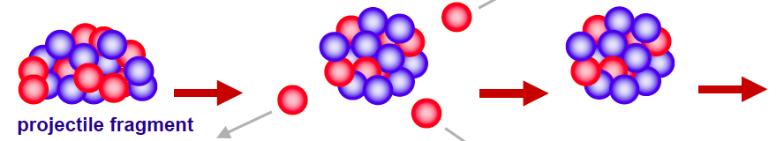
Making Rare Isotope Beam
Target spallation/fission by energetic light projectile
Projectile fragmentation

Slide 21
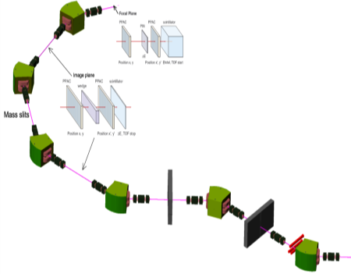
Concept of the Accelerator Complex
IF Linac
U³³⁺
70 MHz
RFQ
200 MeV/u (U),
8 pμA
Medical science
Material science
70 MHz SCL
280 MHz SCL
Future Extension
Stripper
18 MeV/u
Spallation,
Fission Target
μSR
28 GHz SC ECR IS
H₂⁺, D⁺
Medical
Research
Nuclear Data
Material science
Fragment
Separator
ISOL Linac
70 kW
Cyclotron
400 kW
Target
Material
Science
Beta-NMR
RF Cooler
Gas
Catcher,
Gas cell
70 MHz SCL
70 MHz RFQ
Mass
Separator
18 MeV/u
1~5 MeV/u
0.3 MeV/u
10 keV/u
Atomic Trap
Experiments
High Energy
Experiments
Low Energy Experiments
Charge Breeder
Nuclear Astrophysics
Material science
Bio science
Medical science
Nuclear data
ECR IS
Atomic / Nuclear physics
Nuclear Physics

Slide 22
IF Linac Beam Specification
Ion Species | Z/ A | Ion source output |  | SC linac output
 |  | Charge | Current (pµA) | Charge | Current (pµA) | Energy (MeV/u) | Power (kW)
Proton | 1/ 1 | 1 | 660 | 1 | 660 | 610 | 400
Ar | 18/ 40 | 8 | 42.1 | 18 | 33.7 | 300 | 400
Kr | 36/ 86 | 14 | 22.1 | 34-36 | 17.5 | 265 | 400
Xe | 54/ 136 | 18 | 18.6 | 47-51 | 12.5 | 235 | 400
U | 92/ 238 | 33-34 | 11.7 | 77-81 | 8.4 | 200 | 400

Slide 23
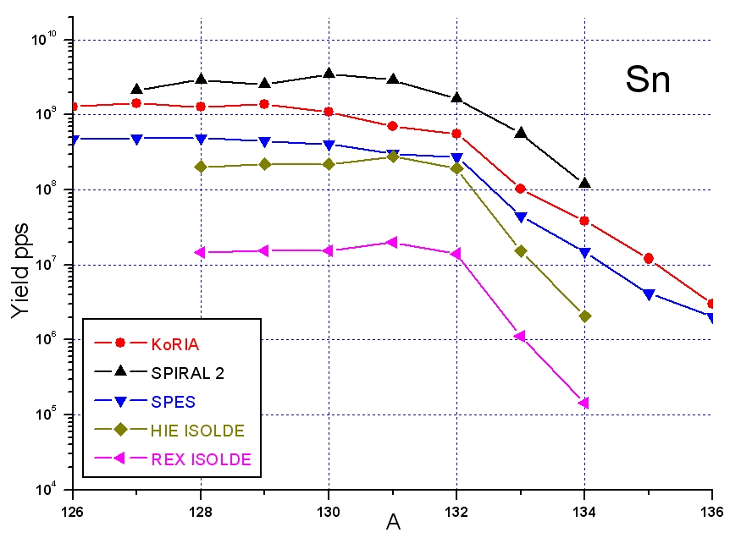
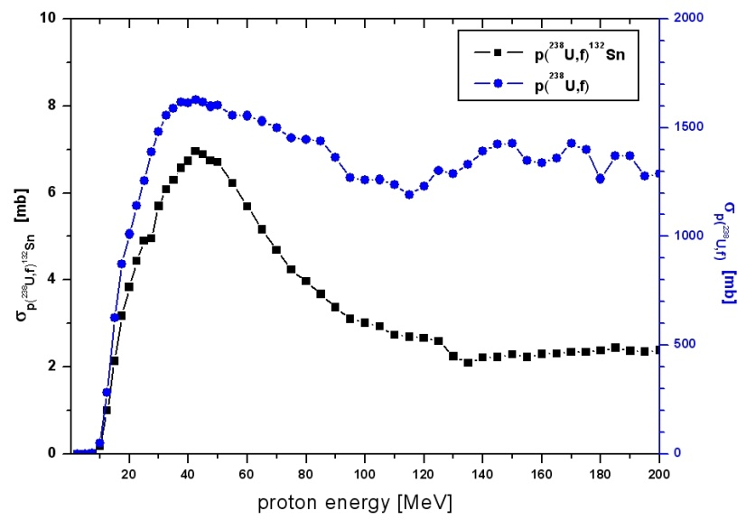
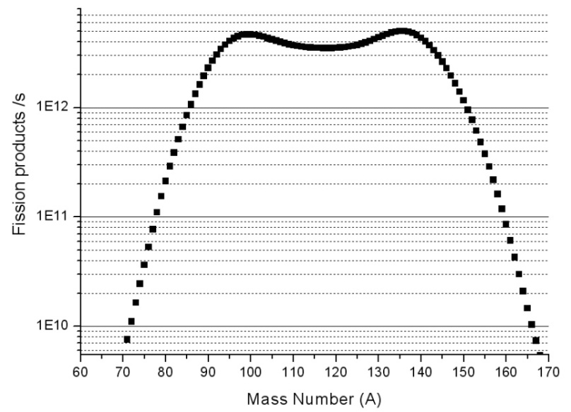
Merit of ISOL
23
Intensity of Sn isotopes
At experimental hall
GOAL: High intensity-high quality RI beam using relatively low beam power and direct fission target
¹³²Sn 9.0 x 10⁸ pps
Simulation of ²³⁸U(p, f)
Model: MCNPX and ETFSI fission model
- Beam: 70 MeV, 1mA proton
- Target: UC₂ of 2.5 g/cm³ and 3 cm thickness
Fission products/sec
¹³²Sn
¹³²Sn cross-section from fission production
Mass Number (A)
-●- ²³⁸U(p,f)
Mass Distribution from fission of ²³⁸U
on ISOL target
σ ²³⁸_{U(p, f)} ¹³²_{Sn} (mb)
σ ²³⁸_{U(p, f)} (mb)
¹³²Sn 4.7 x 10¹¹ pps
-■- ²³⁸U(p,f) ¹³²Sn
Fission products/sec
Sn
~ 1.2 x 10¹⁴ pps
Highest production rate in the world
^{Proton energy (MeV)}
on target
Mass Number (A)

Slide 24
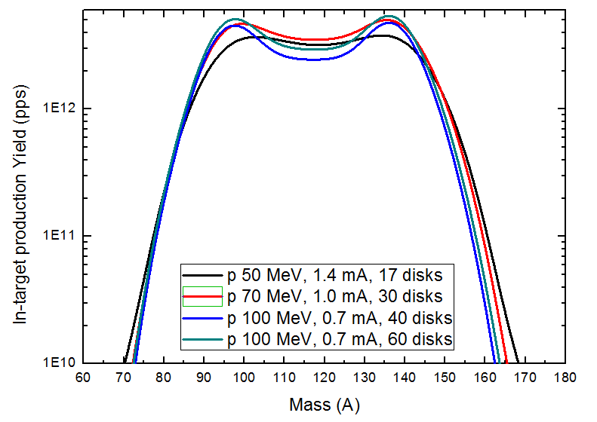
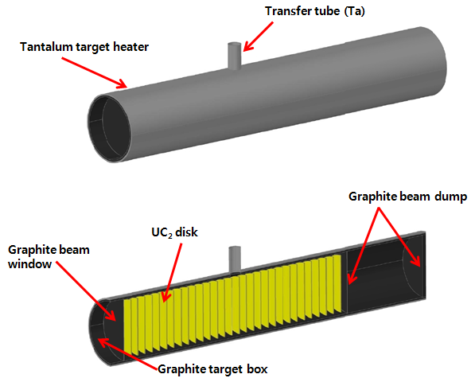
p + ²³⁸U fission product (70kW급)
 | Fission rate (s⁻¹)
p 50 MeV, 1.4 mA, 17 disks | 1.02 x 10¹⁴
p 70 MeV, 1.0 mA, 30 disks | 1.22 x 10¹⁴
p 100 MeV, 0.7 mA, 40 disks | 1.02 x 10¹⁴
p 100 MeV, 0.7 mA, 60 disks | 1.18 x 10¹⁴
15 MeV 이하 dump
20 MeV 이하 dump
너무 direct fission 타겟이 길어 cost및
handling 정도가 지수적으로 증가 하며
현 기술은 없음
타겟이 커짐으로 release efficiency가
떨어져 결국 실험실에 제공되는
yield가 떨어짐
isotope 종류가 그리 많아지지 않음

Slide 25
Estimated RIBs based on ISOL
Isotope | Half-life | Yield at target (pps) | Overall eff. (%) | Expected Intensity (pps)
⁷⁸Zn | 1.5 s | 2.75 x 10¹⁰ | 0.0384 | 1.1 x 10⁷
⁹⁴Kr | 0.2 s | 7.44 x 10¹¹ | 0.512 | 3.8 x 10⁹
⁹⁷Rb | 170 ms | 7.00 x 10¹¹ | 0.88 | 6.2 x 10⁹
¹²⁴Cd | 1.24 s | 1.40 x 10¹² | 0.02 | 2.8 x 10⁸
¹³²Sn | 40 s | 4.68 x 10¹¹ | 0.192 | 9.0 x 10⁸
¹³³In | 180 ms | 1.15 x 10¹⁰ | 0.184 | 2.1 x 10⁷
¹⁴²Xe | 1.22 s | 5.11 x 10¹¹ | 2.08 | 1.1 x 10¹⁰
* Calculated by Dr. B. H. Kang (Hanyang Univ.) for proton beams of 70 MeV and 1 mA with 3 cm thick UC₂ target of 2.5 g/cm³

Slide 26
RI from ISOL by Cyclotron
IFF LINAC
200 MeV/u (U)
SC ECR IS
Future extension area
RFQ
SCL
SCL
Future plan
Stripper
Cyclotron
K~100
μ, Medical
research
H₂+
D+
ISOL LINAC
ISOL
target
In-flight
target
Medical science
SCL
RFQ
Charge
Breeder
Fragment
Separator
Low energy experiments
1
Atom trap
experiment
Nuclear Astrophysics
Material science
Bio science
Nuclear data
3
ISOL with cyclotron driver (70 kW)
2
Atomic / Nuclear physics
High energy
experiments
LINAC
1. ISOL → low E RI
Beam line [for acceleration]
Nuclear Physics
Beam line [for experiment]
2. ISOL → high E RI
Target building
Experimental Hall
3. ISOL → IFF → ISOL (trap)

Slide 27
RI from IFF by High-Power SC LINAC and High-Intensity Stable HI beams
IFF LINAC
200 MeV/u (U)
SC ECR IS
Future extension area
RFQ
SCL
SCL
Future plan
Stripper
Cyclotron
K~100
μ, Medical
research
H₂+
D+
ISOL LINAC
ISOL
target
In-flight
target
17.5 MeV/u (U)
> 11 pμA
Medical science
SCL
RFQ
4
Charge
Breeder
Fragment
Separator
Low energy experiments
5
Atom trap
experiment
Nuclear Astrophysics
Material science
Bio science
Nuclear data
6
7
Stable HI beams
IFF with stable heavy ions
Atomic / Nuclear physics
High energy
experiments
LINAC
4. Low E stable heavy ions
Beam line [for acceleration]
Nuclear Physics
Beam line [for experiment]
5. IFF → low E RI or ISOL (trap)
Target building
6. IFF → high E RI
Experimental Hall
7. High E stable heavy ions

Slide 28
RI from ISOL by High-Power SC LINAC
(Long term future upgrade option)
IFF LINAC
600 MeV, 660 μA
protons
SC ECR IS
Future extension area
RFQ
SCL
SCL
Future plan
Stripper
Cyclotron
K~100
μ, Medical
research
H₂+
D+
ISOL LINAC
ISOL
target
In-flight
target
Medical science
SCL
RFQ
Charge
Breeder
Fragment
Separator
Low energy experiments
8
Atom trap
experiment
ISOL with IFF LINAC
future high-power driver
400 kW (or ~MW) ISOL upgrade
Nuclear Astrophysics
Material science
Bio science
Nuclear data
Atomic / Nuclear physics
High energy
experiments
LINAC
8. High power ISOL
Beam line [for acceleration]
Nuclear Physics
Beam line [for experiment]
Target building
Experimental Hall

Slide 29
Comparison to other facilities 1
29
Facility | Korea | HIE-ISOLDE CERN Swiss (EU) | ISAC I,II TRIUMF Canada | SPIRAL2 GANIL France | SPES INFN Itly
RI beam production | ISOL+IFF+ISOL(trap) | ISOL | ISOL | ISOL | ISOL
Beam energy of RI driver | ISOL: 70 MeV p | H (~1.4 GeV) | H (~500 MeV/u) | H (~33 MeV) D (~40 MeV) HI (~14.5 MeV/u) | H (40-50MeV)
RI beam energy | ISOL: 3~250 MeV/u | 3-10 MeV/u | ISAC I: ~1.8 MeV/u ISAC II: ~16 MeV/u | 2-25 MeV/u | 10 MeV/u
ISOL: Isotope Source On Line
IFF: In-flight fragmentation

Slide 30
Comparison to other facilities 2
30
Facility | Korea | FAIR GSI Germany | FRIB MSU USA | RIBF RIKEN Japan
RI beam production | ISOL+IFF+ISOL(trap) | IFF | IFF+ISOL＋ | IFF+ISOL*
Beam energy of RI driver | IFF: 600 MeV p 200 MeV/u ²³⁸U | 2.7 (²³⁸U) ~ 30 (¹H) GeV/u | ~600 MeV p ~200 MeV/u ²³⁸U | Heavy ion 440-345 MeV/u
RI beam energy | IFF: ~150 MeV/u | 0.4 - 1.5 GeV/u of all masses | Catcher-reacceleration: 3, 12 MeV/u IFF: ~150 MeV/u | < 345 MeV/u
Completion | ~2017 | 2016 | ~2017 | ~2010
ISOL: Isotope Source On Line
IFF: In-flight fragmentation
* Planned
+ Option

Slide 31
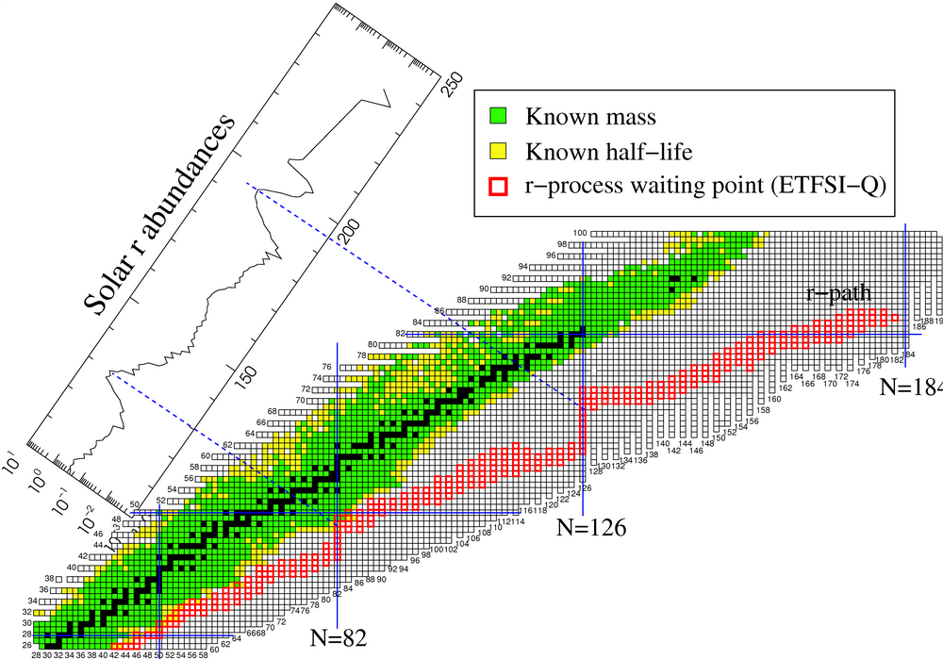
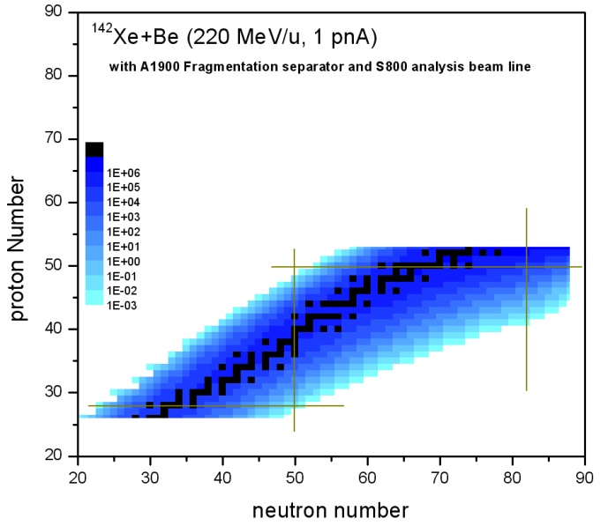
Production of more-exotic medium mass n-rich RI
31
LISE++ calculation
EPAX2 model
dp /p = 2.23%
Target thickness and beam line parameters are optimized for each nuclide
Z =50
r-process
Korea RI Accelerator could reach new n-rich isotope with rates of 10⁻³-10 pps.
Z = 28
N =82
N =50
nuclide | Estimated Intensity (pps)
¹¹⁰Y | 1.8
¹¹⁰Zr | 1.8
¹¹⁴Nb | 1.1
¹¹⁶Mo | 3.8
¹¹⁸Tc | 1.4
¹⁴²Xe (ISOL) → post-accelerator → re-accelerator →
→ In-flight target → Fragmentation separator → experiments
Note that ~10³ times higher than ¹³⁶Xe (350 MeV/u, 10 pnA)+Be.

Slide 32
Facilities for the scientific researches
32
- Design of the experimental facilities in conceptual level
- User training program with the international collaboration
Nuclear Structure
Nuclear Matter
Nuclear Astrophysics
Atomic physics
Nuclear data by fast neutrons
Material science
Medical and Bio sciences
Multi-Purpose Spectrometer
Large Acceptance Multi-Purpose Spectrometer (LAMPS)
KoRIA Recoil Spectrometer (KRS)
Atom & Ion Trap System
neutron Time-of-Flight (n-ToF)
Β-NMR/NQR
Elastic Recoil Detection (ERD)
Laser Selective Ionizer
Heavy Ion Therapy
Irradiation Facility
  KoRIA user community

Slide 33
Facility
Nuclear astrophysics
33
KoRIA Recoil Spectrometer
(KRS)
Beam transport system
with performance of high efficient, high selective and high resolution spectrometer
Configuration
Length: ~25 m
Space : 20 X 5 m²
1) 4 dipole magnets
2) 20 quadruple magnets
3) 4 hexapole magnets
4) velocity filter (Wien filter)
 | RMS mode (recoil mass separator) | IRIS mode (In-flight RI separator) | BT mode (beam transport)
Main purpose | direct measurements of capture reaction (p,γ) and (α,γ) | in-flight RI beam separation using stable or RI beam from KoRIA + spectrometer production of more exotic beams | beam transport from KoRIA to the focal plane of KRS
Requirements | background reduction high mass resolution (M/ΔM) large angular acceptance highly efficient detection system | large angular acceptance high-density production target system high-quality beam (high purity, low emittance, high intensity) | 100% transport efficiency
  KoRIA user community

Slide 34
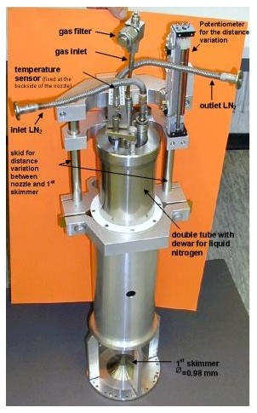
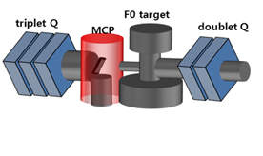
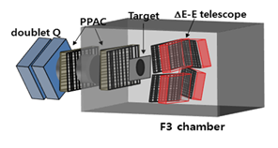
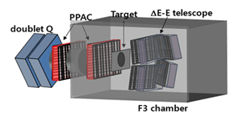
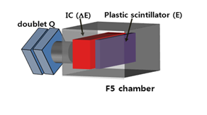
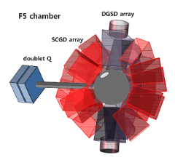
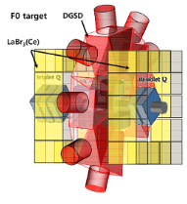
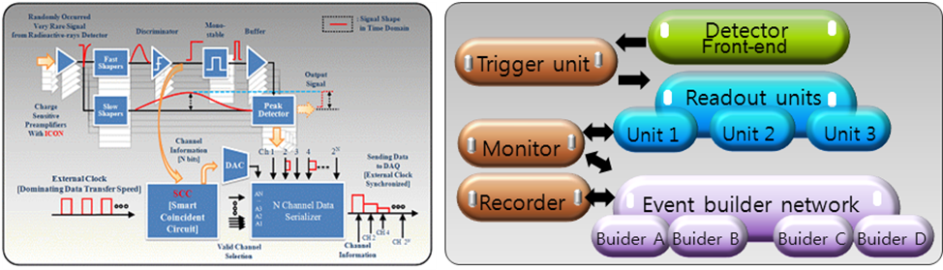
Facility
Nuclear astrophysics
34
Target System
Beam Tracking at F0 & F3
Particle Detection at F3 & F5
 | MCP | PPAC & MWPC
Multiple scattering | ~0.1 mrad | ~0.05 mrad
Counting rate | > 1 MHz | > 2MHz
50 keV (FWHM) @ 5 MeV α-particle
Supersonic jet gas target developed in GSI
Energy loss: < 1 MeV
PID for low-energy recoil particle
Gamma-ray Detection at F0 & F5
Front-end electronics
DAQ
ε~ 20 % @ 2 MeV γ-ray
10⁵ Channels
> 2 GHz high frequency
LaBr₃(Ce)
SCGD
DGSD
Position resolution : < 1 mm

Slide 35
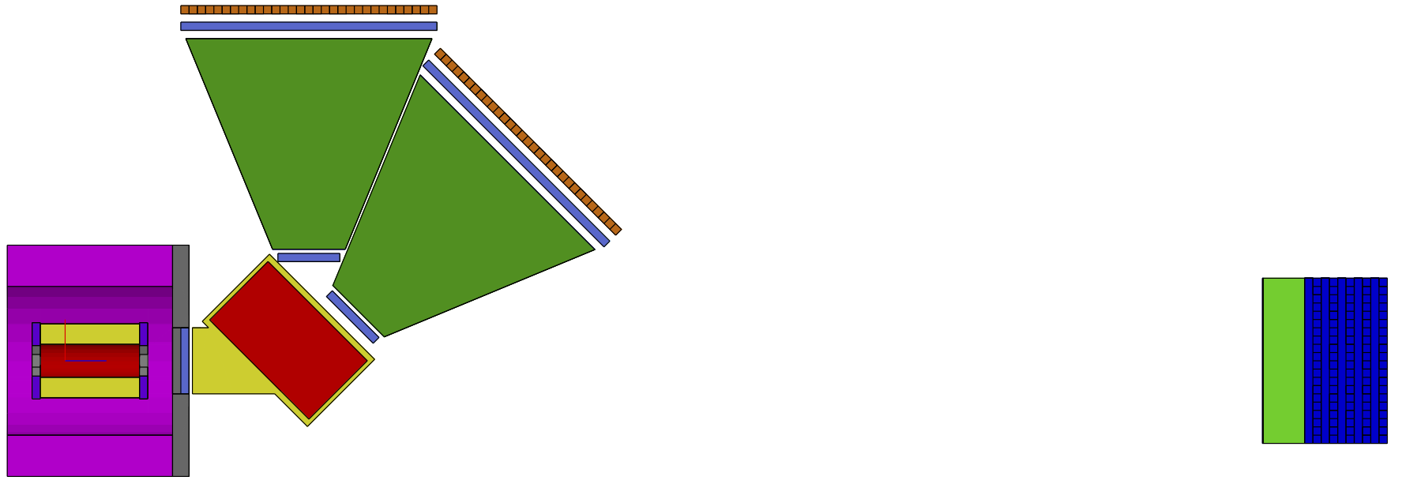
Conceptual Design of LAMPS
(high energy)
Dipole acceptance ≥ 50mSr
Dipole length =1.0 m
TOF length ~8.0 m
Science Goal:
using isototpes with high N/Z at high energy for
Nuclear structure Nuclear EOS
Symmetry energy
EX: : Nuclear collision of
¹³²Sn of ~250 MeV/u
For B=1.5 T,
p/Z ≈ 0.35 GeV/c
at 110º
Low p/Z
High p/Z
For B=1.5 T,
p/Z ≈ 1.5 GeV/c at 30º
Solenoid
magnet
Dipole magnet: We can also consider the large aperture superconducting dipole magnet (SAMURAI type).
Neutron-detector array

Slide 36
Status and Plan
Conceptual Design report (Mar. 2010 - Feb. 2011)
IAC review (Jul. 2011 – Oct. 2011)
Rare Isotope Science Project started in IBS (Dec. 2011)
Technical Design Report (by Jun. 2013)

Slide 37


Slide 38
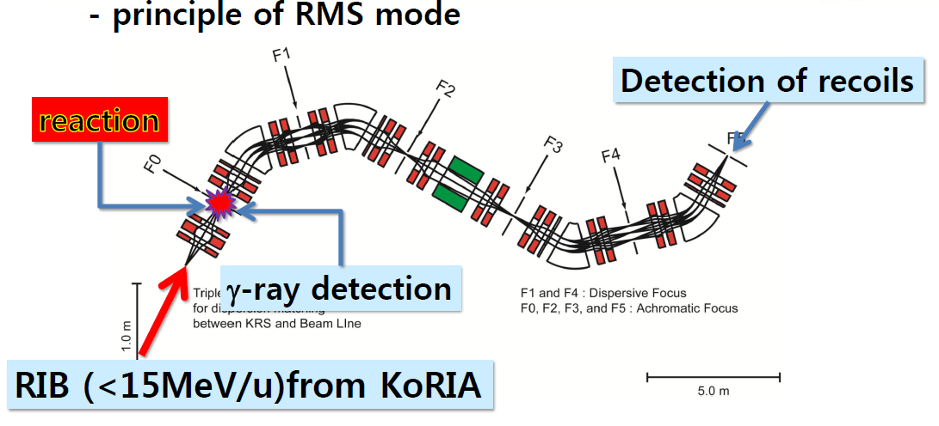
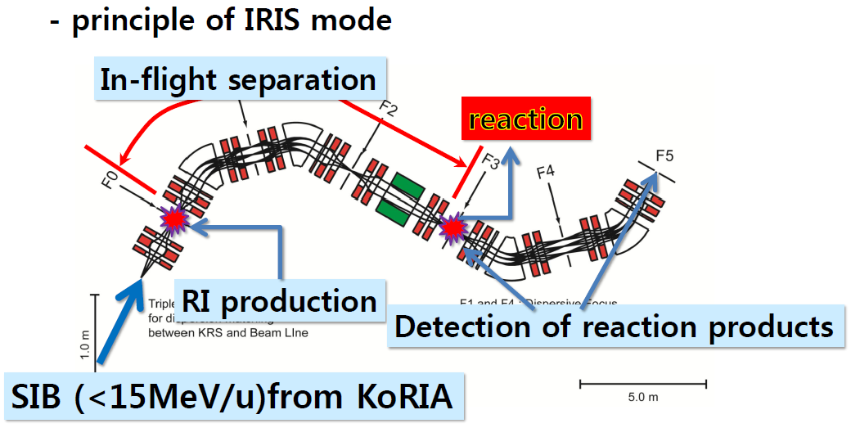

Slide 39
¹⁵O(α,γ)¹⁹Ne
Breakout reaction from hot-CNO to rp-process in stellar explosion such as in binary system (novae and X-ray bursts)
Reaction rate of ¹⁵O(α,γ)¹⁹Ne
by indirect methods
uncertain!!
PRL 98, 242503 (2007)
No direct measurement has been made before!!
Challenges
for direct measurement we need
beam intensity > 10¹¹ pps,
target density > 10¹⁸ atoms/cm²,
recoil detection efficiency > 40%
→ then ~1counts/hr
Notes:
15O(a,g)19Ne 핵반응은 신성 또는 엑스레이버스트와 같은 천체 환경에서 Hot-CNO 순환과정으로부터 폭발적인 수소연소 반응인 rp-process으로의 breakout 핵반응으로 알려져 있습니다.
질량수 100정도까지의 양성자 과잉핵종의 대부분을 생성하는 rp process가 어떠한 천체 환경하에서 일어나는 가를 이해하기 위해서는
15O(a,g)19Ne 핵반응과 같은 breakout 반응에 대한 핵반응율을 측정하는 것이 매우 중요합니다.
15O(a,g)19Ne 핵반응율을 직접 측정하기 위해서는 다음과 같은 challenge가 있습니다.
우선 높은 세기의 15O 방사성 핵종빔이 필요합니다. 아직 이 정도 세기의 15O RI 빔을 생성할 수 있는 시설은 세계에 없습니다.
또한 충분한 두께의 표적, 높은 효율의 되튐 질량분리기 등 도전해야할 과제가 많은 만큼
KoRIA에서의 연구 주제로써 충분한 가치가 있다고 판단됩니다.

Slide 40
⁴⁵V(p, γ)⁴⁶Cr
Very important constraint on building up Core-collapse supernova model
One of key Reactions related to ⁴⁴Ti (Cosmic gamma-ray source) issue,
but still very uncertain.
Key reactions :
3α process , ⁴⁰Ca(α, γ)⁴⁴Ti, ⁴⁴Ti(α, p)⁴⁷V, ⁴⁵V(p, γ)⁴⁶Cr
⁴⁴Ti is the first unstable nucleus on the a-line and feeds one of minor Ca isotopes
, ⁴⁴Ca by beta-decays, i.e. ⁴⁴Ti (β⁺)⁴⁴Sc(β⁺)⁴⁴Ca (1.157MeV –g ray).
Based on the model, more plausible source of ⁴⁴Ti is
the core collapse supernova, especially the mass cut region near core,
but no observations have been presented so far.
Question :
our knowledge on the condition of C-C supernova is certain?
Reduction of uncertainty of nuclear physical measurements on several key
reactions related to ⁴⁴Ti production under C-C supernova condition should be
needed to confirm our model.
Notes:
⁴⁴Ti의 생성은 현재 지구상에 존재하는 Ca 동위원소 중의 하나인 ⁴⁴Ca의 기원에 매우 밀접한 관련이 있는데, 현재의 이론에 따르면 Core collapse supernova에서 특히, 질량 절단면 (Mass cut) 이라는 중심핵 근방에서 주로 생성되는 것으로 알려져 있다. 그러나 Integral 등의 위성 탑재 감마선 망원경의 관측 결과는 매우 부정적이다. 은하계 중심 근방의 질량이 매우 큰 별들의 영역에서 이 ⁴⁴Ti의 붕괴로 부터 나오는 1.157 MeV 감마 선의 관측이 매우 적다는 것이다. 이는 현재의 Core collapse supernova에 대한 우리의 지식에 문제가 있다는 것으로 해결될 수 있다. 따라서 이 모델에 주요 입력 파라미터로 서 관여한 핵반응들에 대한 정확한 정보를 얻는 것이 중요하다. 현재 Network calculation에 의하면 ⁴⁴Ti 생성에 기여하는 주요 반응들로는 ⁴⁵V(p, g)⁴⁶Cr, ⁴⁴Ti(a, p)⁴⁷V, 3a, ⁴⁰Ca(a, g)⁴⁴Ti 등이 있고 이중 ⁴⁵V(p, g)⁴⁶Cr 이 반응율에 의해 아주 민감하게 변한다 는 것으로 알려져 있다 (~ factor of 100).

Slide 41
Radon-EDM Experiment
TRIUMF E929 Spokesperson
T. Chupp (Univ of Michigan)
C. Svensson (Guelph)
Funding: NSF, DOE, NRC (TRIUMF), NSERC
Produce rare ion radon beam
Collect in cell with co-magnetometer
Measure free precession
(γ anisotropy or β asymmetry)
²²³Rn (23 min) EDM projected sensitivity
Facility | ²²³Rn Yield | S_{d} (100 d)
ISAC | 10⁷ – 10⁸ s⁻¹ | 10⁻²⁶ - 10⁻²⁷ e-cm
Project X | 10¹¹ s⁻¹ | 10⁻²⁸ e-cm
~ 10⁻³⁰ e-cm
for ¹⁹⁹Hg

