Slide 1
Low energy effective action of multiple
D2-branes with Romans mass
O-Kab Kwon
Sungkyunkwan University (SKKU)
In collaboration with Gyungchoon Go and Driba Tolla
arXiv:1110.3902, Phys.Rev. D85 026006
YongPyong 2012 Winter Conference
Feb. 21, 2012

Slide 2
Outline
ABJM theory & GT theory
Massive IIA gravity and Romans mass
MP Higgsing of the N=3 GT theory
Vacuum moduli space and fuzzy funnel solution
Brane configuration of N=3 YM CS theory
Discussion

Slide 3

ABJM theory & GT theory
Chern-Simons matter(CSM) theory
U(N)XU(N) gauge group
Chern-Simon levels k and –k (k1+k2=0)
effective action of M2-branes on
small k ➔ dual to M-theory on
large k ➔ dual to IIA string theory on
ABJM Theory
Aharony-Bergman -Jafferis-Maldacena 2008

Slide 4

ABJM theory & GT theory
Chern-Simons matter(CSM) theory
U(N)XU(N) gauge group
Chern-Simon levels k and –k + F0 (k1+k2=F0)
no brane interpretation and gravity dual in M-theory
, 1 GT theory is dual to massive IIA gravity
➔ F0 is identified as the flux of D8-brane
[Gaiotto-Tomasiello 2009]
GT Theory
Gaiotto-Tomasiello 2009
[Fujita-Li-Ryu-Takayanagi 09]
(a model of QHE)

Slide 5

More about GT theory
Gravity dual of N=2,3 GT theories in perturbative level
➔ in massive IIA gravity
[Gaiotto-Tomasiello arXiv:0904.3959]
Gravity dual of N=0 GT theory ➔ solution in massive IIA gravity
: quantitative comparison [Bergman- Lifschytz 10]
Calculation of partition function=partition function in massive IIA
[Jafferis-Klebanov-Pufu-Safdi, Suyama 11]
N=2,3 supersymmetry preserving massive deformation and vacuum solution [OK-Tolla 11]

Slide 6

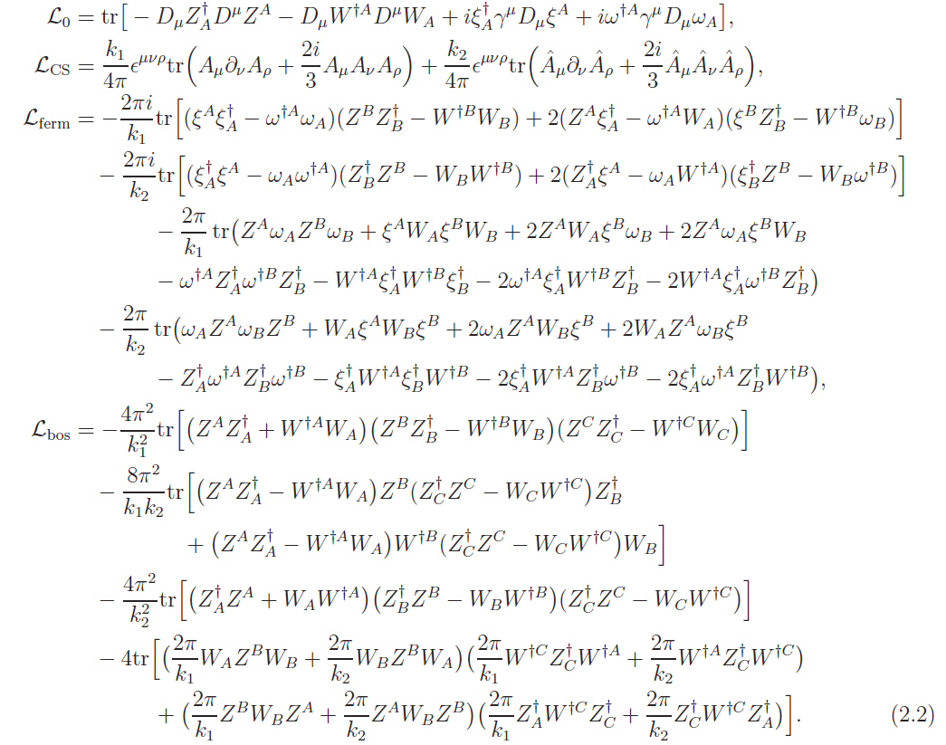
Action of the N=3 GT theory

Slide 7
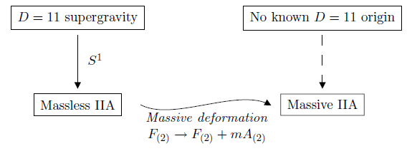

Massive IIA gravity and Romans mass
Introducing the cosmological constant in massless IIA gravity
Aharony et al arXiv:1007.2451, “Massive type IIA string theory cannot be strongly coupled!!” ➔ How about at strong curvature?
Flux of D8-brane
(Romans mass)
[Romans 1986]

Slide 8

Motivation
The only known result for the N=3 GT theory:
dual gravity(large N)
N=3 GT
Massive IIA gravity
for large k
How about the case for small N?

Slide 9

N=6 ABJM
MP Higgising
N=8 SYM
M2-branes on
D2-branes
(M-theory)
(IIA String theory)

Slide 10

Our trial
N=6 ABJM
MP Higgising
N=8 SYM
M2-branes on
D2-branes
(M-theory)
(IIA String theory)
MP Higgising
N=3 GT
N=3 YM CS
D2-branes on
D6- D8-branes background
(brane configurations?)
(M-theory interpretation?)
(massive IIA String theory)

Slide 11

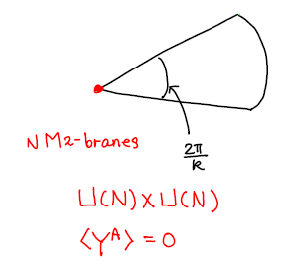
Mukhi-Papageorgakis(MP) Higgs mechanism
Mukhi-Papageorgakis (MP) Higgsing mechanism is allowed only if the bosonic potential has a flat direction.
orbifold identification

Slide 12
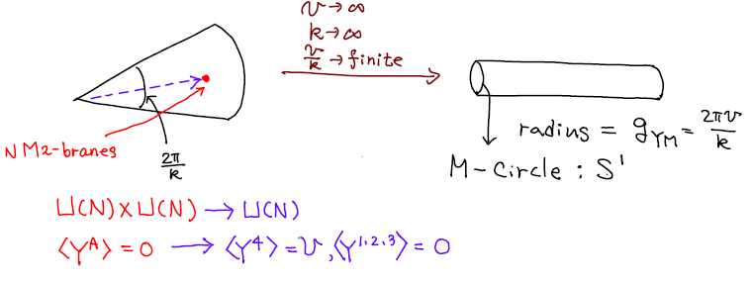
Mukhi-Papageorgakis(MP) Higgs mechanism
Mukhi-Papageorgakis (MP) Higgsing mechanism is allowed only if the bosonic potential has a flat direction.
N=6 ABJM theory N=8 super YM theory
orbifold identification
MP Higgising

Slide 13
N=6 ABJM theory N=8 super YM theory
N=3 GT theory ???
MP Higgising
IR conformal
[Kapustin-Willet-Yaakov, 10, Dongmin-Koh-Lee-Park, 11]
MP Higgising

Slide 14


MP Higgsing of the N=3 GT theory[Go-OK-Tolla 11]
Flat directions of GT theory:
Redefinition of fields:
Chern-Simons level and nonvanishing vev of one scalar field:

Slide 15



N=3 super YM CS theory:

Slide 16

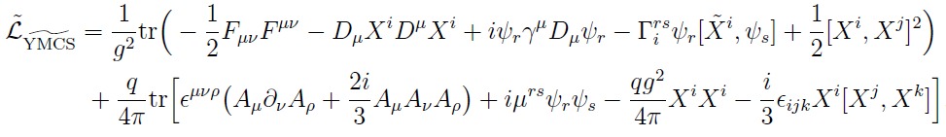
N=3 super YM CS theory:
c.f.) N=3 super YM CS [Kao; Kao-Lee-Lee]

Slide 17





Vacuum moduli space and fuzzy funnel solution
Moduli space ➔ 3 massive field and 4 flat directions
N=1 fuzzy funnel solution: expressed by 7 generators of SU(3), excluding

Slide 18
Our proposal
N=6 ABJM
MP Higgising
N=8 SYM
M2-branes on
D2-branes
(M-theory)
(IIA String theory)
MP Higgising
N=3 GT
N=3 YM CS
D2-branes on
D6- D8-branes background
(brane configurations?)
(M-theory interpretation?)
(massive IIA String theory)

Slide 19
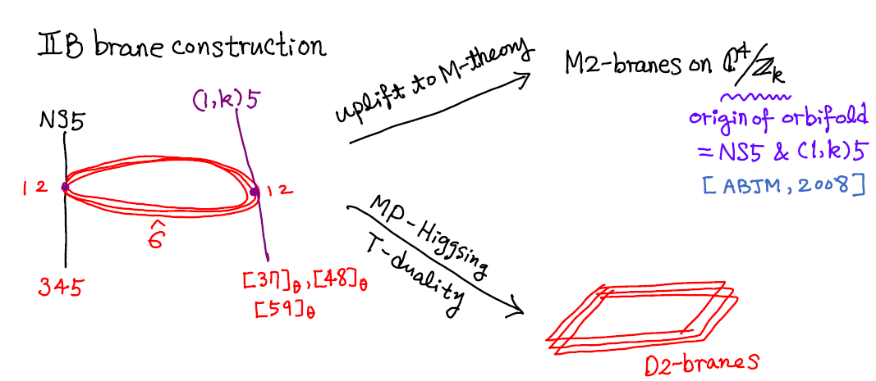
Meaning of MP Higgsing
N=6 ABJM
MP Higgising
N=8 SYM
M2-branes on
D2-branes
(M-theory)
(IIA String theory)

Slide 20
MP Higgsing = moving far away from the orbifold singularity
+ T-duality
= eliminating the NS5 and (1,k)-branes + T-duality
NS5 and (1,k)5-branes

Slide 21
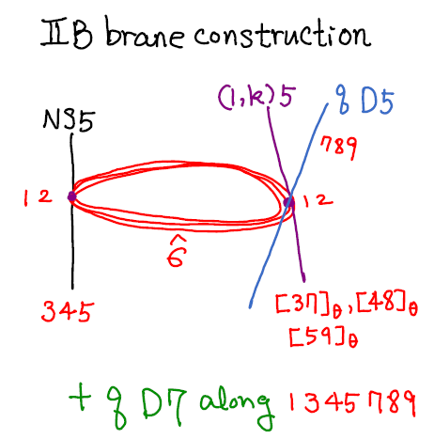
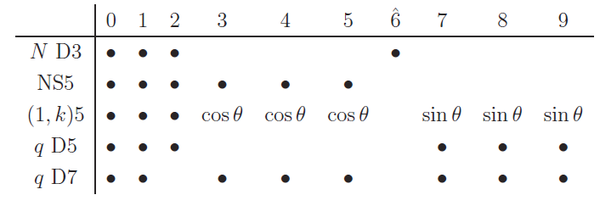
Meaning of MP Higgsing
MP Higgising
N=3 YM CS
N= GT
[Fujita-Li-Ryu-Takayanagi 09]
MP Higgsing = eliminating the NS5 and (1,k)-branes + T-duality

Slide 22
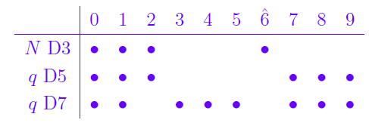
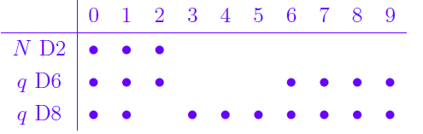
Brane configuration of N=3 YM CS theory
IIB brane configuration:
IIA brane configuration:
2
1,6,7,8,9
N D2
q D6
3,4,5
q D8

Slide 23
Vacuum moduli space and fuzzy funnel solution
Moduli space ➔ 3 massive field and 4 flat directions
N=1 fuzzy funnel solution: expressed by 7 generators of SU(3), excluding

Slide 24
Discussion
Gravity dual and brane construction:
[Gaiotto tomosiello 0901]
GT theory
Gravity dual
+ perturbation for small F0
Brane construction in M-theory?
[Gaiotto tomosiello 0904]
Effective action of multiple D2-branes in the presence of F0 D6 and F0 D8-branes
N=3 YM CS
(Romans mass)
Dual gravity?

Slide 25
N=6 ABJM theory N=8 super YM theory
N=3 GT theory N=3 YM CS theory
N=3 mass-deformed GT ➔ gravity dual?
Fuzzy funnel type of M9-brane solution in GT theory?
MP Higgising
IR conformal
[Kapustin-Willet-Yaakov, 10, Dongmin-Koh-Lee-Park, 11]
MP Higgising
IR conformal?
[OK-Tolla 11]

Slide 27



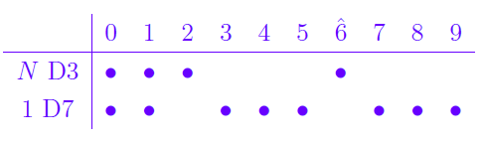

SL(2,Z) monodromy of D7-brane:
➔ Wess-Zumino type coupling:
D7-brane
N D3-branes
Brench cut

