Slide 1
Neutrino and Cosmic Ray Signals
from the Moon
Jeong, Yu Seon
Yonsei University
2012. 2. 21
Jeong, Reno and Sarcevic, Astroparticle Physics 35 (2012) 383
[arXiv:1108.2549]

Slide 2
Outline
Cosmogenic neutrinos
Radio Cherenkov detection
Effective aperture
Signals of neutrinos and cosmic rays
Signal changes with the cross sections and the flux

Slide 3
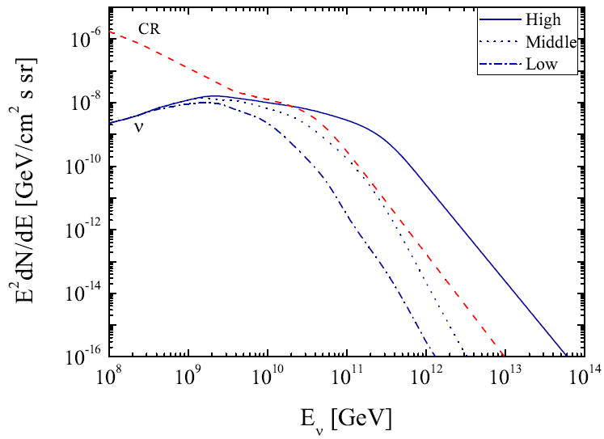





Ultra High Energy Cosmic Rays and Neutrinos
Cosmogenic neutrinos
JRS (2012)
Neutrino fluxes: from K. Kotera, D. Allard, and A. V. Olinto (JCAP, 2010)
Cosmic ray flux: from the Pierre Auger Collaboration (PLB 685, 2010)

Slide 4
The Moon as a detector
The area of the Moon ~ 10⁷ km² -> good as a big detector
For E>10⁷ GeV, neutrinos interact inside the Moon.
The Moon was suggested as a neutrino detector by Dagkesamanskii and Zhelenznykh (1989) based on the prediction of Askaryan effect.
Askaryan Effect (1962) – High energy particle interactions in the materials (e.g. salt, ice, dry rock) produce about 20% net charge excess.

Slide 5
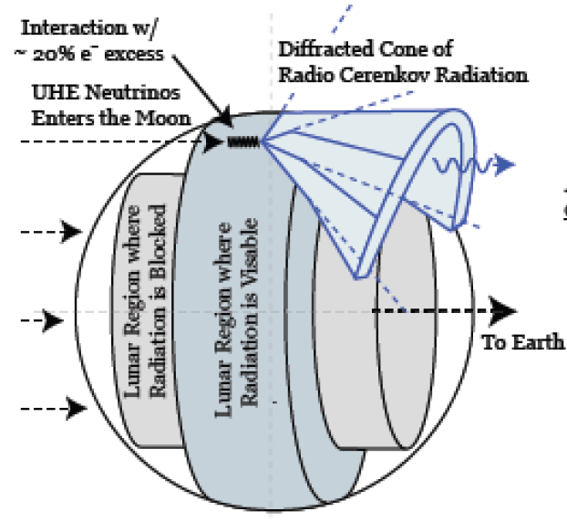
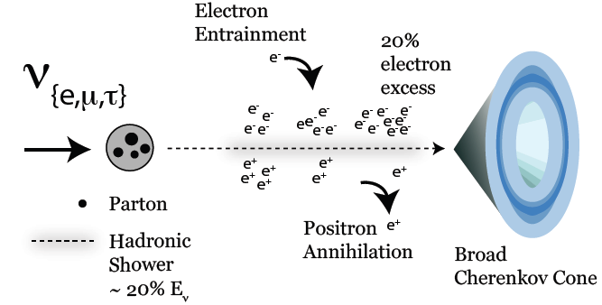
Detection Method – Radio Cherenkov
High energy neutrinos produce showers in the lunar regolith.
While the shower develop in the regolith, 20% of electron excess is created. => Askaryan Effect (G. Askaryan(1962))
The bunch of electrons generates the Cherenkov radiation.
This Cherenkov radiation is observed by the array of antennas.
resun.physics.uiowa.edu

Slide 6
Experiments (Lunar Target)
Parkes telescope, Hankins et al (1996)
Goldstone Lunar UHE Neutrino experiment, Gorham et al. (2001; 2004)
Beresnyak et al. (2005) Kalyazin telescope
Buitink et al. (2008), nuMoon with Westerbork Synthesis Radio Telescope
Jaeger et al., RESUN with VLA

Slide 7
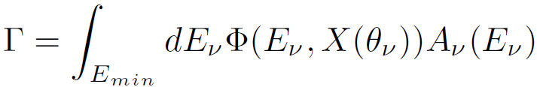
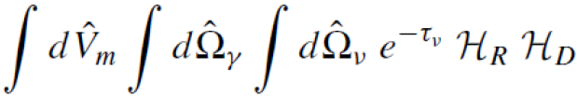




Event Rate
: the flux
: the effective aperture
: the maximum cross sectional area of the detector
: Probability of Interaction within the detector

Slide 8



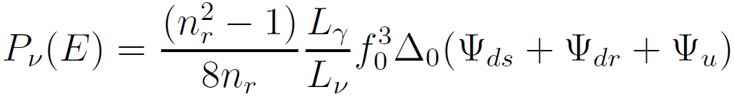
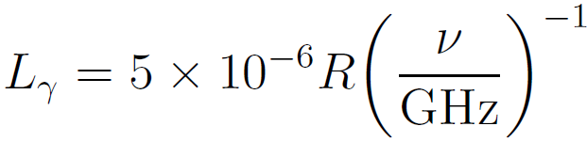
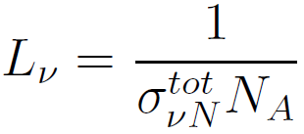

Effective Aperture
: the maximum geometric aperture of the Moon
: the neutrino interaction probability in the Moon
: interaction lengths of photon and neutrinos
: the index of refraction
K. G. Gayley, R. L. Mutel, and T. R. Jaeger Astropart. Phys. 706, 1556 (2009)

Slide 9
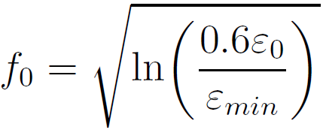

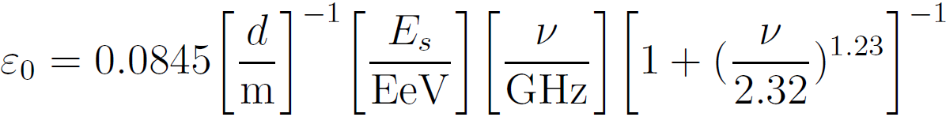

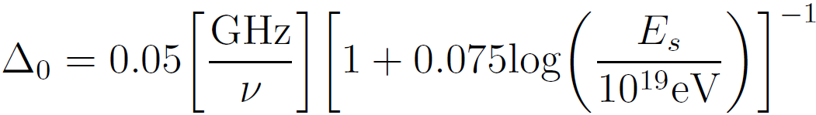
Effective Aperture – more parameters
: Ratio of the full thickness of the Cherenkov cone to the thickness at the minimum detectable electric field
: the minimum detectable electric field
: Maximum electric field
: the shower energy
: the half width of the Cherenkov cone
K. G. Gayley, R. L. Mutel, and T. R. Jaeger Astropart. Phys. 706, 1556 (2009)
Notes:
What epsilon_min depends on the feature of the telescope such as the collection area.

Slide 10

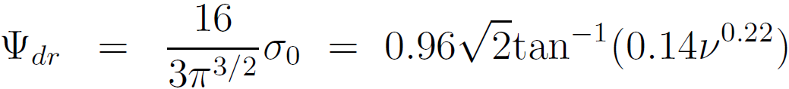
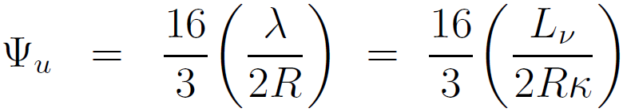
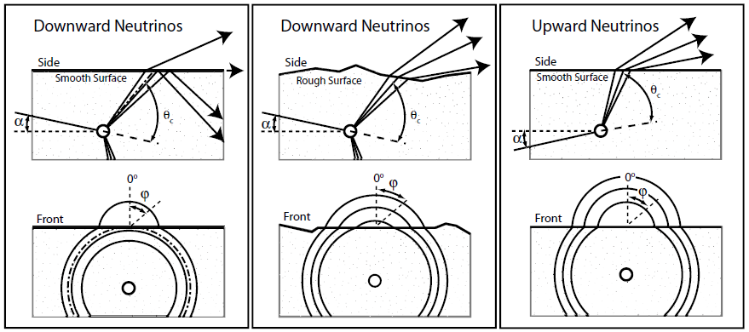
Effective Aperture
K. G. Gayley, R. L. Mutel, and T. R. Jaeger Astropart. Phys. 706, 1556 (2009)
Notes:
Clarify combined f0_and delta_0. and explain what are downward and upward neutrinos

Slide 11
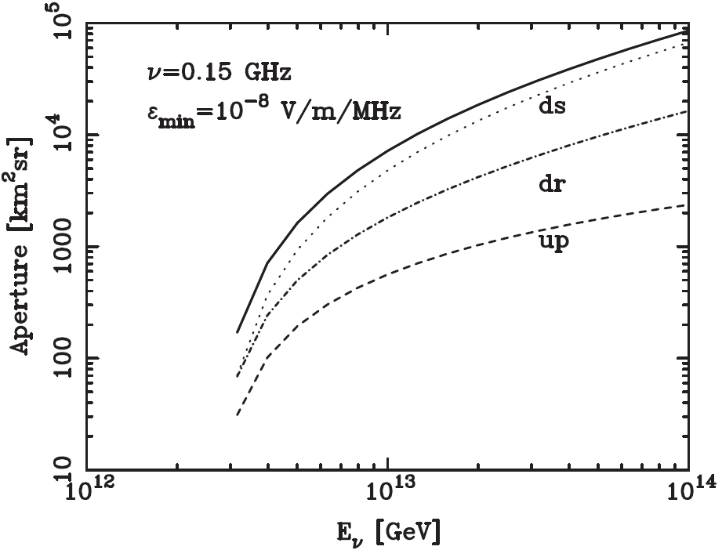
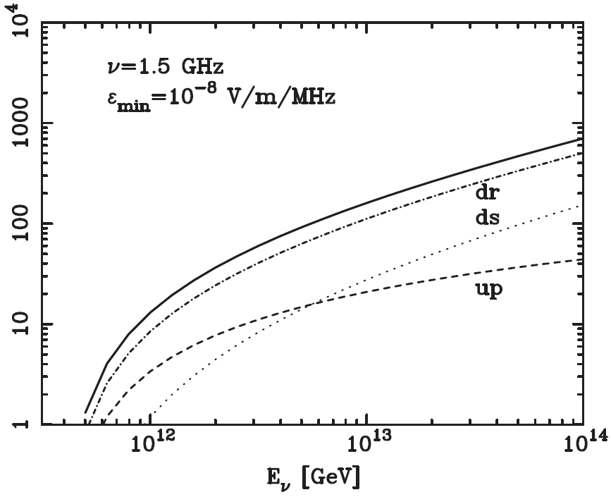
Effective aperture for neutrinos
Width of Cherenkov cone is wider for lower frequencies
→ At low frequency – more smooth contributions.
Jeong, Reno and Sarcevic, Astroparticle Physics 35 (2012) 383

Slide 12
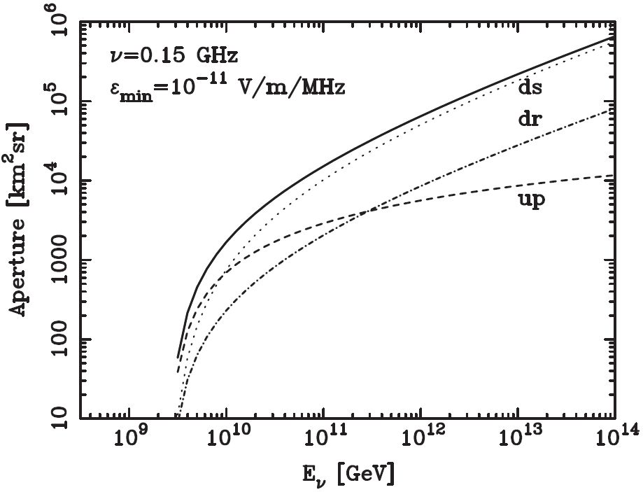
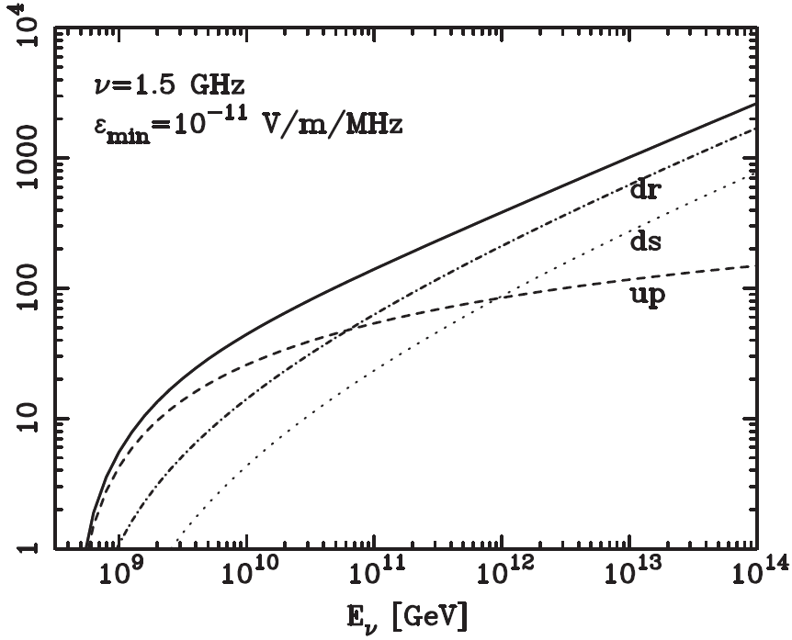
Effective aperture for neutrinos
Lower minimum detectable electric field reduces the minimum energy of neutrinos.
Jeong, Reno and Sarcevic, Astroparticle Physics 35 (2012) 383

Slide 13
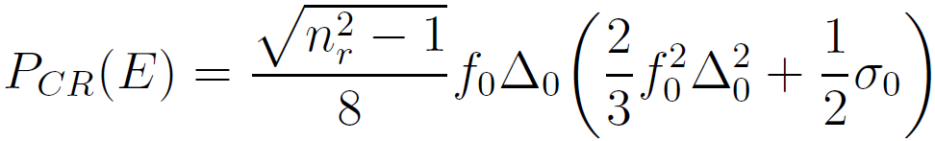
Cosmic ray signals
Interaction length of cosmic rays is short.
There is attenuation effect for the downward particles.
There is no contribution from the upward particles.
The effective aperture for cosmic rays
The effective aperture and event rate for cosmic rays are independent of the cross section.

Slide 14
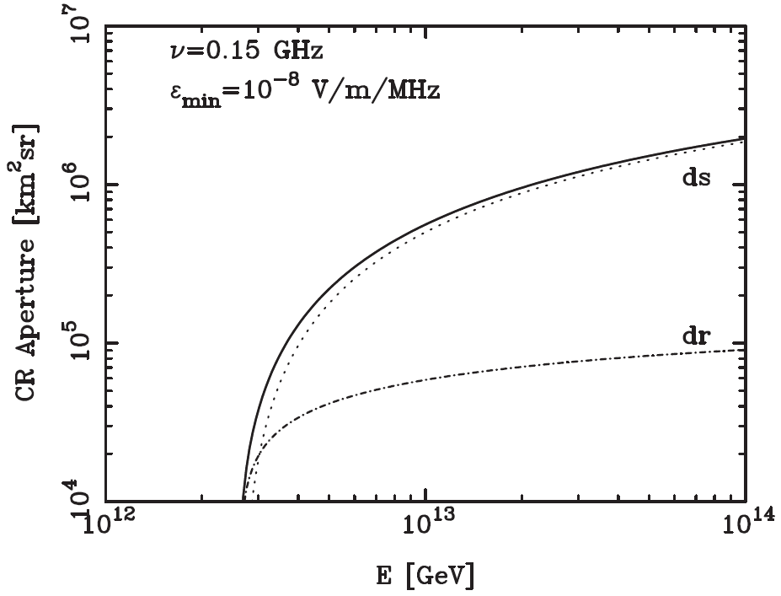
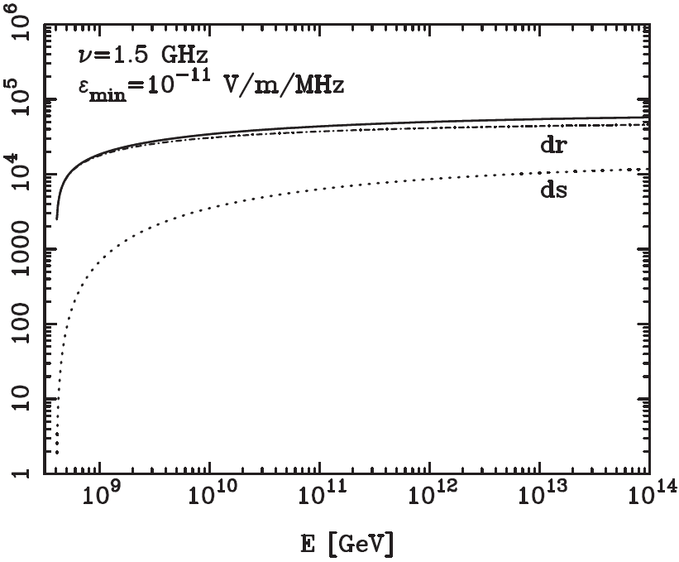
Effective aperture for cosmic rays
Jeong, Reno and Sarcevic, Astroparticle Physics 35 (2012) 383

Slide 15
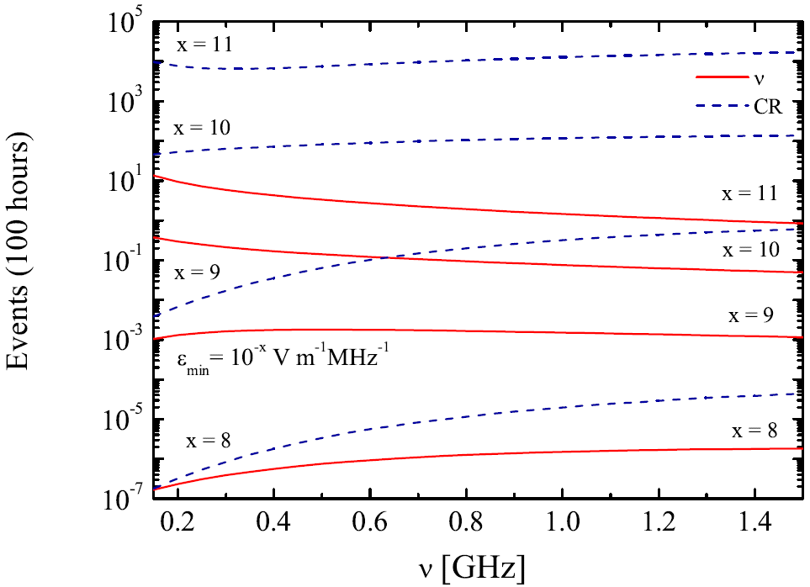
Events of Cosmic Rays and Neutrinos
The Cosmic ray events exceeds the neutrino events.
→ NOT possible to detect the neutrino signal in the SM.
Jeong, Reno and Sarcevic, Astroparticle Physics 35 (2012) 383

Slide 16
How to obtain the higher neutrino events
To increase the neutrino cross section
To increase the neutrino flux

Slide 17
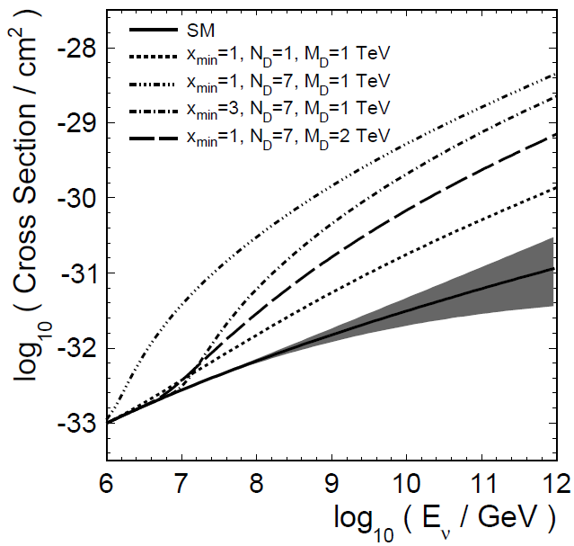

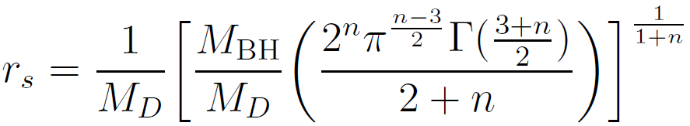
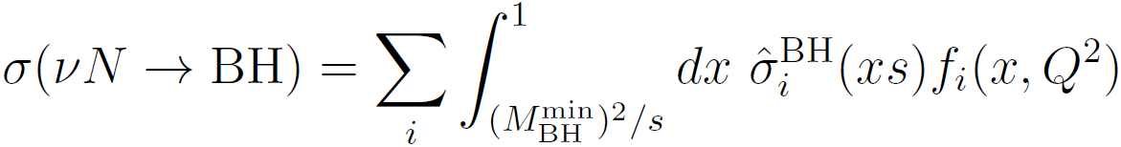

Neutrino Cross Section for mini-Black Hole
A. Connolly et al. Phys. Rev. D. 83. 113009 (2011)

Slide 18
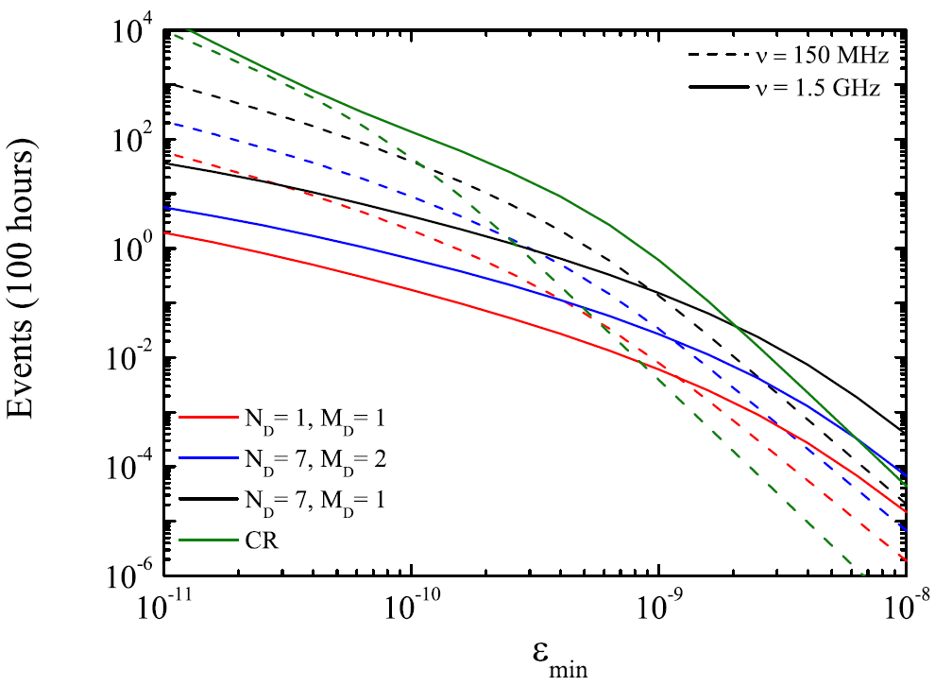
Events with the cross sections for mini-Black Hole production
For ν = 150 MHz,
at ε_{min} ~ 10⁻¹⁰ V m⁻¹ MHz⁻¹, N_{CR} < N_{ν}(σ^{non-SM}).
For ν = 1.5 GHz,
at ε_{min} ~ 10⁻⁹ V m⁻¹ MHz⁻¹,
N_{CR} < N_{ν}(σ^{non-SM}).
Electric field threshold is too low for current capability.
Jeong, Reno and Sarcevic, Astroparticle Physics 35 (2012) 383

Slide 19
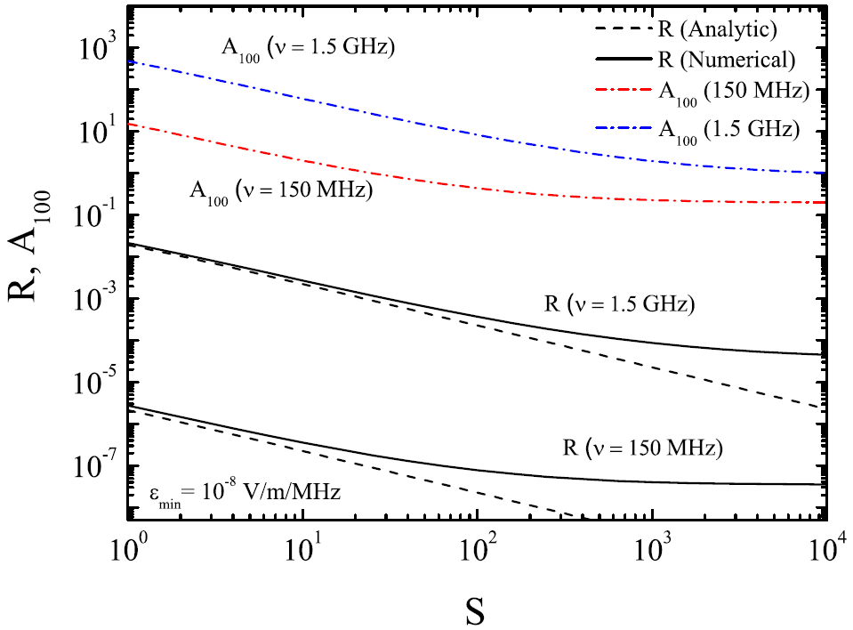



Astrophysical neutrinos
Minimum A to produce one neutrino event in 100 hr.
Jeong, Reno and Sarcevic, Astroparticle Physics 35 (2012) 383

Slide 20
Conclusion
Cosmic ray signals are independent of the cross section.
In the standard model, the cosmic ray signals overwhelm the cosmogenic neutrino signals.
With the enhanced cross sections (in the non-standard model), neutrinos can be detected. But the detection threshold is currently not attainable.
Both enhanced neutrino fluxes and enhanced cross sections could make the neutrino signals observable.

Slide 21
Extra

Slide 22
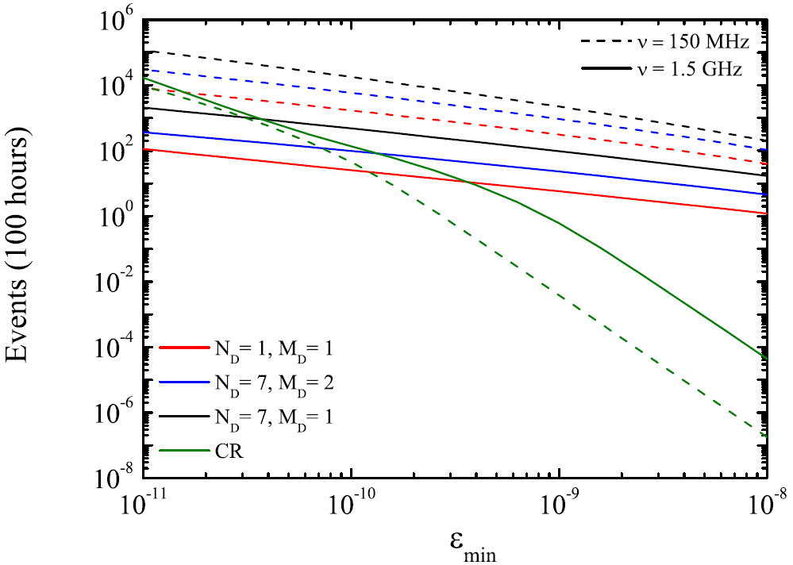
Astrophysical neutrinos
Jeong, Reno and Sarcevic, Astroparticle Physics 35 (2012) 383

Slide 23
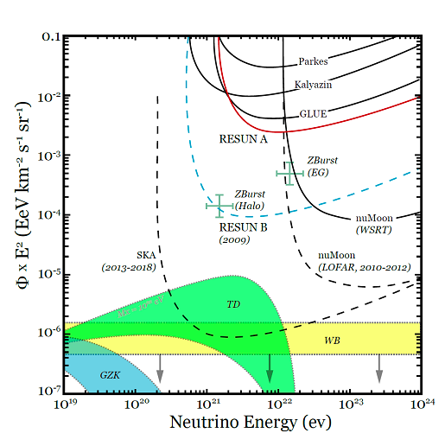
Limits

