Slide 1
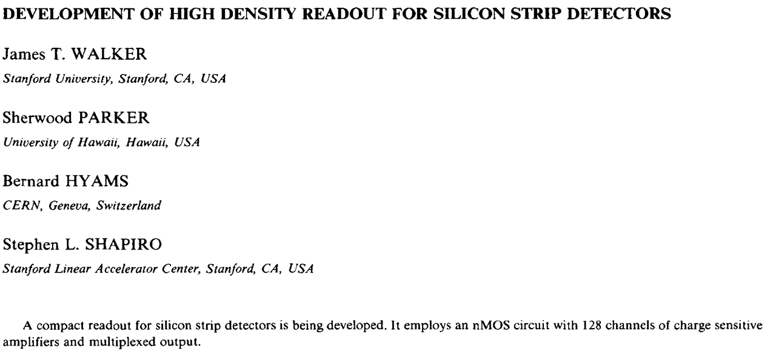
From the Microplex to Neural Systems
Alan Litke
Parker Symposium
31 March 2012
It All Started with Sherwood!!
Microplex Chip
NIM 226 (1984) 200-203.

Slide 2
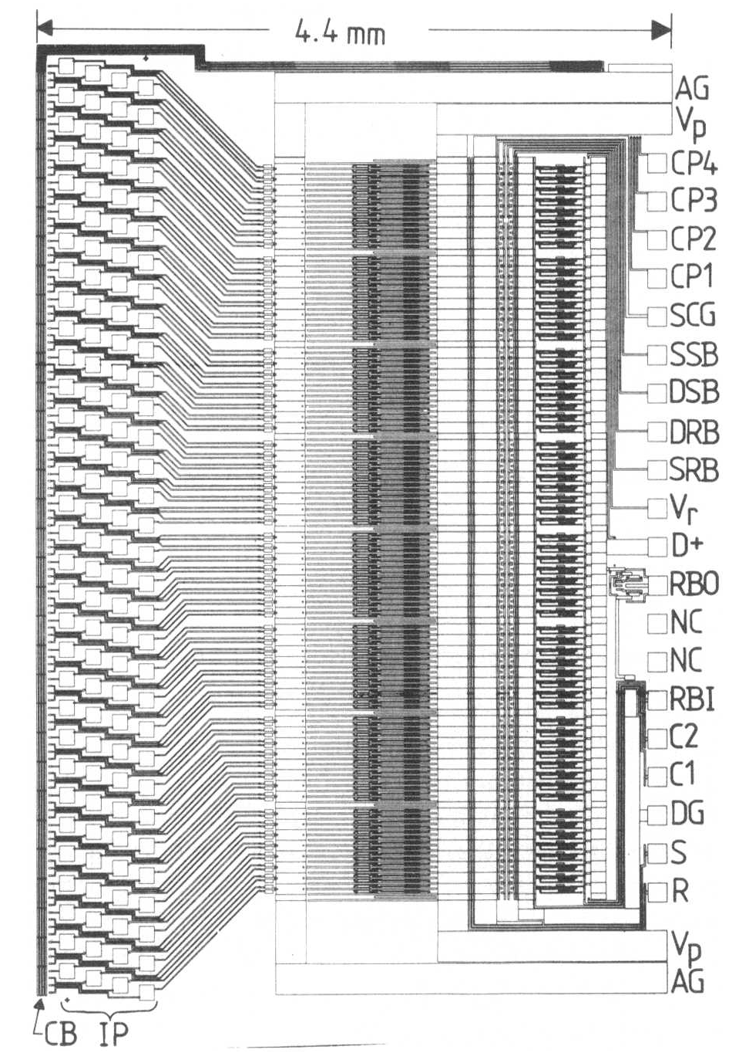
Microplex Layout
128 low-noise amplifier channels
Multiplexed output
High Density Wire Bonding

Slide 3
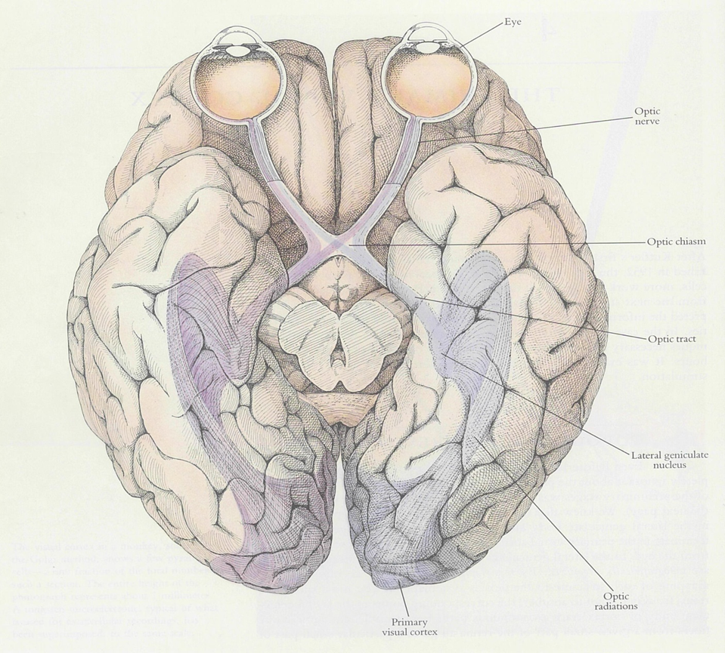
Application to Other Scientific Fields
Pixel detector +
first processing stage
cable
relay station
The Visual System
more
processing
How do neural systems develop (get wired up)?
How do neural systems process information?
How can neural systems be repaired when something goes wrong (due to injury or disease)?

Slide 4
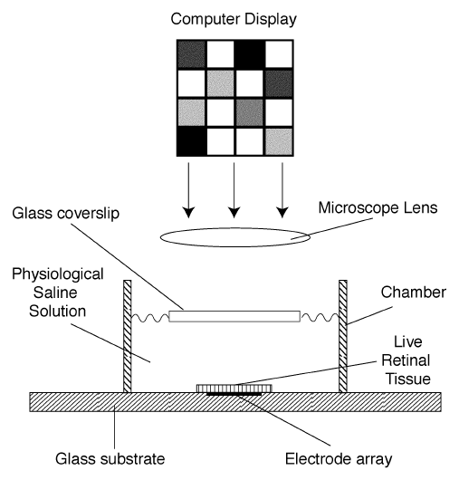
Functional Properties of the Retina
M. Meister, J. Pine, D. A. Baylor,
J. Neuroscience Meth. 51 (1994) 95.

Slide 6
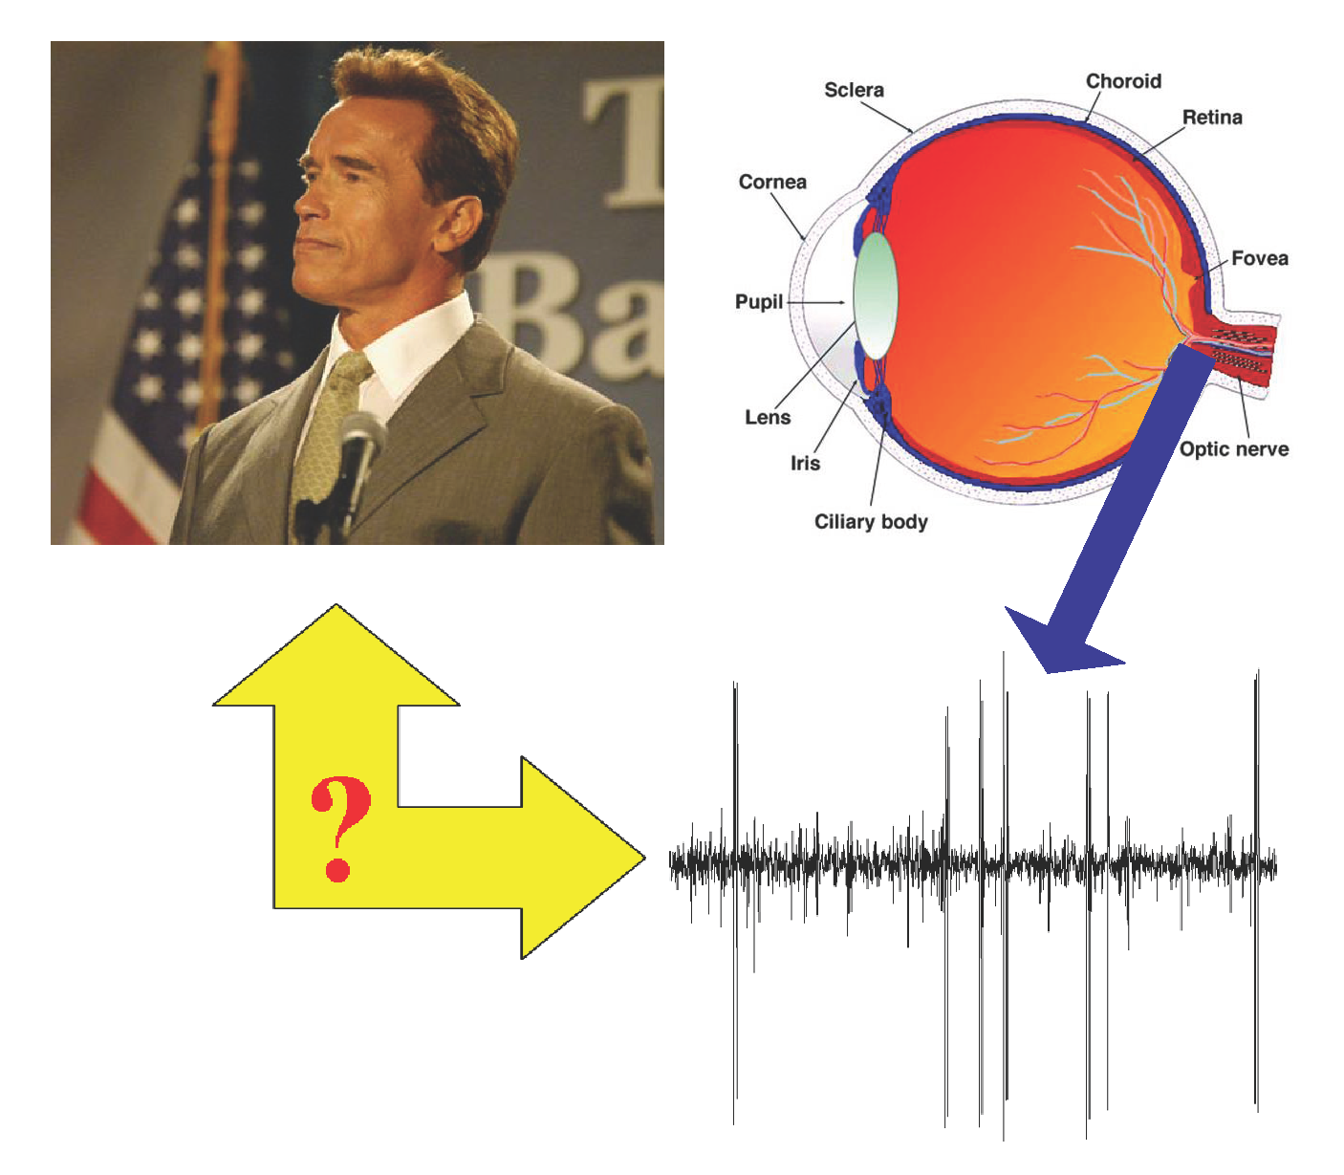
Recording Neural Activity: Retina

Slide 7
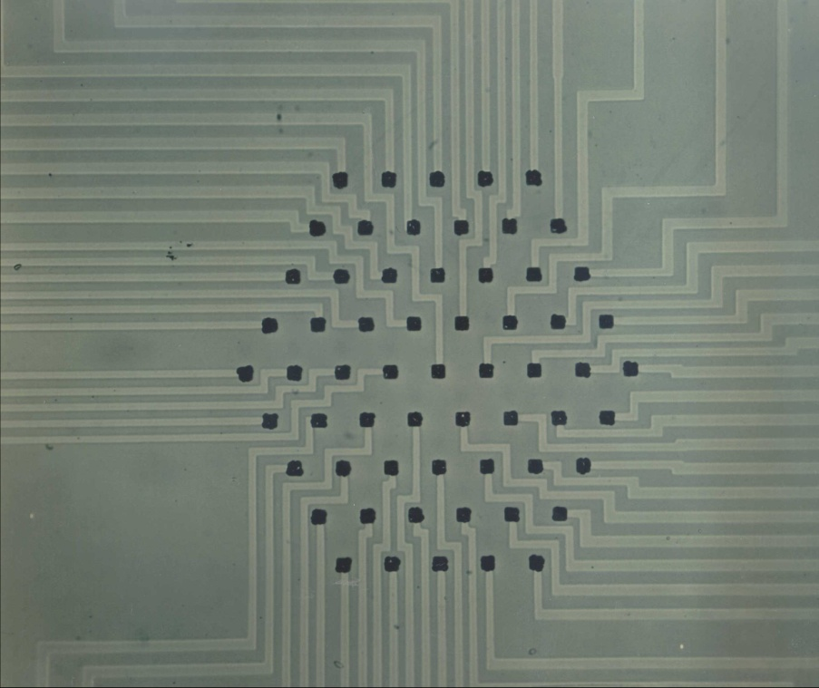
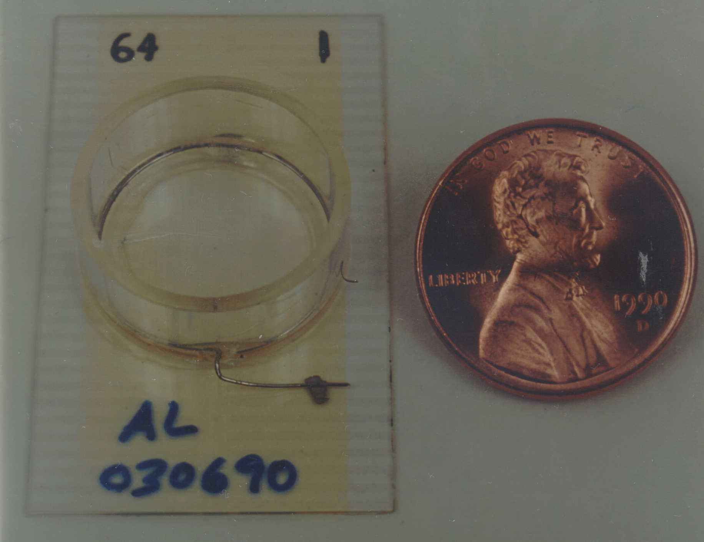
State-of-the-Art Multielectrode Array (1990)
61 electrodes,
60 µm electrode spacing,
conventional electronics
Mechanical “zebra” interconnect,
tens of retinal ganglion cells simultaneously detected

Slide 8
How do we increase, by an order of magnitude, the number of neurons simultaneously detected –
from tens of neurons to hundreds of neurons?
Number of Neurons: one→tens→hundreds→???
Number of Electrodes: 1→61→512→???
Sherwood, with the SSVD project, had shown the way:
Silicon nanofabrication technology
Multichannel low-noise analog amplifier integrated circuits
Time multiplexing
High-density wire bonding for interconnect
→ Make a Neural Recording (&Stimulation) Module
look like an SSVD Module

Slide 9

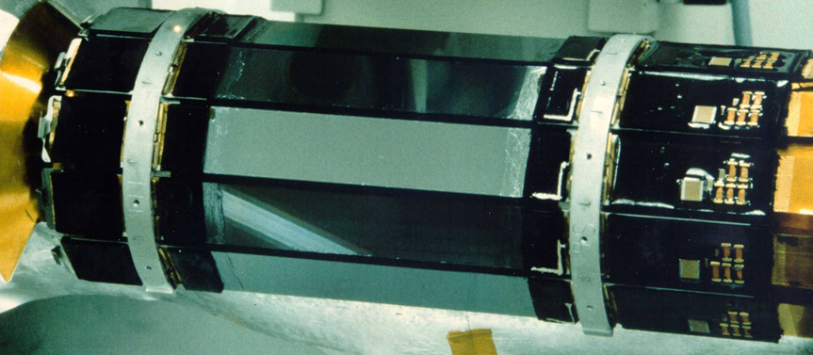
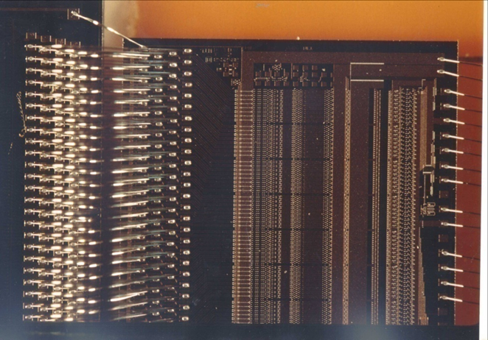
Turn a 61-electrode multielectrode array
into something like a
512-channel Silicon Strip Detector Module
Silicon Strip Vertex Detector:
512 channels/module (18K channels total)
Microplex readout chip
(128 channels, 47.5 µm pitch)

Slide 10
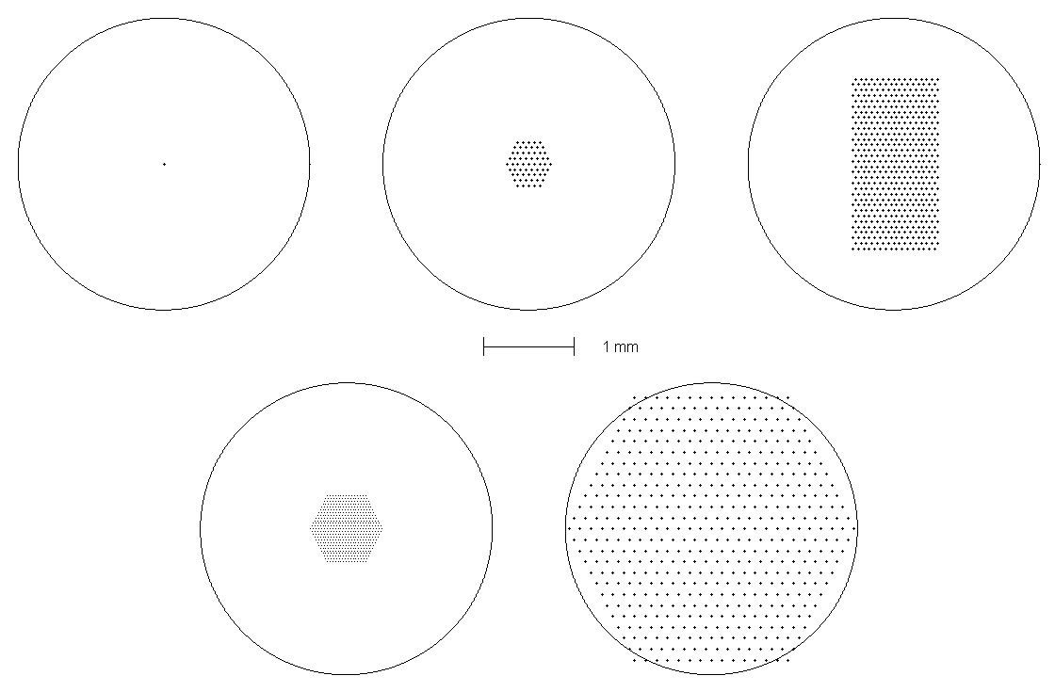
Electrode Array Geometries
(Electrode diameters = 5 µm; area and electrode spacing given below.)
1 electrode:
“traditional”
61 electrodes:
previous state-of-the-art
512 electrodes (32x16):
standard system
Input region
for monkey
MT neuron
0.17 mm²
60 µm
1.7 mm²
60 µm
0.43 mm²
30 µm
7.1 mm²
120 µm
519 electrodes:
high density
(developed by U. Glasgow)
519 electrodes:
large area

Slide 11
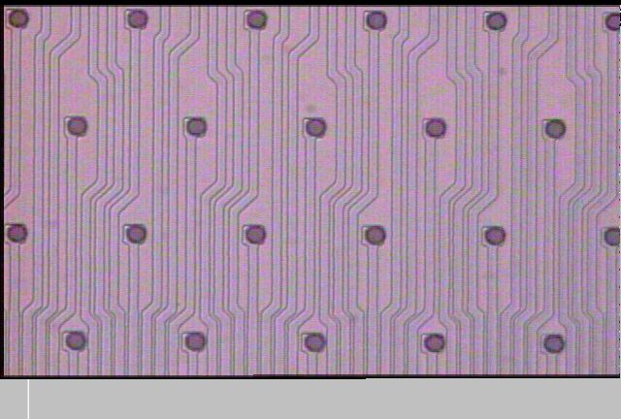
Section of
512-electrode Array (32x16)
60 microns
Electrode diameter = 5 μm
(Litke et al., IEEE Trans. Nucl. Sci. (2004) 1434)

Slide 12
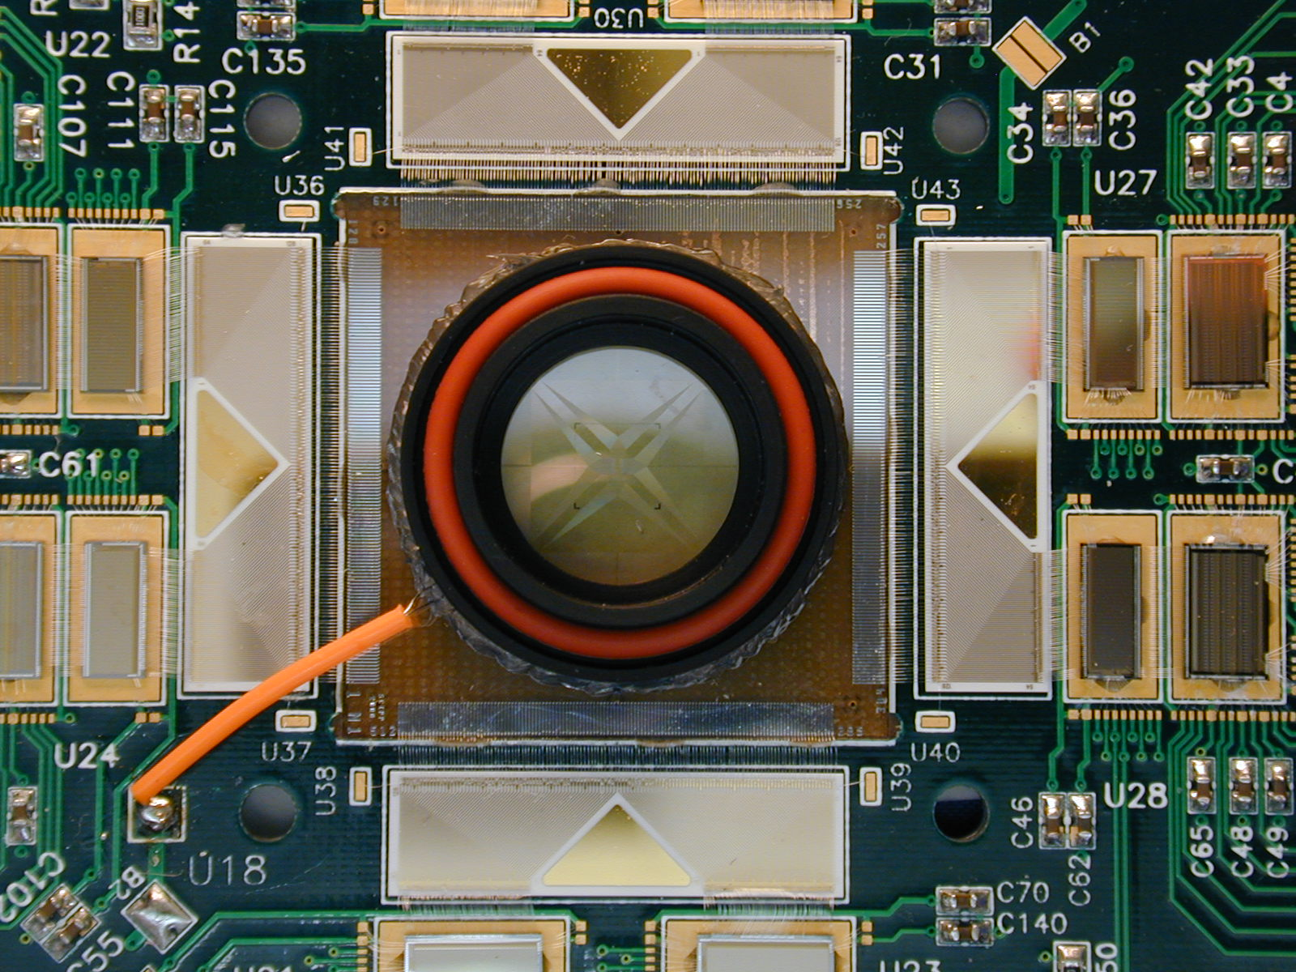
Section of 512-electrode “Neuroboard”
64-channel
Platchip
64-channel
Neurochip
chamber
to reference electrode
512-electrode array
Fan-in

Slide 13
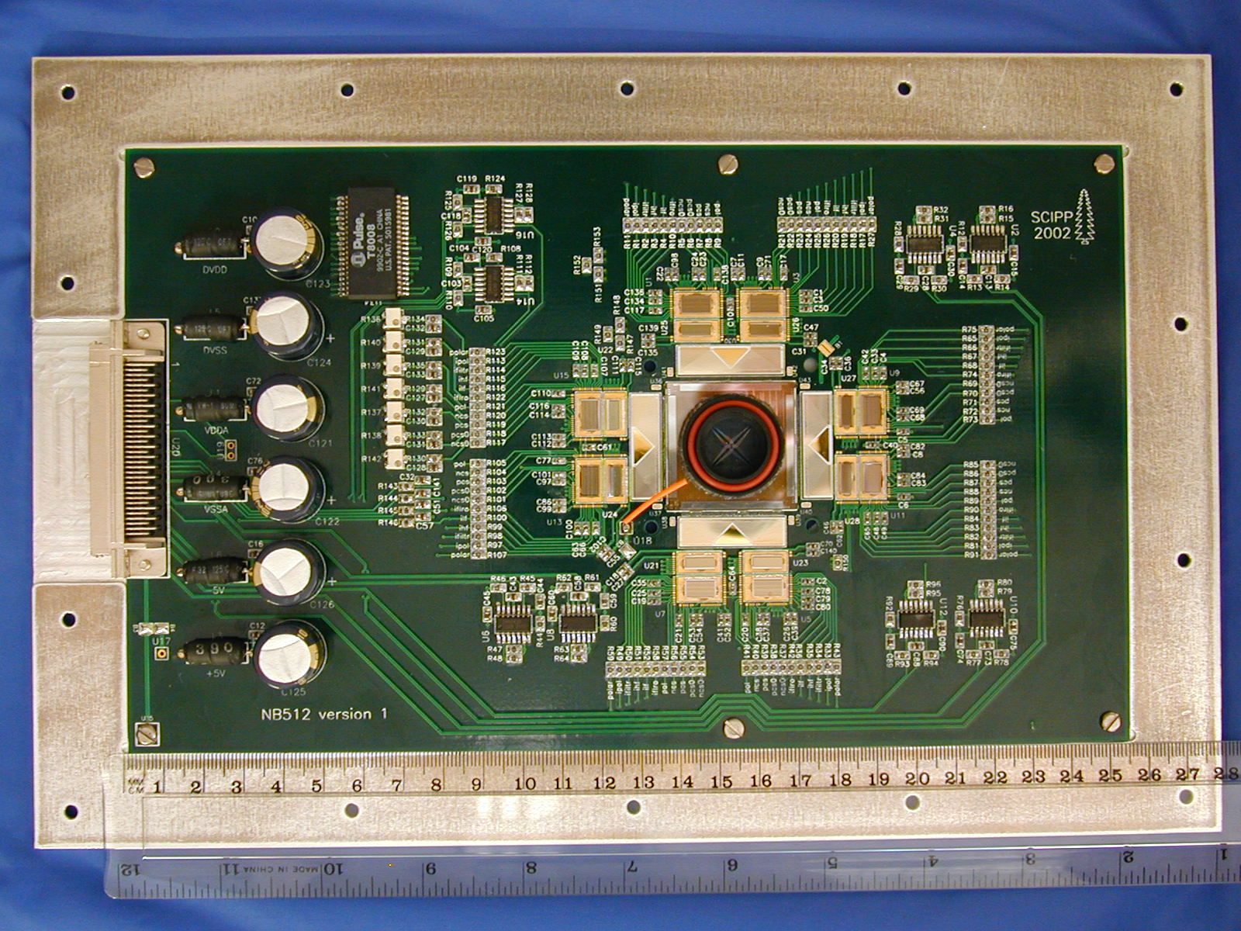
512-electrode “Neuroboard”
64-channel
Neurochip
line driver
chamber
64-channel
Platchip
Fan-in
512-electrode array

Slide 14
Spikes on electrodes ⇒ spikes from identified neurons
2 separate cells
recorded on same
electrode
Same cell
recorded on
2 electrodes

Slide 15
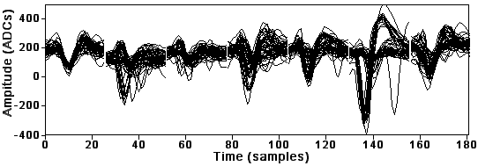
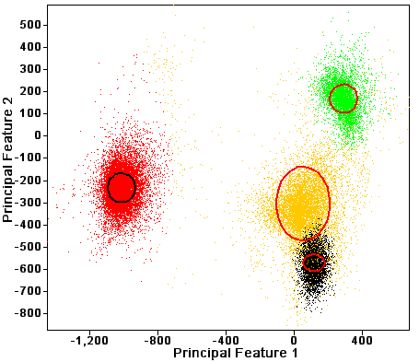
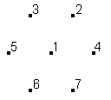
Neuron Identification
(signals on electrodes ⇒ spikes from identified neurons)
7x26=182 measurements
Multiple
electrodes
1.3 ms
Electrode #
1
2
3
4
5
6
7
Principal Components Analysis
Find ~5 most significant variables that are linear combinations of the 182 measurements
Multidimensional Clustering
⇒ Identified Neurons

Slide 16
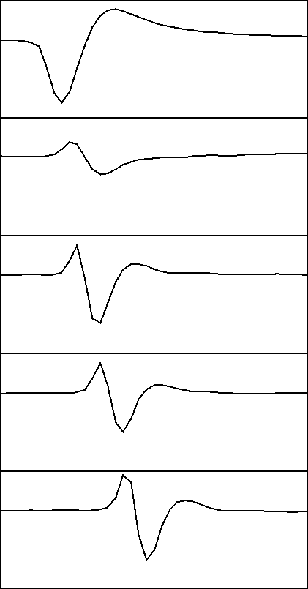
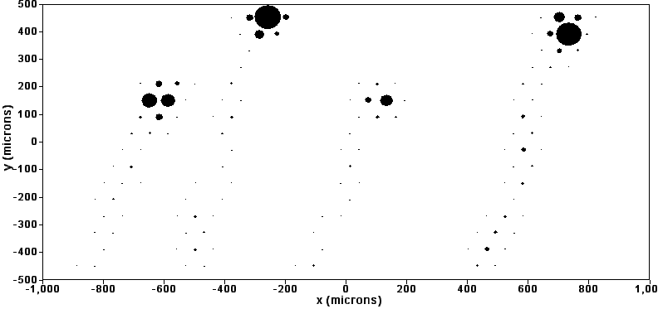
Electrophysiological Imaging
1000 μV
×4
×4
1.6 m/s
×4
Superimposed images of 4 RGCs
×4
2 ms

Slide 17

Measure the visual response properties of identified neurons
⇒ white noise analysis: use time sequence
of random checkerboard images
measure the “spike-triggered average”
(sta) response for each neuron

Slide 18
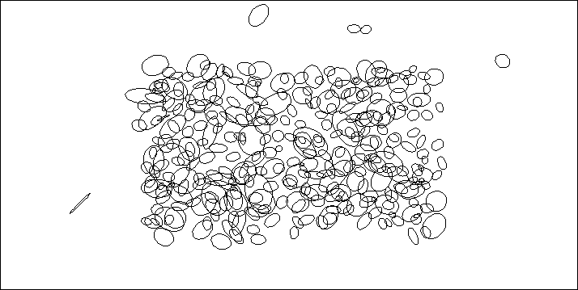
Light-sensitive regions (“receptive fields”) on the retina
for 338 identified retinal ganglion cells (RGCs)
1.6 mm
3.2 mm

Slide 19
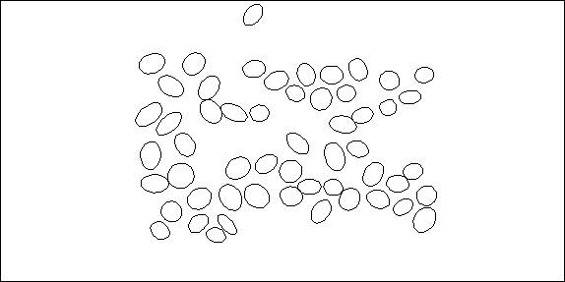
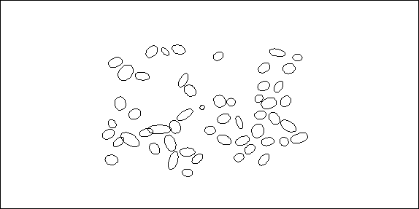
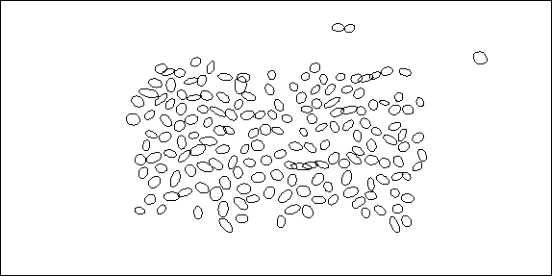
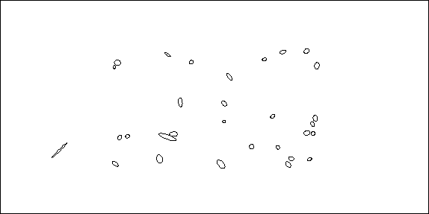
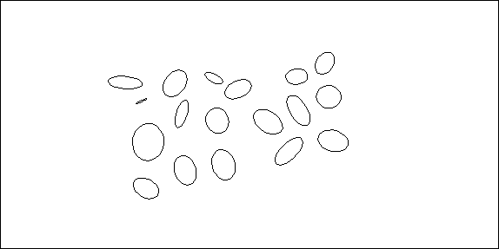
ON-
parasol
OFF-
parasol
ON-
midget
OFF-
midget
1.6 mm
Blue-ON
3.2 mm

Slide 20
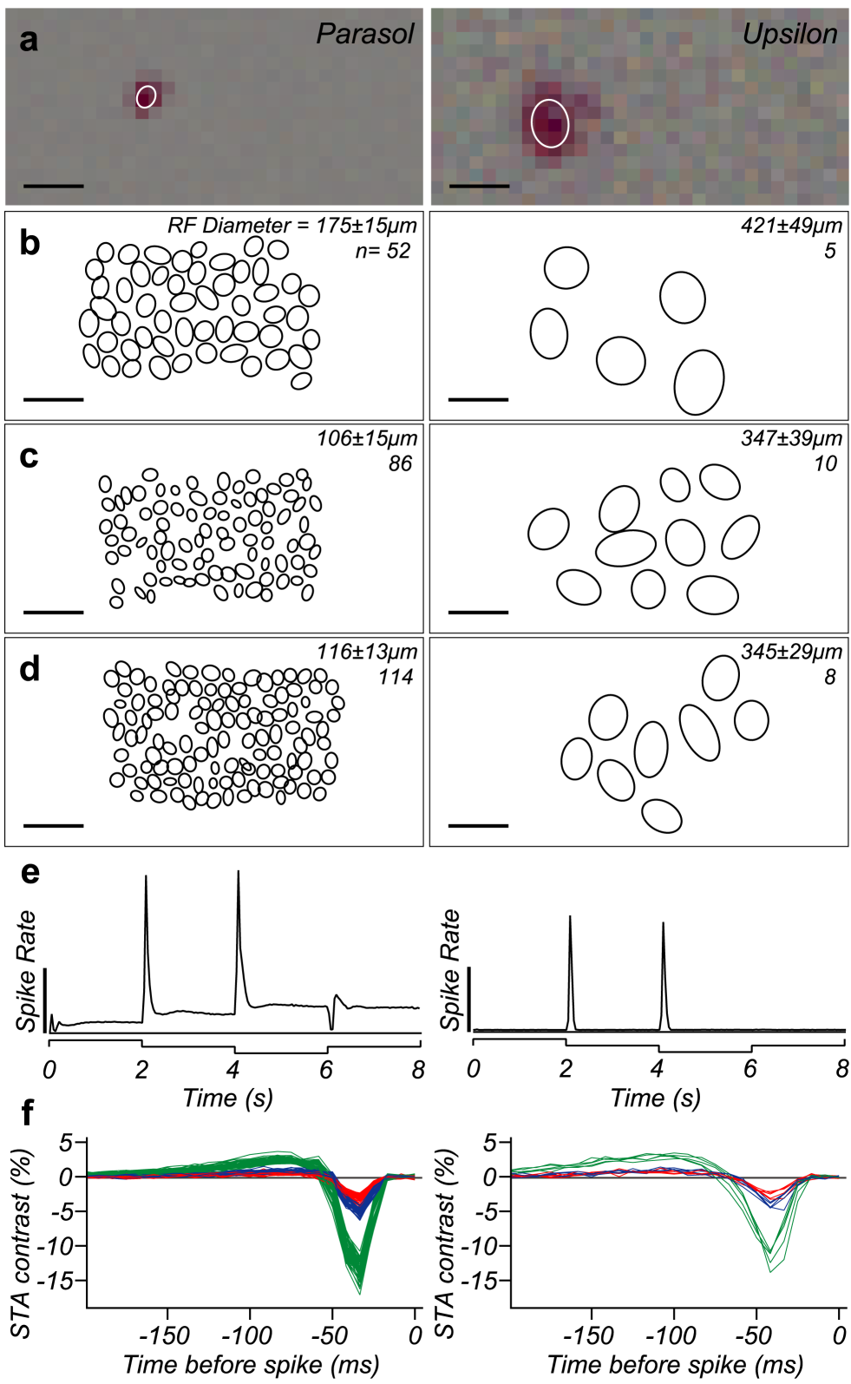
Receptive field
Parasol
Upsilon
Mosaics in 3 preparations
Response to diffuse light steps
Sta time filter

Slide 21
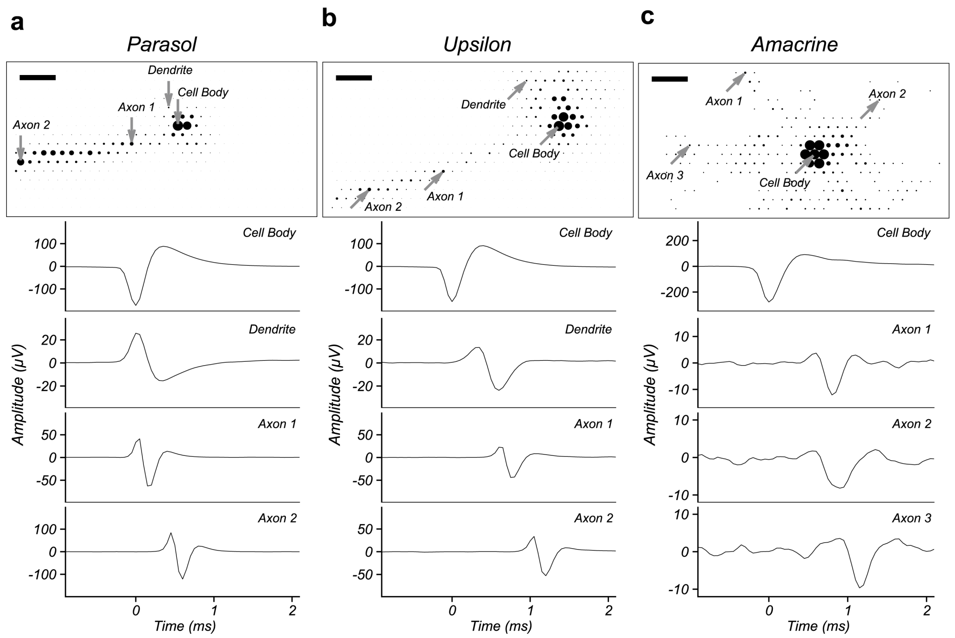
Parasol
Upsilon
Amacrine

Slide 22


OFF Parasol
Upsilon
Polyaxonal Spiking Amacrine

Slide 23
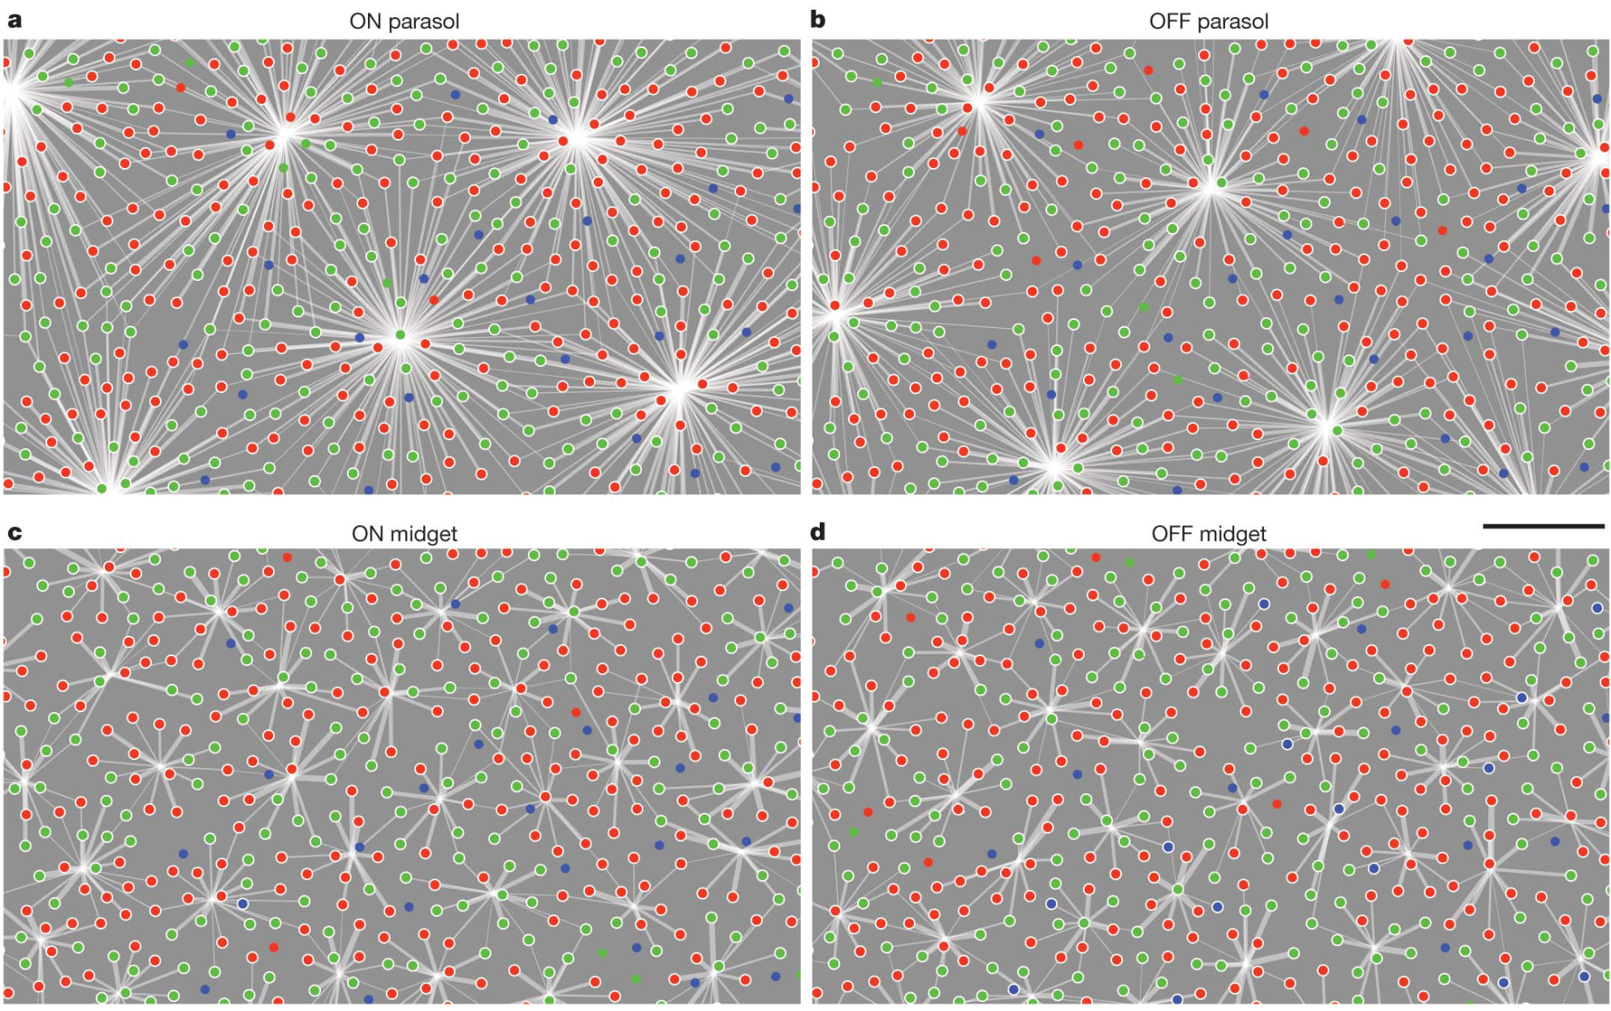
Functional connectivity in the retina at the resolution of individual photoreceptors and individual retinal ganglion cells
(Field et al., Nature 2010)

Slide 24
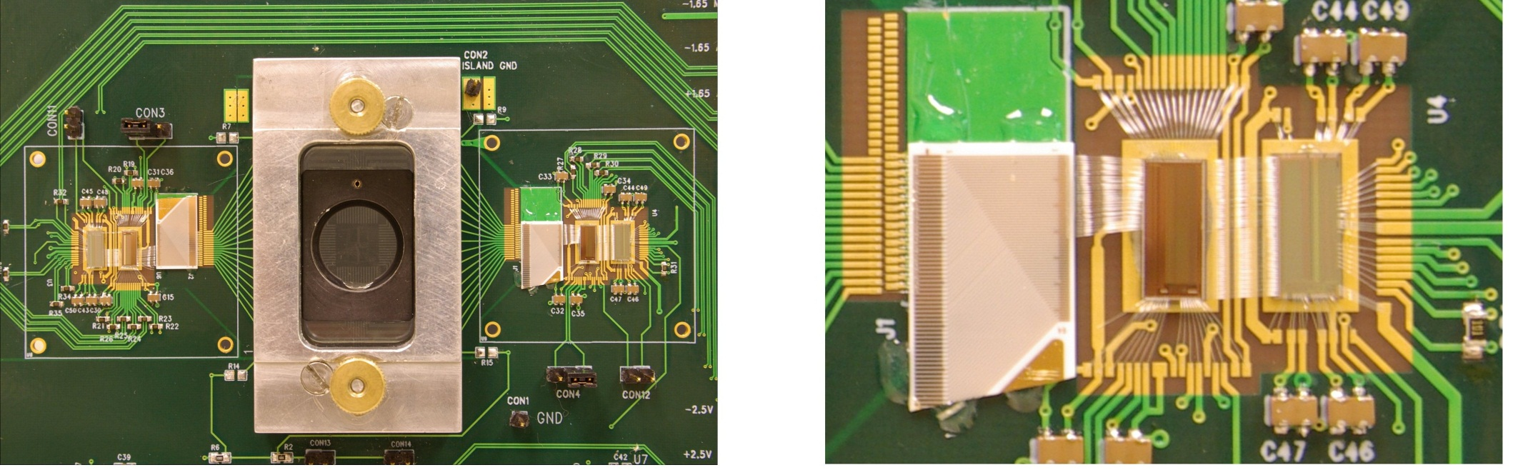
61 Electrode Neural Stimulation/Recording System
Stimchip
Neuroplat chip
Stimchip
64 channels
ability to generate arbitrary, independent stimulation pulses on each channel, under software control
→ spatio-temporal patterned stimulation
(P. Hottowy et al., Analog ICs and Sig. Processing 55 (2008) 239)

Slide 25
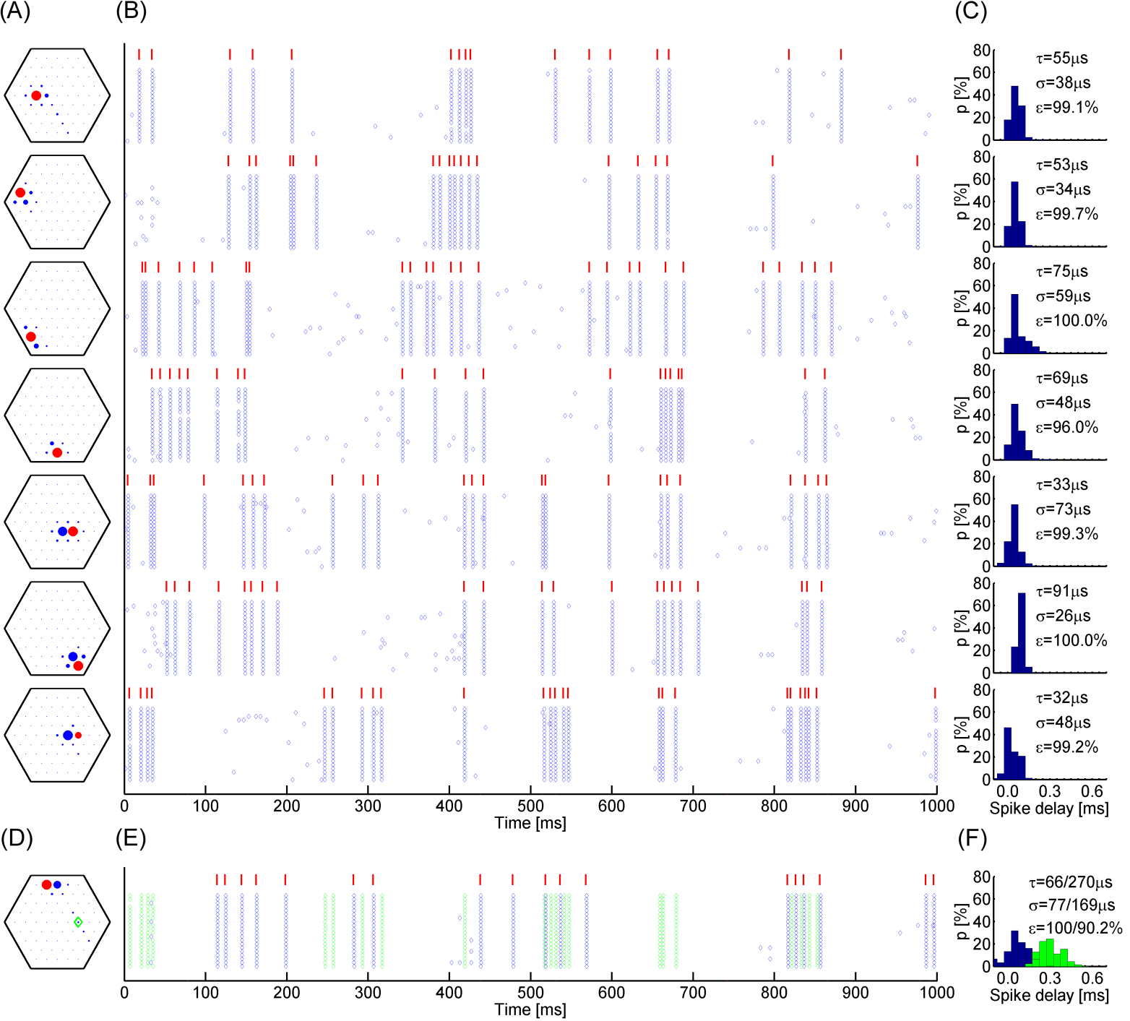
Spatio-Temporal Patterned Stimulation of Multiple Neurons with Multiple Electrodes
(Application to Retinal Prosthesis Studies)

Slide 26
Technology Development and Applications to Other Neural Systems:
Cultured Brain Slices
(with John Beggs, Shinya Ito, Frances Yeh)
Neural Connectivity and Neural Circuitry
Neurological Disorders (with transgenic mice)
Neurotoxicity

Slide 27
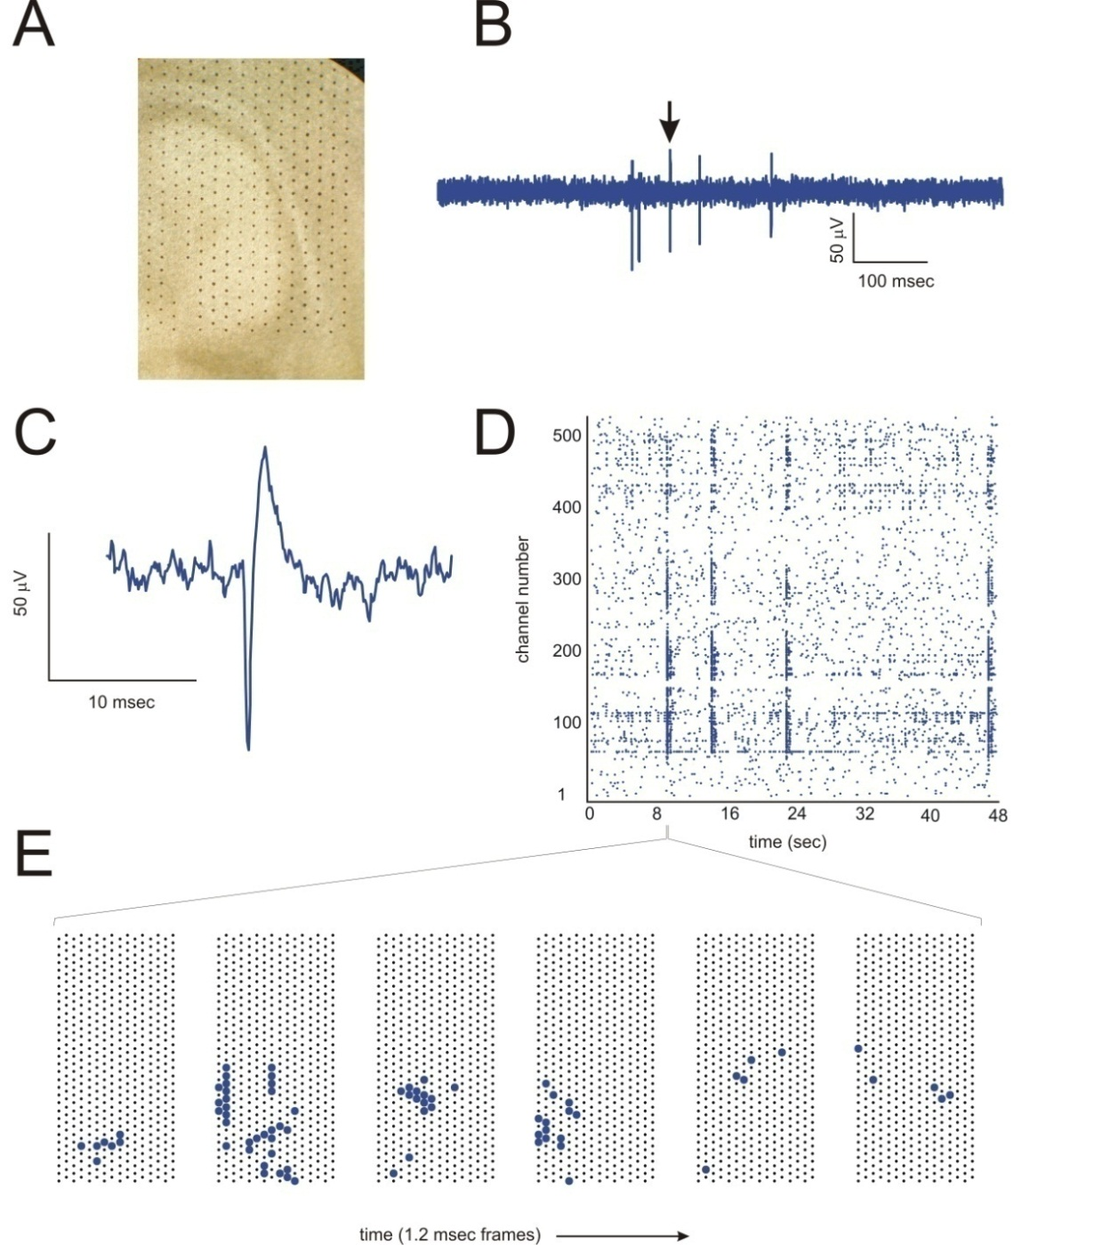
Stimulating & Recording Neural Activity: Cultured Brain Slices
Rat cultured cortical slice on 512-electrode array

Slide 28
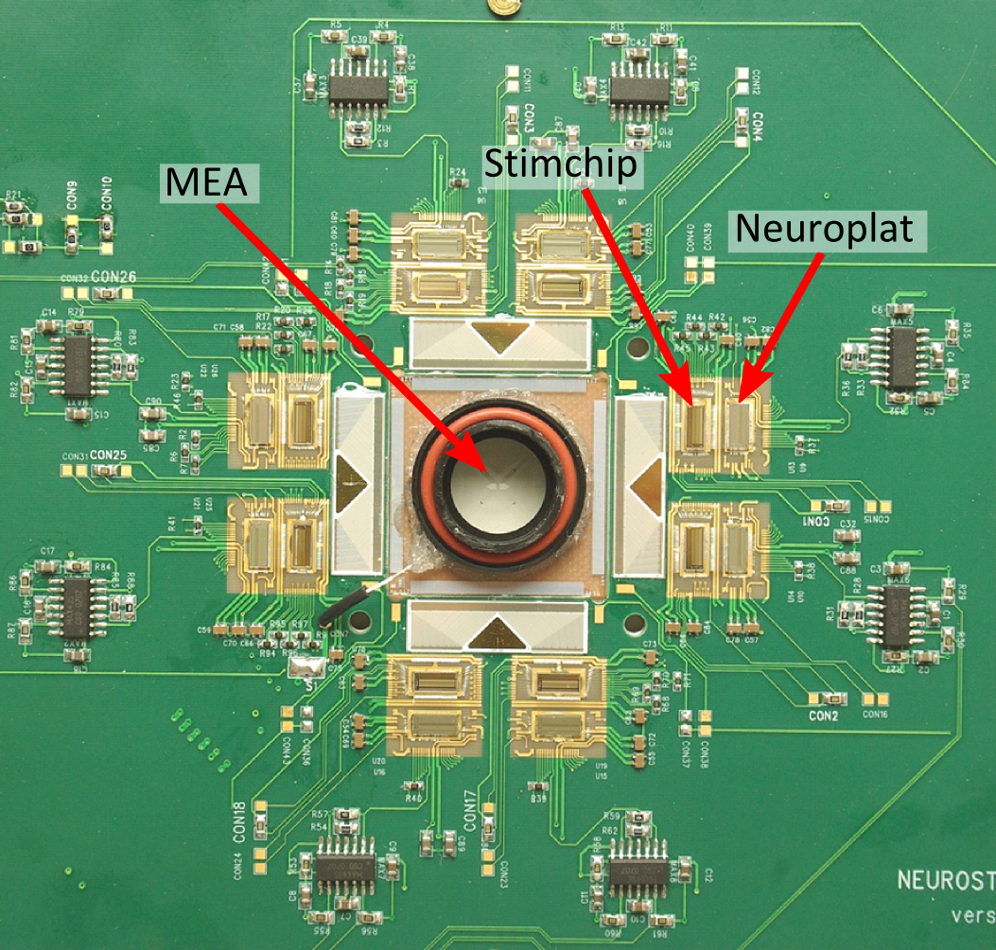
512 Electrode System for Stimulating and Recording Neural Activity
write information into a cortical network and then record its response
⇒ use multielectrode electrical stimulation combined with multielectrode recording (as with retinal prosthesis studies)

Slide 29
Acute Brain Slices
Bed-of-Nails electrode arrays:
can penetrate through ~50 microns of dead tissue due to cut
Based on 3D Detector Technology from Sherwood
First Mechanical prototypes fabricated by Chris Kenney
Electrically Active Bed-of-Nails Arrays Implemented by Debbie Gunning

Slide 30
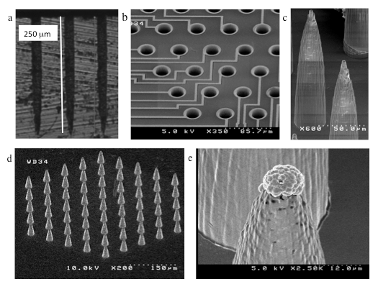
  Bed-of-Nails Electrode Array:
  (Fabricated by Debbie Gunning)
Height=150 microns;
Diameter at base=30 microns
61 electrodes;
60 micron spacing;
height=50 microns

Slide 31
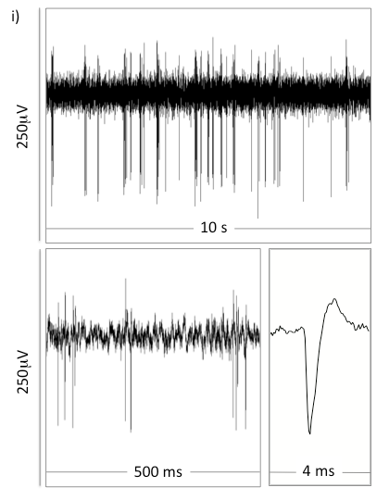
Bed-of-Nails Recording of
Neural Activity in a
Rat Acute Brain Slice

Slide 32
Mechanical prototypes
(fabricated by Debbie Gunning)
Multi-length needles
High density :
30 micron spacing
512 electrodes;
60 micron spacing

Slide 33
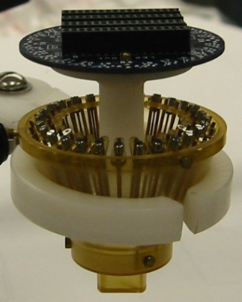
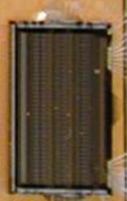
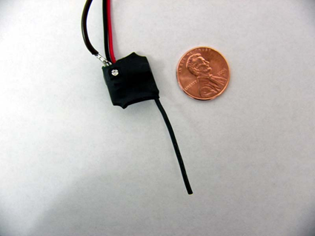
Wireless In-Vivo Brain Activity Recording System
Study the brain activity of awake, naturally-behaving animals
(e.g. burrowing, climbing, flying)
Record brain activity on multiple (~64) electrodes (or ~16 tetrodes) with portable, battery-operated system that can be carried by a freely moving rat or a flying barn owl
Neurochip-based system with wireless telemetry
28 tetrodes
with microdrives
(Neuralynx)
Neurochip
(Dabrowski)
Spy Transmitter
(Meister)

Slide 34
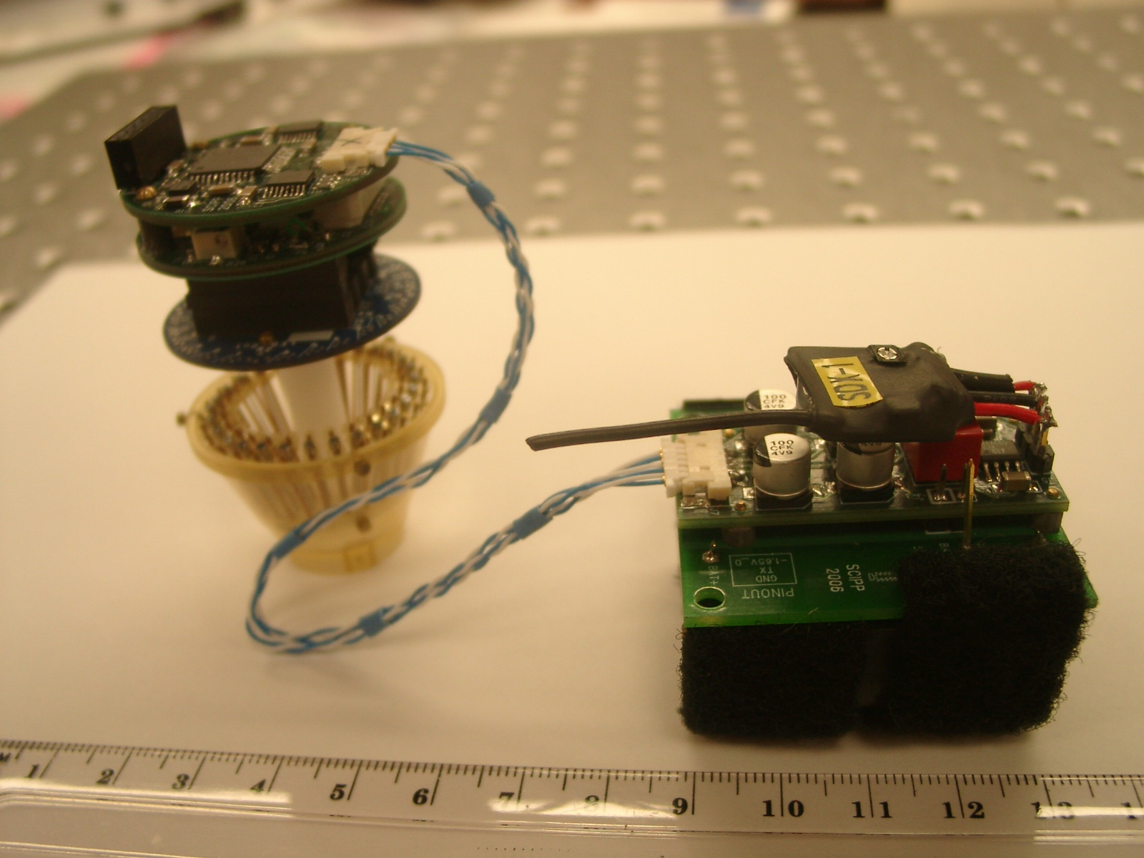

Slide 36
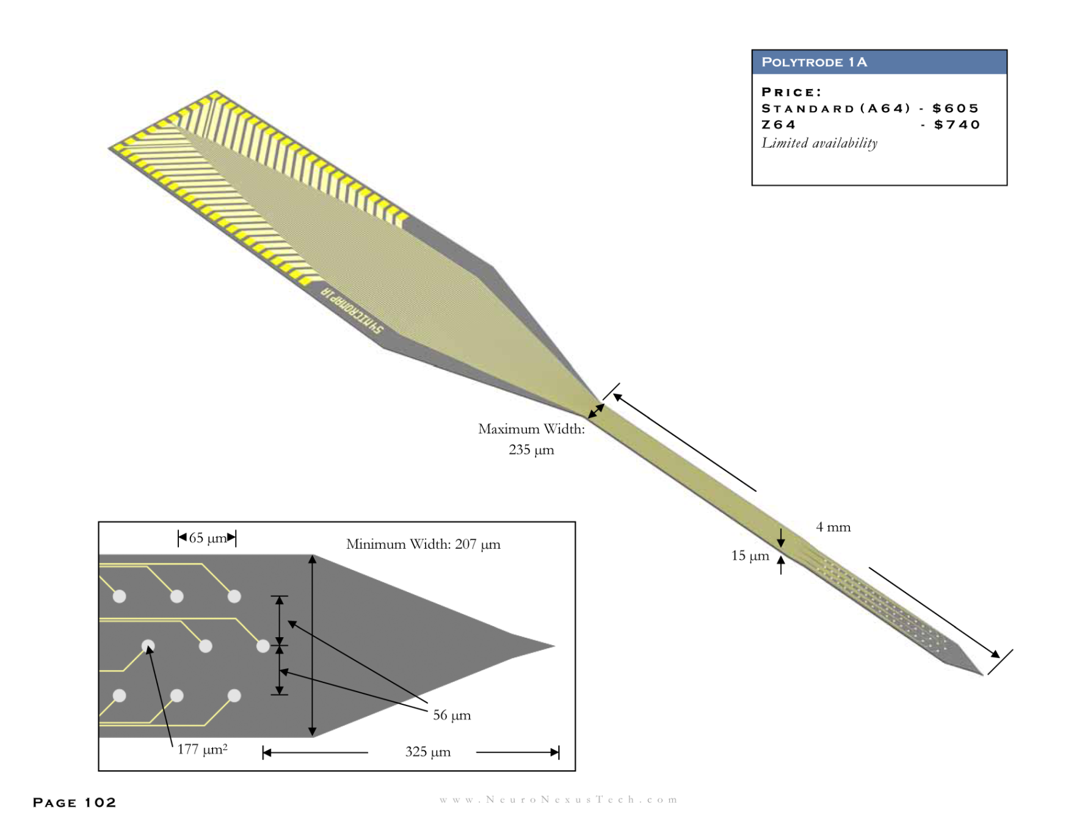
Wired System for Recording Brain Activity In Vivo with Silicon Probes
(with Yi Zuo)
Silicon Probe
(Neuronexus )

Slide 37
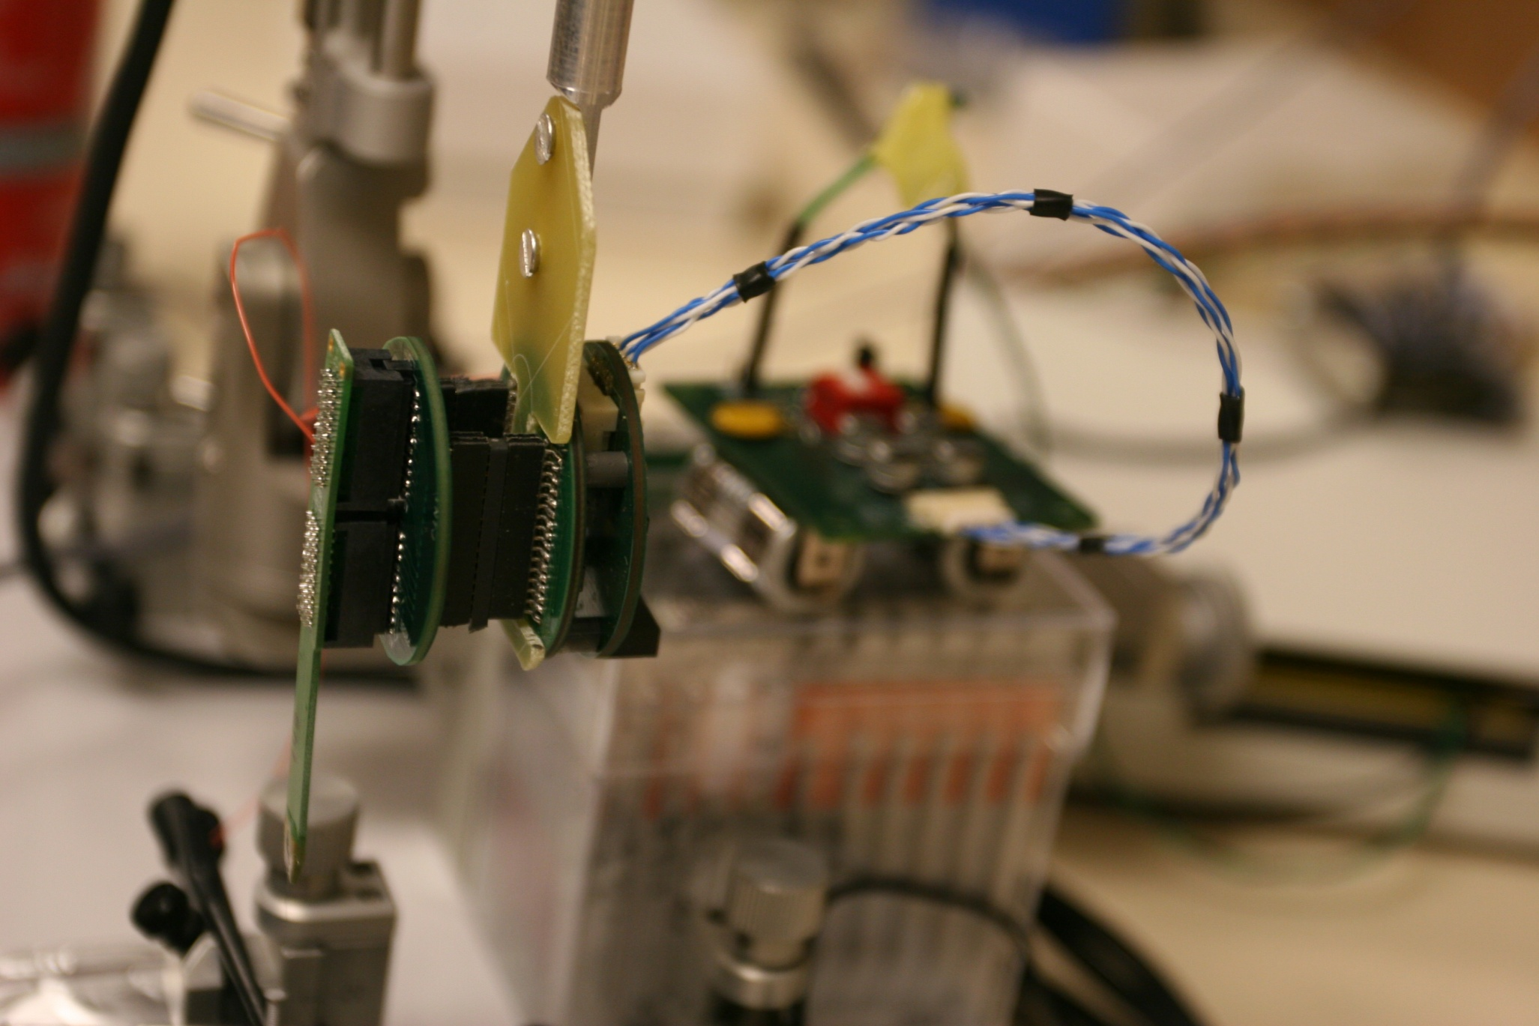

Slide 38
Thank you, Sherwood, for starting me off on this amazing journey.
You are one of my heroes. I have learned so much from you, sometimes much more than I realized I needed to know.
Decades before Google or Wikipedia or Scholarpedia, when I desperately needed information, I could depend on you for accurate and patient answers.
You are a National, even International, Resource. Keep it up!!
My Very Best wishes to you on your 80th birthday.

