Slide 1
Status and performance of strand and cable for the FRESCA2 magnet
Luc OBERLI
Outline :
Main Characteristics of the FRESCA2 strand
Status of the strand order
Performances of the PIT strand
Stability measurements on virgin and on extracted strands
Main Characteristics of the cable
Status of the cable development work
Notes:
Pendant cet expose, j’aimerais vous presenter les resultats des mesures effectuees pour qualifier les billettes fabriquees par BRUKER
Je vais couvrir les sujets suivants: (plan de l’expose)
Parler de l’homogeneite des valeurs de Ic mesurees sur les billettes.

Slide 2
Main characteristics of the FRESCA2 strand
 |  | FRESCA2 specification | PIT | RRP
Strand diameter | (mm) | 1.00 | 1.00 | 1.00
Strand layout | - |  | 192 filaments | 132/169 stack
Sub-element diameter | (μm) | < 50 | ~ 48 | ~ 57
Copper to non-Copper volume ratio | - | 1.25 +/- 0.1 | 1.25 +/- 0.1 | 1.30 +/- 0.1
J_{C}(12 T, 4.2 K) | (A/mm²) | 2500 | 2450 | -
J_{C}(15 T, 4.2 K) | (A/mm²) | 1250 | 1350 | 1575
n-value @15 T and 4.2 K | - | > 30 | > 30 | > 30 expected
RRR (after full reaction) Pilot order Production order | - | > 150 > 150 | Accepted - | > 75 (target >100) -
Piece length Pilot order Production order | (m) | > 150 (target 400 m) > 800 m | Accepted ? | Accepted ?
Notes:
Pour avoir des filaments de 50 microns, le fil doit comporter environ 190 filaments pour un Cu/non Cu de 1.25

Slide 3
Nb₃Sn Strand Procurement Status 1/2
13 km of PIT strand ordered by CERN in March 2010.
used for the cable development work and for the fabrication of the SMC cable.
30 km of PIT strand ordered by CEA and CERN to Bruker-EAS.
delivered and available for the fabrication of the first unit lengths
25 km of RRP strand ordered by CEA and CERN to OST.
expected to be delivered before June 2012
Option for 10 km of RRP strand to be taken by CEA depending of the performances of the RRP strand under fabrication for CERN.
~ 25 km of strand to be ordered by CEA in April 2012.
offers to be received before end of March 2012
~ 45 km of strand to be ordered by CERN in November 2012.

Slide 4
Nb₃Sn Strand Procurement Status 2/2
PIT 0904 1600 m, 2260 m (round)
PIT 0905 4200 m (hexa)
PIT10402 1880 m + 2954 m (hexa)
Quantity delivered to CERN : 12894 m
PIT 10503 3162 m (round)
PIT 11201 2594 m, 2786 m (round)
PIT 11302 4903 m (round)
PIT 11403 1575 m (round)
Quantity delivered to CERN : 15020 m
PIT 23448 404 m, 564 m, 881 m
PIT 23258 1133 m, 1672 m, 547 m, 518 m
PIT 23728 2360 m, 3085 m
PIT 11403 4028 m
Quantity delivered to CERN : 15192 m

Slide 5
Performances of the 1.0 mm PIT strands
Jc values given at 4.2 K for optimized heat treatments.
Quite reproducible values obtained on the 7 billets produced these last 2 years.
The Jc values in magenta were measured by Bruker.
Jc (15T, 4.2K) ~ 1350 to 1500 A/mm² as measured by Bruker
Sample ID | Heat treatment | Jc(12T, 4.2K) | Jc(11T, 4.2K) | Jc(10T,4.2K) | RRR
HE10S00904A24U | 120h/620C + 100h/650C | 2464 / 2539 | 2923 | 3476 | 235
HE10S00905A46U | 120h/620C + 100h/650C | 2451 / 2409 | 2937 | 3459 | 74/97
HE10S10402A15U | 120h/620C + 90h/650C | 2477 / 2452 | 2946 | 3481 | 96/103/105/135
HE10S10503A29U | 100h/620C + 120h/640C | 2528 / 2487 | 2997 | 3523 | 153/155
HE10S11201B01U | 100h/620C + 120h/640C | 2418 / 2468 | 2899 | 3442 | 177
HE10S11201A01U | 100h/620C + 120h/640C | 2616 / 2468 | 3120 | 3687 | 175
HE10S11302B01U | 100h/620C + 120h/640C | 2467 / 2418 | 2911 | 3456 | 165
HE10S11403A01U | 100h/620C + 120h/640C | 2510 / 2565 | 2965 | 3493 | 154/173
HE10S11403B01U | 100h/620C + 120h/640C | 2510 / 2637 | 2969 | 3500 | 179/201
 | (Max – Min)/ Average | 8 % | 7 % | 7 %
Notes:
Comparison of the performances of the 1.0 mm PIT strands showing quite reproducible Jc from billet to billet indicating that the fabrication process is well under control.
Surligner en jaune les billetes avec filaments hexagonaux.

Slide 6
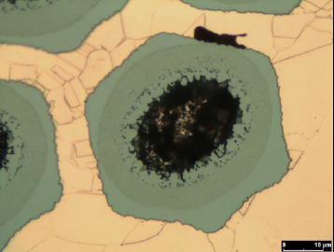
RRR values for round and hexagonal filaments and for various heat treatments
The heat treatment was optimized for the billets with round filaments to have a RRR value greater than 150 while keeping a critical current density higher than 2400 A/mm² at 12 T and 4.2 K, but not successful for the billets with hexagonal filaments.
Heat treatment | HE10S0904 (round filaments) | HE10S0905 (hexagonal filaments)
250h/625C | 254/309 | 67
120h/620C + 100h/650C | 181/188/239 | 52/65/66
120h/620C + 90h/650C | 260/287 | 74/97
A new heat treatment has been strongly recommended by Bruker for the billets produced in 2011: 100h/620C + 120h/640C to optimize the Jc both at 12 T and at 15 T.
HE10S10503 | HE10S11201 | HE10S11302 | HE10S11403
153/155 | 160/172/175/177 | 165 | 154/173/179/201
Notes:
Pour tous les traitements thermiques, le RRR des fils avec filaments hexagonaux est inferieur a 100.

Slide 7
RRR values on extracted strands
In the table, The RRR values measured on extracted strands from 2 types of cable (SMC and FRESCA2 cables) are presented.
Standard heat treatment 120h/620C + 90h/650C | HE10S0904 (round filaments) | HE10S0905 (hexagonal filaments) | HE10S10402 (hexagonal filaments)
Average RRR value for virgin strand | ~ 270 | ~ 85 | ~ 110
SMC cable : 18 strands | 125 to 147 | 57 to 61 | -
FRESCA2 cable : 40 strands | 143 to 189 | 56 to 72 | 52 to 82
Conclusion : Initial RRR values of virgin strands are very important
Notes:
Le tableau presente les resultats pour 2 types de cable, le cable SMC et le cable FRESCA2

Slide 8
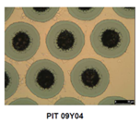
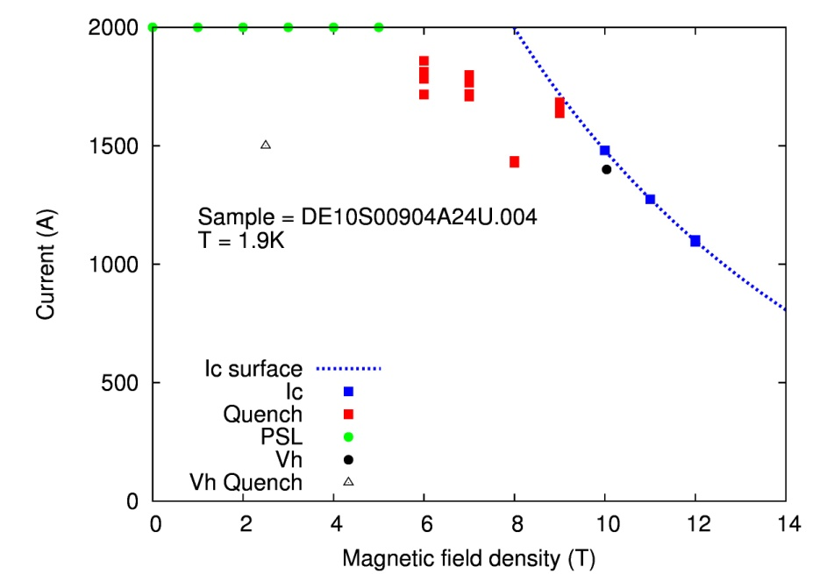
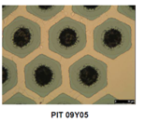
Stability current Is determined by V-H measurements
PIT 0904 strand with round filaments
Is at 4.2 K on virgin strand > 2000 A (RRR > 235)
Is at 1.9 K on virgin strand > 1500 A
Is at 4.2 K on extracted strands > 1500 A (RRR > 135)
PIT 0905 strand with hexagonal filaments
Is at 4.2 K on virgin strand > 1300 A (RRR = 67)
Is at 1.9 K on virgin strand not measured
Is at 4.2 K on extracted strands > 1100 A (RRR = 30)

Slide 10
Main characteristics of the FRESCA2 cable
Cable width | 20.9 mm
Cable mid-thickness at 50 MPa | 1.82 mm
Keystone angle | 0 degree
Cable transposition pitch | 120 mm
Number of strands | 40
I_{C} (12 T, 4.2 K) | 31420 A
I_{C} (15 T, 4.2 K) | 15170 A
n-value @ 15 T and 4.2 K | 20
RRR after HT | > 120
Minimum cable unit length | 260 m
The critical current of the cable is calculated taking into account a degradation of 10 % due to cabling.

Slide 11
FRESCA2 cable development
Work started in 2010 with hard Cu wires to fabricate a cable with the aim to optimize the tooling and the cabling parameters.
Depending of the cable width, the transposition pitch of the cable has to be adapted to get a cable mechanically stable and having no gaps between the strands.
Smaller is the width of the cable, larger could be the transposition pitch.
The best results in terms of mechanical stability were obtained with a cable width of 20.9 mm and 20.4 mm.
Different values for the width, the mid-thickness and the transposition pitch of the cable were tried to minimize the degradation of the Ic during cabling.

Slide 12
Summary of the work carried out to develop
the FRESCA2 cable
9 km of PIT strands used for all the cabling tests performed to develop the cable
Billet number | Cable width | Transposition pitch Mid-thickness | Ic Degradation | Packing Factor
PIT 0905 PIT 0904 | 21.4 mm | 120 mm / 1.82 mm 130 mm / 1.82 mm 120 mm / 1.82 mm 110 mm / 1.86 mm | 19 % 18 % 10.7 % 18 % | 85.6 % 84.9 % 85.6 % 84.7 %
PIT 10402 | 20.9 mm | 120 mm / 1.82 mm 140 mm / 1.82 mm | 15 % 18.5 % | 87.5 % 86.2 %
PIT 10402 | 20.4 mm | 120 mm / 1.806 mm 160 mm / 1.806 mm 120 mm / 1.86 mm 150 mm / 1.86 mm | 14.7% 12.9 % 9.6 % 9.7 % | 89.9 % 88.0 % 87.3 % 85.8 %
Notes:
I would like to point out the high values of the packing factor for the cable with a width of 20.4 mm
Best values of Ic degradation (~ 10 %) obtained with a width of 20.4 mm, but
the cable is too much compacted, at the limit of what can be done with Nb₃Sn.

Slide 13
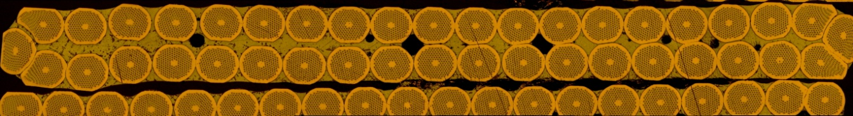
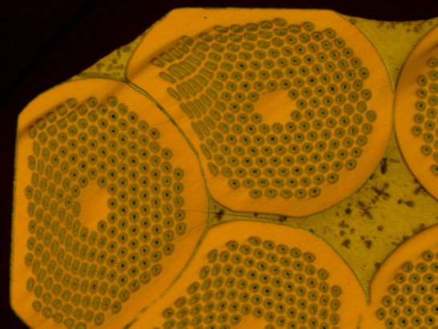
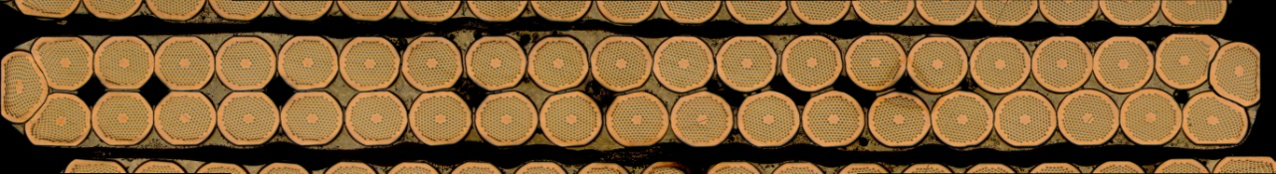
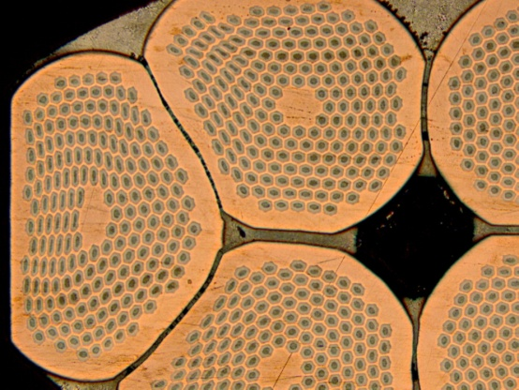
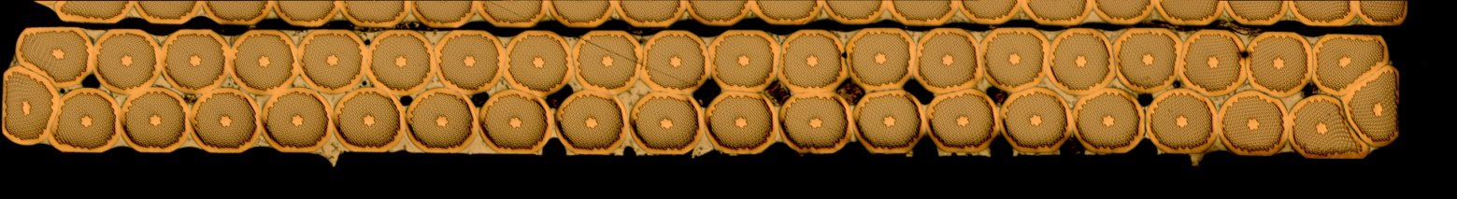
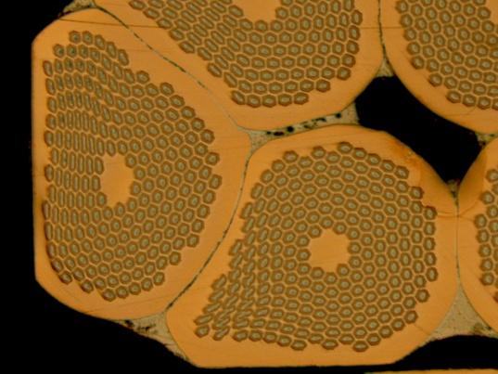
Comparison of different cable cross-section
for a mid-thickness of 1.82 mm
Width of 21.4 mm Total compaction 85.6 %
Width of 20.9 mm Total compaction 87.5 %
Width of 20.4 mm Total compaction 89 %

Slide 14
Conclusion on the cable development
With the results obtained up to now, we already have a cable meeting the required critical current at 15 T. Further decrease of the degradation below 10 % will give us more margin.
To decrease further the degradation below 10%, the best candidate is the cable with a width of 20.9 mm. A new cabling run was already carried out to fabricate a cable with a width of 20.9 mm using PIT strands and playing with the width of the mandrel.
(The results obtained recently with the fabrication of a cable with a width of 21.4 mm giving an average degradation of 10.7 %, indicates that such a degradation can also be achieved with a width of 20.9 mm.)
The development of the FRESCA2 cable will continue with the fabrication of a cable with the RRP strand.

Slide 15
Conclusion on the strand production
Performances of the PIT strands are within the specification, production of the strand is well under control by Bruker.
Stability is not an issue at 4.2 K with the PIT strand.
Measurements have to be performed at 1.9 K on extracted strands.
The production of the OST Strand 132/169 is well advanced with the first billet achieving more than 1575 A/mm² at 15 T and having given a long strand piece length of 3.3 km.

