Slide 1
ESAC Review of the high field dipole design
Reaction Oven, Splicing and impregnation
March 2012 for EuCARD-WP7-HFM
J.C. Perez on behalf of SMC collaboration team
J.C. Perez

Slide 2
OUTLINE
Reaction Oven
Vacuum Impregnation tank
Impregnation mold
Splicing design and tests
Instrumentation and Traces
Sub-scale models activities

Slide 3
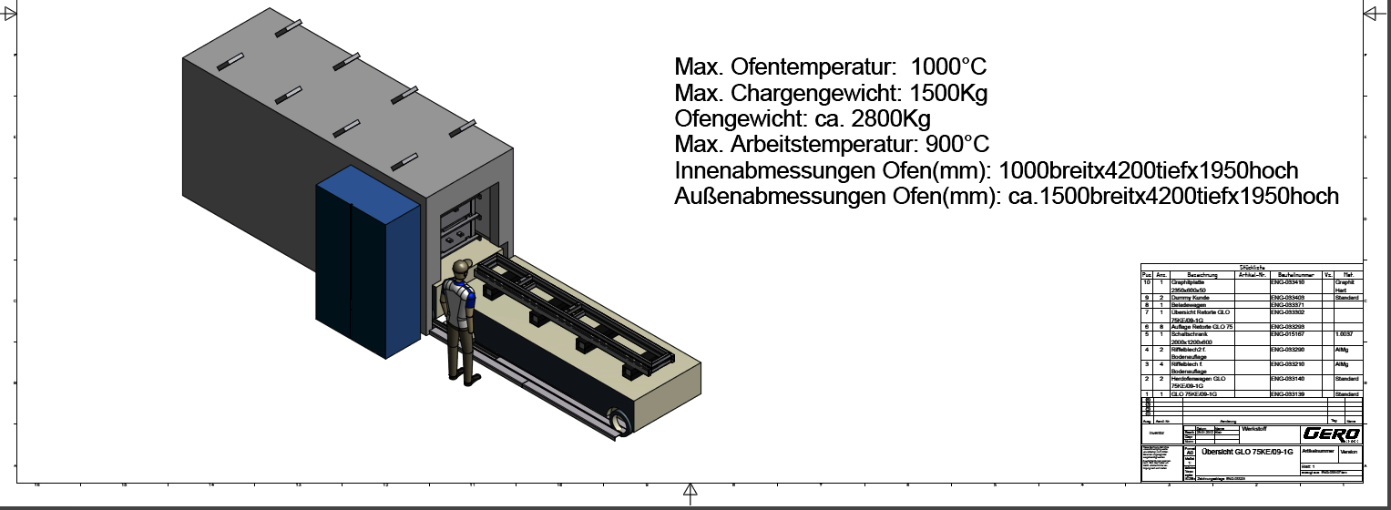

Heat treatment furnace
Technical specification ready beginning 2011
We had issues in Spring 2011 concerning the price proposed in EU
Market survey in US on Spring 2011
Repeat market survey in summer 2011
Acceptable offer received from GERO (Germany) summer 2011
Final contract with GERO placed in September 2011

Slide 4
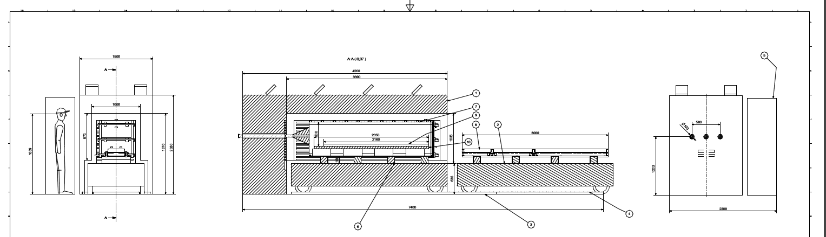
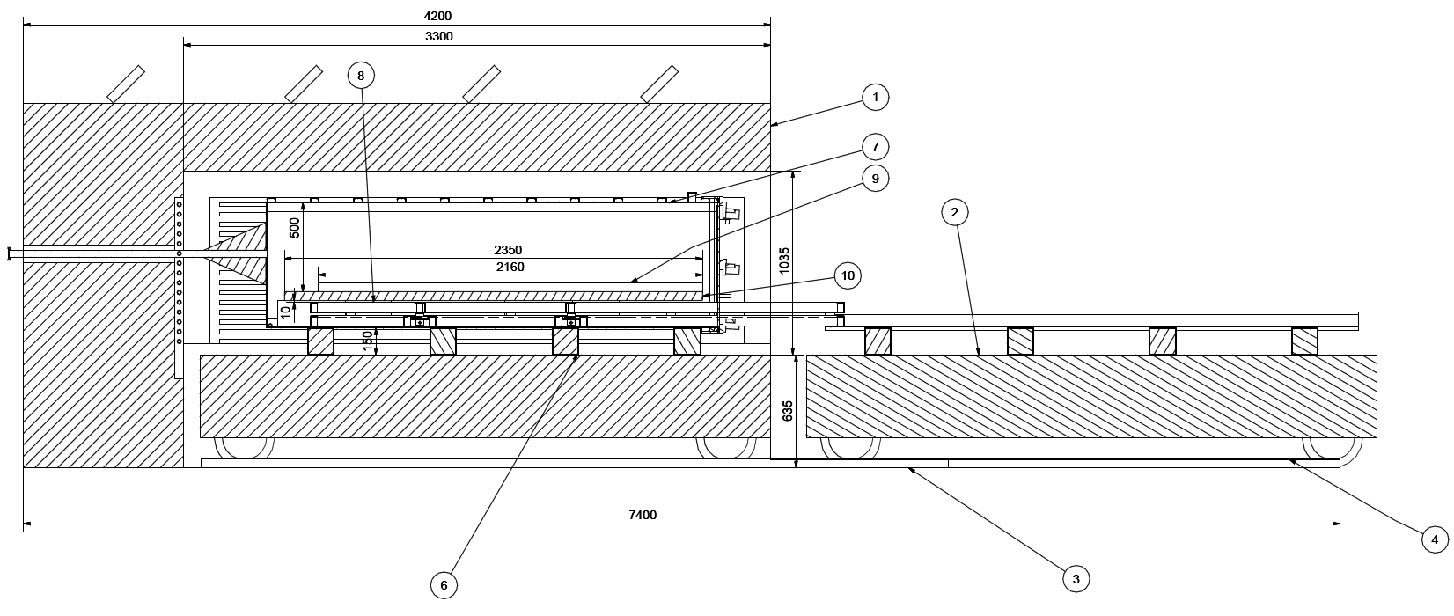
Components
Graphite plate
Transfer table
Loading table
Retort
2
1 Furnace
3 & 4 Checkered plate

Slide 5
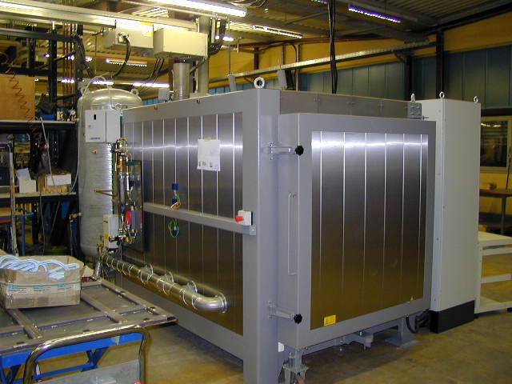
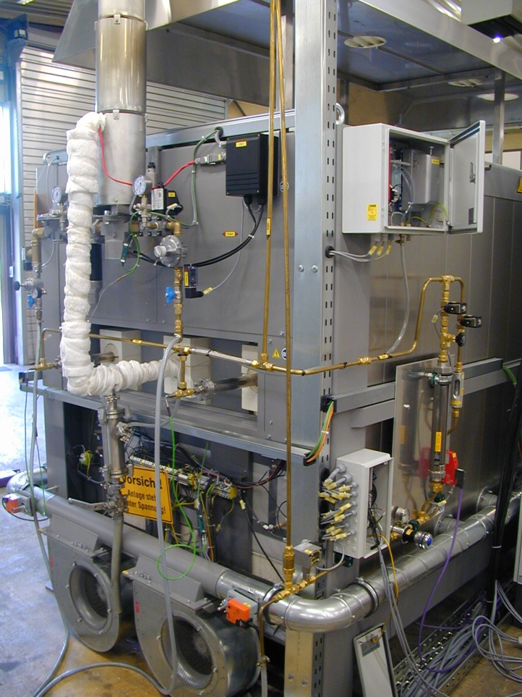
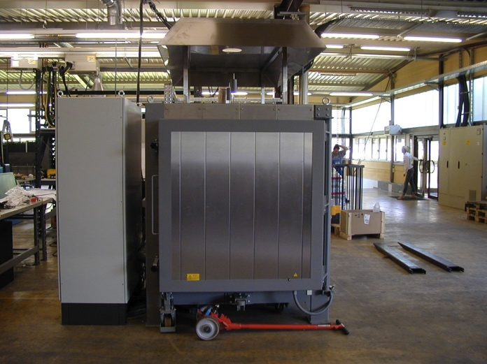
Pictures from Gero
Courtesy F. Lackner

Slide 6

Schedule
Task | Schedule | Persons
CAD design approval, electrical layout | February 21st | GERO Kisir, Geiger
Transfer table and inert gas piping layout | February 27th | GERO Kisir, Geiger
Approval/comments to design | March 1st | CERN
Ordering further components | March 2nd | GERO
Reception furnace box at GERO | Week 21 (May 21st - 27th ) | GERO
Electrical wiring, control assembly, VDE | Week 22 (May 28th - June 3rd) | GERO
Acceptance test at GERO | Week 23 (June 4th - June 10th) | GERO and CERN
Delivery to CERN | Week 24 (June 11th – June 17th ) | GERO and CERN
Transport risk:
A special transport to CERN will be organized from GERO.
Shock sensors will be applied to the furnace.
Risk of small cracks on the inner brickwork. The status will be
investigated after delivery. Smaller cracks will be filled with a special Cement.
Courtesy F. Lackner

Slide 7
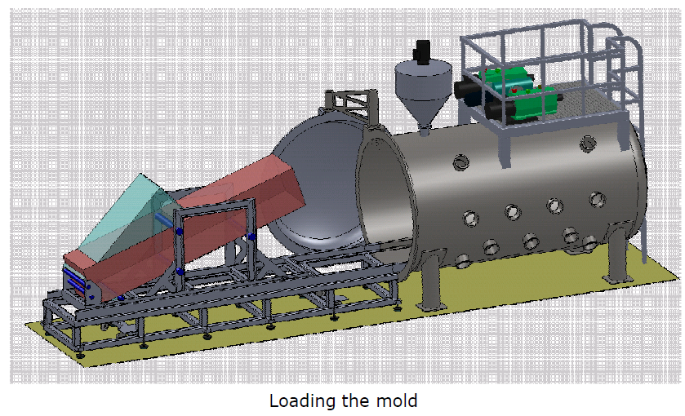
Vacuum Impregnation Tank
A vacuum impregnation facility will be installed in building 927 near the heat treatment furnace
The technical specification has been approved in December 2011
3 confirming offers have been received
The order has been placed middle of March 2012 (TELSTAR-Spain)
Dedicated electrical power lines are installed in 927 laboratory

Slide 8
Vacuum thank delivery schedule
Milestones | Relevant Dates
Signature of the contract | March 15th 2012
Preliminary design review and definition | April 12th 2012
Preliminary manufacturing plan | April 19th 2012
Final design file and Risk assessment presentation | May 2nd 2012
Design file and risk Assessment approval by CERN | June 9th 2012
Tests at supplier premises | August 22nd August
Vacuum tank delivery at CERN | September 6th 2012
Final installation and commissioning | September 20th 2012

Slide 9
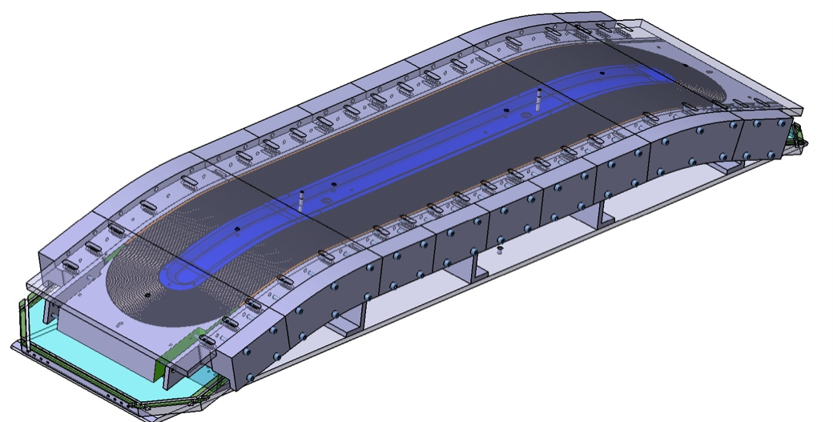
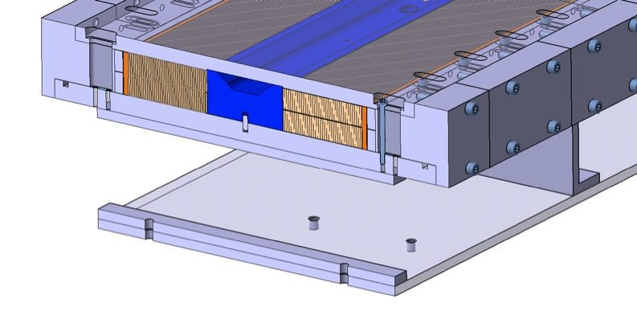
Impregnation mold
Technical meeting on impregnation mold concept held at CEA on 16th of March 2012
CERN team will provide all required information for mold design
The mold concept will be inspired from the reaction tooling
Al alloy with O-rings will be used
CEA will produce the fabrication drawings for impregnation mold layer 3-4 by June the 15th 2012
CERN will launch the price inquiry and follow-up the fabrication
First mold to be delivered at CERN by September the 15th 2012
Reaction mold concept

Slide 10
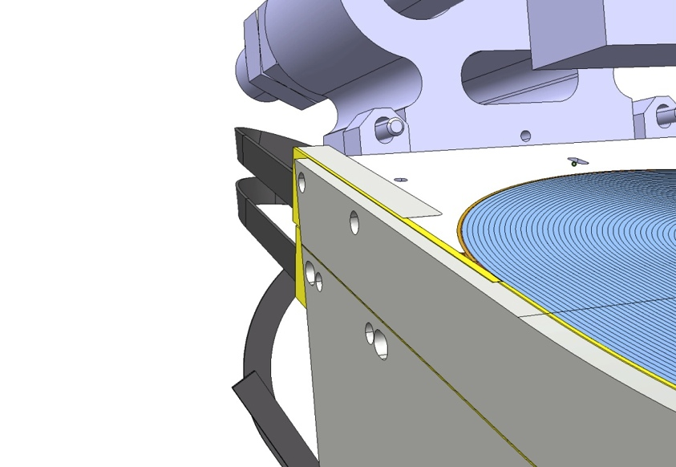
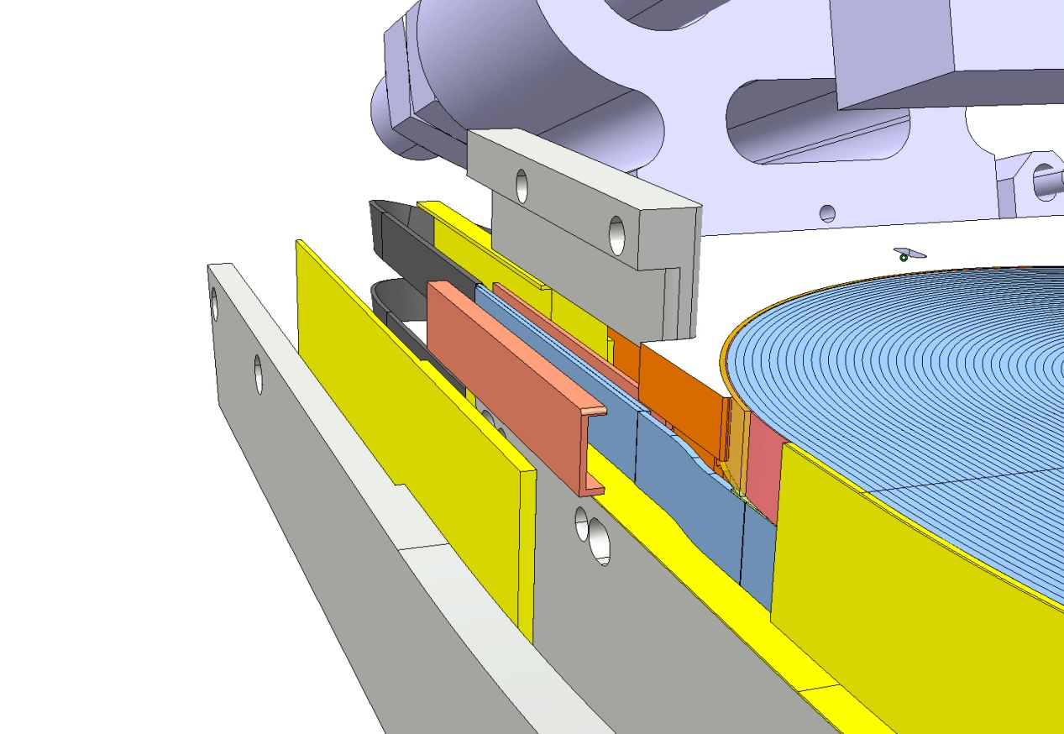
Splice Area Design
Insulating plate
NbTi Lead
Rail
End Shoe
Nb₃Sn/ NbTi Splice
Filler piece
Nb₃SnCoil
Copper stabilizer
Nb₃Sn Cable
Courtesy M. Timmins

Slide 11
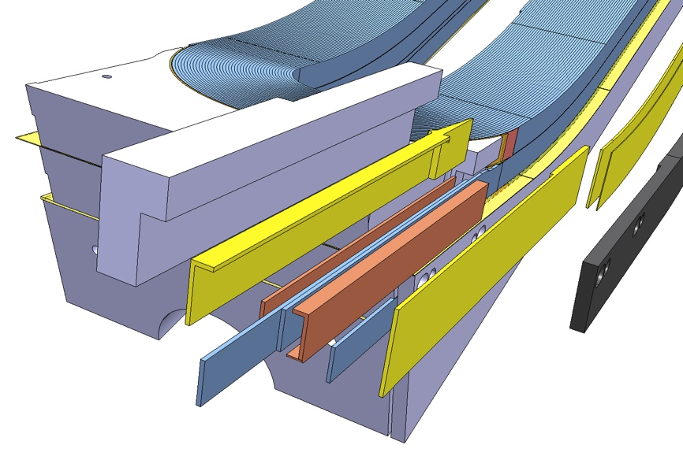
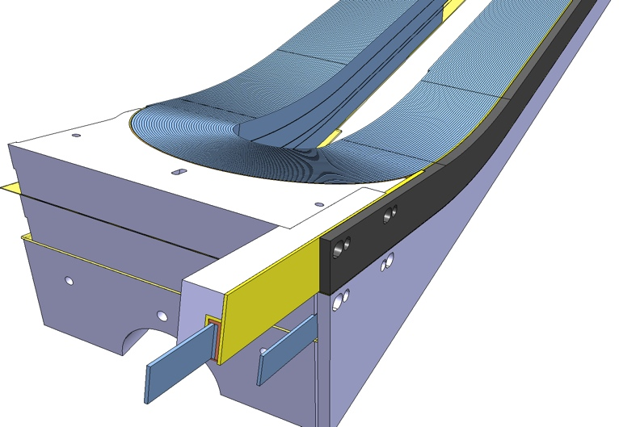
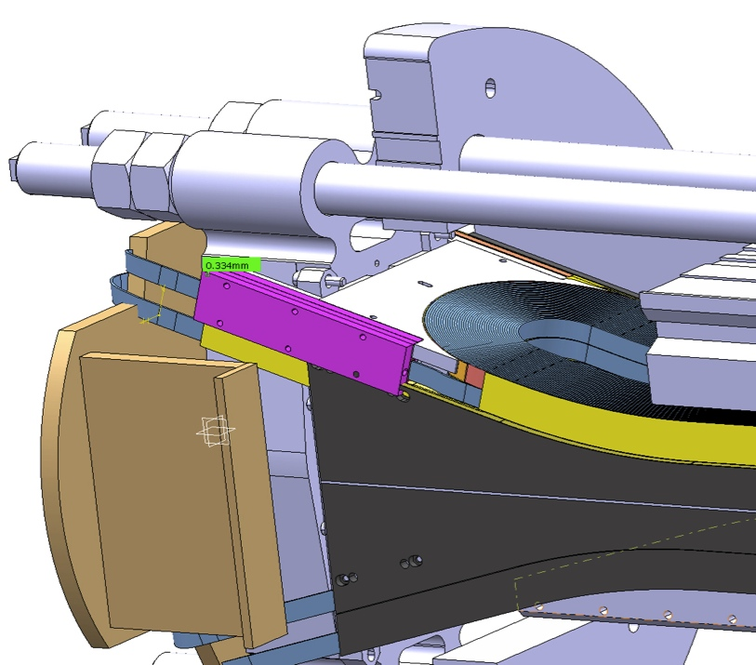
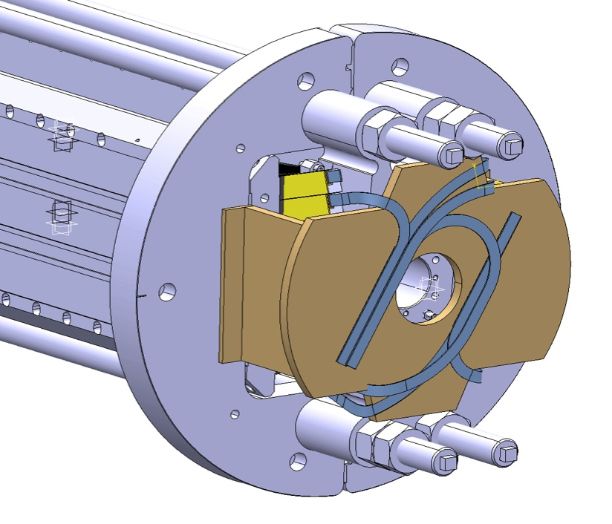
Fresca2 Interconnection

Slide 12
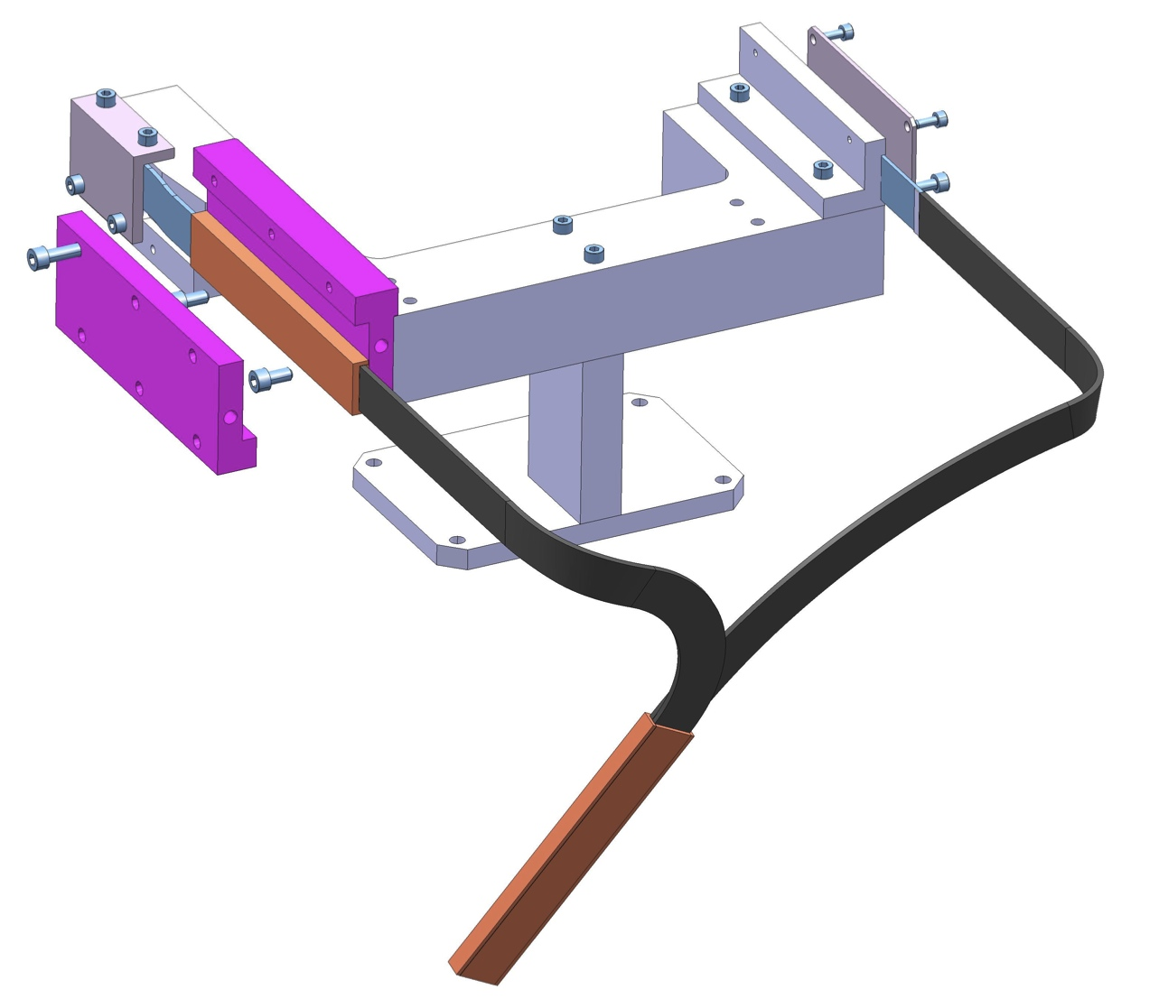
Interconnection Mock-up
An interconnection mock-up has been designed to validate splice operations. The delivery is expected on last week of March.
Validation tests are scheduled on April 2012.

Slide 13
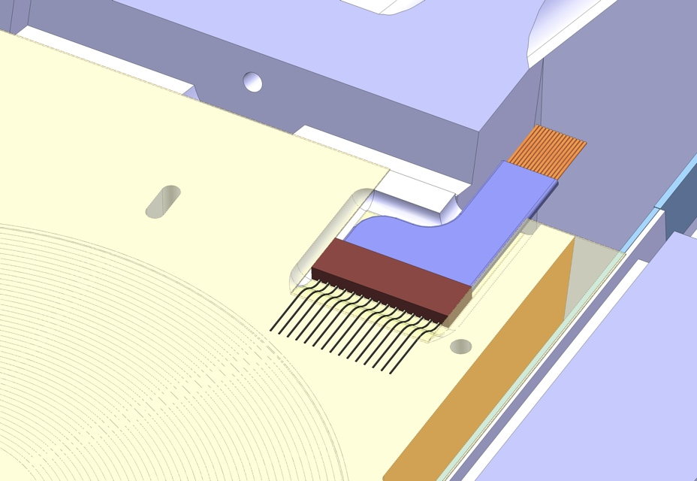
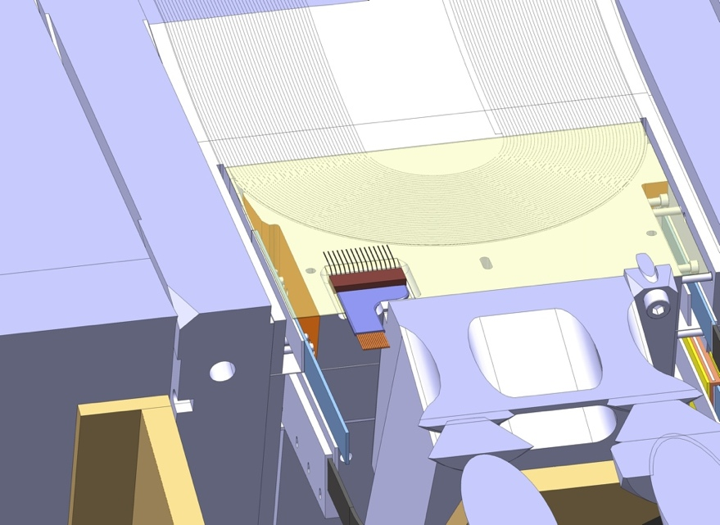
Traces connection
The traces will cover the total surface of the coil
The connections will be hidden in a pocket machined on the end-shoe connection side (mold released)
No wires will come out from the mold during impregnation process
After coil impregnation, wires will be soldered to the traces and routed via a groove machined on the end-shoe (local impregnation)

Slide 14
Quench Heaters & Traces
Inputs for Quench Heaters design will be provided by M. Durante and M. Bajko
E. Todesco will be the reference Engineer at CERN for trace design He will visit different laboratories in the coming weeks to collect all required information on programs and calculation methods presently used to design Quench Heaters (Base line HD3/HQ/LQ?)
Fresca2 traces design and fabrication @ CERN using 50 µm kapton and 25 µm stainless steel sheets (delivery time about 2 months after final design validation)
Final Fresca2 traces are expected for end of October 2012 (on time for the first real coil)
A preliminary trace will be used on the first copper coil

Slide 15
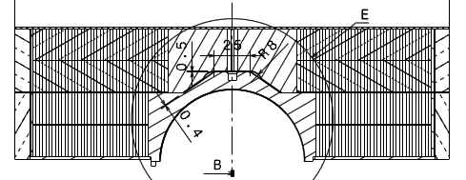
Traces & instrumentation
Each double pancake will be equipped with 2 traces
The coils will be equipped with about 8 Vtaps/layer
No strain gauge in the trace (gauges will be glued layer 1 pole)
6 stations will be placed on the shell mid-plane (12 gauges)
3 stations located on the magnet bore measuring along azimuthal and longitudinal direction
Axial roads will be instrumented (longitudinal direction)
Traces location (4/pole)
RMC trace preliminary design based on HD3 traces
Gauges will be placed
in the magnet bore

Slide 16
Sub-scale models activities
Characterization on strand and cable performance
Layer jump area
Splicing area
Insulation method
Traces connection
Impregnation method
Qualification of new vacuum impregnation tank
Qualification of new oven

Slide 17
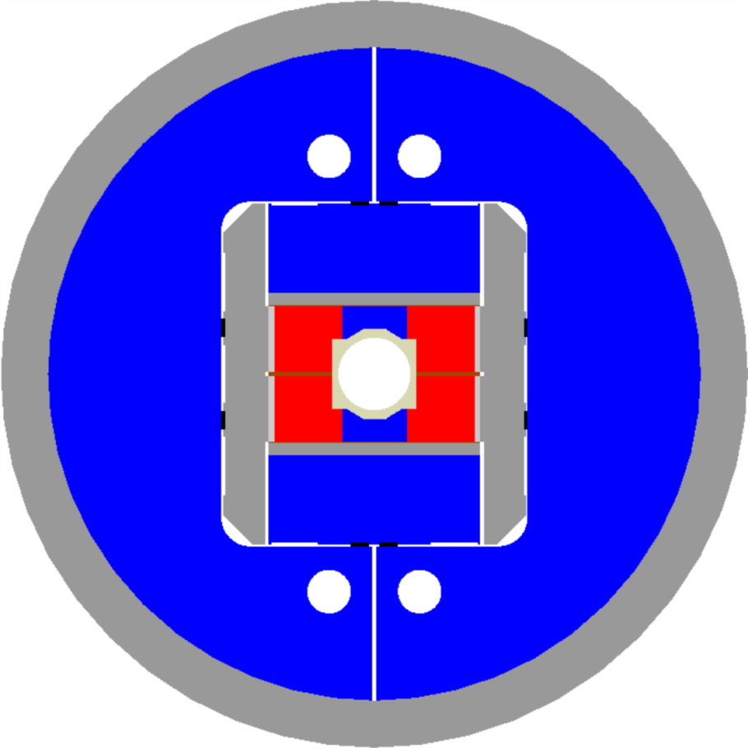
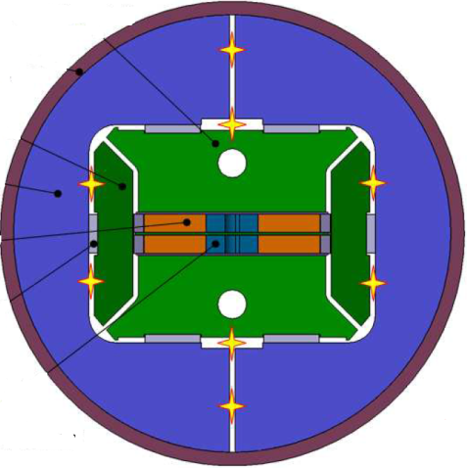
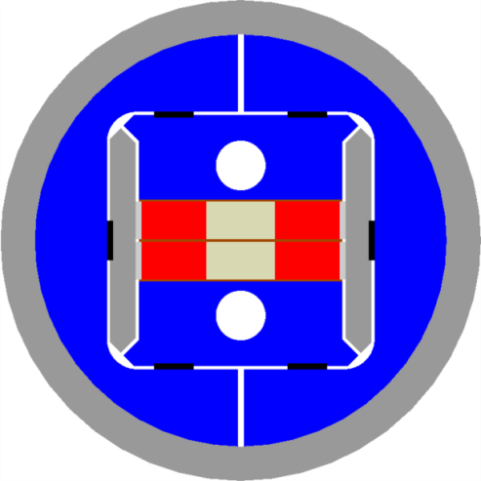
From SMC to RMC towards FRESCA2
SMC
RMC
FRESCA2
RMC goals: test FRESCA2 cable and FRESCA2-type coils in realistic cond.
Constraints
  Layer jump similar to FRESCA2
  Power supply limit ~20 kA
  Magnet OD: 570 mm
Courtesy of P. Ferracin

Slide 18
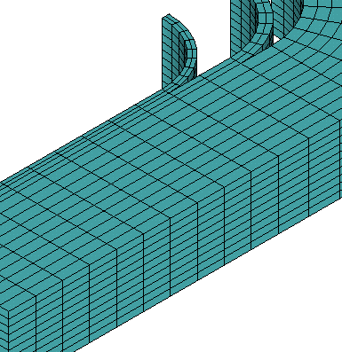
RMC Coil design
Same design as SMC
  2 end spacers
  33 turns (like FRESCA2)
FRESCA2-type layer jump
As a result
  Straight section: 300 mm
    150 mm in SMC
  Coil length: 820 mm
    500 mm in SMC
  96 m of cable per coil
    4.0 km of strand
RMC coil
FRESCA2 coil
Courtesy of P. Ferracin

Slide 19
RMC Magnet Design
RMC configuration
  2 RMC coils
    I_{ss} (1.9 K) = 18.3 kA
      Below power supply limit
    B_{peak} = 16.0 T
  Significantly higher forces
    From 2.2 MN/m in SMC to 5.4 MN/m
  New structure required
    Thicker shell, new yoke design, larger bladders, larger axial rods
RMC
Courtesy of P. Ferracin

Slide 20
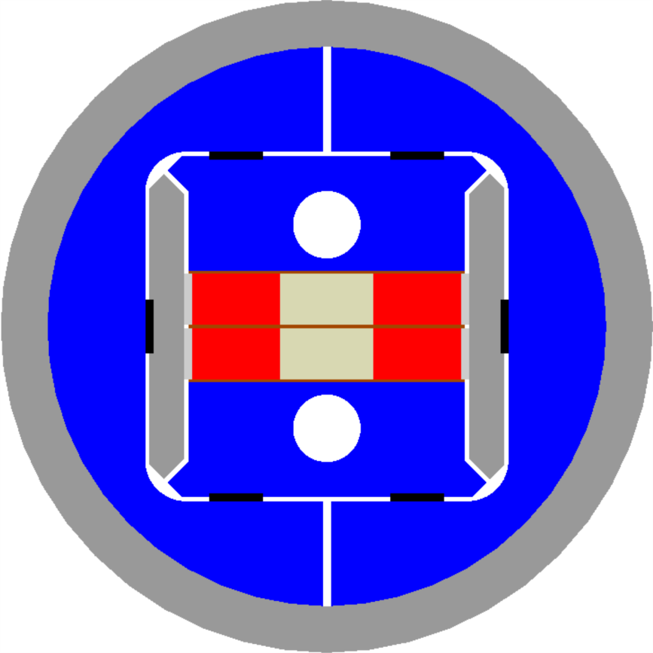
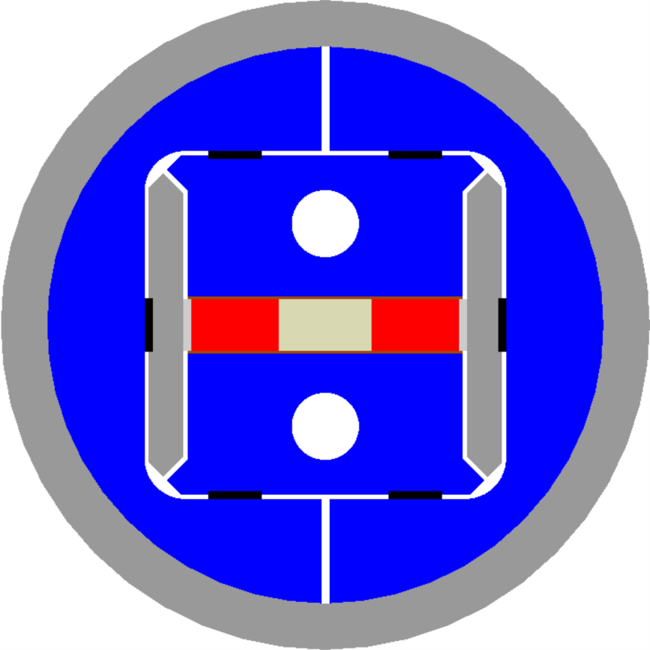
RMC
1 double pancake vs. 2 double pancakes
  Still possible to test individual coils up to 20 kA
    Corresponding to about 93% of I_{ss} @ 4.2 K
Courtesy of P. Ferracin

Slide 21
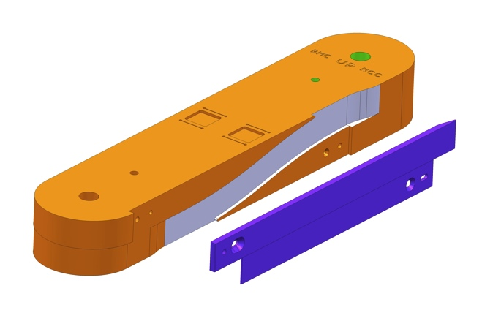
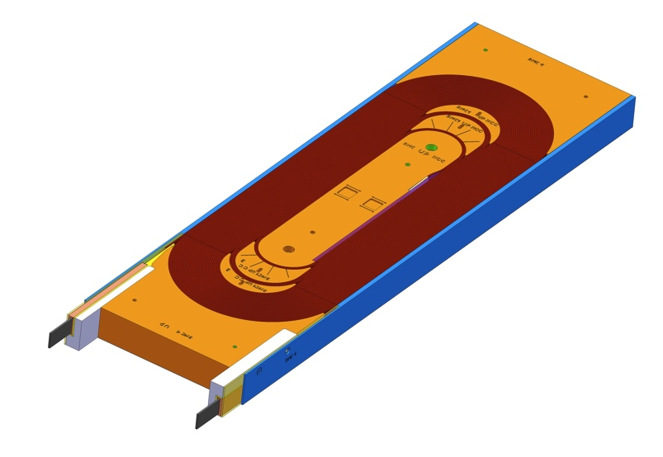
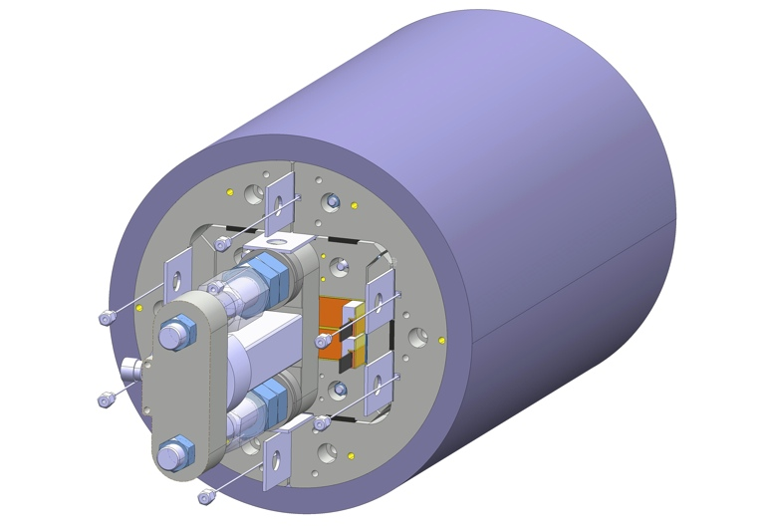
RMC Design Status
Fabrication drawings for coil components, reaction and impregnation tooling approved for execution.
First winding scheduled for September 2012
Mechanical structure design finished. Fabrication drawings are expected within two weeks.
First mechanical assembly using an instrumented aluminum dummy coil scheduled for September.
First cold test expected Q4-2012

Slide 22
On going activities on sub-scale models
Characterization on strand performance in realistic conditions (SMC4 & SMC5)
Characterization on strand and cable performance in realistic conditions ( RMC)
Layer jump area (RMC)
Splicing area (RMC)
Braided insulation (RMC)
Traces connection (RMC)
Impregnation method for Fresca2 type coils (RMC - Close mold)
Qualification of new vacuum impregnation tank Qualification of new oven (RMC)

Slide 23
Next SMC assembled coils
SMC Assembly | Cable Type | Cable Insulation | Scheduled
SMC#3_b | PIT 14 * Ø 1.25 mm | S2-Glass sleeve FNAL type | 2 Coils waiting for reaction
SMC#11T_a | OST RRP 108/127 40 * Ø 0.7 mm | 33 Tex S2-glass braided | Q2-2012
SMC#11T_b | OST RRP 108/127 40 * Ø 0.7 mm | 11 Tex S2-glass braided & Mica 90 µm | Q2-2012
SMC#4 | PIT 18 * Ø 1.00 mm | S2-Glass sleeve 100 µm or S2-glass braided | Q3-2012
SMC#5 | RRP 18 * Ø 1.00 mm | TBD | Q4-2012

Slide 24
Next RMC Coils Production
RMC Assembly | Cable Type | Cable Insulation | Scheduled
RMC#1 coil 1 | PIT 40 * Ø 1.0 mm | S2-Glass braided Or according to FRESCA2 choice | Q3-2012
RMC#1 coil 2 | PIT 40 * Ø 1.0 mm | S2-Glass braided Or according to FRESCA2 choice | Q3-2012
RMC#2 coil 1 | RRP 40 * Ø 1.0 mm | S2-Glass braided Or according to FRESCA2 choice | Q4-2012
RMC#2 coil 2 | RRP 40 * Ø 1.0 mm | S2-Glass braided Or according to FRESCA2 choice | Q4-2012

Slide 25
Acknowledgements
CEA/Saclay:
  M. Durante, P. Manil, J.F. Millot, J.M. Rifflet, F. Rondeaux,
CERN:
  P. Ferracin, E. Fornassiere, J. Humbert, A. Milanese,
  L. Oberli, M. Timmins, G. Villiger,,
Fresca2 collaboration team
Thanks for your attention

