Slide 1
Coil detailed design and fabrication
Winding and reaction
F. Rondeaux

Slide 2
Outline
Coils detailed geometry
  Overview
  Geometry details
  Layer jump
  Posts design
  Electrical insulation
Winding tooling and process
Reaction tooling
      Reaction process, impregnation tooling and process will be discussed by Juan Carlos in the next presentation
Tests program

Slide 3
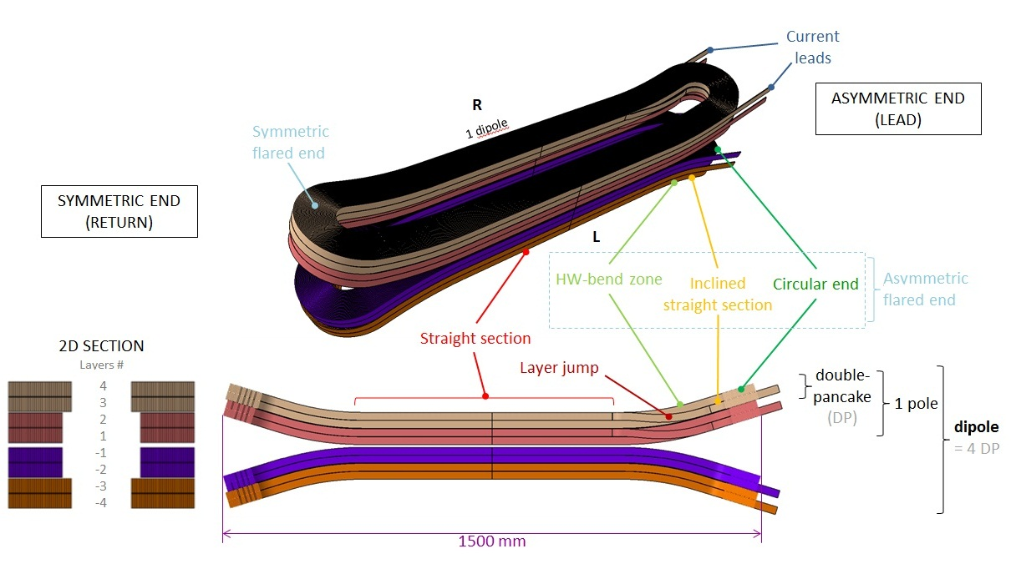

Coils detailed geometry - overview
1 color = 1 cable unit lenght (223 m / 253 m)

Slide 4
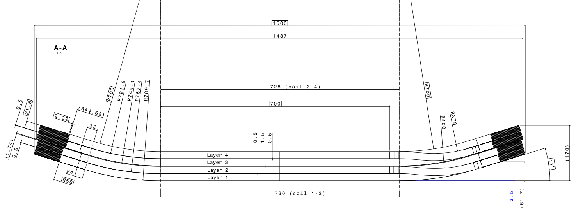
Coils geometry details
Adjustments in double pancake 1-2 and 3-4 following the last review:
  Forced contact between the coils along the straight section: reduce L_{ss} by 2mm for coil 3-4. The ramp angles remain identical everywhere (17°).
  Avoid stress concentration around sharp edges in the ends: enlarge L_{os} to 32mm for coil 3-4.
  => additional gaps of 0.24 mm are created along the ends (to be filled during the assembly process)
  Inter-coils insulation thickness has been increased from 0.5 to 1.5 mm for the instrumentation traces, leading to increase the HW radiuses for coil 1-2
R_{HW} = 700 mm, aperture > 61 mm, h_{tot} < 200 mm
1500
Additional gap
L_{ss} = 728 (coil 3-4)
700
L_{os}

Slide 5
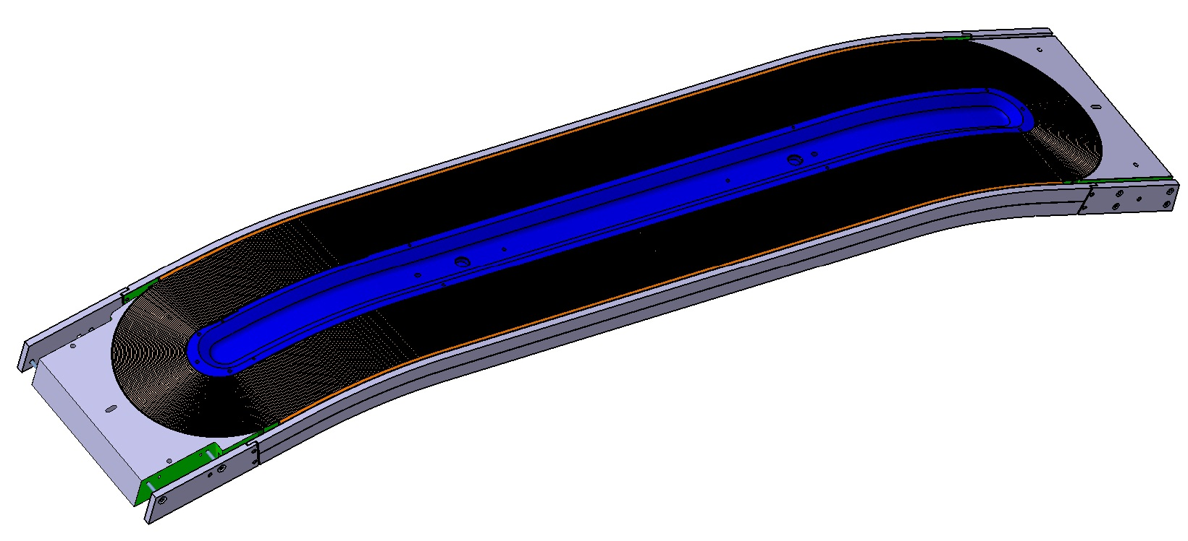
Detailed 3D model of coil 3-4
View of the double pancake with its components
Draftsman:
Jean-François Millot

Slide 6
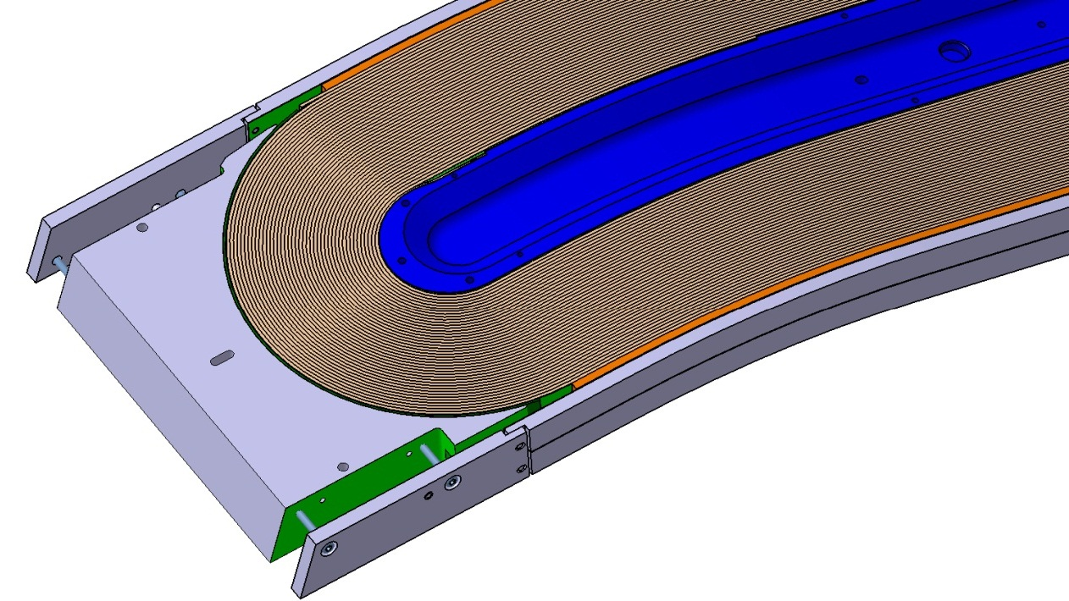
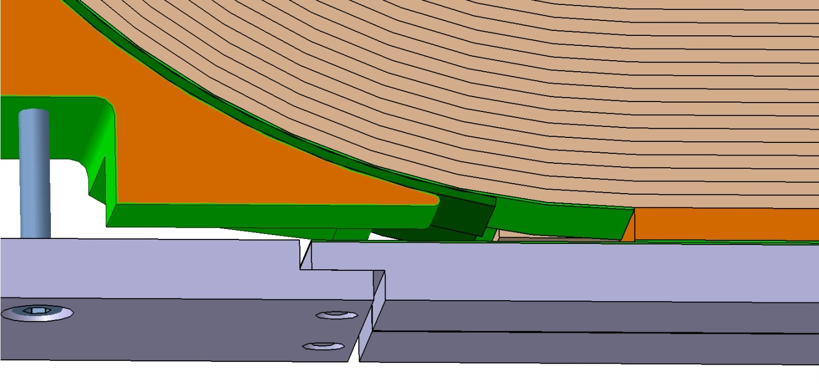
Detailed 3D model of coil 3-4
New rail design
Possibility of 2x0.2 mm steel shim ⬄ obtain continuous contact all along the side of the coil
Reserved space ⬄ max dimension of the reacted coil
0.3 mm-thick alumina coating
Connection design
1.5 mm shim ⬄ fill the gap between coil and horseshoe (offset possible)

Slide 7
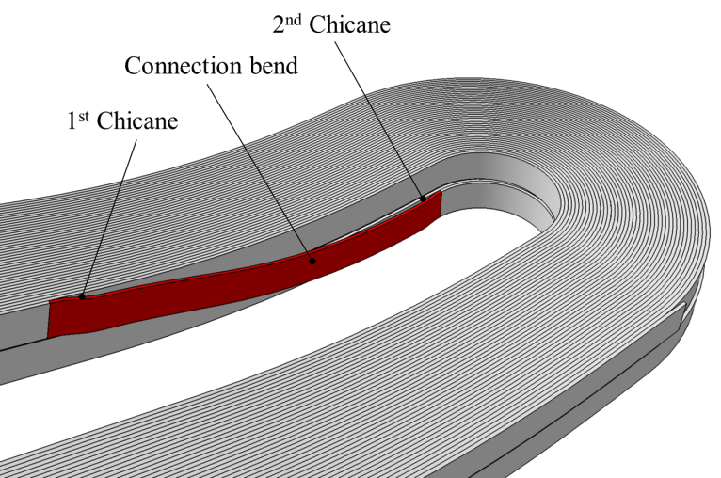
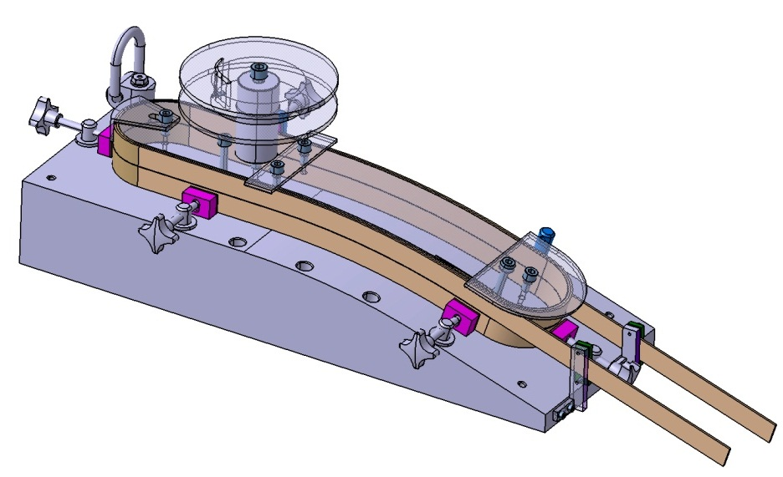
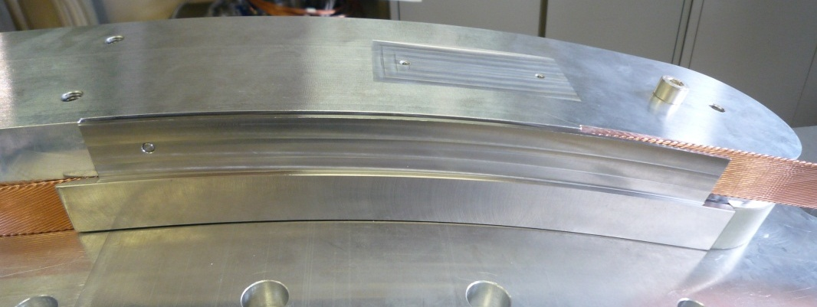
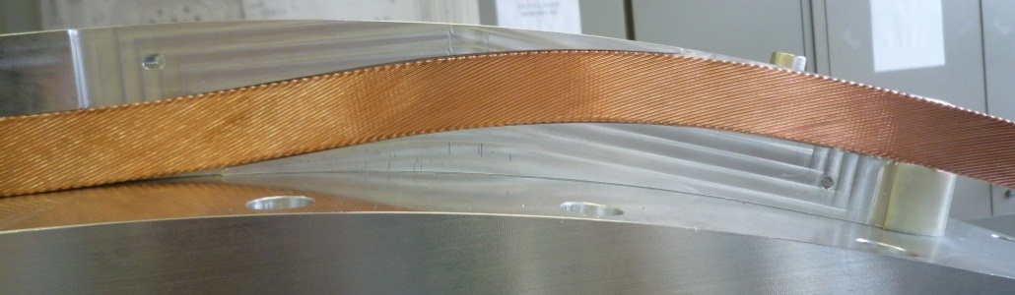
Layer jump
In the HW zone, « double chicane » solution selected
Shim easier to position and fix, ensure better protection of the jump zone
Tests have been done:
Experimental setup
Ref : report on layer jump test SAFIRS-00373-E (2011)

Slide 8
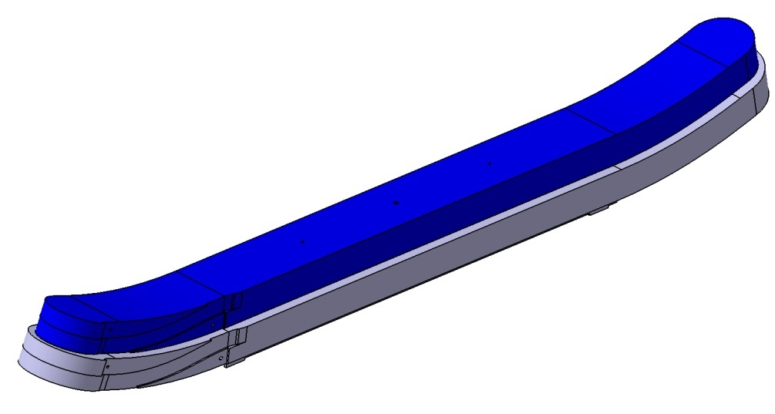
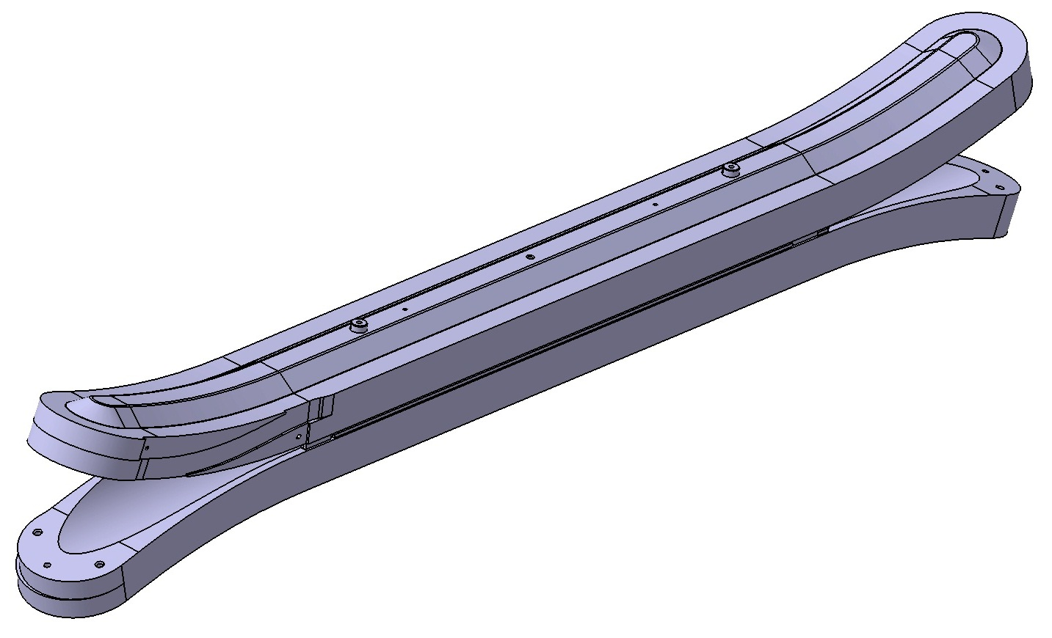
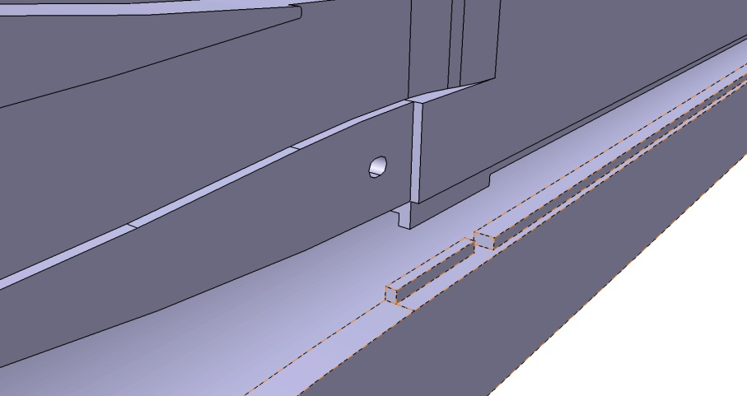
Posts design
Magnetic steel post
Stainless steel / Titanium* post
2 pins Φ16 ⬄ fix the lateral position
Layer jump template
Inter-posts positionning
* choice after the thermal tests

Slide 9
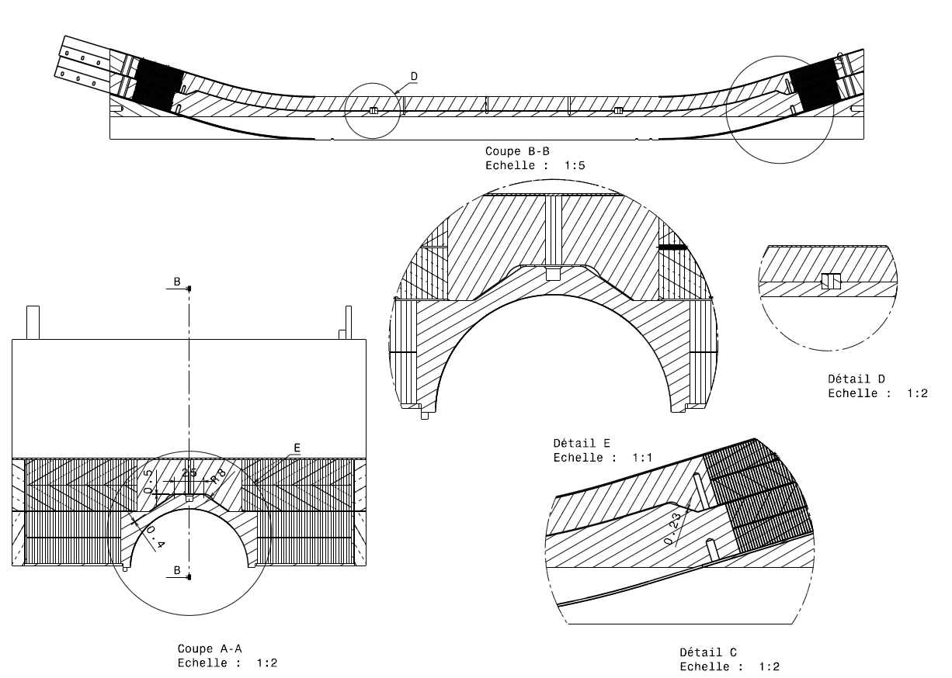
Posts design
Contact zones

Slide 10
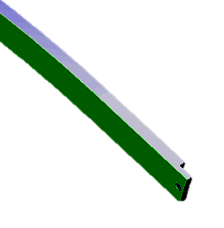
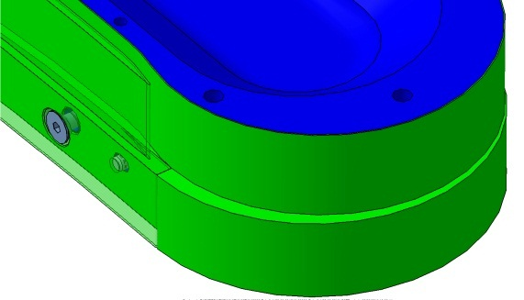
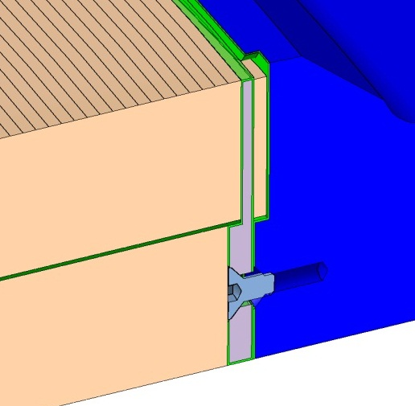
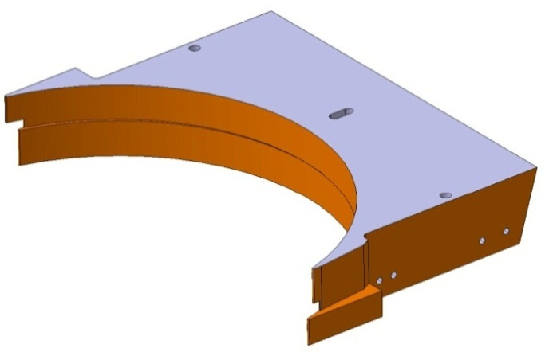
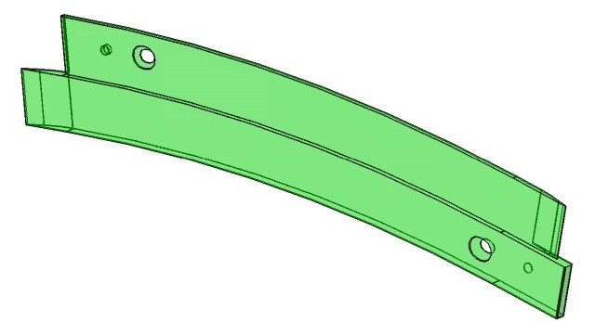
Electrical insulation
Glass fiber impregnated with epoxy resin
  Around cable: braid 0.2 mm
  between layers: sheet of 0.5 mm
  between double pancakes: enlarge to 1.5 mm to allow the installation of the instrumentation (voltage taps connections + quench heaters)
Alumina coating - some parts are partially or totally covered:
  Rails
Posts
Horseshoes
Layer jump shim

Slide 11
Electrical insulation
Vertical pad
1 mm insulation
4
0.5 mm Interlayer insulation
3
0.3 mm insulated trace
1.5 mm
0.9 mm insulation
2
1
2 mm insulation
7 mm intercoil insulation
3 mm insulation

Slide 12
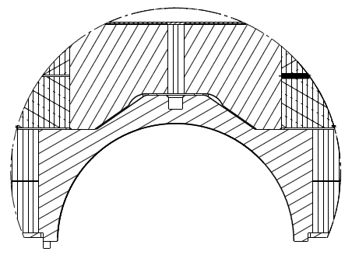
Insulation between double pancakes = 1.5 mm
What we have today
in the prototype:
What would be:
Post 3-4
Post 1-2
t = 0.3 mm
t = 1.5 mm
t = 0.9 mm
t = 0.3 mm
0.3 insulated trace
+ 0.9 insulation
+ 0.3 insulated trace
--------
1.5 inter-coil insulation

Slide 13
Fabrication process – main steps
Conductor insulation
Conductor preparation
Winding
Preparation for the heat treatment:
  Assembly of the reaction mold around the wound coil
  Transport to CERN
Heat treatment
Preparation for impregnation :
  Nb₃Sn/NbTi splice soldering
  Instrumentation, ground insulation and quench heaters integration
Impregnation
Coil assembly
Magnet assembly
At Saclay
At CERN
(cf. Juan Carlos’ presentation)

Slide 14
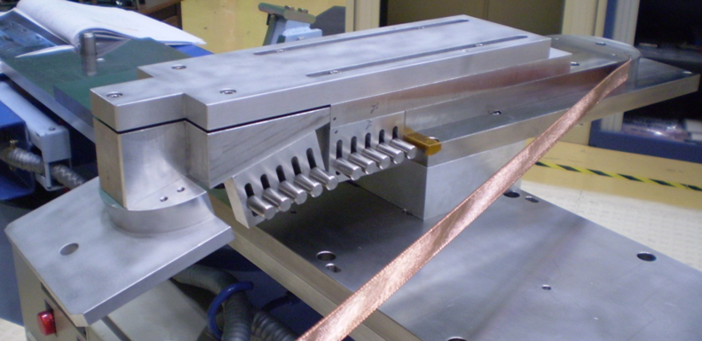
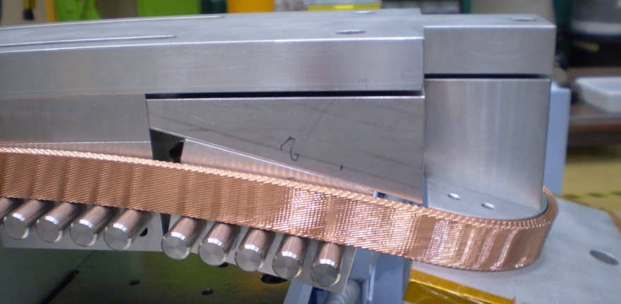
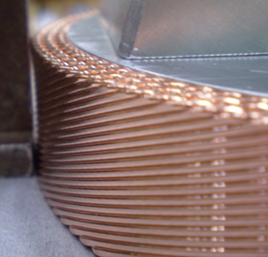
Winding tests
Upside down winding
Simpler tooling
Is the winding easier ? → Yes
Is the conductor stable and in good position? → Yes
But
Dishing
Ref: reports on winding tests
SAFIRS-00152-B (2010) - SAFIRS-00372-C (2011)

Slide 15
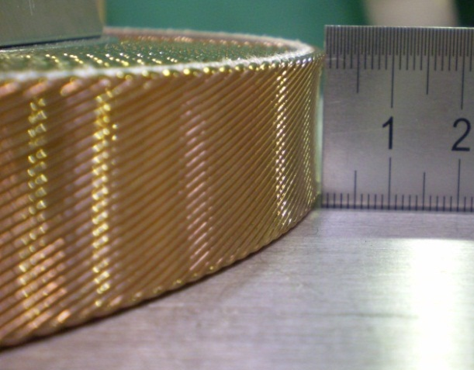
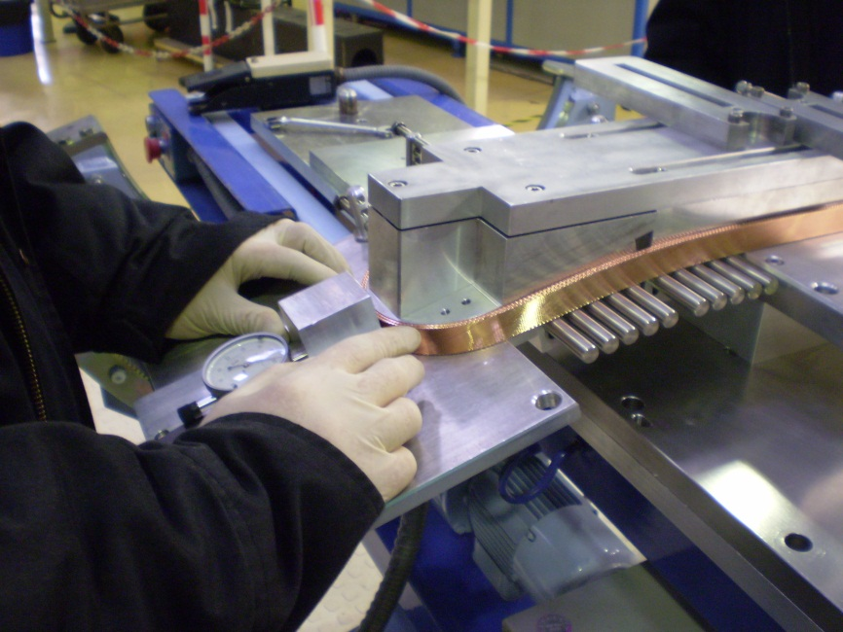
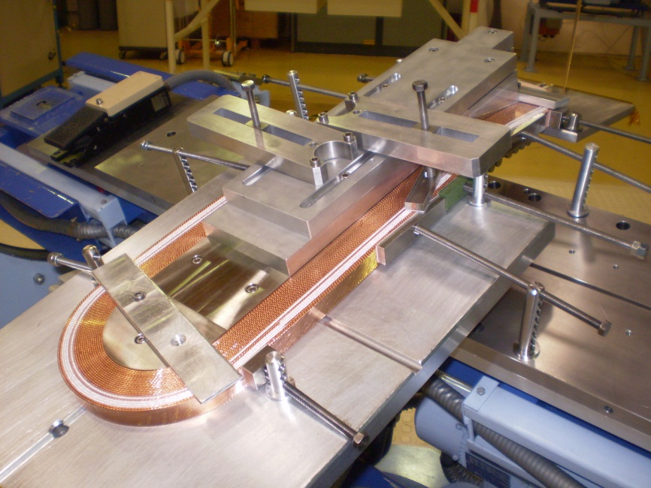
Dishing
Before winding: 0.18 to 0.34 mm under tension of 10 daN
Test over 22 turns (4 with insulation) at 30 daN
Dishing increases turn after turn from ∼0.2 mm to ∼0.9 mm
Around 0.2 mm in the straight section
Slightly larger with flared ends (+ ∼0.1 mm)
Time-dependent

Slide 16
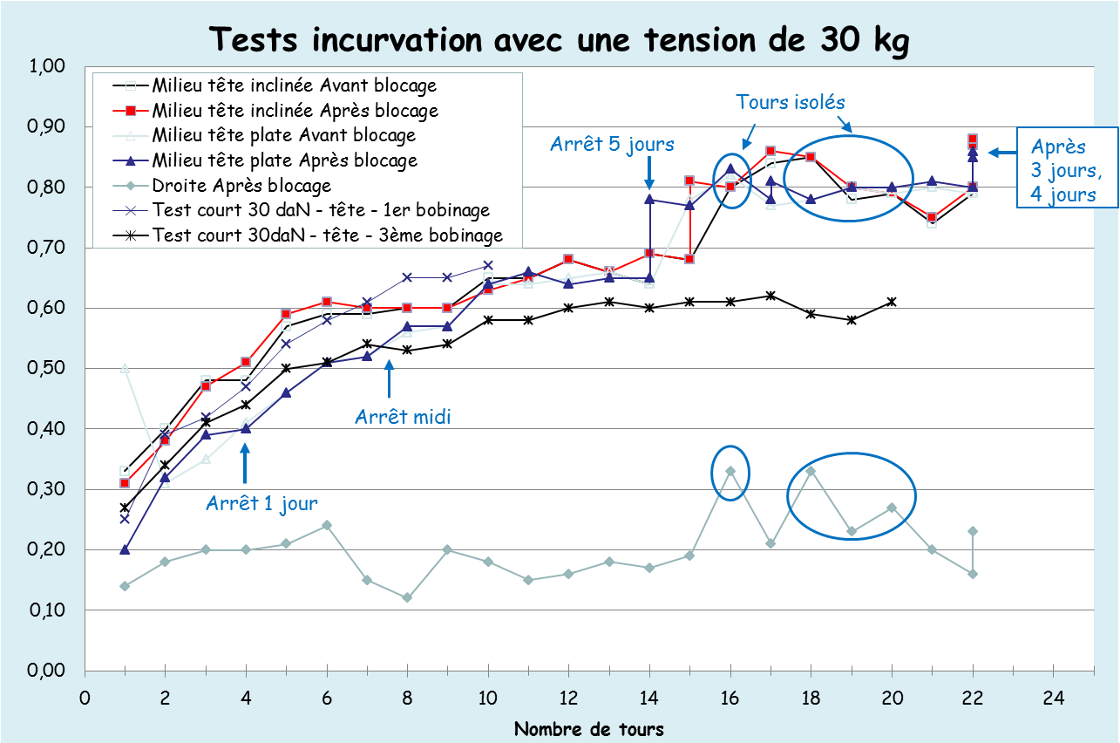
Dishing
Dishing test results under 30 daN tension
Questions: Behavior of Nb₃Sn similar regardless of the strand type?
  Impact on the field quality? On the mechanics?
How to deal with it?
      Should we force the conductor flat? Adapt the molds?

Slide 17
Fabrication process – main steps
Conductor insulation
Conductor preparation
Winding
Preparation for the heat treatment:
  Assembly of the reaction mold around the wound coil
  Transport to CERN
Heat treatment
Preparation for impregnation :
  Nb₃Sn/NbTi splice soldering
  Instrumentation, ground insulation and quench heaters integration
Impregnation
Coil assembly
Magnet assembly
At Saclay
At CERN
(cf. Juan Carlos’ presentation)

Slide 18
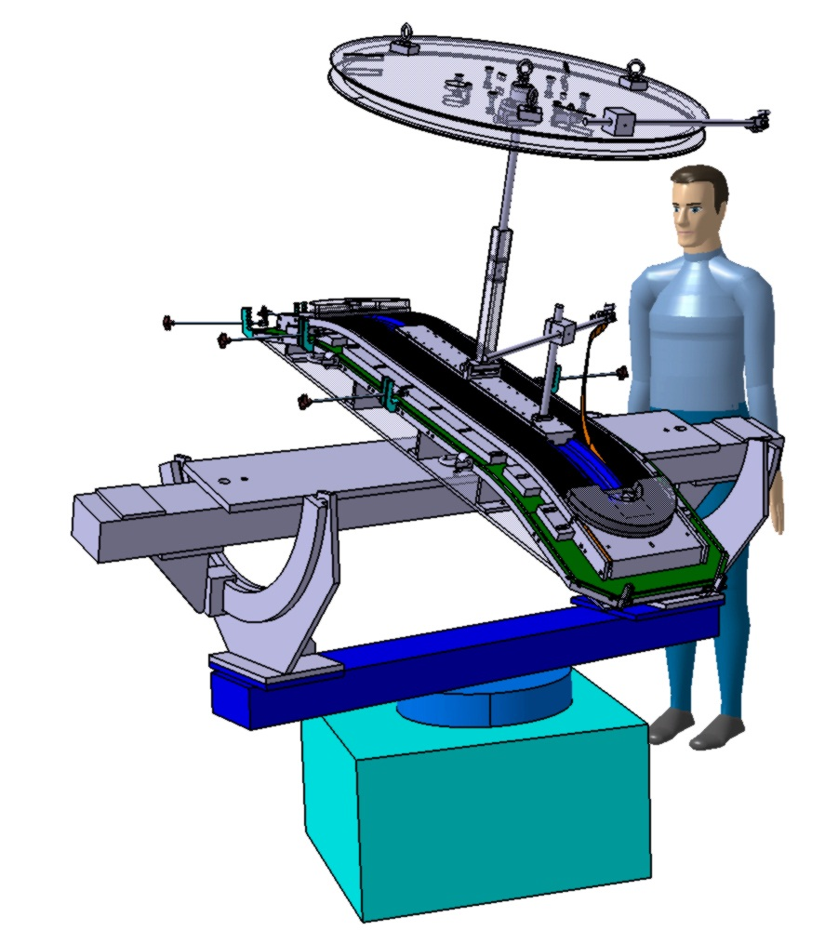
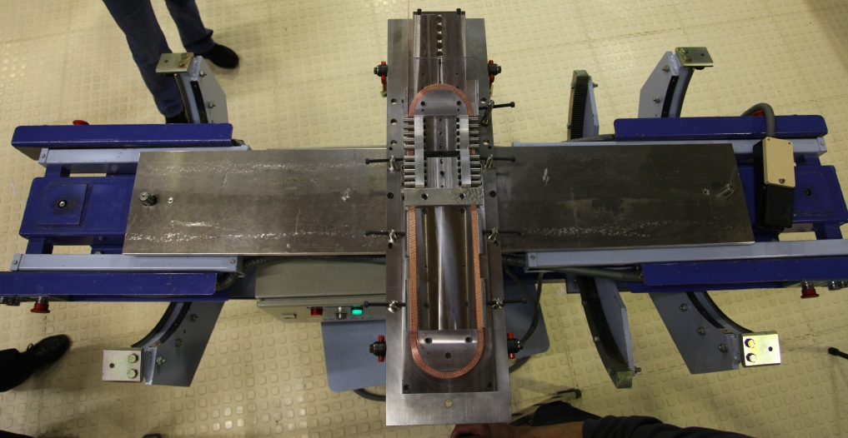
Winding
Heavy pieces are equipped to be handle with crane
Winding table: 190 kg – 1.72 m * 0.45 m
Stock spool with cable : ∼ 60kg
Iron post: 34 kg
Horseshoes: 8 kg
Winding machine existing at Saclay

Slide 19
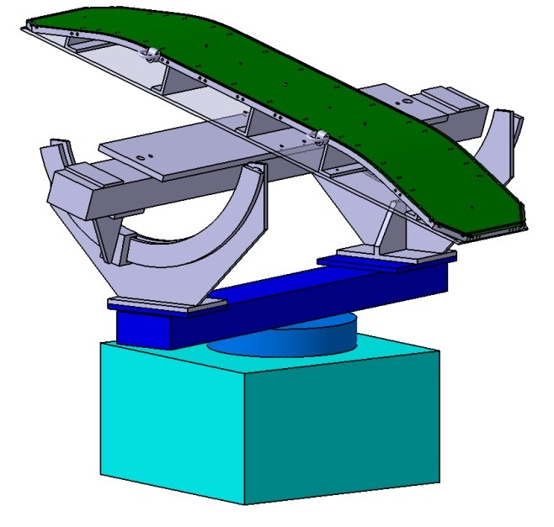
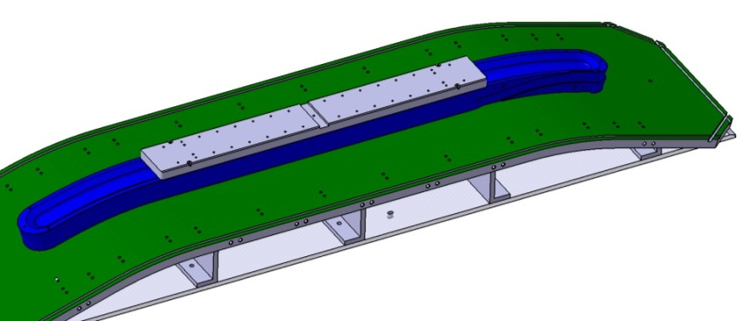
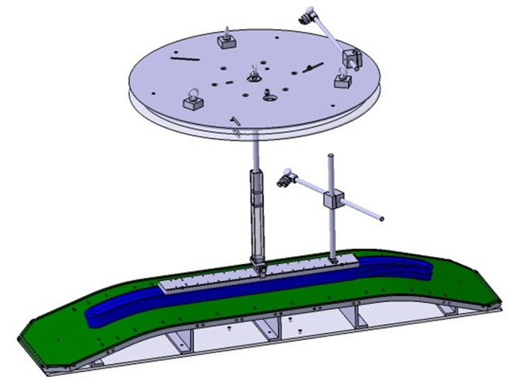
Winding process - installation
Post fixed on the winding table
The winding table is fixed on the winding machine - the table can be tilted to follow the geometry of the coil.
Protection sheet on table: 0.2 mm of mica
The cable is installed
layer 4 on the support spool on the tensioner
layer 3 on the stock spool

Slide 20
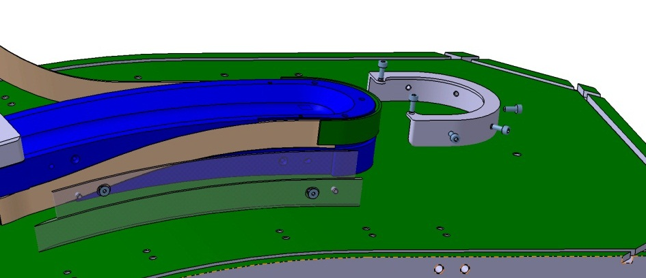
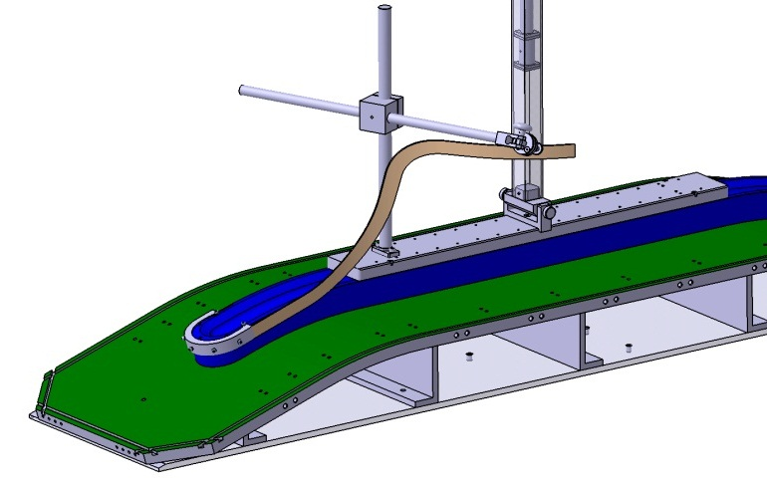
Winding layer 4
The coil winding will start by forming the layer jump.
It is protected with the layer jump shim.
The first layer is wound clockwise

Slide 21
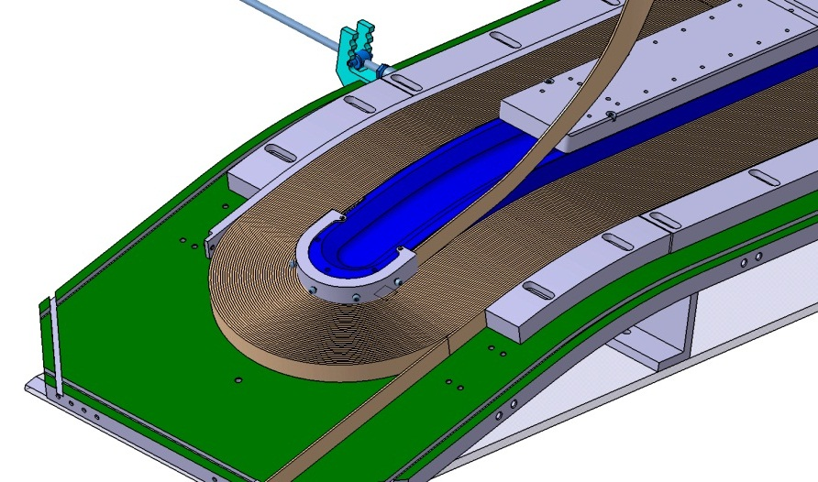
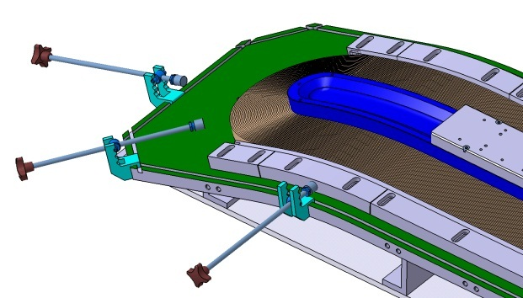
Winding layer 4
During winding, conductor turn will be maintain by lateral compression system using pressure wedges and rods.
Voltage tapes are introduced according to the instrumentation design.
At the end of the layer 4 winding, the bottom layer is maintained through rails and pressure wedges.

Slide 22
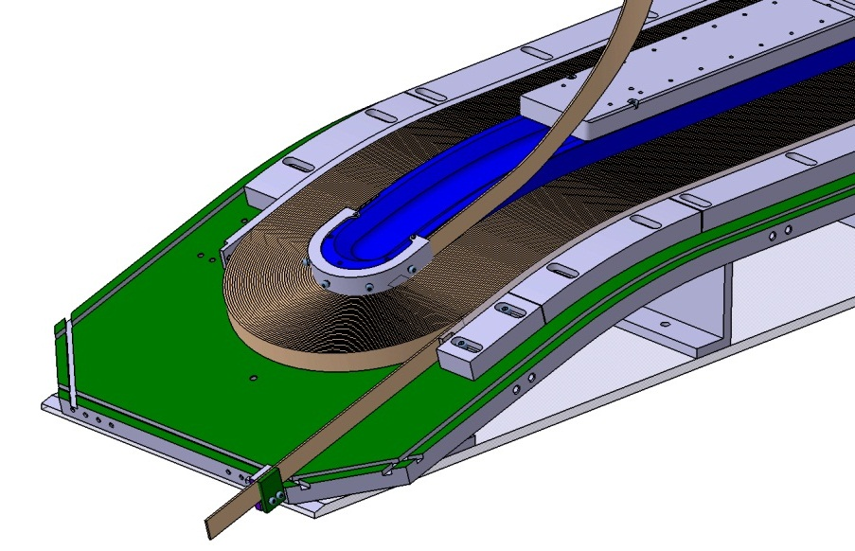
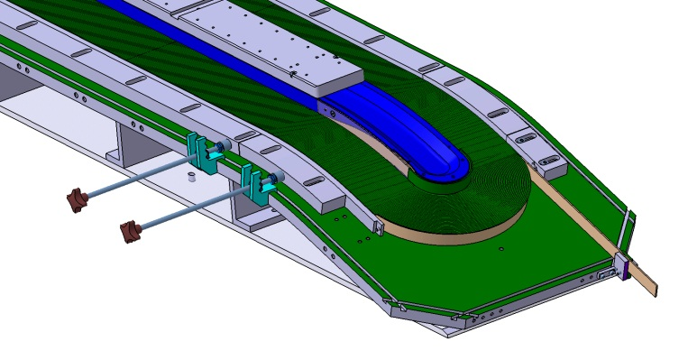
Winding layer 4
The cable is fixed and cut.
The interlayer insulation
is installed and fixed.

Slide 23
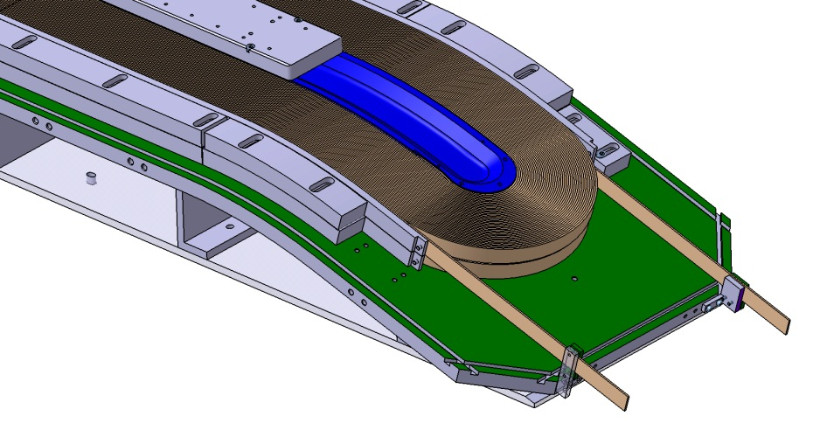
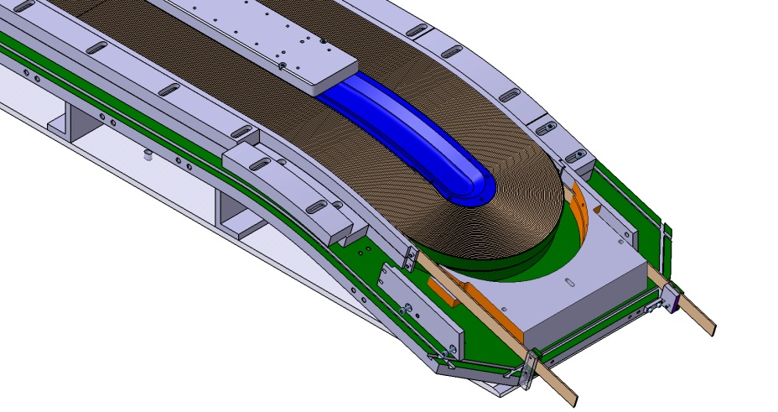
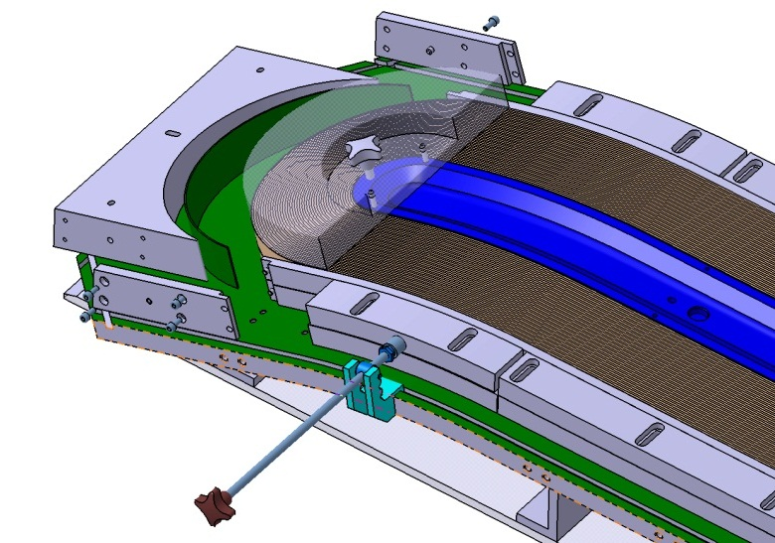
Winding layer 3
The layer 3 is wound over the insulation
Horseshoes are adjusted, if necessary, pushed in place and the rails are fixed.

Slide 24
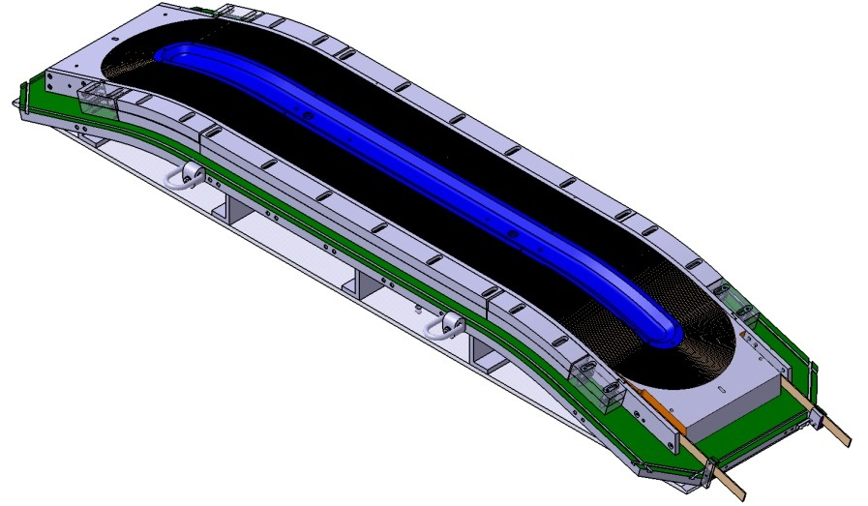
Winding completed

Slide 25
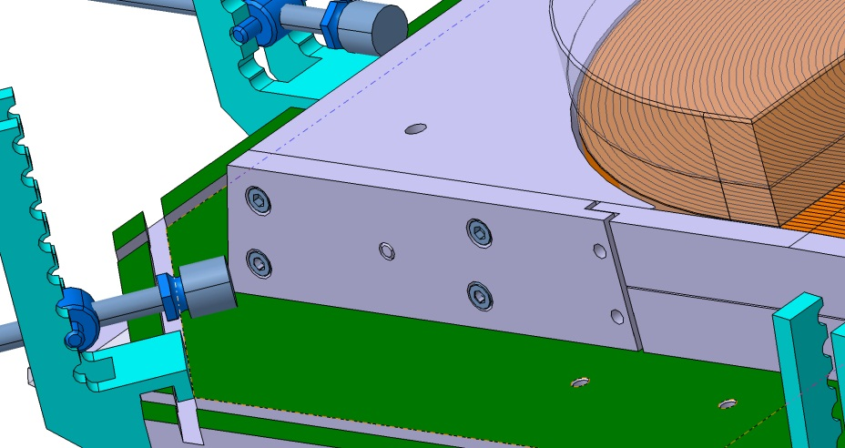
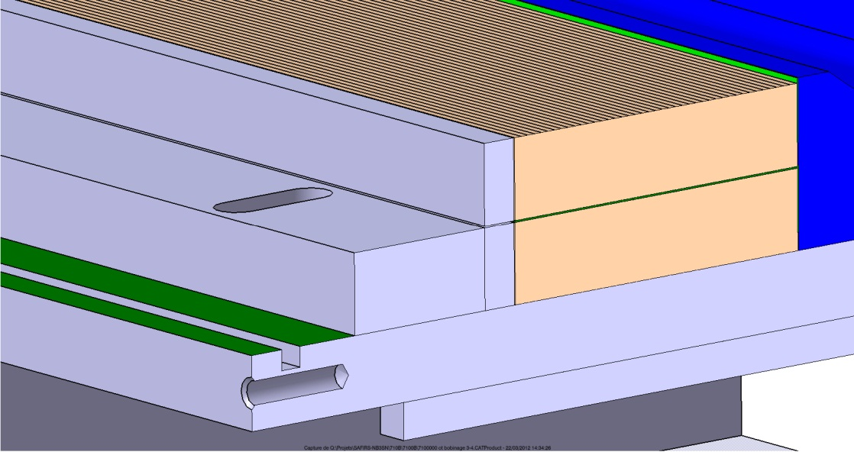
Rails geometry
Fixation of the rails on the horseshoes
Section of the coil

Slide 26
Fabrication process – main steps
Conductor insulation
Conductor preparation
Winding
Preparation for the heat treatment:
  Assembly of the reaction mold around the wound coil
  Transport to CERN
Heat treatment
Preparation for impregnation :
  Nb₃Sn/NbTi splice soldering
  Instrumentation, ground insulation and quench heaters integration
Impregnation
Coil assembly
Magnet assembly
At Saclay
At CERN
(cf. Juan Carlos’ presentation)

Slide 27
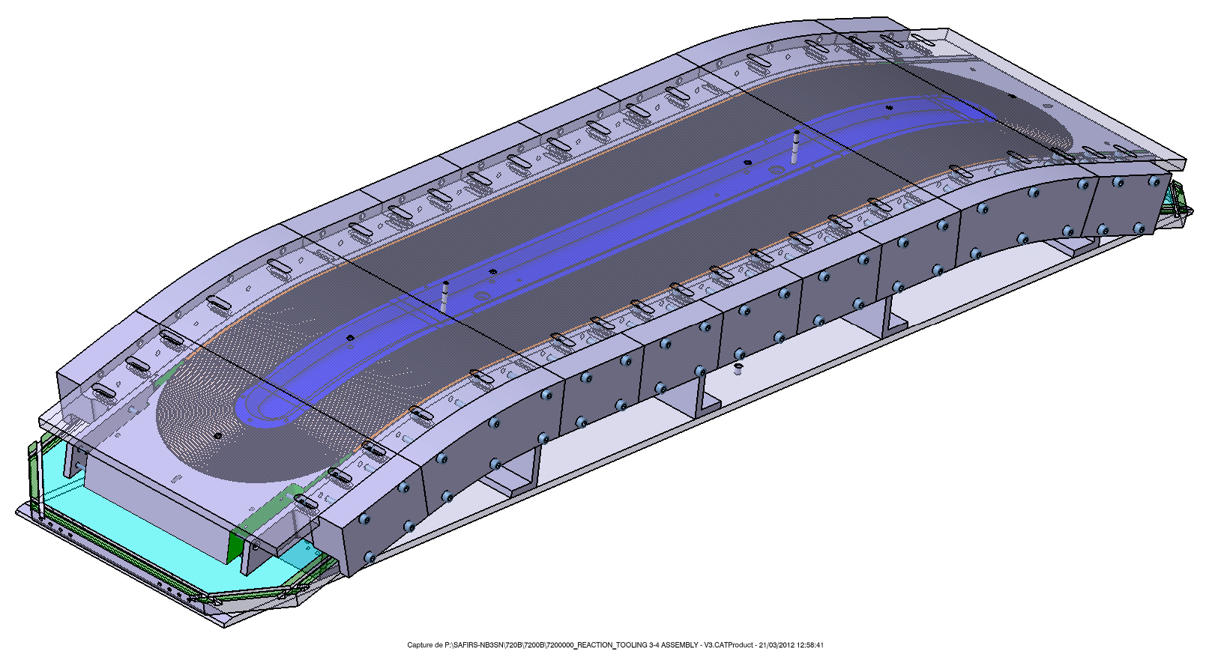
Reaction tooling
The winding table is part of the reaction tooling.
Top plates and pressure wedges are added to complete the tooling.
Segmentation of the pressure wedges to allow replacement of the compression wedges.
This object will be send to CERN for the reaction

Slide 28
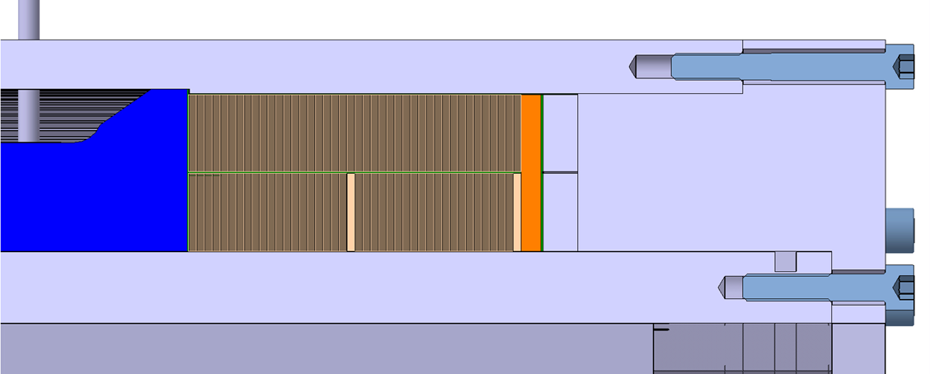
Reaction tooling
Contact zones
(define the cavity volume)
Reaction cavity
4% (respectively 2%) have been added to the dimensions with respect on bare cable thickness (respect. bare cable width).

Slide 29
Tests
Winding configuration: cf. slide 14
Layer jump: cf. slide 7
Dishing: cf. slides 15,16
Mechanical test on stacks under preparation (waiting final insulated conductor)
    Compression at 300 K, at 4K
    Thermal restraint
Conductor behavior during heat treatment: cf. following slide
    Tests to be performed on the 2 types of conductor (PIT, IT)
  Construction of 2 full-scale prototypes with non annealed Cu cable
  1- Type 3-4 (42 turns + the smaller HW bends radius)
  2- Type 1-2

Slide 30
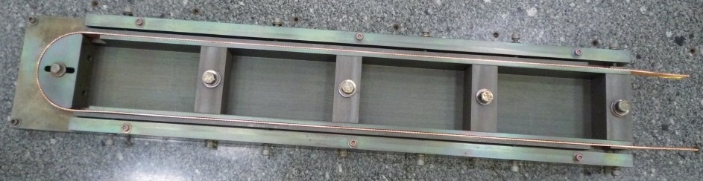
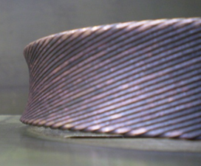
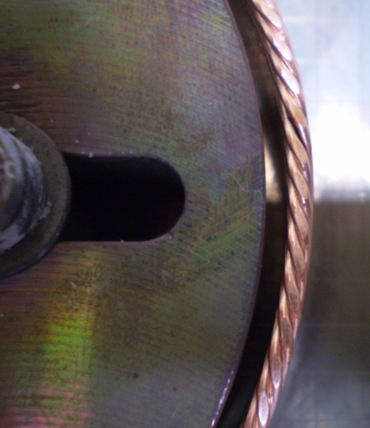
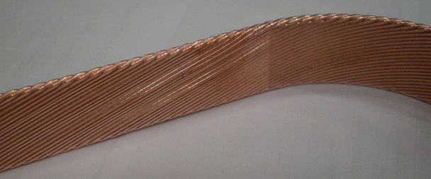
Cable behavior during heat treatment
Preliminary tests
1) PIT cable without "end mandrel"
The dishing is significantly increased after heat treatment
No significant change in overall dimensions
2) PIT cable with "end mandrel"
The cable is unstable in straight parts
The end mandrel has moved (~0.6 mm) and 1.4 mm gap between cable and mandrel has been measured
Dishing in the end part has disappeared
Ref: SAFIRS-00375-I (2011)

Slide 31
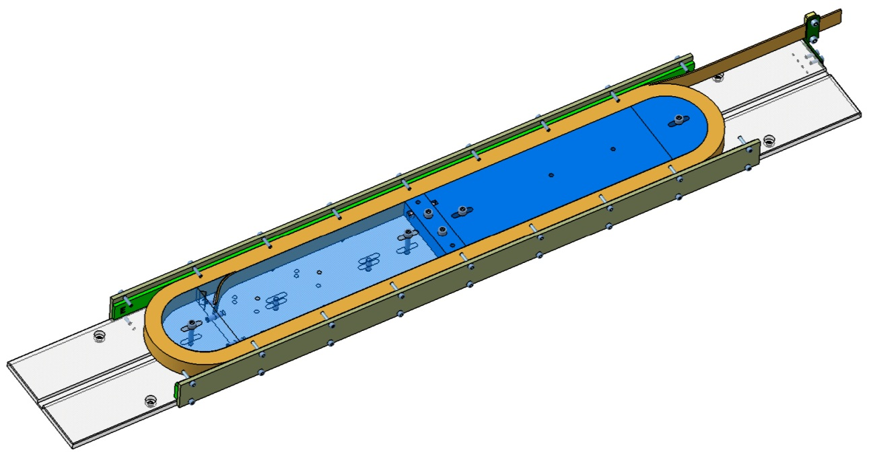


Conductor behavior during heat treatment
New multi-turn dilatation test tooling (up to 10 turns)
3 materials : stainless steel, magnetic steel, titanium
Possibility to remove the central part of the mandrel
Set-up to react 3 molds in same time

Slide 32
Tests program
Winding configuration: cf. slide 14
Layer jump: cf. slide 7
Dishing: cf. slides 15,16
Mechanical test on stacks under preparation (waiting final insulated conductor)
    Compression at 300 K, at 4K
    Thermal contraction
Conductor behavior during heat treatment: cf. slides 30, 31
    Tests to be performed on the 2 types of conductor (PIT, IT)
  Construction of 2 full-scale prototypes with non annealed Cu cable
  1- Type 3-4 (42 turns + the smallest HW bends radius) ➔ winding in July
  2- Type 1-2

Slide 33
Conclusion
The 3D model is available for the coil 3-4
  available soon for the coil 1-2
The winding tooling fabrication is on-going
The winding of the first full scale prototype is foreseen for July
The reaction mold is designed, waiting for approval

