Slide 1
FRESCA2 TEST PLANS @ CERN
by Marta Bajko CERN TE MSC TF on behalf of
Vladislav Benda, Paolo Ferracin,
Christian Giloux, Attilio Milanese , Pierre Minginette, Philippe Perret, Gijs De Rijk, Arnaud Vande Craen, Patrick Viret, Hugues Thiesen
For EuCARD FRESCA2 Review - March 2012 CERN

Slide 2
Summary
Cryogenic test station status at CERN
Inputs and constraints for the test station design
Which cryostat we can use? Characteristics
Main ingredients of the HFM test station
Status of the main ingredients
Integration. Some details.
HFM cryostat conceptual design
Which measurements can be done?
When the cold test can take place?

Slide 3
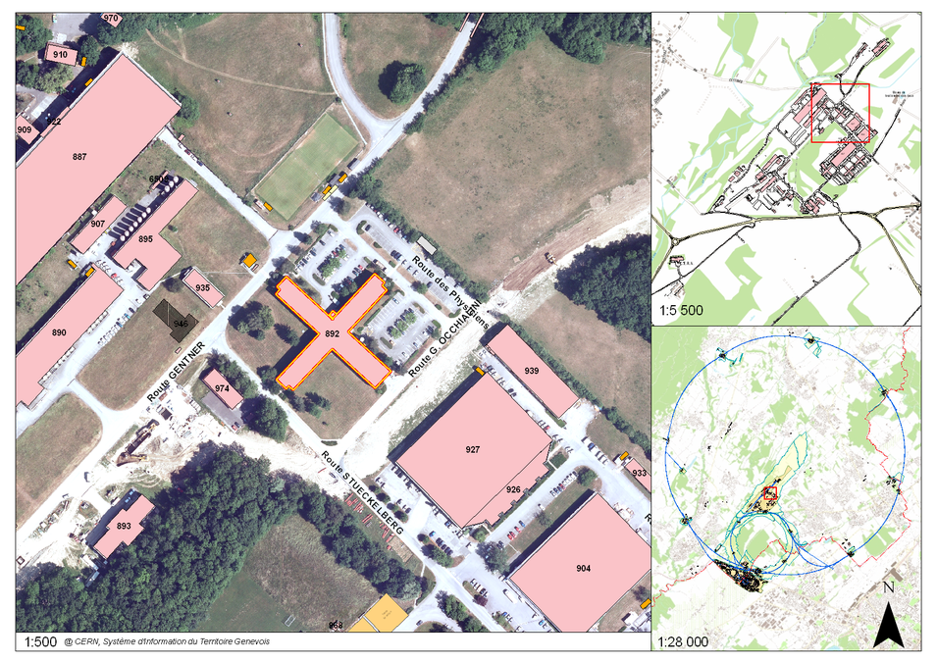
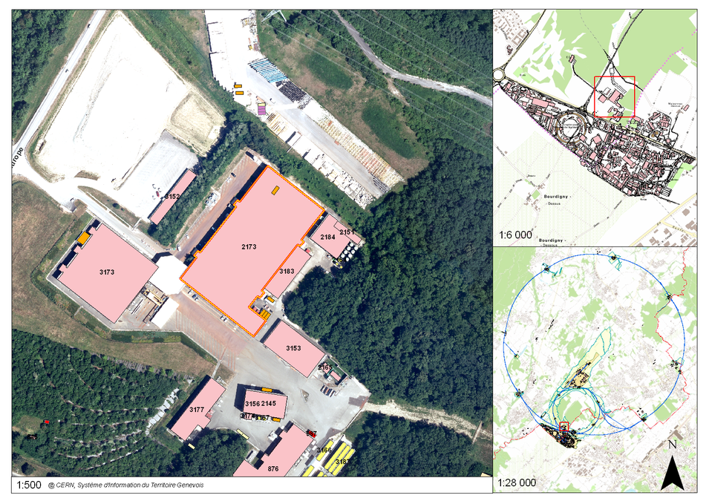
Cryogenic test station at CERN till 2010
  A. Test station with 4 vertical cryostats for stand alone magnets located in Prevessin (building 892)
  B . Tests station with 10 benches in horizontal position, optimized for the main LHC magnets located in point 18 (building 2173)

Slide 4
Cryogenic test station at CERN from 2011
  Tests station with 10 benches in horizontal position, optimized for the main LHC magnets, 3 vertical cryostats and supercritical test station located in point 18 (building 2173 called SM18)

Slide 5
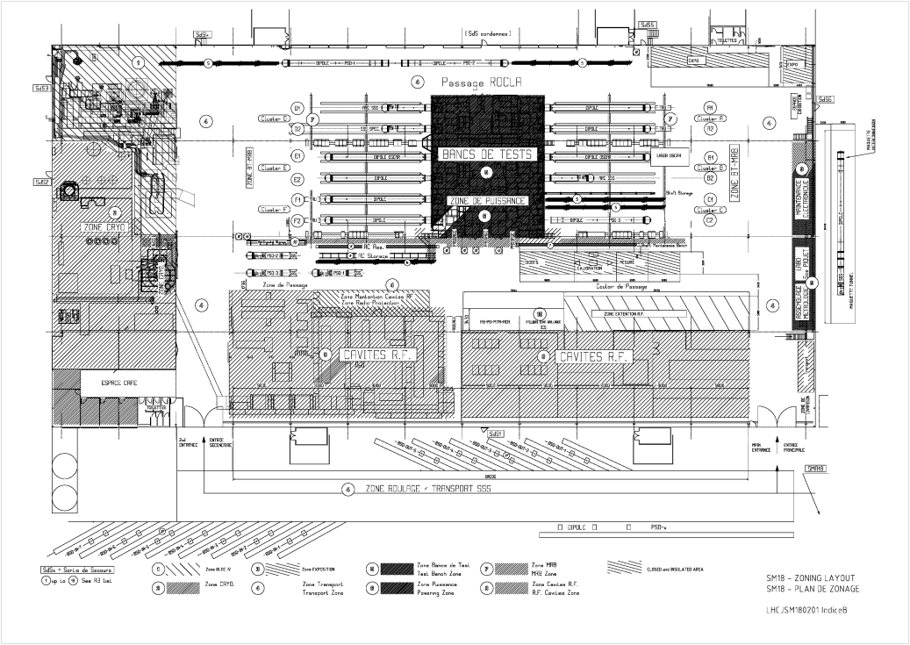
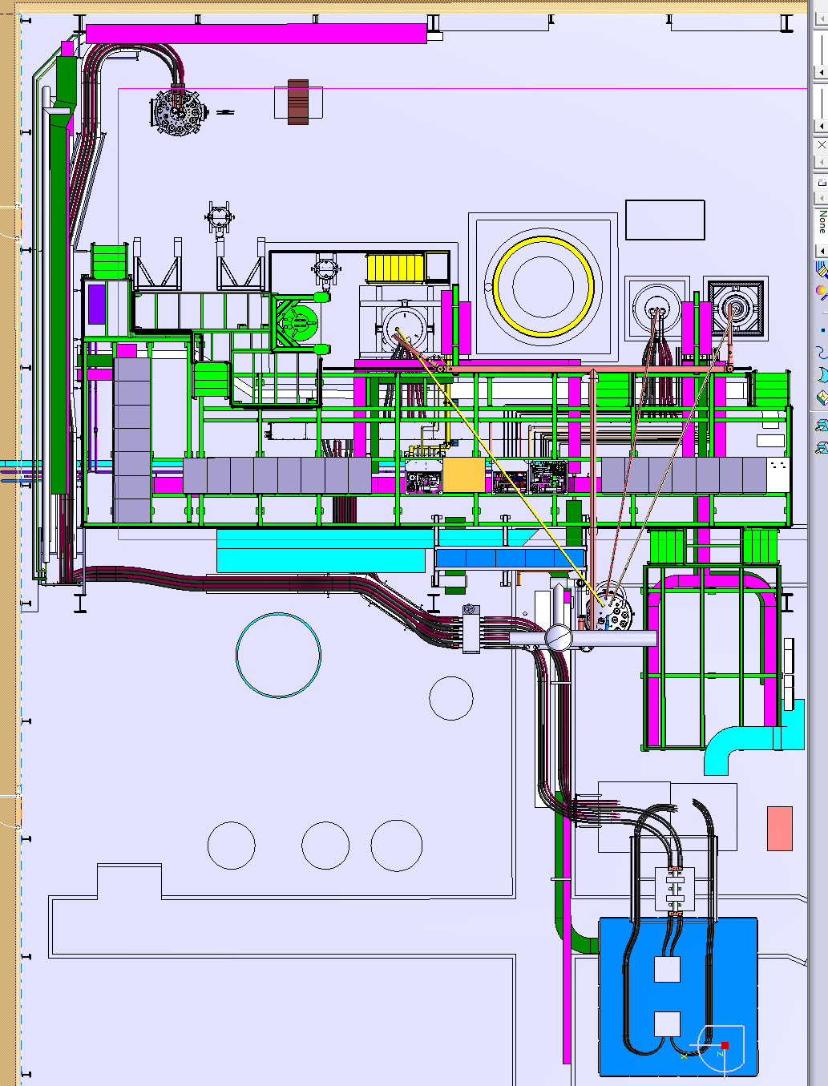
Cryogenic test station SM18 layout
Vertical test benches
Horizontal test benches

Slide 6
The inputs and constrains for the HFM test station
Magnet parameter description | FRESCA2 | LD1 | HTs Insert | Unit
Maximum current Iss@ 1.9 K | 14.9 | 18.1 | 10 | kA
Free aperture diameter | 0.1 | 0.1 | 0.02 | m
Maximum length | 2.5 | 2.5 | 0.75 | m
Maximum outer diameter | 1.03 | 1.36 | 0.1 | m
Maximum weight | 9 | 15 |  | t
Maximum stored energy @ Iss @ 1.9K | 6.5 | 9.2 | 1 | MJ
Inductance | 63 | 56 | 20 | mH
Max ramp rate | 150 |  | 150 | A/s
Splice dissipation | 3.5 |  |  | W
Maximum heat dissipation (when ramping) | 10 | 10 | <1 | W
Requirement | Value
Estimated Lifetime of the high field magnet test facility | > 20 years
Number of thermal cycles (293 K to 1.9 K and back) | ≤ 200
Quenches | ≤ 4000
Number of powering cycles of the magnet | ≤ 10000
Number of powering cycles of the inserts | ≤ 5000
Environmental conditions in the experimental hall | 200 mT
Radiation levels | No radiations
Cooling time from 300 K to 80 K: 3 days

Slide 7
The EXISTING vertical cryostats characteristics
 | Cryostat 1 (LONG) (existing) | Cryostat 2 (existing) | Cryostat 3 (existing)
Useful length (mm) | 3800 | 1600 | 1400
Useful diameter (mm) | 600 | 500 | 800
Cooling time 4.2 K (h) | 44 | 5 | 32
Cooling time 1.9 K (h) | 12 | 2.5 | 8
Working temp (K) | 1.9 | 4.2 | 1.9
Working pressure (mbar) | 1250 | 1250 | 1250
Max weight (t) | 6 | 1.5 | 3
Max energy (kJ) | Tested: 500
Nr of current leads | 2 x 13 kA +1 x 6 kA | 2 x 15 kA | 2x 18 kA or 4x 200 A + 4 x 1200 A
Nr. of available inserts | 1 | 1 | 2
NON of these cryostats allows testing FRESCA 2 magnet
The HFM (FRESCA2 and LD1) cryostat has to be designed on purpose, and an additional power supply of 10 kA is needed for the HTs insert powering …… together with other ancillary equipment

Slide 8
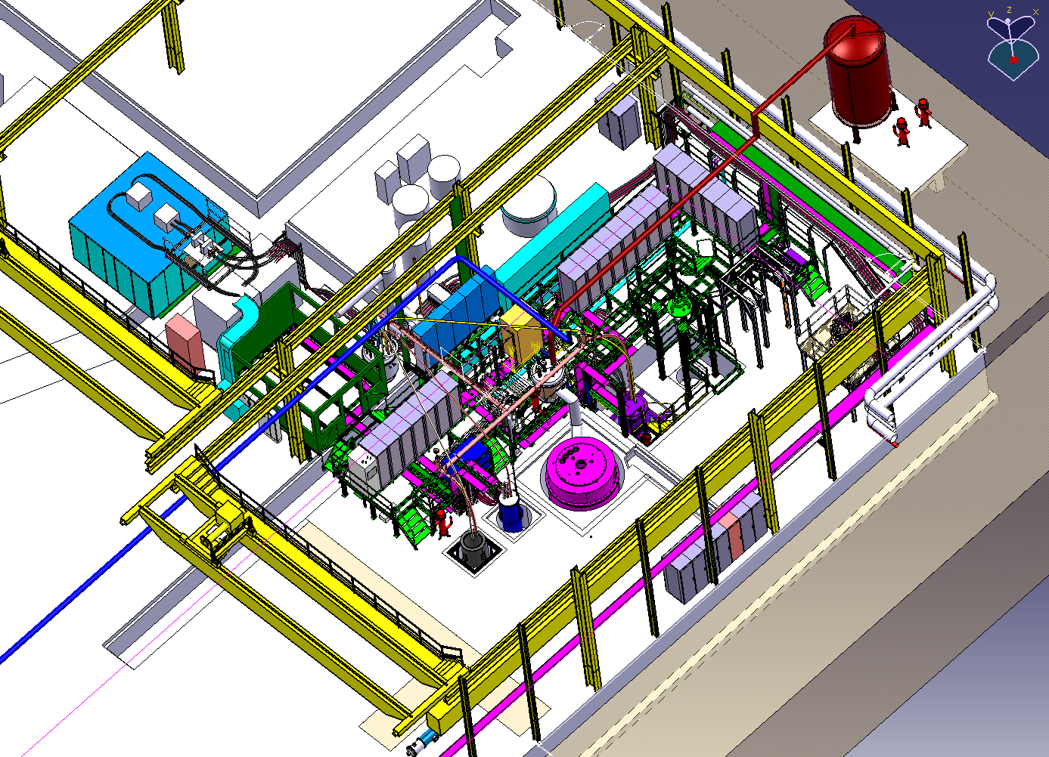
Main ingredients of the HFM test station
He gaz buffer
20 kA power Converter
Dump Resistor
Cryogenic
Control
Cryogenic rack
Control Room
Valve box
DAQ
Pumping line
HFM cryostat
10 kA power Converter

Slide 9
Summary of the status of the main ingredients
20 kA powering circuit
Power supply 20 kA /60 V : available
Switches: available
Cupper bus bars: available
Water cooled cables addressed
Connection to current leads addressed
Copper current leads addressed at CERN
Water distribution critical
Cooling circuit
Magnet pre-cooling pressurised He
Magnet cooling
He gaz recuperation buffer
Cryogenic valve box
Cryogenic control critical
Security PLC to be addressed
DAQ available
10 kA powering circuit
Power supply 10 kA/8 V available design
Switches to be addressed
Cupper bus bars addressed
Water cooled cables addressed
Connection to current leads addressed
Copper current leads addressed at CERN
Water distribution critical
Protection circuit
Dump resistor available for 20 kA circuit, to be addressed for 10 kA circuit
Capacitor benches available
Cryostat: adressed

Slide 10
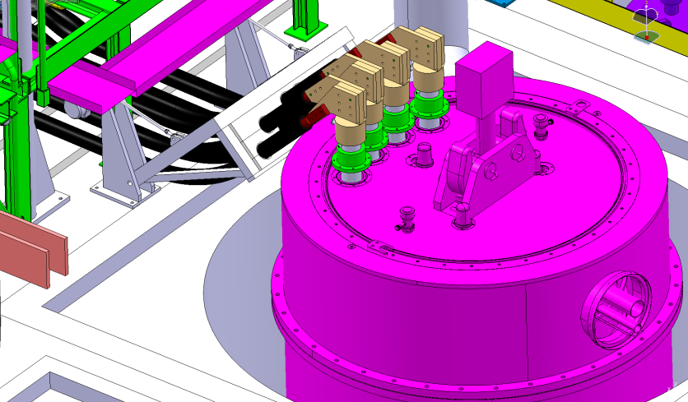
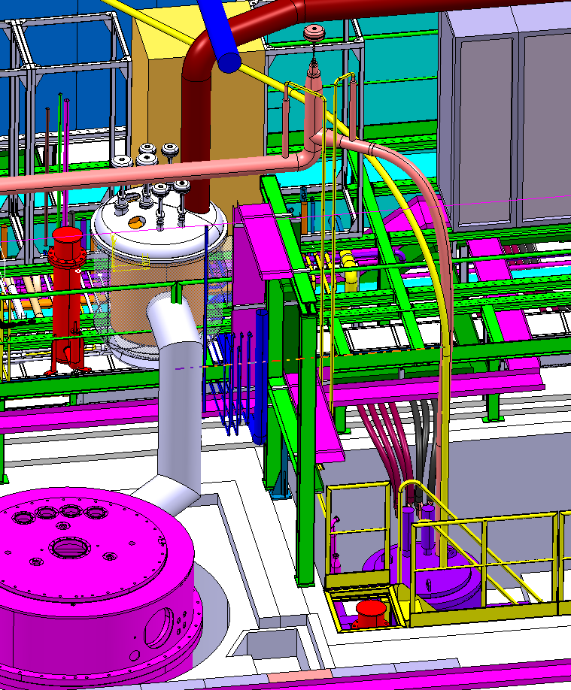
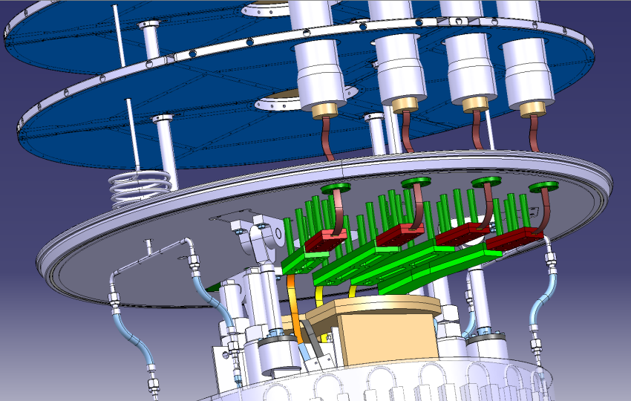
Integration. Some details
Hydraulic connection
Electrical connection
20 kA water cool cable connected to the current leads and the Cu bus bars
He gaz recuperation to the buffer
Pre cooling line
Cu current leads connected to magnet trough low Tc Sc cables under the lambda plate
Valve box

Slide 11
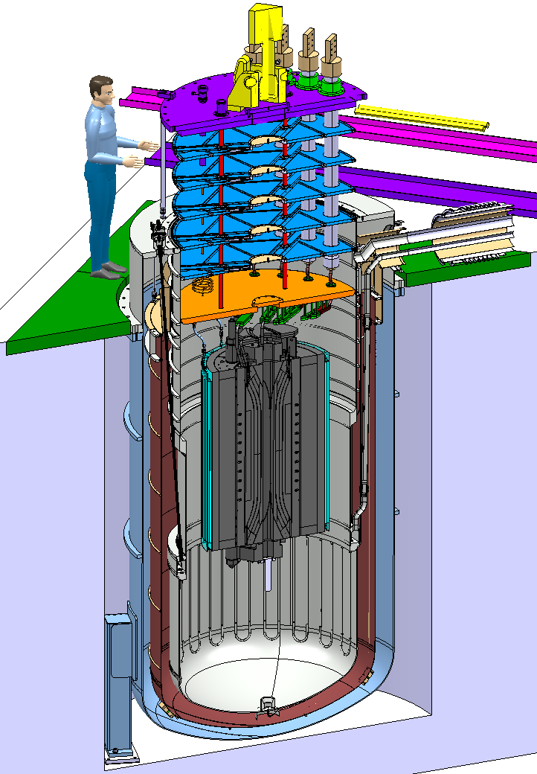
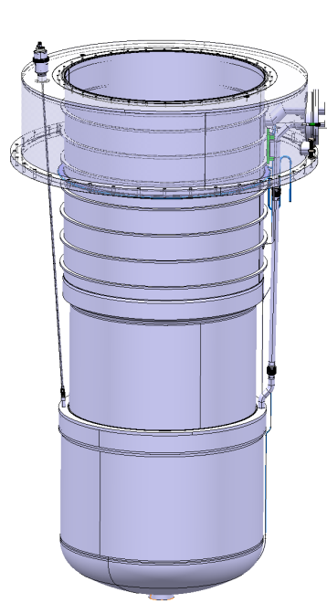
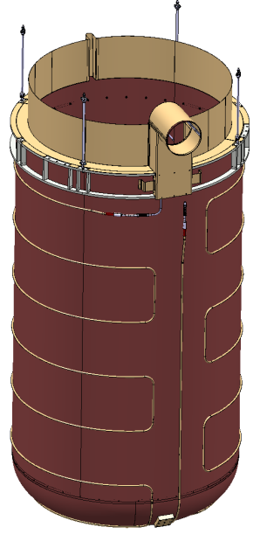
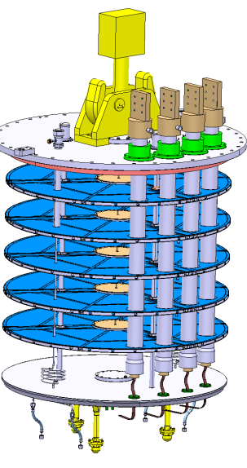
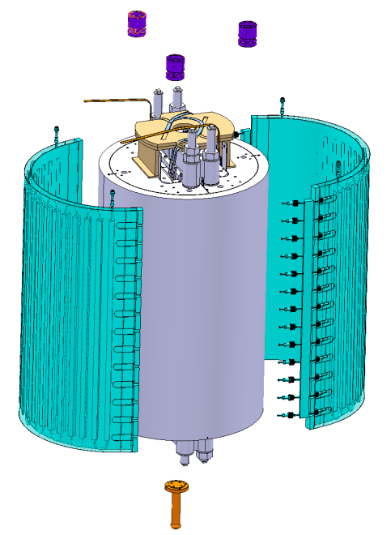
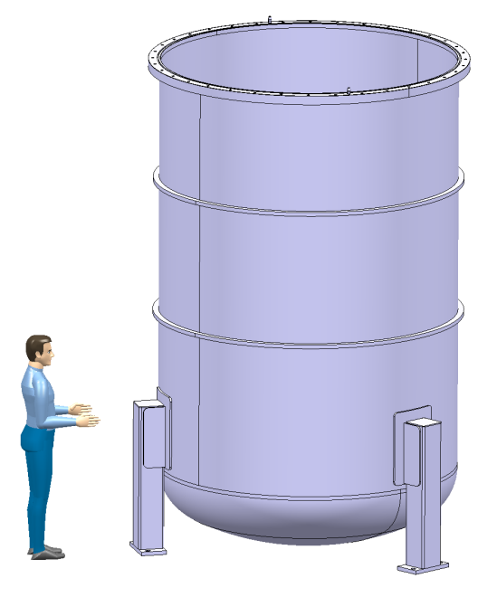
Cryostat conceptual design
Helium vessel ( Max. p= 4 bar)
  Neck: DI: 1612 mm, Length : 1744 mm, Thickness : 3 mm
  Middle part: DI: 1500 mm, Length: 1245 mm, Thickness: 8mm
  Lower part: DI: 1630 mm, Useful length: 1800 mm, Thickness: 8 mm
Cooling time 80 K to 4.2 K: 12 h
Cooling time 4.2 K to 1.9 K: 1.5 days
( dimensioning made for 100 Watts)
Thermal shield
Vacuum vessel ( Max. p= 1.5 bar)
DI : 2300 mm, Length : 3845 mm, Thickness : 8 mm, Weight: 2.8 t
Magnet pre cooling:
pressurized He (15 bar, 80 K)
Insert
  Total Length: 4415 mm
  Top plate: Ø 1800 mm, Thickness: 50 mm
  Lambda plate: Ø 1600 mm, Thickness: 50 mm
  Magnet centering

Slide 12
Cooling to LN2 in January 2013??
@ CERN there is no adequate Dewar for this test
the FRESCA 2 cryostat vacuum vessel is not equipped with security valves and is not INSULATED
A LN2 Dewar of the characteristics: 1.2 m
diameter and 2 m depth may be found on
the market.
A supporting system should be designed
and adapted to such LN2 Dewar

Slide 13
Measurements to do
  Electrical integrity (HiPot, Insulation, Continuity)
  RRR during cool down and warm up
  Splice resistance measurements
  Inductance measurements
  Powering test at 1.9 K and quench localization with V taps ( eventually also quench antenna but it represent an important extra work)
  Protection heater study if required ( we need to know the time constant or the deposited energy on the heaters to set up the circuits; we have up to 400 V or lower and fixed capacitor benches with units of 14 mF)
  Ramp Rate dependence study
  Mechanical measurements with strain gauges
  Magnetic measurements

Slide 14
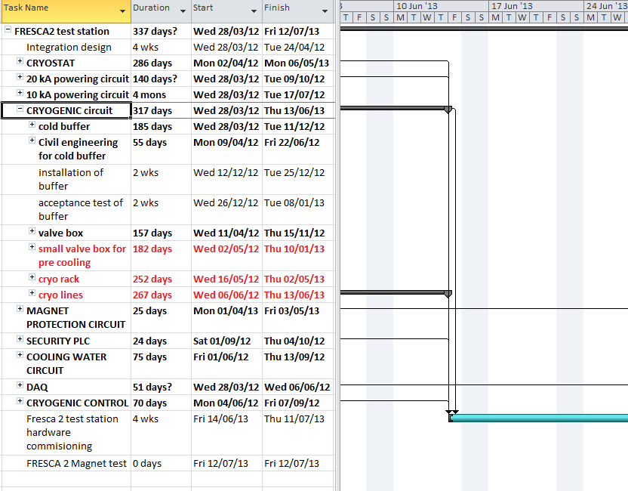
When we can test?
Cryostat is ready: May 2013
Cryogenic system ready June
….And is very optimistic due to the lack of man power and conflict between LS!

