Slide 1
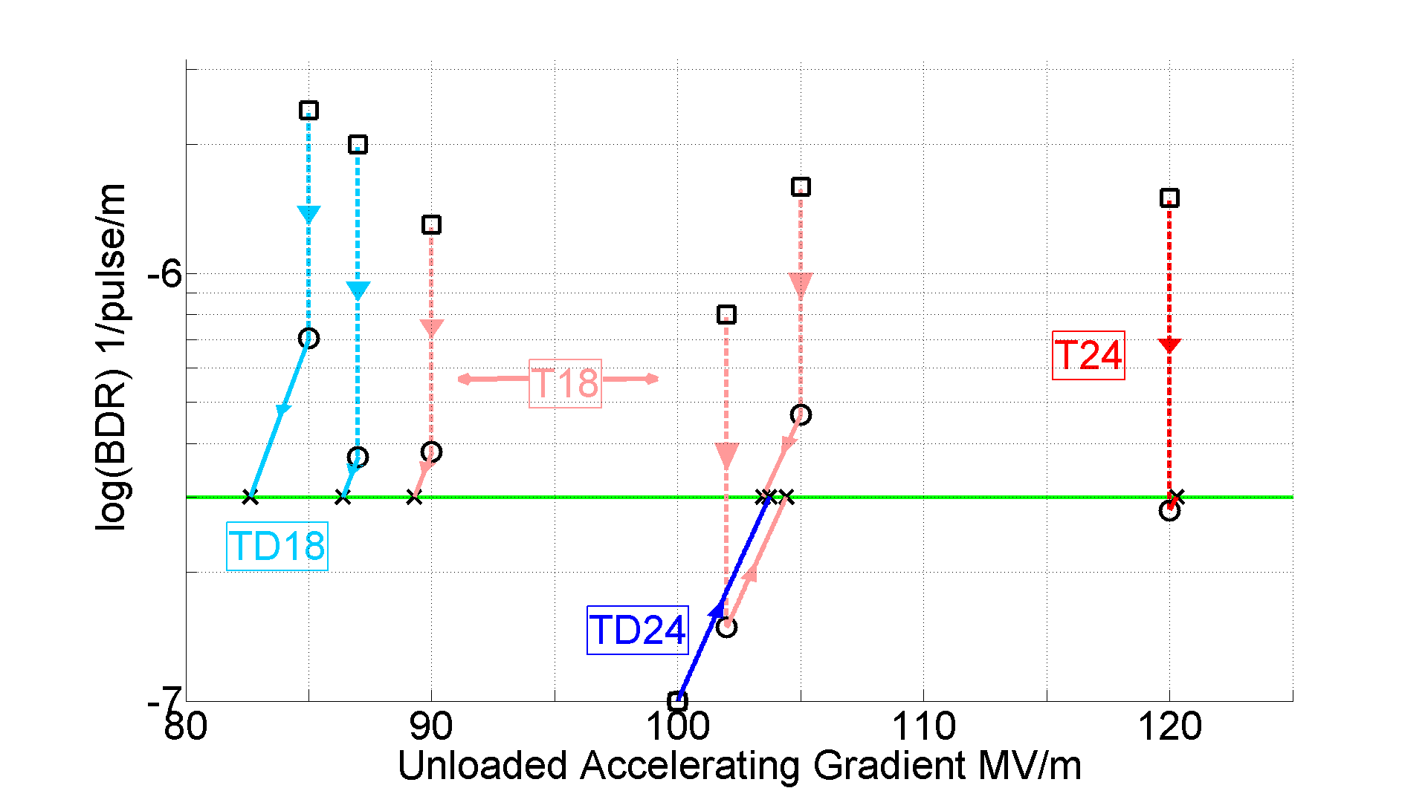
Accelerating gradient test status: 6-3-2012
n.b. TD24 point corresponds to no breakdowns in 250 hr → 4.5x10⁷ pulses
On going test→
Uncertainty range due to the effect of beam loading. This will be measured for the first time in the “dog-leg.”

Slide 2
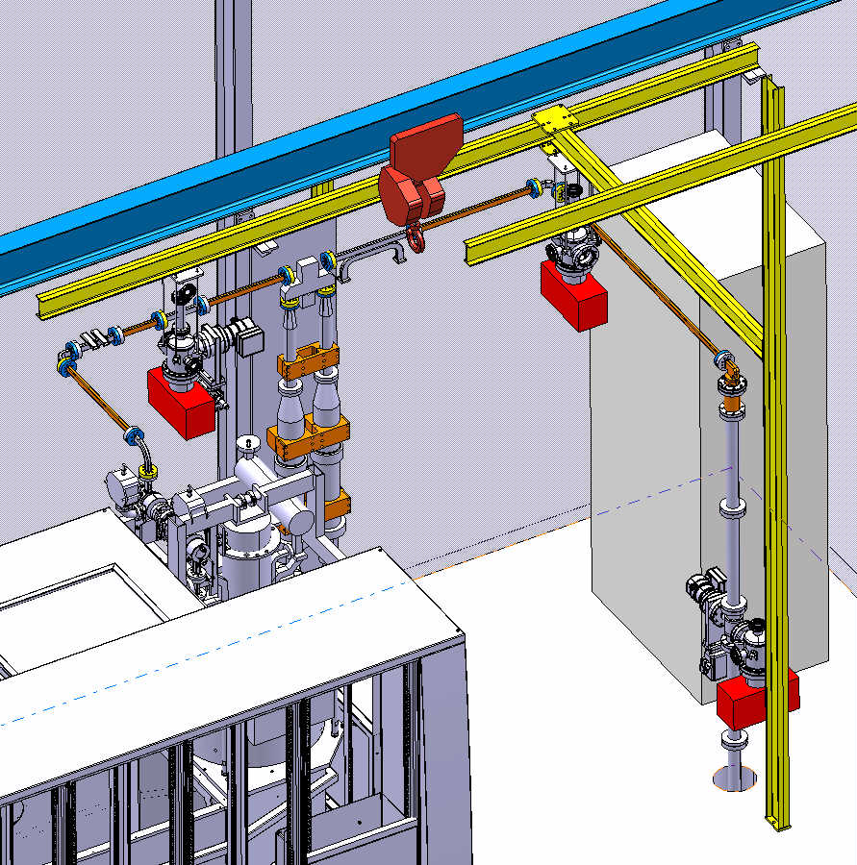
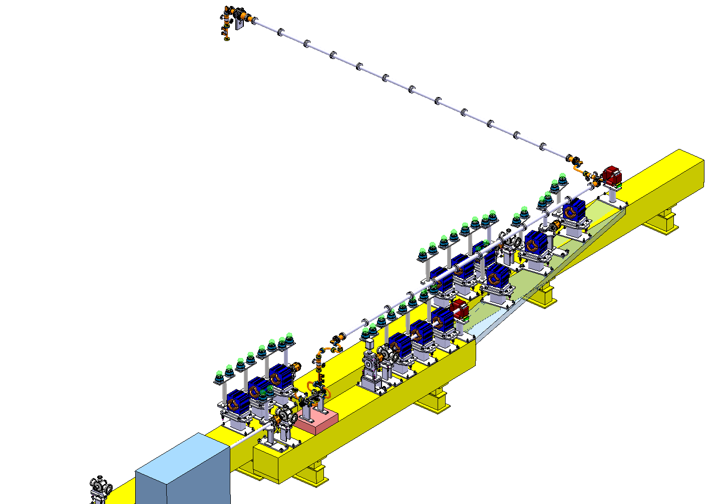
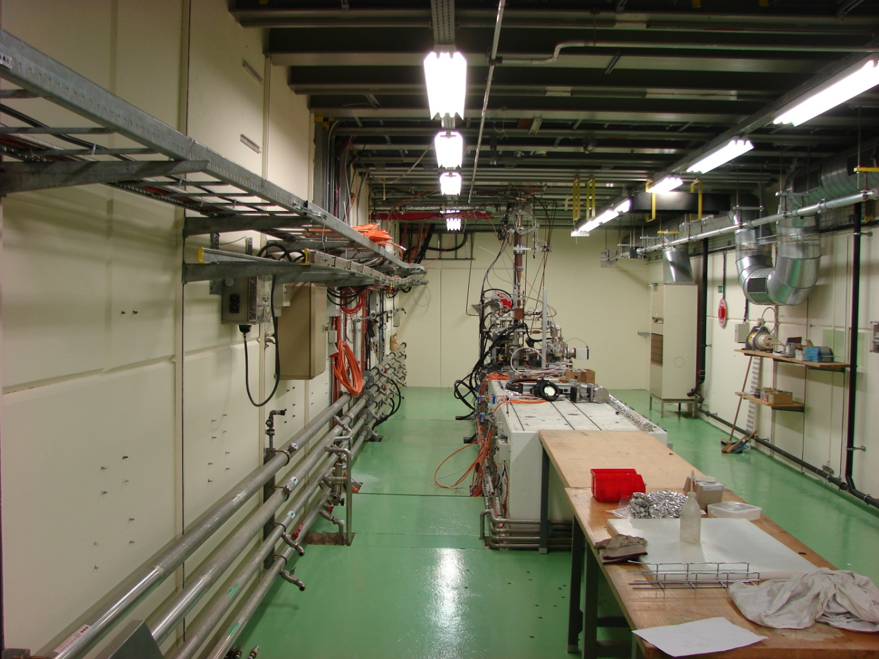
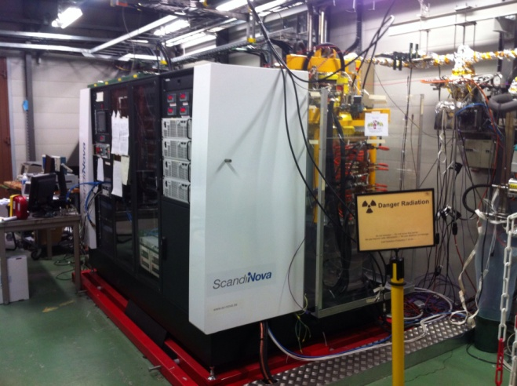
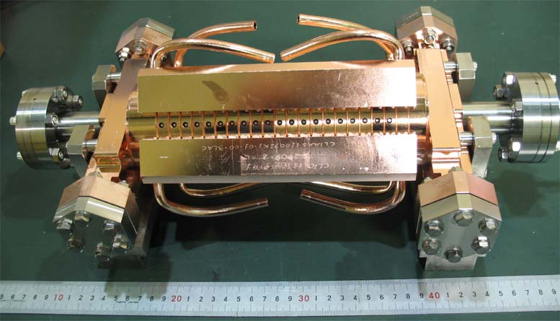
CTF2
1-5 A beam
CTF3
2012?

Slide 3
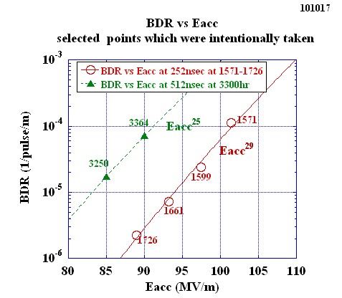
18 series breakdown rate distributions
T18
TD18

