Slide 1
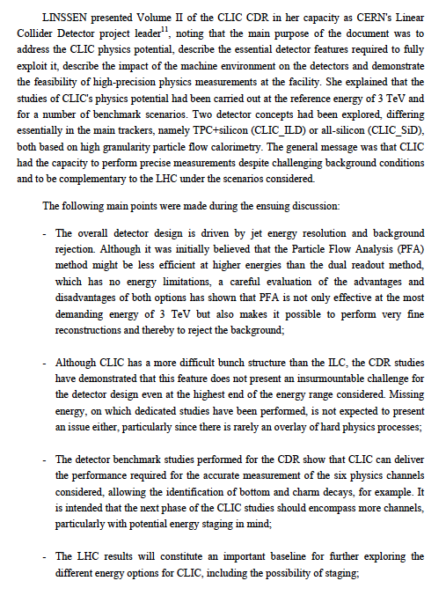
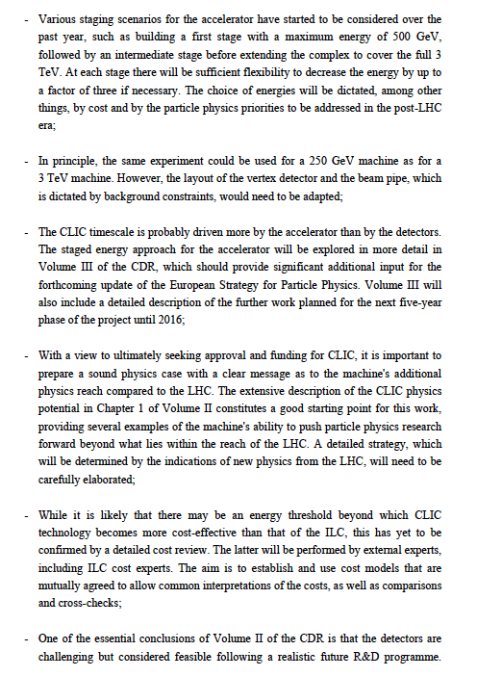
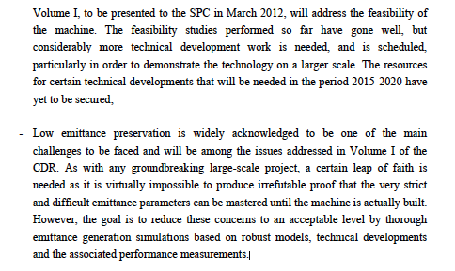

Slide 2
Costing review 21-22.2
Extract from slide of Philippe:
The Panel was impressed by the quality of the presentations and degree of detail to which the value estimate has been studied
No major omissions were found
The Panel endorses the methodology used to make the value estimates
There is a lack of coherence between the two stages (500, 1500 GeV) that must be resolved when the numbers are presented
  Luminosity factor 2 higher than achieveable with nominal bunch charge
  Justification for such high luminosity should be re-examined (since it has a significant cost impact)
The Panel recommends more work on prototyping & collaboration with industry in order to refine value estimates
  More confidence in scaling laws
  Bring precision below the 30 % level
  Inconsistency in costing the 500 GeV stage since component costs are estimated using learning curves corresponding to quantities of 1.5 TeV stage
  Scope for further optimization, e.g. length of TBM girders
Rough comparison with ILC cost data shows no major discrepancy, except in ventilation costs
Clearly state what the claimed uncertainty means (1 sigma, 2 sigma, 90 % ?)
Thanks to all for making this a successful event

Slide 3
Activity leaders are responsible for:
  Overall work-package definition and follow up for their respective activities, covering progress versus goals, resources and schedule
    The activity leaders should interact regularly with the work-package responsible to ensure that the priorities for R&D and studies for their respective areas are carried out, the resources are well understood and used, and that the interfaces between the work-packages are clear
    The activity leaders are responsible for the technical coordination and the overall resource planning and follow-up with respect to Collaborators and CERN line management for their activity areas
  Documentation of and reporting on the activities to the CASC, CSC and CB
    Preparation of the CLIC Project Meetings concerning the activities under their responsibility, including presentation of critical issues and issues that have wider interest or impact
    Informing the work-package leaders about matters of relevance from the CASC, CSC and CB
  The activity leaders can delegate responsibilities and appoint people to help with their task. Such appointment should be reported, discussed and approved by the CASC/CSC
  The activity leaders are members of the CASC and CSC

Slide 4
Work-package leaders
The work-package leaders are responsible for execution of their respective work-packages – technical progress, planning, resources and schedule, as well as documentation of the work-package activities
  The work-package leaders are responsible for the daily interactions with the work-package team, including both collaborators and CERN personnel
  The work-package leaders take part in the resource planning and follow up for their work-package and should work within the resource allocation agreed with the activity managers, collaborators and CERN line management
The WP leaders interface to the activity leaders in planning (technical and resources) and follow up of the work-packages such an overall coherent execution of the activities is ensured
  They report about the work-package activities to the activity managers and the CASC, CSC, CB and in project meetings when requested
  They should identify issues that are critical and need attention and report these to the activity leaders, and CLIC management if appropriate
The WP leaders make sure that there is adequate representation in the meetings that are of relevance to the work-package
The WP leaders can delegate responsibilities and appoint people to help with their task. Such appointment should be reported, discussed and approved by the activity leaders and the CASC/CSC.

