Slide 1
CLIC Conceptual Design and Status
D. Schulte for the CLIC team
SPC March 2012

Slide 2

























CLIC&CTF3 Collaboration
41 Institutes from 21 countries
ACAS (Australia)
Aarhus University (Denmark)
Ankara University (Turkey)
Argonne National Laboratory (USA)
Athens University (Greece)
BINP (Russia)
CERN
CIEMAT (Spain)
Cockcroft Institute (UK)
ETHZurich (Switzerland)
FERMILAB
Gazi Universities (Turkey)
Helsinki Institute of Physics (Finland)
IAP (Russia)
IAP NASU (Ukraine)
IHEP (China)
INFN / LNF (Italy)
Instituto de Fisica Corpuscular (Spain)
IRFU / Saclay (France)
Jefferson Lab (USA)
John Adams Institute/Oxford (UK)
John Adams Institute/RHUL (UK)
JINR (Russia)
Karlsruhe University (Germany)
KEK (Japan)
LAL / Orsay (France)
LAPP / ESIA (France)
NCP (Pakistan)
NIKHEF/Amsterdam (Netherlands)
North-West. Univ. Illinois (USA)
Patras University (Greece)
Polytech. University of Catalonia (Spain)
PSI (Switzerland)
RAL (UK)
RRCAT / Indore (India)
SLAC (USA)
Thrace University (Greece)
Tsinghua University (China)
University of Oslo (Norway)
Uppsala University (Sweden)
UCSC SCIPP (USA)

Slide 3
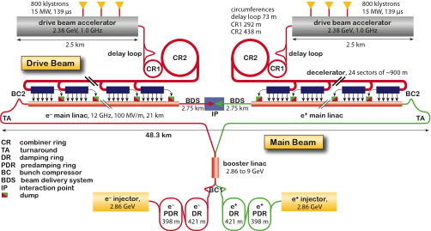
CLIC Layout at 3 TeV
Drive Beam Generation Complex
Main Beam Generation Complex

Slide 4
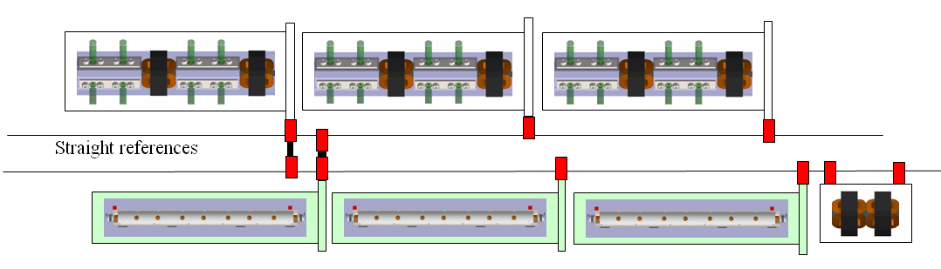
Two-beam Concept

Slide 5
CLIC Main Parameters

Slide 6
Key Design Issues
Main linac gradient
Accelerating structure
Drive beam scheme
Drive beam generation
PETS
Two beam acceleration
Drive beam deceleration
Luminosity
Main beam emittance generation, preservation and focusing
Alignment and stabilisation
Operation and Machine Protection System (robustness)
Detector (experimental conditions)

Slide 7
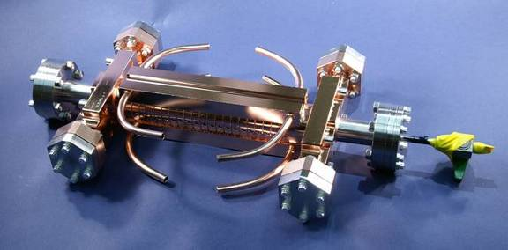
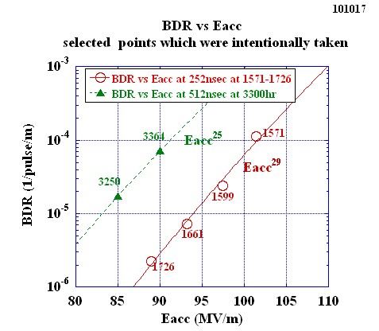
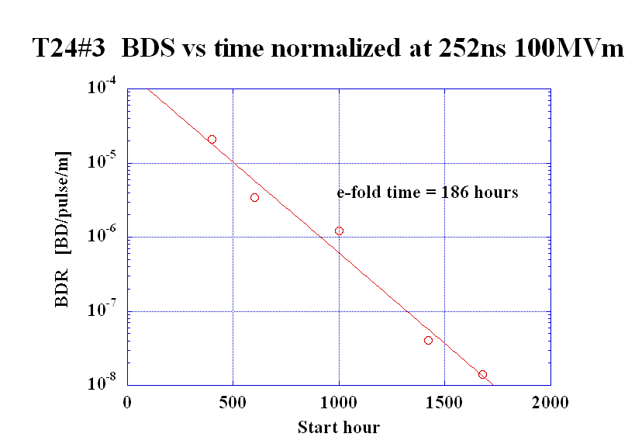
Accelerating Structure
Require <1% probability of even a single break down in any structure
  p ≤ 3x10⁻⁷m⁻¹pulse⁻¹
Design based on empirical constraints

Slide 8
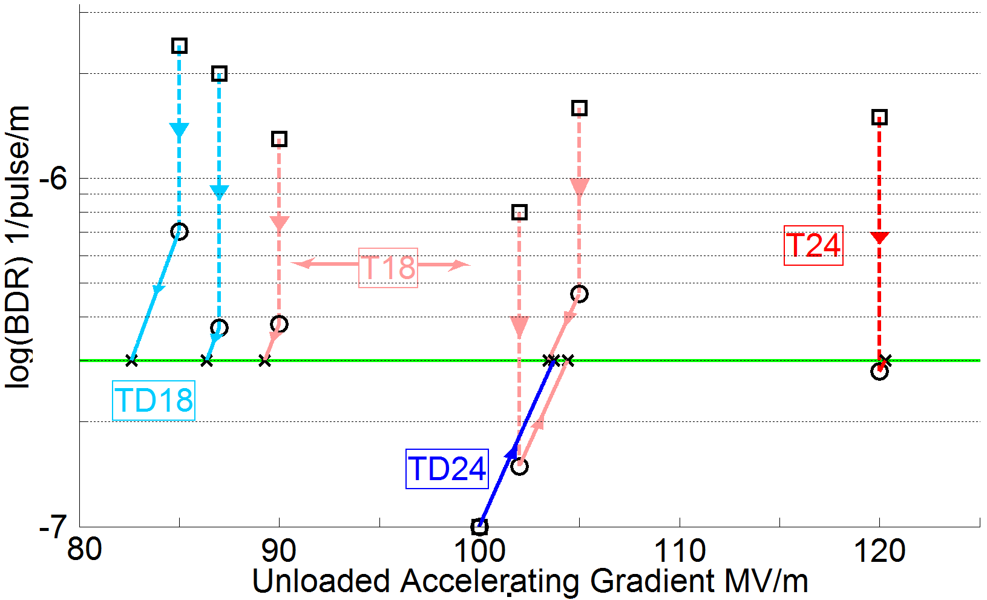
Achieved Gradient
Tests at KEK and SLAC
Measurements scaled according to
 | Simple early design to get started | More efficient fully optimised structure
No damping waveguides | T18 | T24
Damping waveguides | TD18 | TD24 = CLIC goal
Unloaded 103MV/m
Expected with beam loading
86-103 MV/m

Slide 9
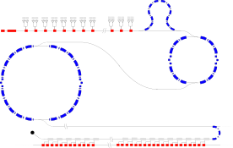
CLIC Power Source Concept
Delay Loop × 2
gap creation, pulse compression & frequency multiplication
Drive Beam Accelerator
efficient acceleration in fully loaded linac
RF Transverse Deflectors
Combiner Ring × 3
pulse compression &
frequency multiplication
Combiner Ring × 4
pulse compression &
frequency multiplication
CLIC RF POWER SOURCE LAYOUT
Drive Beam Decelerator Section (2 × 24 in total)
Power Extraction
Drive beam time structure - initial
Drive beam time structure - final
240 ns
240 ns
5.8 μs
140 μs train length - 24 × 24 sub-pulses
4.2 A - 2.4 GeV – 60 cm between bunches
24 pulses – 101 A – 2.5 cm between bunches

Slide 10
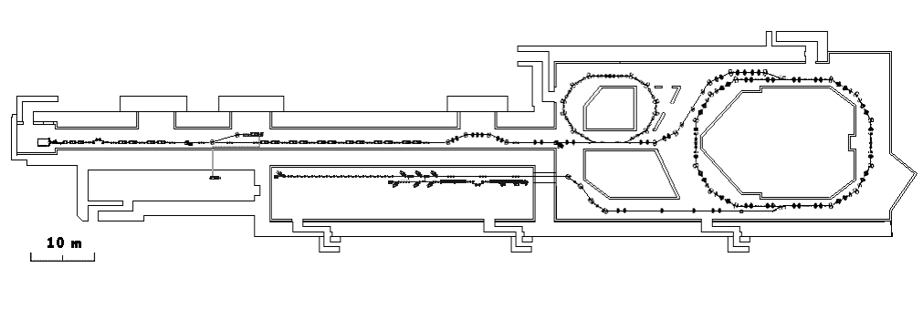
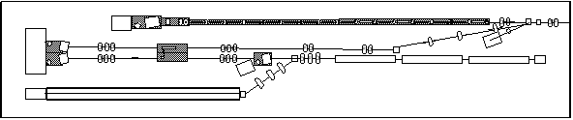
CLIC Test Facility (CTF3)
Delay Loop
Combiner ring
150 MeV e-linac
3.5 A – 1200 ns
Thermionic source
Experimental area
28 A - 140 ns
Recycled infrastructure
made it affordable
causes lots of headache

Slide 11
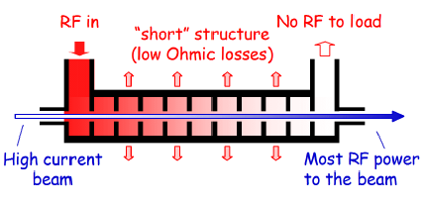
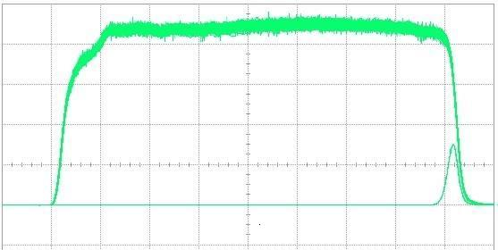
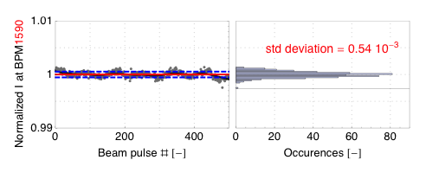
Drive Beam Linac
95.3% RF to beam efficiency
No instabilities
Phase switch works OK
Parameter | CLIC goal | CTF3 routine at end of linac
Transverse emittance | 100μm | 50-60μm
Pulse current | 7.5e-4 | 5.4e-4
RF pulse at structure input
1.5 µs beam pulse
10 m
RF pulse at output

Slide 12
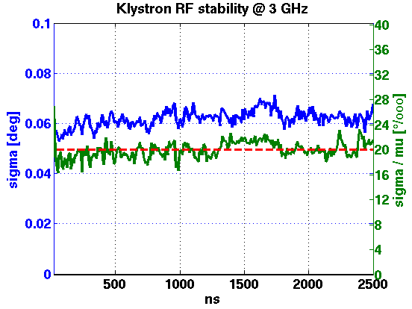
RF Stability
Cannot yet measure beam phase jitter accurately enough
monitor being built (Frascati)
Have specifications for RF
compare to CTF3
Good CTF3 klystron
pulse-to-pulse
10ns time slices
with respect to local phase reference
 | Tolerance | Measured
RF Power | 0.2% | 0.21%
RF Phase | 0.05° | 0.07° (0.035°)

Slide 13
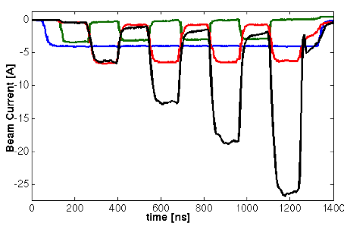
Drive Beam Combination
29 A reached, routinely 25A
CTF3 team
  Significant increase of transverse emittance
  Current jitter increases to O(0.1%-1%)
Focus has been on current
will now further improve beam quality
CTF3 specific issues need to be addressed and limits identified
RF pulse compression
Beam energy in combiner ring is
5% of that in CLIC
Geometric emittance 20 times larger
…
…
Delay loop
After delay loop
End of linac
In combiner ring

Slide 14
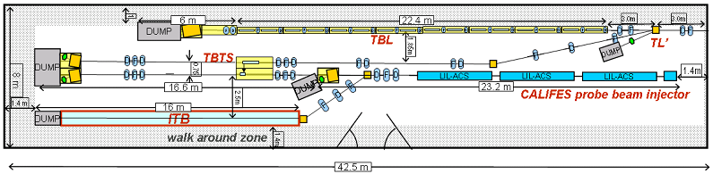
Drive Beam Deceleration and Module: CLEX
TBTS (two-beam test stand)
power transfer to main beam
module design
TBL (test beam line)
drive beam stability during deceleration

Slide 15
PETS
Designed with more margin than accelerating structures
P_{out}≈130MW
Measurements at SLAC:
No breakdown last O(8 10⁶ pulses)
-> P consistent with p≤10⁻⁷/m/pulse

Slide 16
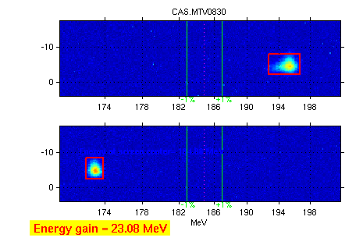
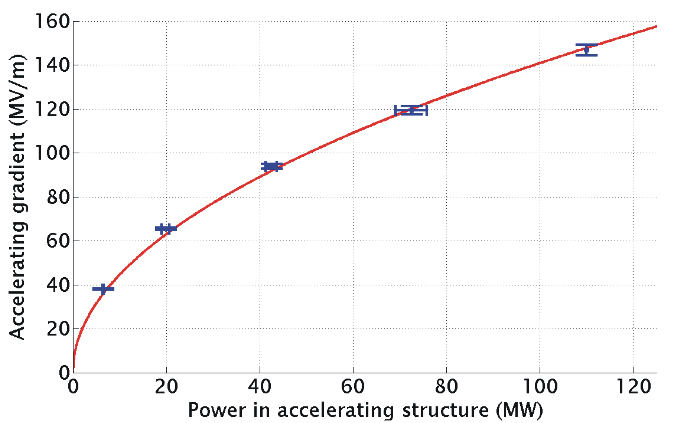
TBTS: Two Beam Acceleration
Maximum gradient 145 MV/m
Consistency between
produced power
drive beam current
test beam acceleration

Slide 17
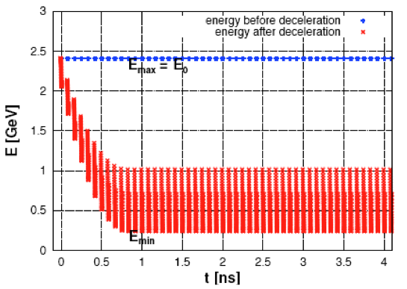
Decelerator Design
≈ 1km (1000 quadrupoles)
100A, 2.4-0.24GeV beam
aperture ≈ 10σ
large energy spread
significant wakefields
3σ-envelope along decelerator
w. imperfections
Final energy along train
Design and simulations are OK

Slide 18
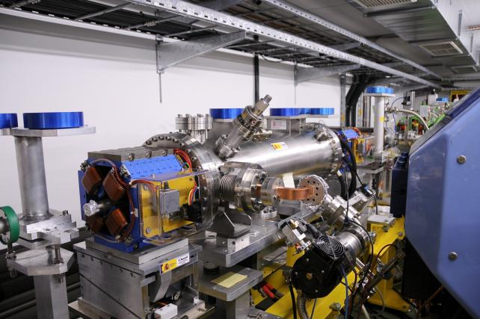
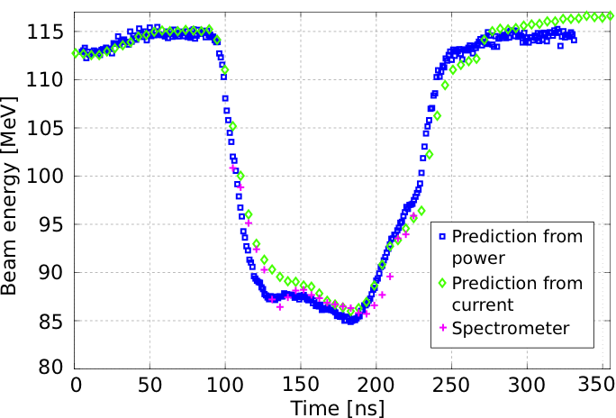
TBL: Drive Beam Deceleration
9 out of 16 PETS installed
Rest will come this year
~26% deceleration
Final goal is 50% deceleration
Up to 21A current
optics understood
no losses in TBL
Good agreement
power production
beam current
beam deceleration

Slide 19
Main Beam Emittances
Beam power
Luminosity
spectrum
Beam Quality
(+bunch length)

Slide 20
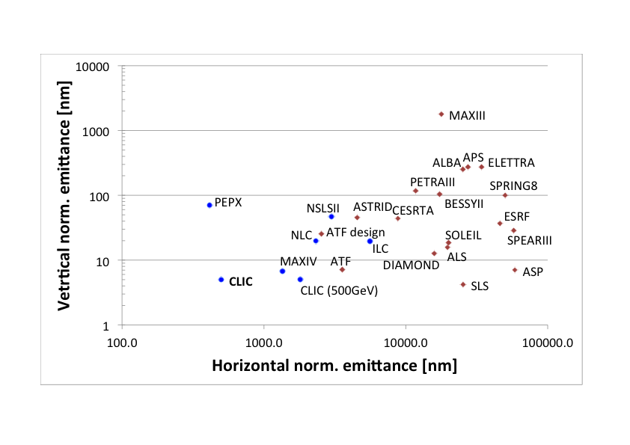
Emittance Generation
Many design issues addressed
lattice design
dynamic aperture
tolerances
intra-beam scattering
space charge
wigglers
RF system
vacuum
electron cloud
kickers
CLIC @3 TeV would achieve 1/3 of luminosity with ATF performance
(3800nm/15nm@4e9)
Damping ring design is consistent with target performance

Slide 21
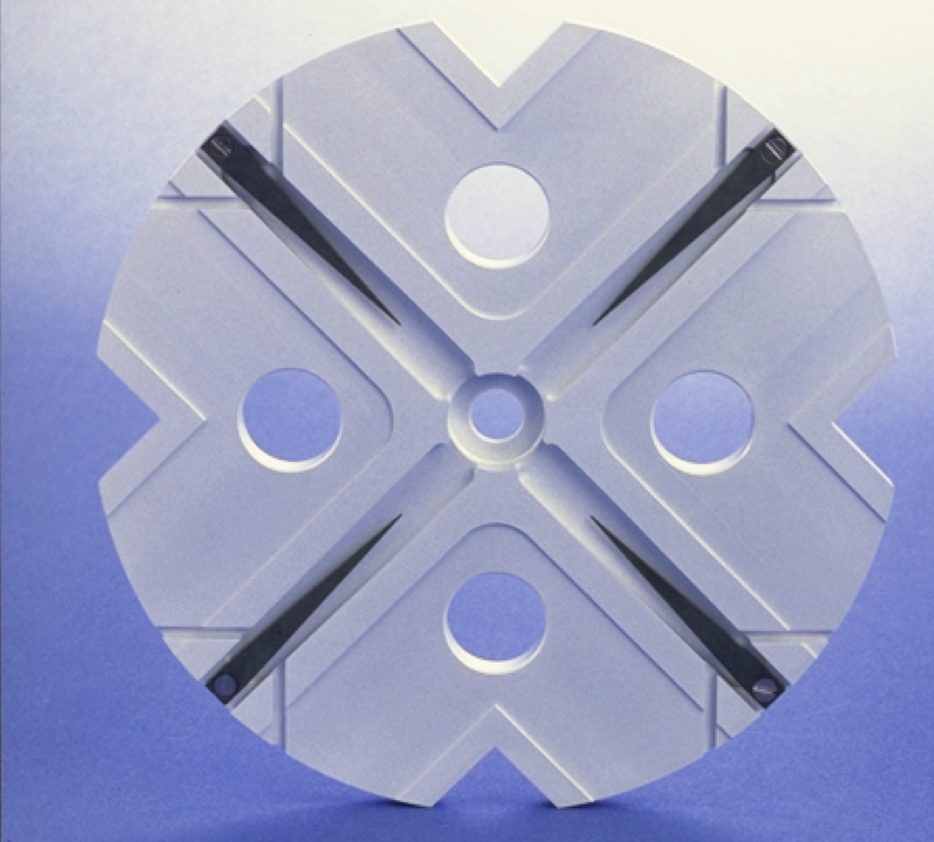
Main Linac
Wakefields limit efficiency
(beam break-up)
Damping
(long-range wakefields)
Strong lattice
-> tight tolerances
Short bunches (short-range wakefield)
Trade-off for aperture (short-range wakefields)

Slide 22
Main Linac Tolerances
Stabilise quadrupole
O(1nm) @ 1Hz
Pre-align BPMs+quads
accuracy O(10μm)
3) Use wakefield monitors accuracy O(3.5μm)
2) Beam-based alignment

Slide 23

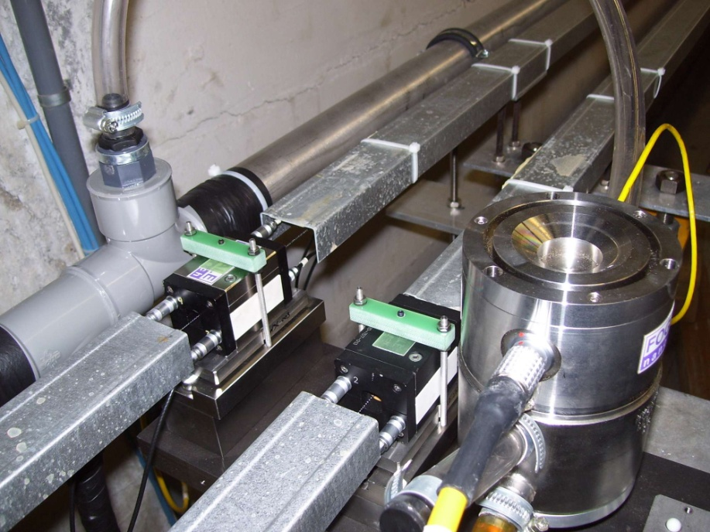
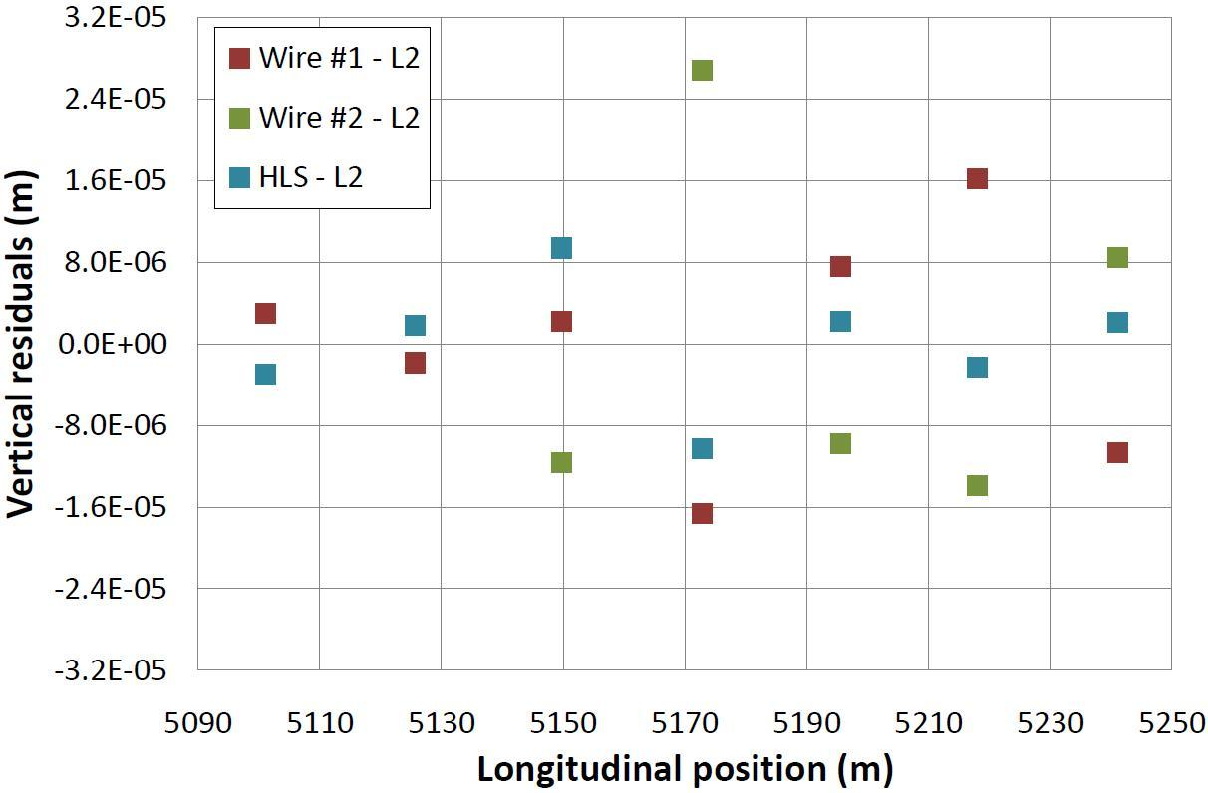
Pre-alignment System
Required accuracy of reference point is 10μm
Test of prototype shows
  vertical RMS error of 11μm
  i.e. accuracy is approx. 13.5μm
Improvement path identified

Slide 24
BDS Design and Alignment
Including 10μm RMS misalignments
Main design issues
chromaticity
non-linear effects
synchrotron radiation
tuning
stability
Full tuning performance
Static imperfections:
Goal is L ≥ 110% L₀
with probability of 90%
Convergence is slow
faster method is being developed
Need more complete imperfection modelling
independent sides
field errors
dynamic imperfections during tuning
realistic signals
Design is OK
Imperfection mitigation comes close to target
Test programme at ATF2 at KEK

Slide 25
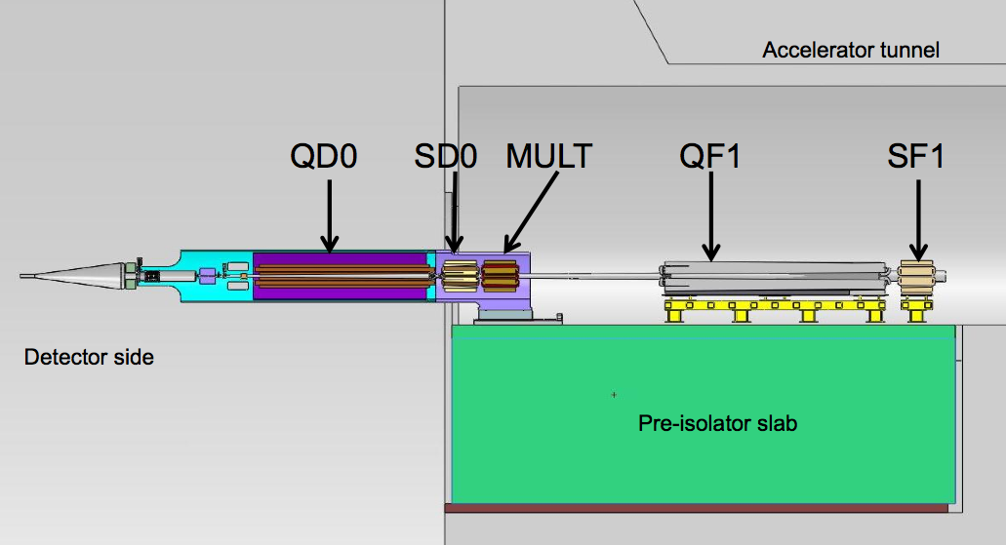
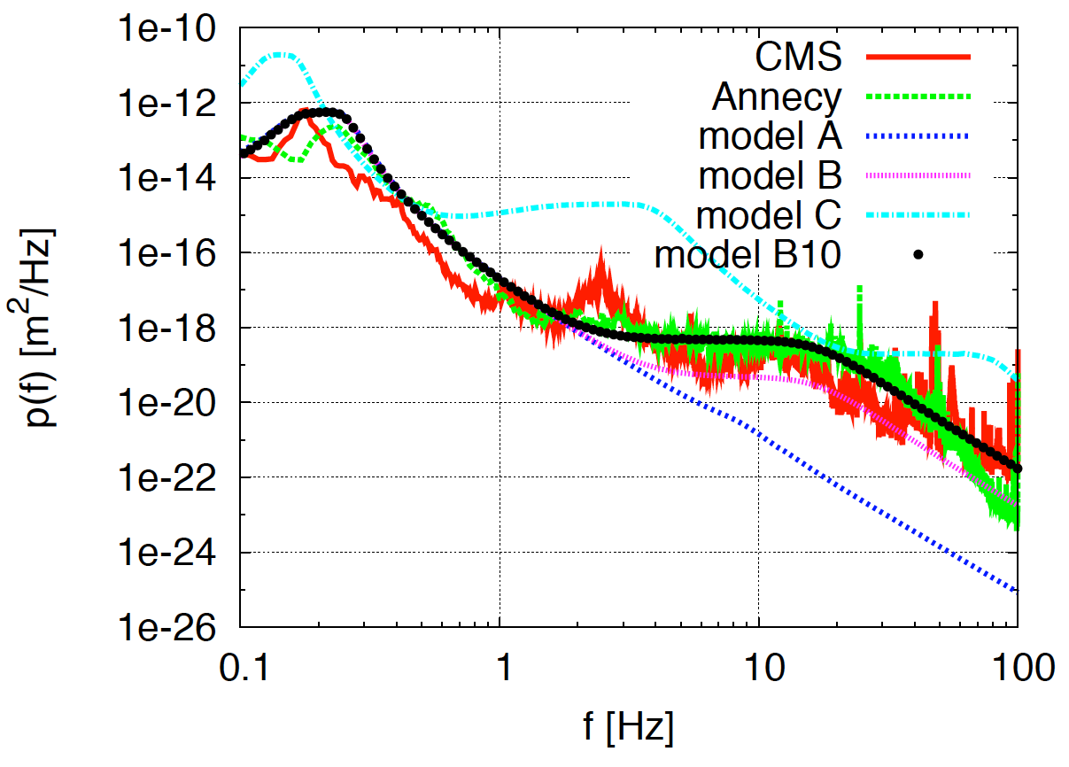
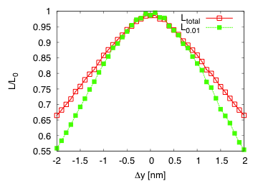
Ground Motion and Its Mitigation
Natural ground motion can impact the luminosity
typical quadrupole jitter tolerance O(1nm) in main linac and O(0.1nm) in final doublet
-> develop stabilisation for beam guiding magnets

Slide 26
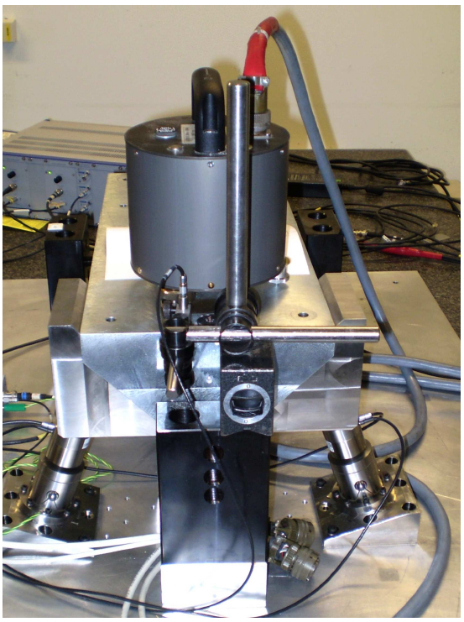
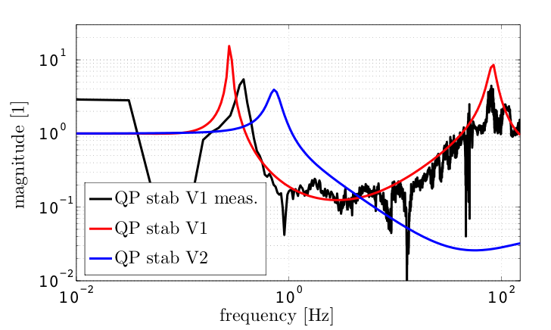
Active Stabilisation Results
Luminosity achieved/lost [%]
 | B10
No stab. | 53%/68%
Current stab. | 108%/13%
Future stab. | 118%/3%
Code
Machine model
Beam-based feedback
Close to/better than target

Slide 27
Machine Protection/Operation
Machine protection concept
inherently robust against fast failures
detect slow failures
Most important example BDS collimation
energy collimators supposed to take a pulse
betatron collimators not
Concept for start-up developed
based on CTF3/LHC experience
Concept developed to operate 3TeV-CLIC at lower energy for physics studies
based on reduced beam current/longer pulses
can cover factor 3 in energy

Slide 28
Potential Staged Parameters

Slide 29
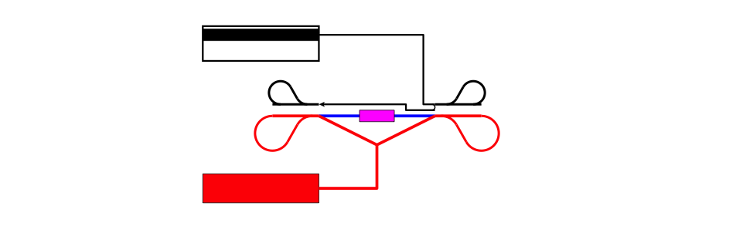
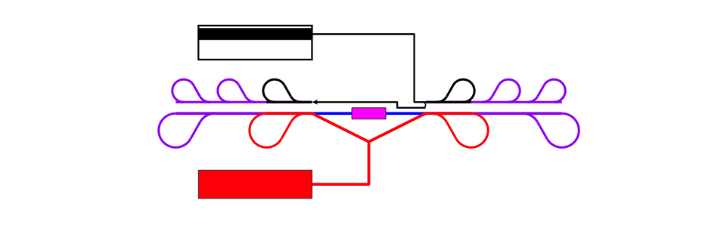
Concept First Stage
Concept! Not to scale

Slide 30
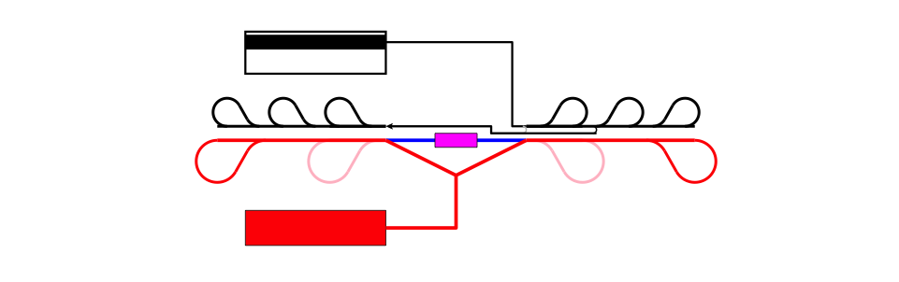
Concept Second Stage

Slide 31
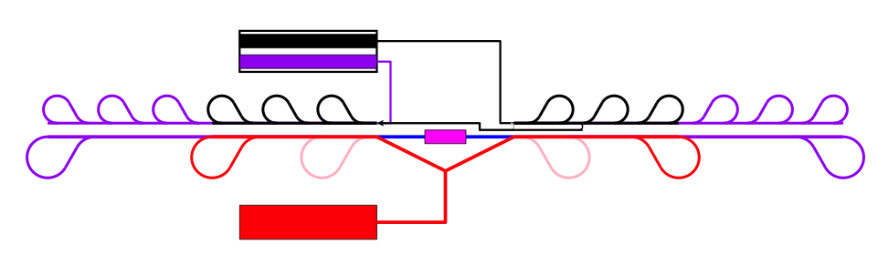
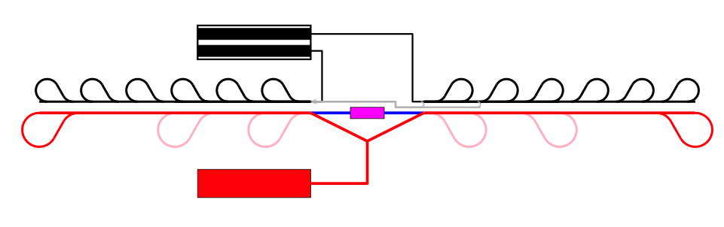
Concept Third Stage

Slide 32
Conclusion
Main linac gradient
Ongoing test: 103MV/m (TD24, unloaded)
Uncertainty from beam loading (86-103)
Drive beam scheme
Generation tested, used to accelerate test beam, deceleration as expected
Improvements on operation, reliability, losses, more deceleration (more PETS) to come
Luminosity
Damping ring like an ambitious light source, no show stopper
Alignment system principle demonstrated
Stabilisation system developed, benchmarked, better system in pipeline
Simulations seem on or close to the target
Operation
Machine Protection
Start-up sequence defined
Most critical failure studied
First reliability studies
Low energy operation developed
More to be done now

Slide 33
Thanks
Thanks to the CLIC collaboration in general
Thanks in particular to:
N. Shipman, I Syratchev, A. Grudiev, W. Wuensch, G. Riddone
M. Csatari
T. Persson, G. Sterbini, P. Skowronski, F. Tecker, R. Corsini,
S. Doebert, A. Dubrovski, W. Farabolini, R. Ruber
H. Meinaud Durand, K. Artoos, J. Snuverink, J. Pfingstner,
R. Tomas, Y. Papaphilippou, A. Latina, B. Dalena, B. Jeanneret
J.-P. Delahaye, S. Stapnes

Slide 34
Reserve

Slide 35
PETS On-Off Mechanism
On-off mechanism is essential for operation
Switch off bad structures/PETS
Successfully tested in CTF3
Power to acc. structure
0N
Forward power in PETS
0FF

Slide 36
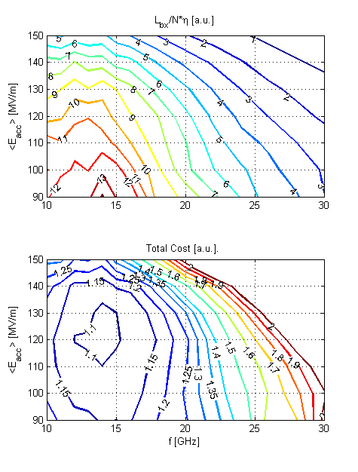
Reminder: 3TeV Parameter Optimisation
Optimisation 1
  Luminosity per linac input power
Optimisation 2
  3TeV total project cost
A.Grudiev, W. Wuensch, H. Braun, D.S.

Slide 37
Parameter and Structure Choice
Potential structures designs
Beam physics constraints
RF limitations
Parameter set
Physics requirements
Structure chosen to work for beam physics
Will tell the story as if we had a structure given
Cost model
Design choice

Slide 38
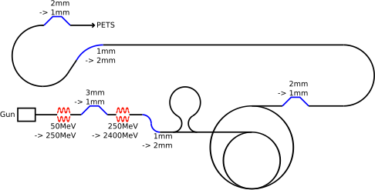
Drive Beam Requirements
Emittance ε_{x,y} ≤ 150μm
Transverse jitter ≤ 0.3σ
Current stability 0.75 •10⁻³
Phase stability 0.2° @ 12GHz
Bunch length stability 1%
RF power stability 0.2%
RF phase stability 0.05°
Phase stability 2.5° @ 12GHz
0.2° @ 1GHz

Slide 39
Main Linac Alignment and Emittance Growth
Target: 90% likely hood of less than 5nm vertical emittance growth

Slide 40
Drive Beam Efficiency
Power on grid
Power on grid
Low frequency long pulse klystrons and modulators are more efficient
89%*70%
70%*55%
1GHz RF power
Long 12GHz RF pulse
97%*92%
70%*92%
Power compression is similar
Drive beam
81%
Short 12GHz RF pulse
Short 12GHz RF pulse
RF to beam efficiency is the same
25%
25%
Beam power
Beam power
11% with other systems included 6.3%
Target 6.2%, with cooling 5.5%

Slide 41
ILC and CLIC Main Parameters

Slide 42
The CLIC Damping Rings CDR parameters
Parameters | 1GHz | 2GHz
Energy [GeV] | 2.86
Circumference [m] | 427.5
Energy loss/turn [MeV] | 4.0
RF voltage [MV] | 5.1 | 4.5
Stationary phase [°] | 51 | 62
Natural chromaticity x / y | -115/-85
Momentum compaction factor | 1.3e-4
Damping time x / s [ms] | 2.0/1.0
Number of dipoles/wigglers | 100/52
Cell /dipole length [m] | 2.51 / 0.58
Dipole/Wiggler field [T] | 1.0/2.5
Bend gradient [1/m2] | -1.1
Phase advance x / z | 0.408/0.05
Bunch population, [e9] | 4.1
IBS growth factor x/z/s | 1.5/1.4/1.2
Hor./ Ver Norm. Emittance [nm.rad] | 456/4.8 | 472/4.8
Bunch length [mm] | 1.8 | 1.6
Longitudinal emittance [keVm] | 6.0 | 5.3
Space charge tune shift | -0.10 | -0.11
The latest DR lattice parameters (CDR version)
  2 RF options at 1 and 2 GHz with the 1 GHz option as the baseline
Main problems of the previous lattice
  Large space charge tune shift (~-0.2) ➔ warning by ACE
    Larger longitudinal emittance needed
  Large RF stable phase (70º) → warning by Alexej
    Larger RF voltage needed (goes to the opposite direction for longitudinal emittance)
  Stay always within the requirements for the transverse emittances

Slide 43
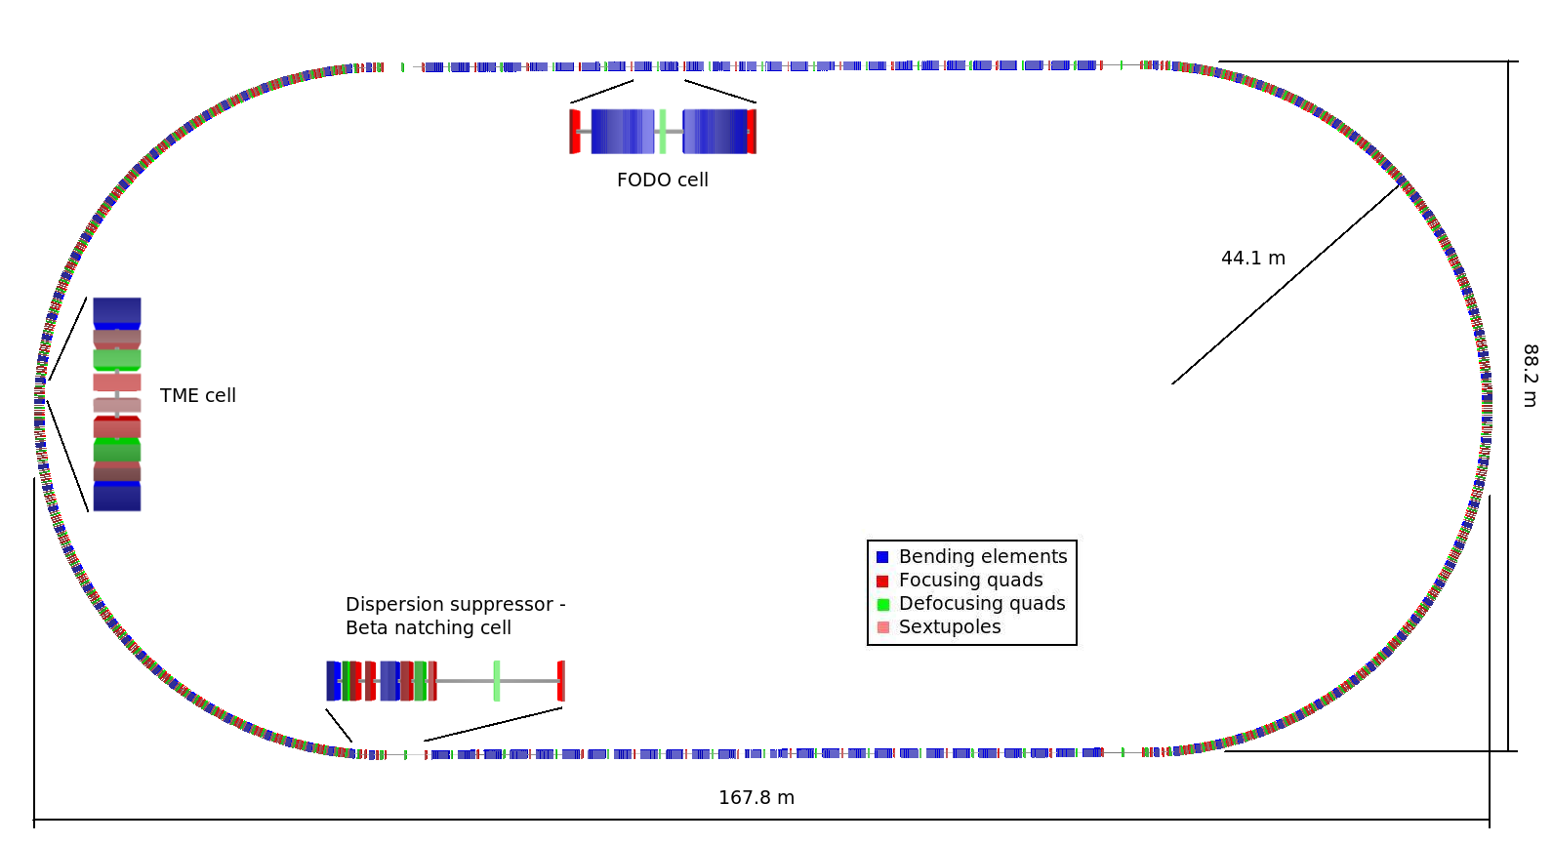
DR layout
Racetrack shape with
  96 TME arc cells (4 half cells for dispersion suppression)
  26 Damping wiggler FODO cells in the long straight sections (LSS)

Slide 44
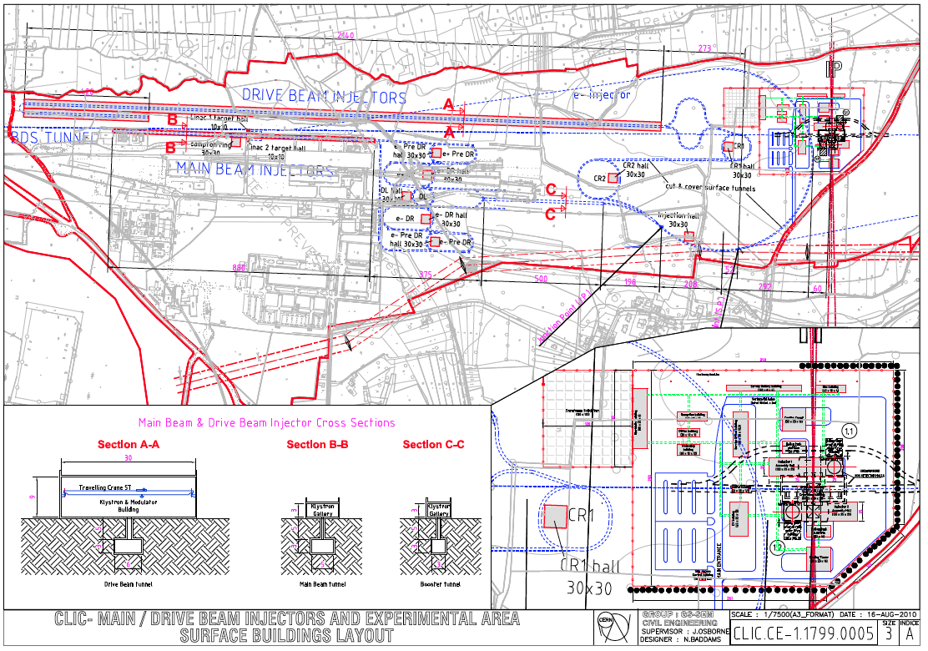
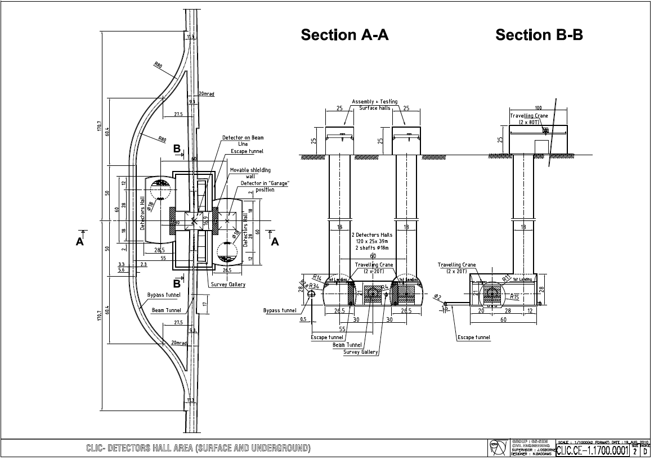
Real Layout
Tunnel implementation
Central Injector complex
Central MDI & Interaction Region

Slide 45
Beam-Beam Effect
Bunches are squeezed strongly to maximise luminosity
Electron magnetic fields are very strong
Beam particles travel on curved trajectories
They emit photons (O(1)) (beamstrahlung)
They collide with less than nominal energy

Slide 46
Active Stabilisation Results
Beam-based feedback
model
Luminosity achieved/lost [%]
Simulation code
 | A | B10
No stab. | 119%/2% | 53%/68%
Current stab. | 116%/5% | 108%/13%
Future stab. |  | 118%/3%

Slide 47
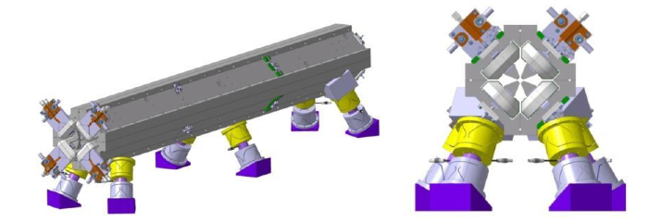
Ground Motion and Its Mitigation
A. Gaddi et al.
Natural ground motion can impact the luminosity
typical quadrupole jitter tolerance O(1nm) in main linac and O(0.1nm) in final doublet
-> develop stabilisation for beam guiding magnets
K. Artoos et al.

Slide 48
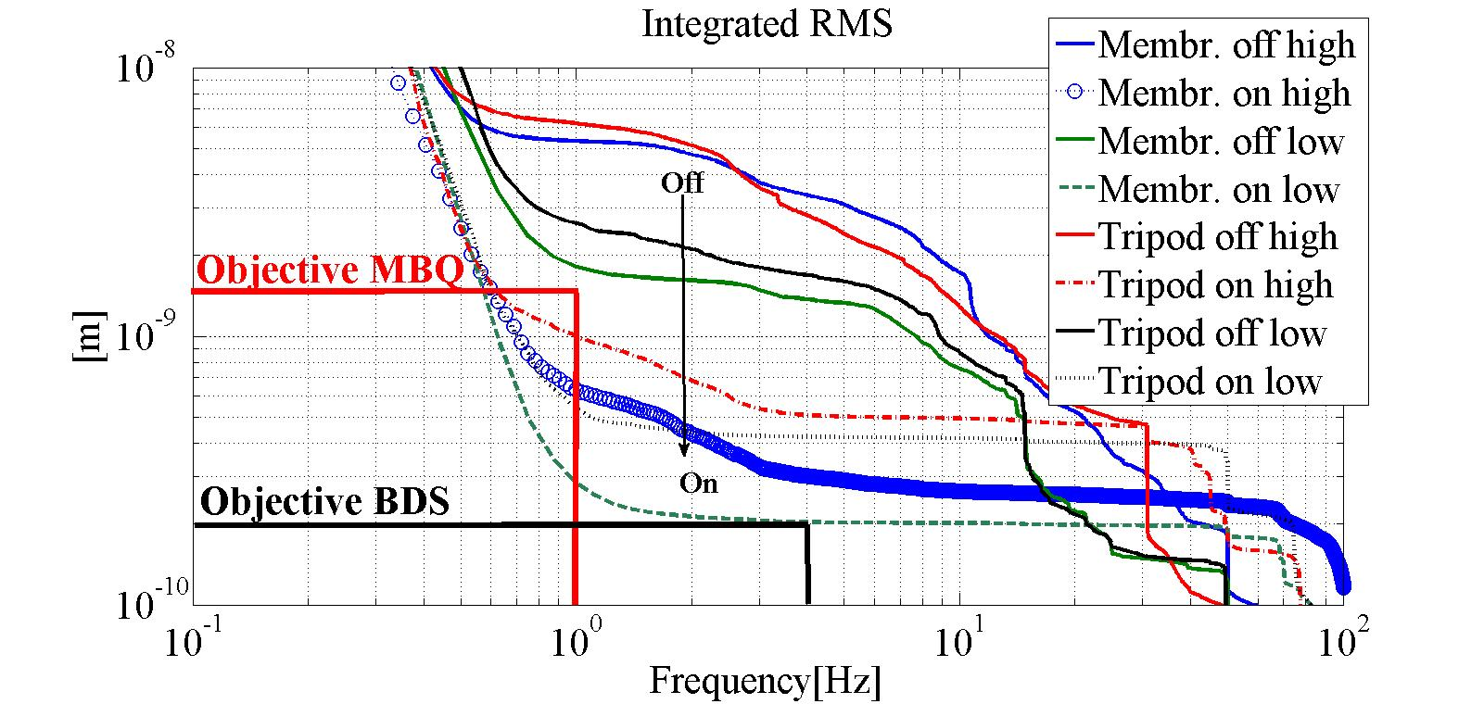
Active Stabilisation Results
K. Artoos et al.
Luminosity achieved/lost [%]
 | A | B10
No stab. | 119%/2% | 53%/68%
Current stab. | 116%/5% | 108%/13%
Future stab. |  | 118%/3%
J. Snuverink, J. Pfingstner

Slide 49
Main Linac Alignment Concept
Pre-alignment O(10um)
with wire system
detailed model in simulations
BPM shown as example
H. Mainaud Durand et al.
Dispersion free steering
aligns BPMs and quadrupoles
Move girders onto the beam
use wakemonitors
removes wakefield effects
BPM alignment errors
Reference | 10µm
Sensor | 5µm
Sensor-cradle | 5µm
Cradle-BPM | 5µm
BPM internal | 5µm
TOTAL | 14µm

Slide 50
TT1 Alignment Results
Wire #1
Wire #2
Wire #3
Hydrostatic network
Legend
WPS
Invar metrological plate
Tiltmeter
HLS
RMS error of 11μm found
  accuracy is approx. 13.5μm
  Target is 10μm
More work remains to be done
  Found two bad points due to mechanical problem
  Stake-out error needs to be determined
Th. Touze et al.

Slide 51
Main Linac
Wakefields limit efficiency
(beam break-up)
1) Pre-align BPMs+quads
3) Use wakefield monitors
2) Beam-based alignment

Slide 52
Active Stabilisation Results
Luminosity achieved/lost [%]
Code
 | B10
No stab. | 53%/68%
Current stab. | 108%/13%
Future stab. | 118%/3%
Machine/feedback model

