Slide 1
CTC Activity Report
General News
Highlights from several working teams

Slide 2
General News
Coordination activity of CTC was much reduced in past 6 months, basically the individual teams were left alone doing their work
Now Ramp-up of the CTC activity to old level over the next 2 months
New membership: Per default each CTC workpackage holder
+ D.Schulte (beam dynamics)
+ R.Corsini (exp. Verification)
Serge Pittet «retires» from CLIC → Linac4 David Nisbet takes lead in Powering workpackage
Edda Gschwendtner «retires» from CLIC → SPS coordination;
workpackage on dump lines and beams disposal split into:
- dump lines design with MDI (Lau Gatignon)
- collimation, masks and beam dumps continues as activity under the guidance of V. Vlachoudis (EN-STI), onset of new collaboration with SOSNY institute (Belarus, Minsk)
Germana Riddone «retires» as CTC scientific secretary; so far no new volunteer....
FC next week for adjudication of placement of contract between CERN-KIT(ANKA, Karlsruhe)-Budker (Novosibirsk) for procurement of DR wiggler magnet plus cryostat and tests at ANKA.

Slide 3
CTC work-packages summary
DR SC Wiggler | P. Ferracin
Survey & Alignment | H. Mainaud
Quad Stability | K. Artoos
Two-Beam module development | G. Riddone
Warm Magnet Prototypes | M. Modena
Beam Instrumentation | T. Lefevre
Collimation, Masks and Beam Dumps | V. Vlachoudis
Controls | M. Draper
RF Systems (1 GHz klystrons & DB cavities, DR RF) | E. Jensen (interim)
Powering (Modulators, magnet converters) | D. Nisbet
Vacuum Systems | C. Garion
Magnetic stray Fields Measurements | S. Russenschuck
DR Exctraction System | M. Barnes
Creation of a “CLIC technology center@CERN" | F. Bertinelli

Slide 4
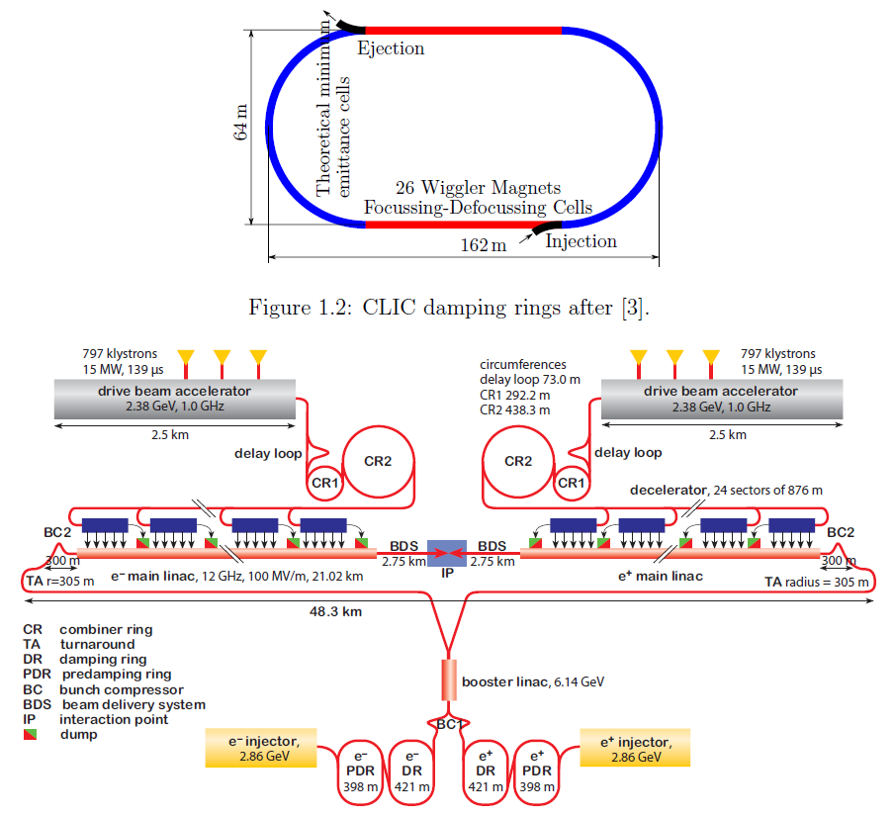
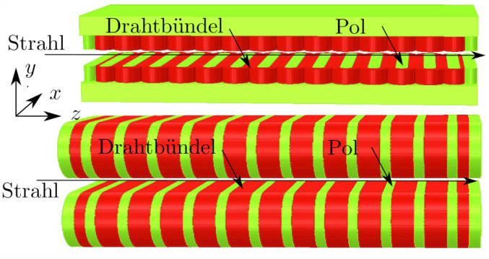
CLIC requirements for the Damping Rings
Norm. hor. emittance: 500 nm
  Horizontal beam size IP: 40 nm
26 wigglers, 2 m long, per DR straight section
DR wiggler
  50-56 mm period
  2.5-3.0 T field
  ~13 mm beam stay clear
  16-18 mm magnetic gap
Two designs and superconducting technologies considered
  Vertical and horizontal racetrack
  NbTi and Nb₃Sn

Slide 5
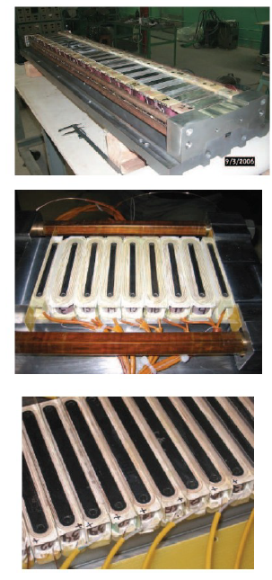
NbTi wiggler development (KIT-Budker)
Horizontal NbTi racetrack wiggler, with parameters representative of CLIC wiggler to be fabricated at Budker and tested at ANKA
  Period: 56 mm
  Magnet length: 1900-2000 mm
  Magnetic Field: > 3 T
  Vacuum gap cold: 13 mm
  Magnetic gap cold: 18 mm
  New cooling technique
Status
  Contract signed by KIT (with Budker) in early December 2011
  Review of Design Report in April
    10% additional payment (65% from CERN)
  Delivery to ANKA expected in 2014
CERN contribution
  Review, follow fabrication and test, support KIT (responsible for the project)

Slide 6
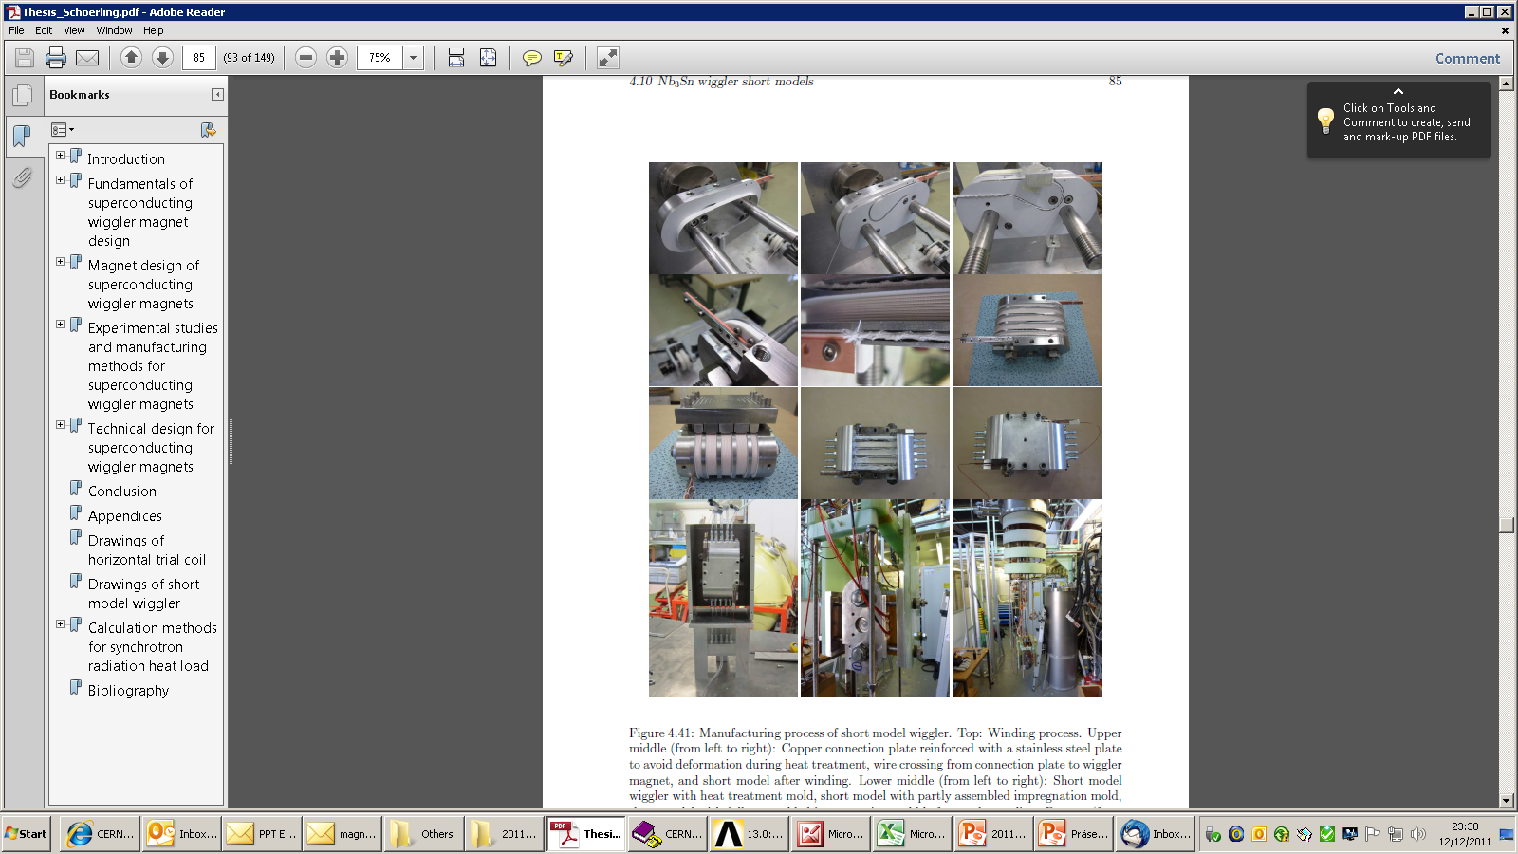
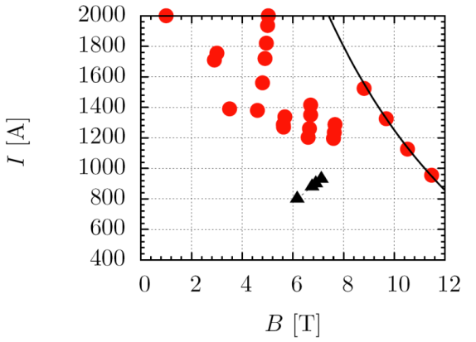
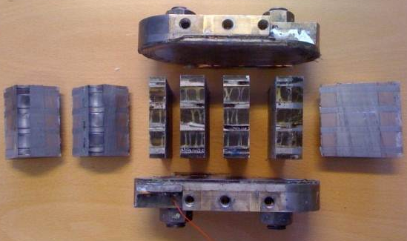
Nb₃Sn wiggler development (CERN)
First vertical racetrack (VR) magnet (3-period) tested in 2011
  Reached 70% of maximum current
  Magnet performance limited by short coil-to-structure
Post mortem investigation
  Electrical checks and visual inspection of cross-sections (see next slides)
Plan
  2012: rebuild and test VR with improved insulation
    Check quench level and temperature margin, and compare with NbTi technology
  2013: build and test horizontal racetrack 3-period model
  2014: 6-period model and decision on long prototype (including building a second cryostat equivalent to first cryostat)

Slide 7
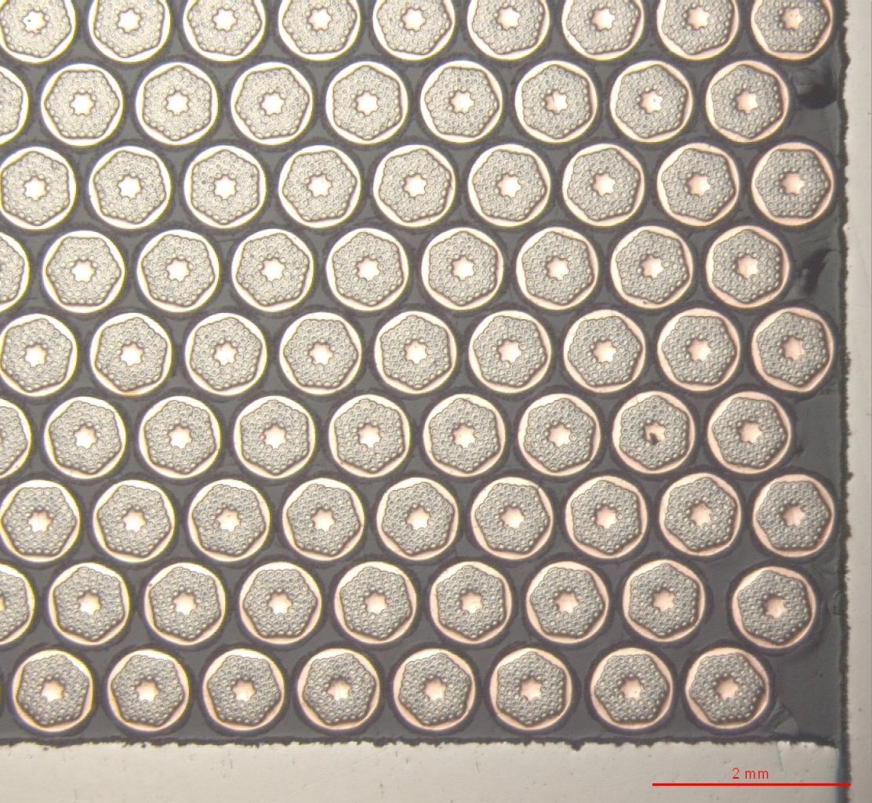
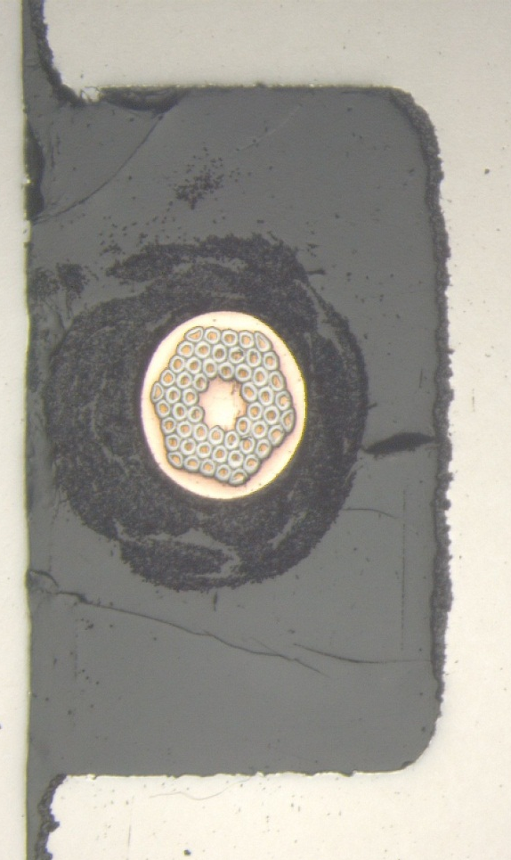
Nb₃Sn wiggler development
VR1 sections
Straight-section block:
good positioning but very thin wire-pole insulation
Transition wire

Slide 8
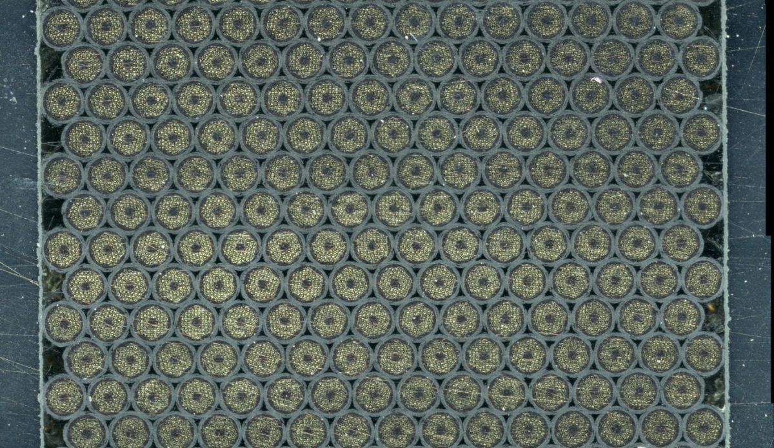
Nb₃Sn wiggler development
VR1 sections
Straight-section block:
good positioning but very thin wire-pole insulation

Slide 9
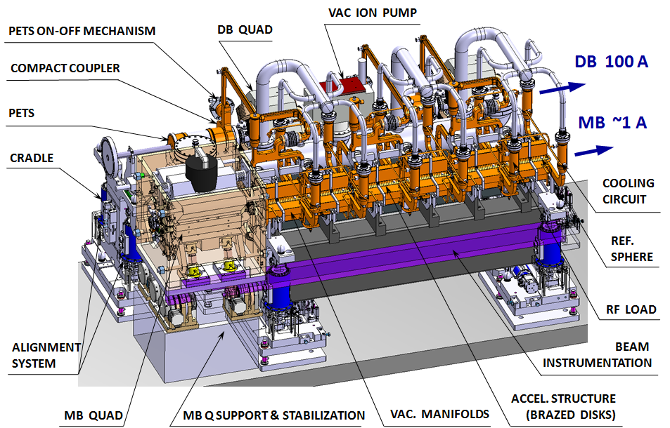
CLIC – Two-beam module
Baseline configuration frozen for Conceptual Design Report (CDR)
Alternatives studies are planned:
Longer girders
Common DB-MB girders
G. Riddone, BE-RF-PM

Slide 10
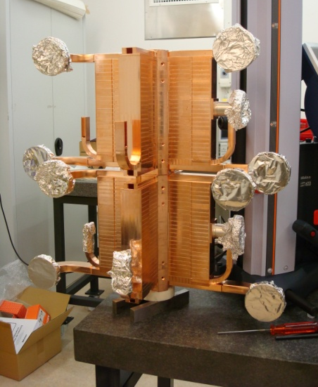
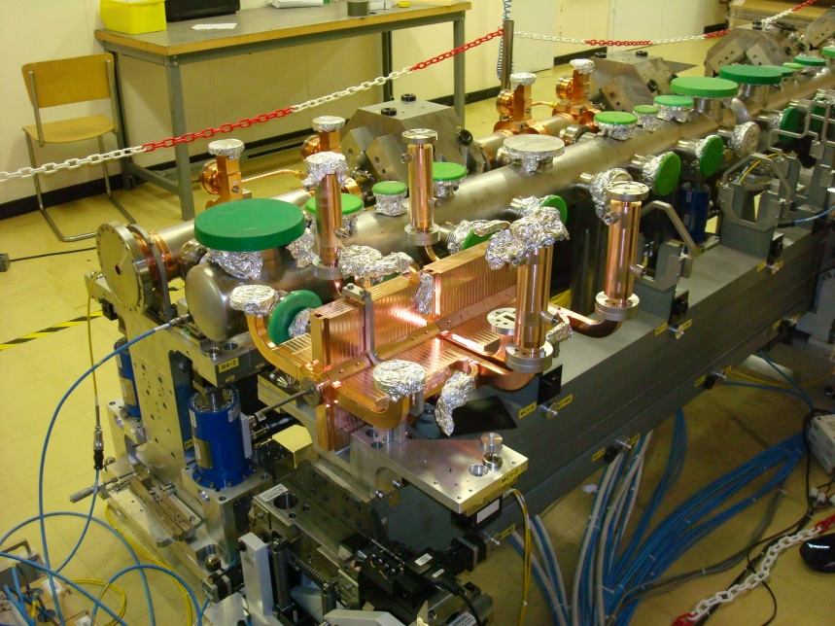
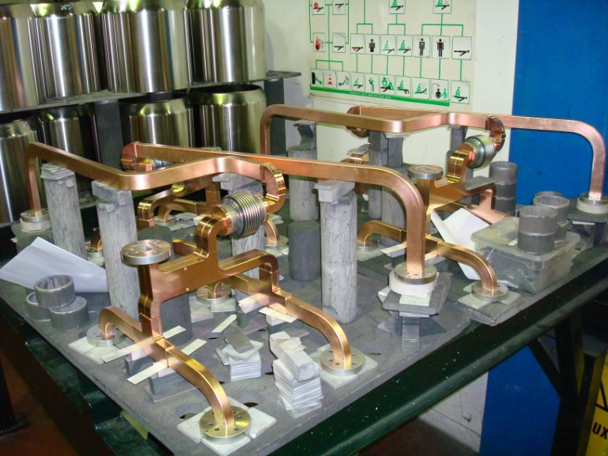
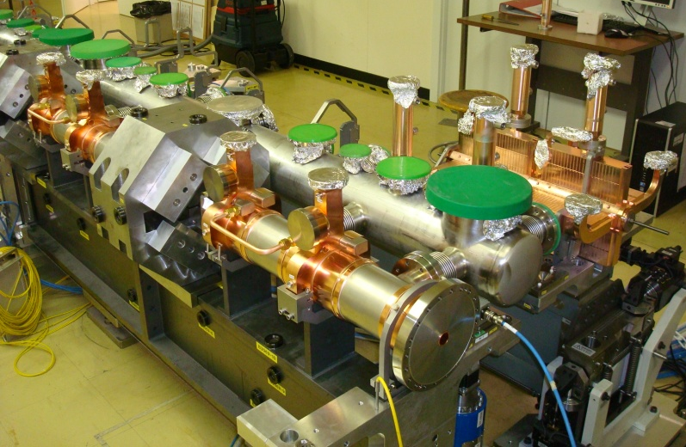
CLIC – Prototype two-beam modules
4 accelerating structures
as one stack: 2-m long
1st and 2nd nearly finished
brazing of 3rd and 4th
unit under way
2 PETS units completed
RF and vacuum
networks
completed
1st module
by end of
April 2012
(B169)
G. Riddone, BE-RF-PM

Slide 11
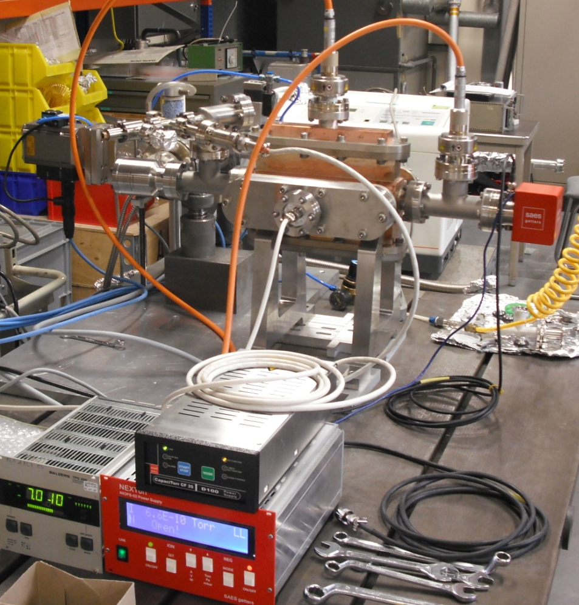
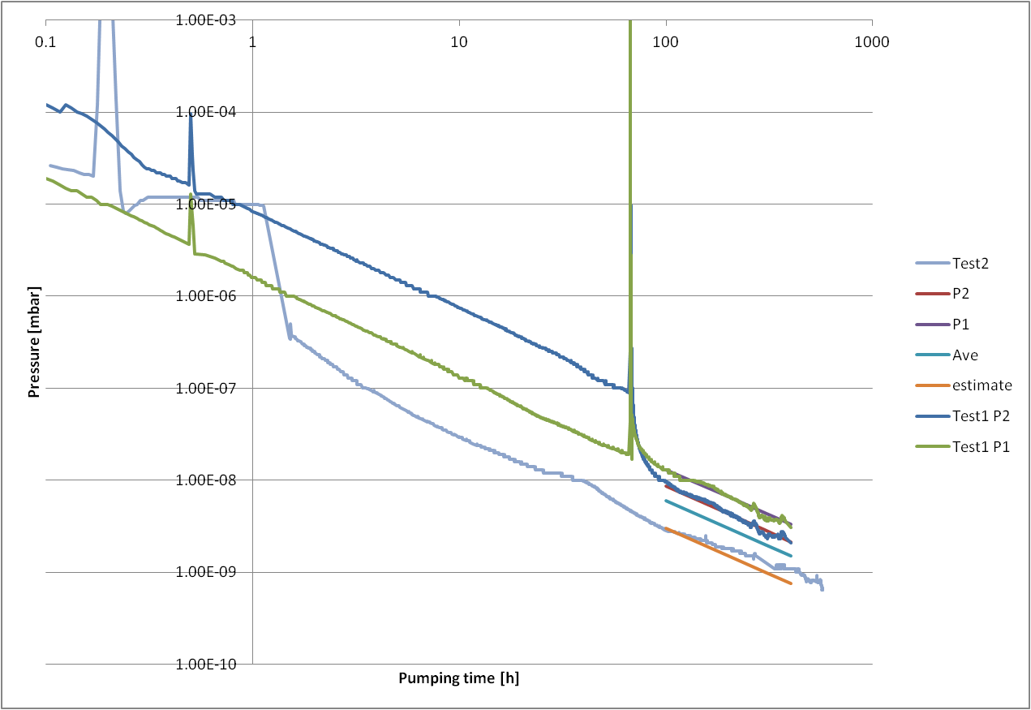
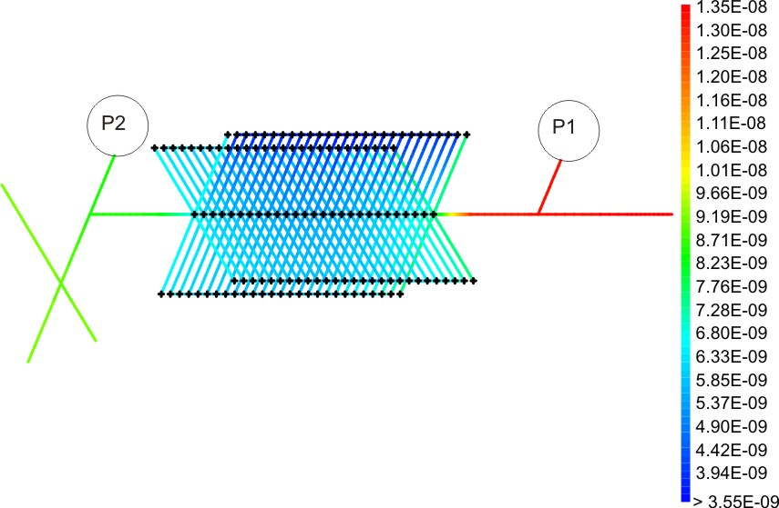
Vacuum tests on a dummy accelerating structure
Pump down curves
Test configuration
Measurements and simulations of different configurations:
central tank with transversal connections to the AS (CDR),
NEG cartridge (Capacitorr),
NEG cartridge + ion pump (Nextorr),
combination of Capacitorr and Nextorr
Pressure profile estimation

Slide 12





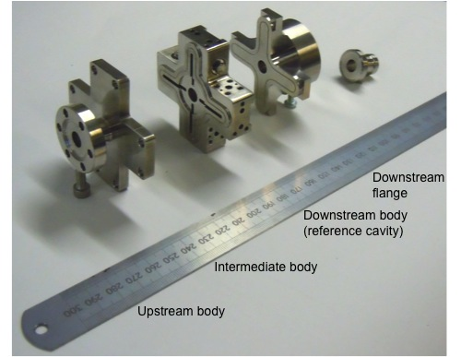
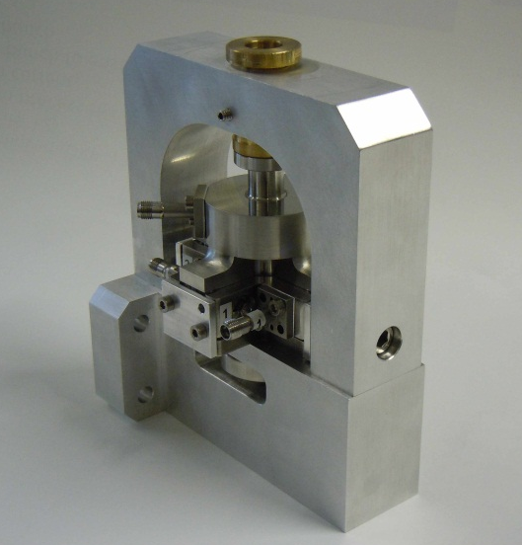
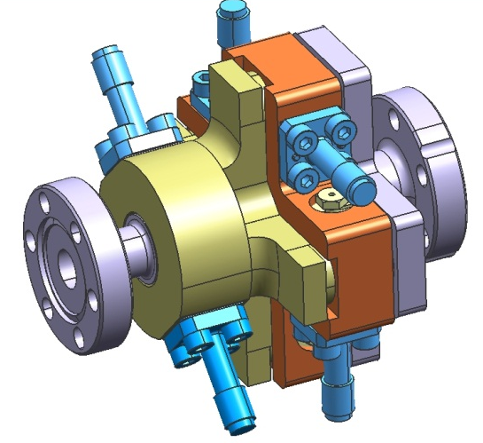
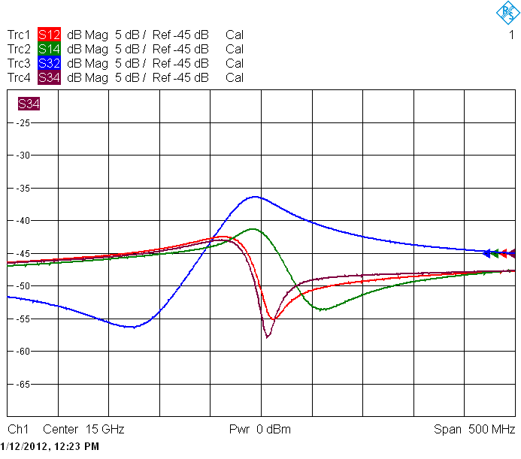
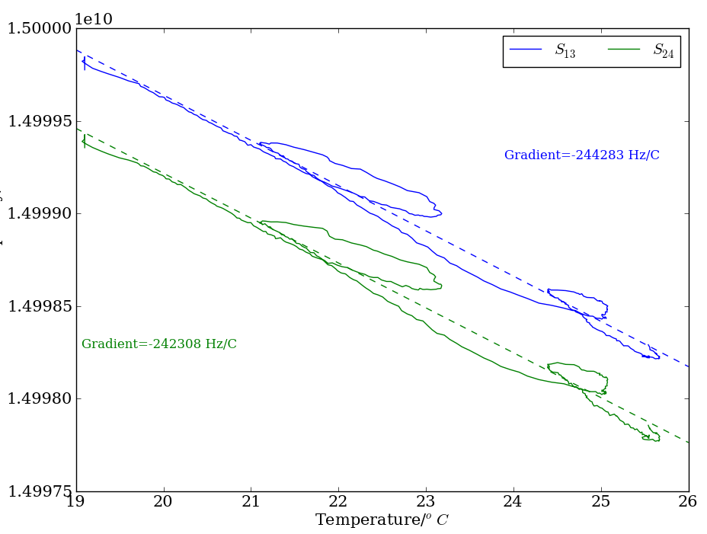

Cold test of the cavity BPM prototype
Dipole-mode
“BPM” resonator
& waveguide
Stainless steel prototype cavity BPM for CTF3
Cold test carried out before brazing
Dipole mode frequency within 5 MHz of the design value of 15 GHz
Q-values and coupling close to expected (~250)
Monopole-mode
“REF” resonator
Frequency vs. temperature variation: 250 kHz/K
Low cross-coupling out of the box: -41 dB average

Slide 13
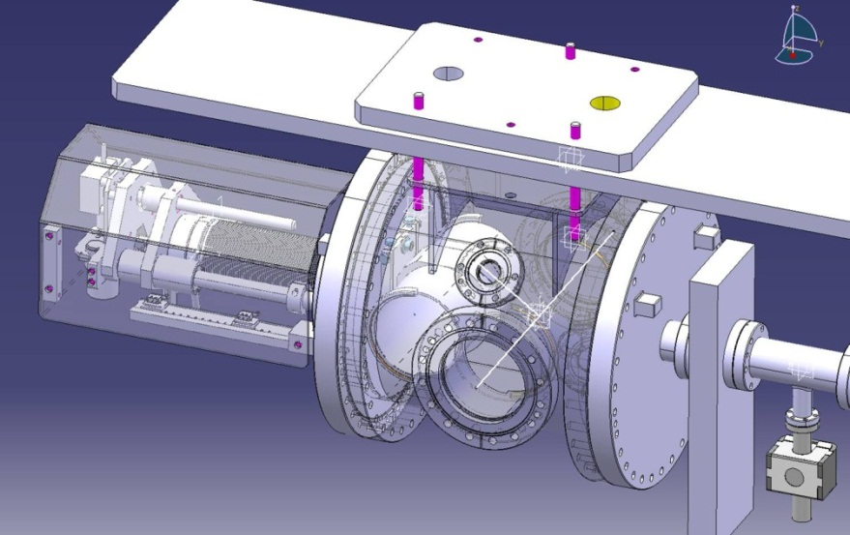
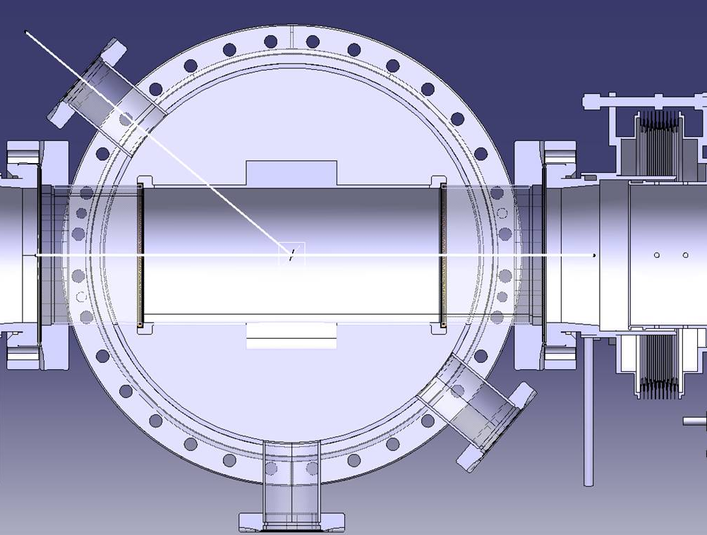
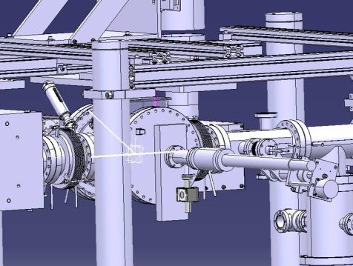
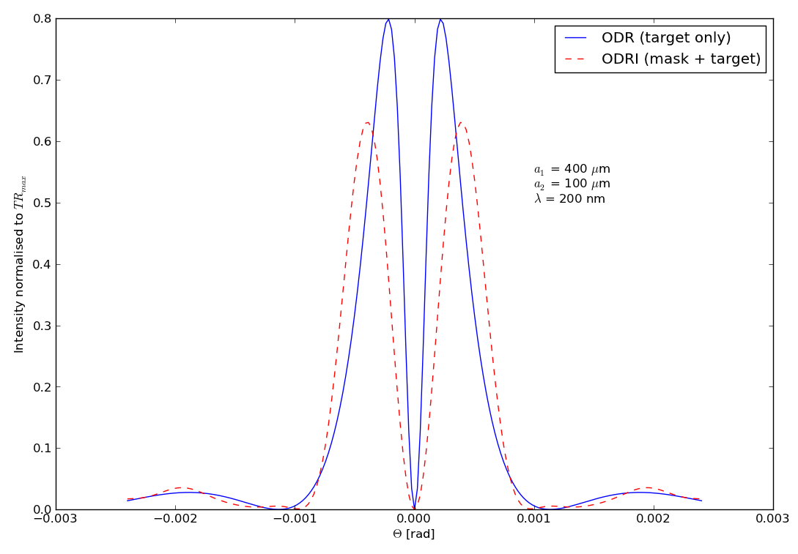
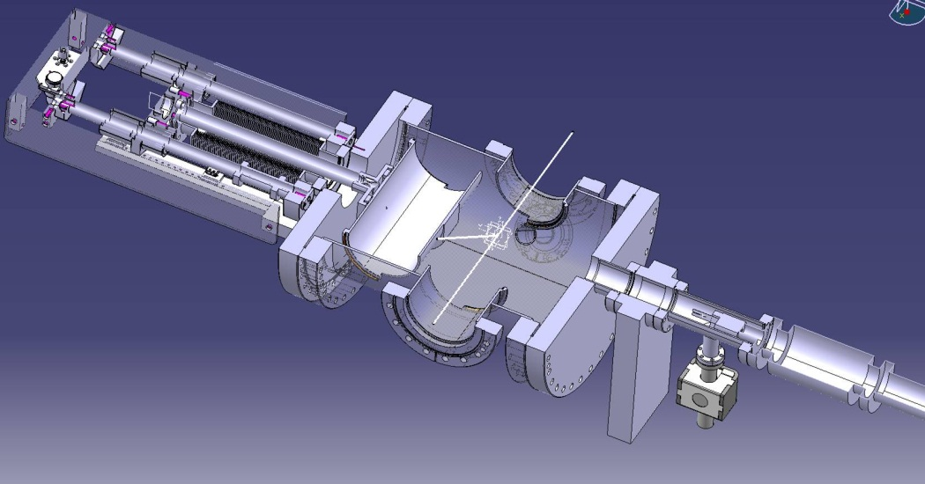
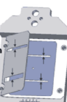


Design of ODR chamber in CESRTA L3 straight section
Observing Optical Diffraction Radiation angular distribution to measure Beam size
ODR
Photons
Electron beam
direction
Integration of Chamber
in the L3 straight section
@ CESR-TA
Simulation of the optical distribution
Mask to stop SR photons
Slit to generate ODR photons
Replacement chamber
Slit-mask assembly

Slide 14



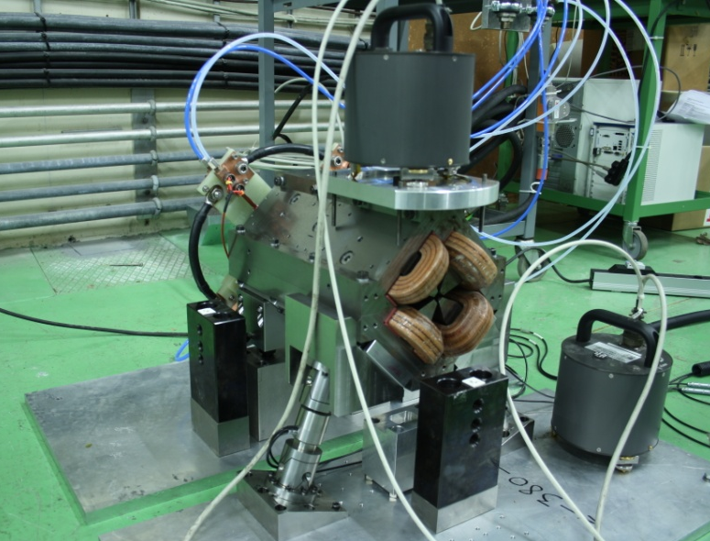
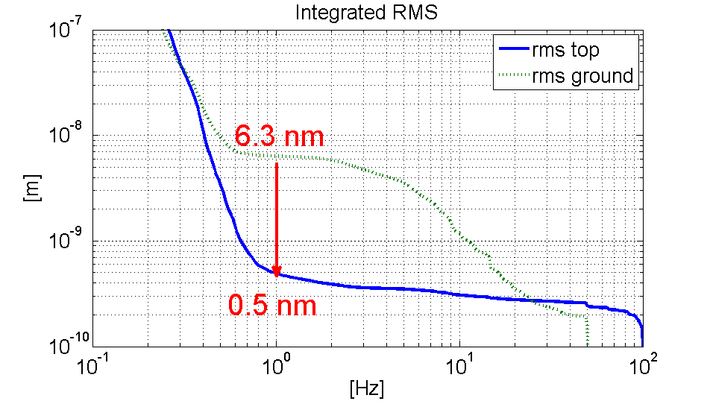
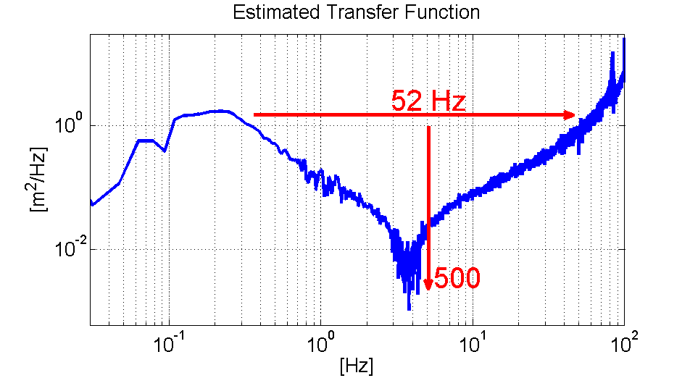
Stabilization on Type 1 magnet
    Water cooling 4 l/min
    With magnetic field on
    With hybrid circuit
Figure | Value
R.m.s @ 1Hz magnet | 0.5 nm (during the day)
R.m.s @ 1Hz ground | 6.3 nm
R.m.s. attenuation ratio | ~13
R.m.s @ 1Hz objective | 1.5 nm
Notes:
This set-up still has two « hard » contact points at the back (herzian contacts) that block the roll, without them the lateral stiffness is small. There is a resonant frequency smaller than 50 Hz. The hard contacts are to be replaced by the x-y guide (next slide)

Slide 15


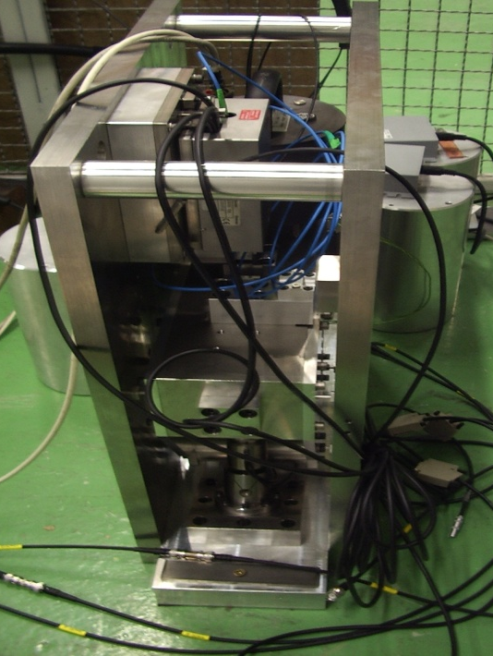
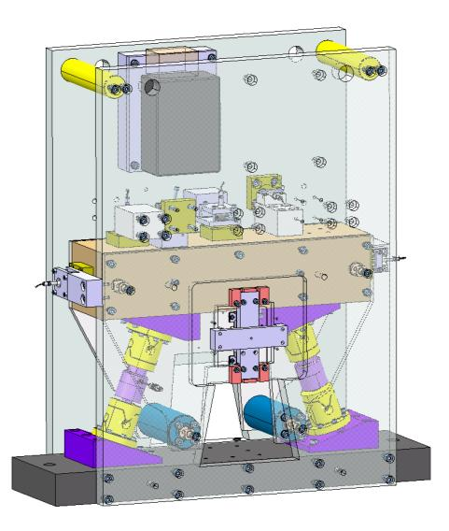
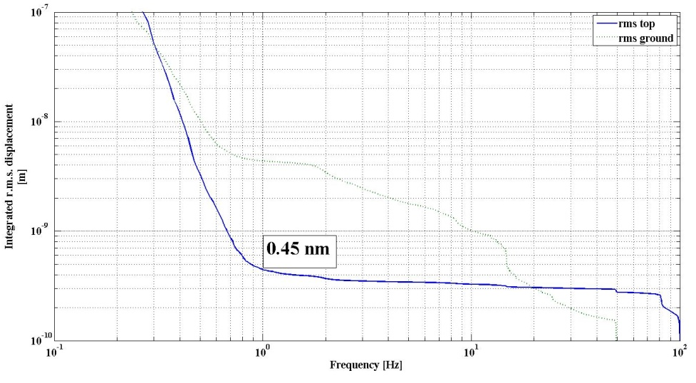
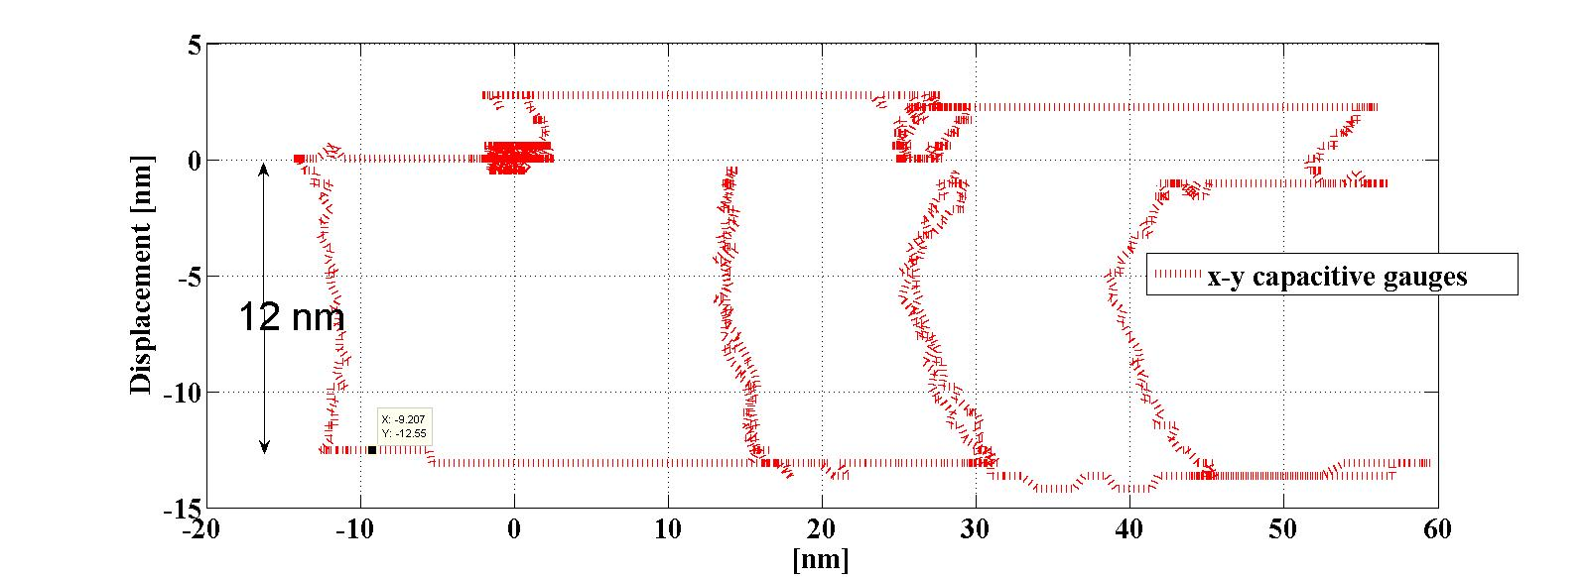
Positioning + Stab. test bench
X-y guide prototype operational
X-y guide « blocks » roll + longitudinal
Increases lateral stiffness by factor 500, increases band width without resonances to ~100 Hz
Introduces a stiff support for nano metrology
cross check with interferometer
1&2
Notes:
Prototype of the x-y guide that improves the mechanics. Block of 52 kg on two actuators. With capacitive gauges, strain gauges, interferometer (CEA/IRFU collaboration) and optical ruler.
Measurements and kinematics greatly improved. Stabilisation same as on type 1 (but without hard points ). This intermediate step confirms our solution for final design for MBQ type 1 and type 4.

Slide 16

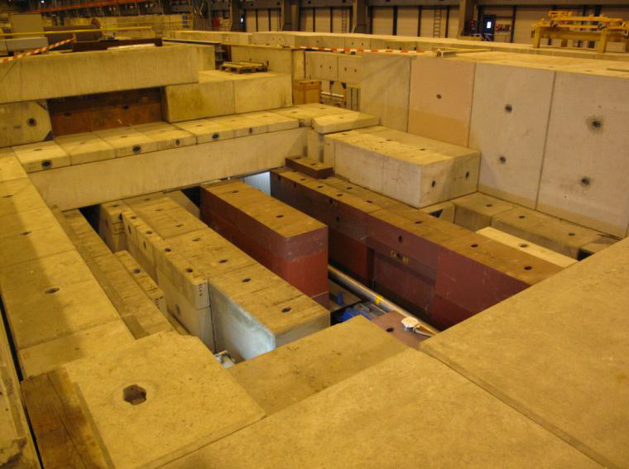
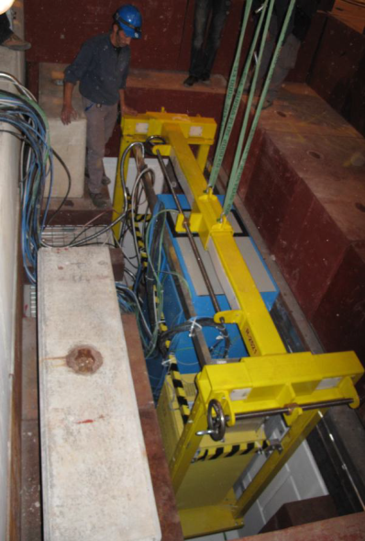
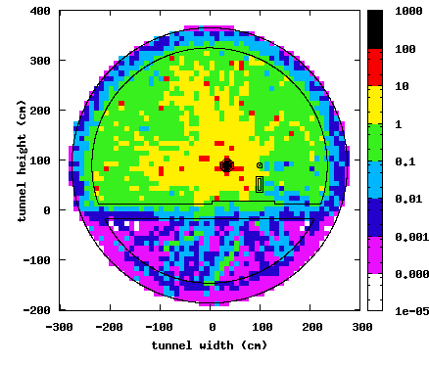
Stabilisation
Radiation tests 2012
Contact with RAD WG
SEU tests in the H4IRAD test stand at CERN planned for August
Several components under evaluation. Larger community working on same problems
Sensitivity simulation of controller to changes in the components
remark from RAD WG: Essential for CLIC: obtain more complete and sure expected radiation values.
Available shielding for electronics in the CLIC tunnel ????
H4IRAD test stand
Pablo Fernandez Carmona
Courtesy S. Mallows

Slide 17
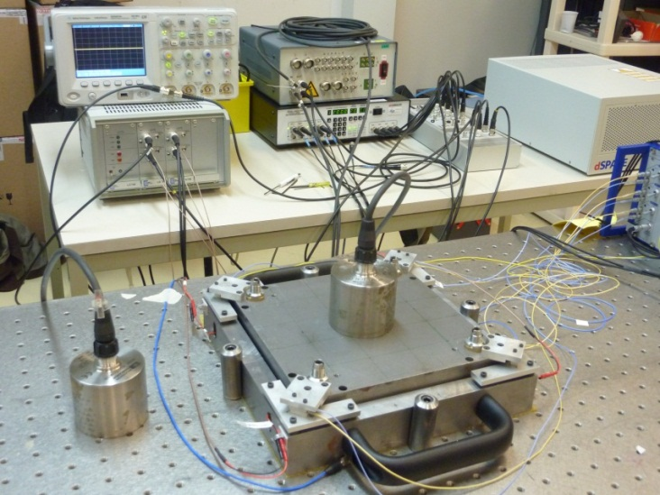
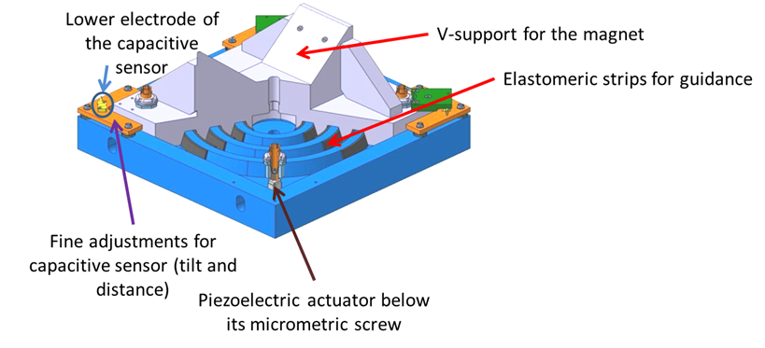
What has been done in Annecy on FF stabilization
Characterize the stabilisation system
Develop a model for the components
Develop control loops
First test on set-up with stabilisation effective between 3-100Hz
Optimization ongoing

Slide 18
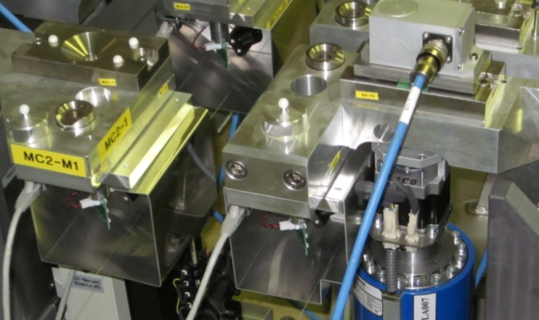
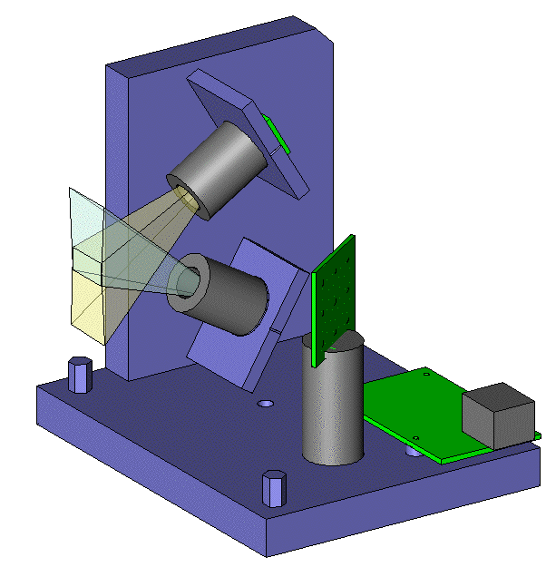
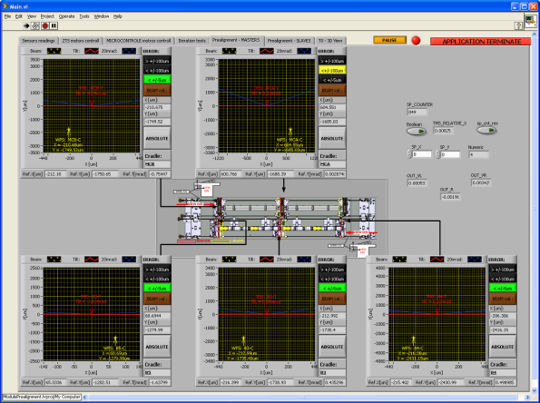
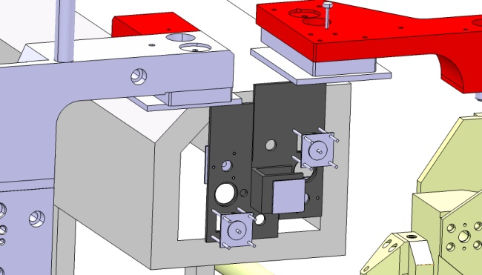
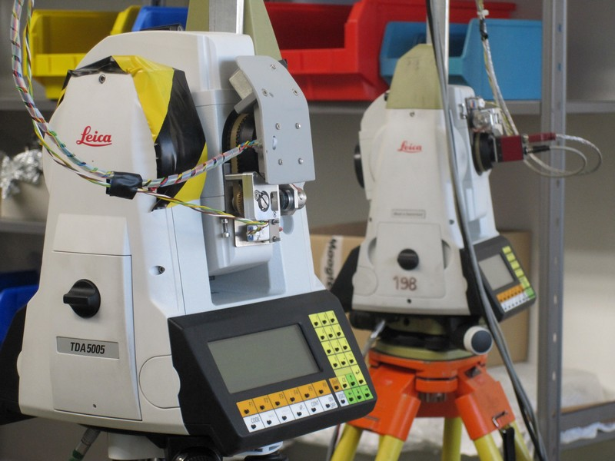
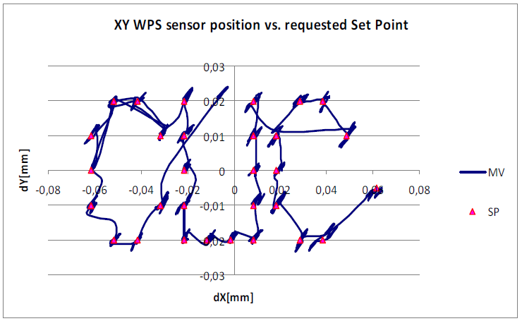
CLIC pre-alignment studies
On the two beam modules prototypes…
cWPS sensors and actuators validated (see next slide)
Articulation concept validated for both solutions of supporting (see next slide)
13 oWPS installed, to be validated.
Alignment systems developed by NIKHEF (optical based Raschain) integrated (installation foreseen in June 2012)
Validation of the fiducialisation strategy under progress
Software in order to acquire sensors and pilot actuators developed under labview ok.
Control algorithms ready
Micro triangulation developed and validated.
Installation of 13 oWPS
Control software
Integration of NIKHEF alignment systems
Regulation
Development of micro triangulation

Slide 19
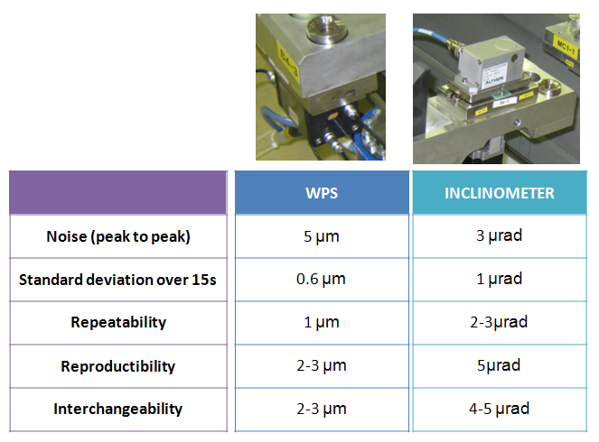
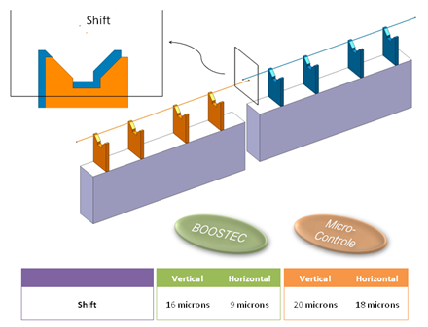
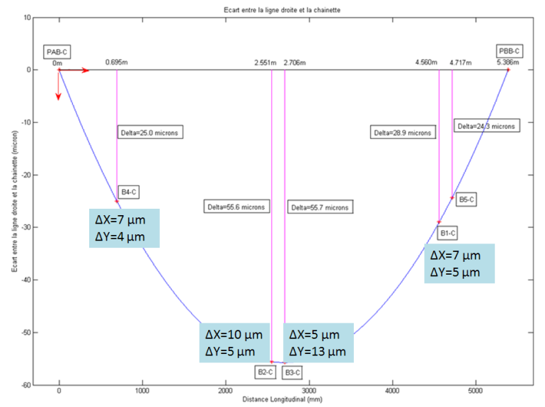
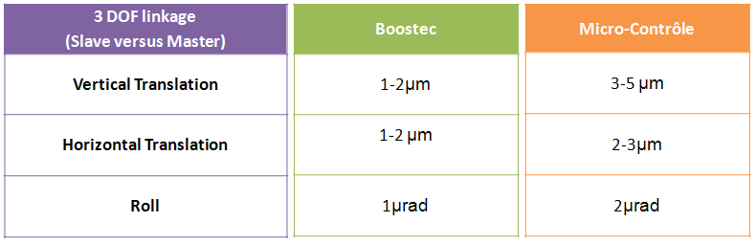
CLIC pre-alignment studies
Latest results on the two beam modules prototypes…
Alignment of the articulation point
Performances of the sensors
Alignment of the girders using AT401 versus alignment using cWPS
Performances of the articulation point

Slide 20




CLIC pre-alignment studies
Development of high resolution cam movers…
5DOF test bench reinstalled in ISR 8.
Development of a smaller cam mover (for type 1 MB quad) under progress
All components ordered
Assembly foreseen end of March

Slide 21






Present Status of Inductive Adder (IA) Development
Components and devices ordered for prototyping an IA
Tests of main components on-going or scheduled:
  Pulse Capacitors
  Semiconductor Switches and Gate Drivers
  Transformer cores (April, by TE/MSC?)
3-D modelling of the IA stack commenced
  Mechanical and electrical design of the IA stack:
  housing of transformer cores, feedthroughs, PCBs, etc.
MOSFET test
10 cm
3D Model of one layer of IA !
Sample transformer cores
Capacitor test
13 cm
5 cm

Slide 22
Present Status of Inductive Adder Development & Planning
The stripline odd mode characterisitic impedance may not be matched to the impedance of the inductive adder, resulting in increased settling time for ripple and hence increased demands on the IA.
Also the IA design for the CLIC 1 GHz baseline is more demanding than for the 2 GHz option.
In addition, although the IA design for CLIC DR is the main goal of the current R&D, the prototype IA is also being designed to meet the specifications of ATF/ALBA test facilities (e.g. increased voltage w.r.t. CLIC DR).
2012 goal is to have tested 2 or 3 layers of IA and ordered significant quantity of components for one-stack.
2013 goal is to build and test one stack and order components for a 2nd stack.
2014 goal is to test in a facility (with beam).

Slide 23


Status Of Development of Striplines
Cross section of striplines studies to achieve:
  Characteristic impedance = 50 Ω
  Excellent field homogeneity
  Possibility to test CLIC DR striplines in ATF & ALBA
  ALBA parameters presently being defined
Beam coupling impedance:
  - Presently being studied
TABLE OF SPECIFICATIONS FOR CLIC DR & PDR, ATF2 AND ALBA
PARAMETER | CLIC DR | CLIC PDR | ATF2 | ALBA
Beam energy (GeV) | 2.86 | 2.86 | 1.30 | 3.00
Total kick deflection angle (mrad) | 1.5 | 2.0 | 5.0
Deflection | horizontal | horizontal | horizontal
Minimum aperture (mm) | 20 | 40 | 12 | 12
Beam pipe range (mm) | 20 - 30 | 40 - 50 | 20 - 30 | 20 - 30
Effective length (m) | 1.7 | 3.4 | 1.3 | 1.3
Field rise time (µs) Field fall time (ns) | 0.56^{A}/1.0^{B} 0.56^{A}/1.0^{B} | 0.43^{A}/1.0^{B} 0.43^{A}/1.0^{B} | < 160 NA
Pulse flat top duration (ns) | 900^{A}/160^{B} | 900^{A}/160^{B} | 280 - 300
Flat top reproducibility (ns) | ± 1 x 10⁻⁴ | ± 1 x 10⁻⁴ | ± 1 x 10⁻⁴
Injection stability (per system) | ± 2 x 10⁻³ | ± 2 x 10⁻² | ± 2 x 10⁻³
Extraction stability (per system) | ± 2 x 10⁻⁴ | ± 2 x 10⁻³ | ± 2 x 10⁻⁴
Injection field inhomogeneity (%) | ± 0.1² | ± 0.1² | ± 0.01³
Extraction field inhomogeneity (%) | ± 0.01¹ | ± 0.1² | ± 0.01³
Repetition rate (Hz) | 50 | 50 | 50
Vacuum (mbar) | 10⁻¹⁰ | 10⁻¹⁰ | 10⁻¹⁰ | 10⁻¹⁰
Pulse voltage per stripline (kV) | ± 12.5 | ± 17.0 | ± 15.0
Stripline pulse current [50Ω load] (A) | ± 250 | ± 340 | ± 300
Peak beam current (A) | 110^{A}/120^{B} | 50^{A}/70^{B} |  | 50
Minimum bunch spacing (ns) | 1.0^{A}/0.5^{B} | 1.0^{A}/0.5^{B} |  | 2.0
Bunch length (ps) | 6.0^{A}/5.3^{B} | 1.0^{A}/1.4^{B} |  | 20.0
Mode matched to 50 Ω characteristic impedance | even | even | odd
Longitudinal beam coupling impedance (Ω) | < 0.05n | < 0.05n | < 0.05n
Transverse beam coupling impedance (kΩ/m) | < 200 | < 200 | < 200
STRIPLINE KICKER
Even mode: same polarity on electrodes.
Odd mode: opposite polarity on electrodes.
¹over 1 mm radius
²over 3.5 mm radius
³over 0.6 mm radius
GEOMETRIC PARAMETERS OF THE CROSS SECTION
PARAMETER | CLIC DR | CLIC PDR | ATF2 | ALBA
Kicker radius (mm) | 24.6 | 51.1 | 24.6
Aperture (mm) | 20 | 40 | 20
Electrode height (mm) | 24.2 | 65.0 | 16.2
Electrode edge length (mm) | 4.9 | 5.0 | 5.0
Electrode edge angle (º) | 45 | 45 | 45
Even mode impedance (Ω) | 50.4 | 50.0 | 69.7
Odd mode impedance (Ω) | 37.3 | 36.2 | 49.7
Field homogeneity (%) | ± 0.01¹ ± 0.1² | ± 0.08² | ± 0.01³
Calculated longitudinal beam impedance (Ω) | 20.3 | 24.6 | 38.2
^{A}1GHz baseline
^{B}2GHz baseline

Slide 24
Present Stripline Planning
Complete the stripline design, by June 2012:
  2D kicker design to optimize the cross section of ATF2/ALBA kicker prototype;
  3D design to study the integrated field homogeneity and beam coupling impedance.
Beam dynamics study, to analyze the impact of the kicker on the beam behavior (ATF2 and CLIC).
Manufacturing of the stripline kicker, from June to December 2012.
Calibration and lab test at CERN, from January to March 2013. It will include:
  Verification of dimensions, including tapering;
  Vacuum compatibility;
  Longitudinal and transverse beam coupling impedance measurements;
  Field homogeneity measurements.
Possible installation of striplines at ALBA, from June to September 2013
Possible test of stripline at ALBA, from October to December 2013.
Installation of striplines at ATF2, from June to September 2014?
Test of striplines at ATF2, from October to December 2014?

Slide 25
More News
Good results from magnet prototypes
→ see M.Modena et al.; CLIC seminar
Things on hold for «CLIC technology center»; project still fully supported by CTC, but unless definite answer to CLIC space requests, concrete planning and designs useless...
New collaboration proposal by JINR/Dubna
- x-band test stand
- laser based alignment system
Both proposals including a significant in-kind contribution
→ Technical evaluation of plans in next 6 months for decision, contracts for FC december 2012
Attractive proposal by National Instruments:
«free» software engineer for labview applications for next 3 years»
based on an increased contract volume:
- prototype for CLEX module acquistion (250 kCHF)
- other (250 KCHF)
My proposal: Re-engineering of CERN x-band test stand controls to 100% Labview/NI equipment and clone-copy at other planned test locations...

