Slide 1
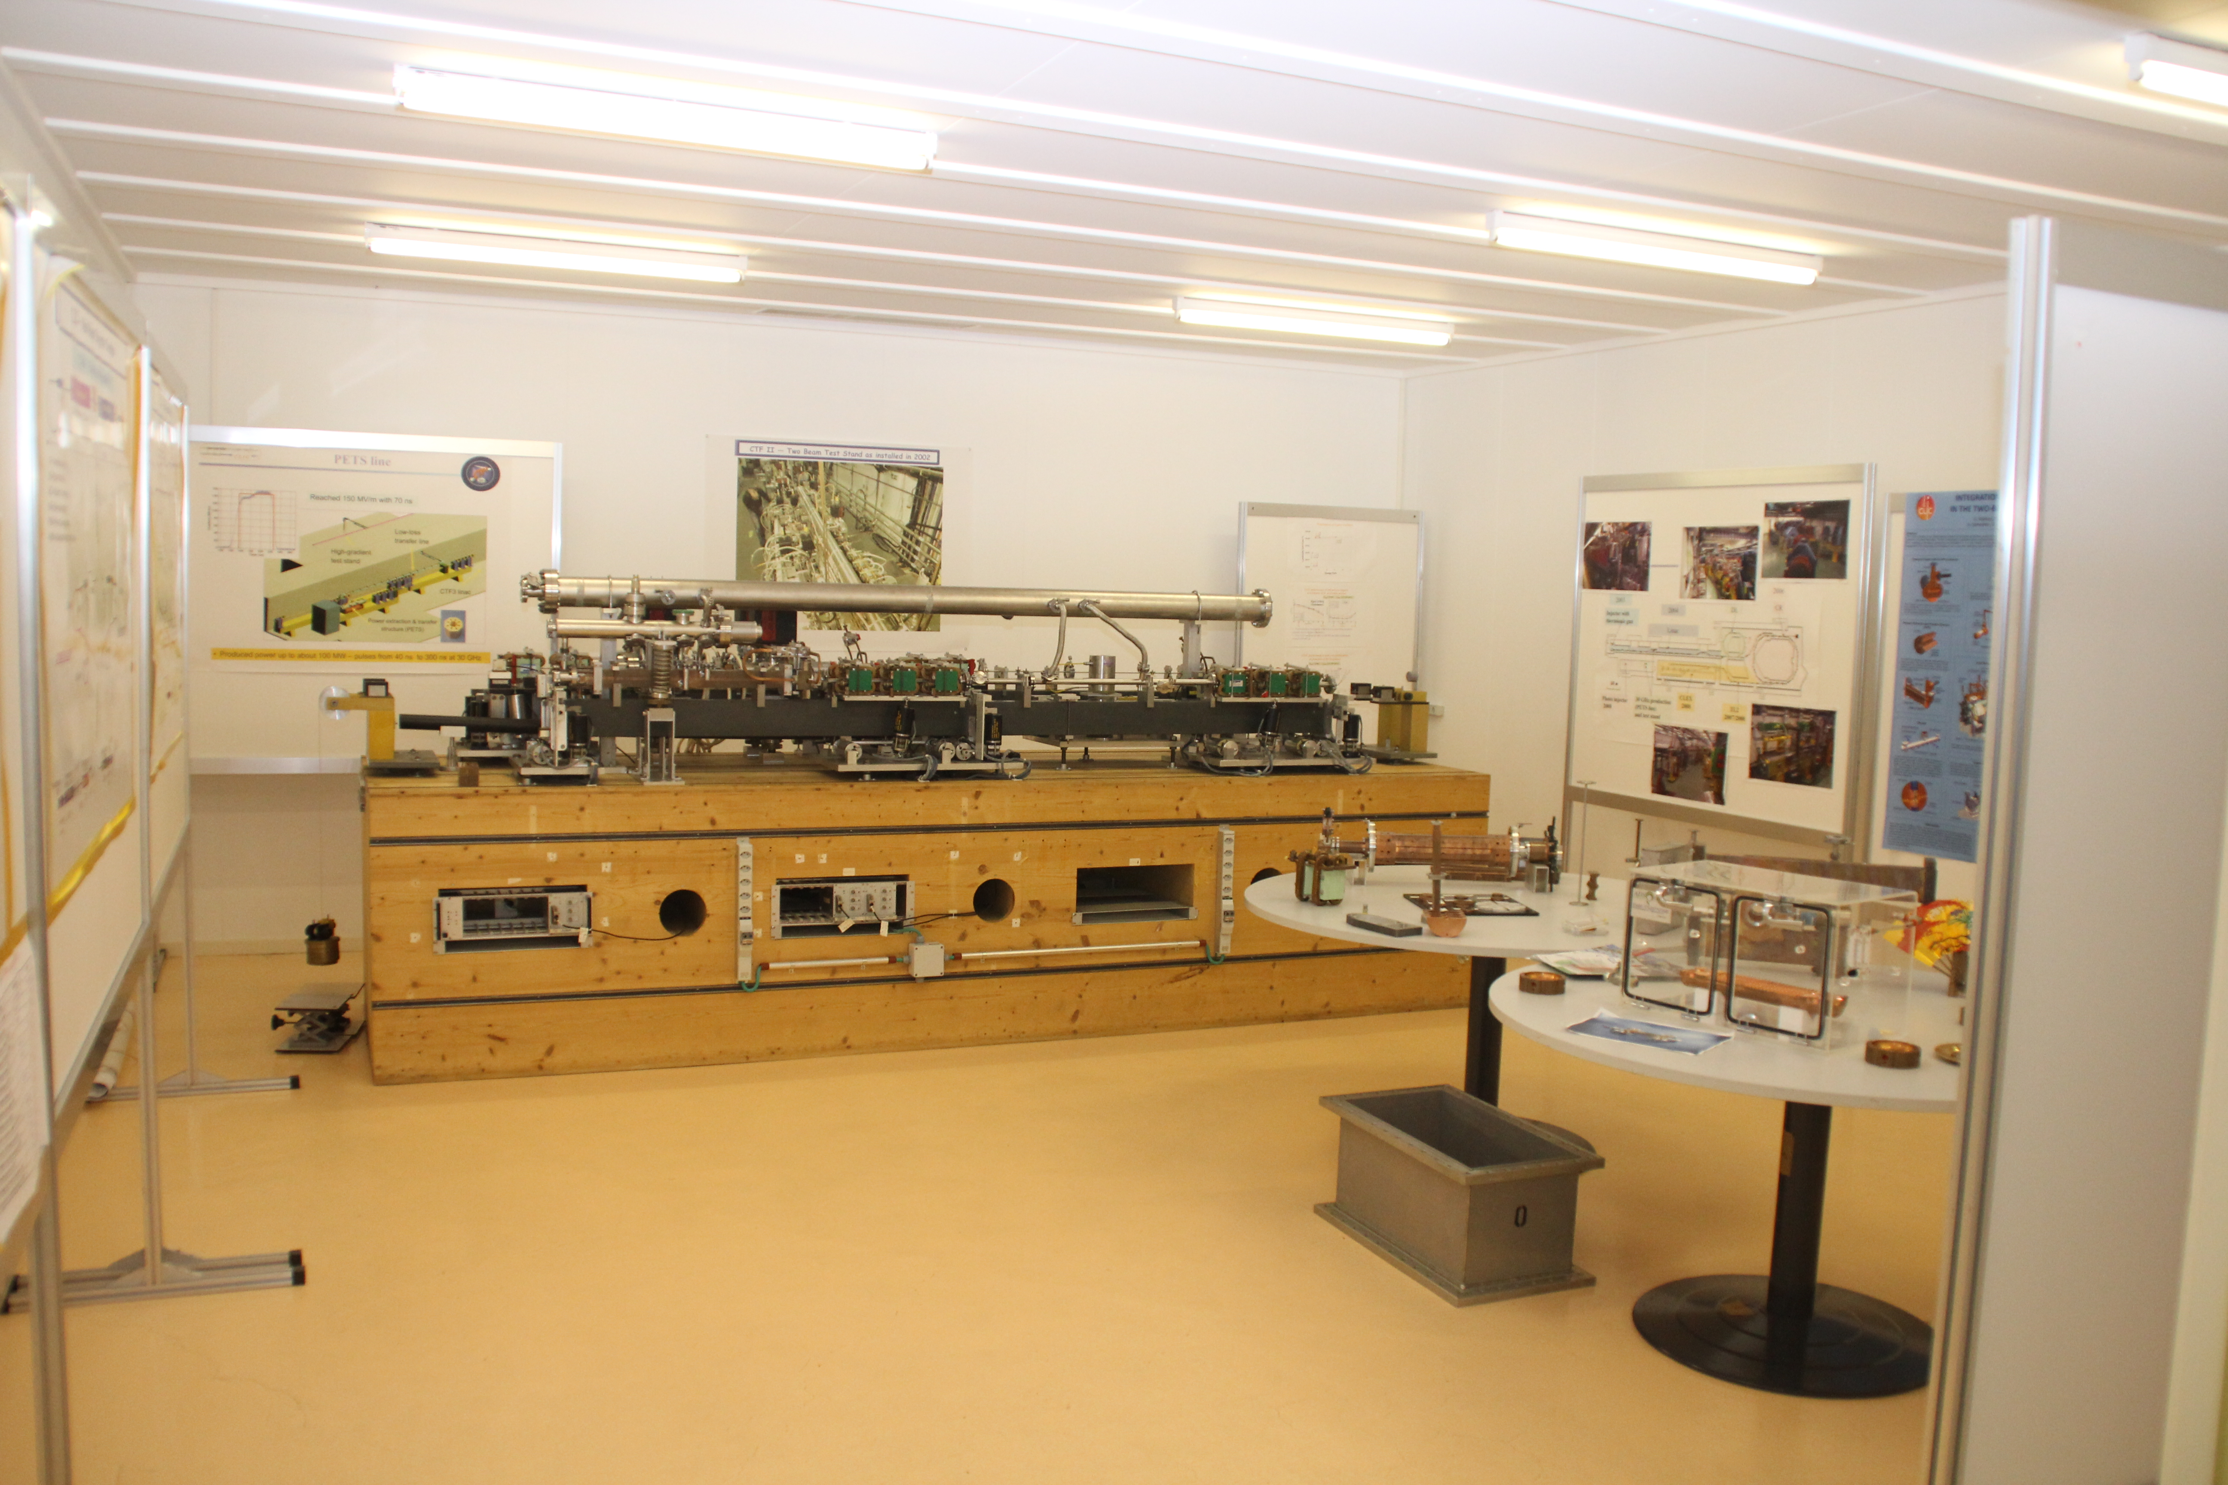
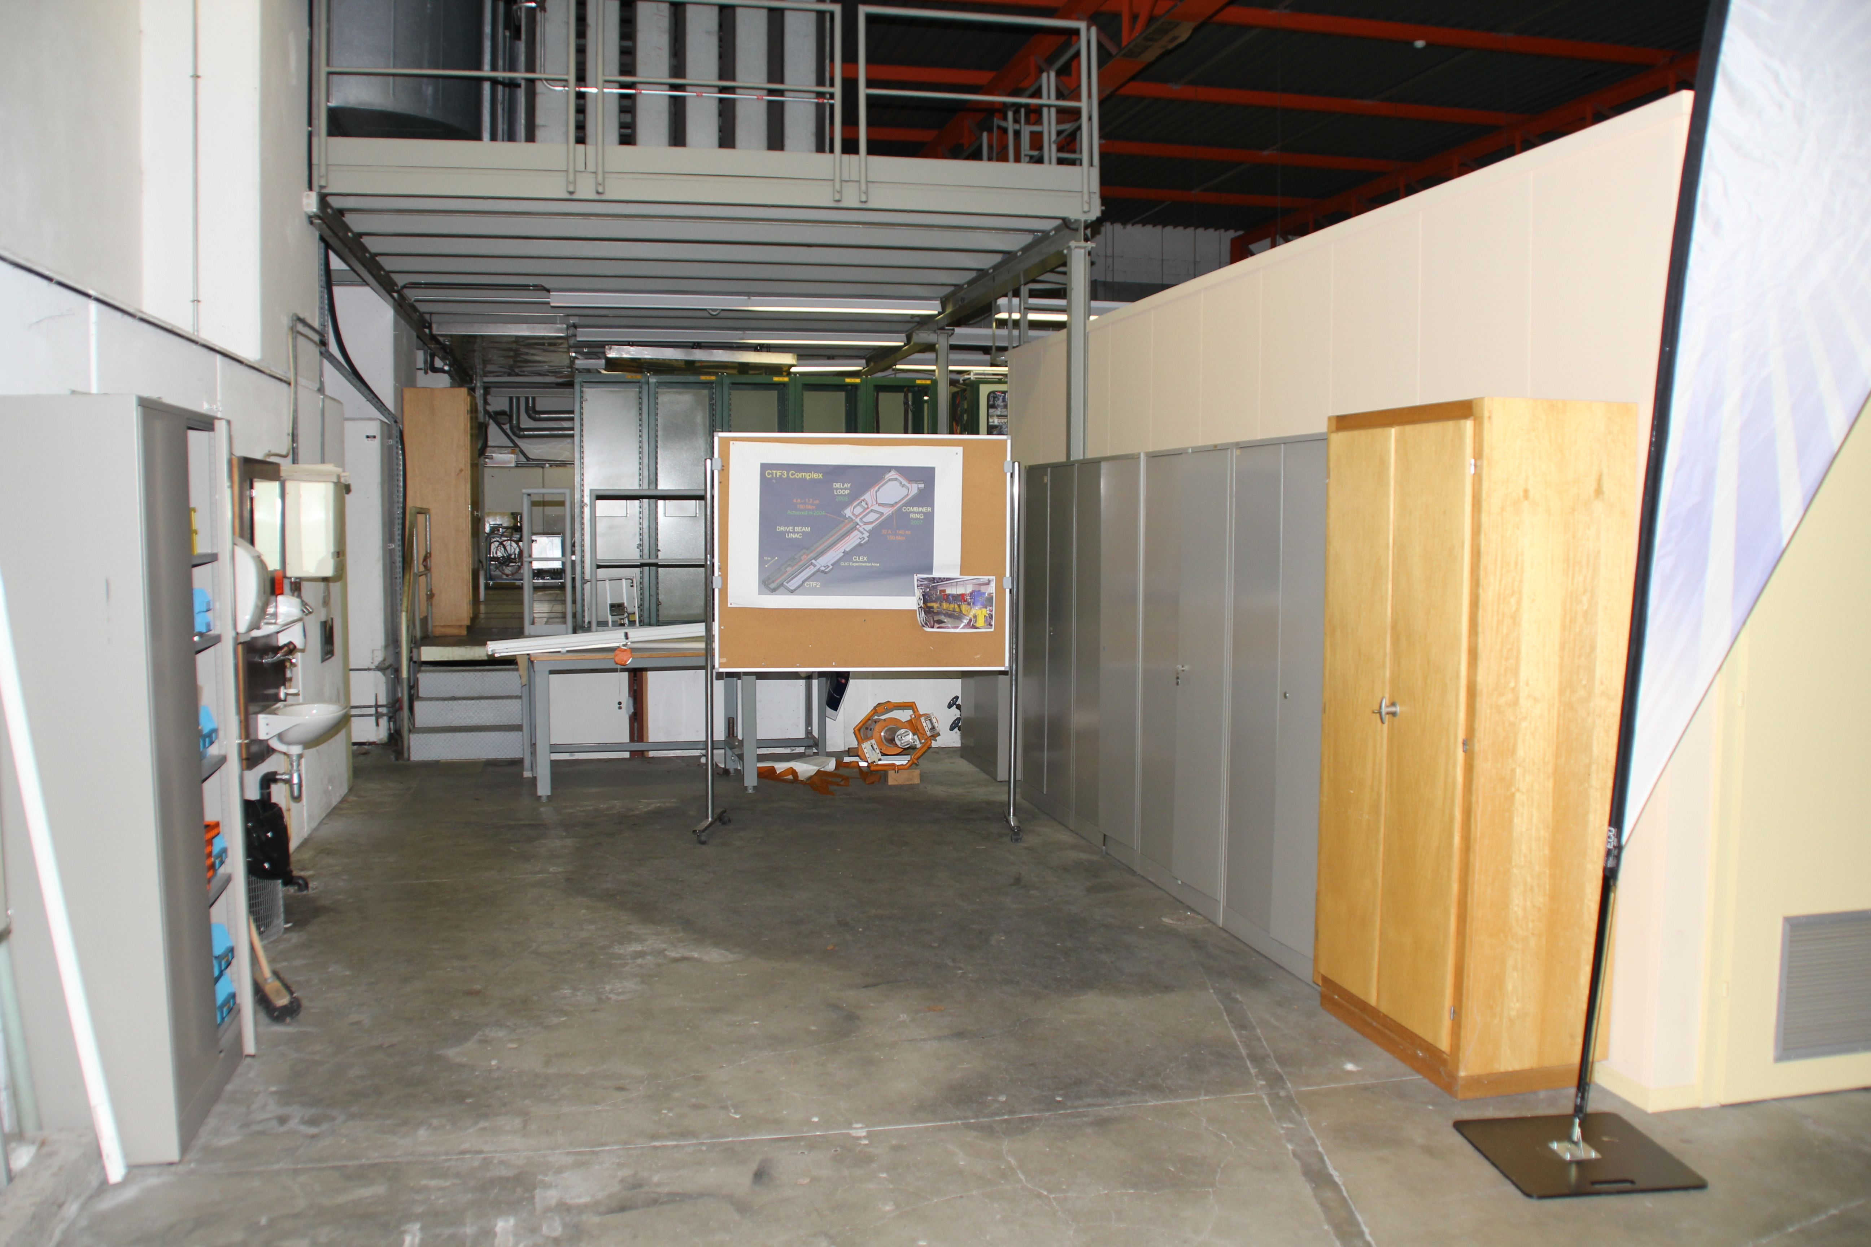
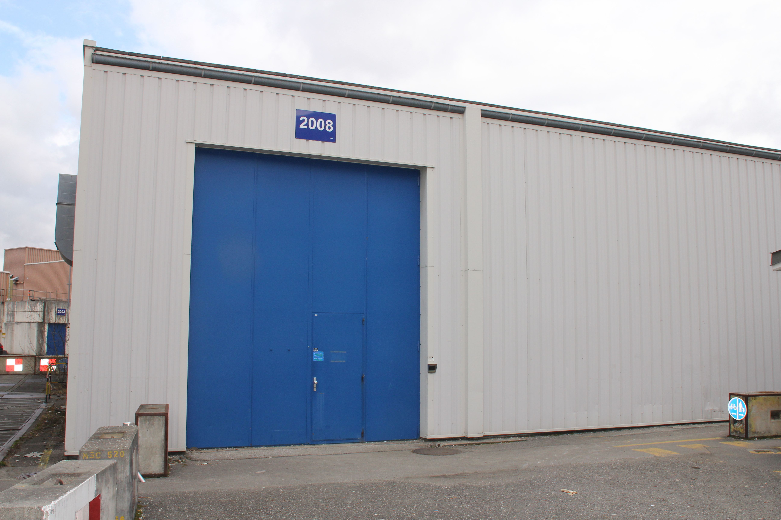
CLIC showroom extension
Building 2008
CTF3
control
room

Slide 2
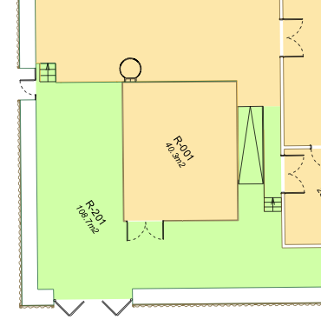
CLIC showroom extension
People:
  Alexia
  Andre-Pierre Olivier (Designer, CLIC web site)
  me (technical contact)
First meeting 31.01.2012
  Discussion of the project, two parts
    existing part with CTF2 installation to keep
    posters to be reworked
    different objects to be put into value
    extension next to the show room for a projection of a movie
follow up
  meeting with Gerry and Fabio Corsanego about extension
  => no problem to have extension up to building wall, emergency exit in corner
  Alexia met Jacques Fichet about a movie, 2 hours turning for 2 min of movie
  3D-movie too expensive
  Photo session in CTF3 – photos in Alexia’s public DFS folder
  Alexia, Andre-Pierre met again 21.02.
next steps
  further contacts (R.Landua)
  cost estimate for extension
  define movie plot, basic message, posters, objects to put, etc…
Ideas are welcome!

