Slide 1
A next facility towards CLIC
Footprint
CALIFES type injector
0.25 GeV, 1.2 A
TBA
6.5 GeV, 1.2 A
0.2 GeV, 101 A
DB Turn around
0.48 GeV, 101 A
DBA
0.48 GeV, 4.2 A
DL
CR1
CR2
Compression
2 x 3 x 4
100 m
H. Braun, CLIC 2008 Workshop

Slide 2
Drive Beam Accelerator DBA
Nominal CLIC DBA injector
A few nominal accelerator modules
equipped with nominal 15 MW, 1 GHz, 50 Hz, 140 μs pulse length klystrons
development of nominal drive beam klystrons & modulators required
Remaining nominal accelerator modules with reduced pulse length klystrons (6 μs)
Total length ≈ 500 m, nominal 4.2 A beam
final energy 0.48 GeV instead of 2.4 GeV for CLIC
6μs pulse length instead of 140μs, for economy, sufficient to produce one nominal bunch train (OPTION: full pulse)
all hardware nominal and re-usable for CLIC !

Slide 3
Delay Loop + Combiner Rings
+ Turnaround
Nominal CLIC Delay Loop, 2 x current multiplication
Nominal CLIC combiner ring 1 , 3 x current multiplication
Nominal CLIC combiner ring 2 , 4 x current multiplication
Nominal DB turnaround with bunch compressor
Total beamline length ≈ 800 m, all components nominal and re-usable for CLIC
Magnets operate at 1/5 of nominal strength.

Slide 4
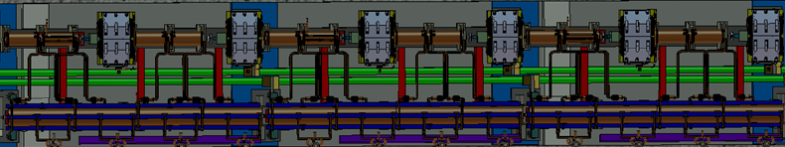
Two Beam Demonstrator
- 46 nominal CLIC modules
(type 1, 6 accelerating structures,1 main beam quadrupole,
3 power extraction structures and 2 drive beam quadrupoles per modules
Drive beam corresponds to 1/10 of a nominal decelerator sector with
deceleration to nominal final energy of T=0.24 GeV
Main beam gets a total acceleration of 6.25 GeV
CALIFES type 0.25 GeV injector ,
(but with nominal CLIC main beam current 1.2 A
and 156 ns pulse-length)
total length ≈ 120 m
all components nominal and re-usable for CLIC

Slide 5
Next facility towards CLIC
Rational
Creates drive beam train nominal for everything but energy (0.48 GeV instead of 2.4 GeV)
Demonstrates nominal DBA injector with all parameters
Demonstrates nominal DBA module with klystron and modulator with all parameters
Demonstrates two beam acceleration over significant distance with fully nominal modules
Forces pre-series production of all mass produced components → Industrialization
Well suited to create confidence in CLIC technology
All hardware investment is re-usable for real CLIC
Problems
Combiner ring beam dynamics more difficult than in real CLIC (like in CTF3)
Expensive (but re-usable)
No obvious use of 6.5 GeV main beam but for testing (injector for prototype damping ring, FEL ? )
→ May be needed for qualification of structures/two-beam modules prior to final installation
→ Other potential uses: test beams, nuclear physics, plasma wake-field acceleration…

Slide 6
Layout considerations I
CALIFES type injector
0.25 GeV, 1.2 A
6.5 GeV, 1.2 A
0.2 GeV, 101 A
TBA
Beam lines cross-over
DB Turn around
0.48 GeV, 101 A
1) Linac longer than initially thought (500 m rather than 200 m)
DBA
0.48 GeV, 4.2 A
CR1
3) Separate injection/extraction in CR1
DL
CR2
2) Omega-shaped delay loop
100 m ?

Slide 7
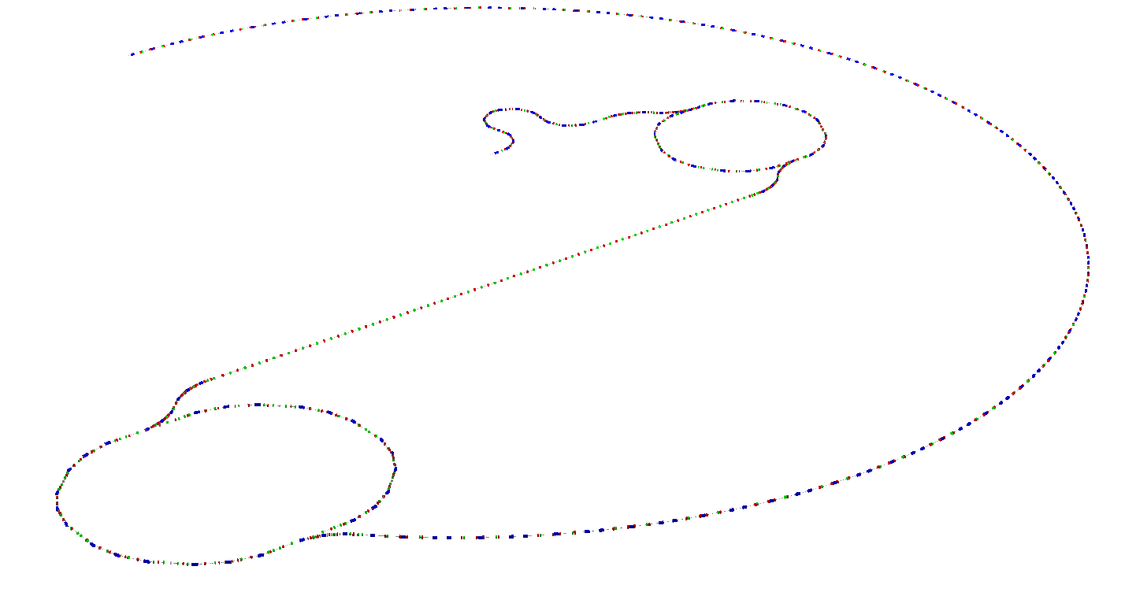
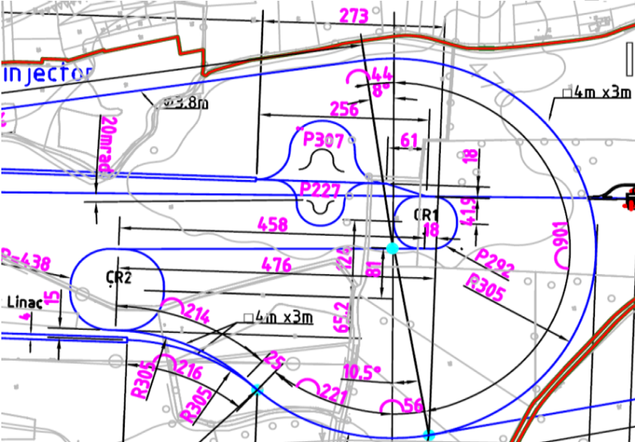
Layout considerations II
What about the consistency with the CDR layout?
Final location?
~ 500 m

Slide 8
Beam Parameters
Drive beam (TBA entrance)
Energy 480 MeV
Emittance, norm. rms ≤ 150 um
Energy spread, rms ~ 1 %
Bunch length, rms 1 mm (3.6 ps)
Bunch charge 8.4 nC
Pulse Current 101 A (4.2 A in DBA)
Pulse length 244 ns (~ 6 us in DBA, option for full pulse length – 140 us)
Rep. Rate 50 Hz
Probe beam (end of TBA)
Energy 6.5 – 6.75 GeV (250 to 500 MeV injector exit, 6.25 GeV acceleration)
Emittance, norm. rms 1 – 20 um (both horizontal and vertical)
Energy spread, rms 0.1 – 1 %
Bunch length, rms ~ 0.5 mm (1.8 ps – may changed by adding a bunch compressor)
Bunch charge 0.2 - 1 nC
Pulse Current 0.4 – 2 A
Pulse length up to 156 ns (possibility of single bunch)
Rep. Rate up to 50 Hz

Slide 9
Parameters considerations
Drive Beam
Pulse length (6 um against 140 um)
500 GeV vs. 3 TeV parameters (or new baseline)?
Probe Beam
500 GeV vs. 3 TeV parameters (or new baseline)?
Difficult to obtain “CLIC main beam” like parameters (e.g., total charge in pulse – beam loading limitations in photo-injector)
Parameters for CLIC testing (may require increase in injector energy)
Possibility of flat beams to be explored
Parameter flexibility needed for other potential uses (e.g., small energy spread for FEL or other applications…)
Will prepare list of realistic parameters for CLIC tests, explore possibilities for other applications

Slide 10
CTF3 program 2012-2016
CTF3 Consolidation, upgrades and operation (CTF3-001) (needed to ensure other WPs)
Drive Beam feed-forward and feedback (CTF3-002)
TBL beyond 2012 (CTF3-003)
Two Beam Modules in CLEX (CTF3-004)
Program will last until 2016. The plan is to stop CTF3 operation then (may expect a short extension to complete the program, especially for CTF3-004.

Slide 11
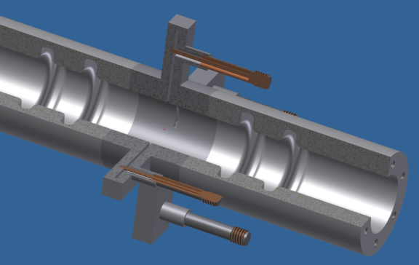
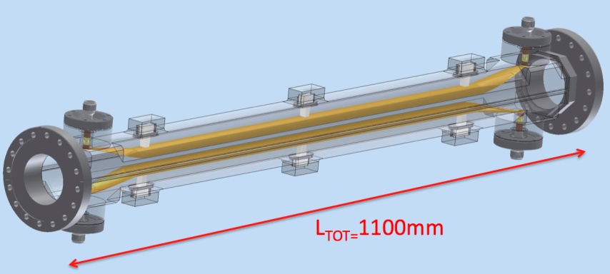
Drive Beam feed-forward and feedback (CTF3-002)
Fast kickers
Phase monitor
CLIC drive beam phase feed-forward concept
Stripline kicker
Phase monitor
  Not a single experiment – more a series of related studies:
  Measure phase and energy jitter, identify sources, devise & implement cures, extrapolate to CLIC
  Phase monitor tests in 2012
  First feedback/feed-forward tests in 2013
  Show principle of CLIC fast feed-forward
  Close link to collaborating partners (INFN, Oxford…)
CTF3 - Phase feed-forward
P. Skowronski, P. Burrows, A.Ghigo

Slide 12
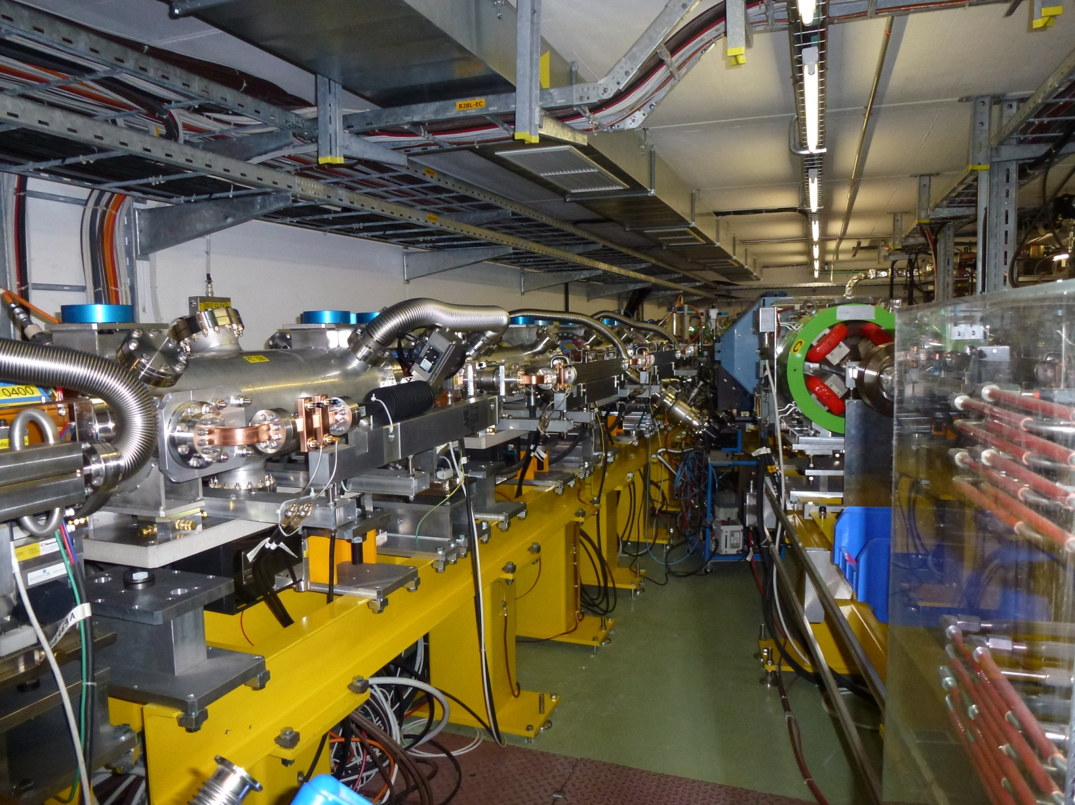
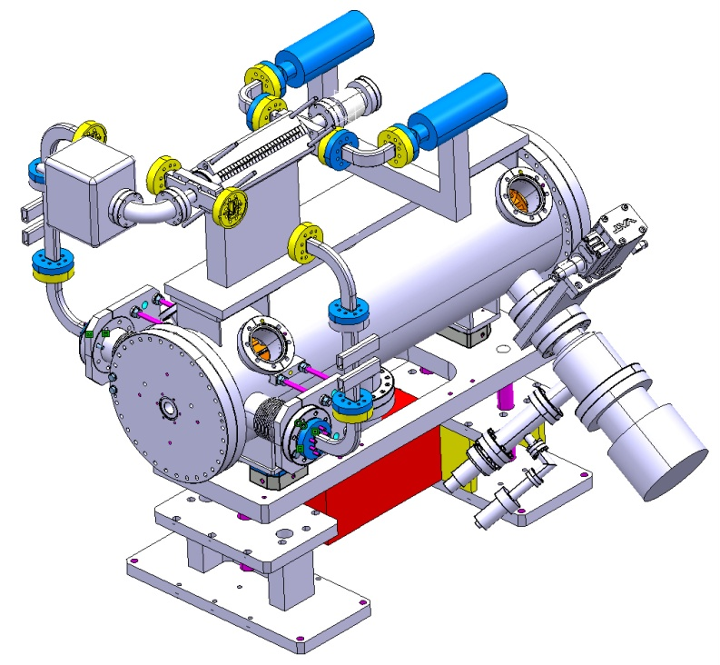
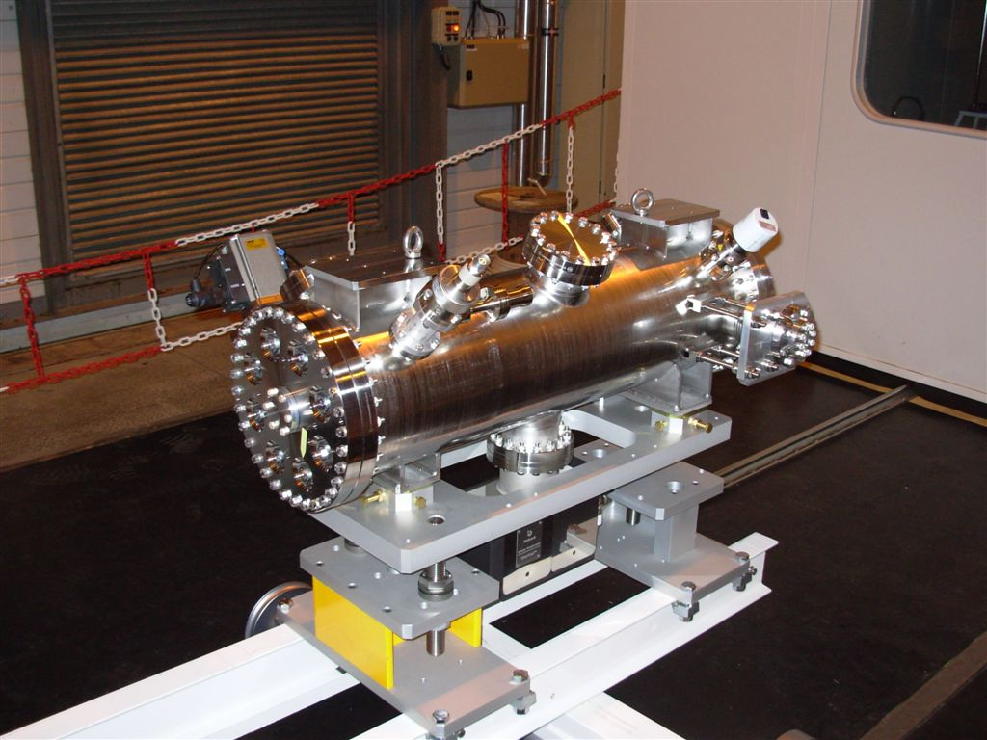
TBL beyond 2012 (CTF3-003)
Upgrade TBL to a test facility relevant for CLIC post-CDR work
12 GHz power production for structure conditioning
Working experience with a real decelerator
Beam dynamics studies, pulse shaping, feedbacks, etc
Last batch of four PETS installed in late 2012 will be adapted
to high-power testing
One (or two slots) tested at beginning of 2013
Gradual increase of slots to 4-8 slots and rep rate to 25-50 Hz
S. Doebert
Accelerating structure under test
Beam
RF
PETS tank

Slide 13
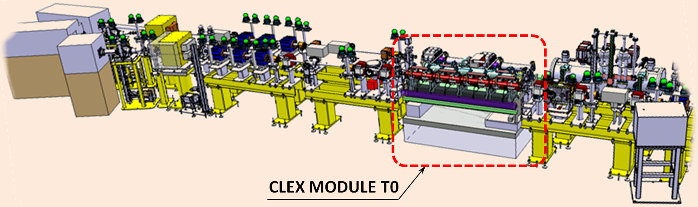
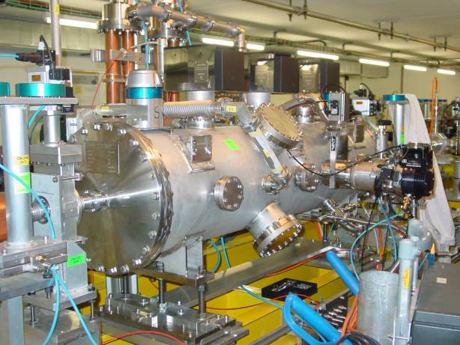
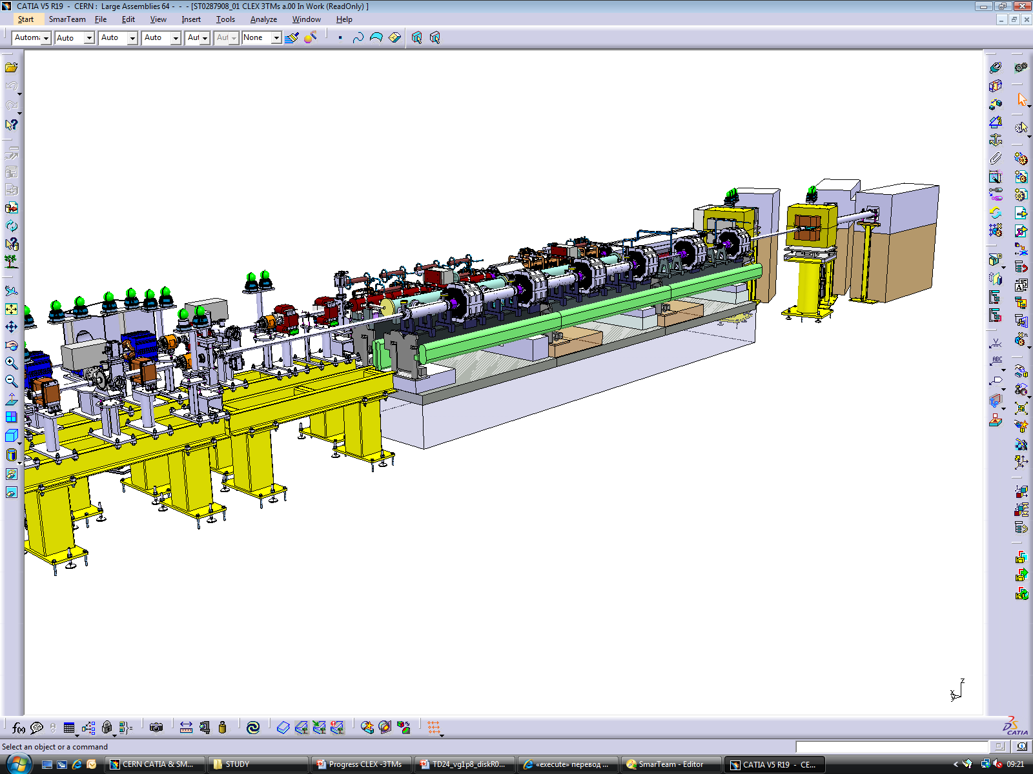
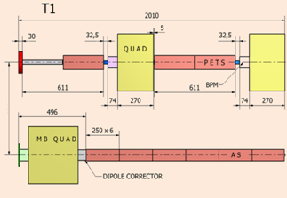
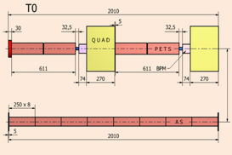
Two Beam Modules in CLEX (CTF3-004)
3D model of integration of
the first CLIC Module in CLEX (2013)
Module T0
CLEX - Three two-beam modules (2014)
TBTS PETS tank
Drive beam
G. Riddone
Probe beam
Schematic layout of CLIC Modules in CLEX

Slide 14
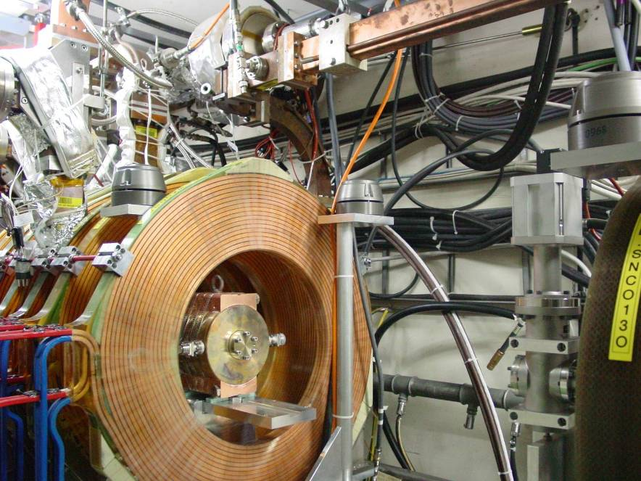
CLIC Zero front-end
2012-2016
Build and commission 30 MeV Drive Beam front-end with nominal CLIC parameters | Build and commission 30 MeV Drive Beam injector with nominal CLIC parameters Build and commission a few Drive Beam accelerator nominal modules Contribution to Technical Design of full CLIC Zero facility
CTF3 Injector
Modulator-klystrons, 1 GHz
CLIC Drive Beam injector schematic layout
TWTs, 500 MHz
Magnetic chicane, diag. & collimation
Quads
Quads
Gun
SHB 1-2-3
PB
Buncher
Acc. Structures
~ 140 keV
~ 6 MeV
~ 30 MeV

Slide 15
Resource profiling for CLIC Experimental Facilities 2012 – 2016
(Personnel - including collaborators)
FTE
Year

Slide 16
Resource profiling for CLIC Experimental Facilities 2012 – 2016
(Material - including collaborators)
FTE
Year

Slide 17
CLIC Zero – cost evaluation and considerations
My last evaluation of the material cost of CLIC Zero(Autumn 2010) was 390 MCHF.
From the review of the CLIC CDR value estimate (22 February 2012) I derived about 340 MCHF (without infrastructure and probe beam injector, which are equal to 48 MCHF in my evaluation). DBA is about 60% of the total cost in both cases. (Too good to be true…)
The CLIC Zero front-end material cost estimation is about 20 MCHF, over 5 years. The overall CLIC material budget in 2012-2016 is about 20 MCHF per year.
Need a very large increase in yearly budget in order to complete the facility in 5-7 years. Is it realistic, and under which conditions?

Slide 18
Full CLIC 0
Most of DBA ready
Full DB generation CLIC 0-
Front-End
20-30 MeV

Slide 19
Many Thanks

Slide 20
Material cost per year, CLIC 0- and upgrade to CLIC 0

Slide 21
Beam Parameters – initial guess
Drive beam (TBA entrance)
Energy 480 MeV
Emittance, norm. rms ≤ 150 um
Energy spread, rms ~ 1 %
Bunch length, rms 1 mm (3.6 ps)
Bunch charge 8.4 nC
Pulse Current 101 A (4.2 A in DBA)
Pulse length 244 ns (~ 6 us in DBA, option for full pulse length – 140 us)
Rep. Rate 50 Hz
Probe beam (end of TBA)
Energy 6.5 GeV (250 MeV injector exit, 6.25 GeV acceleration)
Emittance, norm. rms ≤ 20 um (both horizontal and vertical)
Energy spread, rms ≤ 0.1 %
Bunch length, rms ~ 0.5 mm (1.8 ps - may be reduced by adding a bunch compressor)
Bunch charge 0.6 nC
Pulse Current 1.2 A
Pulse length up to 156 ns (possibility of single bunch)
Rep. Rate up to 50 Hz

