Slide 1
Heavy ion MD results and requests for 2012

Slide 2
MD results from 2011 Heavy ion run
Proton-lead feasibility test (only one on “MD time”)
  Injection, ramp, rephasing (cogging) with different revolution frequencies
  2nd part of MD lost (more bunches, collisions)
  Reported at LSWG 8/11/2011
ALICE polarity reversal
  Pass through small long-range separations
  Important for future physics conditions
BFPP mitigation
  Bump technique applied successfully
Pb collimation quench test
  No quench but quite successful
Much data on emittance, luminosity evolution, etc

Slide 3
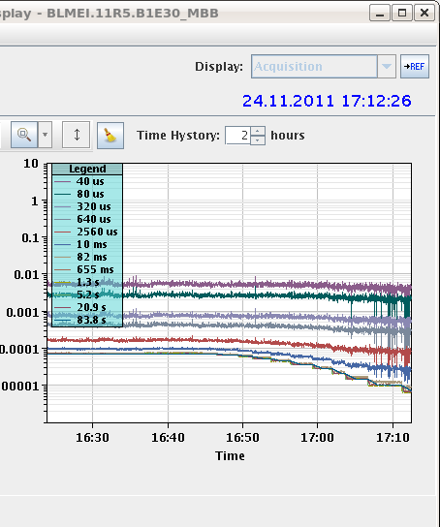
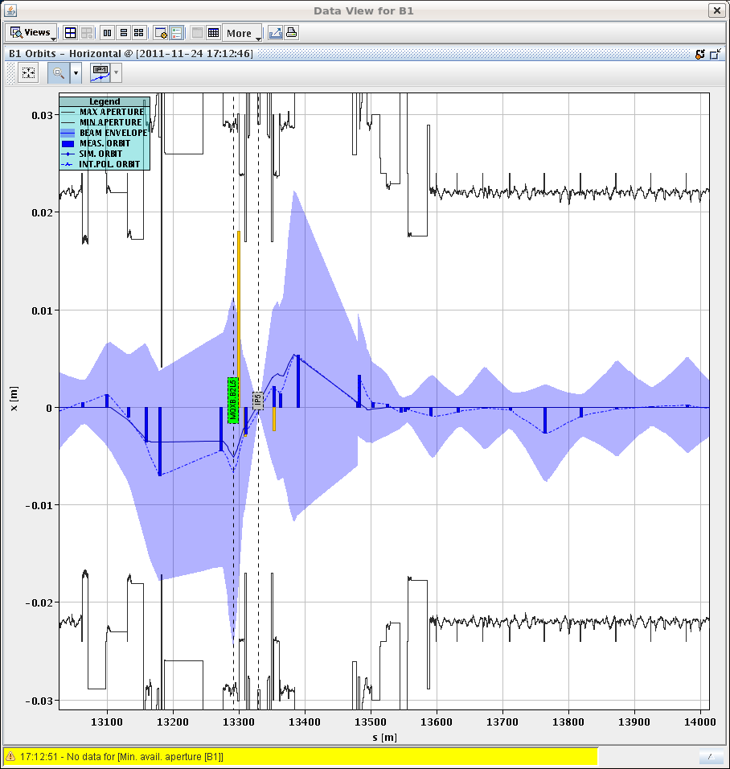
BFPP mitigation with orbit bump
12 sigma envelopes from online model

Slide 4
6/12/2011 – quench test on physics time
09:00 – 15:30 : quench test – 3 attempts – no quench.
Attempt no.1:
  1.8×10¹¹ charges / beam, ~20 bunches.
  Rapid 1/3 order resonance crossing beam2 H plane. Beam dump on BLM thresholds.
  Loss on 10 ms int. window of monitor BLMQI.09L7.B2I10_MQ. This monitor had its master thresholds increased RS > 80 ms.
Attempt no. 2:
  Reverted to initial master threshold on BLMQI.09L7.B2I10_MQ (and another monitor), but set MF to 1.
  3.4×10¹¹ charges / beam, ~37 bunches.
  Rapid 1/3 order resonance crossing beam2 H plane. Beam dump on BLM thresholds at Q19 (not modified) on 82 ms RS.

Slide 5
Quench test (continued)
Attempt no. 3:
  MF set to 0.3 for 26 arc monitors (cells 11L7, 19L7, 29L7, 24R5).
  3.2×10¹¹ charges / beam, ~37 bunches. RF M1B2 tripped.
  Slow resonance approach on for B2 H. Lost most of the beam, but no dump.
  B1H dumped on BLMs during fast resonance crossing.
Comments:
  No quench during all these exercises.
  For fill3, beam2 shortly lost the cryo start in the matching section 67 due to increased temperature (2.7K from 1.9K) in the missing dipole. Limit is 2.15K.
  Otherwise cryo temperature increase at the 20mK level at the Q9.

Slide 6
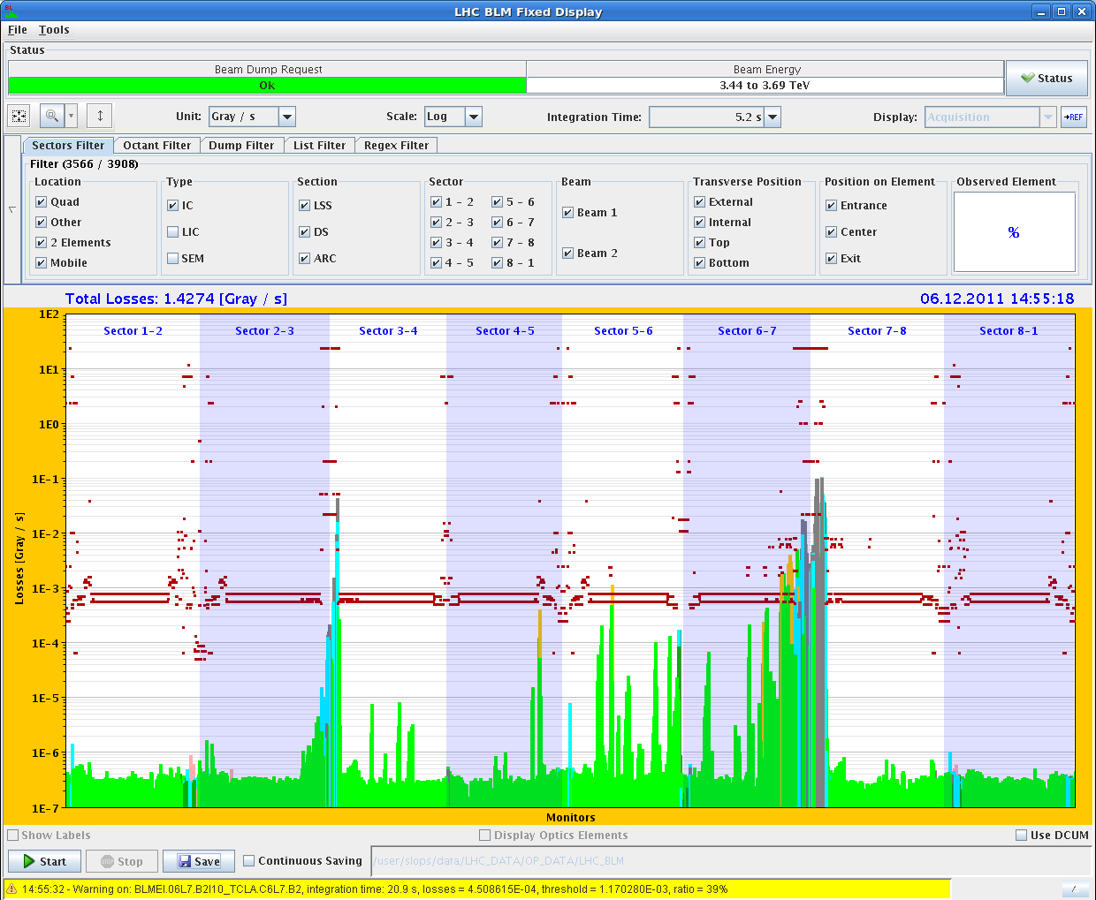
Attempt no. 3 – slow crossing B2H

Slide 7
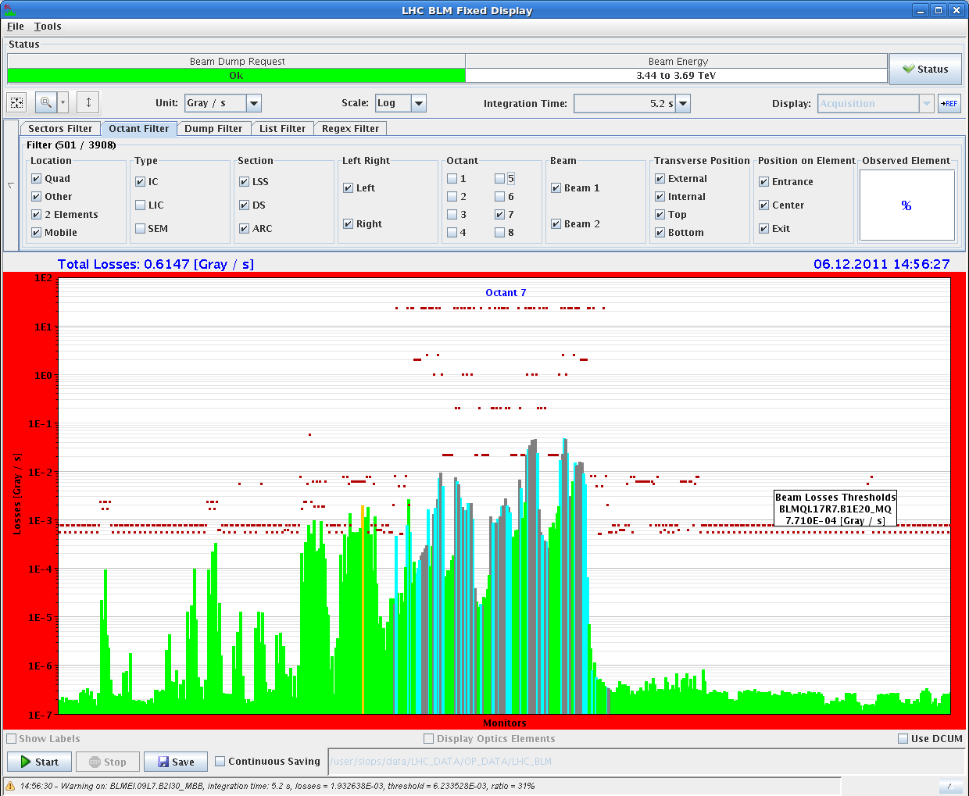
Attempt no. 3 – slow crossing B2H

Slide 8
Quench test summary
Test | Beam | Loss rate | Dump Location | Dump RS | Dump/ Quench limit
Fast | 2 | 2×10¹⁰/75 ms | Q9 | 10 ms | ~1.5
Fast | 2 | 2.5×10¹⁰/100 ms | Q19 | 82 ms | ~2
Slow | 2 | 5.4×10¹⁰/ s | Q9 | - | ~1
Fast | 1 | 2.7×10¹⁰/500 ms | Q11 | 82 ms | To be analyzed

Slide 9
Requests for 2012, preliminary
Continue p-Pb feasibility
  As soon as possible Week 33 or floating?
  Crucial to plan physics programme
    Experiments need to plan for luminosity
Pb collimation quench test (no MD request yet)
  Go further, better conditions (BLMs, ADT, …)
Pb collimation, reduce local energy deposition
  Extend BFPP technique to IR7, IR3, several bumps, know locations, signs for isotopes
  New idea, needs study
Proton collimation, reduce local energy deposition
  Similar technique may work for protons
  New idea, needs study

