Slide 1


Management eines Departments (PH-Department)
Paul Schwerdtner
Paul Judt

Slide 2
AGENDA
Organisation
  CERN
  PH-Department
Arbeitsplatz
Aufgaben und Herausforderungen
  Budgets
  RRB-Meeting
Fazit

Slide 3
ORGANISATION
Director General
Rolf Heuer
Head of International Relations
Felicitas Pauss
Director of Research and Computing
Sergio Bertolucci
Director of Accelarators and Technology
Stephen Myers
Director of Administration and General Infrastructure
Sigurd Littow
PH
IT
BE
TE
EN
FP
GS
HR

Slide 4
ORGANISATION
PH
AGS
Alice
ATLAS
CMS
DT
EDU
ESE
LCD
LHCb
SFT
SME
TH
TOTEM

Slide 5
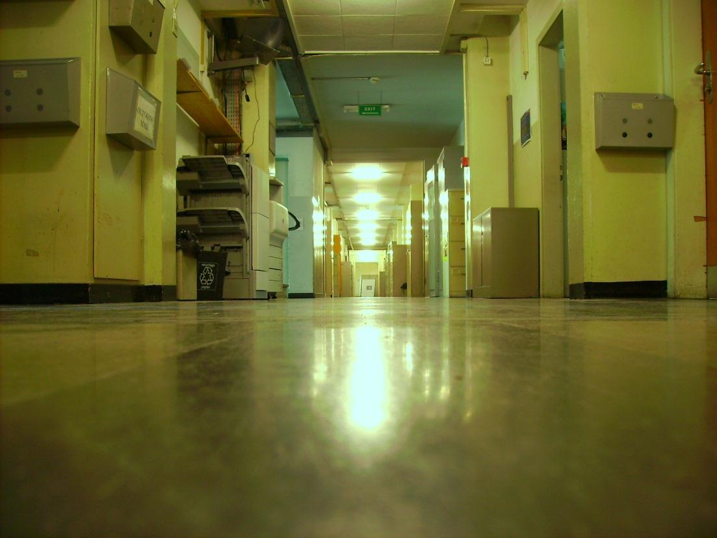
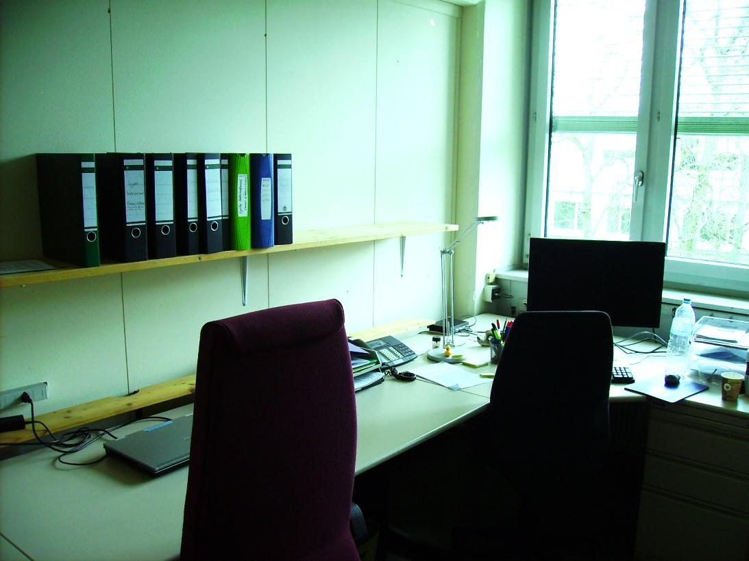
ARBEITSPLATZ
Building 4 / 1. Stock / Raum 37

Slide 6
AUFGABEN
Vorbereitung der RRB-Meetings:
  Sichtung gegebener Dokumente (vor allem M&O Budget Requests)
  Erstellung der Dokumentmappen
  Aktualisierung der Sharepoint-Datenbank
  Verfassen eines zusammenfassenden Berichts
Teilnahme an den RRB-Meetings:
  Protokollieren

Slide 7
M&O BUDGETS
ATLAS Cat. A | 2012 | 2013 | Difference | Percentage
Detector related costs | 6227 | 6568 | 341 | 5.476152
Secretariat | 305 | 305 | 0 | 0
Collaborative Tools | 120 | 507 | 387 | 322.5
Core computing | 2128 | 2128 | 0 | 0
On-line Computing | 5035 | 3314 | 1721 | 34.18073
Test Beams and calibration | 2440 | 910 | 1530 | 62.70492
Laboratory operations | 125 | 105 | 20 | 16
General Services | 3740 | 3963 | 223 | 5.962567
Total Cat. A (without Power) | 20120 | 17800 | 2320 | 11.53082

Slide 8
M&O BUDGETS
ATLAS Cat. B | 2012 | 2013 | Difference | Percentage
Mechanics & Cooling & Cryogenics | 410 | 196 | 214 | 52.19512
Standard electronics | 1675 | 1578 | 97 | 5.791045
Controls | 155 | 142 | 13 | 8.387097
Subdetector spares | 1380 | 503 | 877 | 63.55072
Areas | 385 | 308 | 77 | 20
Communications | 40 | 32 | 8 | 20
Store items | 115 | 215 | 100 | 86.95652
Hired manpower | 1935 | 2242 | 307 | 15.86563
TOTAL Cat. B | 6095 | 5217 | 878 | 14.40525
GRAND TOTAL | 26215 | 23017 | 3198 | 12.20

Slide 9
BUDGETVERTEILUNG
(2012 (Revised Budget) Resources allocations and expenses)
Notes:
Gesamtsumme: 2012 ausgegeben: 1,2MiaCHF

Slide 10
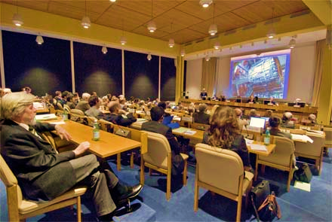
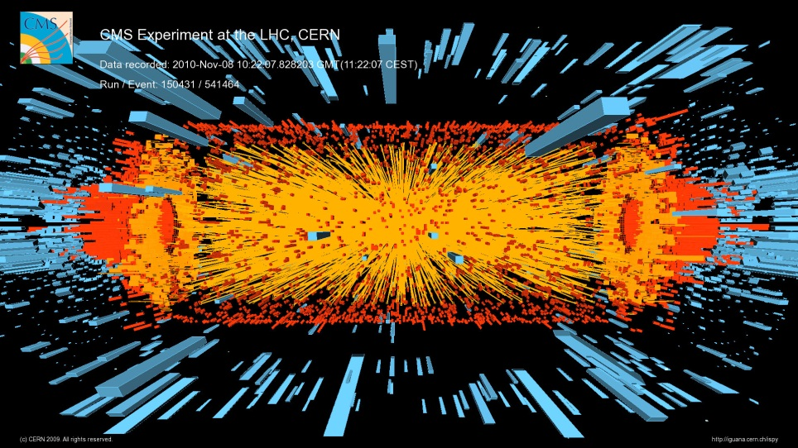
RRB-MEETING
Montag, 23/04/2012
  14:00h: Plenary (Council Chamber)
  15:30h: CMS Meeting (60-6-015)
    Physikalische Grundlagen
    Status des Experiments
    Pläne und Ziele von CMS
    Budget Anfragen
    Diskussion

Slide 11
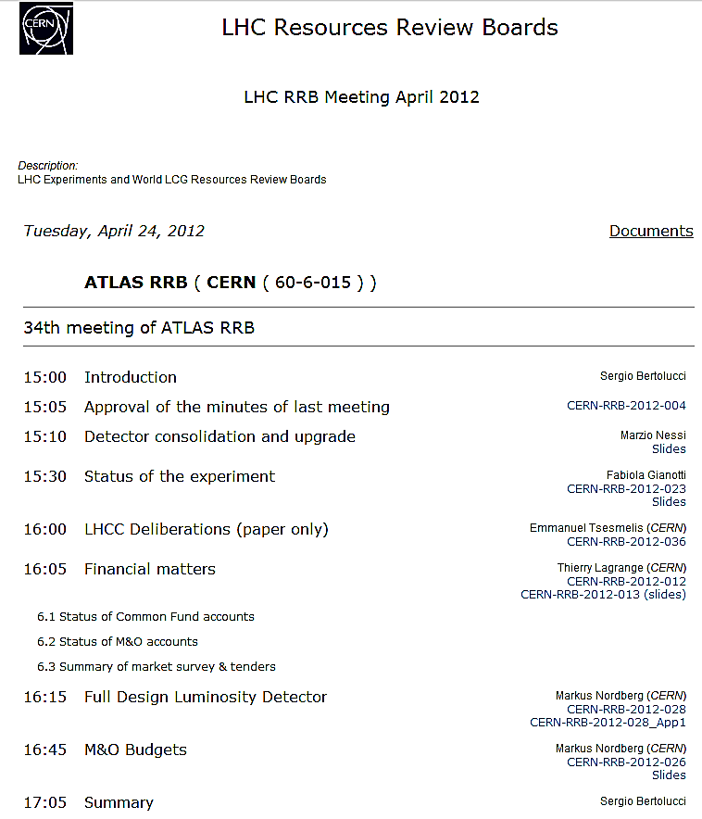
RRB-MEETING
Dienstag, 24/04/2012
  09:00h: Computing Meeting (60-6-015)
  11:30h: TOTEM Meeting (60-6-015)
  15:30h: ATLAS Meeting (60-6-015)
  19:00h: Cocktail dinner
Mittwoch, 25/04/2012
  09:00h: ALICE Meeting (60-6-015)
  11:00h: LHCb Meeting (60-6-015)

Slide 12
FAZIT
Guter Einblick in die Organisationsstrukturen
Kennenlernen der Abläufe “hinter” der Physik
Umgang mit Budgetzahlen
Symphatisches Umfeld
VIELEN DANK

Slide 13
Management eines Departments (PH-Department) – BACKUP
Paul Schwerdtner
Paul Judt

Slide 14
BUDGET STRUKTUR
CERN
Programmes
Sub Programmes
PPA
Zum Beispiel: | INFS LHC | LHCDETEC LHCCOMP LHCMACH | RHC RPA RPC RPB RIA RTO

Slide 15
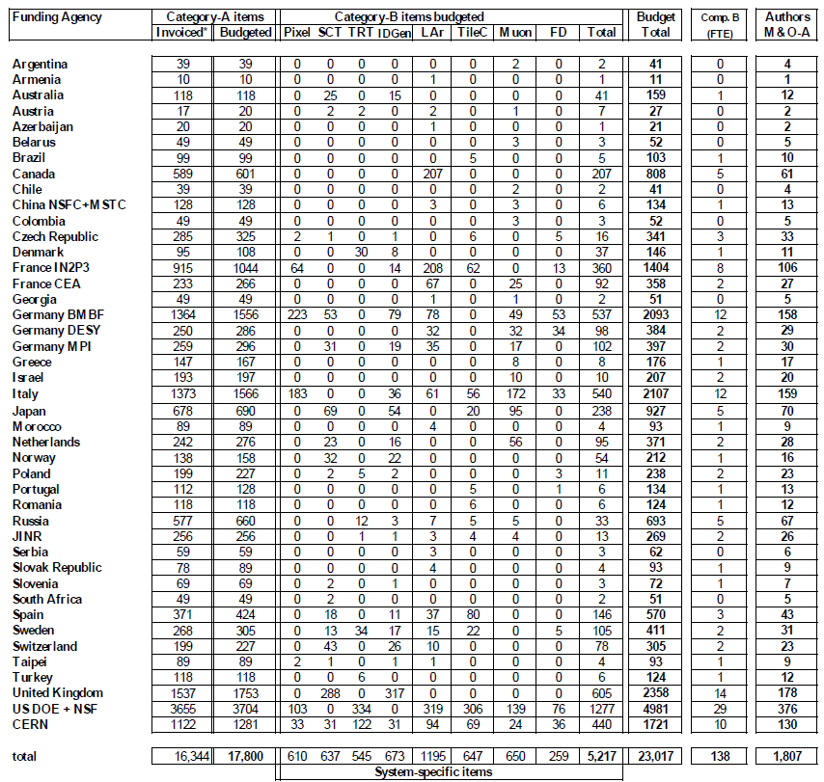
FINANZIERUNG
Member States:
Austria, Belgium, Bulgaria, the Czech Republic, Denmark, Finland, France, Germany, Greece, Hungary, Italy, the Netherlands, Norway, Poland, Portugal, the Slovak Republic, Spain, Sweden, Switzerland and the United Kingdom
Non-Member/Observer States:
z.B.: USA, Russia, Japan, India, Iran…
Proposed Sharing of M+O Contributions for ATLAS in 2013 by Funding Agency (kCHF)

