Slide 1
For the RD50 Simulation Group
Electric Field Modeling by simulations with ISE-TCAD
Mercedes Miñano
mercedes.minano@ific.uv.es
IFIC - Valencia

Slide 2
Outline
2D Pad Sensor simulated by ISE-TCAD
  2Defects radiation model
Full Depletion Voltage
Electric Field Distribution @ 10¹⁵ cm⁻²
Temperature Effects
Electric Field Distribution vs. Fluence
Leakage Current
  Single level radiation model
Summary and next steps

Slide 3
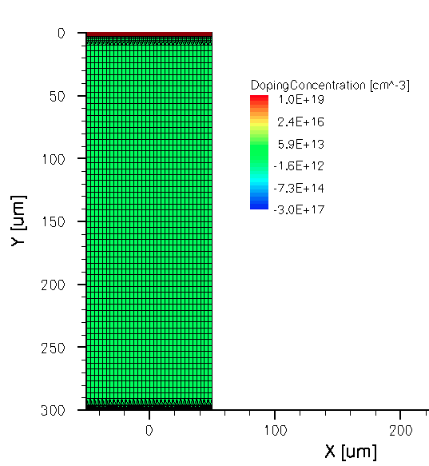
2D Pad Detector
p⁺ implant
As proposed from the RD50 Detector Simulation Group :
Simulations by Synopsys ISE-TCAD
Version D-2010.03 of a pad sensor has been carried out with the next characteristics:
DOPING PROFILES
[p⁺] = 3 x 10¹⁷ cm⁻³
[n-bulk] = 6 x 10¹¹ cm⁻³
[n⁺] = 1 x 10¹⁹ cm⁻³
n bulk
Detector thickness ---- d=0.03 cm
Backplane
N⁺
Radiation induced deep levels

Slide 4
ISE-TCAD Code used for simulations
Parameters:
Bias Voltage, temperature and fluence
Electrode {
{Name="nplus" Voltage=0.0 Material="Aluminum"}
{Name="pimplant" Voltage=0.0}
}
Physics {
Temperature=@<Temperature>@
Mobility( DopingDep CarrierCarrierScattering HighFieldSaturation Enormal)
Recombination(SRH(DopingDep) SurfaceSRH)
EffectiveIntrinsicDensity(Slotboom) }
Physics (material="Silicon") {
#if @<Fluence==0>@ ## No Traps
#else
Traps (
(Acceptor Level fromValBand Conc=@<Fluence>@ EnergyMid=0.595
eXsection=1.0E-15 hXsection=1.0E-15 )
(Donor Level fromValBand Conc=@<Fluence>@ EnergyMid=0.48
eXsection=1.0E-15 hXsection=1.0E-15 )
)
#endif }
Physics(MaterialInterface="Oxide/Silicon") {
#if @<Fluence==0>@
Charge(Conc=4e11)
#else
Charge(Conc=1e12)
Recombination(surfaceSRH)
#endif }
Standard physics model for a sensor with no radiation damage
Radiation model for traps
Oxide charge

Slide 5
Full Depletion Voltage
T=290K
The n-type bulk is inverted to p-type with irradiation at 10¹³ cm⁻²
Fluence [cm-2] | Vfd [V]
0 | 48
1e12 | 41
1e13 | 7
1e14 | 285
3e14 | 955
1e15 | 3245
3e15 | 10086

Slide 6
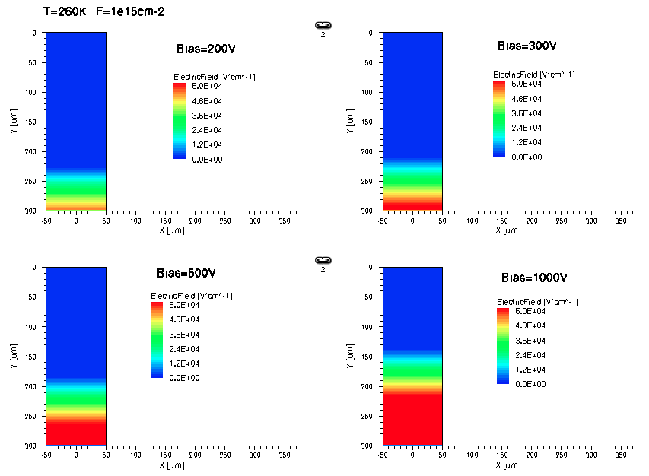
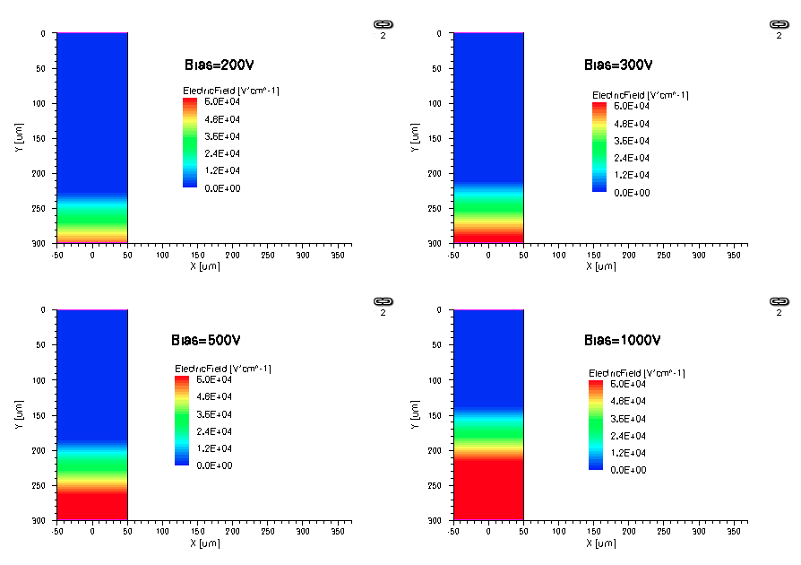
Electric Field Distribution @ 10¹⁵ cm⁻²
T=260K
T=290K
Inverted sensor
N→P bulk
The electric field grows from the sensor backplane

Slide 7
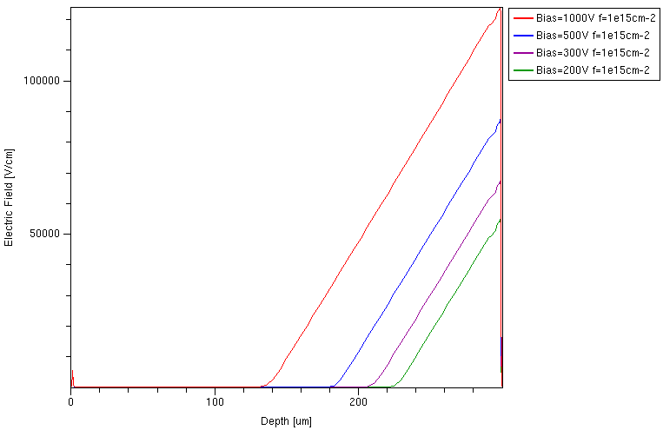
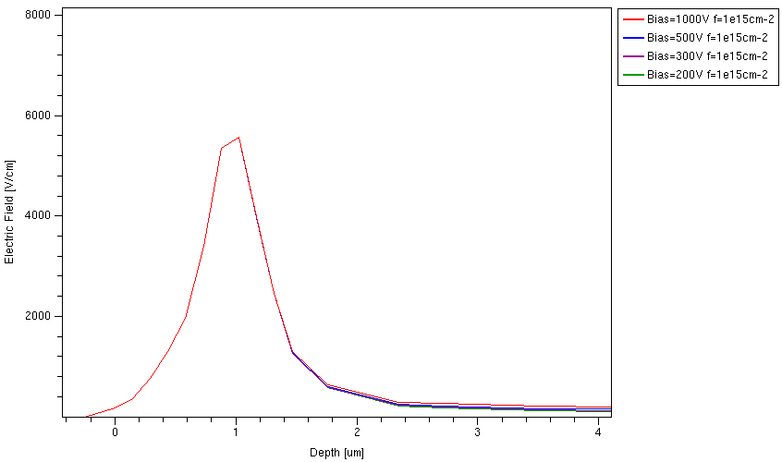
T=290K φ = 1 x 10¹⁵ cm⁻²
Electric Field Distribution through sensor depth
Backplane
The peak at front contact does not depend on bias voltage
Front plane (p+)

Slide 8
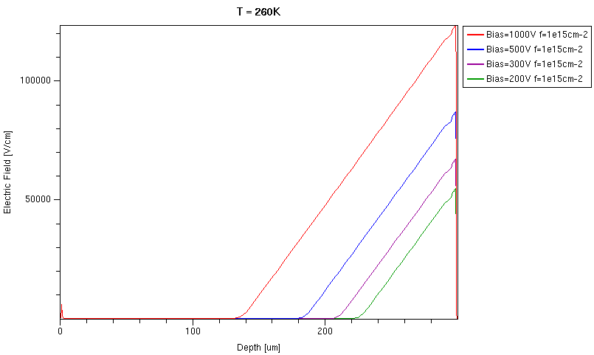
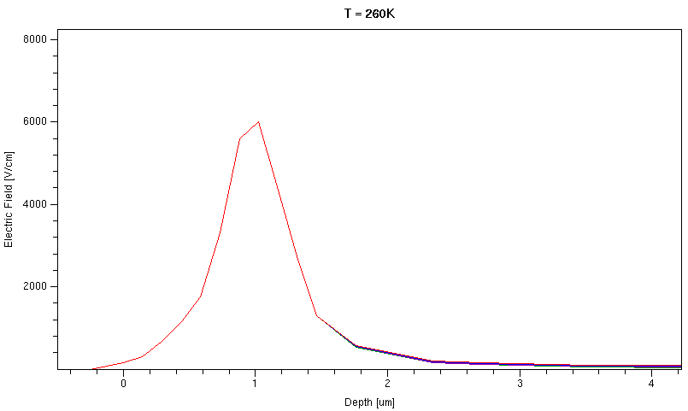
T=260K φ = 1 x 10¹⁵ cm⁻²
Electric Field Distribution through sensor depth
Front plane (p+)
Backplane

Slide 9
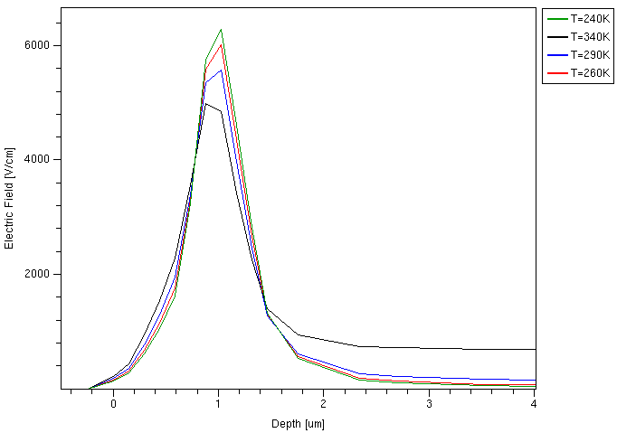
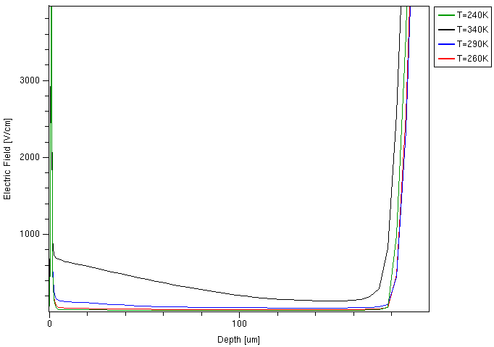
Temperature Effects
@500V and irradiated at 10¹⁵ cm⁻²
P+
P+
N+
backplane
The peak at p+ contact decreases as temperature increases, whereas a double junction effect is more evident.

Slide 10
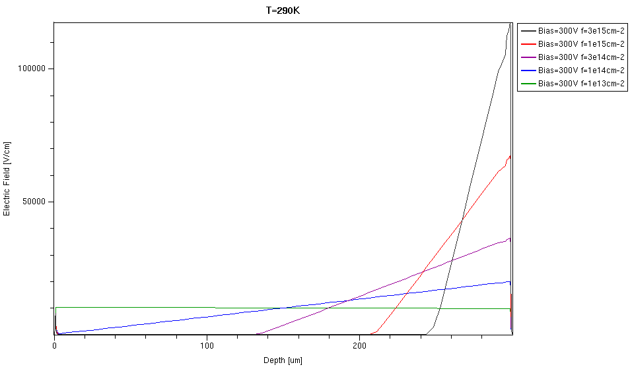
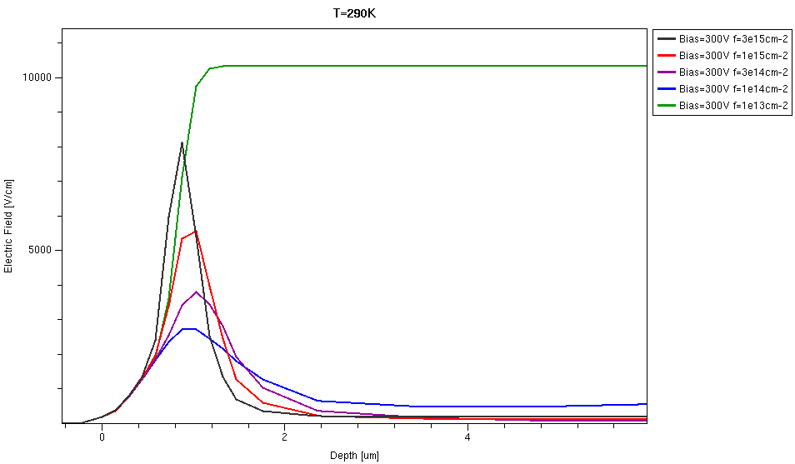
T=290K Bias=300V
Electric Field Distribution
As intrinsic silicon
Higher with dose after SCSI

Slide 11


Leakage Current
Bulk generated current calculated from a single level model:
V = 100 μm² x 300μm
Current related damage rate
T [K] | α [x10⁻¹⁷ A/cm]
290 | 4
260 | 0.2
Moll’s Thesis →

Slide 12
Summary
Following the Vladimir’s proposals, simulations with ISE-TCAD have been carried out in order to perform a cross-test of the software.
The results are focused in Electric Field distribution in irradiated sensors (2 midgap level model) and some conclusions can be extracted:
  After bulk inversion an asymmetric double peak is seen at both sides of the sensor.
  The peak at p+ contact seems to depend on:
    Temperature
    Irradiation dose
Full depletion voltage and leakage current (single level model) characteristics are also presented.

Slide 13
Next Steps
Charge collection efficiency
Implementation of avalanche effect
Trap configuration
Geometrical dependence
…
…
Any suggestion is wellcome

Slide 14
Back Up

Slide 15

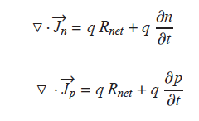
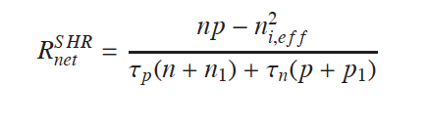
Physics Models
Poisson Equation
Transport Equations
Shockley-Read-Hall Model

Slide 16
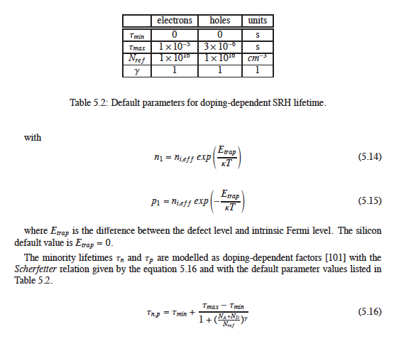

Slide 17
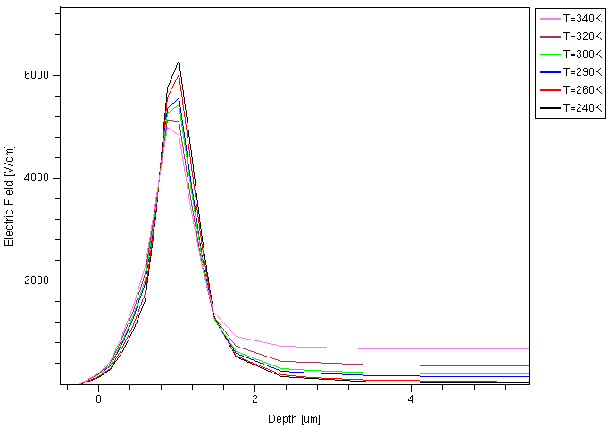
Electric Field
500V – 10¹⁵ cm⁻²

Slide 18

Leakage Current
T=260K
T=290K

