Slide 1



SPL cavities design and construction;
Design evolution for ESS needs
Ofelia Capatina (CERN), Juliette Plouin (CEA), Guillaume Olry (IPNO)
on behalf of the SPL cavity development team

Slide 2
Overview
          Collaboration: who is doing what
          SPL equipped cavities
          SPL beta=1 CERN cavities
          Cavity design evolution from SPL to ESS
          Summary

Slide 3
collaboration: who is doing what?
Beta 0.65
IPN Orsay: 1 cavity with Titanium Helium vessel
Beta 1.0
CEA/Saclay: 1 cavity with Titanium Helium vessel
Stainless Steel Helium vessels and tuning systems for the CERN cavities
CERN: 4 cavities with Stainless Steel vessels
2 ≠ RF coupler types
BNL: 1 « Universal » cavity
HOM
Rostock U.: HOM coupler design
Royal Holloway U. of London: Cavity-to-cavity coupling effects
BNL: Cavity-to-cavity coupling effects & HOM coupler design
SHORT-CRYOMODULE
CERN & IPN Orsay
Guillaume Olry, IPNO, talk SRF 2011 Chicago
Notes:
Cavité = souvent premier objet de R&D sur les projets d’accélérateurs

Slide 4
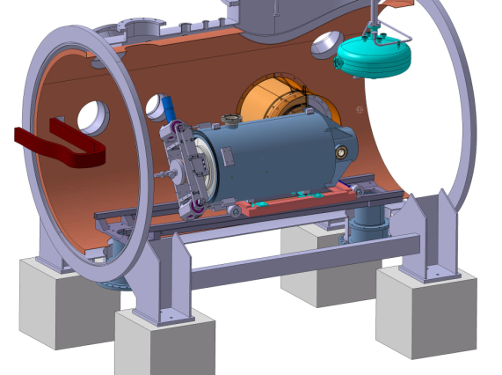
SPL equipped cavities
Beta = 0.65
  RF design done by IPNO
  Mechanical design done by IPNO
  Titanium helium tank
  1 niobium cavity to be manufactured by IPN Orsay
  To be tested in the “CRYHOLAB” at CEA Saclay
  CEA tuner
  CEA main coupler
Configuration to be tested in CRYHOLAB

Slide 5
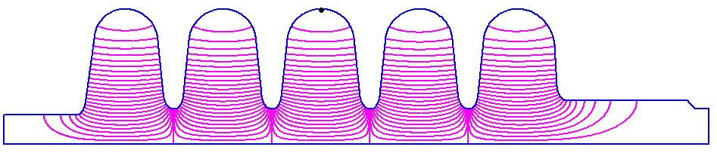
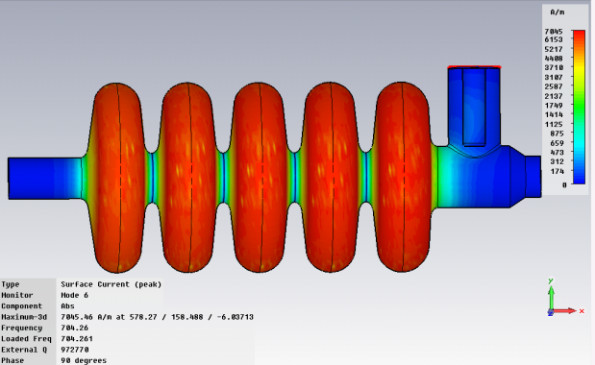
Beta 0.65
RF design
→ Operating gradient: 19 MV/m
  Epk/Eacc<2.6 (<-> Epk=50 MV/m)
  Bpk/Eacc<5.2 mT/(MV/m) (<-> Bpk=100 mT)
EM calculations
  1/ in 2D with SUPERFISH
  2/ in 3D with CST MWS → RF coupler integration
f (MHz) | 704.0
Epk/Eacc | 2.63
Bpk/Eacc (mT/MV/m) | 5.12
K (%) | 1.45
r/Q (Ohm) | 275
G (Ohm) | 197
Vacc @βg & 1 Joule (MV) | 1.11
Qo (@2K, Rres=2nΩ) | 3.9 10¹⁰
Transit Time Factor | 0.65
E field
Guillaume Olry, IPNO, talk SRF 2011 Chicago
Notes:
Cavité = souvent premier objet de R&D sur les projets d’accélérateurs

Slide 6
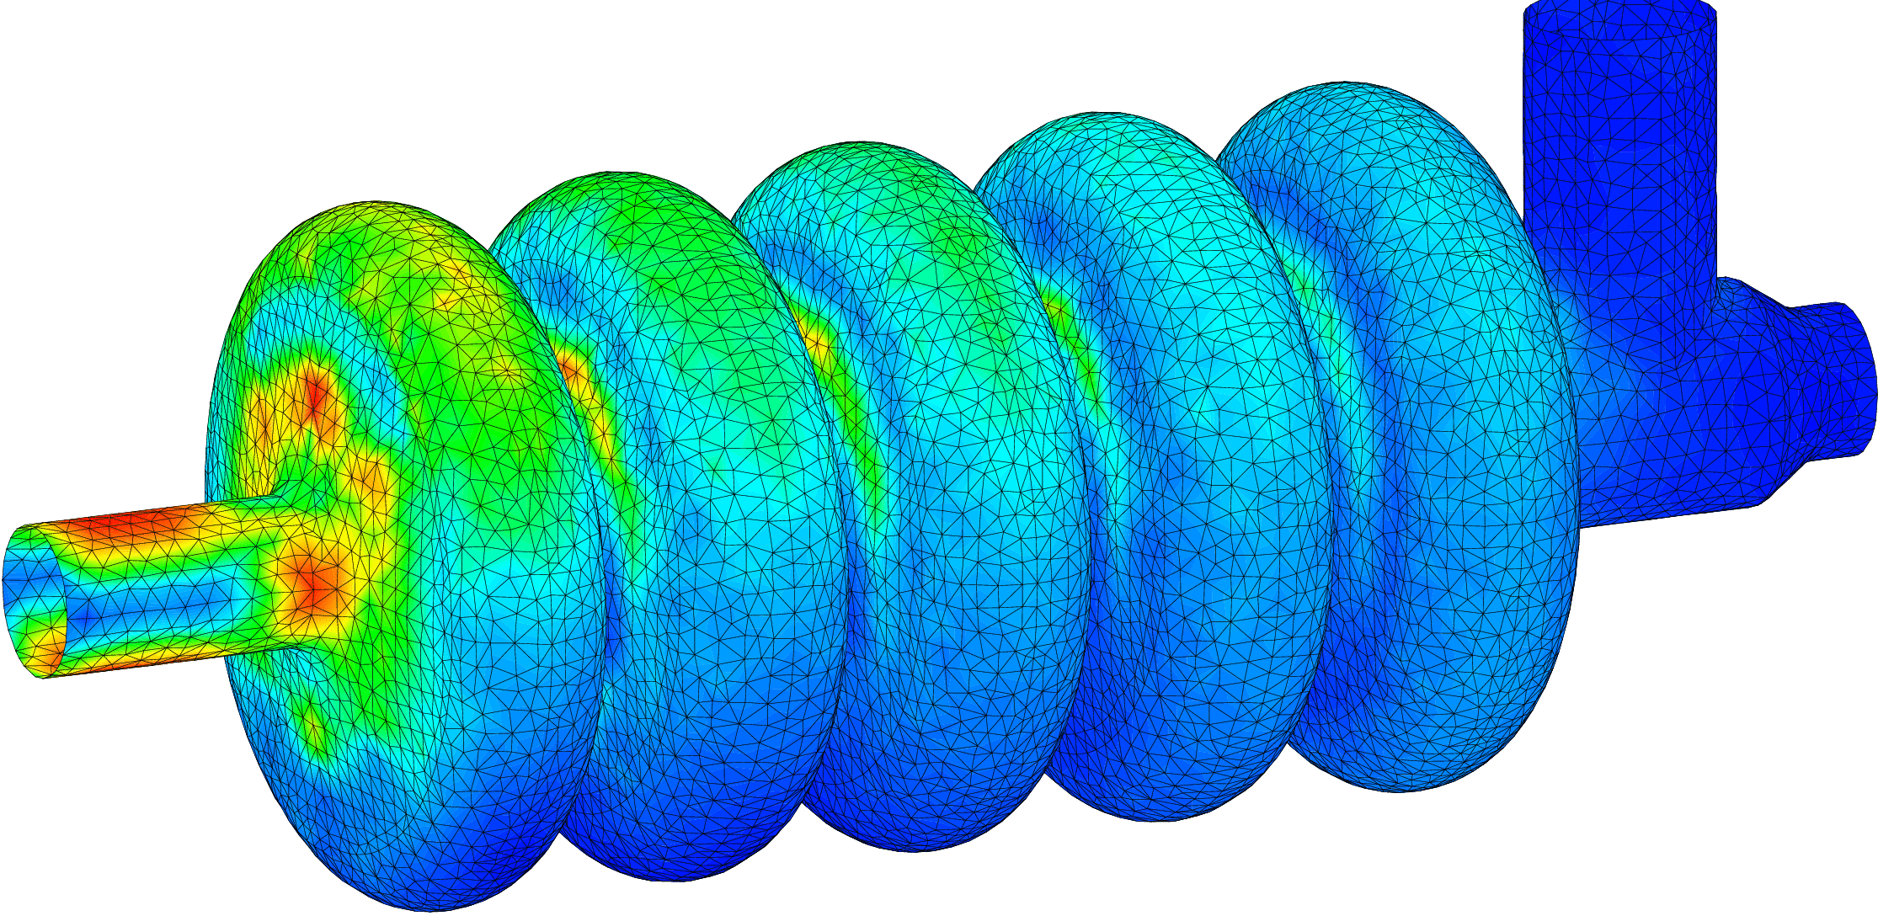
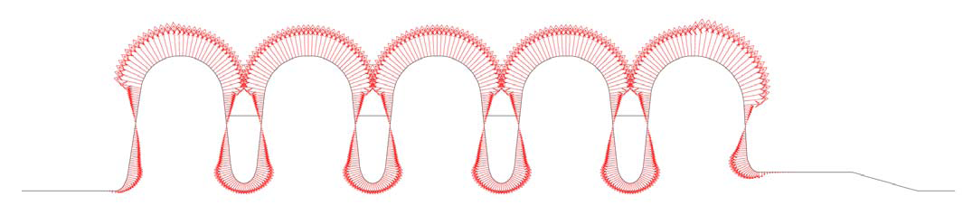
Beta 0.65
Mechanical design
Von Mises stresses for 1.5 bar @ 300K < 50 MPa with 4mm
46 MPa
Cavity walls = 4mm
→ Niobium cost ~70 k€
Lorentz forces detuning factor : K_{L}~ -1.6 Hz/(MV/m)²
1 stiffening ring
94mm
beam axis
Guillaume Olry, IPNO, talk SRF 2011 Chicago
Notes:
Cavité = souvent premier objet de R&D sur les projets d’accélérateurs

Slide 7
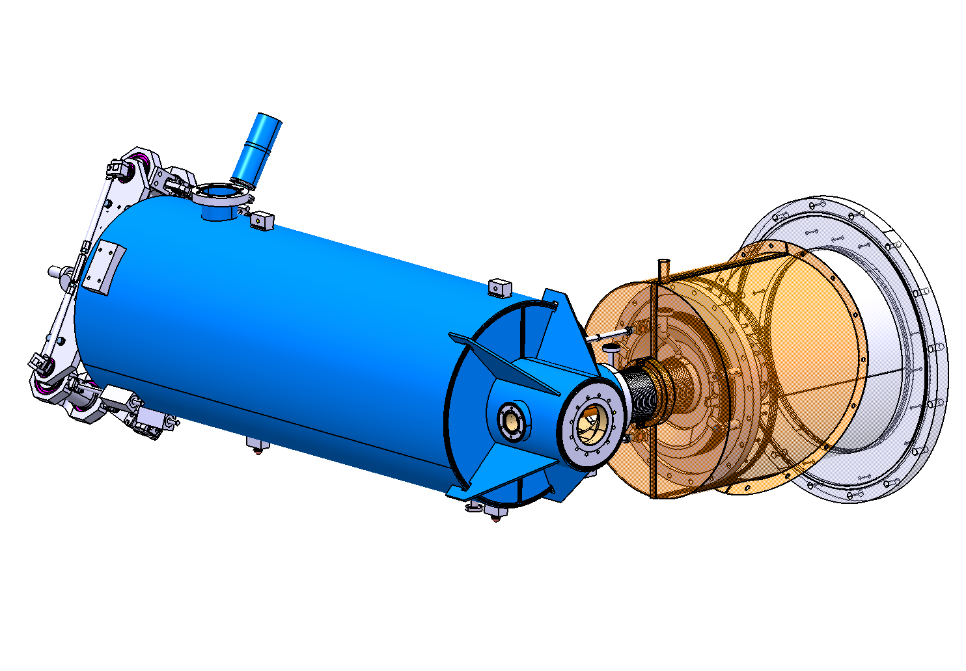
SPL equipped cavities
Beta = 1, CEA cavity
  RF design done by CEA (will be compared later in this talk to ESS design)
  Mechanical design done by CEA
  Titanium helium tank
  1 niobium cavity to be manufactured by CEA
  To be tested in the “CRYHOLAB” at CEA Saclay
  CEA tuner
  CEA main coupler
Configuration to be tested in CRYHOLAB

Slide 8

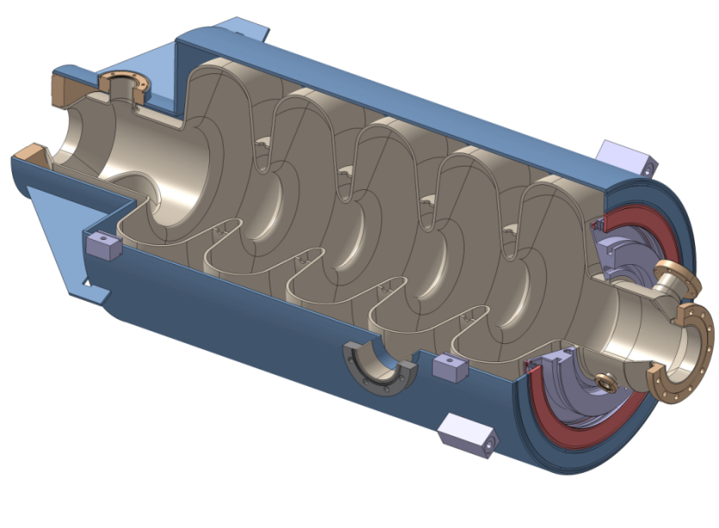
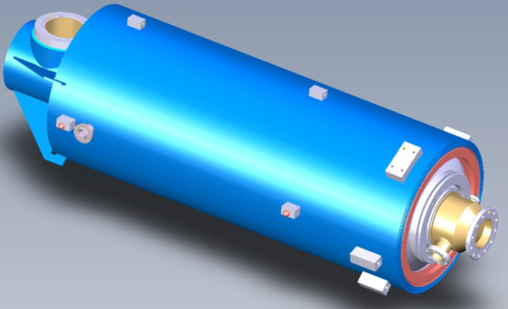
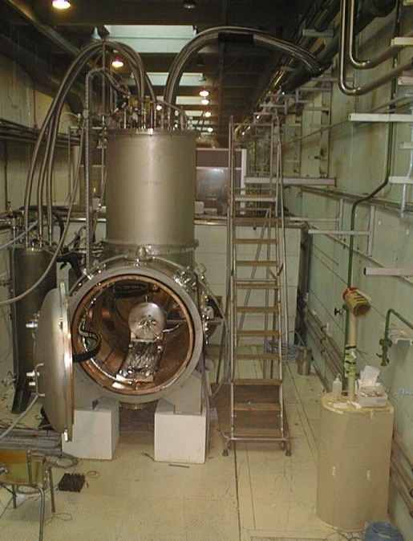
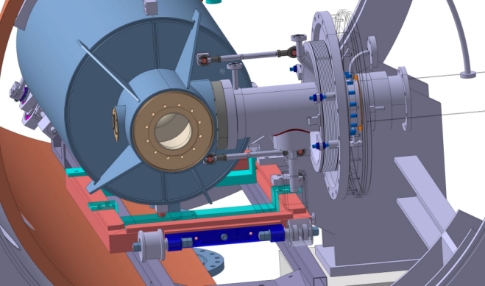

Beta 0.65 & Beta=1 common features
Orders: end of 2011
Same helium vessel design and same end-groups
Titanium He vessel
IPN Orsay beta 0.65
CEA Saclay beta=1
→ Final test in horizontal cryostat with the same auxiliary components (tuning system + RF coupler)
Guillaume Olry, IPNO, talk SRF 2011 Chicago
CRYHOLAB
Notes:
Cavité = souvent premier objet de R&D sur les projets d’accélérateurs

Slide 9
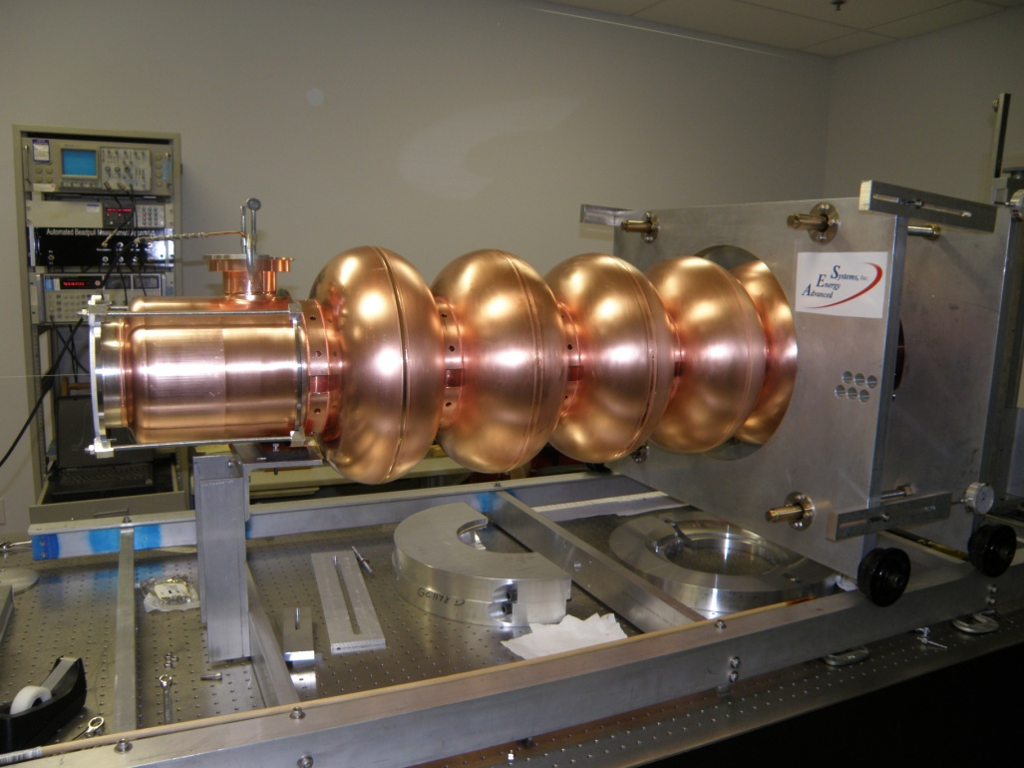
SPL equipped cavities
Beta = 1, BNL cavities
  1 copper cavity and 1 niobium cavity designed and manufactured by BNL
  Will be presented by Rama Calaga today at 14h00

Slide 10
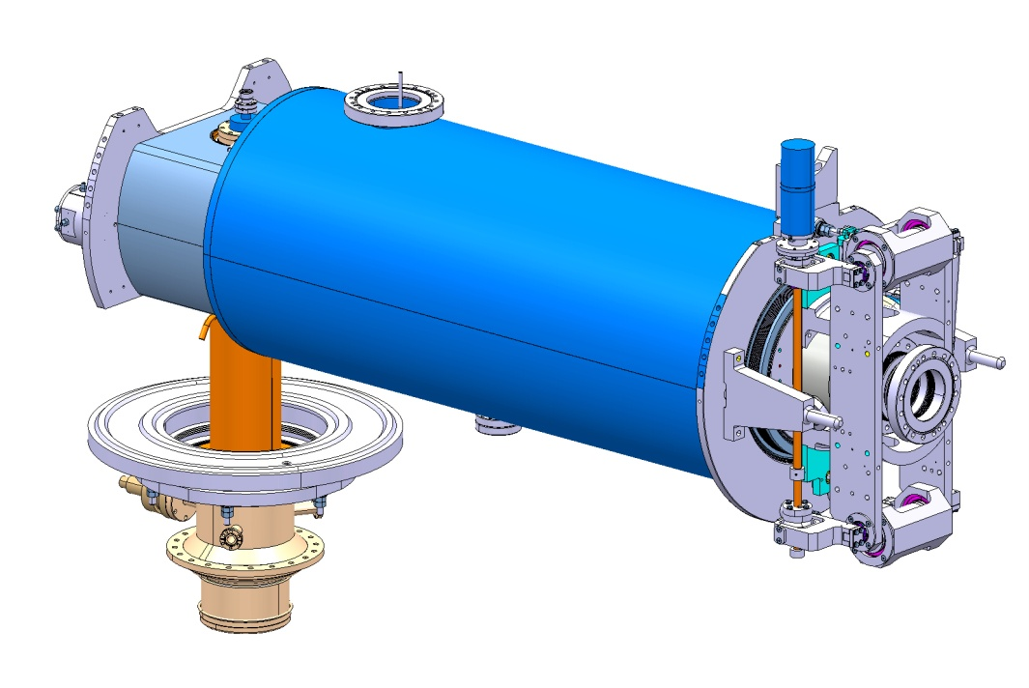
SPL equipped cavities
Beta = 1, CERN cavities
  RF design done by CEA
  Mechanical design done by CEA and CERN
  Stainless steel helium tank
  2 copper cavity manufacturing ongoing at CERN
  5 niobium cavities to be manufactured by end 2012
    4 in industry (Research Instruments)
    1 at CERN
  To be tested in the short cryo-module at CERN
  CEA tuner
  CERN main coupler
  (talk of Eric Montesions tomorrow)
Configuration to be tested in cryo-module

Slide 11
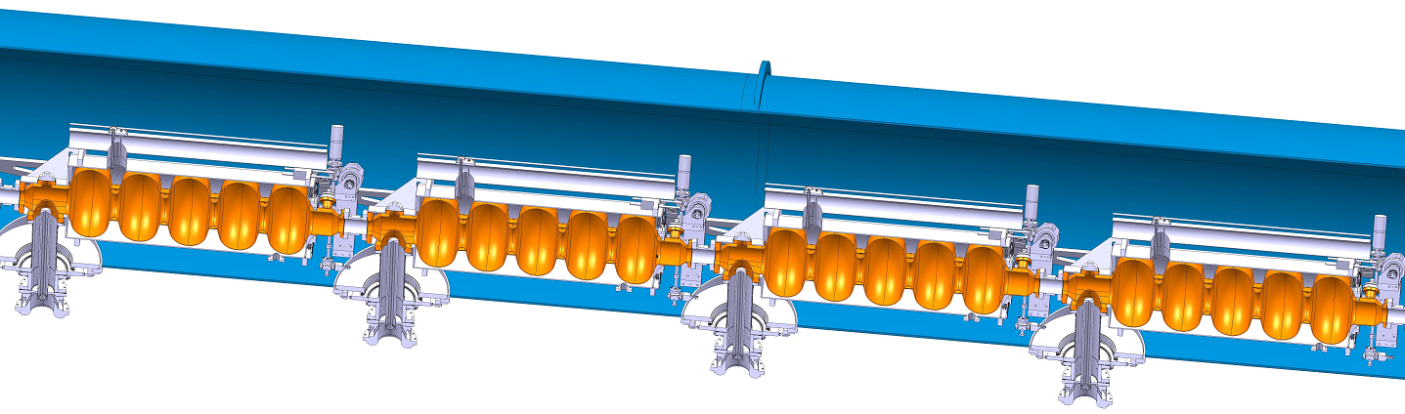
SPL beta=1 CERN cavities
A string of 4 “equipped beta=1 cavities” + main coupler to be installed into a short cryo-module by 2013
1490.5 mm
Schematic view
of string of 4 “equipped
cavities” and main coupler
Short cryo-module design to be done by IPN Orsay
(see talk tomorrow by Vittorio Parma)

Slide 12
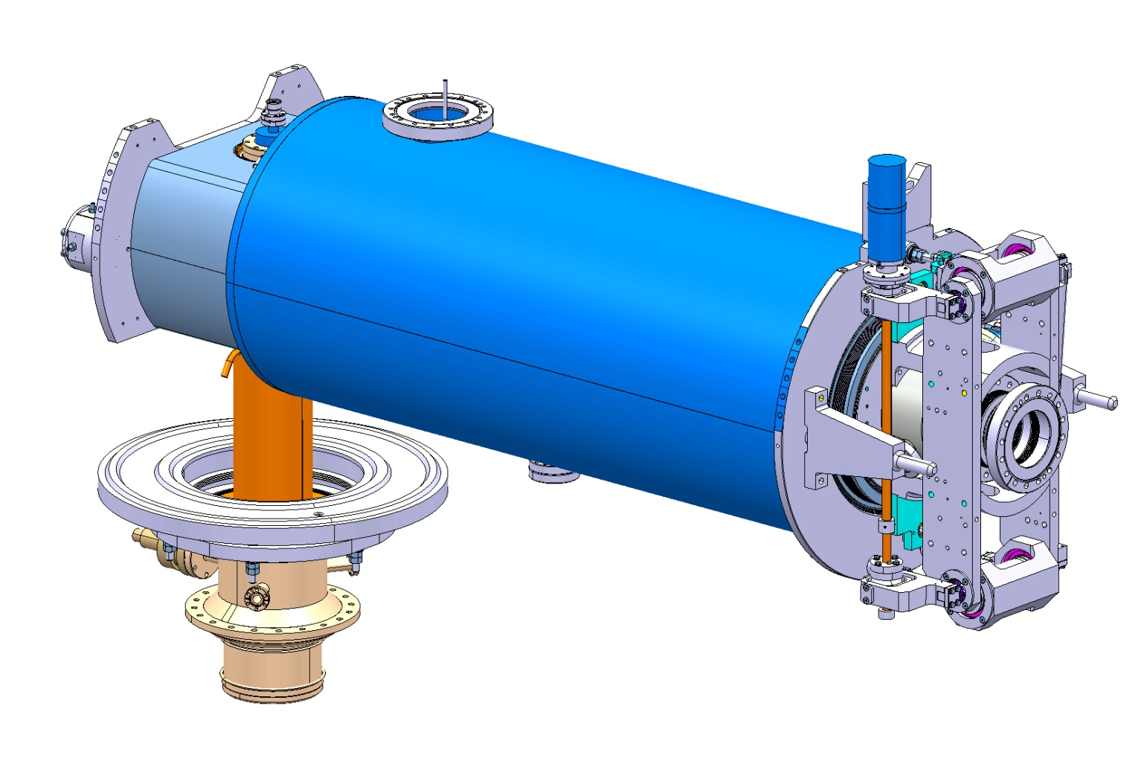
SPL beta=1 CERN cavities
SPL beta = 1 cavity + helium tank + tuner + main coupler to be installed and tested in cryo-module at CERN
Stainless Steel helium tanks designed by CERN;
4 tanks to be provided by CEA;
to be welded on cavity by CERN
Tuners to be provided by CEA
Main couplers to be provided by CERN
(see Eric Montesino’s talk tomorrow)

Slide 13
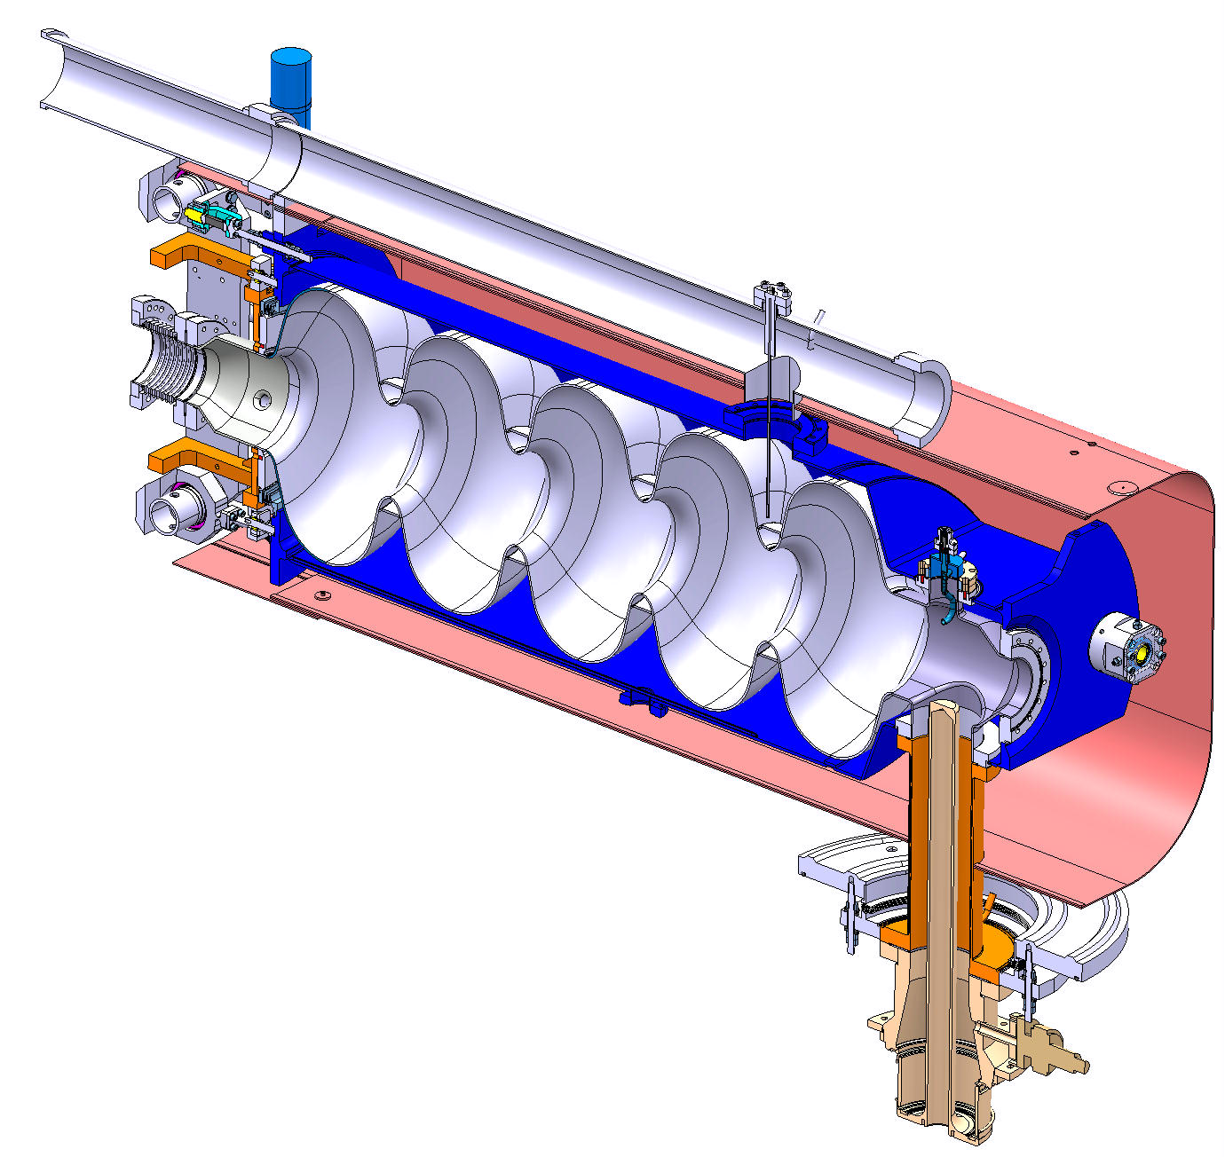
SPL beta=1 CERN cavities
SPL beta = 1 cavity + helium tank + tuner + main coupler to be installed and tested in cryo-module at CERN
Helium Tank
Bulk Niobium 5-cells Cavity
HOM Coupler
Tuner
Magnetic Shielding
Power Coupler

Slide 14
SPL beta=1 CERN cavities
RF design
  Done by CEA Saclay in 2009
  Comparison RF design SPL / ESS later in this talk

Slide 15
SPL beta=1 CERN cavities
Mechanical dimensioning
  Static (quasi-static)
    Lorentz detuning
    Maximum pressure / sensitivity to fluctuation
    Deformation for tuning
    Handling configurations
  Natural vibration modes
  Bucking

Slide 16
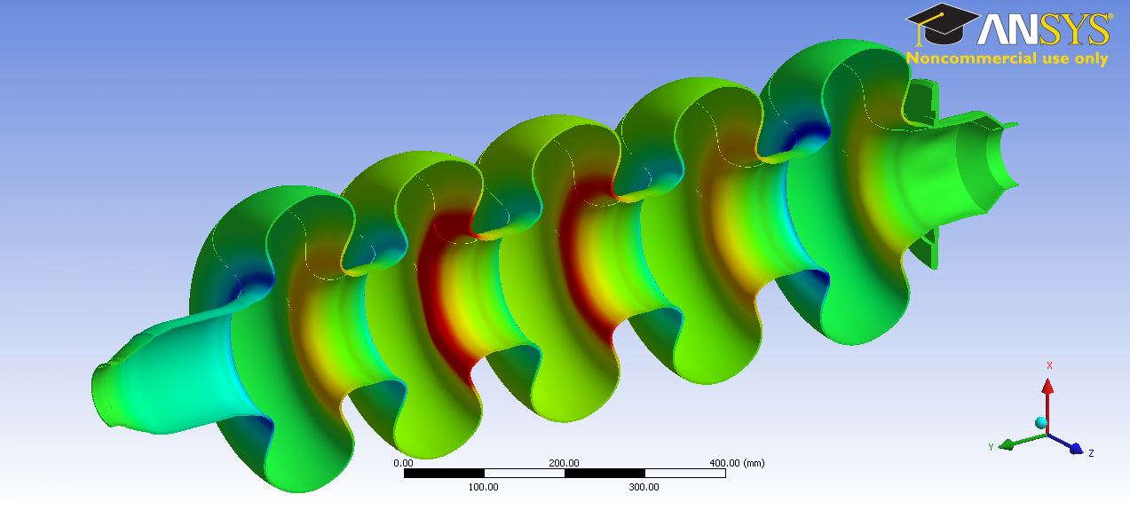
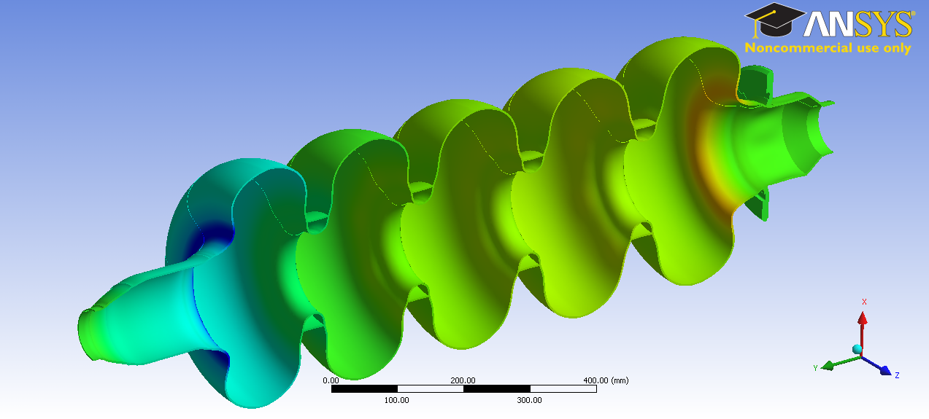
SPL beta=1 CERN cavities
Lorentz detuning
Without
stiffening rings
With
stiffening rings

Slide 17
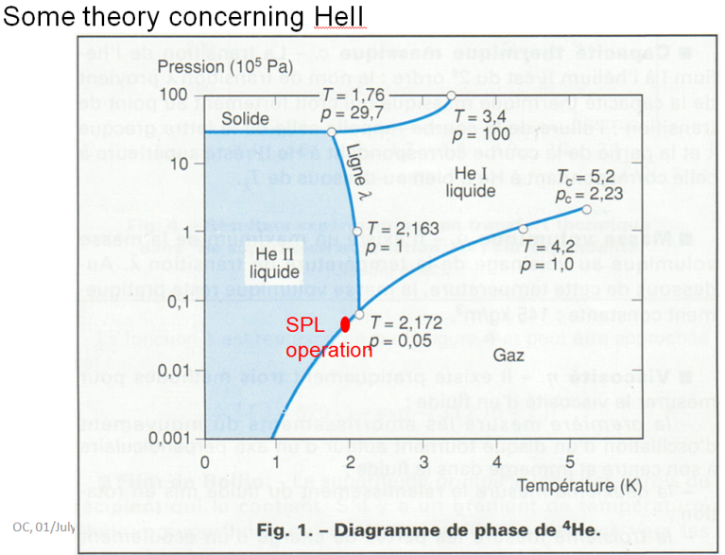
SPL beta=1 CERN cavities
Helium tank
  Two configurations designed and partially tested / interfaces: Titanium and Stainless steel
  Stainless steel helium tank chosen as baseline for CERN cavities
  Helium ports dimension:
    The helium ports dimensions were calculated with respect to maximum heat flow to be evacuated through
For details see Ofelia Capatina’s presentation in the frame of the 4th collaboration meeting in Lund

Slide 18
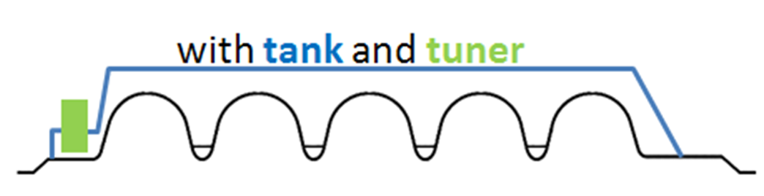
SPL beta=1 CERN cavities
Helium tank + tuner act as boundary conditions to cavity => different stiffness gives different deformation of cavity due to Lorentz forces
  Zero tank + tuner stiffness equivalent to
  free-free BC for cavity
  Infinite tank + tuner stiffness equivalent to
  fix-fix BC for cavity

Slide 19
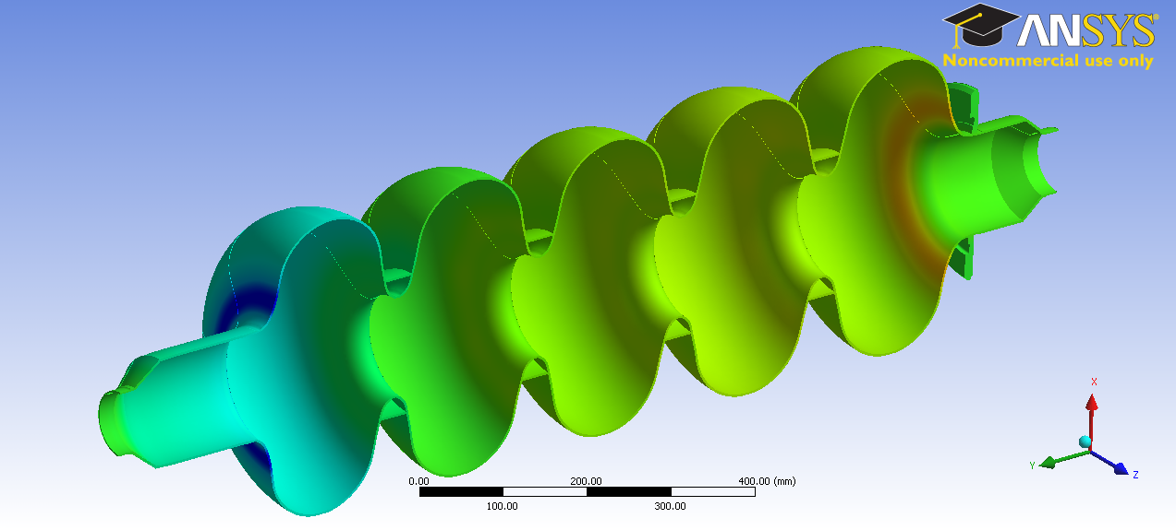
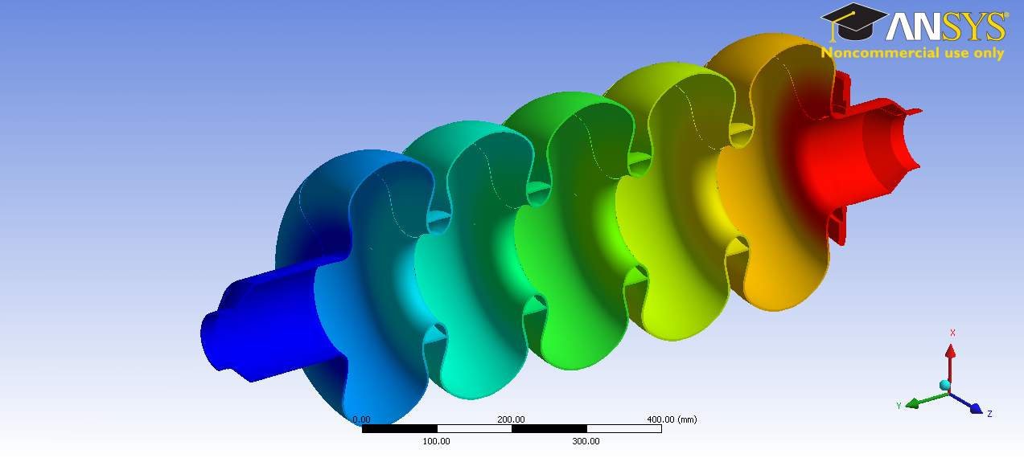
SPL beta=1 CERN cavities
Deformation under Lorentz forces
Fix-fix BC
Free-free BC

Slide 20
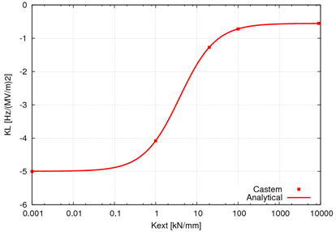
SPL beta=1 CERN cavities
Lorentz detuning => min helium tank stiffness 100 kN/mm
∞ tank +
tuner
stiffness
Detuning coefficient K_{L}≈1.2 Hz/(MV/m)²
for real ext stiffness
0 tank + tuner stiffness

Slide 21
SPL beta=1 CERN cavities
Manufacturing
  4 niobium cavities by industry and 1 niobium cavity by CERN by end of 2012
    Talk by Gonzalo Arnau concerning materials
    Talk by Said Atieh concerning manufacturing and R&D
  2 copper cavities manufacturing ongoing
    Help to adjust manufacturing parameters and identify possible
    1 cavity will be used for HOM measurements
    1 cavity will be used for sputtering tests
    Talk by Nuria Valverde concerning manufacturing
Cavity preparation
  Talk by Leonel Marques concerning Elecro-Polishing plant at CERN
  Field flatness measurement system and tuning system still to be designed

Slide 22
Cavity design evolution from SPL to ESS
Juliette Plouin CEA-Saclay

Slide 23
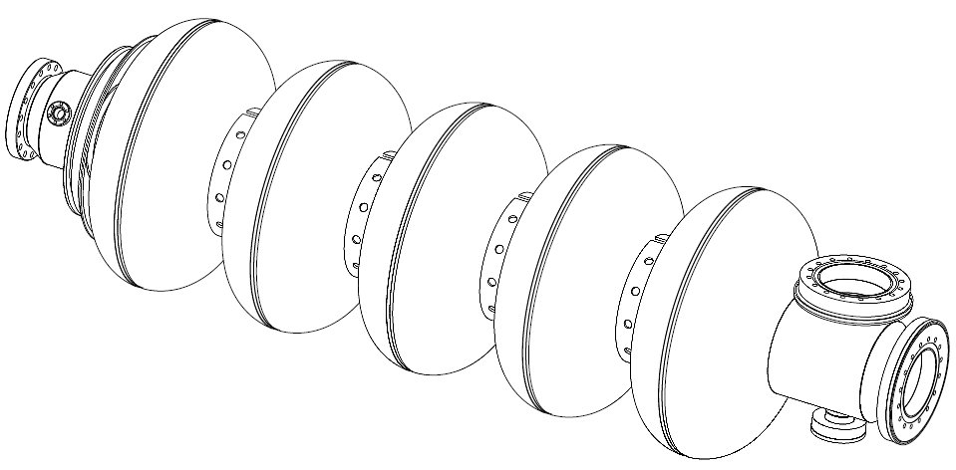
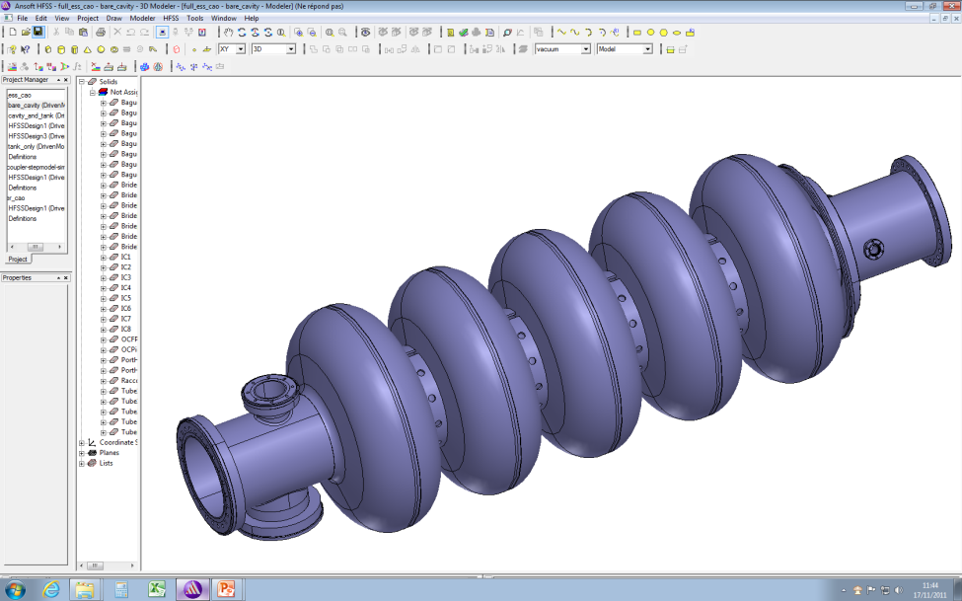
Cavity RF design : SPL vs ESS
RF frequency | 704.42 MHz
Cavity geometrical beta | 1
Accelerating gradient | 25 MV/m
Maximum surface E field | 40 MV/m
Average pulse current | 40 mA
Peak RF power | 1 MW
Repetition frequency | 50 Hz
Duty cycle | 5%
Operating Temperature | 2 K
RF frequency | 704.42 MHz
Cavity geometrical beta | 0.86
Accelerating gradient | 18 MV/m
Q₀ at nominal field | > 6 10⁹
Maximum surface E field | 40 MV/m
Average pulse current | 50 mA
Peak RF power | 900 kW
Repetition frequency | 14 Hz
Beam pulse length | 2.86 ms
Operating Temperature | 2 K
DESIGN PARAMETERS
DESIGN PARAMETERS
Bpk/Eacc [mT/(MV/m)] | 4.20
Epk/Eacc | 1.99
G [Ohm] | 270
Cell to cell coupling | 1.92 %
r/Q [Ohms] | 566
L_{acc} = Ngap.β.λ/2 [m] | 1.0647
Bpk/Eacc [mT/(MV/m)] | 4.3
Epk/Eacc | 2.2
G [Ohm] | 241
Cell to cell coupling | 1.8 %
r/Q [Ohms] | 477
L_{acc} = Ngap.β.λ/2 [m] | 0.915
Cell wall angle | > 8°
SPL
ESS
RF PARAMETERS
RF PARAMETERS
Ø96mm
Ltot=1393mm
Ø140mm
Ltot=1315mm
Juliette Plouin CEA-Saclay
Ø96mm
Ø140mm

Slide 24
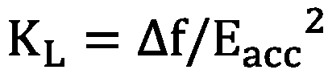
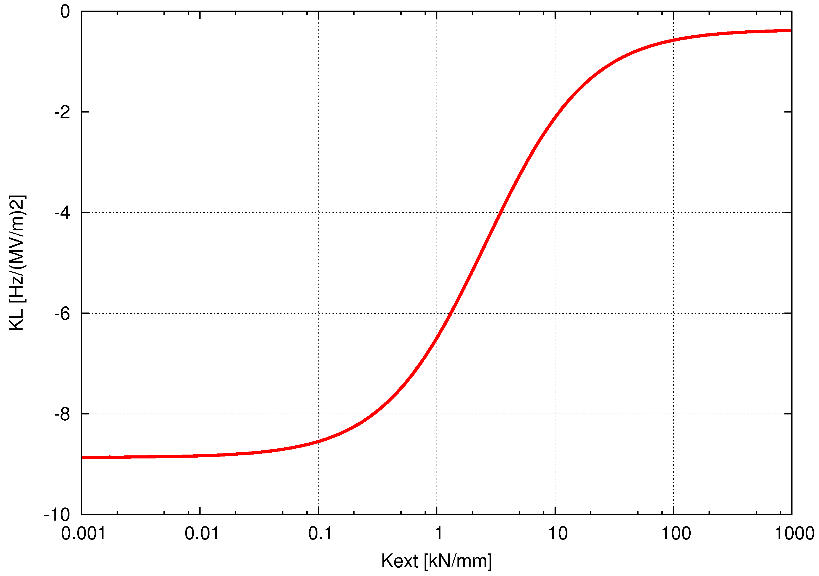

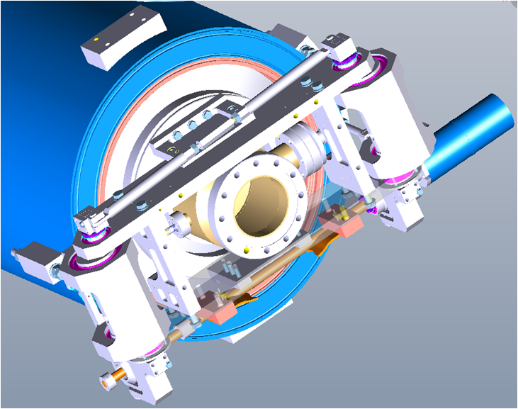
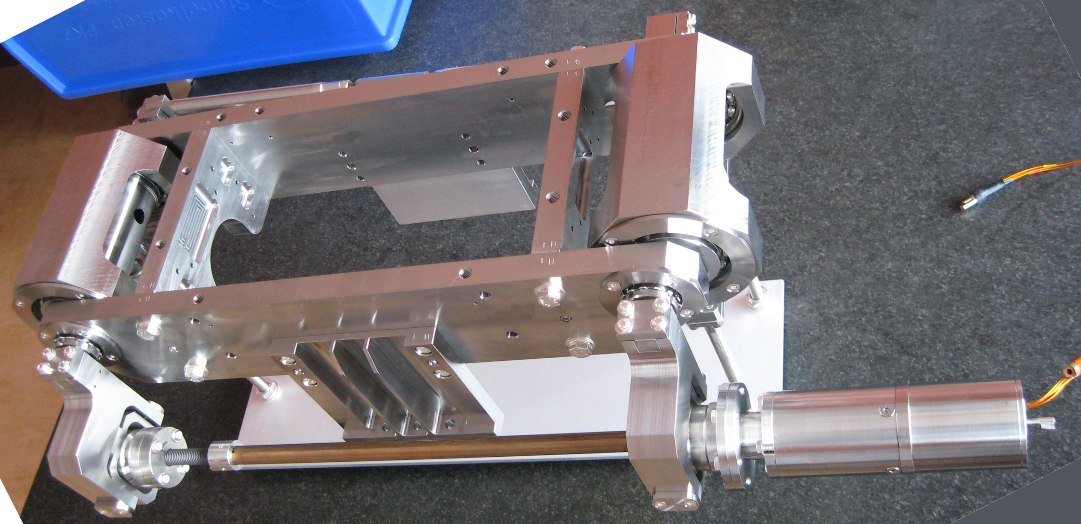
Coupled RF/mechanicals design
Reduction of K_{L} with stiffening rings (SPL and ESS)
Nominal wall thickness [mm] | 3
Cavity stiffness Kcav [kN/mm] | 3.84
Tuning sensitivity Δf/Δz [kHz/mm] | 164
K_{L} with fixed ends [Hz/(MV/m)²] | -0.55
K_{L} with free ends [Hz/(MV/m)²] | -5
Pressure sensitivity K_{P} [Hz/mbar] (fixed ends) | 1.2
Nominal wall thickness [mm] | 3.6
Cavity stiffness Kcav [kN/mm] | 2.59
Tuning sensitivity Δf/Δz [kHz/mm] | 197
K_{L} with fixed ends [Hz/(MV/m)²] | -0.36
K_{L} with free ends [Hz/(MV/m)²] | -8.9
Pressure sensitivity K_{P} [Hz/mbar] (fixed ends) | 4.85
SPL
ESS
K_{ext} (tank + tuner)≈35kN/mm
K_{L}≈-1.2 Hz/(MV/m)²
Δf ≈ 750 Hz @ 25MV/m
K_{ext} (tank + tuner)≈30 kN/mm
K_{L}≈-1 Hz/(MV/m)²
Δf ≈ 325 Hz @ 18 MV/m (1/3 of cavity bandwidth )
SPL tuner
SPL and ESS cavities will be equipped with Saclay V type tuners for slow and fast tuning
Juliette Plouin CEA-Saclay

Slide 25
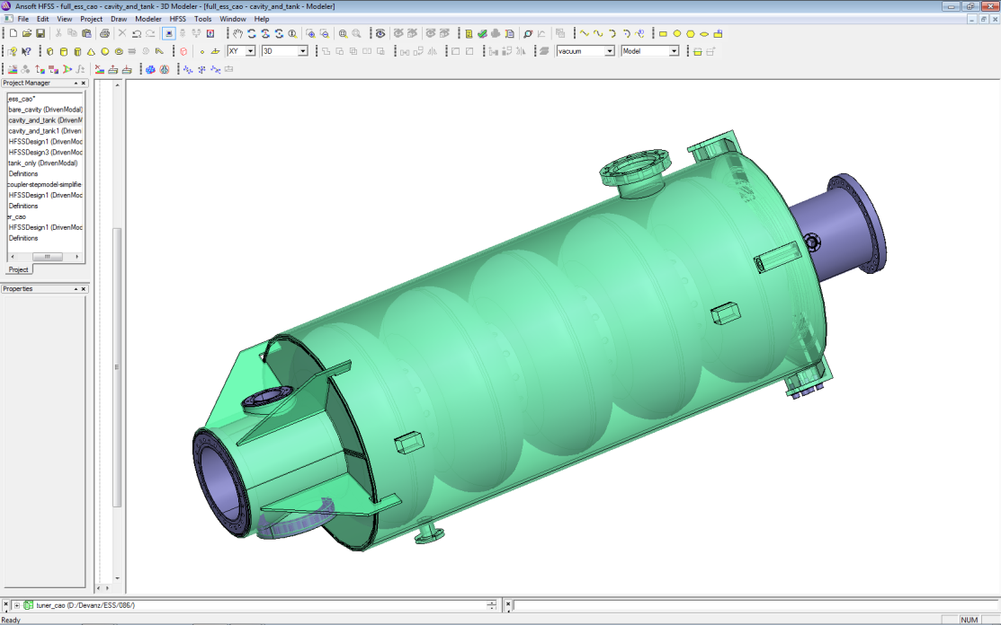
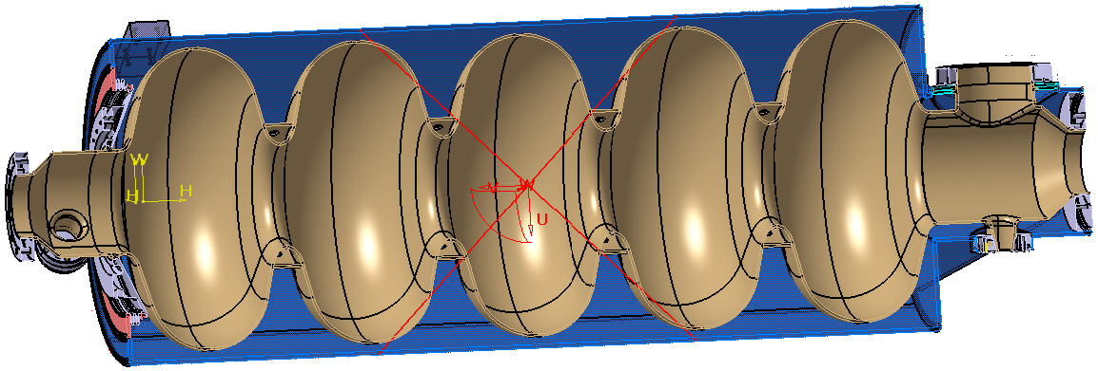
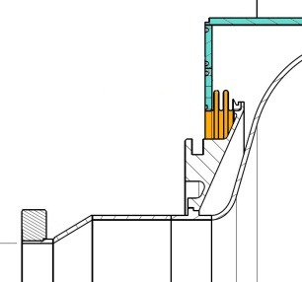
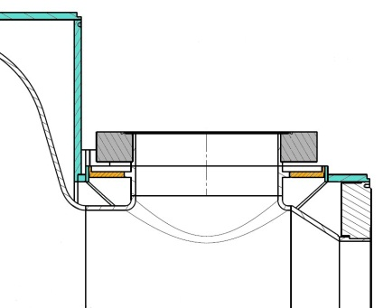
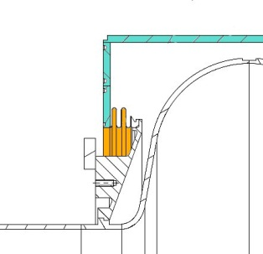
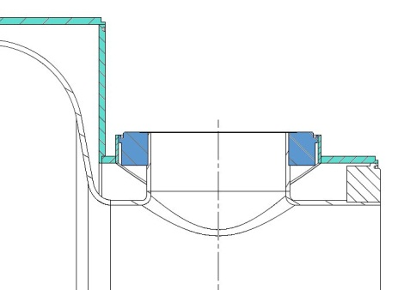
Mechanicals design
Saclay prototype : possible integration in Cryholab
Helium tank in Ti
Stainless Steel flange+copper gasket
Helium tank in Ti
Bellows (Ti)
Intermediate piece in Ti
Nb/Ti flanges
Intermediate piece in Ti
Bellows (Ti)
Intermediate piece in Ti
Helium tank in Ti
Helium tank in Ti
Helium tank in Titanium (limits the differential shrinkage with Nb during cooling down)
All flanges made of Nb or Nb/Ti
except the FPC flange, in stainless steel with copper gasket, to be compatible with the HIPPI coupler, and for safety reasons
  intermediate piece in Ti needed
Helium tank in Titanium (limits the differential shrinkage with Nb during cooling down)
All flanges made of Nb or Nb/Ti
The position of the HOM ports could change after the prototypes, in relation with HOM couplers studies (SPL and ESS)
Juliette Plouin CEA-Saclay

Slide 26
  ESS cavity without extremity “cones”
    + easier to extract the HOM propagating in a larger tube
    + easier for the manufacturing
    + easier for electro polishing and more generally for cavity cleaning
    + more rigid, thus less sensitive to Lorentz forces
    - longer cavity (for larger tubes one should increase the length to avoid the fundamental mode to be dissipated on the inter-cavities bellow)
    - bigger flanges
    - a priori more difficult to mount the tuning system
Juliette Plouin CEA-Saclay

Slide 27
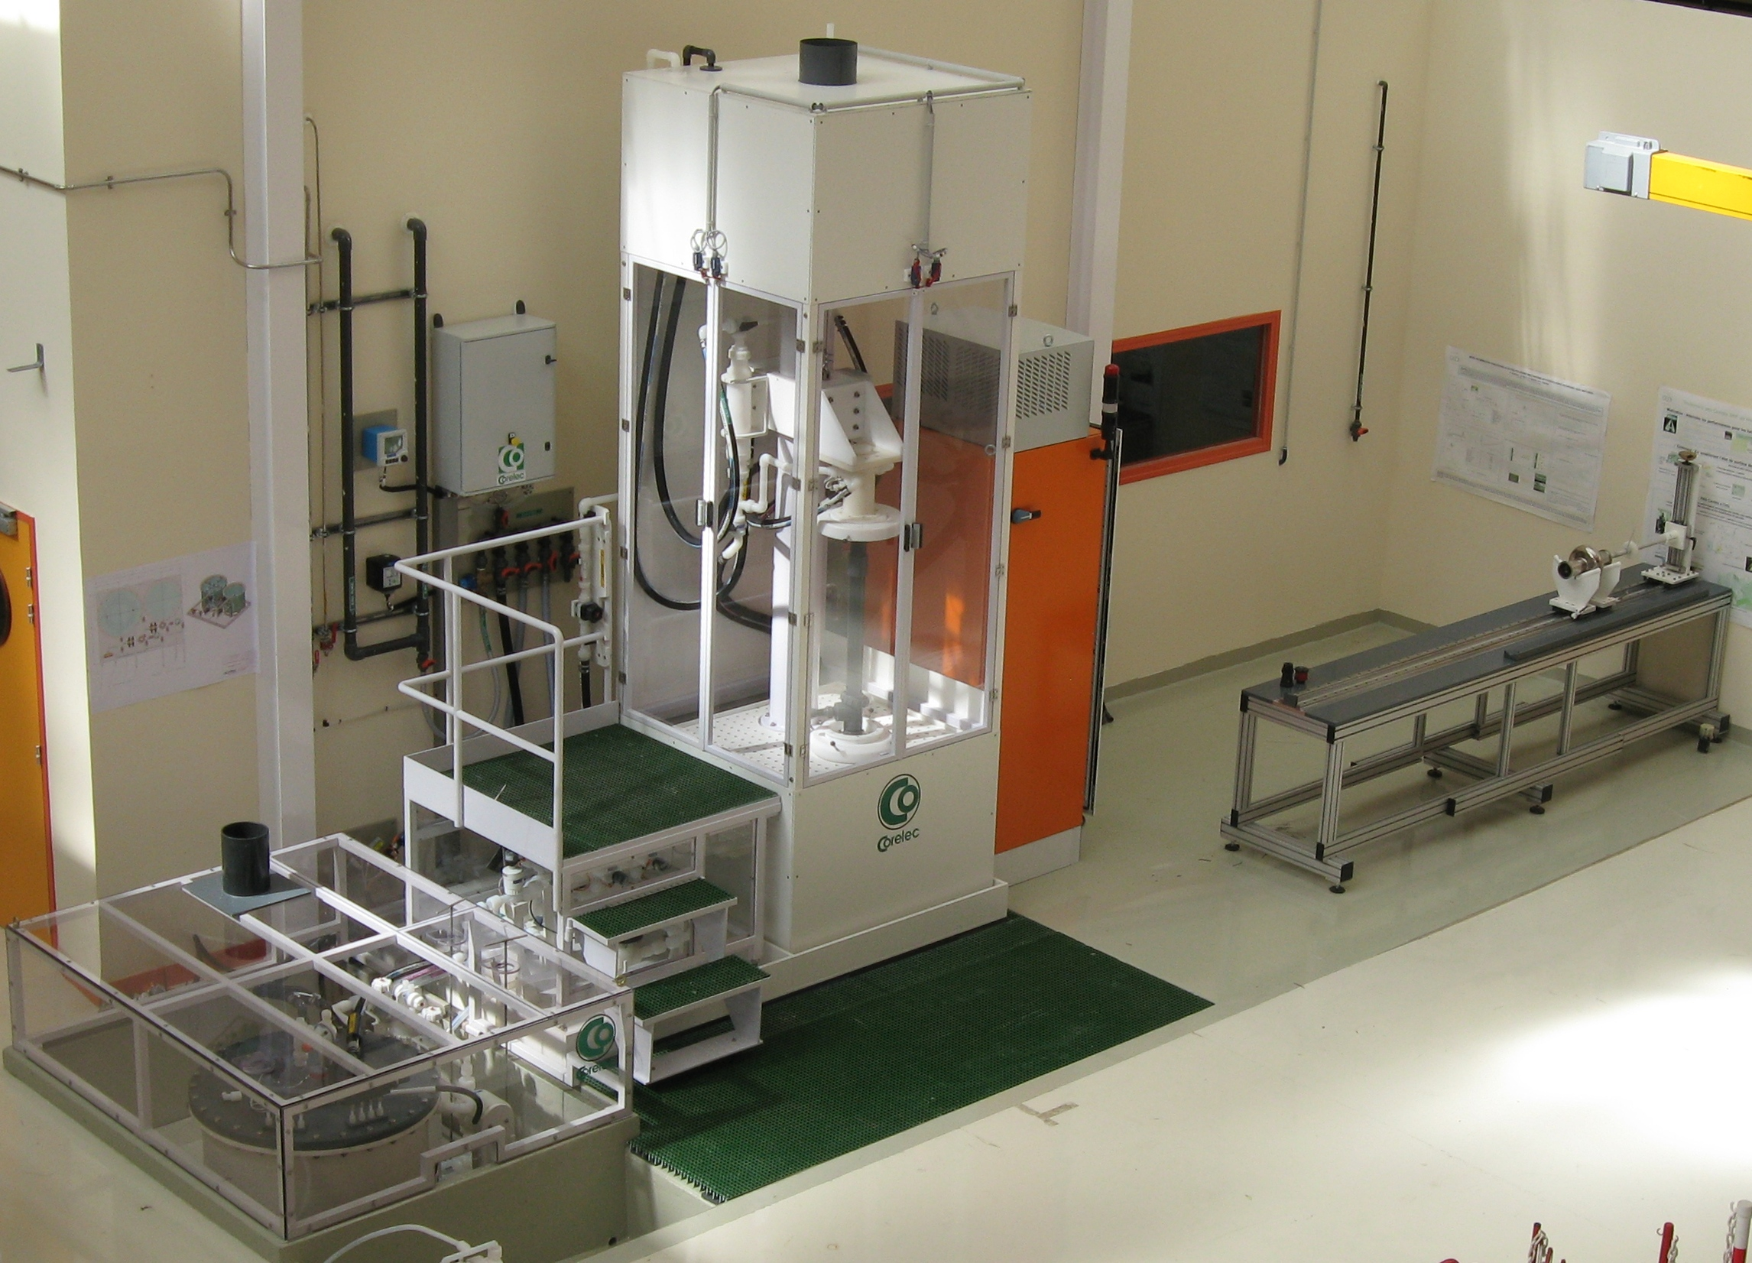
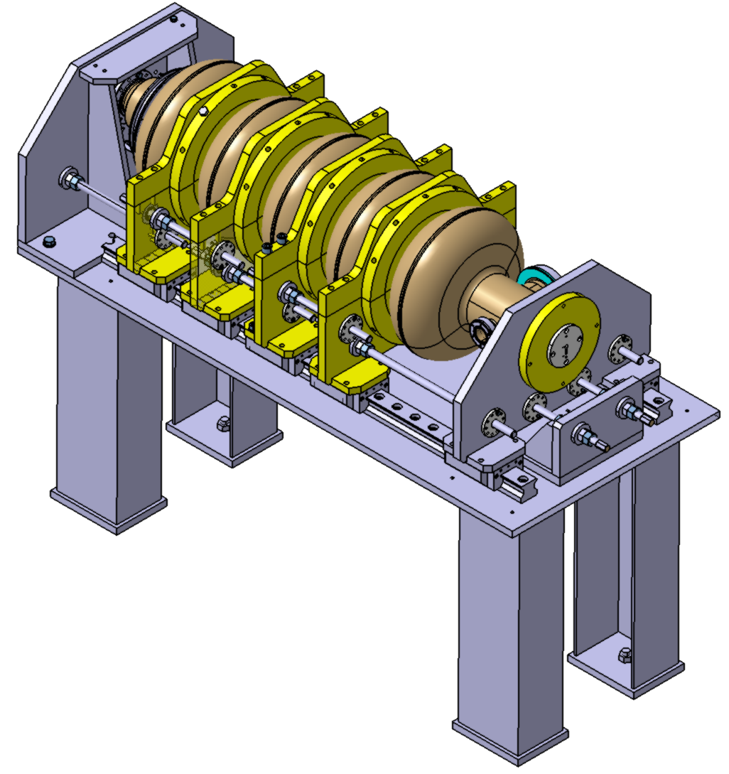
Equipment for cavity preparation
Vertical electro-polishing (installed and tested at Saclay)
Ready to use for both SPL and ESS cavities
Cavity tuning set-up for field flatness achievement at room temperature (under development)
Cell by cell tuning between plates
This set-up is adaptable for both SPL and ESS cavities
Juliette Plouin CEA-Saclay

Slide 28
Summary
Several cavity developments all over the world, related to the SPL project
They will be tested independently by each collaborator in their own testing facilities
Cavities to be installed in the SPL cryo-module will be provided by CERN by end of next year:
  4 to be manufactured in industry
  1 (spare) to be manufactured at CERN
SPL beta=1 cavity design by CEA was used as basis for beta=0.86 cavity design for ESS

