Slide 1



EPPOG Physics Masterclasses 2012
Moderating the Video Conference
Kate Shaw
Udine/ICTP

Slide 2
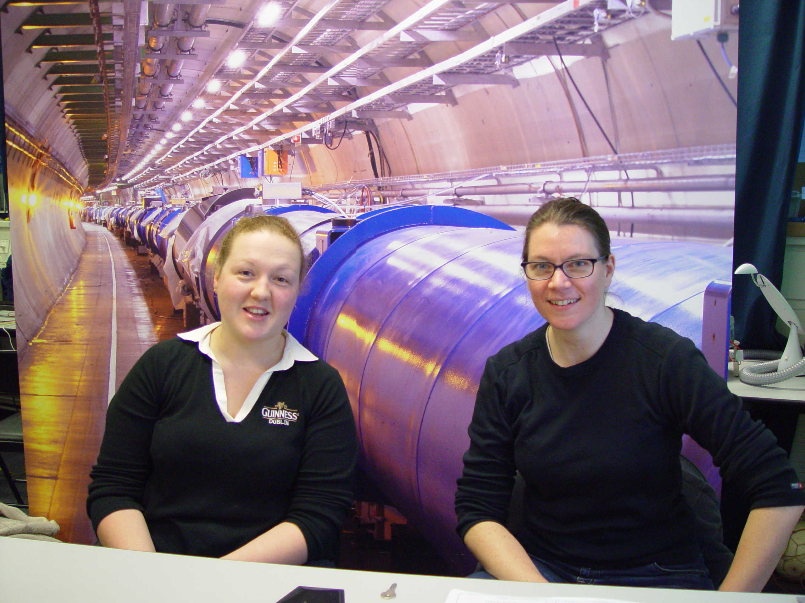
Moderators
You are going to be the face of CERN to hundreds of students around the world!

Slide 3
The Video Conference
16:00
16:10
16:20
16:30
16:40
16:50
17:00
Welcome & icebreaker
Reports of measurements
Combination & discussion of measurement
Open discussion
Quiz
Good Bye
One hour video conference with 3-5 institutes
The VC should:
convey the internationality of the event
demonstrate how physicists work together internationally
encourage students to exchange experiences between masterclasses
demonstrate improvement in accuracy by combination of different data sets
most importantly: BE FUN FOR THE STUDENTS!

Slide 4
The Video Conference
16:00
16:10
16:20
16:30
16:40
16:50
17:00
Welcome & icebreaker
Reports of measurements
Combination & discussion of measurement
Open discussion
Quiz
Good Bye
One hour video conference with 3-6 institutes
The VC should NOT:
deepen the understanding of the physics
teach English vocabulary of particle physicists
contain a basic discussion of the measurement
create a competition regarding the measurements

Slide 5
Welcome & icebreaker
16:00
16:10
16:20
16:30
16:40
16:50
17:00
Welcome & icebreaker
Reports of measurements
Combination & discussion of measurement
Open discussion
Quiz
Good Bye
The welcome has to be on schedule, common and interactive!!
Students should immediately feel they should actively take part in the VC
Introduce yourself and explain where you are
Put on the live stream from Control rooms onto shared desktop
Explain what will be happening in the next hour
Display a map showing all the connected sites
Ask one short question to each masterclass

Slide 6
Reports of measurements
16:00
16:10
16:20
16:30
16:40
16:50
17:00
Welcome & icebreaker
Reports of measurements
Combination & discussion of measurement
Open discussion
Quiz
Good Bye
Put up the results page onto the shared desktop and address each masterclass one by one
Students should report for up to two minutes on results, uncertainties, difficulties and express any questions they had
All reports must be given in a row – NOT interrupted by questions or comments
Then at the end students have the chance to comment and ask questions

Slide 7
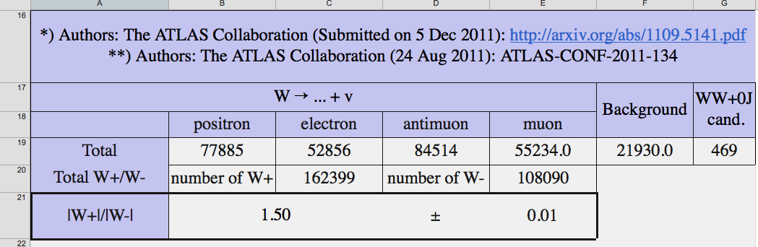
Combination & discussion of measurement
16:00
16:10
16:20
16:30
16:40
16:50
17:00
Welcome & icebreaker
Reports of measurements
Combination & discussion of measurement
Open discussion
Quiz
Good Bye
All masterclasses will do the same measurement but different data
Combine the results in the table
Summarize and comment.
Compare to the theory/experimental results
Stress why using different data from different sources is beneficial (stats and reduces bias)
Students here can ask questions. Encourage discussion between the masterclasses

Slide 8
Open discussion
16:00
16:10
16:20
16:30
16:40
16:50
17:00
Welcome & icebreaker
Reports of measurements
Combination & discussion of measurement
Open discussion
Quiz
Good Bye
Discussion can expand to more open and general questions
They can be on anything from…
  Life at CERN
  LHC, size, magnets, cost, power consumption
  Detectors & experiments
  The Universe, the Big Bang, dark matter, black holes, time travel…
  How to get into physics/working at cern
Give short answers

Slide 9
The Quiz
16:00
16:10
16:20
16:30
16:40
16:50
17:00
Welcome & icebreaker
Reports of measurements
Combination & discussion of measurement
Open discussion
Quiz
Good Bye
7Tev Quiz – who wants to be a millionaire?
Moderators show English version on shared desktop.
Seven questions – each multiple choice
Each student plays alone
Correct answer revealed after each question
Scoring is done by each student
No comparisons, no prizes
Don’t phone in it’s just for fun!

Slide 10
Quiz
Welcome to the
MASTERCLASSES QUIZ!
Rules of the Game
7 questions, 4 answers to choose (A,B,C,D)
mark your answer on your answer sheet before the timer ends!
moderators will then reveal the correct answer
if you have answered correctly, you may tick off the next energy level
Let‘s check which energy level you can reach!
Please note:
this quiz is for fun, not for competition!
we won‘t compare results

Slide 11
Quiz
Welcome to the
MASTERCLASSES QUIZ!
GO!
Ready?
Set

Slide 12

Quiz Question Sheet
Which particle is the mediator
of the Strong Force?
Neutralino
Gluon
1
A
C
Snail
Pigsino
B
D

Slide 13
Quiz Question Sheet
Which particle is the mediator
of the Strong Force?
Neutralino
Gluon
1
A
C
Snail
Pigsino
B
D

Slide 14
Quiz Question Sheet
How much of our universe
is made of matter or energy,
about which we know
almost nothing about?
13%
100%
2
A
C
96%
32.8%
B
D

Slide 15
Goodbye
16:00
16:10
16:20
16:30
16:40
16:50
17:00
Welcome & icebreaker
Reports of measurements
Combination & discussion of measurement
Open discussion
Quiz
Good Bye
There has to be a clear common end of the VC after 60 minutes!
Say goodbye to everyone and thank them for taking part!
Do not keep discussion going even if the students are asking questions
If they and you want some discussion can continue after the goodbye on a voluntary basis

Slide 16
Vidyo Information
Mute noisy institutes!
Select a participant
Buttons for mute audio, video and kick off will show
Audio is done via the H323 terminal installed in the BC room.
Thus you must immediately mute the desktop client, both speaker and mic icons
To share the Desktop from the VC PC click the third button on the Vidyo interface and choose which application you wish to share
Complete instructions are in the manual. Login in and have a go!

Slide 17
Information
Moderators Manual – has all the information you need for the VC!
Twiki https://twiki.cern.ch/twiki/bin/view/Main/InternationalMasterclassesModeratorManual
Schedule will show which VC you are signed up for
http://physicsmasterclasses.org/neu/index.php?cat=schedule
Two Locations for the VC
  Teachers Lab (building 3-R-002) – obtain keys from office 3-R-006
  CMS center (building 354-1-002, first floor, main room)
Names and numbers of contact people for both rooms are available on the twiki and in the Manual
VC meeting rooms – video link up via Vidyo
  Common login and passwords. – Available from the manual and twiki soon.
Please arrive 30 minutes before the start of the VC to setup, prepare and download material including: (all can be downloaded/accessed from links in manual and twiki)
Live stream from the control room
Masterclass map
Table/website for combination of results
Animated Quiz

Slide 18
Finally
So smile, initiate dialogue and make it fun! The success of the conference relies on you! (no pressure)

