Slide 1
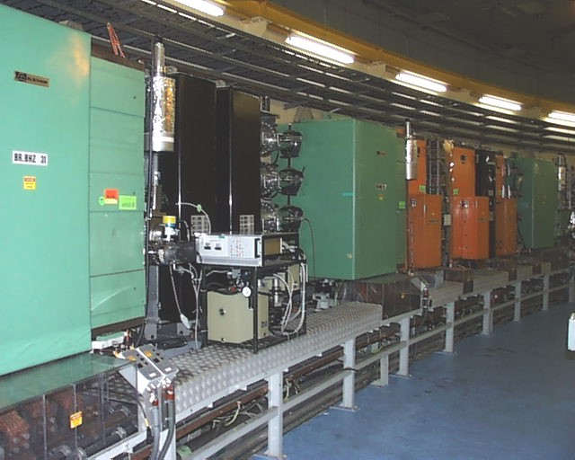
The LIU-PSB Project
K. Hanke
for the PSB Upgrade WG
SGUI 02/02/12

Slide 2

The LIU Project
The LHC Injectors Upgrade Project (LIU) has been put in place
to propose and implement the means for:
allowing LHC & HL-LHC to reach their maximum potential for physics
ensuring a reliable operation of the LHC for physics until the end of its life (≥ 2030 taking into account possibilities of LHeC & HE-LHC…)
proper use of resources (> 150 MCHF material budget and > 300 man.years) with unavoidable interferences with other priorities of the organization
SGUI 2-Feb-2012

Slide 3
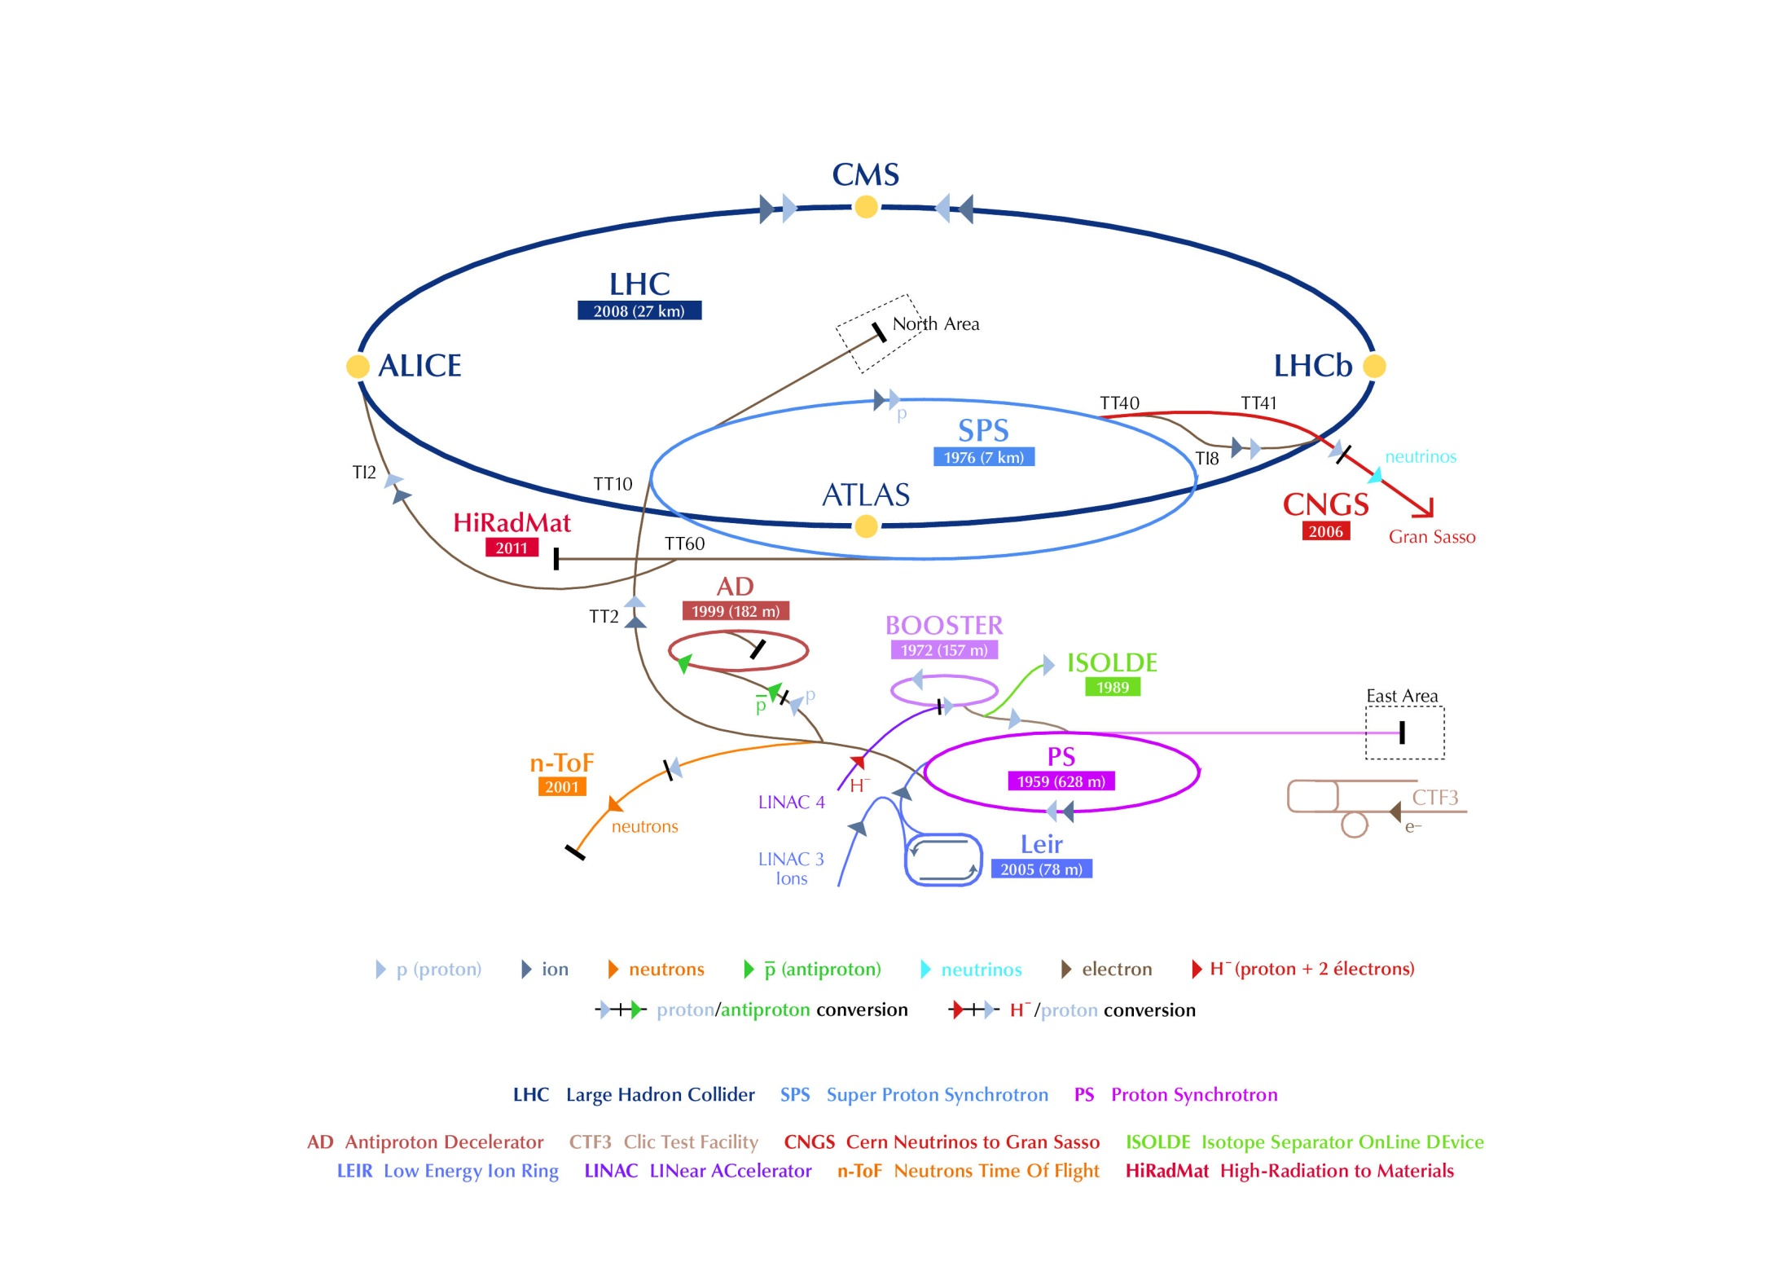
The LIU Project
LIU-SPS
LIU-PSB
LIU-L4
LIU-PS
SGUI 2-Feb-2012

Slide 4
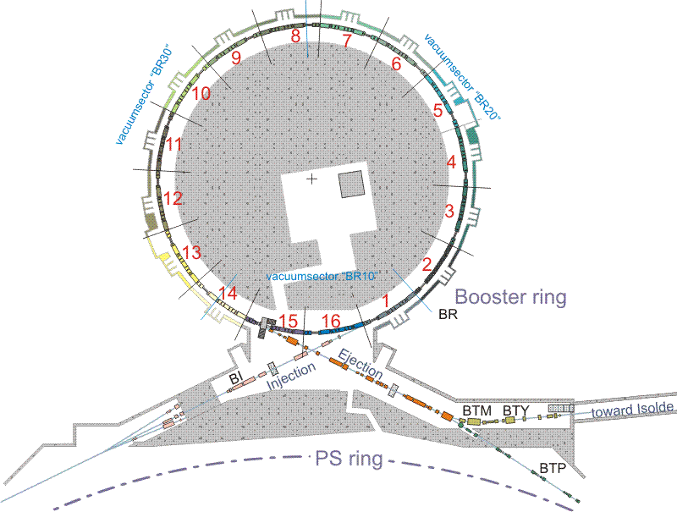
Scope of LIU-PSB
upgrade of the injection
from 50 MeV protons to
160 MeV H- and increased
intensity
re-build injection line for
160 MeV
replace injection septum by
stripping foil
injection bumps
diagnostics
…
upgrade of rings and
extraction / transfer from
1.4 GeV to 2.0 GeV and
increased intensity
replace main power supply,
number of smaller power
supplies, magnets, kickers,
etc.
SGUI 2-Feb-2012

Slide 5
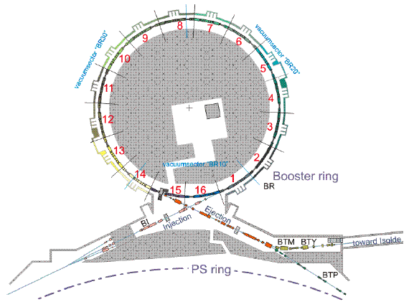
High Brightness Beams for LHC
From Linac4
E_{kin} =50 MeV → 160 MeV
To PS
E_{kin} =1.4 GeV → 2 GeV
Linac4 will allow for production of higher brightness beams in the PSB
  higher injection energy (160 MeV)
  H⁻ injection
higher extraction energy into the PS (2 GeV)
  eases PS injection (weaker space charge, transversely smaller beams)
SGUI 2-Feb-2012

Slide 6
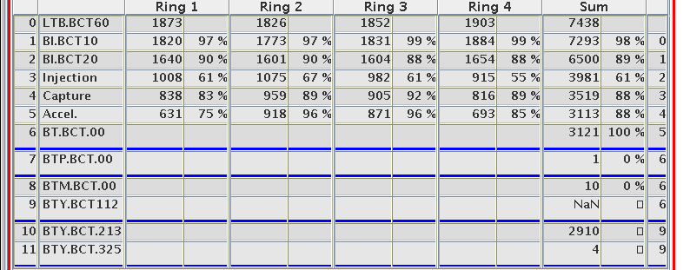
Why rebuilding the Injection Region
increased energy from 50 MeV to 160 MeV with Linac4
reduce space-charge effects at PSB injection
injection of H- ions rather than protons
significantly reduce injection losses (at the moment about 50% of the beam is lost on the injection septum!)
more flexibility in tailoring emittances by transverse phase space painting
SGUI 2-Feb-2012

Slide 7
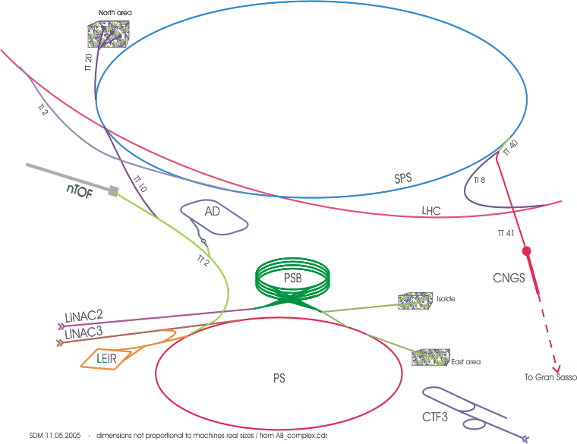
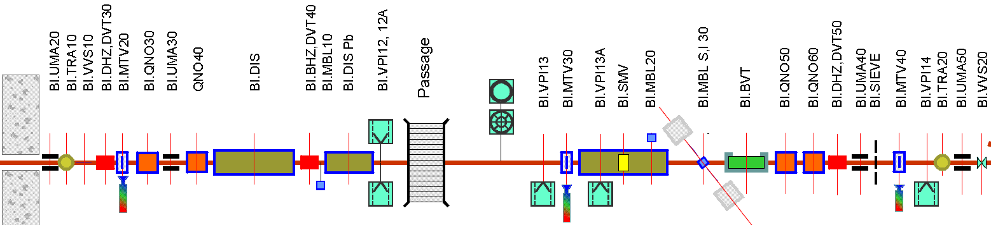
Injection Region for 160 MeV
~0.36 Tm required from BI.BVT for ~175 mrad @ 160 MeV
new BI.SMV,
4 mm thick septum and 70 mm horizontal aperture for
~165 mrad @ 160 MeV with associated new pulse generator.
modify BI.DIS for
4.3 mrad @ 160 MeV
performance increase of 1.9 in ∫B•dl of
BI.DVT30, BI.QNO30, BI.QNO40, BI.DVT40.
remove obsolete BI.DIS Pb
SGUI 2-Feb-2012

Slide 8
Present Multiturn Injection
horiz. beam momentum
septum
closed orbit at injection (t₁)
2
1
7
3
horiz. co-ordinate
4
5
6
as this process takes place, subsequent linac
beam “slices” are injected, with increasing
oscillation amplitude around the instantaneous
closed orbit (“horizontal stacking”)
beamlets are now “polygons”, as they
have undergone several cuts
they spiral up around the (moving)
closed orbit, leading to a density
distribution which is dense in the core
and less dense in the outer part
closed orbit
after one turn (t₂)
closed orbit after
second turn (t₃)
etc.
SGUI 2-Feb-2012

Slide 9
Charge Exchange Injection
more technical details:
→ review held 9-10 November, see
https://indico.cern.ch/conferenceTimeTable.py?confId=158153#20111109
SGUI 2-Feb-2012

Slide 10
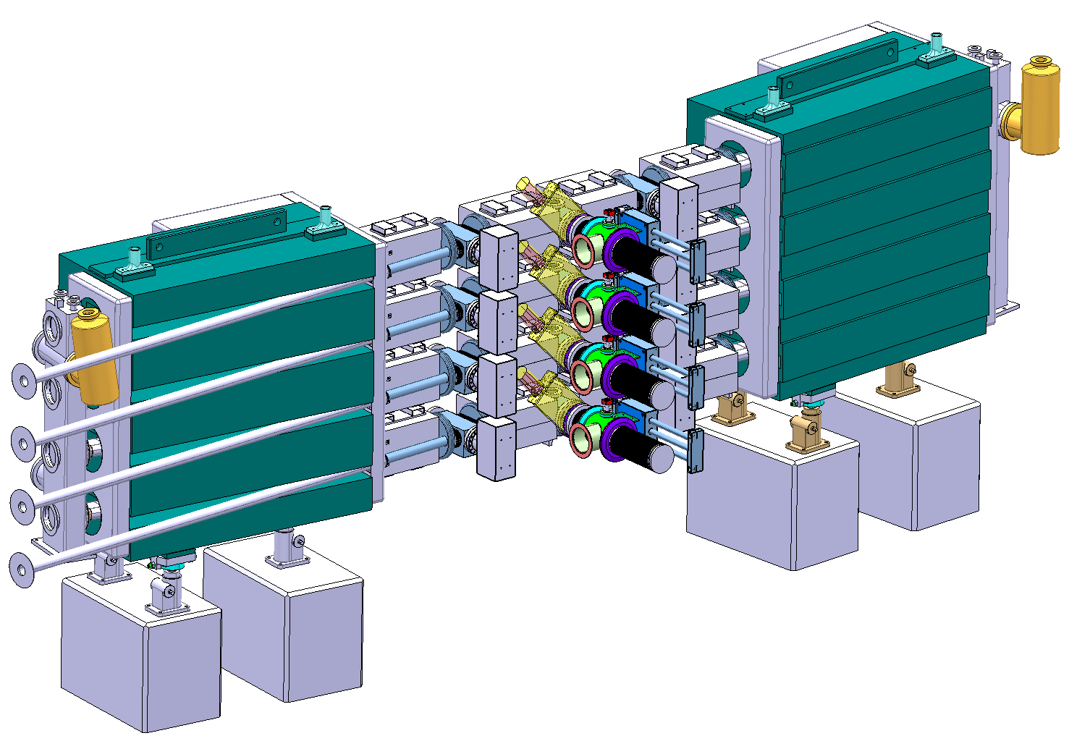
Injection Region Lay Out
BSW2 Merging Dipoles
BSW 3 & 4 Dipoles
BSW1 Septa
Existing PSB Dipole Magnets
Internal H⁰ Dump
Vacuum manifold
Stripping Foil System
&
Beam Observation
SGUI 2-Feb-2012

Slide 11
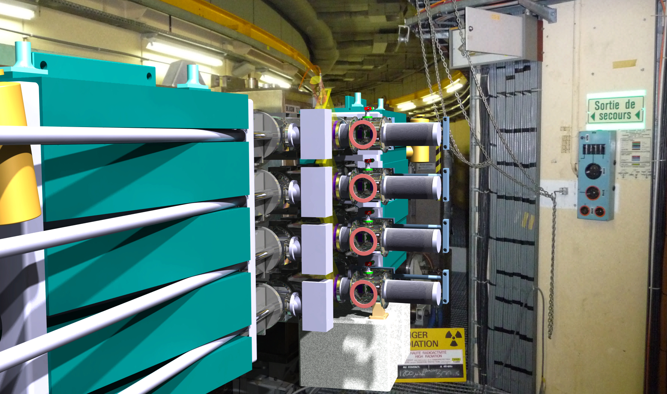
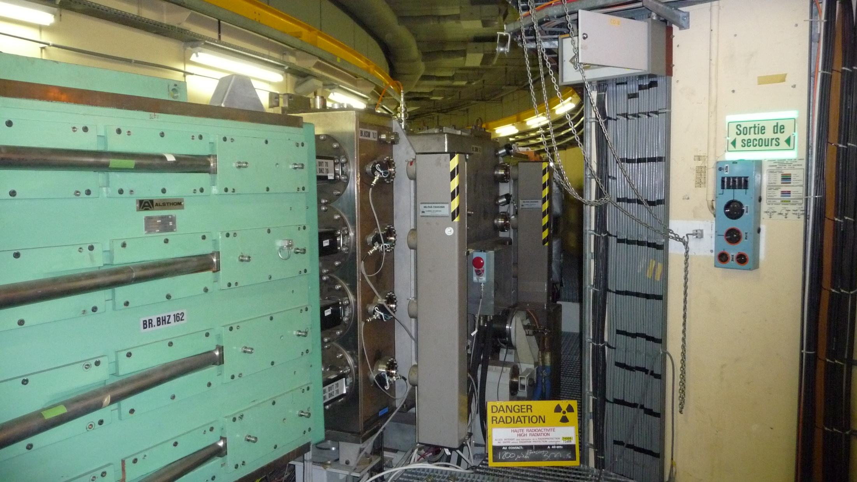
Present and Future Injection Region
B. Goddard, Review on PSB 160 MeV H⁻ Injection, 9-10 November 2011
SGUI 2-Feb-2012

Slide 12
Booster Injection Planning
2013 |  |  |  |  |  |  |  |  |  |  |  | 2014 |  |  |  |  |  |  |  |  |  |  |  | 2015
1 | 2 | 3 | 4 | 5 | 6 | 7 | 8 | 9 | 10 | 11 | 12 | 1 | 2 | 3 | 4 | 5 | 6 | 7 | 8 | 9 | 10 | 11 | 12 | 1 | 2 | 3 | 4 | 5 | 6 | 7 | 8 | 9 | 10 | 11 | 12
long LHC injectors stop LS1
 |  |  |  | Linac4 commissioning
 |  |  |  |  |  |  |  |  |  |  |  |  |  |  |  | Linac4 reliability run
 |  |  |  |  |  |  |  |  |  |  |  |  |  |  |  |  |  |  |  |  |  |  |  |  |  |  |  |  |  |  |  |  | potential
2016 |  |  |  |  |  |  |  |  |  |  |  | 2017 |  |  |  |  |  |  |  |  |  |  |  | 2018
1 | 2 | 3 | 4 | 5 | 6 | 7 | 8 | 9 | 10 | 11 | 12 | 1 | 2 | 3 | 4 | 5 | 6 | 7 | 8 | 9 | 10 | 11 | 12 | 1 | 2 | 3 | 4 | 5 | 6 | 7 | 8 | 9 | 10 | 11 | 12
 |  |  |  |  |  |  |  |  |  |  |  |  |  |  |  |  |  |  |  |  |  |  |  | long LHC injectors stop LS2
slot |  |  |  |  |  |  |  |  | potential slot |  |  |  |  |  |  |  |  |  |  |  |  |  |  | potential slot
Connection of Linac4 to the PSB during LS1 ruled out
Connect to the PSB during an intermediate length shut-down (“LS1.5”)
Connect to the PSB during LS2 (presently assumed in 2018)
hope to know more after Chamonix 2012
detailed planning being worked on
SGUI 2-Feb-2012

Slide 13
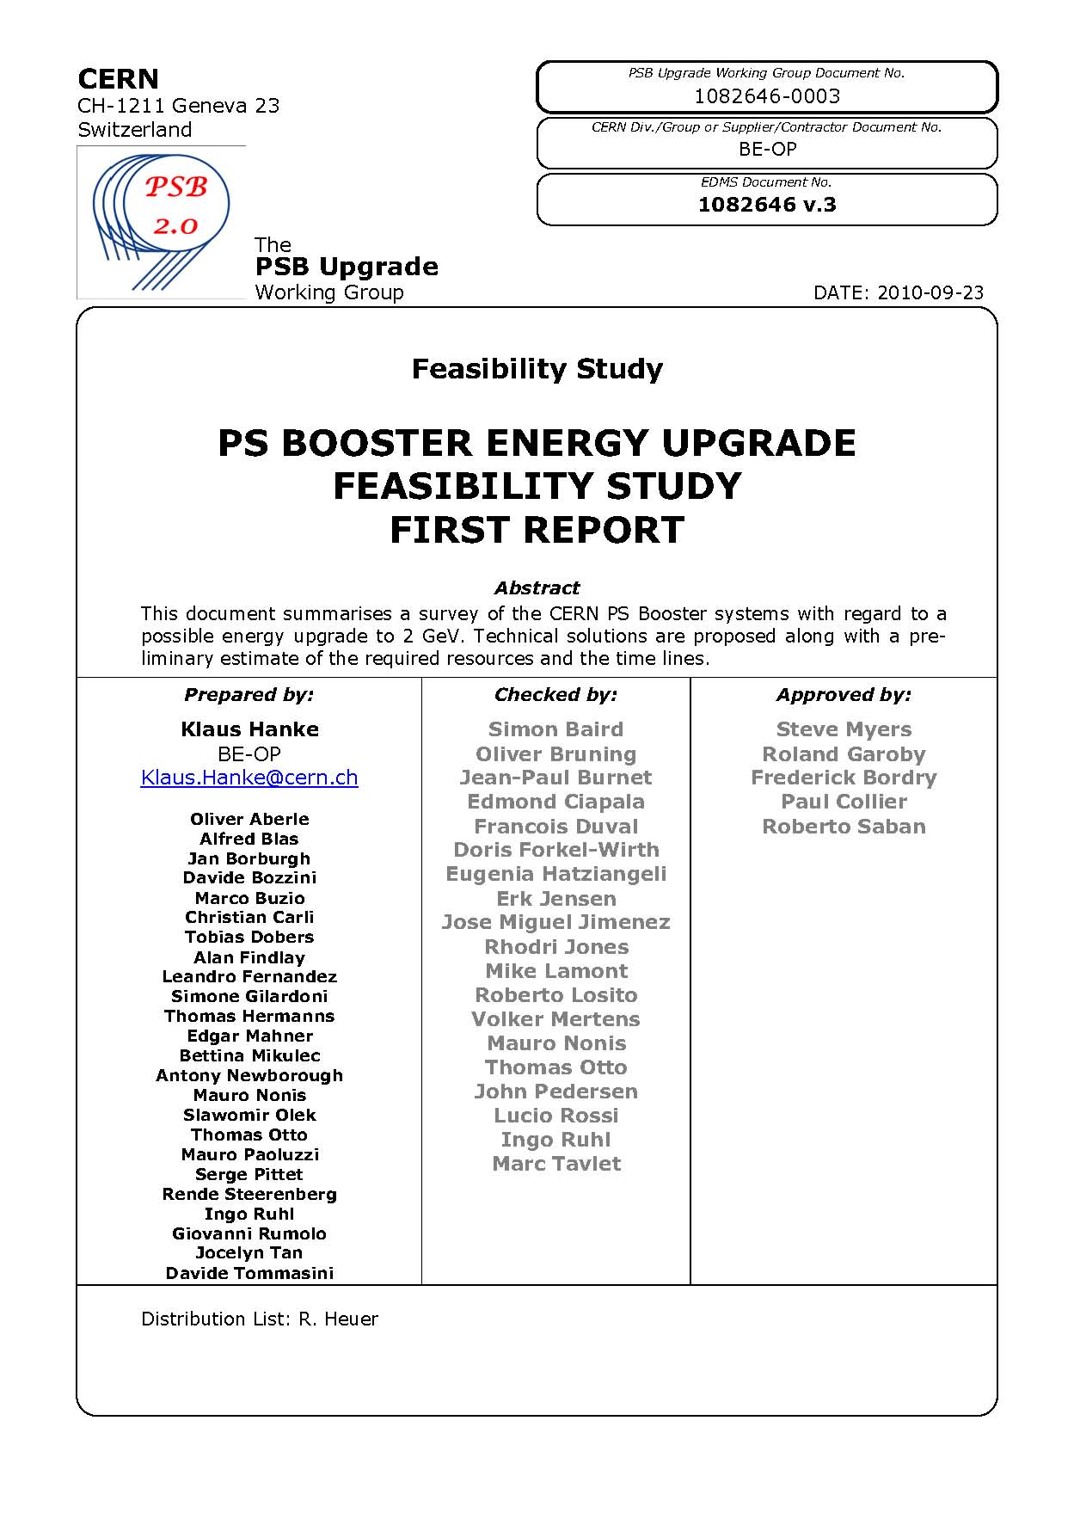
Upgrade of the Booster to 2.0 GeV
study launched following Chamonix 2010
→ feasibility, cost & time lines confirmed
RCS alternative studied following Chx. 2011
Booster option retained
3rd energy upgrade:
from 800 MeV to 1 GeV (1988)
from 1 GeV to 1.4 GeV (1999)
from 1.4 GeV to 2.0 GeV (LS2)
- no technical showstoppers identified
however a number of equipment and
systems need to be changed or upgraded
- high-impact items: MPS, RF, kickers, septa, …
SGUI 2-Feb-2012

Slide 14


Expected Performance Gain with 2.0 GeV
LASLETT TUNE SHIFT
if we assume that:
the optics at the PS injection remains the same
the bunch length does not change
SGUI 2-Feb-2012
G. Rumolo

Slide 15
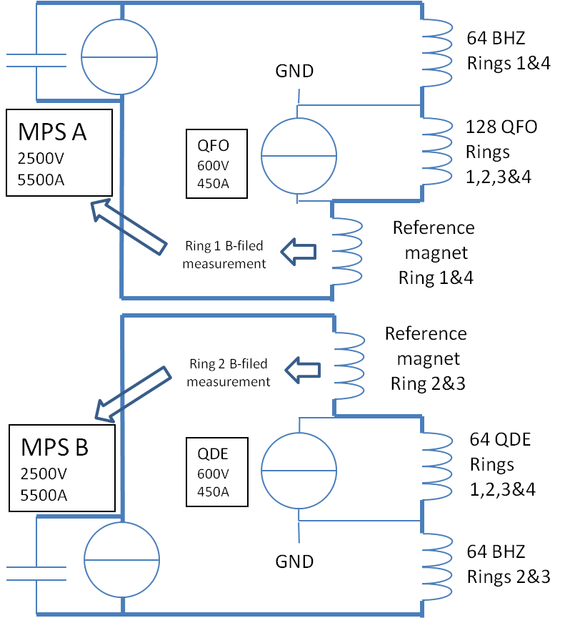
Main Power Supply
physics |  | LS1 |  | physics |  |  | LS2 | physics
2011 | 2012 | 2013 | 2014 | 2015 | 2016 | 2017 | 2018 | 2019
Alternative with new magnet studied
Design baseline confirmed and refined
Specification ready for submission
Market survey and call for tender completed
Converter manufactured and installed
Converter system commissioned
Converter commissioned and ready for operation
Benefits
Overall voltage available increases and would allow a reduction of the RMS current using a faster ramping.
The capacitor bank totally absorbs the peak power on the 18kV network. Meyrin SVC would then become optional.
Spare sharing between MPS A and B and eventually with POPS.
Only a few new cables needed between the reference magnet (BCER) and the MPS.
New B-field regulation to minimize eddy currents and saturation effects impact at higher current and acceleration rate.
Drawbacks
Cost.
SGUI 2-Feb-2012
S. Pittet

Slide 16
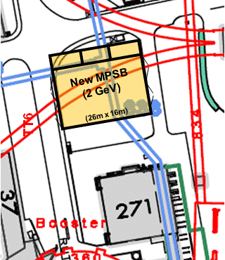
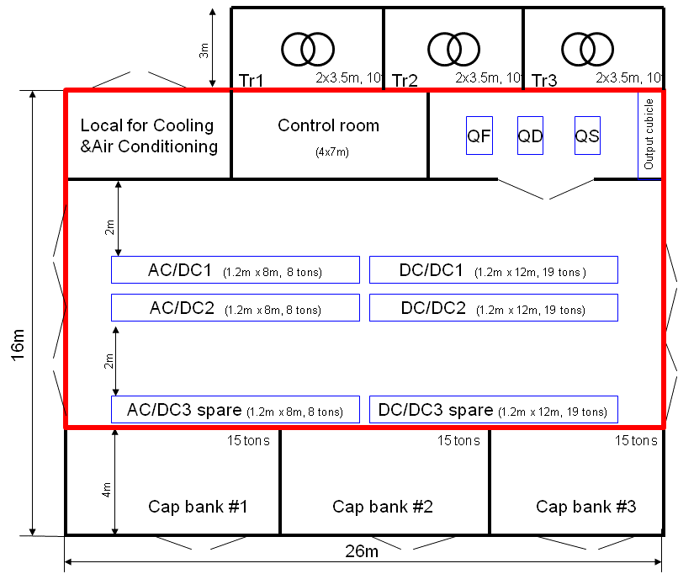
Main Power Supply
physics |  | LS1 |  | physics |  |  | LS2 | physics
2011 | 2012 | 2013 | 2014 | 2015 | 2016 | 2017 | 2018 | 2019
Civil engineering pre-study completed
Civil engineering designed
Civil engineering heavy workload done
Building infrastructure & services ready
With this new building:
We can install and commission during Booster operation.
We have a backup power supply during the first years.
Easy connection to existing cables and cooling services.
SGUI 2-Feb-2012
S. Pittet

Slide 17
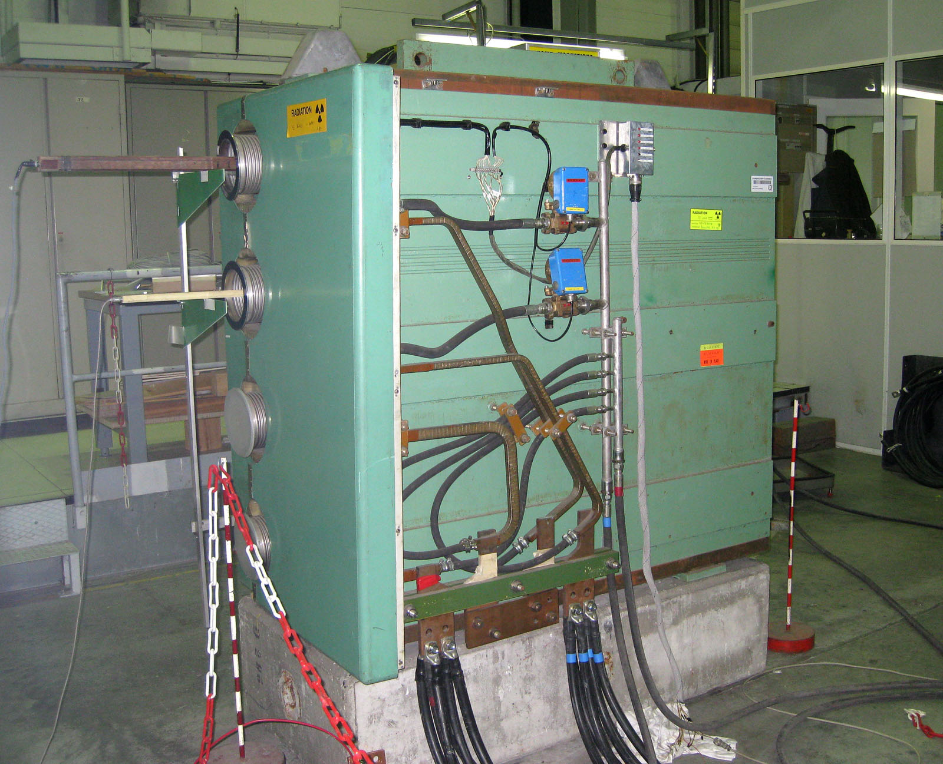
Magnets
- main dipoles can operate at 2 GeV
with some modifications (cooling,
retaining plates)
- some concern about mechanical
stress when pulsing at 2 GeV and
0.8 Hz
- number of other magnets to be
changed
Booster main magnet undergoing tests for
operation at 2 GeV
SGUI 2-Feb-2012
A. Newborough

Slide 18
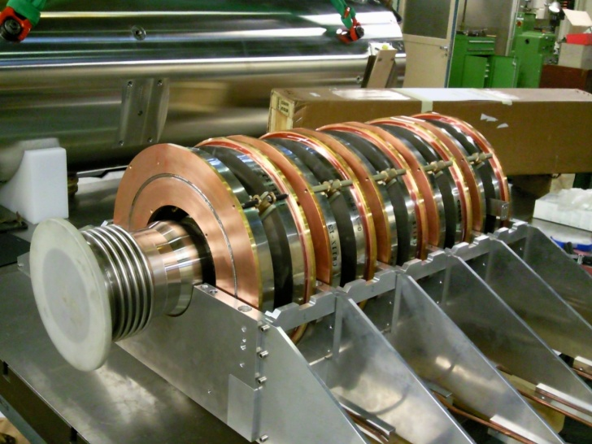
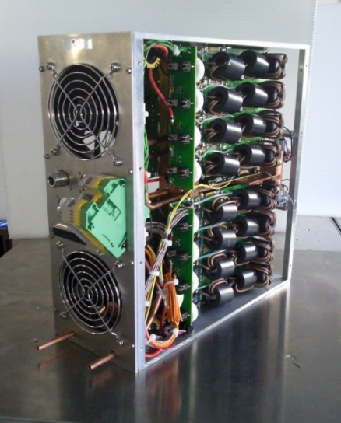
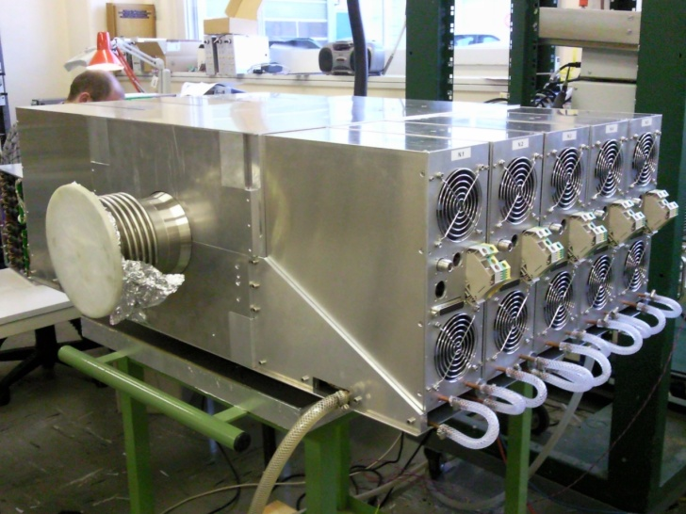
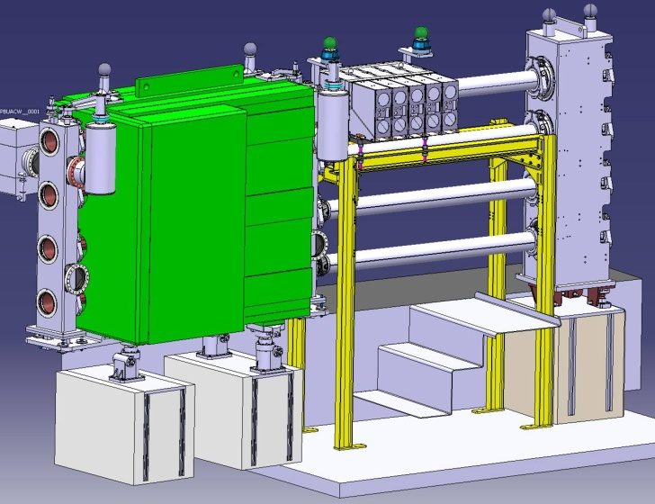
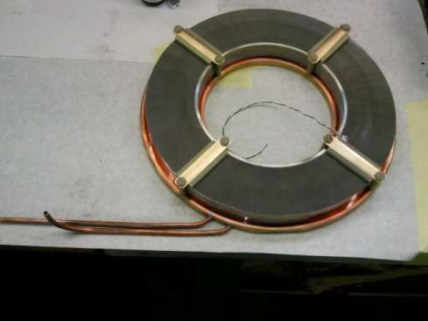
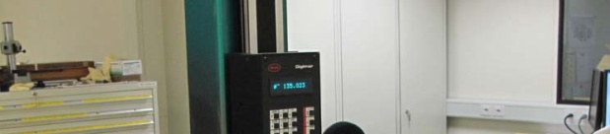
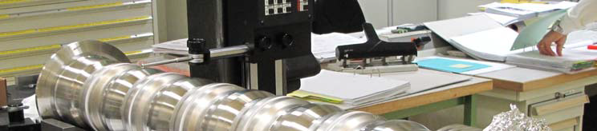
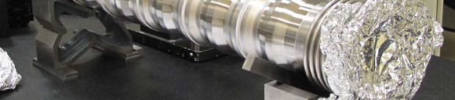
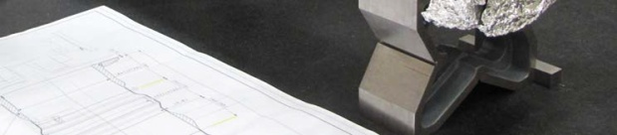
RF System
5-cells open cavity.
Solid-State amp.
Full assembly.
Installation layout in PSB 6L1.
Vacuum chamber.
Finemet® on a
cooling ring.
M. Paoluzzi
SGUI 2-Feb-2012

Slide 19
Other Items
Cooling & Ventilation
- refurbishment of cooling station
and some distribution piping
- complete refurbishment of existing
ventilation plant keeping the same
functionalities
Electrical Systems
- re-design of the system has started
Beam Intercepting Devices
- new dump and beam stopper being designed
- removal of the old and installation of the new
dump being studied for LS1
Extraction & Transfer
- number of septa/kickers cannot
operate at 2 GeV, notably extraction
kickers (BE.KFA) and recombination
septa (BT.SMV)
Other items:
- beam instrumentation, transport, controls,
interlocks, design office, vacuum, etc. etc.
SGUI 2-Feb-2012

Slide 20
LIU-PSB WBS
https://espace.cern.ch/liu-project/liu-psb/default.aspx
https://edms.cern.ch/document/1146814/12
 | Work-Package | Responsible | Unit
2. | Beam Dynamics | C. Carli | BE/ABP
3. | Magnets | D. Tommasini, A. Newborough | TE/MCS
4. | RF Systems | A. Findlay, M. Paoluzzi, M.E. Angoletta, A. Blas, A. Butterworth | BE/RF
5. | Power Converters | S. Pittet, D. Nisbet | TE/EPC
6. | Instrumentation | J. Tan | BE/BI
7. | Beam Intercepting Devices | O. Aberle, A. Massi | EN/STI
8. | Vacuum System | J. Hansen | TE/VSC
9. | L4-PSB Transfer and PSB Injection | W. Weterings, C. Carli | TE/ABT, BE/ABP
10. | PSB Extraction and PSB-PS Transfer | J. Borburgh, W.Bartmann | TE/ABT
11. | Controls | S. Jensen | BE/CO
12. | Electrical Systems | D. Bozzini, S. Olek | EN/EL
13. | Cooling and Ventilation | M. Nonis | EN/CV
14. | Installation, Transport and Handling | I. Ruehl, C. Bertone | EN/HE
15. | Civil Engineering | L.A. Lopez-Hernandez | GS/SE
16. | Radiation Protection | J. Vollaire | DGS/RP
17. | Interlock Systems | B. Puccio, P. Dahlen, B. Todd | TE/MPE
18. | Alarms |  | --/---
19. | Access Systems - Doors |  | --/---
20. | Survey | T. Dobers | BE/ABP
21. | Commissioning and Operation | B. Mikulec | BE/OP
22. | Dismantling |  | --/---
SGUI 2-Feb-2012

Slide 21
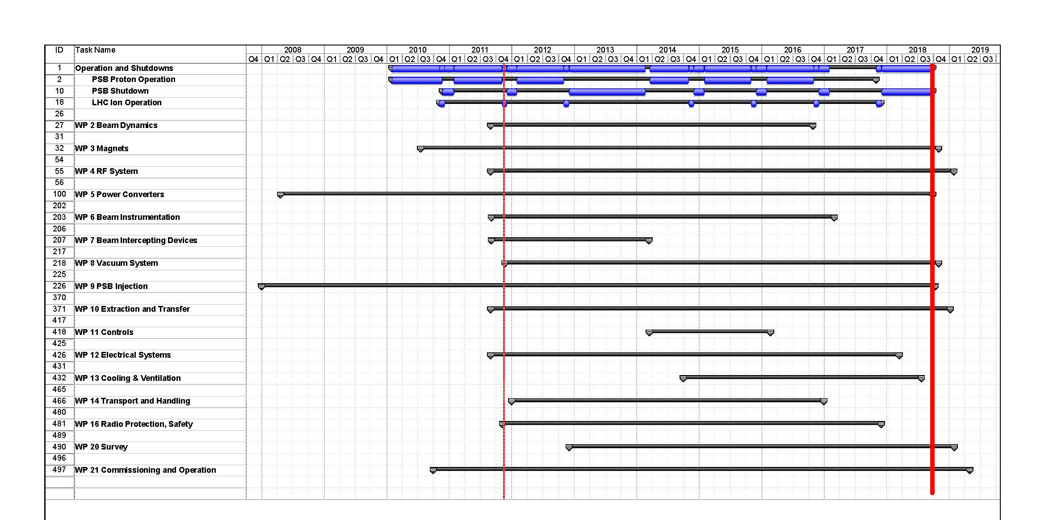
Time Lines
Linac4 connection possible as from end 2015, constrained by LHC stops
full upgrade including 2 GeV to be completed during LS2
SGUI 2-Feb-2012

Slide 22
BTY Line at 2 GeV
pre-study done by D. Voulot
can the BTY line handle the 2 GeV beams?
how many magnets/power supplies need to be replaced?
consequences for the shielding? beam intercepting devices?
assumptions:
Consider BTY line only: BT, BTM are already covered by LIU
Base settings:
  NORM.GPS/NORM.HRS working sets
  MAD files
assume no change in optics
assume only 1.4 and 2 GeV available after the upgrade (PSB cannot provide both 1 and 2 GeV beams)
SGUI 2-Feb-2012
D. Voulot

Slide 23
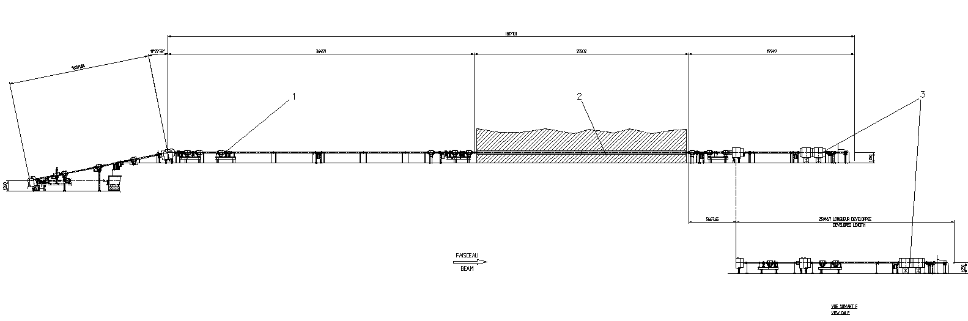
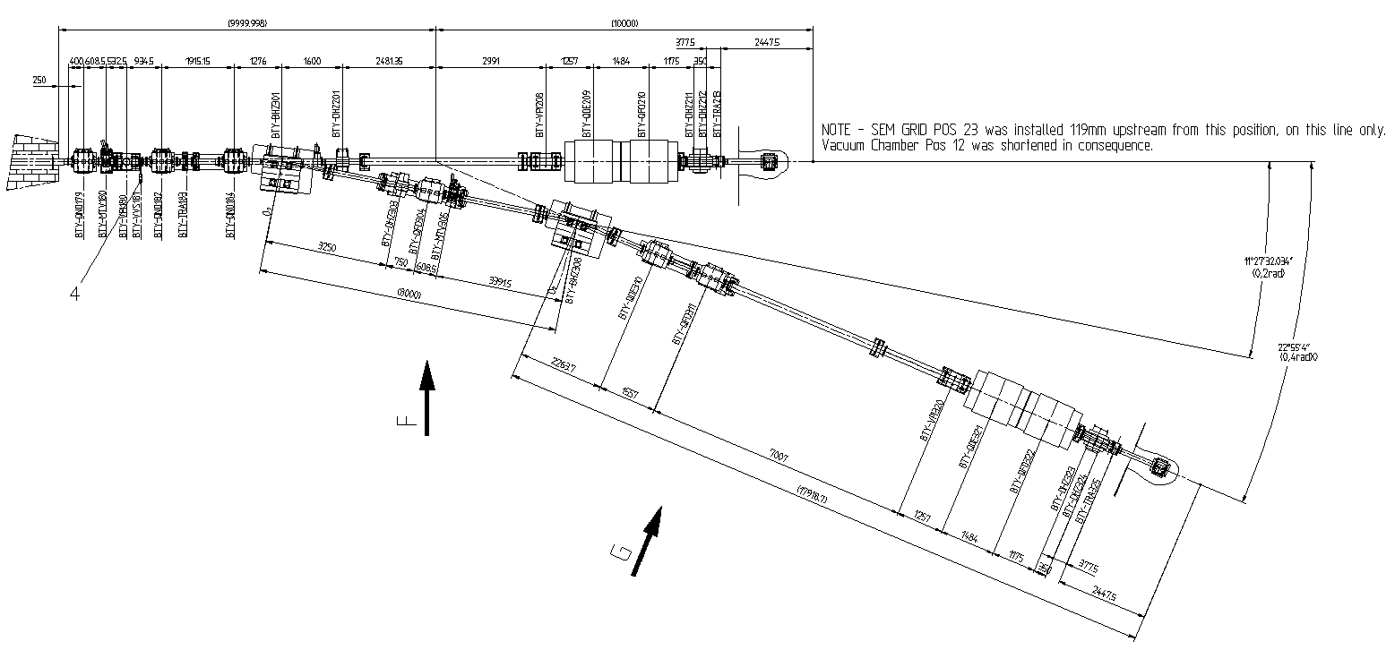
BTY Line
BTY.BVT116
BTY.BVT101
Rte.
Democrite
BT
BTM
GPS
GPS + HRS lines inside target area
BTY.BHZ301
HRS
BTY.BHZ308
SGUI 2-Feb-2012
D. Voulot

Slide 24
BTY Magnets
quadrupoles
  Q100 target focalization (4 units)
  Q130 beam transport (15 units)
dipoles
  HB4 from former ISR transfer lines (4 units)
correctors
  type 1 H-V corrector magnets from PSB (14 units)
  correctors have enough margin for 2 GeV
SGUI 2-Feb-2012
D. Voulot

Slide 25
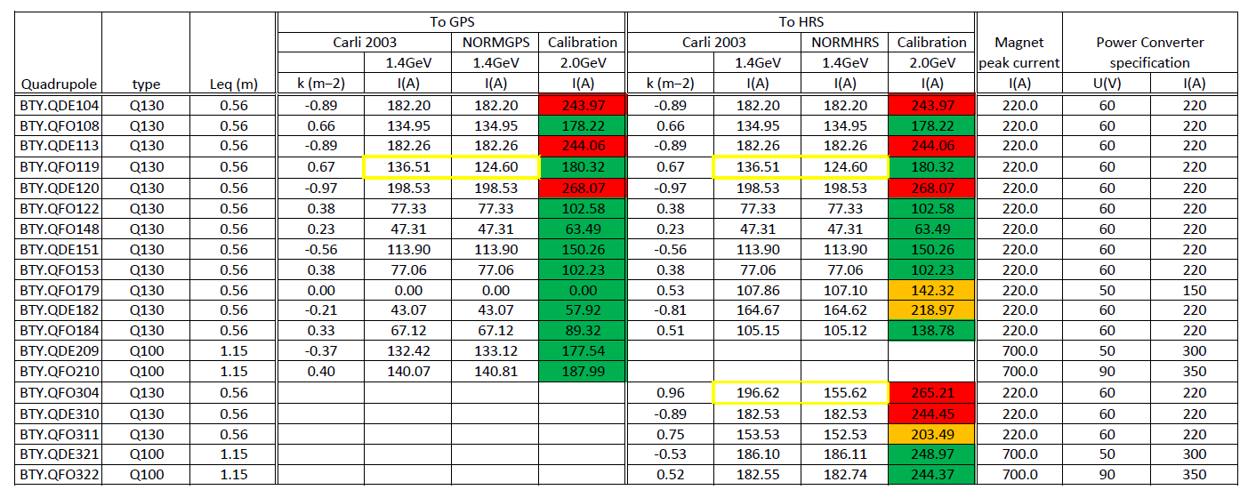
Quadrupoles
some disagreement between calculated and actual settings (assume largest value)
5 quadrupoles exceed the limits (red), 3 within 10% of specifications (orange)
new power supplies are required
magnets can be upgraded → tests needed
SGUI 2-Feb-2012
D. Voulot

Slide 26
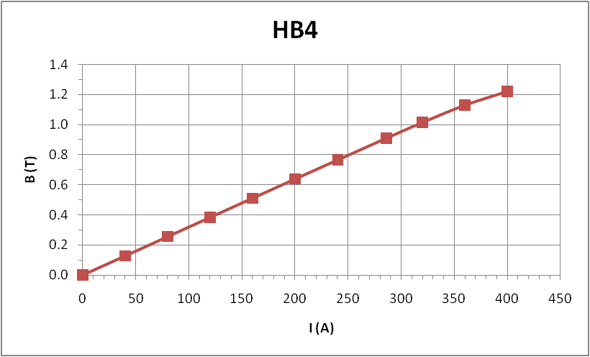
Dipoles
power converters cannot cope with the new currents → need to be replaced
magnets can probably be upgraded to 600 A (increased water cooling) → need simulations and test
calibration curve starts to show saturation above 350 A
two dipoles need to become PPM (BVT101, BHZ301)
special scheme used to go from zero to normal setting, cannot pulse quickly from normal setting to zero
SGUI 2-Feb-2012
D. Voulot

Slide 27
PPM Operation
all quadrupoles operate in DC mode except BTY.QFO179, BTY.QDE182 and BTY.QFO184
both magnets and power converters are designed for PPM operation
PPM operation could help reduce water cooling needs by reducing the RMS currents
test of power converters in PPM mode in December 2011 with 1 and 1.4 GeV settings
OK for all units except:
  1 Q130: BTY.QDE120 (to be replaced anyway)
  2 Q100: BTY.QDE209 and BTY.QDE321
need to test field stability with beam (planned for next start-up)
SGUI 2-Feb-2012
D. Voulot

Slide 28
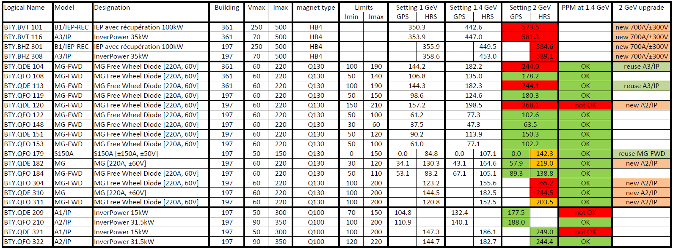
BTY Magnet & Power Supply Summary
need nine new power supplies and reassign three
keep Q100 BTY.QDE209 and BTY.QDE321 in DC
operate all other quadrupoles in PPM between 2 GeV and lowest possible value → need to adjust the limits
same mode of operation for the two switching dipoles (3-way PPM, cannot switch down in consecutive pulses) → need test
Courtesy S. Pittet
SGUI 2-Feb-2012
D. Voulot

Slide 29
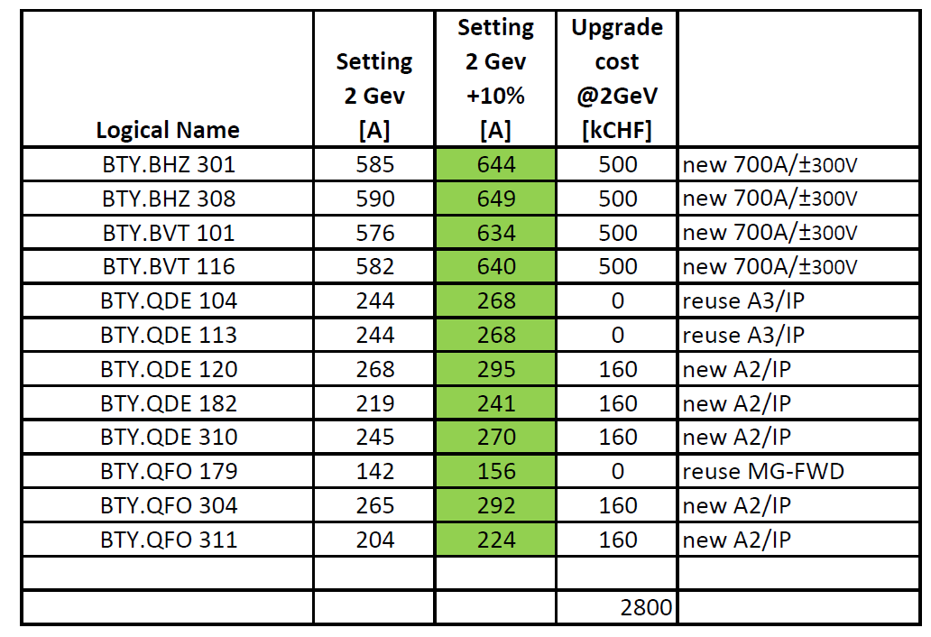
Power Supply Summary and Cost Estimate
total cost for power supplies ~2.8 MCHF
largest cost item are dipole supplies (need high power for switching)
the cabling for the four dipoles needs to be replaced ~37 kCHF
assume all magnets can be kept
Courtesy S. Pittet
SGUI 2-Feb-2012
D. Voulot

Slide 30
RP and Shielding
radiation will scale with power (no significant change in cross sections between 1.4 and 2 GeV)
BTY shielding design was very conservative (AH Sullivan 1993)
  assuming that: ‘1% of the maximum beam, or 0.2% per meter of beam path, could be lost anywhere continuously along the beam line’
  ‘maximum losses for which hand-on maintenance of the accelerator component would be possible due to the high residual dose rate (several mSv/h near the beam line)’
in reality losses and residual dose rates are many orders of magnitude lower (several uSv/h)
shielding is not expected to be an issue even for a four fold increase of the beam power (2.8 →10 kW)
need more detailed analysis plus RP survey after power upgrade
SGUI 2-Feb-2012
D. Voulot

Slide 31
Beam Intercepting Devices
main concern: beam stopper
not water cooled
designed for lower beam power
replacement of all beam stoppers foreseen as part of the PS complex consolidation
other beam intercepting devices: SEM-grids, MTVs
standard diagnostics used elsewhere in the PS complex
should stand the power increase
SGUI 2-Feb-2012
D. Voulot

Slide 32
LIU-PSB Summary
initial Task Force has turned into an approved project within LIU
TDR to be written
ongoing MD activity during the next years
some work during coming winter stops (removal ion distributor,
Finemet test installation, …)
some work to be done during LS1: change of the Booster dump, renovation
of handling equipment, cables?, …)
most work in LS2 (complete hardware upgrade); if Linac4 connection could be
advanced, this would reduce the stress on the intervening groups and on the
recommissioning, and is therefore the preferred scenario
if Linac4 and the 2 GeV upgrade will coincide in LS2, we will have a lot to do
SGUI 2-Feb-2012

Slide 33
BTY@2GeV Summary
upgrade to 2 GeV feasible at a total cost of about 2.8 MCHF
assume all magnets can be upgraded
  →need extra cooling
  →need simulations and tests
PPM operation would help saving power and cooling needs
  →initial test in December, test with beam next spring
at first glance little concern with shielding and beam intercepting devices (need more detailed analysis)
have not assessed targets and target area, only BTY line!
see https://edms.cern.ch/document/1178703/1.0
not part of LIU! / would need its own little project & funding
The 2 GeV Booster for the beams to the PS is approved and will come by LS2.
If ISOLDE wants to take advantage of the increased energy, clear
interest must be stated and things need to be brought on their way
rather soon.
SGUI 2-Feb-2012
D. Voulot

