Slide 1
Beams of refractory elements
Laser break-up molecules and ionization
N. Imai, B.A. Marsh, M. A. Czapski, D. Fink, V. Fedosseev,
T.M. Mendonca, S. Rothe, R. Rossel, M. Seｌiverstov, T. Stora

Slide 2
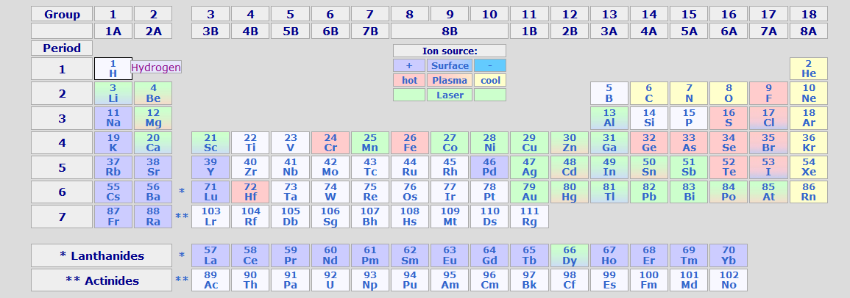
Refractory elements
melting points ~ 2000 K

Slide 3
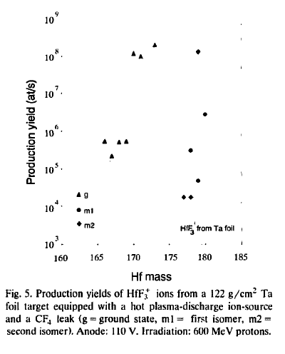
Molecular beams
ZrF₃⁺ @ ORSAY
by isocele2 Z. Phys. A 309, 185 (1982)
HfF₃⁺ @ isolde
NIMB 62(1992)535
SrF ₂powder + CF₄ gas
³He beam
ZrF₃⁺ was extracted by Plasma ion source
Ta foil + CF₄ gas
p beam
HfF₃⁺ was extracted by
Plasma ion source

Slide 4
Laser-induced breakup + ionization
F
F
Zr
Zr¹⁺
Laser-dissociation
Resonant-ionization

Slide 5
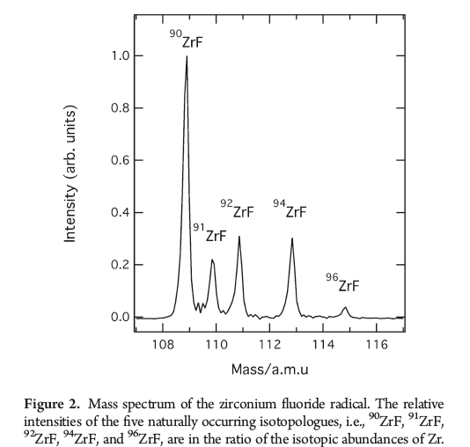
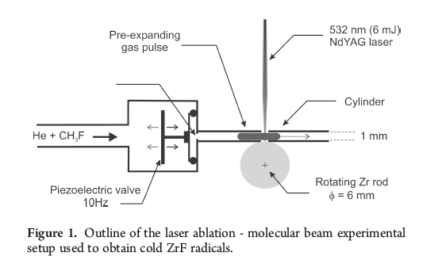
Feasibility study
Producing ZrF⁺
Laser radiation of 2 steps:
breaking up molecules,
ionizing Zr
S. Soorkia et al.,
J. Phys. Chem. A, 2011, 115 (34), pp 9620–9632,
ZrF
ZrF¹⁺
TOF tube
285nm + 400~470nm
TOF spectrum
w/He+ CH₃F gas (2%)

Slide 6
Basic parameters
Ionization of Zr : Zr → Zr⁺ + 1e-
Ionization energy Zr(I)
= 6.63390 eV ~2 x 355nm (3.5 eV)
cross section ~ 4x10⁻¹⁷ cm² (Fe)
Bonding energy of ZrF : ZrF → Zr +F
= 6.3 eV (!?) ~2 x 355nm (3.5 eV)
cross section ~ 5x10⁻¹⁹cm² (SF₆) !?

Slide 7
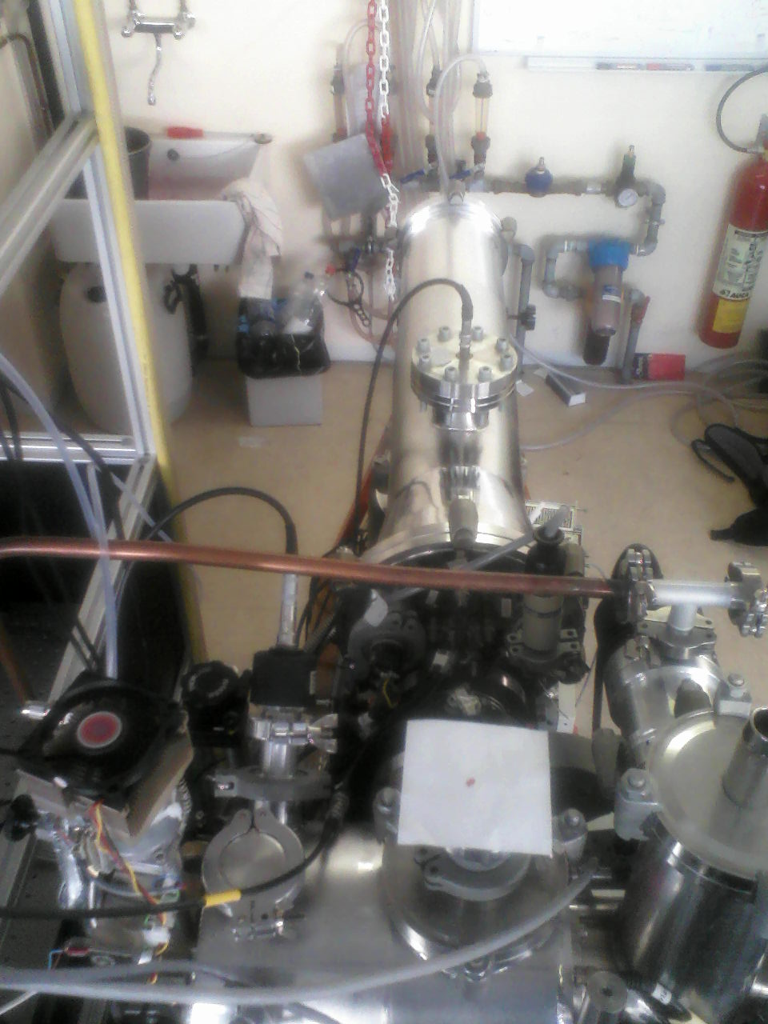
Test with 355nm@ LARIS lab.
-Top view-
Ablation laser
532 nm (2.3 eV)/
1064 nm (1.16 eV)
TOF tube
MCP
skimmer
Solenoid
valve
Zr rod
Pulsed gas flow
Ar
+
CF₄ gas
UV laser: 355 nm (3.5 eV)
of Nd/Yag
Valve and lasers are operated with 10 Hz.

Slide 8
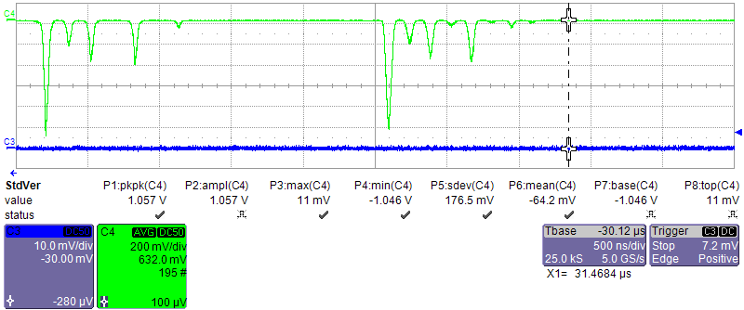
TOF spectrum w/only Ar
⁹¹Zr
⁹¹ZrO
⁹⁴ZrO
⁹⁰Zr
⁹²Zr
⁹⁴Zr
⁹⁶Zr
⁹⁰ZrO
⁹²ZrO
⁹⁶ZrO
Ablation laser: 355 nm 8 mJ
UV(non-resonant ionization): 355 nm 2.3 mJ

Slide 9
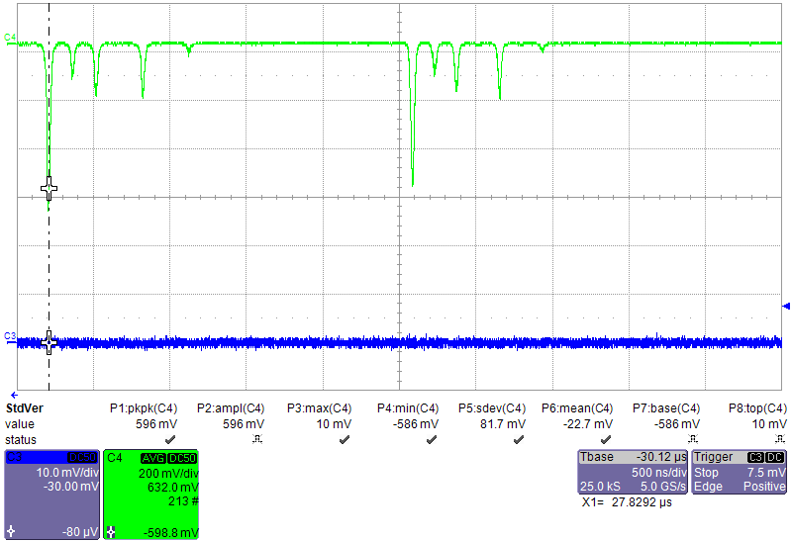
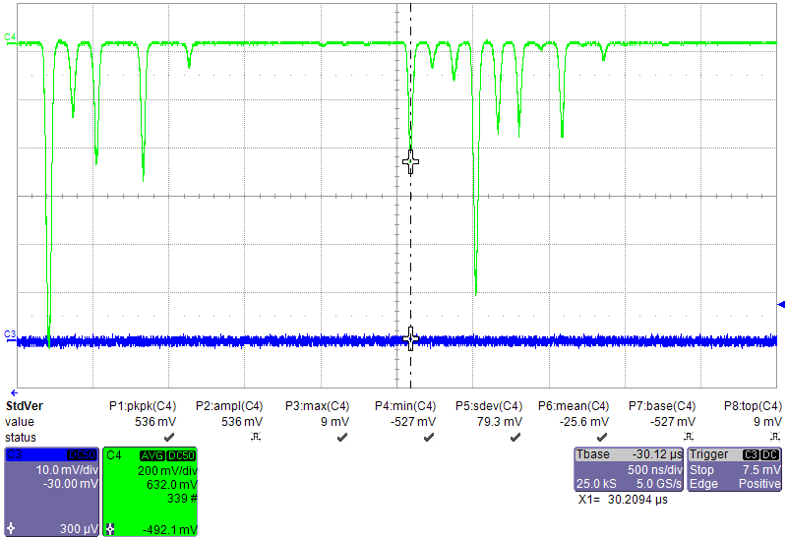
TOF spectrum w/Ar + CF₄(6%)
Only Ar
ZrF⁺ peaks were seen but
disappeared in several
minuets.
Zr⁺ peaks were enhanced and seemed stable.
We couldn’t distinguish the breakup and ionization effect.
ZrO
Zr
Large enhancement!
Ar+CF₄
ZrO + ZrF
Ablation laser: 532 nm 8 mJ
UV(non-resonant ionization): 355 nm 2.3 mJ

Slide 10
UV as dissociator and excitator
Confirmation of ZrF
Optimizing enhancement of Zr w/CF4
CF₄ 4.3%
@5663
CF₄ closed
@7730
CF₄ 2.4%
@4138
CF₄1%
@2635
CF₄1.5%
@3870
5.8%@6315
CF₄ 3.3%
@4914
CF₄0.5%
@1061
CF₄0.2%
@556
Pulse height of ⁹⁰Zr [V]
HV of MCP
-3000 → -2800V
CF₄ > 6% may be too much.
A few % is enough to enhance the ⁹⁰Zr.
Time [s]

Slide 11
Non resonant ionization of Zr
Ablation laser:
1064 nm 3mJ
Dissociation + Ionization:
355 nm 2mJ
Only Ar
Ar+ CF₄(2.4%)
Yield of ⁹⁰Zr⁺ was enhanced by 1 order of magnitude!

Slide 12
Mass spectrum
Zr⁺
ZrO⁺
No ZrF⁺ was seen w/Ar +CF₄
Ratio of Zr/ZrO doesn’t change so much

Slide 13
UV (355nm) power dependence
Only Ar gas flow
Zr → Zr⁺ : 6.6 eV
2. Ar + CF₄ (2.4%) gas flow
Zr → Zr⁺
and
ZrF → Zr + F
Zr → Zr⁺
Ar+CF₄
Ar only
No difference between Ar and Ar+CF₄
Breaking-up molecules seems saturated.

Slide 14
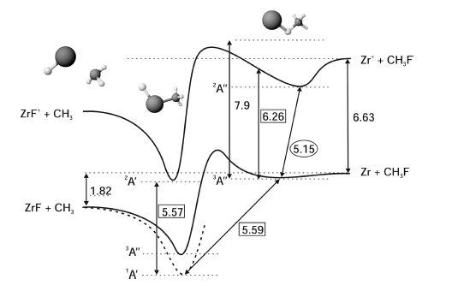
Possible mechanism
ZrF = Zr + F – 6.3 eV
ZrF + CH₃ = Zr +CH₃F -1.82 eV
ZrF+CF₃ = Zr+CF₄ -0.83 eV
S. Soorkia et al.,
J. Phys. Chem. A, 2010, 114 (18), pp 5655
0.83 eV = 1520 nm
1064 nm Nd:Yag is enough ?

Slide 15
On-going works…
Resonant ionization:
1st step 281.4920 nm + 532 nm
= 543218 cm⁻¹
Molecular breakup:
3rd hw (355nm), 2nd hw (532nm), 1064 nm of Nd:Yag
power dependence/time difference will be checked.
Removing of ZrO from Zr rod
Etching the Zr rod with acid prior to ablation
I.E.
53506.0 cm⁻¹
= 6.6 eV
532 nm
4d²5s5p t ³F
J=2
35514.53 cm⁻¹
= 4.4 eV
3.5 mJ UV
+ 6mJ 532 nm
281.4920 nm (air)
4d²5s² a ³F
J=2
0 cm⁻¹

Slide 16
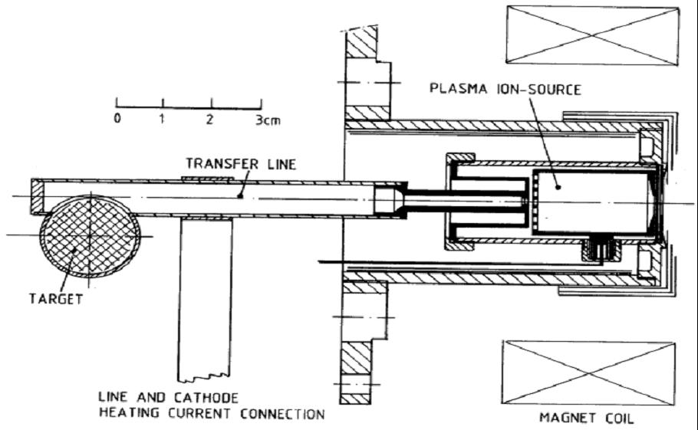
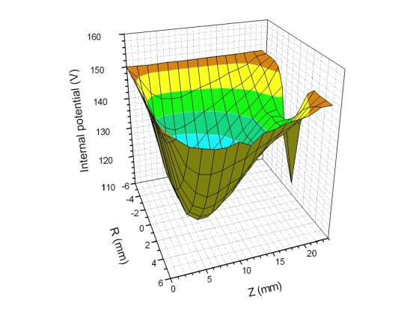
How to implement at ISOLDE?
VADIS + RILIS
  Breaking-up molecule:
VADIS cavity w/several eV ?
or breakup laser ?
  Resonant ionization: RILIS
The resonant ionization scheme hasn’t
been established yet.

Slide 17
Summary
Feasibility study of breaking-up refractory element fluoride is on-going with ablation + TOF spectrometer of Zr.
In the case of non-resonant ioniztion, with small injection of CF₄ in Ar gas, large enhancement of Zr⁺ peaks were observed.
Both laser for resonant ionization of Zr and break-up molecules are ready.
Further investigation of the phenomenon provides promising experimental opportunity.

Slide 18
Outlooks
Implementation with VADIS + RILIS
Establishment of resonant-ionization:
hopefully 3 steps-resonant ionization

Slide 19
La Fin

Slide 20
Mass spectrum of resonant ionization
In both cases, only Zr peaks
were observed.

