Slide 1


Hie-Isolde
Plans and schedule for the Long Shutdown LS1
SGUI
CERN, 2 February 2012
Erwin Siesling

Slide 2
Abstract
  Hie-Isolde – Impact on the facility
  Work during and around LS1
  Until LS1:
  Civil Engineering, Main Services
  During LS1:
  Civil Engineering (tunnel in hall), Main Services, Cryogenics, Beam transfer Line
  End of LS1 and into the 2014 run:
  Cryogenics, Beam transfer Line, Cryo Modules, commissioning
  Possible other LS1 activities..

Slide 3
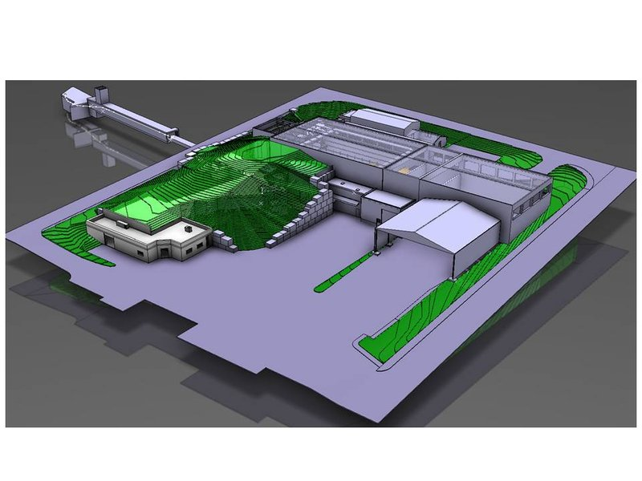
Isolde changes

Slide 4
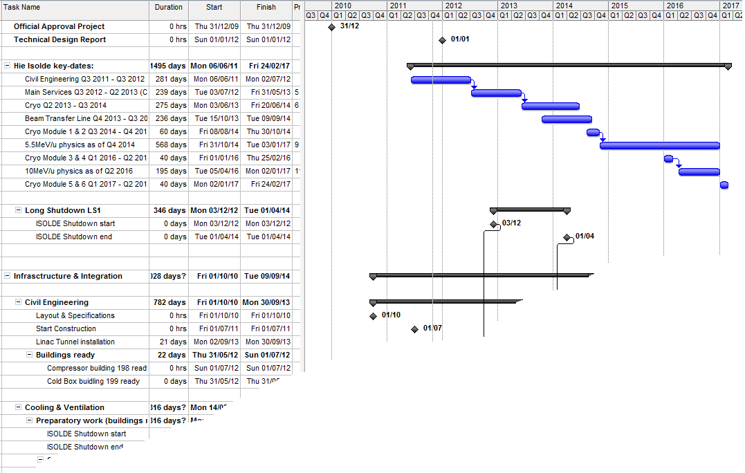
Hie-Isolde Planning
Hie-Isolde installation planning in EDMS:
Projects – Accelerators - Hie-Isolde – Infrastructure & Integration - Planning
https://edms.cern.ch/nav/P:CERN-0000072786:V0/P:CERN-0000090679:V0/TAB3

Slide 5
Hie-Isolde Planning
  Activities until LS1: Civil Engineering & Main Services
Start LS1
3 dec 2012
2011
2012
2013
2014
2015
2016
Q1
Q2
Q3
Q4
Q1
Q2
Q3
Q4
Q1
Q2
Q3
Q4
Q1
Q2
Q3
Q4
Q1
Q2
Q3
Q4
Q1
Q2
Q3
Q4
Beam Transfer Line
Civil
Cryo
Main services
Ventilation
Demi water
CM 1&2
Electrical syst.s
CM 3&4
CM 5&6
5.5MeV/u
10MeV/u
Timeline:
sd
sd
LS1
CM1&2
sd
sd
Dec 2012 - Apr 2014
shutdown
Cryo Mod 1 & 2 install
(Isolde normal operations)
(REX perturbations)
Isolde & REX Ops

Slide 6
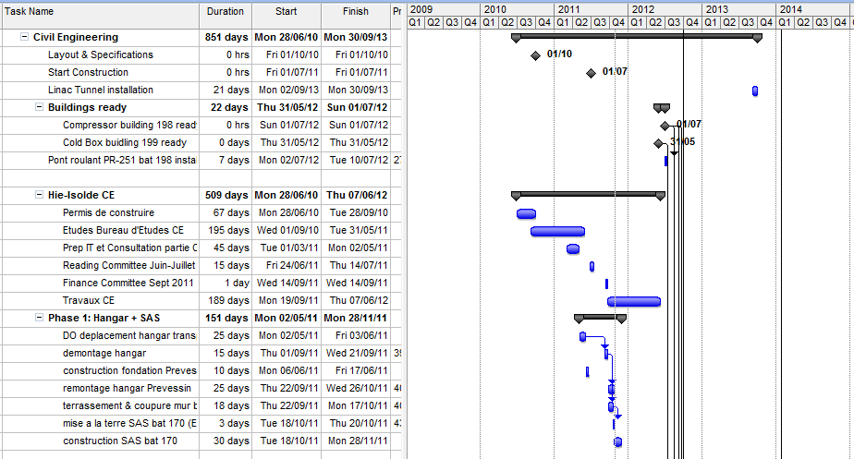
Until LS1
Civil Engineering
LS1
GS/SE : DANIEL PARCHET, ELISEO PEREZ-DUENAS

Slide 7
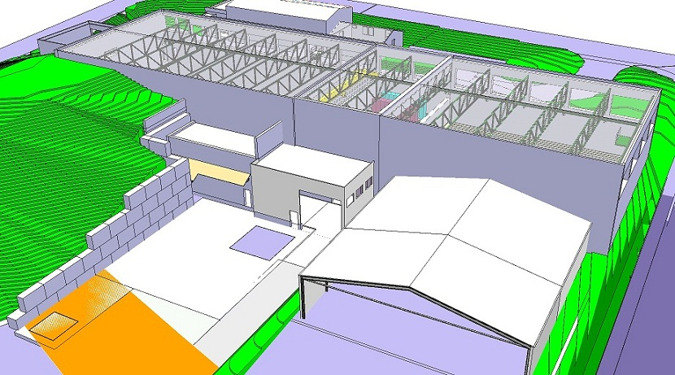
Civil Engineering
Construction starting date: Aug 2011

Slide 8
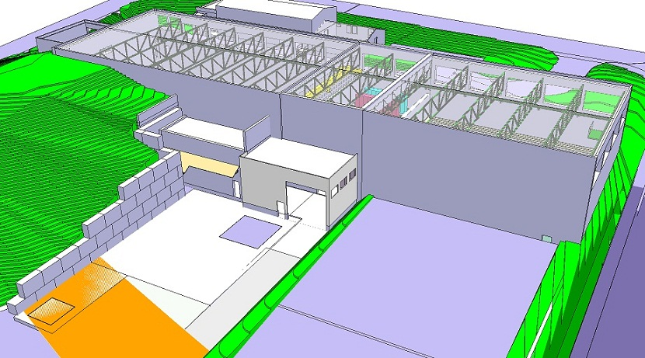
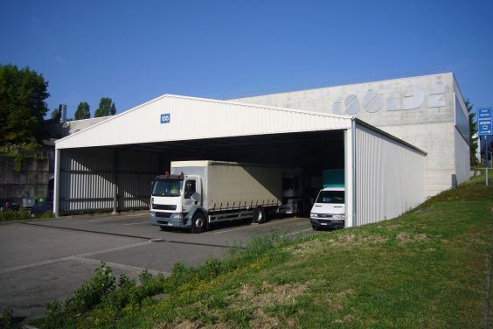
Civil Engineering
Removal of the transport hangar
September 2011

Slide 9
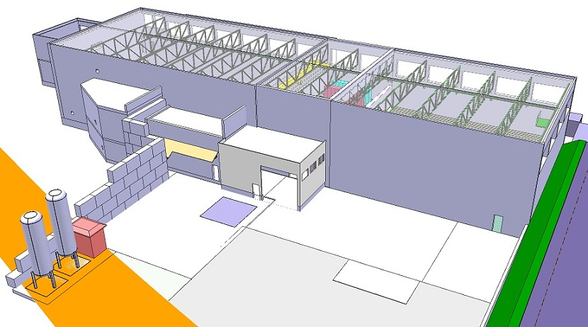
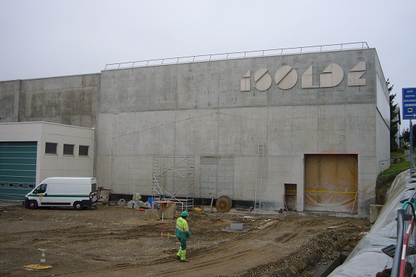
Civil Engineering
Cutting the Hall 170 wall & Terrain flattening
October 2011

Slide 10
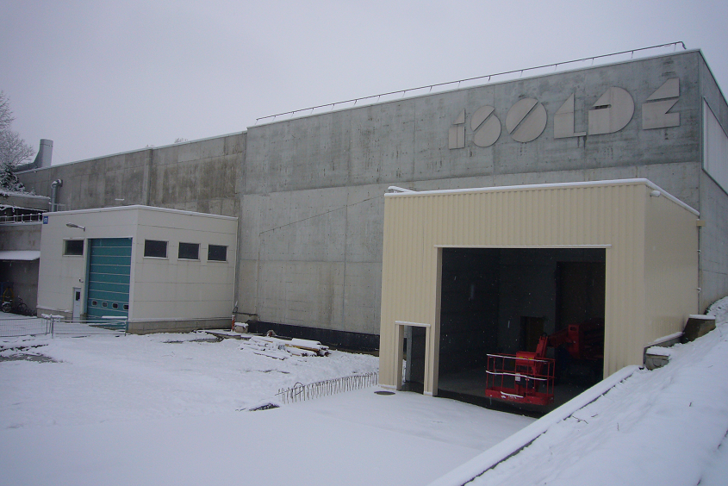
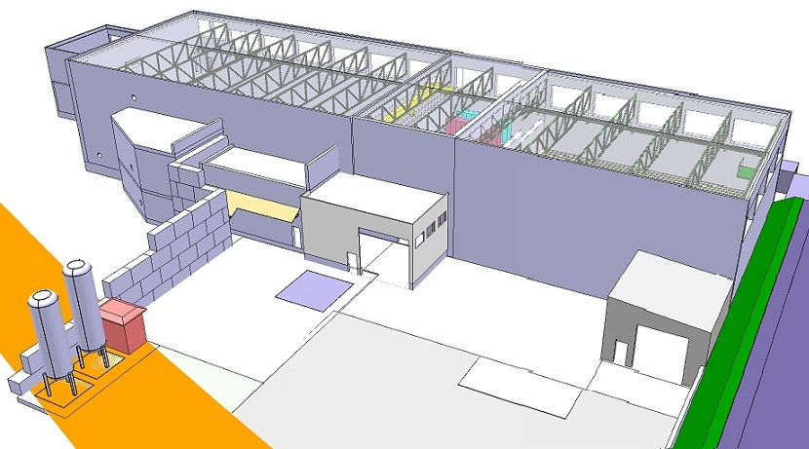
Civil Engineering
New SAS
January 2012

Slide 11
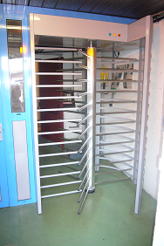
Access 2012 run
Move of the controlled access
Shutdown, February 2012

Slide 12
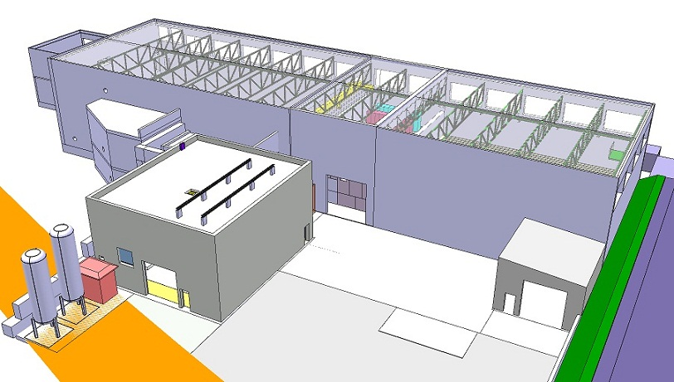
Civil Engineering
Compressor Building B.198
Start February 2012

Slide 13
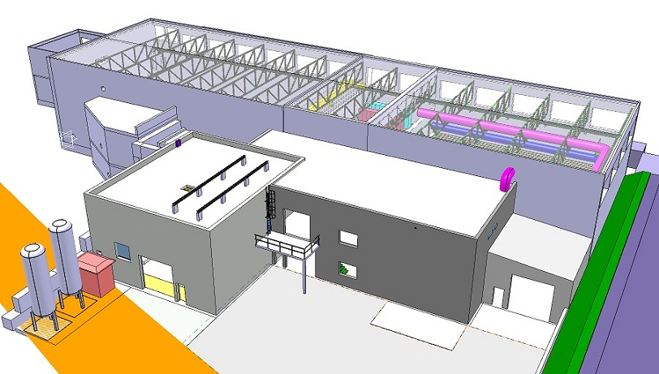
Civil Engineering
Cold Box Building B.199
Civil Engineering finished July 2012

Slide 14
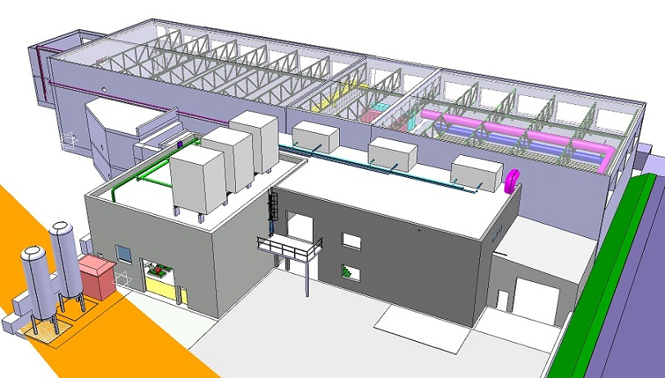
Main Services
Electrical systems, Cooling & Ventilation
Start installation Main Services July 2012

Slide 15
Hie-Isolde versus LS1
  Activities during LS1: Civil Engineering (tunnel in hall), Main Services, Cryogenics, Beam transfer Line
Start LS1
3 dec 2012
End LS1:Start Low E physics apr 2014
2011
2012
2013
2014
2015
2016
Q1
Q2
Q3
Q4
Q1
Q2
Q3
Q4
Q1
Q2
Q3
Q4
Q1
Q2
Q3
Q4
Q1
Q2
Q3
Q4
Q1
Q2
Q3
Q4
Beam Transfer Line
Civil
Cryo
Main services
Ventilation
Cooling water
CM 1&2
Electrical syst.s
CM 3&4
CM 5&6
5.5MeV/u
10MeV/u
Timeline:
Winter physics Jan-March 2013 ?
sd
sd
LS1
CM1&2
sd
sd
Dec 2012 - Apr 2014
Main services
(dismantling + installation works)
shutdown
Cryo Mod 1 & 2 install
(Isolde normal operations)
(REX perturbations)
Isolde & REX Ops

Slide 16
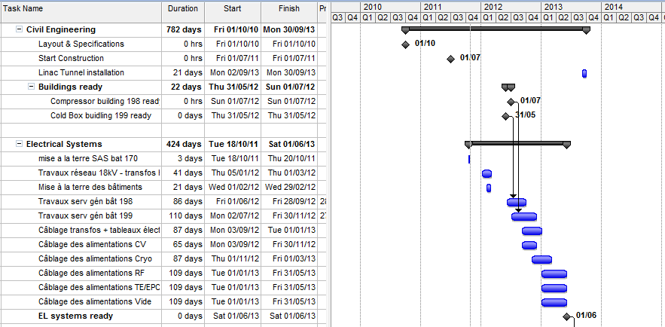
Into LS1
Electrical systems
LS1
EN/EL : RENE NECCA

Slide 17
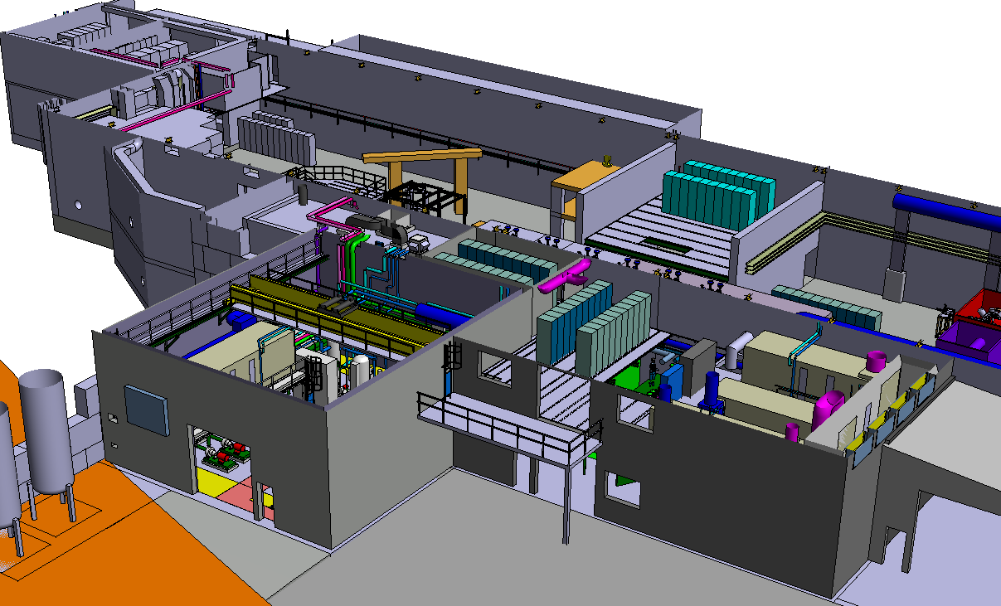
Electrical systems
Electrical systems: July 2012 – June 2013

Slide 18
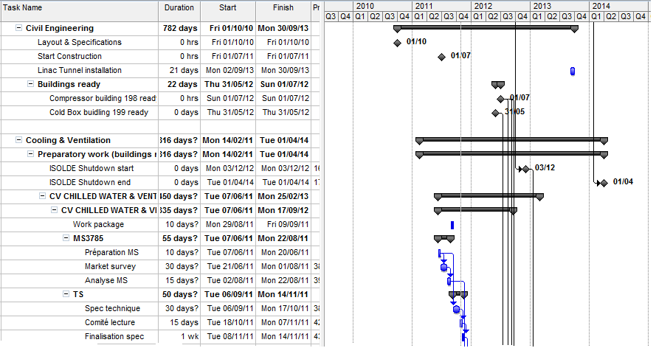
Cooling & Ventilation
LS1
Start of LS1:
3 dec - Keydate!
EN/CV : PAUL PEPINSTER, BENOIT LACARELLE

Slide 19
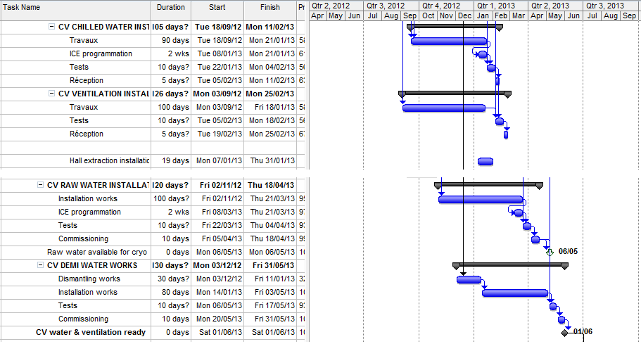
Cooling & Ventilation
LS1
Point of No Return!
EN/CV : PAUL PEPINSTER, BENOIT LACARELLE

Slide 20
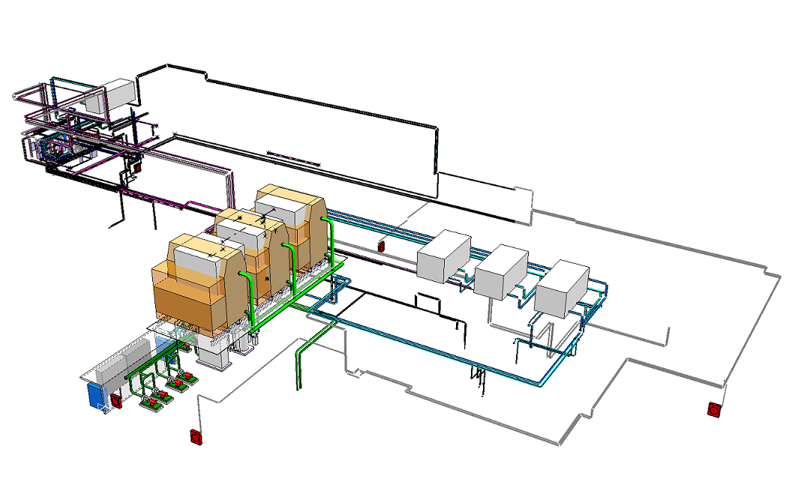
Cooling & Ventilation
Cooling & Ventilation: July 2012 – June 2013

Slide 21
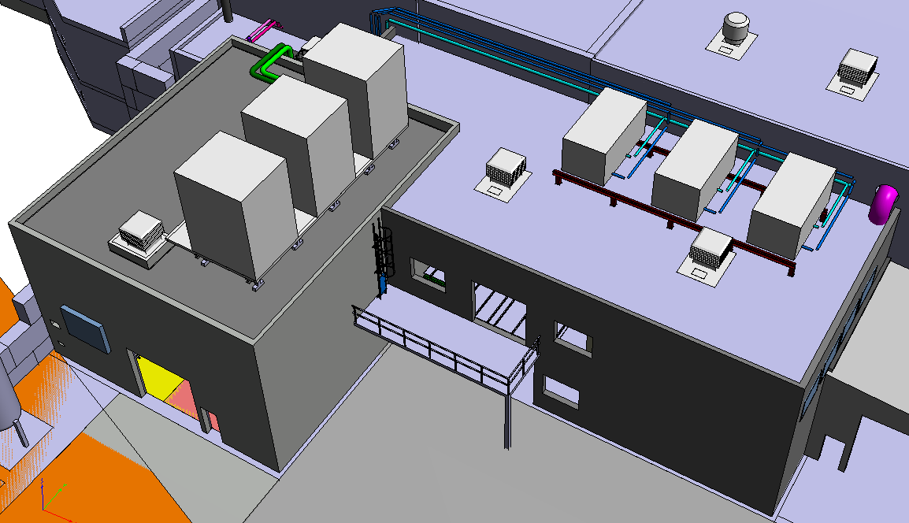
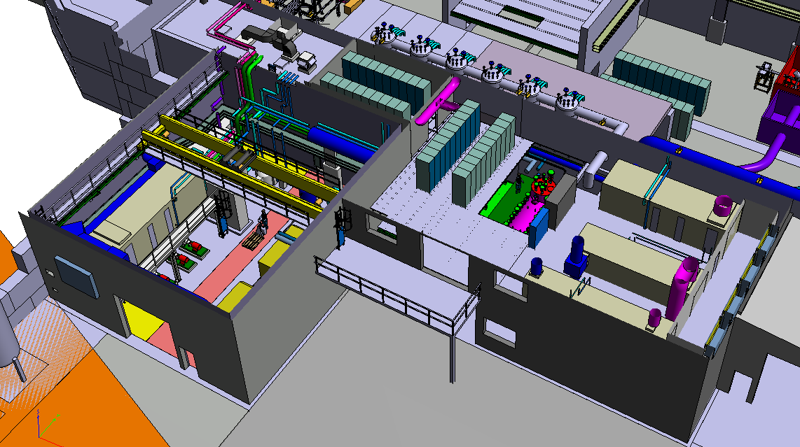
Cooling & Ventilation
Ventil units
Cooling & Ventilation: July 2012 – June 2013

Slide 22
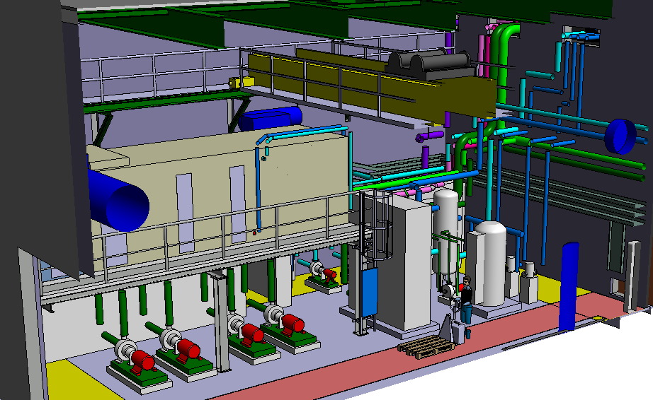
Cooling & Ventilation
Ventilation unit
Cooling units
Cooling & Ventilation: July 2012 – June 2013

Slide 23
LS1 and 2014 run
  Activities LS1 into 2014 run: Cryogenics, Beam transfer Line, Cryo Modules, commissioning
End LS1:Start Low E physics apr 2014
2011
2012
2013
2014
2015
2016
Q1
Q2
Q3
Q4
Q1
Q2
Q3
Q4
Q1
Q2
Q3
Q4
Q1
Q2
Q3
Q4
Q1
Q2
Q3
Q4
Q1
Q2
Q3
Q4
Beam Transfer Line
Civil
Cryo
Main services
Ventilation
Demi water
CM 1&2
Electrical syst.s
CM 3&4
CM 5&6
5.5MeV/u
10MeV/u
Timeline:
sd
sd
LS1
CM1&2
sd
sd
Dec 2012 - Apr 2014
shutdown
Cryo Mod 1 & 2 install
(Isolde normal operations)
(REX perturbations)
Isolde & REX Ops

Slide 24
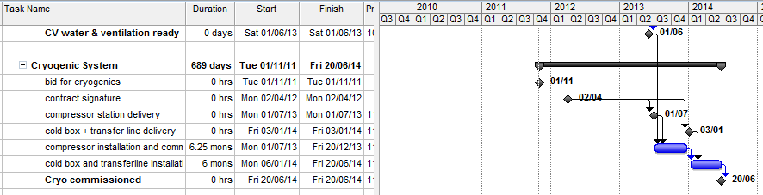
LS1 and 2014 run
Cryogenics
CM1&2
LS1
TE/CRG : NICOLAS DELRUELLE, JOS METSELAAR

Slide 25
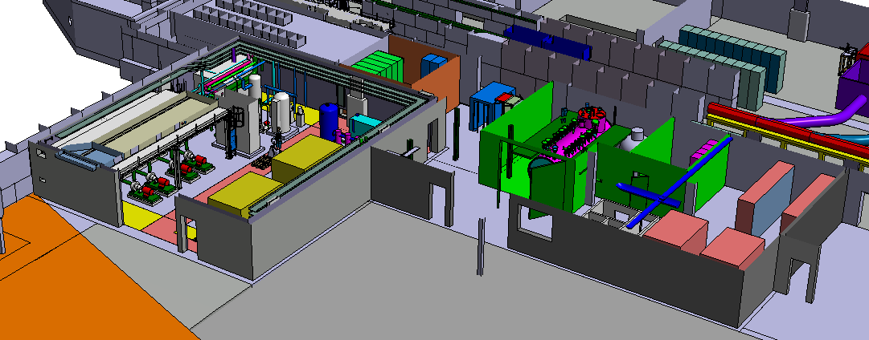
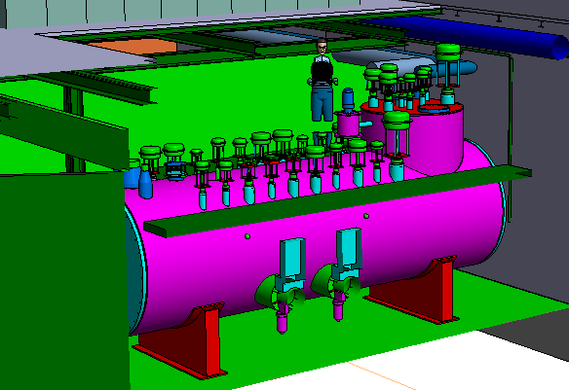
Cryogenics
Compressors: July 2013 – December 2013
Cold Box: Jan 2014 – June 2014

Slide 26
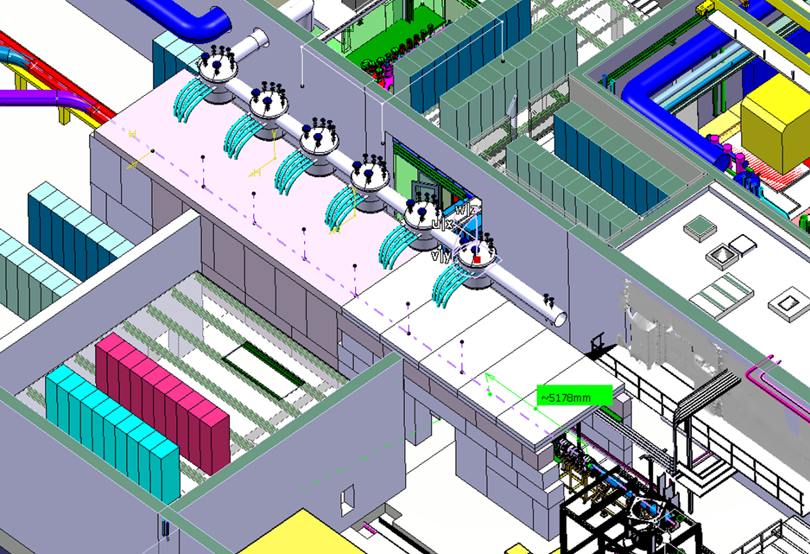
Tunnel and Cryo Line
Cutting walls & install tunnel: Sep 2013 LS1
Cryo Cold Line: January 2014 – June 2014

Slide 27
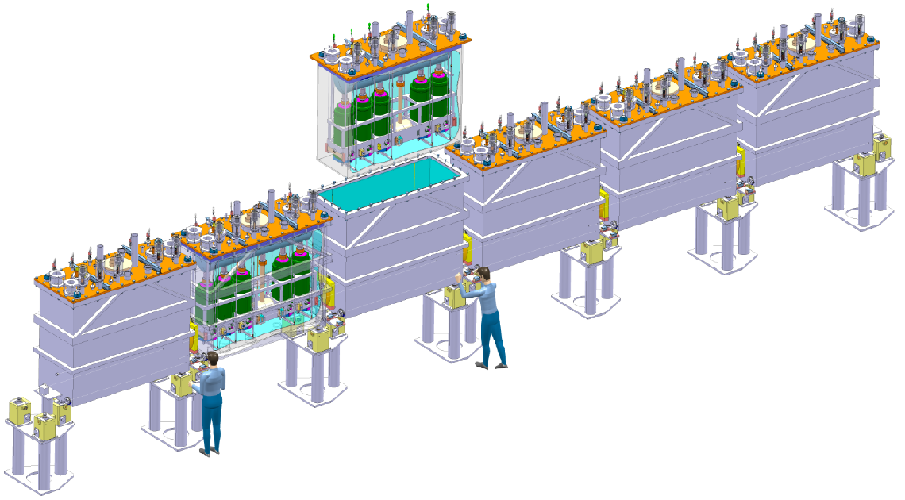
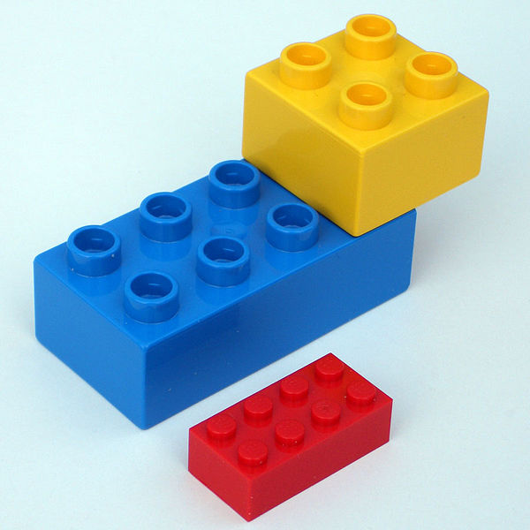
Superconducting Linac
Modular installation

Slide 28
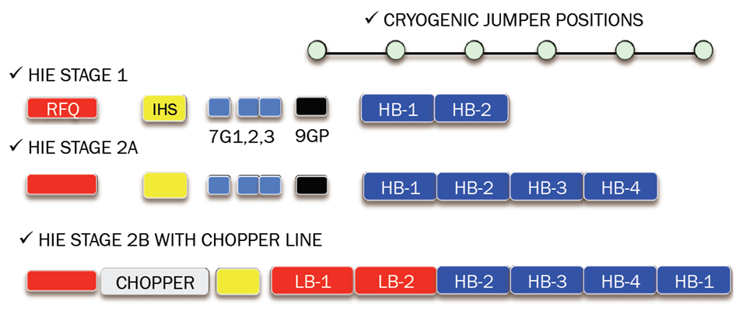
Modular installation
Schematic:
Courtesy: Matteo Pasini, Matthew Fraser

Slide 29
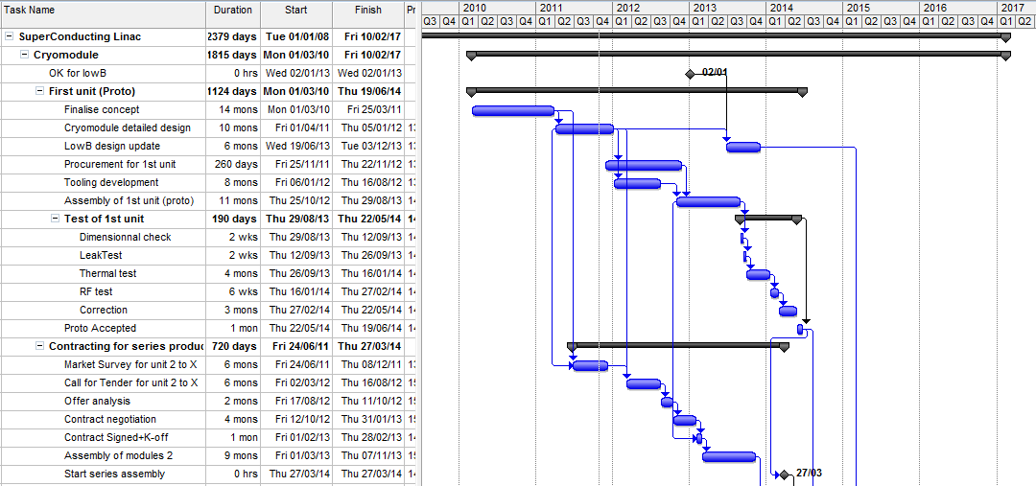
Superconducting Linac
LS1
Cavity and CM development and tests: Isolde facility not affected
TE/MSC: JEAN-PHILIPE TOCK, YANN LECLERCQ, ARNAUD BOUZOUD

Slide 30
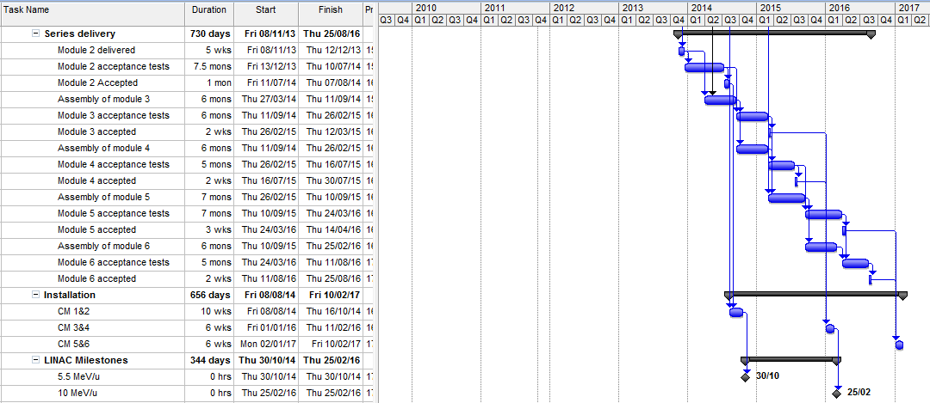
Superconducting Linac
LS1
CM1&2
TE/MSC: JEAN-PHILIPE TOCK, YANN LECLERCQ, ARNAUD BOUZOUD

Slide 31
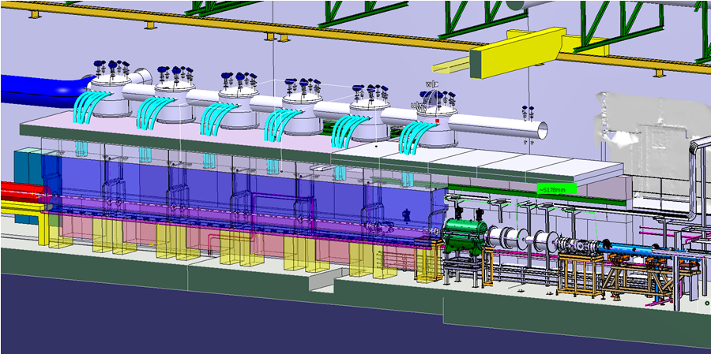
Hie-Isolde SC Linac
Hie-Isolde SC Linac:
5.5MeV/u by the autumn of 2014
First 10MeV/u by March 2016
Bunched beam by 2017 ?

Slide 32
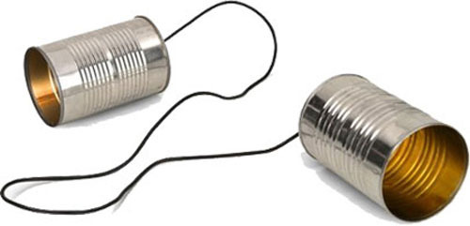
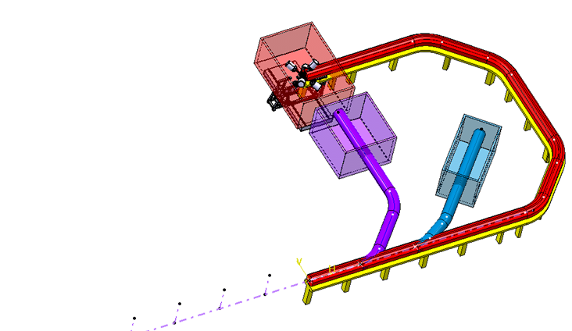
Beam Transfer Line

Slide 33
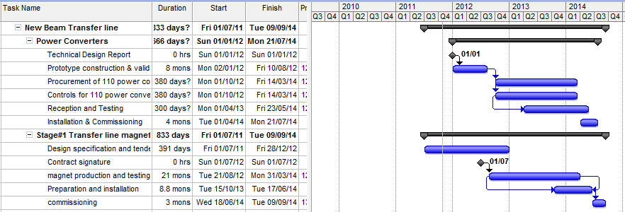
Beam Transfer Line
LS1
CM1&2
EN/HDO : YACINE KADI, TE/EPC: DAVID NISBET, TE/MSC: JEREMY BAUCHE, TE/ABT: BRENNAN GODDARD, BE/OP: DIDIER VOULOT

Slide 34
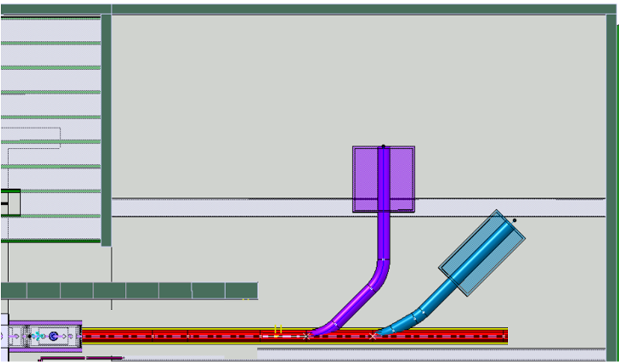

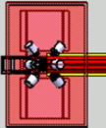


Beam Transfer Line Stage 1
Miniball
Exp.
station
Actar / Helios
Miniball
Beam diagnostics
Straight line with 2 branches – Oct 2013 - Sept 2014
Miniball move: Oct 2013 – April 2014

Slide 35
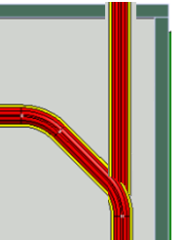
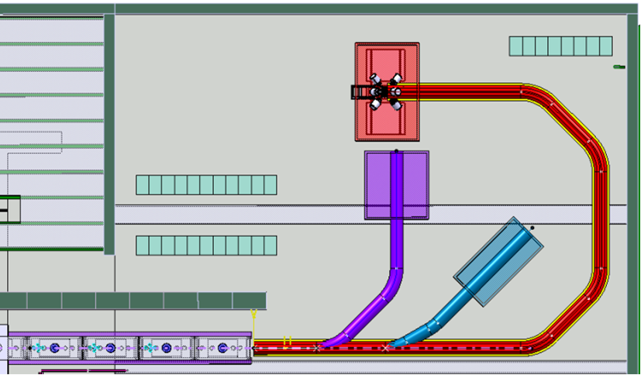

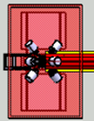
Stage 3
Beam Transfer Line Stage 2
Spectrometer
Miniball
TSR
Miniball
Exp. station
Actar / Helios
The bend
Stage 3:
TSR and beyond..
2nd Miniball move and Spectrometer installation

Slide 36
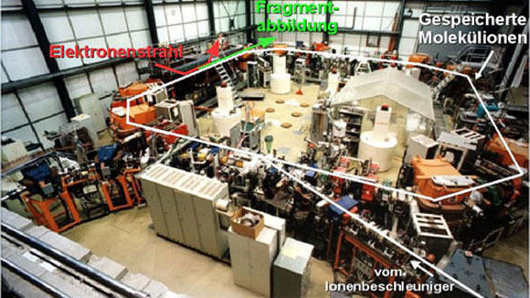
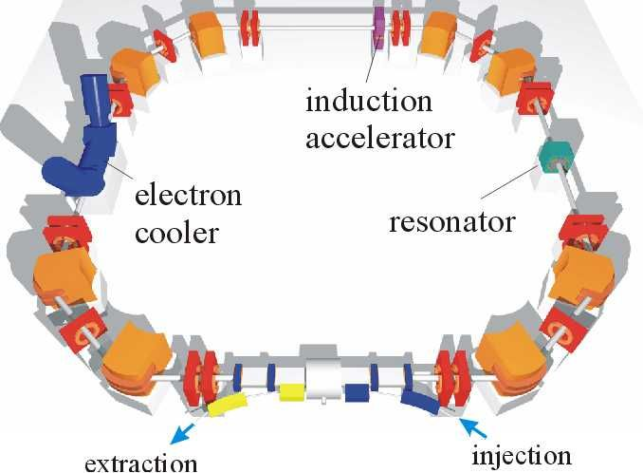
Possible LS1 activities
TSR @ Hie-Isolde
TSR Max
Planck Institute
Heidelberg
TSR@Hie-ISOLDE
LOI endored Jan 2011
TDR submitted Jan 2012
(K. Blaum, Y. Litvinov)

Slide 37
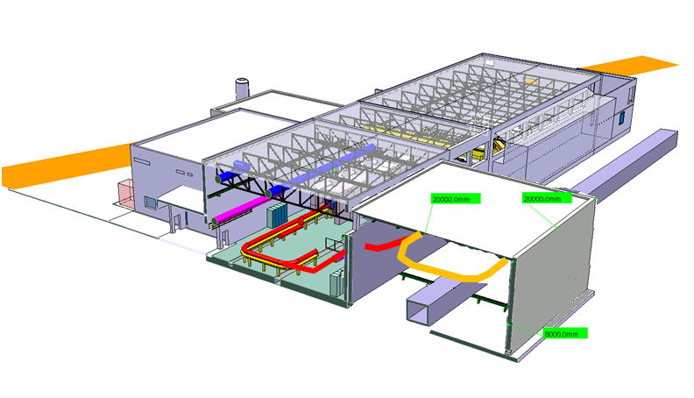
TSR @ Hie-Isolde
Jura (west) side
23.3m
24.6m
Proposed layout to fit the TSR:
Installation above the CERN service-tunnel
Tilted beamline coming up from the machine.
Cost study:
Eliseo Perez-Duenas GS/SE
3m

Slide 38
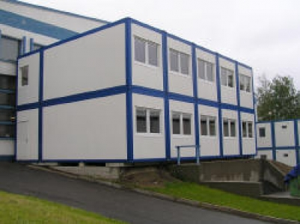
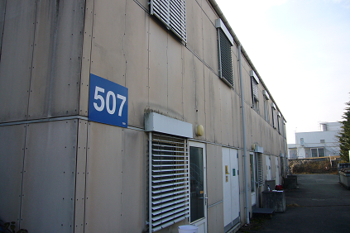
User Facilities
1. Increasing the surface of the Solid State Lab in building B.115:
For RP safety reasons all solid state activities will be moved from B.275 to B.115
This will suppress the existing workshop in B.115 and courtyard between B.115 and B.601
2. Replace the existing building 507 by a new building / modular cabins:
Ground floor (only accessible from within the surveyed area):
- Labs and workshop
First floor (accessible from outside the surveyed area):
- Data Acquisition rooms
- Meeting room/Visitors Center
  Cost study:
  Eliseo Perez-Duenas GS/SE
under discussion

Slide 39
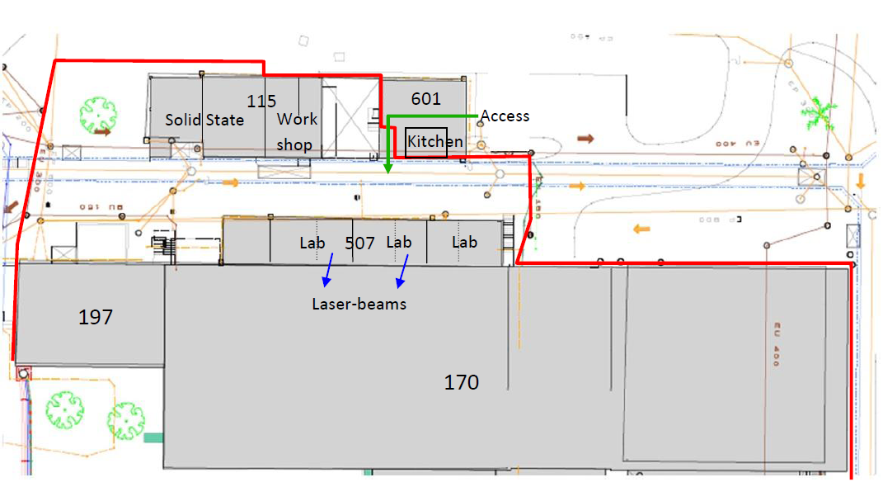
User Facilities
Present situation: - ground floor
Control room

Slide 40
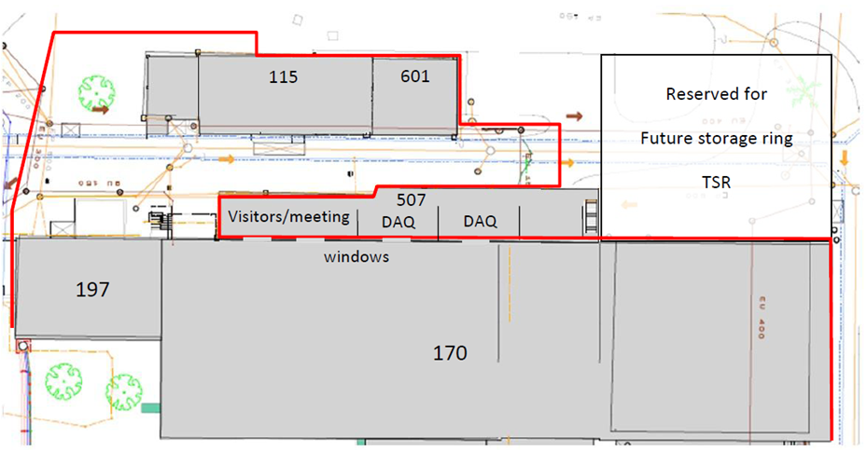
Replace building 507
Possible future situation: - first floor 507 accessible from outside the surveyed area):
Control room

Slide 41
Acknowledgement
GS/SE : DANIEL PARCHET, ELISEO PEREZ-DUENAS, NATASHA LOPEZ-HERNANDEZ
EN/MEF : STEPHANE MARIDOR
BE/ABP : FREDERIK WENANDER
BE/OP : DIDIER VOULOT
PH/SME : YORICK BLUMENFELD
EN/HDO : YACINE KADI
BE/RF : MATTEO PASINI, MATTHEW FRASER
EN/CV : PAUL PEPINSTER, BENOIT LACARELLE
EN/EL : RENE NECCA
TE/CRG : NICOLAS DELRUELLE, JOS METSELAAR
EN/STI : RICHARD CATHERALL, ANA-PAULA BERNARDES
GS/DI : CYRILLE BEDEL
TE/MSC : JEAN-PHILIPE TOCK, YANN LECLERCQ,
    ARNAUD BOUZOUD

