Slide 1
NNLO corrections to qqbar -> ttbar
Alexander Mitov
Theory Division, CERN
Based on:
P. Baernreuther, M. Czakon, A. Mitov `12

Slide 2
I’ll discuss the total inclusive cross-section.
Relevant for this workshop in the following ways:
    Gives normalizations,
    An orthogonal, stringent constraint on SM/data.

Slide 3
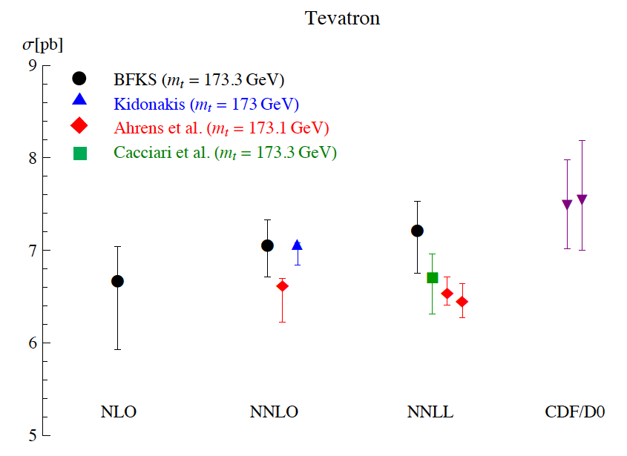
Until now analyzed in approximate NNLO
Beneke, Czakon, Falgari, Mitov, Schwinn `09
… as an extension of the NLO
... resumed NLL
and now NNLL resummation
Nason, Dawson, Ellis ‘88
Beenakker et al ‘89
Sterman, Kidonakis ‘97
Bonciani, Catani, Mangano, Nason ‘98
Beneke, Falgari, Schwinn ‘10
Czakon, Mitov, Sterman ‘10
Ahrens et al ’10-’11
Beneke, Falgari, Klein, Schwinn `11
Comparison between various groups shows:
Significant differences between various predictions
Suggests the true approximate NNLO uncertainty
The realistic improvements over NLO+NLL are small (to be expected)
Cacciari, Czakon, Mangano, Mitov, Nason `11

Slide 4
Our answer: compute the full NNLO
Baernreuther, Czakon, Mitov `12
So far published qq → tt +X
Remaining reactions in the works
First ever hadron collider calculation at NNLO with more than 2 colored partons.
First ever NNLO hadron collider calculation with massive fermions.

Slide 5

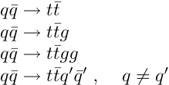
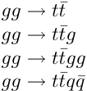

Structure of the cross-section
Relative velocity
of tT
The partonic cross-section computed numerically in 80 points. Then fitted.
Many contributing partonic channels:
Computed. Dominant at Tevatron (~85%)
All of the same complexity. No more conceptual challenges expected (just lots of CPU)

Slide 6
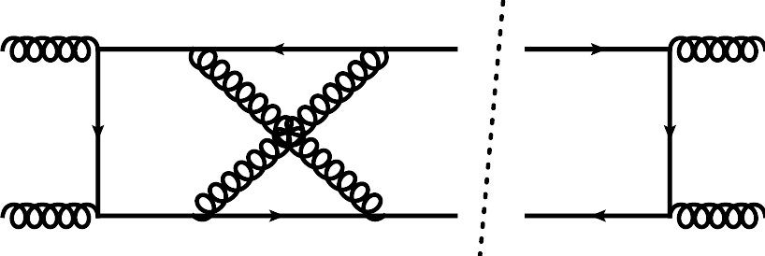
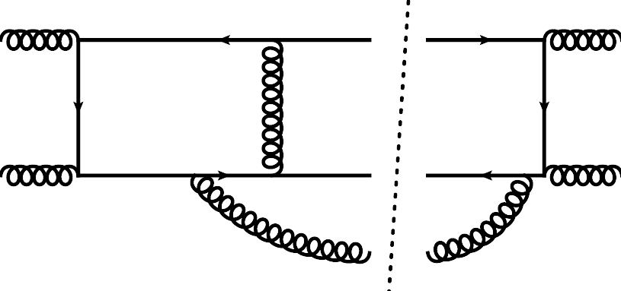
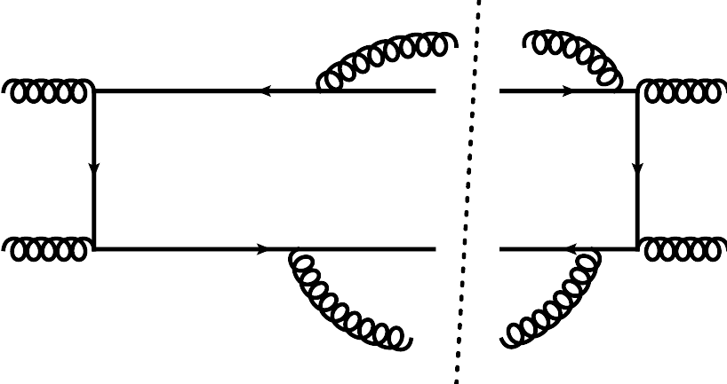
What goes into the NNLO?
There are 3 principle contributions:
  2-loop virtual corrections (V-V)
  1-loop virtual with one extra parton (R-V)
  2 extra emitted partons at tree level (R-R)
Czakon `08
1-loop amplitude: thanks to S. Dittmaier `07
Czakon `10-`11
And 2 secondary contributions:
  Collinear subtraction for the initial state
  One-loop squared amplitudes (analytic)
Known, in principle. Done numerically.
Korner, Merebashvili, Rogal `07
Glued together in STRIPPER subtraction scheme
(inspired by FKS and Sector Decomposition)
Czakon `10
Frixione, Kunszt, Signer `96

Slide 7
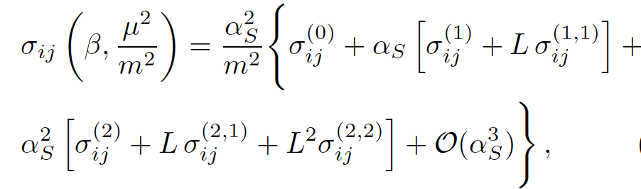
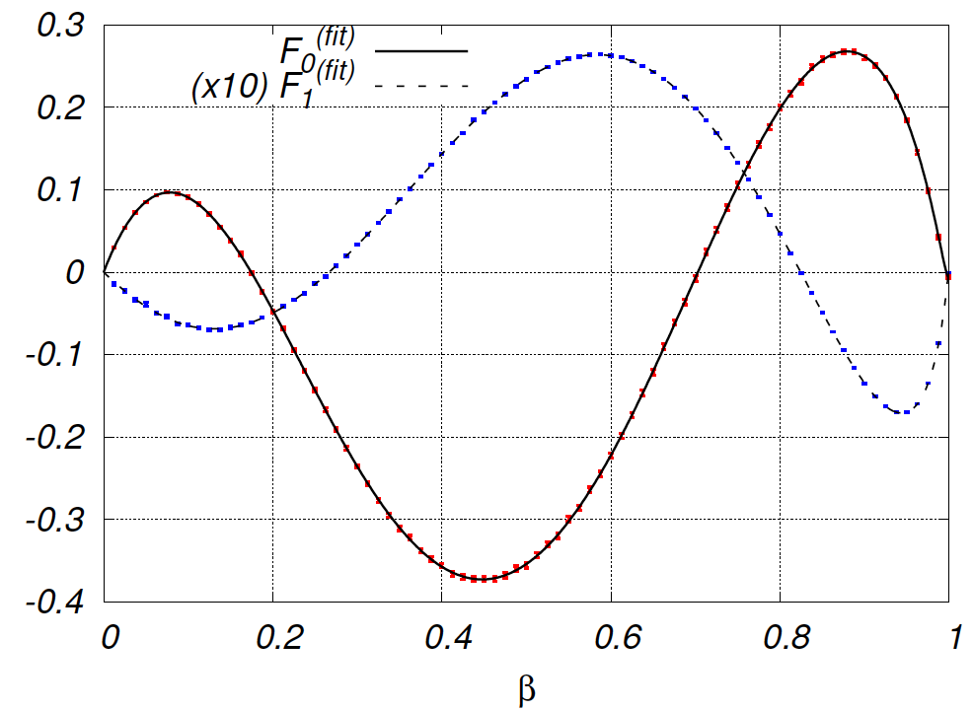
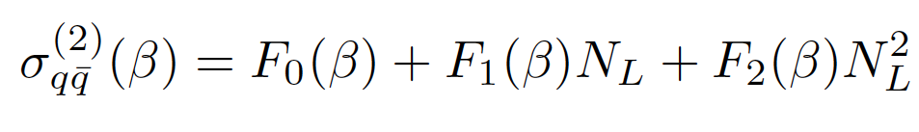
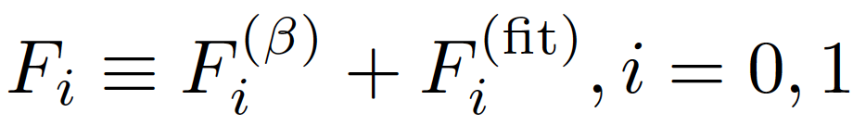
Results @ parton level
Notable features:
  Small numerical errors
  Agrees with limits
Partonic cross-section through NNLO:
The NNLO term:
Numeric
Analytic
The known threshold
approximation
P. Baernreuther et al arXiv:1204.5201
Beneke et al `09

Slide 8
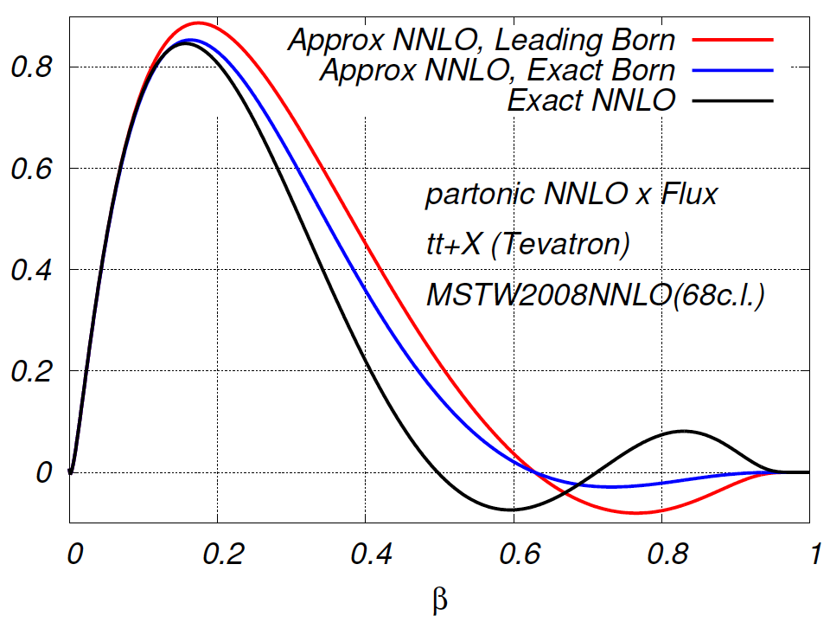
What happens once we add the flux?
P. Baernreuther et al arXiv:1204.5201
Approximate NNLO is a an OK approximation at parton level
There are non-trivial cancellations; the integrated numbers are closer to the exact
ones than one might anticipate
The power corrections to the Leading Born term have important effect

Slide 9
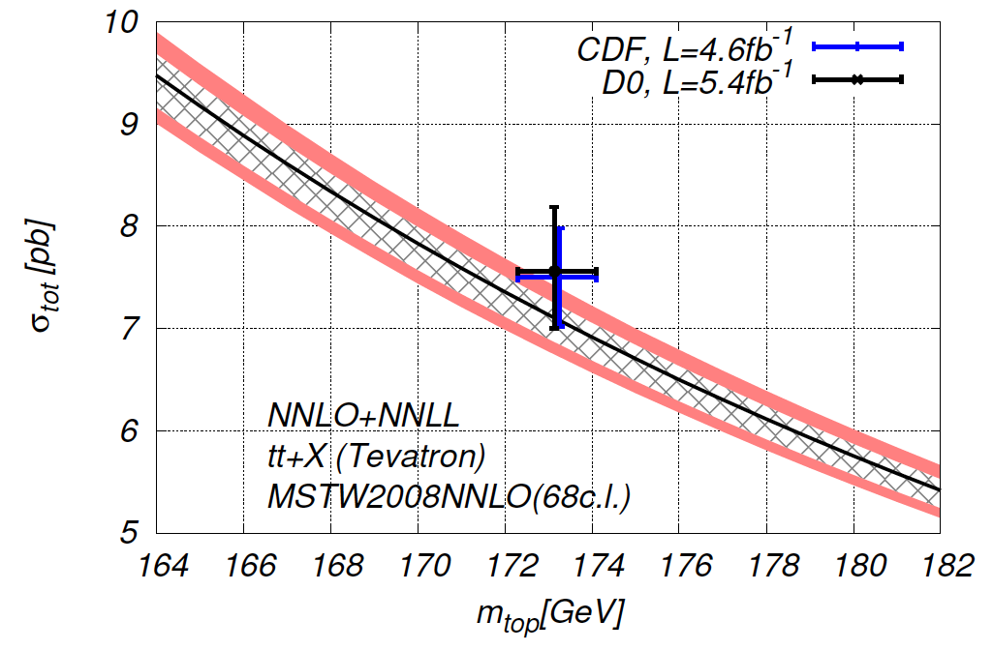
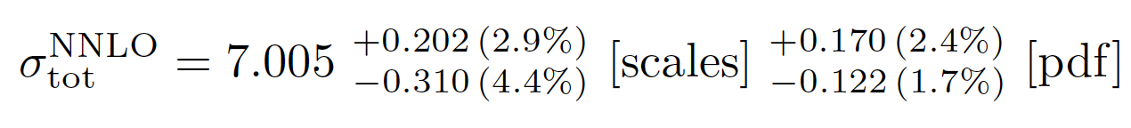
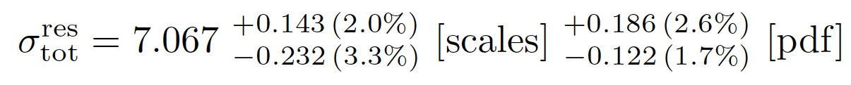
Here are the numbers for the Tevatron:
Independent F/R scales
MSTW2008NNLO
mt=173.3
P. Baernreuther et al arXiv:1204.5201
NNLO
Best prediction at NNLO+NNLL
Two loop hard matching coefficient extracted and included
Very week dependence on unknown parameters (sub 1%): gg NNLO, A, etc.
50% scales reduction compared to the NLO+NNLL analysis of
Cacciari, Czakon, Mangano, Mitov, Nason ‘11
6.72 + 3.6% - 6.1%

Slide 10
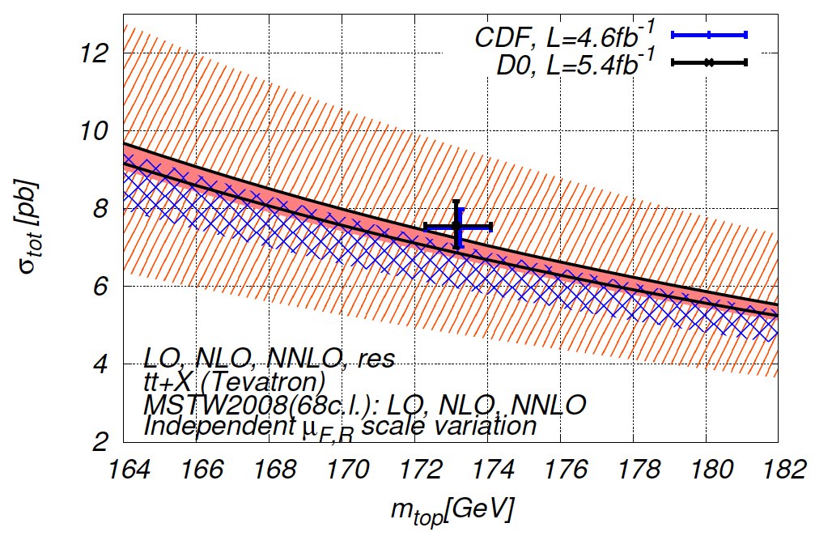
Good perturbative convergence:
Independent F/R scales
mt=173.3
P. Baernreuther et al arXiv:1204.5201
Good overlap of various orders (LO, NLO, NNLO).
Suggests our (restricted) independent scale variation is good

Slide 11
K-factors:
  Tevatron
  Fixed Order only
Same K-factors with NLO pdf
σ^{NNLO} (NNLO pdf) =
5.22059 + 1.23417 + 0.548064
σ^{NNLO} (LO, NLO, NNLO pdf’s) =
6.61926 ; 6.68123 ; 7.00531
(α_{S} )²
(α_{S} )³
(α_{S} )⁴
(α_{S} )²
(α_{S} )²
+(α_{S} )³
(α_{S} )²
…(α_{S} )⁴
K_{NLO/LO}=1.24
K_{NLO/LO}=1.01
K_{NNLO/NLO}=1.08
(K_{NNLO+NNLL/NLO}=1.09)
K_{NNLO/NLO}=1.05
K-factors alone not totally adequate without taking uncertainties into account

Slide 12
Implementation and numbers
We have also prepared the tools for top physics:
Top++ : a C++ program for the calculation of the total cross-section:
Includes:
  Fixed Order:
    LO,NLO,
    NNLO_approx (gg),
    exact NNLO (qqbar)
  Resummation (in Mellin space; full NNLL already there).
Very user friendly.
Developments:
  ver. 1.1: Approx NNLO +NNLL (Released)
  ver. 1.2: NNLO(qqbar) + NNLL. Complete Tevatron pheno. (Released)
  ver. 2.0: Full NNLO + NNLL (Sometime this year)
Czakon, Mitov `11

Slide 13
Summary and Conclusions
Computed the NNLO to qqbar -> ttbar
Future work:
  Compute the remaining partonic reactions
  Compute the forward-backward asymmetry
  Compute differential distributions
  Add top decay
Significantly improved precision; right now O(½) from the experimental one at Tevatron
Compute many more processes: dijets, W+jet, H+jet, etc @ NNLO
Facing the future, the stumbling block seems to be the availability of 2-loop amplitudes
Our work is a strong motivation for new developments in this direction, too.

